Slide 1
Australian Politics 2018-2023
Unit 3 and 4

Slide 2
At a glance
The VCE Australian Politics 2018-2023 replaces the units within the Australian and Global Politics Study Design 2012-2017.
 | 2012-2017 | 2018-2023
Unit 3 | Evaluating Australian democracy | Evaluating Australian democracy
Unit 4 | Australian public policy | Australian public policy

Slide 3
At a glance
Titles of each Area of Study
Unit | Areas of Study | 2012-2017 | 2018-2023
Unit 3 | AOS 1 | Australian democracy | Australian democracy
 | AOS 2 | Australian democracy in perspective | Comparing democracies: Australia and the United States of America
Unit 4 | AOS 1 | Domestic policy | Domestic policy
 | AOS 2 | Foreign policy | Foreign policy
Notes:
Note the unit headings – meant to assist you find the connections across areas of study in each unit.
Activity - individual
How would you describe a student at the end of the four units?
The following two slides will take use through this in more detail.

Slide 4
Summary of Changes
Reduction, refinement and consolidation of Key Knowledge in Unit 3.
Refinement of Key Knowledge in Unit 4.
Significant changes to the Key Skills Unit 3-4.
Key Knowledge includes key terms and concepts that must be explicitly taught and applied.
Reduction in the number Assessment Task Types.
Notes:
Key terms and concepts must be explicitly taught and applied- they are examinable

Slide 5
Key Terms and Concepts
All terms are examinable.
The Advice for Teachers will include a glossary.

Slide 6
Key Terms and Concepts
Key Skills states that students must be able to:
“define and explain key terms and concepts relating to foreign policy” (U4AOS2)
All terms and concepts in the Key Knowledge must:
Explicitly taught and learned
Applied and linked
Advice for Teachers will have a glossary for Australian Politics Units 1, 3-4
In Unit 3 and 4 they are examinable

Slide 7
Case Studies
“VCE Global Politics is a contemporary study and focus must be on examples and case studies from within the last 10 years. However, contemporary issues and events may need to be contextualised for students and this may require some investigation prior to this timeframe.” Study Design
Teaching in 2022- Cases Studies from 2012 onwards
Teaching in 2018- case studies from ??? Onwards

Slide 8
Advice for Teachers
published before the end of Term 2, 2017
Developing a learning program
Activities of each Area of Study
Approaches to developing SAC’s
Assessment advice in the form of rubrics
Glossary for Australian and Global

Slide 9
Assessment
School-assessed Coursework tasks have changed
To ensure authentication of students work:
Commercially purchased SAC’s must always be modified
SAC’s used from previous years must always be modified
It is the teachers responsibility to ensure that their SAC’s authenticate the Study Design

Slide 10
Assessment
The exam specifications will be published early 2018 and will include a sample exam.
In 2018, the examination will reflect changes in the 2018 -2023 Unit 3 and 4 Australian Politics Study Design.
The sample examination will be updated to reflect the changes in the Study Design.

Slide 11
Unit 3
Values and principles that underpin the Australian political system.
Explores how key elements of liberal democracy and representative government operate in theory and practice.
Evaluates the Australian liberal democratic system further by comparing it with the political system of the United States of America (USA).
Analyse key aspects of the US political system, including the electoral process, the operation of the legislative branch and the protection of rights and freedoms.

Slide 12
Area of Study 1
Inquiry Questions shape student thinking in the Unit.
Consider Australia values and principles as a liberal democracy.
Features and functions of the Australia’s system of government.
Consider the extent to which democratic values and principles are upheld.
Evaluate the democratic strengths and weaknesses of the Australian political system using contemporary examples as evidence.
Change in the cognitive demand of the outcome.

Slide 13
U3 AOS1 Outcome
Unit AOS1 2012-2017 | Unit AOS1 2018-2023
…. student should be able to describe and analyse key aspects of democratic theory and practice, and evaluate the strengths and weaknesses of the Australian democratic system | …. student should be able to explain the key values and principles of the Australian political system and evaluate the system’s democratic strengths and weaknesses.

Slide 14
Key Knowledge AOS1
Key terms and concepts must be explicitly taught and applied.
Reduction, consolidation of Key Knowledge
Notes:
Key terms must be taught and are examinable- students need to be able to define and explain
Each knowledge dot point is unpacked

Slide 15
Key Skills AOS1
Unit 3 AOS1 2012-2017 | Unit 3 AOS1 2018-2023
define and use key concepts relating to democratic theory and practice describe the values and principles of democracy recognise and explain the differences between democratic values and principles, and democratic practices analyse and evaluate the operation of electoral systems analyse and evaluate the operation of the legislature describe and evaluate the protection of democratic rights and freedoms evaluate the extent to which democratic values are upheld evaluate the strengths and weaknesses of the Australian political system access, interpret and draw conclusions from information gathered from a range of sources. | define and explain key terms and concepts relating to democratic theory and practice in Australia explain the key values and principles of liberal democracy explain key features of government in Australia explain and evaluate the protection of democratic rights and freedoms analyse the operation of electoral systems and the parliament evaluate the extent to which democratic values are upheld by the Australian political system evaluate the democratic strengths and weaknesses of the Australian political system use evidence from contemporary examples to explain and analyse institutions and processes of Australian government develop arguments, explanations and points of view on the Australian political system which use evidence from contemporary examples.

Slide 16
Developing a learning Program
Theory v In Practice: examination of media articles supporting and opposing extent to which the values and principles underpinning a liberal democracy (such as accountability, participation, representation) are achieved in Australia; chart and construct an evaluation (using examples/evidence) to support.
Write a report on the funding of political campaigns in Victoria; pairs/individuals take on a variety of political parties or independents. Complete a practice extended response evaluating the extent to which this supports democratic values.
Analyse a range of print and digital campaign ads (money spent on political advertising, source of funds, timeslots, demographics, capital cities v regional markets, message, positive or negative ad, impact).
Review a session of Question Time in class; evaluate the system’s democratic strengths and weaknesses.

Slide 17
Case Study
Examples of Collective Ministerial Responsibility
Tony Abbott inside or outside of Cabinet

Slide 18
Area of Study 2
Inquiry Questions shape student thinking in the Unit.
Significant Change
Comparison of the Australian political system with that of the American system of Government.
The Key Skills have been substantially developed.
Notes:
The study no longer requests a comparison with other political systems – UK, Germany or India

Slide 19
U3 AOS2 Outcome
Unit 3 AOS2 2012-2017 | Unit 3 AOS2 2018-2023
…. the student should be able to critically compare the political system of Australia with one other democracy, and evaluate an aspect of the selected political system that Australia might adopt to strengthen its democracy. | …. the student should be able to analyse the key features of the political system of the United States of America and critically compare the political systems of Australia and of the United States of America in terms of the extent to which democratic values and principles are upheld.

Slide 20
Key Knowledge AOS2
Key terms and concepts must be explicitly taught and applied.
Key Knowledge is contextualised within the American political system.
Greater emphasis on the electoral system of the USA.
The operation of the legislation branch and political parties are consolidated within the Key Knowledge “the Congress of the USA”.
The comparison remains the same.

Slide 21
Key Skills AOS2
Unit 3 AOS2 2012-2017 | Unit 3 AOS2 2018-2023
define and use key concepts relating to political systems critically examine and evaluate the strengths and weaknesses of the Australian democratic system and one other democratic system evaluate an aspect of the selected political system Australia might adopt to strengthen its democracy access, interpret and draw conclusions from information gathered from a range of sources. | define and explain key terms and concepts relating to political systems in the USA and Australia explain the key features of the US political system explain and evaluate the protection of democratic rights and freedoms analyse the features and operation of the US electoral system and Congress analyse the role and constraints of political leadership evaluate the extent to which democratic values are upheld by the US political system critically compare the US system with the Australian system and the extent to which each reflects liberal democratic values use contemporary examples and evidence to explain, analyse and compare the political systems develop arguments, explanations and points of view which use evidence from contemporary examples

Slide 22
Developing a learning Program
Storyboard the process of electing a member of Parliament v Congress and/or Prime Minister v POTUS.
Chart a comparison of the two systems on graphic organisers; then complete a practice extended response/essay on this comparison.
Class debate: The PM has a more powerful role and fewer constraints than the POTUS.
Watch an episode of a television program relating to US politics; for example The Circus, Inside the Biggest Story on Earth or The West Wing. Discuss the similarities and differences in US and Australian democratic political values that are evident

Slide 23
Developing a learning Program
Investigation into the differing voting practices across US states; comparison with problems identified in the 2013/2016 Australian elections.
Compare the process of registering to vote in Australia with the process in X number of US states.

Slide 24
Unit 4 Australian public policy
Focuses on Australian federal public policy formulation and implementation.
Students investigate ONE contemporary Australian domestic policy issue.
Examples and case studies from within the last 10 years.

Slide 25
Area of Study 1
Minimal changes
Outcomes remain the same
Refinement of Key Knowledge
Significant changes to Key Skills

Slide 26
U4 AOS1 Outcome
Unit 4 AOS1 2012-2017 | Unit 4 AOS1 2018-2023
…. the student should be able to explain how Australian federal domestic public policy is formulated and implemented, analyse the factors which affect these processes, and critically evaluate a selected contemporary domestic policy issue. | …. the student should be able to explain how Australian federal domestic public policy is formulated and implemented, analyse the factors which affect these processes and critically evaluate a selected contemporary domestic policy issue.
No Change to Outcome Statement
Notes:
Remains the same outcome

Slide 27
Key Knowledge AOS1
Key terms and concepts must be explicitly taught and applied.
Change of terms from bureaucracy to “the public service.”
Addition of “role and significance of ministerial advisers.”
Change of “the role of…” to “the contribution of the opposition, minor parties…”
Addition to “elements outside…: international influences, ….”
Focus on “ONE selected contemporary policy and government response.”

Slide 28
Key Skills AOS1
Unit 4 AOS1 2012-2017 | Unit 4 AOS1 2018-2023
define and use key concepts relating to domestic policy critically evaluate a selected contemporary domestic policy issue identify the range of influences on policy making and implementation explain and analyse the policy-making and implementation process access, interpret and draw conclusions from information gathered from a range of sources | define and explain key terms and concepts relating to domestic policy analyse the role and influence of government institutions in public policy formulation and implementation analyse the role and influence of elections and the electoral mandate in public policy formulation and implementation analyse the role and influence of the Opposition, minor parties and independents in public policy formulation and implementation analyse the influences on policy making of elements outside the formal institutions of government critically evaluate ONE selected contemporary domestic policy issue develop points of view, explanations and arguments about policy making and implementation which use contemporary examples as evidence

Slide 29
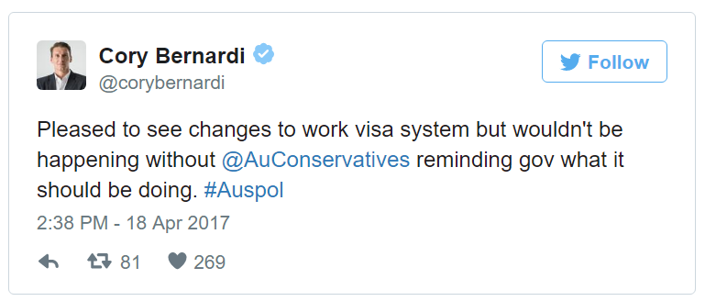
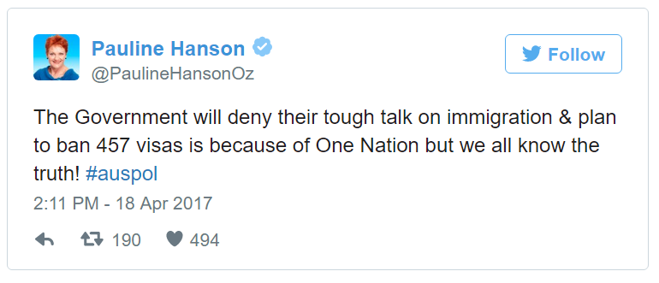
Developing a learning Program
CASE STUDY
Research and prepare a case study on a contemporary policy and government response.
Pairs or individuals
Examine the role of:
Executive
Prime Minister
Commonwealth Parliament
Judiciary
Elections and electoral mandate
Elements outside formal institutions
Create a POLICY WALL
Key contributors
Media reports
Annotated
Continually added to
Allocated/all in

Slide 30
Developing a learning Program
EXTENDED RESPONSE PRACTICE
What influences the policy decisions and actions of the Commonwealth Parliament?
What opportunities exist for individuals and groups to participate in the decisions of government?
“Participation is a fundamental democratic principle, however, in practice the government is unable to respond to many, often competing interests, which seek to influence the contents of domestic policy.” To what extent do you agree?

Slide 31
Case Studies
Use examples and case studies from within the last 10 years.
CONTEMPORARY EVIDENCE & EXAMPLES:
457 visa changes
Broader changes to citizenship laws
May Budget
Health care reforms, including changes to GP care
Gas market intervention
Gonski 2.0

Slide 32
Area of Study 2
Change:
Students “consider the main elements of Australian foreign policy and TWO key challenges it faces.”
Change in the cognitive demand of the Outcome statement.
Notes:
Doing 2 there was a reduction from the old SD
You could do more depth
Domestic policy there is an expectation to be thorough.

Slide 33
U4 AOS 2 Outcome
Unit4 AOS2 2012-2017 | Unit4 AOS2 2018-2023
…. the student should be able to describe, analyse and discuss the nature, objectives and instruments of contemporary Australian foreign policy, and the challenges facing Australian foreign policy. | …. the student should be able to analyse the nature, objectives and instruments of contemporary Australian foreign policy, and evaluate TWO key selected challenges facing Australian foreign policy.

Slide 34
Key Knowledge AOS2
Key terms and concepts must be explicitly taught and applied
TWO of the following key challenges facing contemporary Australian foreign policy:
global and regional conflicts
humanitarian crises and natural disasters
the threat of global terrorism
climate change and environmental issues
the economic development of the region
refugees, people smuggling and trafficking in persons
Notes:
– protection of human rights is not longer one of the key challenges

Slide 35
Key Skills AOS2
Unit 4 AOS2 2012-2017 | Unit 4 AOS2 2018-2023
define and use key concepts relating to foreign policy compare domestic and foreign policy describe the formulation and implementation of foreign policy explain foreign policy objectives analyse instruments of foreign policy analyse challenges facing foreign policy access, interpret and draw conclusions from information gathered from a range of sources | define and explain key terms and concepts relating to foreign policy explain and analyse the nature of contemporary foreign policy formulation and implementation explain the key objectives of Australian foreign policy analyse the key instruments of contemporary foreign policy evaluate TWO key selected challenges facing contemporary foreign policy use contemporary examples and evidence to explain and evaluate Australian foreign policy develop points of view, explanations and arguments about formulation and implementation of foreign policy which use contemporary examples as evidence

Slide 36
Developing a learning Program
Class debate on the topic of “the national interest; what is it and who defines it?”
Analyse recent speeches by the Foreign Minister (positioning of Australia, key objectives, key instruments).
Pair/individual presentations on two challenges (current status, short-term, long-term).
Prepare a report for DFAT identifying and analysing two challenges (current status, short-term, long-term).
Construct a concept map linking key objectives with recent examples of the use of key instruments.
Compile a PNQ chart on the key instruments of contemporary Australian foreign policy.
Notes:
Class debate: Our long-term ‘national interest’ is better served by China than the United States.

Slide 37
CONTEMPORARY EVIDENCE & EXAMPLES:
Pence visit to Australia (April 2017).
Turnbull’s first face-to-face meeting Trump (May 2017).
North Korea’s ‘warning’ following Julie Bishop’s threat of further sanctions (April 2017).
Rise of protectionism in US and UK – impact on trading relationship with China and India?
Australia-China High-Level Security Dialogue (April 2017).

Slide 38
Assessment
Unit 3 and 4 2012-2017 | Unit 3 and 4 2018-2023
a multimedia presentation a visual representation a case study an essay a report a test structured questions short-answer questions an extended response. | For each outcome, select one or more of the following: a multimedia presentation a case study an essay a report short-answer questions an extended response

Slide 39
Assessment
The exam specifications will be published early 2018 and will include a sample exam.
In 2018, the examination will reflect changes in the 2018 -2023 Unit 3 and 4 Australian Politics Study Design.
The sample examination will be updated to reflect the changes in the Study Design.

Slide 40
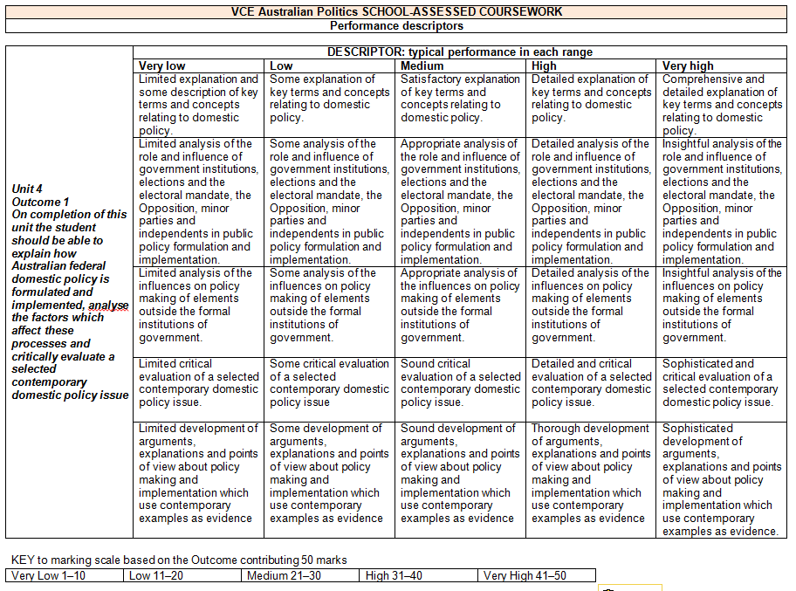
Rubrics
Notes:
The Advice for Teachers will include assessment rubrics, they are not mandated, however, they can be adapted and modified to suit your SAC tasks.

Slide 41
Questions

Slide 42
Contact
Gerry Martin- Curriculum Manager (History and Civics)
Telephone: 61 3 9032 1694
Mobile: 04 428 039 083
e-mail: martin.gerard.f@edumail.vic.gov.au

