Slide 1
Curriculum Mapping Template for Victorian Aboriginal Languages
Mapping your lesson plans to the Curriculum Mapping Template

Slide 2
Essential documents
Victorian Curriculum F-10 – Victorian Aboriginal Languages: http://victoriancurriculum.vcaa.vic.edu.au/languages/victorian-aboriginal-languages/introduction/rationale-and-aims
Curriculum Mapping Templates: http://www.vcaa.vic.edu.au/Pages/foundation10/viccurriculum/curriculum-area-advice.aspx

Slide 3
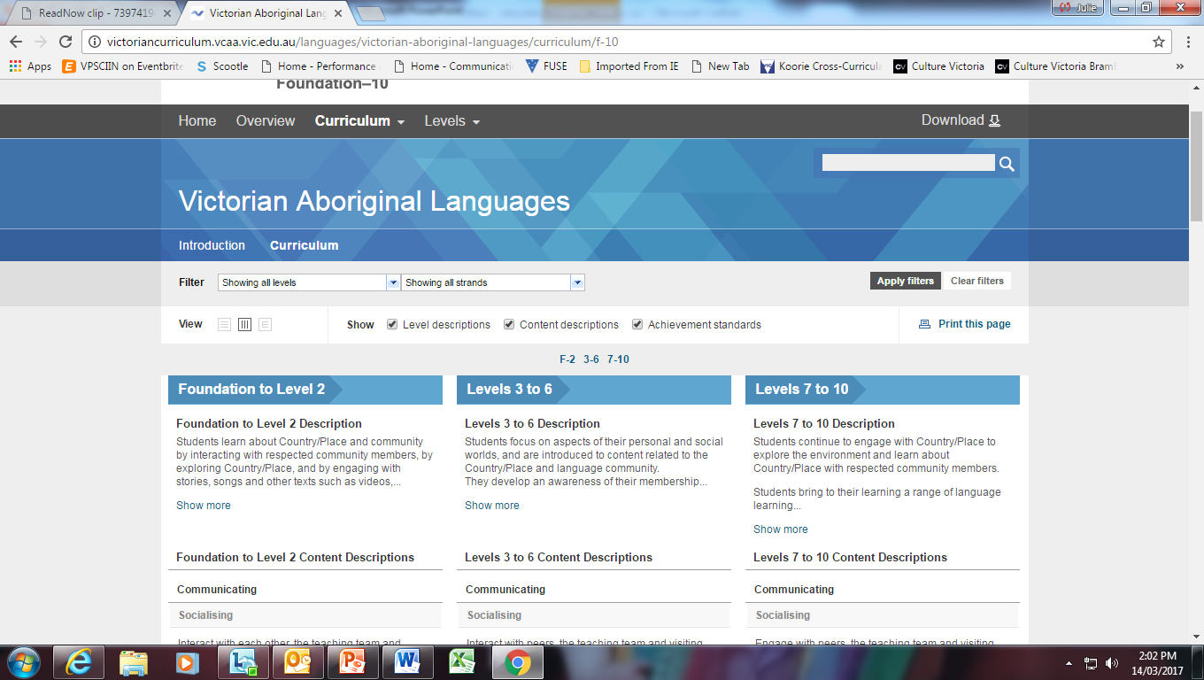
Victorian Aboriginal Languages

Slide 4
Curriculum Mapping Template Victorian Aboriginal Languages

Slide 5
Outline or general plan
Topics, eg, family, animals, famous Aboriginal Victorians
Weeks, eg, Week 3 to Week 6
Year level, eg, Foundation, Year 10
Terminology, eg, verb, noun, suffix (that is, the terms used to talk about language)
Language focus, that is, the actual words, phrases and/or sentences you are going to teach the students, eg, bap, mam

Slide 6
Outline or General Plan
Resources, eg, family tree worksheet, online game.
Assessment , eg, observation of appropriate Language use, work samples, quiz, spelling test (that is, how you know about students’ learning). Include informal as well as formal assessment.
Activities , eg, singing a song in Language, practising modeled sentences (make sure you include reading, writing, speaking and listening tasks)
Revision every class (start the lesson with revision, you must keep practising the same words over and over)

Slide 7
Sample lesson plan Victorian Aboriginal musical instruments
Instruments used by Victorian Aboriginal people to make music | Greeting routine Invite a local community member to talk about and play an Aboriginal musical instrument, appropriate to the community member and the students Discuss the roles and cultural events where music is performed and who is permitted to play what instruments. Use Language terms where possible. Talk about the connections between music and dance at local cultural events and in family life | Greeting: dalk Leaf: Red gum tree: White gum tree: To listen: Man: Woman: Child: Stick: Boomerang: | Alternatively, watch Uncle Herb Patten playing the gum leaf Ossie Cruze playing the gum leaf Note that the didgeridoo is not a traditional Koorie instrument

Slide 8
Sample outline
Topic – Victorian Aboriginal Musical Instruments
Weeks –Weeks 3-4
Year level - Level 1
Terminology - verb, noun, present tense, present tense suffix

Slide 9
Sample outline
Language focus –
Greeting: dalk man: kuli
leaf: girra, woman: leyurk
child: paingku to listen: nyern-
stick: kalk I listen: nyernan
boomerang: wani you listen: nyernangarr
red gum tree: bial he/she/it listens: nyerna
white gum tree: bap

Slide 10
Sample outline
Resources – respected Community member, or screen to play videos Uncle Herb Patten playing the gum leaf and/or Ossie Cruze; gum leaves for students
Assessment – observation of students playing instruments, casual conversation with students using focus words (speaking and listening), and student participation.

Slide 11
Sample outline
Activities –
Greeting routine with teacher and guest
Revision - mother: bap, father: mam, grandmother: gukwan (mother’s mother), mim (father’s mother) using flash cards as prompts
Students listen to local community member talking about and playing the musical instrument (gum leaf).
Students try to play instrument (gum leaf).

Slide 12
Sample outline
Discussion about when and where music is performed and who is allowed to play specific instruments, with students using Language words where known.
Discussion about music and dance, and where they are performed in the community, eg, at community celebrations, at home with parents
Students learn a dance appropriate to the instrument being demonstrated (Note that we have added this last activity to the sample unit.)

Slide 13
Content description
Interact with each other, the teaching team and visiting respected community members, using language and gestures to greet and talk about self and family
Code
VCLVC130

Slide 14
Elaborations
participating in everyday exchanges, such as greeting and leave taking
interacting with the teaching team and visiting respected community members and community speakers, using appropriate protocols such as respect terms, behaviour and forms of address
introducing and describing self, family, friends, favourite objects and pets, using familiar and modelled language, supported by visual props such as drawings, photos
listening to questions (such as what, who, where) about self, family, friends and immediate environment and responding with words and actions, including gesture

Slide 15
Corresponding Achievement Standards
(1) Students interact with the teaching team, respected community members to talk about themselves and family, using familiar modeled language and gestures.
(2) They use appropriate protocols when interacting with respected community members and community speakers, such as appropriate forms of address, terms of respect and behaviour.

Slide 16
Recording the Achievement Standard

Slide 17
Content description
Participate in guided group activities, such as games, songs and simple tasks, using movement and gestures to support understanding and to convey meaning
Code
VCLVC131

Slide 18
Elaborations
participating in games, tasks and activities that involve turn taking, guessing, matching and choosing objects using modelled questions and responses
participating in action games and songs by matching actions to words
following instructions by moving around or locating objects in the classroom
accompanying respected community members to gather traditional materials, such as nuts, twigs, bark, seeds, shells for use in craft related language activities

Slide 19
Elaborations
working collaboratively on a class performance or activity
working collaboratively to adapt and perform action songs, for example, by changing lyrics, substituting words and phrases based on modelled patterns, rehearsing and performing songs with appropriate gestures and actions
grouping and sorting natural objects from Country/Place, for example, leaves, stones, shells according to culturally appropriate categories

Slide 20
Corresponding Achievement Standards
(3) They use movement, gestures and modeled questions and responses to participate in guided group activities, for example, collaborating to adapt and perform action songs.

Slide 21
Foundation – Level 2
You have THREE YEARS to complete all of the Content Descriptions.
You might tick off only one Achievement Standard after two weeks of lessons.

Slide 22
Assessment Grid

Slide 23
Contacts
VCAA: Julie Reid 9032 1679
Reid.julie.j@edumail.vic.gov.au
VAEAI: Vaso Elefsiniotis
9481 0800 or 0425 278 867
vaso@vaeai.org.au

