Slide 1
Victorian Curriculum English
Levels A-D
Students with Additional Needs
Jacquiline Getreu
Specialist Teacher
Literacy in the Early Years
Notes:
ABLES professional learning site: http://deecdvic.tech-savvy.com.au/
ABLES website loaded: http://www.education.vic.gov.au/school/teachers/teachingresources/diversity/Pages/integratingables.aspx
http://victoriancurriculum.vcaa.vic.edu.au/overview/diversity-of-learners

Slide 2
Agenda
DET – responsibilities toward Special Needs students
Reasonable Adjustment to the Victorian Curriculum to accommodate the diversity of learners
Victorian Curriculum: Levels A-D
ABLES
  Professional Learning Modules
  assessment of students working toward Foundation Level

Slide 3
Diversity of Learners
The objectives of the Victorian Curriculum are the same for all students. The curriculum offers flexibility for teachers to tailor their teaching in ways that provide rigorous, relevant and engaging learning and assessment opportunities for students with disabilities.
Most students with disabilities can engage with the curriculum provided the necessary adjustments are made to the complexity of the curriculum content and to the means through which students demonstrate their knowledge, skills and understanding.
For some learners, making adjustments to instructional processes and to assessment strategies enables students to achieve educational standards commensurate with their peers.
For other students, teachers will need to make appropriate adjustments to the complexity of the curriculum content, focusing instruction on content different to that taught to others in their age group. It follows that adjustments will also need to be made to how the student’s progress is monitored, assessed and reported.

Slide 4
Reasonable Adjustment
Education providers have three main types of obligations. They must:
  consult
  make reasonable adjustments
  eliminate harassment and victimisation.
Consultation
  Education providers must consult in order to understand the impact of a student's disability and to determine whether any adjustments or changes are needed to assist the student.
Reasonable adjustments
  The Standards set out a process whereby education providers can meet the obligation to make reasonable adjustments where necessary.
  An adjustment is a measure or action taken to assist a student with disability to participate in education and training on the same basis as other students.

Slide 5
Reasonable Adjustments
Quality differentiated teaching practice – minor adjustments to teaching
Supplementary adjustments – modified/tailored programs
Substantial adjustments - regular direct support or close supervision in highly structured situations
Extensive adjustments - personalised modifications to all courses and programs, school activities and assessment procedures
http://www.education.vic.gov.au/school/teachers/health/Pages/dataresources.aspx#link68

Slide 6
Teaching Reasonable Adjustment
English / Level 2 / Literature / Creating literature
Content Description:
Create events and characters using different media that develop key events and characters from literary texts
What supports do you have in place for your diversity of learners?

Slide 7
Example of a Supplementary Reasonable Adjustment
Level 1: Writing/Literacy/Creating texts.
Content Description: Construct texts that incorporate supporting images using software including word processing programs(VCELY197)
Use a visual reminder of the tasks to achieve
Rubric has less criteria complexity
A Rubric with visuals next to the criteria &/or only 3 levels
Photostory 3 for Windows – reduce the number of slides required to make a 3 - 4 sequence sequel – beginning on 1 slide, middle (1-2 slides) and end (1 slide)/use less elements for each photo

Slide 8
Levels A - D
The Victorian Curriculum is a continuum and supports every student to learn. To this end, the Victorian Curriculum F–10 includes students working towards Foundation.
http://victoriancurriculum.vcaa.vic.edu.au/overview/diversity-of-learners

Slide 9
Levels A- D
For a small percentage of students with disabilities, their learning will be well below the Victorian Curriculum Foundation standards. ‘Towards Foundation Level Victorian Curriculum’ provides this cohort of students with access to curriculum content and standards that enables students to move toward the learning described at Foundation level.
The ‘Towards Foundation Level Victorian Curriculum’ is integrated directly into the curriculum and is referred to as ‘Levels A to D’.
Levels A to D focus on progressing students from a pre-intentional to intentional engagement in learning. They support students to develop their independence as they explore, participate and engage in the world around them. As students progress through these levels, the amount of support decreases as they proceed towards becoming independent learners.
‘Levels A to D’ are not associated with any set age or year level that links chronological age to cognitive progress

Slide 10
Level A and Level B
Level A: Beginning to Explore | Learning activities to assist students to attend to and explore the world around them with as much independence as possible. Activities to move students a pre-intentional level of responding to a response indicating beginning intention. Requires 1:1 with teacher/Education Support Students demonstrate some awareness and recognition.
Level B: Active Exploration | Students become more reliant on verbal prompts and gestures to facilitate their learning. They begin to explore their world independently and engage in simple cause-and-effect play activities. Students can focus on structured learning activities for short periods of time. They respond to familiar people and events and begin to use ‘yes/no’ responses.

Slide 11
Level C and Level D
Level C: Intentional Participation | Students respond more consistently to prompts and simple clear directions They begin to show independence They notice their peers. They participate in structured learning activities with others. They begin to use pictures, photos and objects to communicate personal interests and experiences. They start to use and link some familiar words and images to construct a meaningful communication.
Level D: Building Independence | Teacher support and curriculum scaffolding enables students to participate cooperatively in group learning activities. They express their feelings, needs and choices in increasingly appropriate ways. The combine and sequence key words and images to communicate personal interests and to recount significant experiences. They indicate beginning understanding of social rules and expectations and are beginning to reflect on their own behaviour.

Slide 12
Planning: for the needs of the
A–D student
Students will learn that narratives have a recognisable basic structure.
Students will learn the concept of point of view in narrative, how point of view shapes the way stories are told and how illustrations can shape point of view.
Students will learn that point of view can change according to which character is relating events in the narrative.
Students will create an imaginative reconstruction of a well-known story using digital technology.
Who tells the story? – unit of work: TLF-IDR11585:

Slide 13
Content Descriptions
Reading & Viewing: Text structure and organisation
Level C: Recognise that texts and communication can take various forms including multimodal and picture books (VCELA071)
Level D: Investigate different forms of texts and the relationship between symbols, images and objects (VCELA106)
Level 2 - Understand that different types of texts have identifiable text structures and language features that help the text serve its purpose (VCELA212)
Writing: Creating Texts
Level C: Use software or application by selecting images and typing to ‘label’ images (VCELY093)
Level D: Use software or application by selecting images and suggesting simple sentences to accompany the image(VCELY128)
Level 2 - Construct texts featuring print, visual and audio elements using software, including word processing programs (VCELY233)

Slide 14
Assessment of students in
Levels A–D
In order to assess students’ knowledge and understanding of storytelling traditions, ask them to complete a piece of work that reflects something that they read, saw or learned during the unit. They might create a drawing, write a short report, a poem or story, or prepare a PowerPoint slide.
Storytelling traditions - unit of work: TLF-IDR11570 Year F - 2

Slide 15
Achievement Standards
Level C: They can select pictures that are important to create a picture storybook.
Level D: They select and sequence pictures and key words to describe a personally significant event or experience.
Foundation: …students use familiar words and phrases and images to convey ideas.
Year 1: …students provide details about ideas or events, and details about the participants in those events.
Year 2: Students create texts that show how images support the meaning of the text.

Slide 16
Reporting
All Victorian government schools are required to report on student achievement against the Victorian Curriculum F-10 achievement standards for every student at least twice a year. Schools have the flexibility to determine the timing, frequency and format of reports in partnership with students, parents and the local community.
VRQA requirement: A school must ensure that there is ongoing assessment, monitoring and recording of each student’s performance and provide each student and parent with access to accurate information about the student’s performance. Access to information must include at least two written reports to parents per year.
Given the range of variables, schools should have the capacity to report against both what has been taught and, where appropriate, against individual learning targets rather than against the same nominal norm-referenced standard across all learning areas

Slide 17

Abilities Based Learning and Education Support is a set of resources to support teaching and learning for students working towards Foundation.

Slide 18
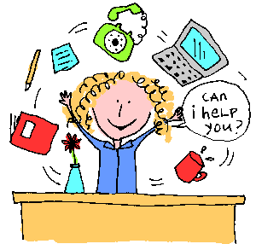
The professional learning modules introduce you to the fundamental principles of ABLES and step you through how to use the ABLES suite of resources.
ABLES
Professional Learning

Slide 19

The ABLES assessment tools for students with disabilities and additional learning needs are completed online.
The assessments provide a comprehensive profile of a student’s strengths and abilities in foundational learning skills.

Slide 20
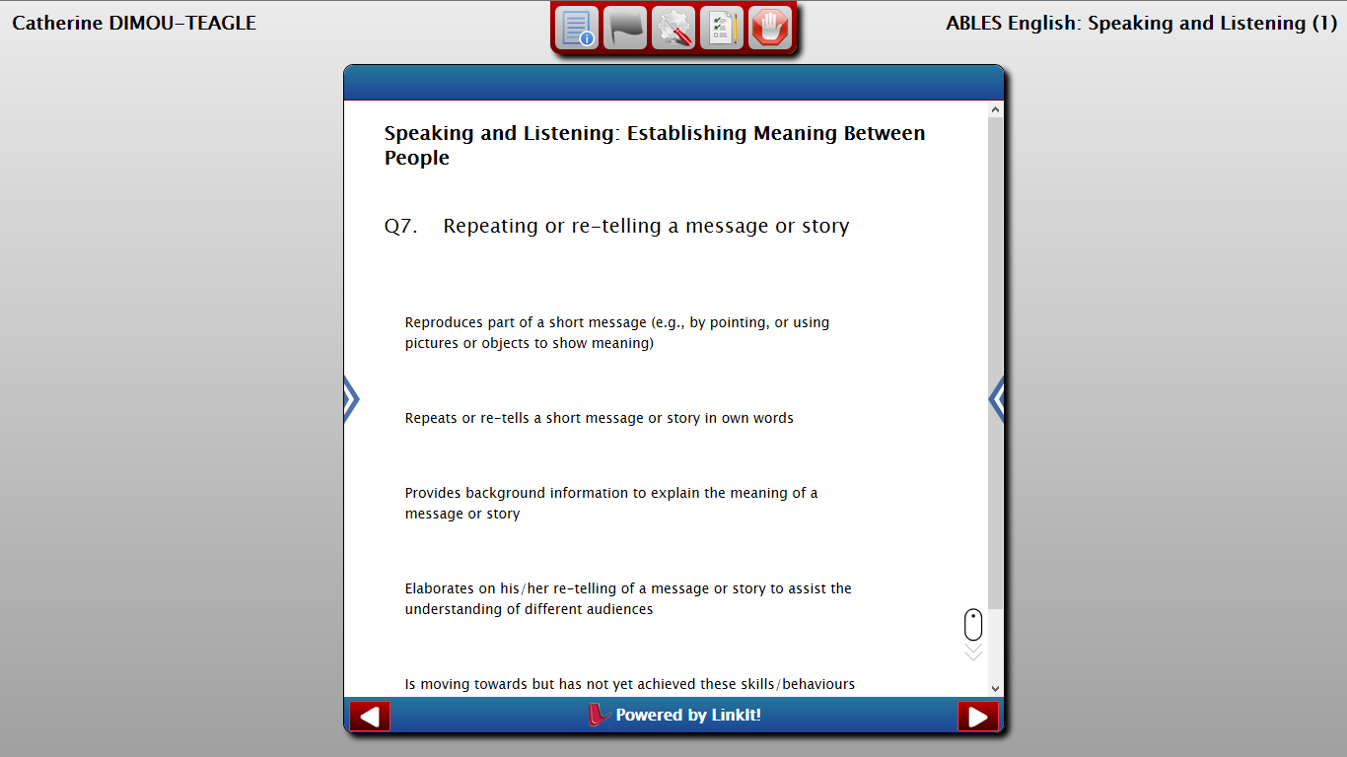
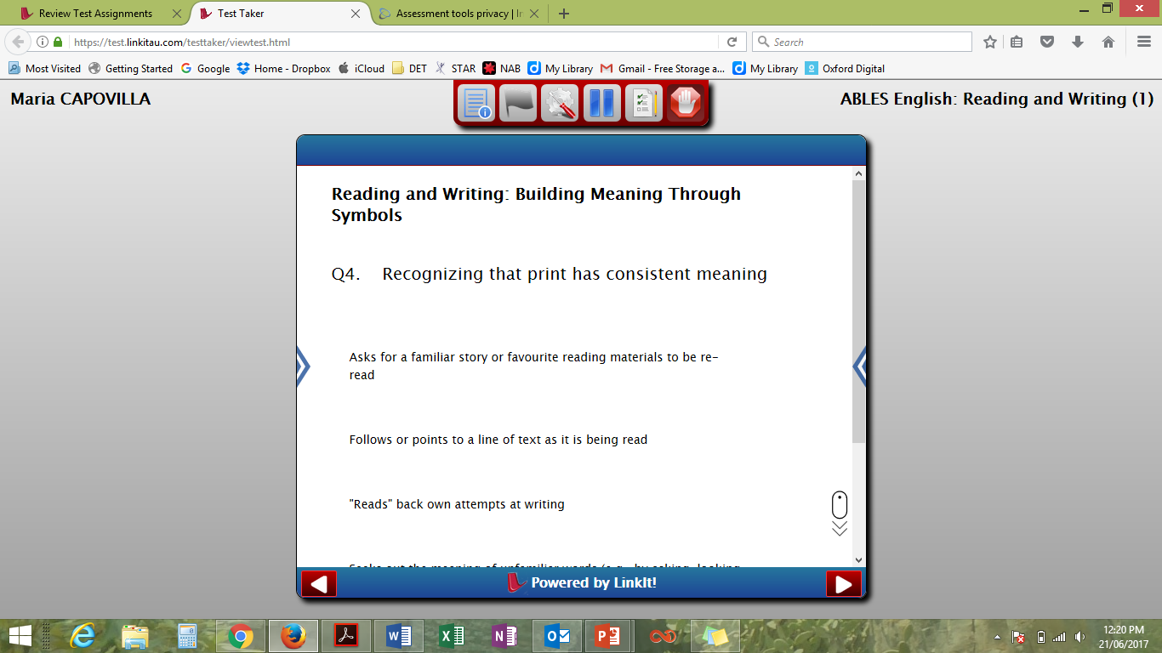
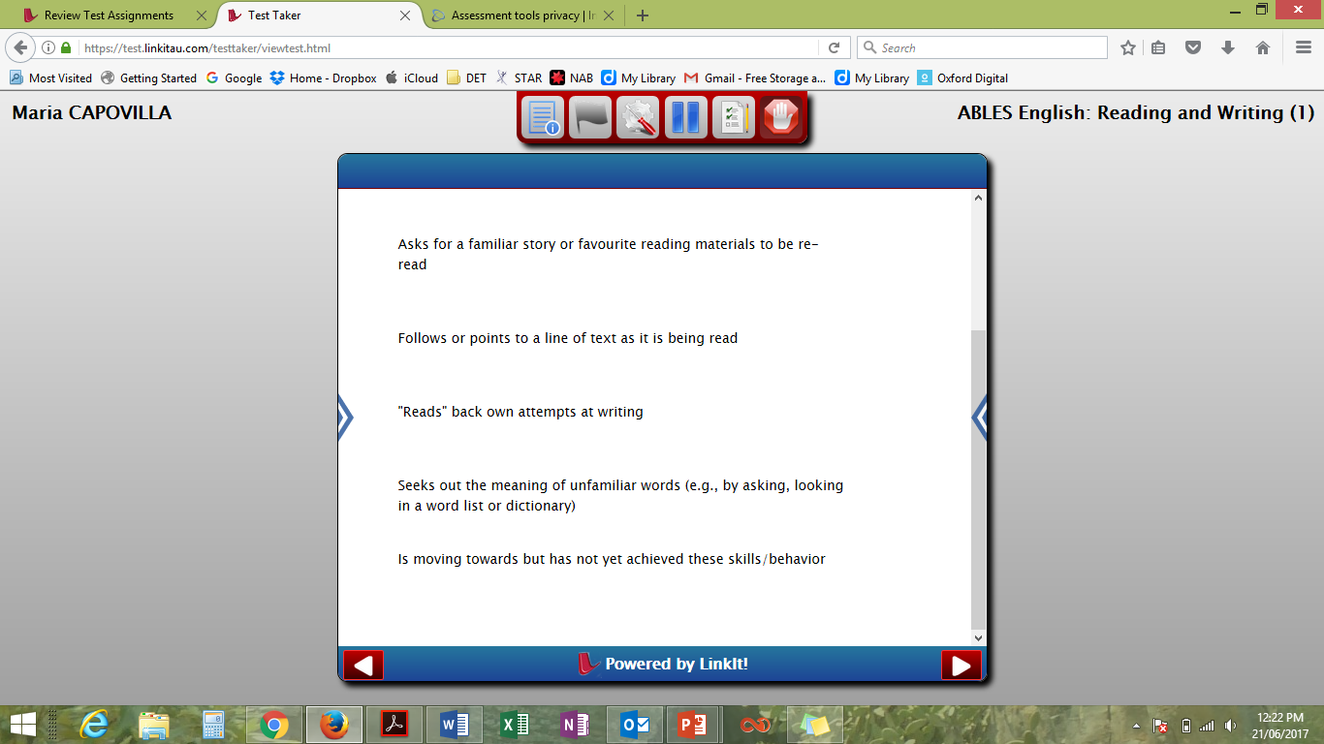
Sample questions:

Slide 21
What are the ABLES assessments?
The Insight Platform hosts a range of assessments across learning areas. Relevant to this PowerPoint are the ABLES assessment tools:
English, Speaking and Listening – the development of functional communication skills leading towards recognition and use of the social conventions of communication
English, Reading and Writing (current name on website) – the development of the use and interpretation of symbolic forms of representation leading towards early reading and writing
Other ABLES Assessment tools include the Personal and Social Capability
  mathematics, movement (specific to physical disability), digital literacy & critical & creative thinking are currently in the research phase.

Slide 22
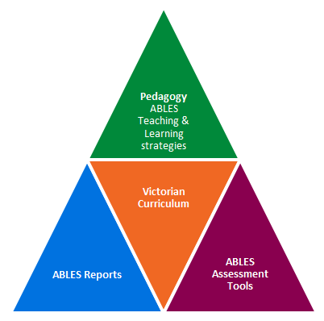
Integrating ABLES
Provides strategies for teaching and learning for students with disabilities.
The teacher can apply the ABLES assessment tool to identify their students’ readiness to learn.
Contains sample reports.
Notes:
http://www.education.vic.gov.au/school/teachers/teachingresources/diversity/Pages/integratingables.aspx

Slide 23
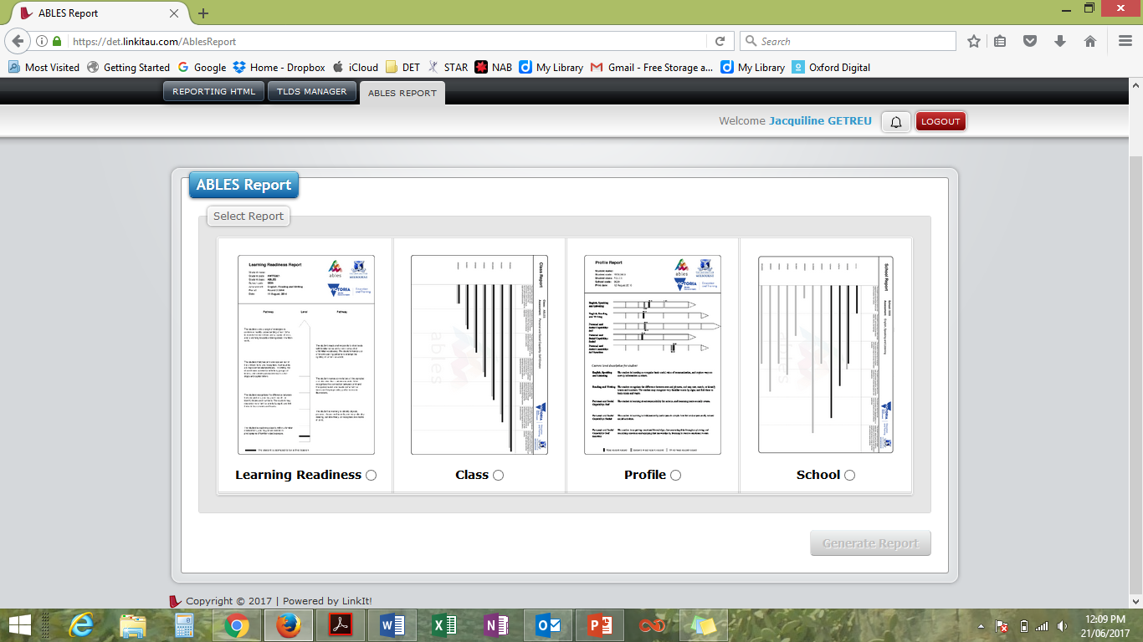
What are the Reports?
Teachers are provided with explicit guidance material and resources, including assessment tools and reporting systems that assist them to effectively plan and teach for the individual needs of students. The ABLES Assessment Tool identifies a student’s readiness to learn along a particular developmental learning pathway.
http://victoriancurriculum.vcaa.vic.edu.au/overview/curriculum-design/standards-and-levels

Slide 24
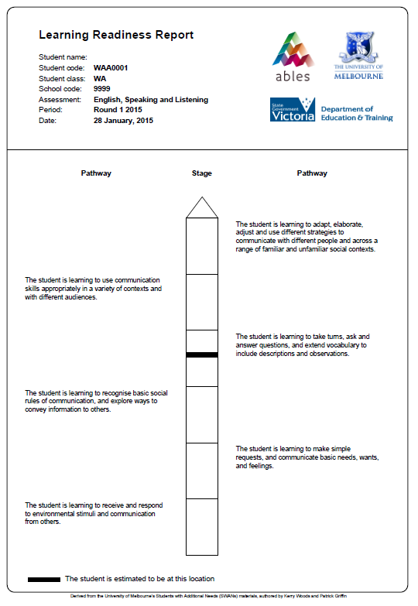
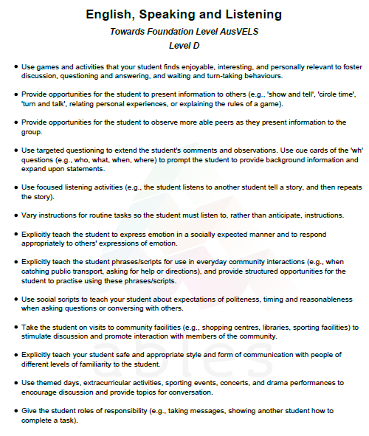

Slide 25
Learning progress (6 months)
Where on the pathway are my students working?
How much progress have they made?
Did some make more progress than others?
Why?

Slide 26
Questions & Feedback
Any questions?
My questions:
Did this session prepare you to use the DET & VCAA resources in curriculum for students with additional needs?
What further resources or professional learning will develop your confidence in teaching and learning programs for students with additional needs?
How can this be achieved?

Slide 27
Resources
Victorian Curriculum site - Diversity of Learners tab including pre-intentional to intentional definitions
http://victoriancurriculum.vcaa.vic.edu.au/overview/diversity-of-learners
Key ABLES resources http://www.education.vic.gov.au/school/teachers/teachingresources/diversity/Pages/ablesresources.aspx
Username = school #
Password = Vic_ABLES22

Slide 28
Resources
How to do Personalised Learning & Support Plans:
http://www.education.vic.gov.au/school/teachers/support/Pages/lspmod32curric2.aspx
Online training for Students with Disabilities http://www.oltaustralia.net/courses_victoria.asp?stateid=9&schooltype=1

Slide 29
Location / Contact details
VCAA websites
Victorian Curriculum F-10
http://victoriancurriculum.vcaa.vic.edu.au
Victorian Curriculum F-10 Resources and Support
http://www.vcaa.vic.edu.au/Pages/foundation10/viccurriculum/viccurr-resources.aspx
Curriculum Planning Resources:
http://curriculumplanning.vcaa.vic.edu.au/home
DET websites
Learning Diversity resources http://www.education.vic.gov.au/school/teachers/teachingresources/diversity/Pages/default.aspx
Queries
Jacqueline Moore
moore.jacqueline.j@edumail.vic.gov.au

