Slide 1
Integrating Media Arts across the Victorian Curriculum
Webinar, 02 May, 2017

Slide 2
Session overview
Structure of the Media Arts curriculum
Curriculum mapping & assessment Media Arts
Media Arts – Arts, Technologies and English

Slide 3
Victorian Curriculum: The Arts
4
Strands:
explore & express/represent ideas
practices
present & perform
respond & interpret
+
2
Organising ideas:
students learn as artist and as audience
Students learn by making & responding

Slide 4
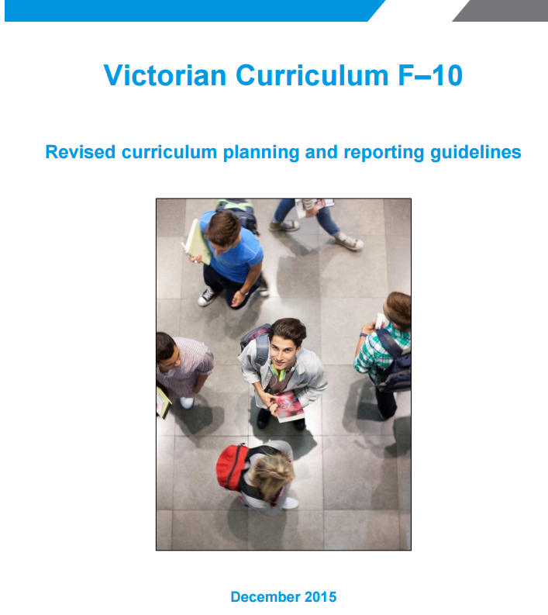
Revised Curriculum planning and reporting guidelines
In relation to the Arts F–6:
F-2
At the Foundation stage (Prep–Year 2), schools focus on five curriculum areas: English, Mathematics, The Arts, Health and Physical Education and Personal and Social Capability’.
(p. 19). At these levels, substantial attention should be paid to the Arts.
3-8
An Arts program that in Years 3–4 includes all five Arts disciplines and at Years 5–6 and 7–8 consists of at least two Arts disciplines, one from the Performing Arts and one from the Visual Arts.
(p. 20)
9-10
An arts program that inlcudes in this band of schooling learning in at least one arts discipline.
(p.21)
http://www.vcaa.vic.edu.au/Documents/viccurric/RevisedF-10CurriculumPlanningReportingGuidelines.pdf
Notes:
The challenge is to reconcile the twin demands of providing a learning program that maintains a focus on a common entitlement to core knowledge and skills and high expectations of every student whilst also allowing students opportunities to develop and pursue areas of individual interest and expertise.
At F all 5 Arts disciplines will be taught but not necessarily evenly weighted.
At 1 – 2 all 5 Arts disciplines over the two years but not necessarily evenly weighted.
At F – 2 schools need to plan so the Arts receive significant attention this means that in Foundation and 1 – 2 the curriculum for all 5 Arts disciplines must be delivered. How this happens is a matter for school decision. Schools will make these decisions as a result of their planning process, considering the context, the expertise and the resources available.
DET will collect assessments for all strands and achievement standards.

Slide 5
Learning in Media Arts
Media Arts Practices
In Making and Responding students engage with the key concepts, story principles and both technical and symbolic elements of media arts.
Making in Media Arts is the use of knowledge, skills, techniques, process and materials that communicate ideas and intentions.
Students design, produce and distribute media artworks.
Responding includes exploring, analysing and interpreting media artworks.
In making and responding to media artworks, students develop critical perception, personal expression and collaboration.

Slide 6
Learning in Media Arts
Media forms: film, news reports, documentary, advertising, animation, music videos, video games, graphic novels and multimodal media arts forms.
Key media concepts: used to tell stories; technologies used to produce, access and distribute media; various institutions that enable and constrain media production and distribution; audiences; representation.
Technical and symbolic elements of media: including composition, space, time, movement, sound, colour and lighting for media forms in different contexts.
Story principles: structure, intent, characters, setting, points of view and genre.
Techniques and processes: pre-production, post production, distribution, engagement.
Materials: images, sound, text and technologies.

Slide 7
Media Arts strands
Strand | Explore and Represent Ideas | Media Practices | Present and Perform | Respond and Interpret
 | Explore, investigate and experiment with ideas and develop characters, representations and viewpoints through characters, sound, settings, stories and text. | Use media technologies and media conventions to create and represent stories in media forms. | Planning, producing, distributing for specific audiences and contexts in media forms. | … reflecting, questioning, analysing and evaluating as an audience and producer. …Identify specific features and purposes of media artworks.

Slide 8
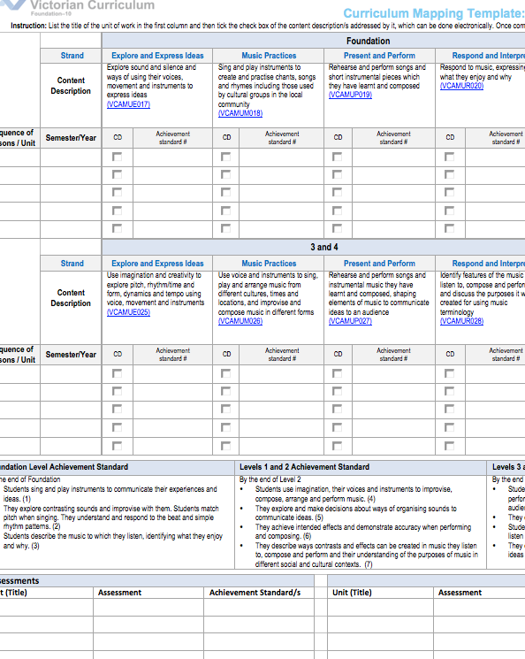
Curriculum mapping
Mapping identifies the extent of curriculum coverage in units of work and clearly links teaching, learning and assessment while working with the curriculum continuum.
Mapping templates support teachers to identify where content descriptions and achievement standards are being explicitly addressed within the school’s teaching and learning program.
Instructions:
http://www.vcaa.vic.edu.au/Pages/foundation10/viccurriculum/curriculumplanning.aspx
Templates
For each Arts discipline
F-6
7-10

Slide 9
vcaa.vic.edu.au/Pages/foundation10/viccurriculum/media/cpa.aspx

Slide 10
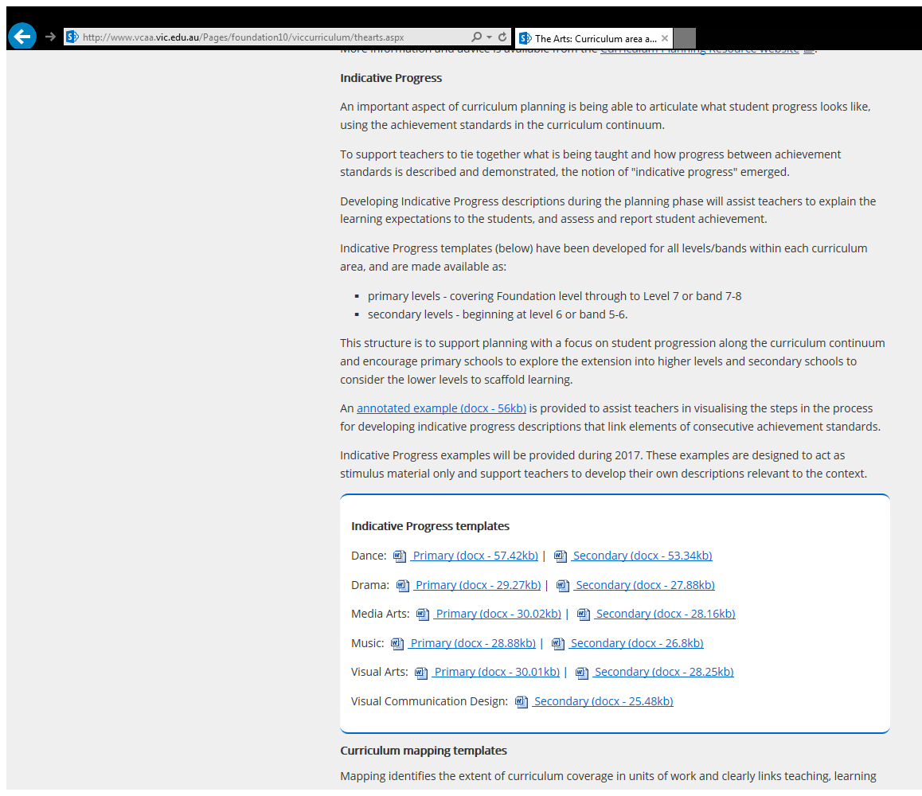
vcaa.vic.edu.au/Pages/foundation10/viccurriculum/thearts.aspx

Slide 11
Primary Content Descriptions & Elaborations
Level 4 Content Descriptors | Level 4 Achievement Standards
Explore & Represent
Investigate and devise representations of people in their community, through settings, ideas and story structure in images, sound and text. | Creating a sequence of images, sounds and text or a combination of these, to clearly establish the beginning, middle and end of a story or an event
Media Arts Practices
Use media technologies to create time and space through the manipulation of images, sounds and text when telling stories. | Applying text to accompany still or moving images, for example credits in a title sequence selecting appropriate fonts, colour and suitable length of time for display
Present and Perform
Plan, create and present media artworks for specific purposes with awareness of responsible media practice. | Storyboarding and filming a short sequence showing a conflict by selecting camera angles, lighting and costume to convey meaning without dialogue
Respond and Interpret
Identify intended purposes and meanings of media artworks, using the key concepts of media arts. | Describing representations and interpreting meaning in media artworks from different social, cultural or historical contexts, for example, different ways traditional stories can be retold using media technologies
Notes:
Show Primary mapping template and Unit planner

Slide 12
Primary Content Descriptor & Achievement Standards
Level 4 Content Descriptors | Level 4 Achievement Standards
Investigate and devise representations of people in their community, through settings, ideas and story structure in images, sound and text. | Students describe similarities and differences between media artworks they make and view. They discuss how and why they and others use images, sound and text to make and present media artworks.
Use media technologies to create time and space through the manipulation of images, sounds and text when telling stories. | Students use the story principles of intent, structure, setting, characters, media elements and media technologies to make and share media artworks that communicate ideas to an audience.
Plan, create and present media artworks for specific purposes with awareness of responsible media practice. | Students use the story principles of intent, structure, setting, characters, media elements and media technologies to make and share media artworks that communicate ideas to an audience.
Identify intended purposes and meanings of media artworks, using the key concepts of media arts. | Students describe similarities and differences between media artworks they make and view. They discuss how and why they and others use images, sound and text to make and present media artworks.

Slide 13
Secondary Content Descriptions & Achievement Standards
Level 7 – 8 Content Descriptors | Level 8
Explore & Represent
Experiment with the organisation of ideas to structure stories through media conventions and genres, to create viewpoints in images, sound and text. Develop media representations to show familiar or shared social can cultural beliefs and values. | Students use genre, media conventions and shape technical and symbolic elements for specific purposes and meanings. They evaluate how they and others use these media conventions and elements to make meaning. Students produce representations of social values and viewpoints in media artworks for particular audiences and contexts. They design production processes, and control equipment and technologies to achieve their intentions.
Media Arts Practices
Develop and refine media production skills to shape the technical and symbolic elements of images, sounds and text for a specific purpose and meaning. Plan, structure and design media artworks that engage audiences. | Students identify and analyse how representations of social values and viewpoints are portrayed in the media artworks they make, distribute and view. Students use genre, media conventions and shape technical and symbolic elements for specific purposes and meanings. Students produce representations of social values and viewpoints in media artworks for particular audiences and contexts. They design production processes, and control equipment and technologies to achieve their intentions.
Notes:
Show Secondary unit outline.

Slide 14
Level 8 Content Descriptors | Level 8 Achievement Standard
Present and Perform
Present media artworks within different community and institutional contexts, with consideration of ethical and regulatory issues. | Students identify and analyse how representations of social values and viewpoints are portrayed in the media artworks they make, distribute and view. Students use genre, media conventions and shape technical and symbolic elements for specific purposes and meanings. They evaluate how they and others use these media conventions and elements to make meaning. Students produce representations of social values and viewpoints in media artworks for particular audiences and contexts.
Respond and Interpret
Analyse how technical and symbolic elements are used in media artworks to create representations influenced by story, genre, values and viewpoints of particular audiences. Identify specific features and purposes of media artworks from contemporary and past times to explore viewpoints and enrich their media art making. | Students identify and analyse how representations of social values and viewpoints are portrayed in the media artworks they make, distribute and view. They evaluate how they and others use these media conventions and elements to make meaning. They identify and analyse the social and ethical responsibilities of both makers and users of media artworks.

Slide 15
Video Postcards St. Josephs College - Echuca
ABC Open Website
https://open.abc.net.au/

Slide 16
Example: ‘Video Postcards’
Activity | Content Descriptor
View ABC Open website to view ‘video postcards’. Discuss the representation of ideas, story, genre of the video and the viewpoints represented by the creator as well as the viewer. | Respond & Interpret Analyse how technical and symbolic elements are used in media artworks to create representations influenced by story, genre, values and viewpoints of particular audiences. Identify specific features and purposes of media artworks from contemporary and past times to explore viewpoints and enrich their media art making.
Students plan their own video postcard using storyboarding. They document the use of the technical and symbolic elements in their planning. Their product will demonstrate the use of technology in shooting and editing their product considering their audience. | Media Arts practices Develop and refine media production skills to shape the technical and symbolic elements of images, sounds and text for a specific purpose and meaning. Plan, structure and design media artworks that engage audiences.

Slide 17
Example: ‘Video Postcards’
Achievement Standard | Assessment criteria
Students identify and analyse how representations of social values and viewpoints are portrayed in the media artworks they make, distribute and view. They evaluate how they and others use these media conventions and elements to make meaning. Students produce representations of social values and viewpoints in media artworks for particular audiences and contexts. | Respond & Interpret Students discuss the social values portrayed in the video postcards from different viewpoints. What are the social values convey? They evaluate the use of media conventions in the postcards and discuss the media conventions they have used in their work to convey meaning. Students identify the audience for their post card and the social values and viewpoints they convey in their work.
They design production processes, and control equipment and technologies to achieve their intentions. | Media Arts practices Students use technologies using ipad cameras and moviemaker to create their digital postcard. They discuss the processes used to create meaning in their work.

Slide 18
Across the Arts Levels 3–4
Dance | Drama | Media Arts | Music | Visual Arts
Improvise and structure movement ideas for dance sequences using safe dance practice, the elements of dance and choreographic devices | Explore ideas and narrative structures through roles and situations and use empathy in their own improvisations and devised drama | Investigate and devise representations of people in their community through settings, ideas and story structure in images, sound and text. | Use imagination and creativity to explore pitch, rhythm/time and form, dynamics and tempo using voice, movement and instruments | Explore artworks from different cultures and times to express ideas in visual artworks.
Explore & Express/Represent
Improvise, investigate, ideas, imagination
Notes:
Website: Show filtering – The Arts

Slide 19
Across the Arts Levels 5 & 6 – Arts practice
Dance | Drama | Media Arts | Music | Visual Arts
Develop technical and expressive skills in fundamental movements and body actions and use choreographic devices to create dance sequences | Develop skills and techniques of voice and movement to create character, mood and atmosphere and focus dramatic action | Develop skills with media technologies to shape space, time, colour, movement and lighting, within images, sounds or text when telling stories | Develop and practise technical skills and use of expressive elements of music in singing, playing instruments, improvising, arranging and composing | Select and apply visual conventions, materials, techniques, technologies and processes specific to different art forms when making artworks
Arts Practices

Slide 20
Across the Arts Levels 9 & 10 – Respond & Interpret
Dance | Drama | Media Arts | Music | Visual Arts | Visual Communication Design
Evaluate their own choreography and performance, and that of others, to inform and refine future work | Evaluate how the elements of drama, forms and performance styles in devised and scripted drama to convey meaning and aesthetic effect | Analyse and evaluate how technical and symbolic elements are manipulated in media artworks to challenge representations framed by social beliefs and values in different community and institutional contexts | Evaluate a range of performances and compositions to inform and refine their own music making | Analyse and interpret artworks to explore the different forms of expression, intentions and viewpoints of artists and how they are viewed by audiences | Analyse and evaluate the factors that influence design decisions in a range of visual communications from different historical, social and cultural contexts
Analyse a range of dance from contemporary and past times to explore differing viewpoints and enrich their dance making | Analyse a range of drama from contemporary and past times to explore differing viewpoints and enrich their drama practice | Analyse and evaluate a range of media artworks from contemporary and past times, to explore differing viewpoints and enrich their media arts making | Analyse a range of music from contemporary and past times, to explore differing viewpoints and enrich their music making, and consider music in international contexts | Analyse, interpret and evaluate a range of visual artworks from different cultures, historical and contemporary contexts to explore differing viewpoints | Analyse and evaluate the use of methods, media, materials, design elements and design principles in visual communications from different historical, social and cultural contexts

Slide 21
Technologies & Media Arts
MEDIA ARTS
Explore and Represent Ideas | Media Practices |  | Present and Perform |  | Respond and Interpret
Explore, investigate and experiment with ideas and develop characters, representations and viewpoints through characters, sound, settings, stories and text. | Use media technologies and media conventions to create and represent stories in media forms. |  | Planning, producing, distributing for specific audiences and contexts in media forms. |  | … reflecting, questioning, analysing and evaluating as an audience and producer. …Identify specific features and purposes of media artworks.
DIGITAL TECHNOLOGIES
Digital Systems |  | Data and Information |  | Creating Digital Systems
Hardware, software and network components of digital systems. How data is transmitted between components in a system. |  | How data is collected and represented and how it is interpreted in context to produce information. |  | Interrelated processes and associated skills by which students create digital solutions.
Notes:
Show website and filtering

Slide 22
Technologies & Media Arts
MEDIA ARTS
Explore and Represent Ideas | Media Practices |  | Present and Perform |  | Respond and Interpret
Explore, investigate and experiment with ideas and develop characters, representations and viewpoints through characters, sound, settings, stories and text. | Use media technologies and media conventions to create and represent stories in media forms. |  | Planning, producing, distributing for specific audiences and contexts in media forms. |  | … reflecting, questioning, analysing and evaluating as an audience and producer. …Identify specific features and purposes of media artworks.
DESIGN & TECHNOLOGIES
Technologies and Society |  | Technologies Contexts |  | Creating Designed Solutions
Focus on how people use and develop technologies. Economic, environmental, ethical, legal and functional factors, and the impact of technologies on individuals, families, local, regional and global communities and the environment. |  | Materials and technologies (sub strand) Traditional, contemporary and emerging materials and specialist areas that involve the extensive use of technologies. Working with materials and production processes. |  | Design thinking, design processes and production processes. Investigating, Generating, Producing, Evaluating, Planning and managing.

Slide 23
Achievement Standard comparison
Level 6 Media Arts | Level 6 Design & Technologies
By the end of Level 6: Students use materials and media technologies to make media artworks for specific audiences and purposes, using intent, structure, setting and characters to communicate viewpoints and genre conventions. They explain the purposes of media artworks made in different cultures, times and places for different audiences. | By the end of Level 6: Students describe some competing considerations in the design of solutions taking into account sustainability. They describe how design and technologies contribute to meeting present and future needs. Students explain how the features of technologies impact on designed solutions for each of the prescribed technologies contexts. Students create designed solutions for each of the prescribed technologies contexts, suitable for identified needs or opportunities. They combine design ideas and communicate these to audiences using graphical representation techniques and technical terms. Students record project plans including production processes. They select and use appropriate technologies and techniques correctly and safely to produce designed solutions.
Notes:
Show planner for Visual Arts and Media Arts

Slide 24
Media Arts & English
Table represents connections between the Media Arts curriculum & the English curriculum
 | READING & VIEWING | WRITING | SPEAKING & LISTENING
Language | Expressing & Developing ideas Text structure & organisation. | Text structure & organisation | Language variation & change Language for interaction Expressing & developing ideas.
Literature | Responding to literature Examining literature Literature in Context | Creating literature | Literature & Context Responding to literature Examining literature
Literacy | Texts in context Interpreting, analysing, evaluating | Creating texts | Interacting with others
Notes:
Show links on website.

Slide 25
Curriculum planning – media arts concepts (With thanks to Eltham College)
Project 1: Analysis of a media product
Analysis of technical & symbolic elements
Story principles
Materials
Exercises: Media practices
Use of technical & symbolic elements
Pre-production, production, post-production
Image, sound, text
Production techniques – camera techniques
Post production – editing (still and moving images)

Slide 26
Ideas for curriculum concepts
Project 2: A Day in 60 seconds
Project planning – creative thinking, storyboarding, shot lists or photomontage.
(Audience, intent, presentation, distribution).
(image, sound, text)
Production – filming/shooting/drawing/creation of text
Editing – After Effects, PhotoShop, InDesign
Distribution/Presentation - Audience

Slide 27
Feedback
Please complete the survey from F-10 to let me know about the relevance of this presentation for your work and whether it met your expectations.
You can also email me directly:
Kathryn Hendy-Ekers
Curriculum Manager: Visual Arts
Phone: 61 3 9032 1697
Email: Hendy-Ekers.Kathryn.L@edumail.vic.gov.au

