Slide 1
Victorian Curriculum
English (F-6)

Slide 2
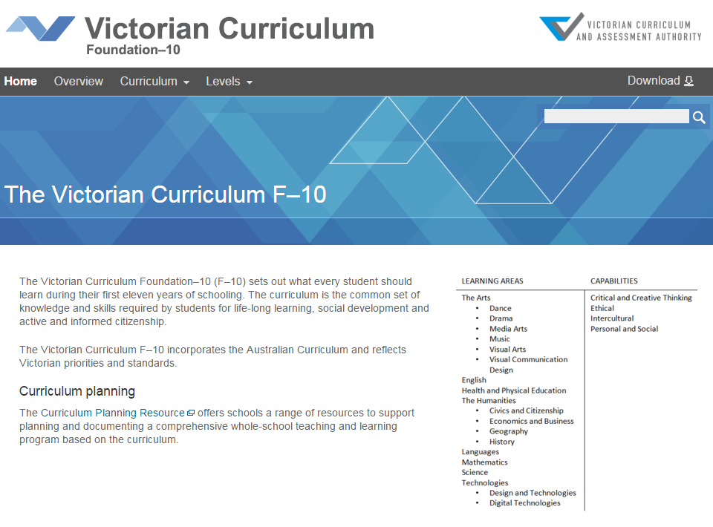
Agenda
Overview
Aims
Structure & Features
Differences from AusVELS
Strands
Activities
EAL & Literacy
Key questions for planning

Slide 3
Victorian Curriculum F–10
Released in September 2015 as a central component of the Education State
Provides a stable foundation for the development and implementation of whole-school teaching and learning programs
The Victorian Curriculum F–10 incorporates the Australian Curriculum and reflects Victorian priorities and standards
http://victoriancurriculum.vcaa.vic.edu.au/

Slide 4
Aims
The English curriculum aims to ensure that students:
learn to listen to, read, view, speak, write and reflect on increasingly complex and sophisticated spoken, written and multimodal texts across a growing range of contexts with accuracy, fluency and purpose
appreciate, enjoy and use the English language in all its variations and develop a sense of its richness and power to evoke feelings, convey information, form ideas, facilitate interaction with others, entertain, persuade and argue
understand how Standard Australian English works in its spoken and written forms and in combination with non-linguistic forms of communication to create meaning
develop interest and skills in inquiring into the aesthetic aspects of texts, and develop an informed appreciation of literature.

Slide 5
Conceptual structure
Study of literary texts of personal, cultural, social and aesthetic value
The first achievement standard at Foundation and then at Levels 1, 2, 3, 4, 5, 6, 7, 8, 9 and 10
Language
Literature
Literacy
Read and view
Knowledge of the English language and how it works
Content descriptions and elaborations
Speak and listen
Write
Students will demonstrate their knowledge and skills in these areas through the language modes
Interpret and create texts with appropriateness, accuracy, confidence, fluency and efficacy for a range of contexts

Slide 6
Features of the English curriculum
A continuum of learning
structured as a continuum across levels of learning achievement.
The cumulative curriculum
Students gradually develop their knowledge and skills with language over time.
For example, students learn about nouns and then gradually build on that knowledge to apply it in more sophisticated way across subsequent levels of the curriculum.
The spiralling curriculum
Students apply their knowledge and skills in different texts and contexts.
For example, students investigate the role of nouns in narrative texts, then later in persuasive texts.

Slide 7
Changes from AusVELS to Victorian Curriculum
Substantially similar to AusVELS English, with the majority of the curriculum unchanged.
Some changes to strengthen particular areas and clarify others.
The Sound and letter knowledge sub-strand, previously located in the Language strand, has been renamed as Phonics and word knowledge and is now comprised of three focus areas, that have been strengthened through the addition of new content descriptions :
Phonological and phonemic awareness
Phonic knowledge
Spelling.
The content descriptions in the Handwriting focus area have been revised to make the connection between phonics and handwriting more explicit.
Content descriptions have been added to improve the development of knowledge and skills in the Experimentation and adaptation and Analysing and evaluating texts focus areas.
The Purpose and audience focus area from within the Interpreting, analysing, evaluating sub-strand has been deleted to avoid duplication of content.
Content descriptions within the Listening and Speaking interactions focus area have been combined and consolidated.
There have been minor refinements across the curriculum to improve consistency and readability, and to remove repetition.

Slide 8
Structure

Slide 9
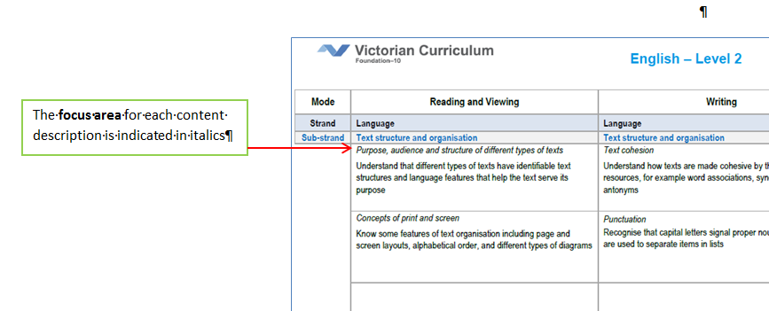
Structure
A3 format scope and sequence charts

Slide 10
The Language strand
knowledge of the English language and how it works
Sub-strands
Language variation and change
Expressing and developing ideas
Language for interaction
Text structure and organisation
Phonics and word knowledge
Register
everyday
specialised
field
technical
informal
formal
tenor
more spoken like
more written like
mode

Slide 11
Key questions for planning
What knowledge about language do teachers need to have to deliver the curriculum effectively?
What pedagogies will most effectively support students to develop knowledge and skills related to language?
How might work in other learning areas provide opportunities to explicitly teach content from the language strand and provide evidence of learning?

Slide 12
The Literature strand
the study of literary texts of personal, cultural, social and aesthetic value
Sub-strands
Literature and context
Responding to literature
Examining literature
Creating literature
Texts which:
have the potential to enrich the lives of students
expand the scope of student experience
represent effective and interesting features of form and style

Slide 13
Possible approaches to the study of literature:
close reading to develop a critical understanding and appreciation of the aesthetics and intellectual aspects of texts
cultural studies, with emphasis on the different ways in which literature is significant in everyday life
structuralism, with its emphasis on close analysis of literary works and the key ideas on which they are based (eg: a detailed study of differing styles of literary work)
comparativism, with its emphasis on comparisons of works of literature from different language, ethnic and cultural backgrounds
historicism, with its emphasis on exploring the relationships between historical, cultural and literary traditions.

Slide 14
Key questions for planning
What literary texts have we selected for study?
How do these texts allow for delivery of the curriculum?
Have we selected a suitable range of texts?
On what basis have we selected the texts?

Slide 15
The Literacy strand
ability to interpret and create texts with appropriateness, accuracy, confidence, fluency and efficacy for learning in and out of school, and for participating in Australian life more generally
Sub-strands
Texts in context
Interacting with others
Interpreting, analysing and evaluating
Creating texts

Slide 16
Key questions for planning
How might work in/from other learning areas provide opportunities to explicitly teach content from the literacy strand and provide evidence of learning?
How do learning experiences, texts and assessment allow for increasing complexity of application?
What non-literary texts have we selected for study?
How do these texts allow for delivery of the curriculum?
Have we selected a range of texts?
On what basis have we selected the texts?

Slide 17
Activity 1
In small groups, select one of the sentences below.
Draw/create the visuals that could accompany the sentences to enhance meaning.
Compare your work and consider the differences in meaning.
They stared into the distance.
Darkness fell.
Walk carefully.
It happened suddenly.

Slide 18
Activity 1
4. Consider how this activity provides students with opportunities to demonstrate the achievement standards across a range of levels.
Level 2 – Writing
Students create texts that show how images support the meaning of the text.
Level 3 – Writing
Students' texts include writing and images to express and develop in some detail experiences, events, information, ideas and characters.
Level 4 – Writing
They create texts that show understanding of how images and detail can be used to extend key ideas.

Slide 19
Activity 2
The rabbits came many grandparents ago.
At first we didn’t know what to think.
There weren’t many of them.
Some were friendly.
But our old people warned us.
Be careful.
They won’t understand the right ways.
They only know their own country.
Draw a map that illustrates the connections between the nouns that refer to ‘The rabbits’ and to ‘we’.
The nouns/noun groups are highlighted in red.
The Rabbits, John Marsden and Shaun Tan

Slide 20
Students need to keep track of the connections or relationships between nouns and how these contribute to the meaning of a text.
The rabbits came many grandparents ago.
At first we didn’t know what to think.
There weren’t many of them.
Some were friendly.
But our old people warned us.
Be careful.
They won’t understand the right ways.
They only know their own country.
Many of them
The rabbits
Some
They
They
We
us
The Rabbits, John Marsden and Shaun Tan
The right ways
Their own country
Level 4 | Understand how texts are made cohesive through the use of linking devices including pronoun reference and text connectives

Slide 21
Building on this, students need to develop control over vocabulary to express greater precision of meaning, and consider how this develops over a whole text.
One day Jake went to the shop. Jake was a medium sized boy with brown hair and green eyes. He was very messy and liked to mess things up on purpose. He was going to the shop to make a big mess. There was a giant stack of cans near the front of the shop. He walked up to the stack and pulled out the can at the bottom of the pile. The cans toppled down and food spilled everywhere. He walked off, satisfied. He got back home and walked up to his room. There were empty coke cans and scrunched-up balls of paper everywhere. He was about to start playing his DS when his mom came into the room.
Year 5 English – Work Sample 1, ACARA
What do the nouns tell us about the character Jake? How could we support this student to improve their writing?
Level 5 | Understand the use of vocabulary to express greater precision of meaning, and know that words can have different meanings in different contexts
Level 6 | Investigate how vocabulary choices, including evaluative language can express shades of meaning, feeling and opinion

Slide 22
Students develop an understanding of how nouns can be used to classify and communicate complex whole/part relationships or taxonomies.
Shakespeare was arguably the most notable playwright of the Elizabethan era, working as part of the Lord Chamberlain’s Men. Other prominent playwrights of this golden age of English history included Christopher Marlowe and Ben Johnson, both part of the Admiral’s men.
Elizabethan era
Level 7 | Understand and explain how the text structures and language features of texts become more complex in informative and persuasive texts and identify underlying structures such as taxonomies, cause and effect, and extended metaphors
Lord Chamberlain’s Men
Admiral’s Men
Marlowe
Shakespeare
Johnson

Slide 23
The knowledge and skills support students as they move into the VCE.
2011 Section A: Upper range response
How is McGirr’s own character revealed in his book Bypass: the story of a road?
In his meandering tale Bypass: the story of a road, Michael McGirr leads his readers on a journey down ‘Australia’s main street’, the Hume Highway ensuring that the stretch of bitumen is seen in a unique and refreshing way. From his bicycle saddle, McGirr is able to make use of his keen eye for detail as he observes, ponders and enlightens on the intricacies of human behaviour. Not only does his unique and honest narrative detail his journey from Sydney to Melbourne, it also offers an insight into the personal and spiritual journal that McGirr has embarked on.

Slide 24
Activity 2 questions
What are the implications for planning at the:
whole school level?
year/cohort level?
other?

Slide 25
Curriculum mapping templates
Identify where content descriptions and achievement standards are being explicitly addressed within the school’s teaching and learning program
Handout – Level 7 Curriculum Mapping Template
http://www.vcaa.vic.edu.au/Pages/foundation10/viccurriculum/english/englishcmt.aspx

Slide 26
EAL
During 2016, the VCAA and DET is working in a partnership to develop the Victorian Curriculum F–10 English as an Additional Language (EAL), which will be aligned to the new Victorian Curriculum F–10 English.
The curriculum will be accompanied by teaching and learning resources.
Building on the EAL Companion to AusVELS, the EAL Developmental Continuum P–10 and findings from assessment research being undertaken by DET, the EAL curriculum will focus on the language skills needed by students for whom English is an additional language and will take account of the diverse nature of this group through multiple pathways for learning English and learning in English.
It is intended that the EAL curriculum will be available from Term 1, 2017.

Slide 27
Literacy across the curriculum
Literacy is foundational to all learning areas and capabilities in the Victorian Curriculum.
It is not one of the four capabilities which have separately articulated content descriptions and achievement standards.
Students develop knowledge and skills across the Language and Literacy strands of the English curriculum.
Much of the explicit teaching of literacy occurs in the English learning area, however, it is strengthened, made specific and extended in other learning areas as students engage in a range of learning and assessment with significant literacy demands.
Resources will be prepared to support teachers to understand the language demands of different learning areas, and demonstrate how English content descriptions apply to particular texts.

Slide 28
Level 3 — Understand that verbs represent different processes (doing, thinking, saying, and relating) and that these processes are anchored in time through tense
English
Nam wondered if he would ever find his way home. (Thinking – provide insight into a character’s perspective)
Science
Photosynthesis is the process of converting light into chemical energy. (Relating – define a technical term)
History
During World War II, Germany invaded Poland. (Doing – sequence of events)
HPE
The ABS reported that Australians obtained over a third (35%) of their total energy from ‘discretionary foods’. (Saying – report relevant data from expert source)

Slide 29
Key questions for planning
What are the language and literacy demands of learning in other curriculum areas?
How might language be a barrier to students demonstrating success?
How can the content descriptions from English (across a range of levels) provide the basis for explicit instruction in other learning areas?

Slide 30
Questions
Jacqueline Moore | Curriculum Manager, English
T: (03) 9032 1691
E: moore.jacqueline.j@edumail.vic.gov.au

