Slide 1
Victorian Curriculum: Unpacking Health and Physical Education (for Secondary teachers)

Slide 2
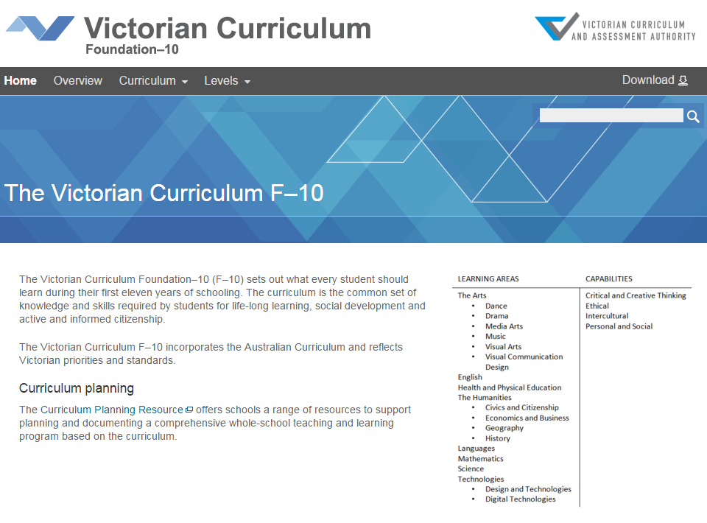
Victorian Curriculum F–10
Released in September 2015 as a central component of the Education State
Provides a stable foundation for the development and implementation of whole-school teaching and learning programs
The Victorian Curriculum F–10 incorporates the Australian Curriculum and reflects Victorian priorities and standards
http://victoriancurriculum.vcaa.vic.edu.au/

Slide 3
Terminology
AusVELS - VELS component | Victorian Curriculum
Domains | Curriculum areas
Dimensions | Strands and sub-strands
------- | Content descriptions
Learning focus | -------
Standards | Achievement standards

Slide 4
Structure
Strands and sub-strands
Strands | Personal, Social and Community Health | Movement and Physical Activity
Sub-strands | Being healthy, safe and active | Moving the body
 | Communicating and interacting for health and wellbeing | Understanding movement
 | Contributing to healthy and active communities | Learning through movement
Achievement standards
The first achievement standard at Foundation and then at Levels 2, 4, 6, 8 and 10.
A curriculum for students with disabilities is provided in this learning area.

Slide 5
Focus areas
The focus areas provide the context through which the
Content Descriptions and Achievement Standards
are taught and assessed
Alcohol and other drugs | Active play and minor games (Foundation to Level 6)
Food and nutrition | Challenge and adventure activities
Health benefits of physical activity | Fundamental movement skills (Foundation to Level 6)
Mental health and wellbeing | Games and sports
Relationships and sexuality | Lifelong physical activities
Safety | Rhythmic and expressive movement

Slide 6
Focus areas application Levels 7-8: Personal social and community health
Content description | Elaboration
Investigate and select strategies to promote health, safety and wellbeing | investigating reasons why young people choose to use or not use drugs, and proposing strategies to make informed choices (AD) researching a variety of snack and lunch options, and evaluating nutritional value, value for money and sustainability impacts to create a weekly menu plan (FN) researching opportunities in the local community to participate in regular physical activity and examining how accessible these opportunities are for students (HBPA) proposing and practising strategies for celebrating safely, including assertiveness, refusal skills, planning travel arrangements and contingency plans (AD, FN, RS, S) examining strategies for safe practices in different environments, including home, transport and aquatic environments (S)

Slide 7
Focus areas application Levels 9-10: Movement and Physical Activity
Content description | Elaboration
Transfer understanding from previous movement experiences to create solutions to movement challenges | drawing parallels between successful movement strategies in one sporting situation and how similar strategies could be used effectively in a different sport (GS) speculating on possible outcomes of innovative solutions to movement challenges based on past experiences (LLPA, RE, CA, GS) reflecting on successful movement solutions and proposing how they can be transferred to new movement challenges (CA, LLPA, GS, RE) demonstrating motivation, persistence, confidence and commitment when faced with difficult or unfamiliar movement tasks (GS, RE, CA, LLPA)

Slide 8
Key messages
Shaped by five interrelated propositions:
focuses on educative outcomes
takes a strengths-based approach
values movement
develops health literacy skills
includes a critical inquiry approach

Slide 9
Aims
Health and Physical Education aims to develop the knowledge, understanding and skills to enable students to:
access, evaluate and synthesise information to take positive action to protect, enhance and advocate for their own and others’ health, wellbeing, safety and physical activity participation across their lifespan
develop and use personal, behavioural, social and cognitive skills and strategies to promote a sense of personal identity and wellbeing and to build and manage respectful relationships
acquire, apply and evaluate movement skills, concepts and strategies to respond confidently, competently and creatively in a variety of physical activity contexts and settings
engage in and enjoy regular movement-based learning experiences and understand and appreciate their significance to personal, social, cultural, environmental and health practices and outcomes
analyse how varied and changing personal and contextual factors shape understanding of, and opportunities for, health and physical activity locally, regionally and globally.

Slide 10
Health and Physical Education Web Tour
http://www.vcaa.vic.edu.au/Pages/foundation10/f10index.aspx

Slide 11
Victorian Curriculum F-10
Revised curriculum planning and reporting guidelines
http://www.vcaa.vic.edu.au/Documents/viccurric/RevisedF-10CurriculumPlanningReportingGuidelines.pdf
Notes:
Specific sectoral requirements related to curriculum provision and reporting are the responsibility of and published by the relevant sectoral authorities
A minimum of two written reports to parents per year.
Independent schools must meet the minimum requirements established by VRQA and the requirements of the Commonwealth Government as set out on the Education Act 2013.
Government and Catholic sector schools meet these requirements by reporting student progress against the achievement standards set out in the eight learning areas and four general capabilities of AusVELS.

Slide 12
Years 7–10 (in two-year bands)
Schools teach and report on student achievement in each of the following curriculum areas during each two year band of school, in accordance with the whole school teaching and learning plan:
The Arts (Note: Years 9–10 can be Visual or Performing)
Humanities: including History, Geography, Economics and Business (from Year 5 or 6), and Civics and Citizenship (from Year 3 or 4)
Technologies: including Design and Technologies and Digital Technologies
Capabilities: Critical and Creative Thinking, Intercultural, Ethical, and Personal and Social Capability
Languages
Health and Physical Education

Slide 13
Curriculum Planning
Schools can decide how to structure their teaching and learning program. Content descriptions across the learning areas and capabilities can be combined to create teaching and learning programs.
Schools will design teaching and learning programs to:
reflect local resources, expertise and contexts, and allows for specialisation and innovation
ensure every student has the opportunity to learn the knowledge, understandings and skills defined in the curriculum
HPE resources, including Curriculum Mapping Templates: http://www.vcaa.vic.edu.au/Pages/foundation10/viccurriculum/hpe/hpe.aspx

Slide 14
Curriculum connections between Health and Physical Education and other curriculum areas

Slide 15
HPE, the Personal and Social Capability and relationships
The study of respectful relationships is in both Health and Physical Education and the Personal and Social Capability.
The Personal and Social Capability (P&SC) involves learning to recognise and regulate emotions, develop empathy for others and understand relationships, establish and build a framework for positive relationships, work effectively in teams and develop leadership skills
HPE enables students to recognise personal qualities, understand identity and strategies for respectful relationships
Together HPE and P&SC develops knowledge and skills to promote safe and respectful relationships

Slide 16
Health and Physical Education & Design and Technologies
The study of food and nutrition is in Health and Physical Education and Design and Technologies (D&T)
In D&T students learn how to apply knowledge of the characteristics and scientific and sensory principles of food, to food selection and the design and preparation of food for specific purposes and consumers. They also develop understandings of contemporary technology-related food issues such as convenience foods, highly processed foods, food packaging and food transport.
In HPE food and nutrition is included as a focus area, which emphasises the development of knowledge and skills that support students to make healthy choices about food and nutrition.
Together HPE and D&T provide opportunity for students to develop knowledge about food and nutrition and the skills to enable healthy eating.

Slide 17
Health and Physical Education, the Arts and Dance
Dance is in the Health and Physical Education and the Arts
Students make and perform dances in both learning areas
In the Arts, the focus is on the student as an artist and audience and learning through choreography, performance and appreciation of dance and dance-making
In Health and Physical Education, the focus is on rhythmic and expressive movement activities with an emphasis on dance as a lifelong physical activity and the development of movement skills, concepts and patterns
Together HPE and the Arts: Dance provide ways for students to develop personal and social skills and critically appraise cultural and social factors that shape their own identities, body and communities

Slide 18
Health and Physical Education, Geography and place
The study of place and outdoor environments is in Health and Physical Education and Geography.
The Geography curriculum explores and analyses the characteristics of the places that make up our world, using the concepts of place, space, environment, interconnection, sustainability, scale and change
HPE includes outdoor recreation as part of the challenge and adventure activities focus area.
HPE explore the influence of connection to place and communities on health and wellbeing
Together Geography and HPE (with Science and the Personal and Social Capability) enable students to experience and reflect on outdoor activities and to connect with the natural environment

Slide 19
Health and Physical Education and Ethical Capability
Both Health and Physical Education and the Ethical Capability enable students to explore complex social issues
The Ethical Capability strengthens students’ capacity to make decisions informed by an understanding of the values, principles, concepts and ideas that underpin different assumptions, and an ability to analyse and evaluate these.
Health and Physical Education focuses on the importance of treating others with integrity, fairness and compassion, and valuing and respecting diversity and equality for all. Students explore concepts of fair play, equitable participation, empathy and respect in relationships.
Together HPE and the Ethical Capability enables students to develop skills to understand the ethical aspects of issues and to reflect on the decisions that impact on health, wellbeing, safety and physical activity.

Slide 20
Support for schools
VCAA has employed specialist teachers to support schools implement the Victorian Curriculum in relation to Health Education and the Personal and Social Capability:
through development of resources (Term 1 and 2)
providing professional learning for schools (Term 3 onwards)

Slide 21
Questions?

Slide 22
Nerida Matthews Curriculum Manager, Health and Physical Education VCAA
Phone: 90321721
Email: matthews.nerida.a@edumail.vic.gov.au

