Slide 1
Planning 7-10 Music learning using Victorian Curriculum
Helen Champion
Webinar, 13 2016

Slide 2
Session overview
Introduction
Victorian Curriculum is designed for use in instrumental and classroom music learning programs
Documents and resources
Curriculum
Music Education Guide
Music Education Framework
Victorian Curriculum: The Arts - Music
Design assumptions
Content
Organisation

Slide 3
Planning music learning
Formal and informal planning
Documentation
Schools
Teachers
Students
Classroom, IM and ensembles
What do you do?
What works?

Slide 4
Curriculum design
Victorian Curriculum: The Arts
Same framework for all Arts disciplines
Designed for use in multiple contexts
No set pedagogies, repertoire or styles

Slide 5
Victorian Curriculum: The Arts
4
Strands:
explore & express/represent ideas
practices
present & perform
respond & interpret
+
2
Organising ideas:
students learn as artist and as audience
Students learn by making & responding

Slide 6
Interdependent content
Concept
Knowledge and skills
Contexts
What is to be taught?
What knowledge and skills do students already have? And what knowledge and skills will acquire or develop?
What is the context for the learning?

Slide 7
Unpacking a concept
BEAT
COUNTING, NOTE VALUES, BEAT/RHYTHM, … FEEL, SYNCOPATION, ACCENT …
LISTENING, COMPOSING, PERFORMING, ACOUSTIC, DIGITAL, NOTATING, IMPROVISING, SOLO, GROUP, STYLES ….

Slide 8
EXPLORE & EXPRESS
PRACTICES
BEAT
Shape, stillness, closed, Imagining, trialling
COUNTING, NOTE VALUES, BEAT/RHYTHM, … FEEL, SYNCOPATION, ACCENT …
PRESENT & PERFORM
working individually, in pairs, in small groups etc.
RESPOND & INTERPRET
LISTENING, COMPOSING, PERFORMING, ACOUSTIC, DIGITAL, NOTATING, IMPROVISING, SOLO, GROUP, STYLES ….

Slide 9
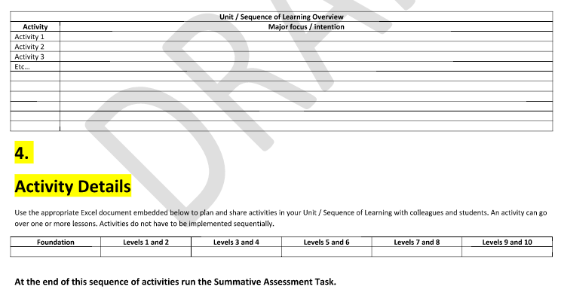
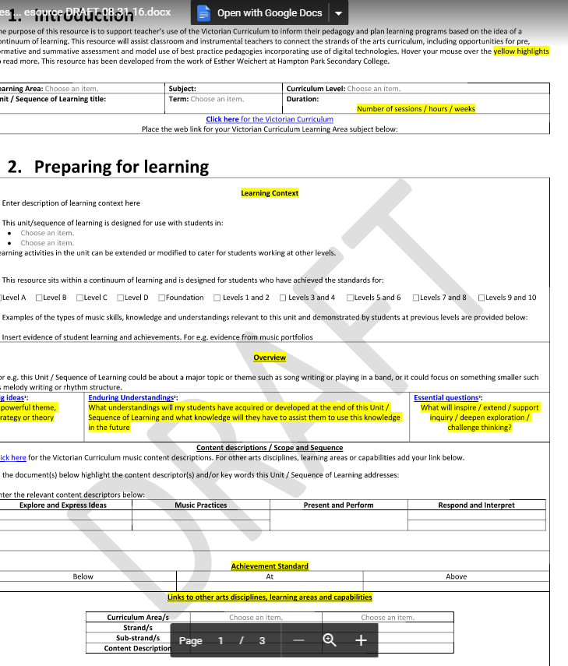
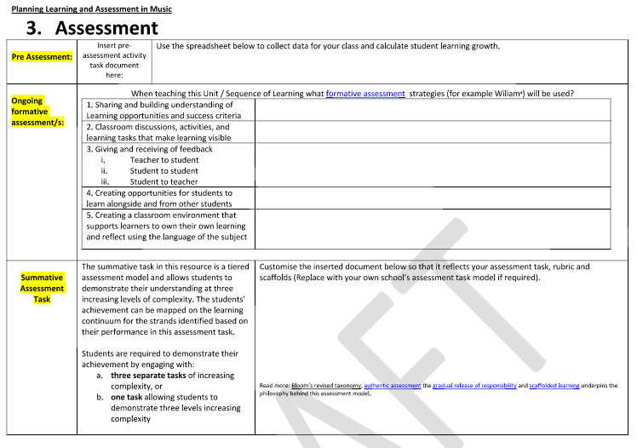
Sample school planning template

Slide 10
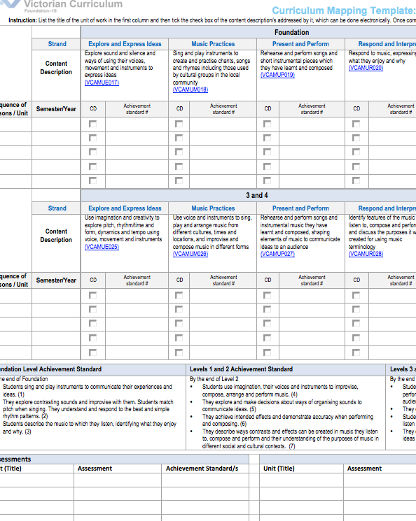
Curriculum mapping
Mapping identifies the extent of curriculum coverage in units of work and clearly links teaching, learning and assessment while working with the curriculum continuum.
Mapping templates support teachers to identify where content descriptions and achievement standards are being explicitly addressed within the school’s teaching and learning program
Instructions:
http://www.vcaa.vic.edu.au/Pages/foundation10/viccurriculum/curriculumplanning.aspx
Templates
For each Arts discipline
Levels A-D
F-6
7-10

Slide 11
Activity #1: Which level?
Talk about what the concept of ‘a continuum of learning’ means for your music program
Consider the information you know about
The group of students for whom you are planning
Context
prior learning
Interests
How much learning time is available
And then,
Identify the content description/s and level/s that is/are likely to be the best fit
Consider how the learning program for a particular group of students could be varied to cater for different learning needs?
EXPLORE & EXPRESS
PRACTICES
PRESENT & PERFORM
RESPOND & INTERPRET

Slide 12
Activity #2: The big idea
What is the purpose of the unit/learning? (The big, central idea)
1. Describe the unit/sequence of learning in 20 words or less
EXPLORE & EXPRESS
PRACTICES
PRESENT & PERFORM
RESPOND & INTERPRET

Slide 13
Activity #2: unpacking
why is this activity in the learning plan for this student/group of students?
EXPLORE & EXPRESS
PRACTICES
PRESENT & PERFORM
RESPOND & INTERPRET

Slide 14
Activity #2b: more unpacking
List key activities for this unit/sequence
Listening
Composing/improvising
Skill development
Performing
Responding
Interpreting
EXPLORE & EXPRESS
PRACTICES
PRESENT & PERFORM
RESPOND & INTERPRET

Slide 15
Activity #2c: even more unpacking
how is the activity
introduced?
taught?
aligned to prior learning?
varied to cater for different levels of knowledge and skill?
how does the activity connect to the rest of the unit/sequence?
What opportunities are there for formative assessment?
self-assessment
peer-assessment
teacher observation
EXPLORE & EXPRESS
PRACTICES
PRESENT & PERFORM
RESPOND & INTERPRET

Slide 16
Activity #3: identifying possible connections
Thinking about the same activity or aspect of the unit/sequence,
when students are ‘exploring’ or ‘expressing’ what music practices are they using?
are they also ‘responding’ or ‘interpreting’?
does this activity contribute to
presentation of a performance?
an actual performance
how are digital technologies used for learning and teaching in this activity? How could they be used?
EXPLORE & EXPRESS
PRACTICES
PRESENT & PERFORM
RESPOND & INTERPRET

Slide 17
Activity #3a: unpacking the connections
Draw a mind-map showing how the activities
- connect
- map against content descriptions
Identify knowledge and skills students need to have before they begin the unit
EXPLORE & EXPRESS
PRACTICES
PRESENT & PERFORM
RESPOND & INTERPRET

Slide 18
Experiment with elements of music, in isolation and in combination, using listening skills, voice, instruments and technologies to find ways to create and manipulate effects (VCAMUE033)
Develop music ideas through improvisation, composition and performance, combining and manipulating the elements of music (VCAMUE034)
improvise, compose, trial
Create, practise and rehearse music to develop listening, compositional and technical and expressive performance skills (VCAMUM035)
Structure compositions by combining and manipulating the elements of music and using notation (VCAMUM036)
create, practise, compose, trial, seek feedback, refine, document
EXPLORE & EXPRESS
PRACTICES
Compose /improvise using a motif or chord progression. Document and perform the work
PRESENT & PERFORM
RESPOND & INTERPRET
listen, analyse, interpret, respond
Analyse composers’ use of the elements of music and stylistic features when listening to and interpreting music (VCAMUR038)
Identify and connect specific features and purposes of music from contemporary and past times to explore viewpoints and enrich their music making(VCAMUR039)
rehearse, present, perform, evaluate
Rehearse and perform to audiences in different settings and contexts, a range of music they have learnt or composed, using techniques and expression appropriate to style (VCAMUP037)

Slide 19
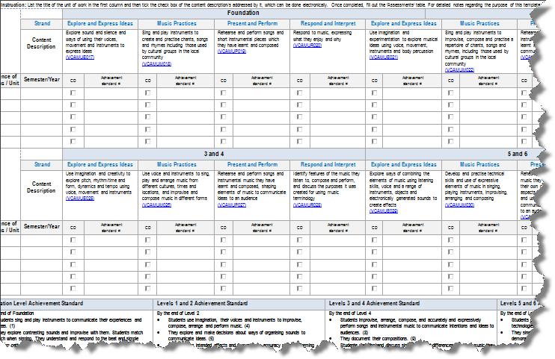
Activity #5: Document audit results and ‘things to do’ or ‘questions’
For example,
Check that all information required for school planning template is available
revise, add or delete activities
incorporate formative assessment opportunities
use digital technologies
enhance skill development

Slide 20
… and, how does music learning connect with
CAPABILITIES
INQUIRY LEARNING
OTHER LEARNING AREAS
LITERACY, NUMERACY OR ICT
CO-CURRICULAR EVENTS

Slide 21
Next steps
update rubrics, success criteria, learning intentions etc.
transfer information to school curriculum planning template
discuss the process and findings with colleagues and/or curriculum leaders
& maybe
repeat for other units
write a new unit or sequence of learning using this process as a checklist

Slide 22
Feedback
Please complete the survey the F-10 unit will email to you so that I get your feedback about the relevance of this presentation for your work and whether it met your expectations. You can also email me directly:
Helen Champion
Curriculum Manager: Performing Arts
phone: 61 3 9032 1723
email: champion.helen.h@edumail.vic.gov.au

