Slide 1
Using Victorian Curriculum to plan F-6 Music learning
Helen Champion
Webinar, 3 November 2016

Slide 2
Session overview
Victorian Curriculum: The Arts - Music curriculum
Design assumptions
Content
Organisation
Adapting and adopting existing learning materials
Resources

Slide 3
Workshop materials
Before the session starts, please make sure that you have
An existing unit of work or sequence of learning
And, if possible
a copy of your school’s curriculum planning template
open these web pages
Structure chart
F-10 scope and sequence
Curriculum mapping template and instructions
And … you’ll probably want to take some notes as you complete the workshop activities – either paper or digital is fine.

Slide 4
Curriculum design
Victorian Curriculum: The Arts - Music
Same framework for Instrumental Music & classroom
Designed for use in multiple contexts
No set pedagogies, instruments or repertoire

Slide 5
Victorian Curriculum: The Arts
4
Strands:
explore & express/represent ideas
practices
present & perform
respond & interpret
+
2
Organising ideas:
students learn as artist and as audience
Students learn by making & responding

Slide 6
Making and responding as artist and audience
PERFORMER
COMPOSER
LISTENER
singing, playing, composing, improvising, arranging,
interpreting, developing skills & techniques, notating, recording,
performing,
reflecting, analysing,
evaluating

Slide 7
Interdependent content
Concept
Knowledge and skills
Contexts
What is to be taught?
What knowledge and skills will students acquire or develop?
What is the context for the learning?

Slide 8
Unpacking a concept
BEAT
Keeping a beat, counting, beat against rhythm, beat and tempo, feel, subdividing etc.
Listening, composing, performing, notating, acoustic, digital, solo, group, styles etc.

Slide 9
EXPLORE & EXPRESS
PRACTICES
BEAT
Keeping a beat, counting, beat against rhythm, beat and tempo, feel, subdividing etc.
PRESENT & PERFORM
Listening, composing, performing, notating, acoustic, digital, solo, group, styles etc.
RESPOND & INTERPRET

Slide 10
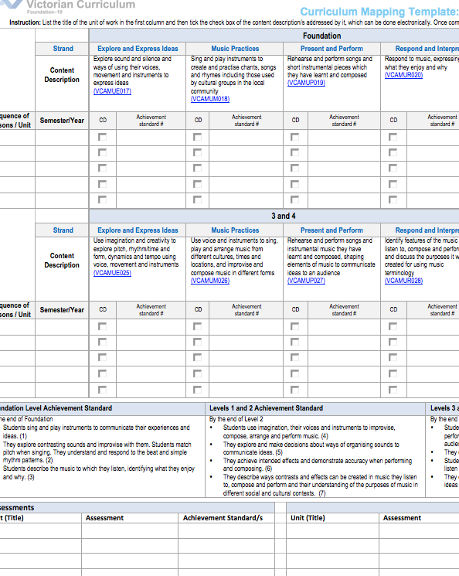
Curriculum mapping
Mapping identifies the extent of curriculum coverage in units of work and clearly links teaching, learning and assessment while working with the curriculum continuum.
Mapping templates support teachers to identify where content descriptions and achievement standards are being explicitly addressed within the school’s teaching and learning program
Instructions:
http://www.vcaa.vic.edu.au/Pages/foundation10/viccurriculum/curriculumplanning.aspx
Templates
For each Arts discipline
Levels A-D
F-6
7-10

Slide 11
Activity #1: Analysis
EXPLORE & EXPRESS
PRACTICES
PRESENT & PERFORM
RESPOND & INTERPRET
Describe the unit/sequence of learning in 20 words or less
List the main resources
Identify when & where the unit/sequence occurs with the music program
whole school
level

Slide 12
Activity #2: Unpacking
Choose one aspect of the unit/sequence
why is this activity in the unit/sequence learning plan
what knowledge and skills
expected
Developed
what modes of music-making and learning are used:
listening, composing, performing, responding, interpreting
do students learn about instrumental techniques, compositional devices or processes, elements of music?
EXPLORE & EXPRESS
PRACTICES
PRESENT & PERFORM
RESPOND & INTERPRET
how is the activity
introduced?
taught?
aligned to prior learning?
varied to cater for different levels of knowledge and skill?
how does the activity connect to the rest of the unit/sequence?

Slide 13
Activity #3: Strand focus
Thinking about the same activity or aspect of the unit/sequence,
when students are ‘exploring’ or ‘expressing’ what music practices are they using?
are they also ‘responding’ or ‘interpreting’?
EXPLORE & EXPRESS
PRACTICES
PRESENT & PERFORM
RESPOND & INTERPRET
Does this activity contribute to
presentation of a performance?
an actual performance
How are digital technologies used?

Slide 14
Activity #3: Which level?
EXPLORE & EXPRESS
PRACTICES
PRESENT & PERFORM
RESPOND & INTERPRET
Are adjustments required to align all of the activities in the unit/sequence of learning with a single level?
How can each activity be varied to cater for different learning needs?
higher level
lower level
Consider the information you’ve gathered about this activity/aspect of a learning sequence and
Identify the content description/s and level/s that is/are the best fit/s

Slide 15
Activity #5: Assessment opportunities
Describe the assessment strategies associated with the activity you have been analysing. Consider:
formative
summative
self, peer and teacher feedback
EXPLORE & EXPRESS
PRACTICES
PRESENT & PERFORM
RESPOND & INTERPRET
Highlight sections of the achievement standard/s that are addressed by this activity
at the level
at the previous level
at the following level

Slide 16
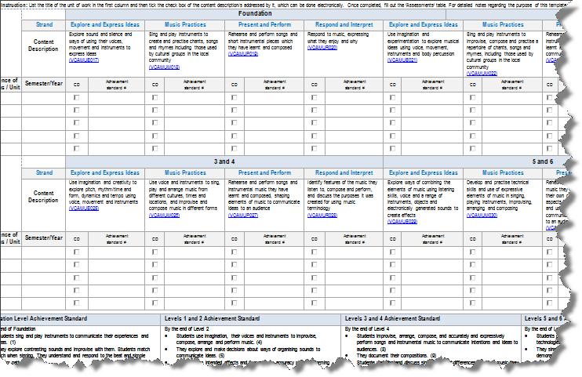
Activity #5: Document audit results and ‘things to do’ or ‘questions’
For example,
Check that all information required for school planning template is available
revise, add or delete activities
incorporate formative assessment opportunities
use digital technologies
enhance skill development
change style or repertoire

Slide 17
And, can the activity/unit/sequence connect with
CAPABILITIES
INQUIRY LEARNING
OTHER LEARNING AREAS
LITERACY, NUMERACY OR ICT
CO-CURRICULAR EVENTS

Slide 18
Next steps
update rubrics, success criteria, learning intentions etc.
transfer information to school curriculum planning template
discuss the process and findings with colleagues and/or curriculum leaders
& maybe
repeat for other units
write a new unit or sequence of learning using this process as a checklist

Slide 19
Feedback
Please complete the survey the F-10 unit will email to you so that I get your feedback about the relevance of this presentation for your work and whether it met your expectations. You can also email me directly:
Helen Champion
Curriculum Manager: Performing Arts
phone: 61 3 9032 1723
email: champion.helen.h@edumail.vic.gov.au

