Slide 1
The Victorian Curriculum
English

Slide 2
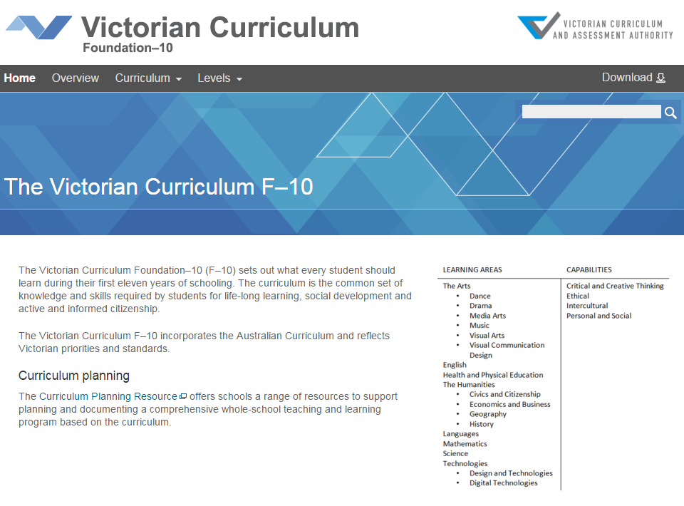
The Victorian English Curriculum 7–10
released in September 2015 as a central component of the Education State
provides a stable platform for the development and implementation of whole-school teaching and learning programs
the Victorian Curriculum F–10 incorporates the Australian Curriculum and reflects Victorian priorities and standards
http://victoriancurriculum.vcaa.vic.edu.au/

Slide 3
The Victorian English Curriculum 7–10
‘In most schools, the mandated curriculum will not constitute the whole teaching and learning program. This enables schools to develop particular specialisations and areas of expertise and innovation while ensuring the mandated curriculum is delivered.’

Slide 4
Aims
The English curriculum aims to ensure that students:
learn to listen to, read, view, speak, write, create and reflect on increasingly complex and sophisticated spoken, written and multimodal texts across a growing range of contexts with accuracy, fluency and purpose
appreciate, enjoy and use the English language in all its variations and develop a sense of its richness and power to evoke feelings, convey information, form ideas, facilitate interaction with others, entertain, persuade and argue
understand how Standard Australian English works in its spoken and written forms and in combination with non-linguistic forms of communication to create meaning
develop interest and skills in inquiring into the aesthetic aspects of texts, and develop an informed appreciation of literature.

Slide 5
Conceptual structure
Study of literary texts of personal, cultural, social and aesthetic value
The first achievement standard at Foundation and then at Levels 1, 2, 3, 4, 5, 6, 7, 8, 9 and 10
Language
Literature
Reading and viewing
Literacy
Knowledge of the English language and how it works
Writing
Speaking and listening
Content descriptions and elaborations
Students will demonstrate their knowledge and skills through three language modes
Interpret and create texts with appropriateness, accuracy, confidence, fluency and efficacy for a range of contexts

Slide 6
Strands of learning in English
Strand | Sub-strands
Language | Language variation and change
 | Language for interaction
 | Text structure and organisation
 | Expressing and developing ideas
 | Phonics and word knowledge
Strand | Sub-strands
Literature | Literature and context
 | Responding to literature
 | Examining literature
 | Creating literature
Strand | Sub-strands
Literacy | Texts in context
 | Interacting with others
 | Interpreting, analysing, evaluating
 | Creating texts

Slide 7
Features of the Victorian curriculum
A continuum of learning
Structured as a continuum across levels of learning achievement not years of schooling.
The cumulative curriculum
Students gradually develop their knowledge and skills with language over time.
For example, students learn about nouns and then gradually build on that knowledge to apply it in more sophisticated way across subsequent levels of the curriculum.
The spiralling curriculum
Students apply their knowledge and skills in different texts and contexts.
For example, students investigate the role of nouns in narrative texts, then later in persuasive texts.

Slide 8
From AusVELS English to Victorian Curriculum English
Substantially similar to AusVELS English, with the majority of the curriculum unchanged.
Some changes to strengthen particular areas and clarify others.
The Sound and Letter Knowledge sub-strand (previously located in the Language strand) has been renamed as Phonics and Word Knowledge and is comprised of three focus areas:
Phonological and phonemic awareness
Phonic knowledge
Spelling.
The Purpose and Audience focus area from within the Interpreting, Analysing, Evaluating sub-strand has been deleted to avoid duplication of content.
Content descriptions within the Interacting with others sub-strand have been combined and consolidated.
No changes to Achievement Standards in Levels 7 -10.

Slide 9
Phonics and word knowledge
Level 7
‘Understand how to use spelling rules and word origins to learn new words and how to spell them’
At Level 8
‘Understand how to apply learned knowledge consistently in order to spell accurately and to learn new words including nominalisations’
At Level 9
‘Understand how spelling is used creatively in texts for particular effects, for example characterisation and humour and to represent accents and styles of speech’

Slide 10
Structure

Slide 11
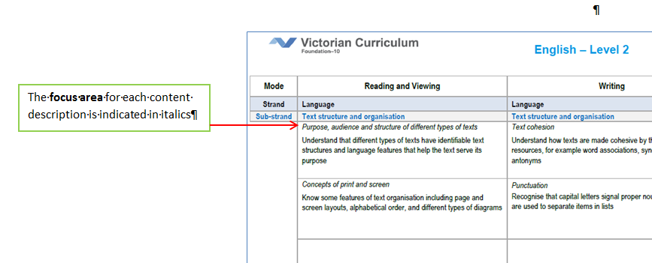
Structure
A3 format scope and sequence charts

Slide 12
The Language strand
knowledge of the English language and how it works
Sub-strands
Language variation and change
Expressing and developing ideas
Language for interaction
Text structure and organisation
Phonics and word knowledge
Register
everyday
specialised
field
technical
informal
formal
tenor
more spoken like
more written like
mode

Slide 13
Planning discussion
What kinds of language knowledge do teachers most need in order to teach this part of the curriculum effectively?

Slide 14
Key language knowledge
Phonics and phonemic awareness
Functional grammar (as opposed to traditional grammar)

Slide 15
The Literature strand
the study of literary texts of personal, cultural, social and aesthetic value
Sub-strands
Literature and context
Responding to literature
Examining literature
Creating literature
Texts which:
have the potential for enriching the lives of students
expand the scope of their experience
represent effective and interesting features of form and style.

Slide 16
Possible approaches to the study of literature:
Cultural studies - different ways in which literature is significant in everyday life
Structuralism - close analysis of literary works and the key ideas on which they are based
(eg. detailed stylistic study of differing styles of literary work)
Comparativism - comparisons of works of literature from different language, ethnic and cultural backgrounds
Historicism - exploring the relationships between historical, cultural and literary traditions.

Slide 17
Planning discussion
What are the key questions to ask when selecting literary texts for class-room study in Levels 7-10?

Slide 18
Key questions
What literary texts do we have on our list?
On what basis have we selected these texts?
Do these texts allow for rich literary analysis?
Have we selected a suitable range of texts?

Slide 19
The Literacy strand
The ability to interpret and create texts with appropriateness, accuracy, confidence, fluency and efficacy for learning in and out of school, and for participating in Australian life more generally
Sub-strands
Texts in context
Interacting with others
Interpreting, analysing and evaluating
Creating texts

Slide 20
Planning discussion
How can we maximise the literacy development of our students within and beyond the English curriculum?

Slide 21
Literacy opportunities
Multi-modal and non-literary texts should be selected for study
Work in/from other learning areas can provide opportunities to teach content from the literacy strand and provide evidence of learning

Slide 22
Literacy across the curriculum
Literacy is foundational to all learning areas and capabilities in the Victorian Curriculum.
It is not one of the four capabilities which have separately articulated content descriptions and achievement standards.
Students develop knowledge and skills across the Language and Literacy strands of the English curriculum.
Much of the explicit teaching of literacy occurs in the English learning area, however, it is strengthened, made specific and extended in other learning areas as students engage in a range of learning and assessment with significant literacy demands.
Resources will be prepared to support teachers to understand the language demands of different learning areas, and demonstrate how English content descriptions apply to particular texts.

Slide 23
Possible steps for integrating the Victorian Curriculum
whole-school audit of current programs
preparation of Scope and Sequence - we asked our teams to break the scope and sequence down into Skills (what the students learn to do) and Knowledge (what they learn about
definition of units – use mapping template
development of units
development of lesson sequence.

Slide 24
EAL
During 2016, the VCAA and DET is working in partnership to develop the Victorian Curriculum F–10 English as an Additional Language (EAL), which will be aligned to the new Victorian Curriculum F–10 English.
The curriculum will be accompanied by teaching and learning resources.
Building on the EAL Companion to AusVELS, the EAL Developmental Continuum P–10 and findings from assessment research being undertaken by DET, the EAL curriculum will focus on the language skills needed by students for whom English is an additional language and will take account of the diverse nature of this group through multiple pathways for learning English and learning in English.
It is intended that the EAL curriculum will be available from Term 1, 2017.

Slide 25
Comments/Questions
Jacqueline Moore | English Curriculum Manager
T: (03) 9032 1691
E: moore.jacqueline.j@edumail.vic.gov.au

