Slide 1
Science Delivery Opportunities Levels F–6
Victorian Curriculum F–10 Online professional learning session
Maria James
Science Curriculum Manager

Slide 2
Session aims
Summarise key features of the Victorian Curriculum with a focus on primary school (Levels F-6) changes and opportunities for Science
Present an overview of assessment and reporting
Consider different structures and opportunities for delivering primary Science within the Victorian Curriculum.
Your filter: Can this work/value-add for me?

Slide 3
Victorian Curriculum F-10 design and structure
The Victorian Curriculum F-10 is:
derived from the Australian Curriculum
based on eight learning areas and four capabilities that each include content descriptions and achievement standards.
Learning areas | Capabilities
English | Critical and Creative Thinking
Mathematics | Personal and Social Capability
Science | Intercultural Capability
Health and Physical Education | Ethical Capability
Humanities and Social Sciences (History, Geography, Civics and Citizenship; Business and Economics)
Languages
The Arts
Technologies (Design and Technologies and Digital Technologies)

Slide 4
STATUS OF CURRICULUM COMPONENTS
Band descriptions
advisory
Content descriptions
Elaborations
mandated
Achievement standards
mandated
advisory

Slide 5
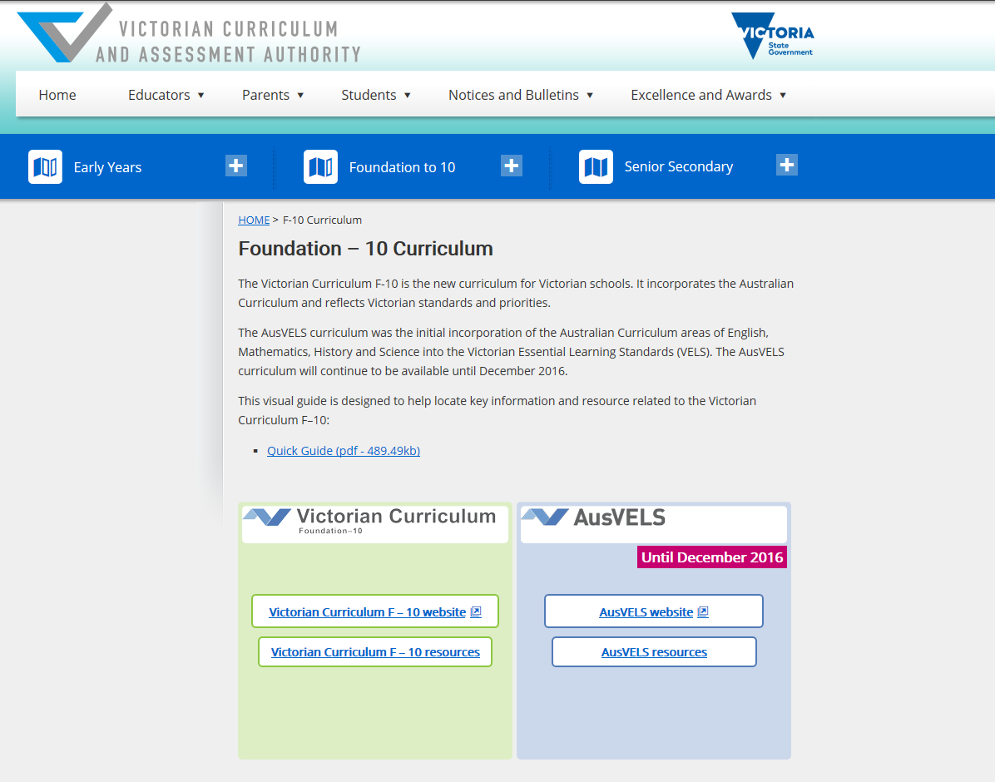
Curriculum and Resources
Curriculum
2016 school choice between AusVELS and Victorian Curriculum F-10
Victorian Curriculum from 2017
Resources
General advice
Specific curriculum advice
Curriculum planning templates: whole-school; curriculum area; year level; units; samples
Bookmark and check for updates
Evolving: email science feedback and suggestions to:
james.maria.m@edumail.vic.gov.au
http://www.vcaa.vic.edu.au/Pages/foundation10/f10index.aspx

Slide 6
Take a web tour
Three tours:
Overview of the website
The introduction section
Using the view and filter options

Slide 7
Key features of the Science curriculum

Slide 8
Science structured in bands
F-2 3-4 5-6 7-8 9-10
The science curriculum is represented in two- or three-year level bands on a continuum, similar to other learning areas
An achievement standard is provided for each band
“Banding” of levels provides greater flexibility for schools in curriculum organisation and delivery
Towards Foundation Levels A–D support students with a disability.

Slide 9
Science curriculum structure
Australian Curriculum and AusVELS Science |  |  | Victorian Curriculum F-10 Science
Strand | Sub-strand |  | Strand | Sub-strand
Science Understanding | Biological sciences |  | Science Understanding | Science as a human endeavour
 | Chemical sciences
 |  |  |  | Biological sciences
 | Earth and space sciences |  |  | Chemical sciences
 | Physical sciences |  |  | Earth and space sciences
Science as a Human Endeavour | Nature and development of science |  |  | Physical sciences
 | Use and influence of science
 |  |  | Science Inquiry Skills | Questioning and predicting
Science Inquiry Skills | Questioning and predicting
 |  |  |  | Planning and conducting
 | Planning and conducting
 |  |  |  | Recording and processing
 | Processing and analysing data and information
 |  |  |  | Analysing and evaluating
 | Evaluating |  |  | Communicating
 | Communicating

Slide 10
Science skills F-12 continuum
Victorian Curriculum F-10 Science Inquiry Skills | VCE key science skills
Questioning and predicting | Develop aims and questions, formulate hypotheses and make predictions
Planning and conducting | Plan and undertake investigations Comply with safety and ethical guidelines Conduct investigations to collect and record data
Recording and processing | Conduct investigations to collect and record data
Analysing and evaluating | Analyse and evaluate data, methods and scientific models Draw evidence-based conclusions
Communicating | Communicate and explain scientific ideas

Slide 11
Biological sciences changes
Level | AC/AusVELS content description | Victorian Curriculum F-10 content description
F-2 | F: Living things have basic needs, including food and water | Living things have a variety of external features and live in different places where their basic needs, including food, water and shelter, are met
 | 1&2: Living things have a variety of external features
 | 1&2: Living things live in different places where their needs are met
 | 1&2: Living things grow, change and have offspring similar to themselves | Living things grow, change and have offspring similar to themselves
3-4 | Living things have life cycles | Different living things have different life cycles and depend on each other and the environment to survive
 | Living things, including plants and animals, depend on each other and the environment to survive

Slide 12
Chemical sciences changes
Level | AC/AusVELS content description | Victorian Curriculum F-10 content description
F-2 | F: Objects are made of materials that have observable properties | Objects are made of materials that have observable properties
 | 1&2: Everyday materials can be physically changed in a variety of ways | Everyday materials can be physically changed or combined with other materials in a variety of ways for particular purposes
 | 1&2: Different materials can be combined, including by mixing, for a particular purpose
3-4 | Solids, liquids and gases have different observable properties and behave in different ways | Solids, liquids and gases behave in different ways and have different observable properties that help us to classify them
 | Changes to materials can be reversible, such as melting, freezing, evaporating; or irreversible, such as burning and rusting | Changes to materials can be reversible, including melting, freezing, evaporating; or irreversible, including burning and rusting

Slide 13
Earth and space sciences: no changes!

Slide 14
Physical sciences changes Levels 3-8
Level | AC/AusVELS content description | Victorian Curriculum content description
3-4 | 3: Heat can be produced in many ways and can move from one object to another | Heat can be produced in many ways and can move from one object to another; a change in the temperature of an object is related to the gain or loss of heat by the object
5-6 | 6: Electrical circuits provide a means of transferring and transforming electricity | Energy from a variety of sources can be used to generate electricity; electric circuits enable this energy to be transferred to another place and then to be transformed into another form of energy
 | 6: Energy from a variety of sources can be used to generate electricity

Slide 15
AusVELS strand → new VC sub-strand: Science as a human endeavour (primary)
Level | Levels F-6 content descriptions
F-2 | People use science in their daily lives
3-4 | Science knowledge helps people to understand the effect of their actions
5-6 | Scientific understandings, discoveries and inventions are used to inform personal and community decisions and to solve problems that directly affect people’s lives

Slide 16
Why combine SHE and SU?
What conceptual understandings and skills are involved in teaching the following content description?
SU Levels F-2: Observable changes occur in the sky and landscape; daily and seasonal changes affect everyday life
Rainbows
Cloud formations and rain
Tidal patterns
Clothing/sport choices
Floods/ droughts
Autumn leaves
Moon and stars
Mud in winter
Sunrise and sunset

Slide 17
Why combine SHE and SU?
Examples:
Seasonal changes: planting schedules, fire prevention strategies before summer; water conservation over summer; cloud seeding
Weather predictions to determine holiday plans; sunscreen protection; sand bank construction for flood danger
Buildings to withstand fire/ flood/ tornadoes in susceptible areas
Low and high tides – fishing, swimming
Measuring, monitoring and predicting weather: barometer; rain and temperature gauges; anemometers
Solar heaters/ BBQs.
Content description:
SU Levels F-2: Observable changes occur in the sky and landscape; daily and seasonal changes affect everyday life
Add ‘science as a human endeavour’ content description:
SHE Levels F-2: People use science in their daily lives

Slide 18
Why combine SHE and SU?
SU Levels F-2: Light and sound are produced by a range of sources and can be sensed
Sunglasses
Shade cloths in playgrounds, nurseries, orchards
Sunlight/torches/ LEDs/ fluorescent/ solar garden lights
Rainbows
Differences in types of musical instruments: wind; percussion; string
SU Levels F-2: Everyday materials can be physically changed or combined with other materials in a variety of ways for particular purposes
How can new objects (for example, bird’s nest, toys) be made from recycled materials?
Knitting/weaving
Paper recycling/ marbling
Construction: Sand/mud/straw bricks
Plastic/aluminium recycling excursion
Start with ‘science as a human endeavour’ content description:
SHE Levels F-2: People use science in their daily lives
SU Levels F-2: Living things grow, change and have offspring similar to themselves
Pets and pet care; aquarium maintenance; baby animals – farms/home/school

Slide 19
Question: Why aren’t ‘dinosaurs’ in the primary science curriculum?
the curriculum is based around concepts and skills
‘dinosaurs’ is a context through which scientific concepts and skills may be developed at all levels of the primary science curriculum, for example:
Levels F-2: The way objects move depends on a variety of factors including their size or shape
Levels F-2: Respond to, and pose, questions
Levels 3-4: Living things can be grouped on the basis of observable features and can be distinguished from non-living things
Levels 5-6: The growth and survival of living things are affected by the physical conditions of their environment
Levels 5-6: Sudden geological changes can or extreme weather conditions can affect Earth’s surface.

Slide 20
Designosaurs
Task
Create dinosaurs based on the answers to various questions, for example:
Do you prefer to eat meat or vegetables? (if meat, then draw sharp teeth on your designosaur; if vegetables, draw flat teeth
Do you prefer to live on water or on land or both? (which features will be important for survival on land and/or water?)
Do you like running around all day playing games, finding things and seeing new places or do you like to just laze around and stay near home?
Curriculum Opportunities: links to The Arts; Mathematics; History; Geography; Technologies; Critical and Creative Thinking

Slide 21
Assessment and reporting
Achievement standards outline what the student is able to do
Achievement standards are based on the content descriptions
Reporting in Victoria will be against the achievement standards
Achievement standards considered as a continuum of learning, not an age-determined set of expectations
Different students will be working towards achievement standards at different levels
Teaching and learning activities and assessment tasks can be differentiated to suit learning needs, including complexity of issues or contexts
Students demonstrate what they are able to do through the products they present for assessment
Assessment can be used to adjust teaching.
PLEASE NOTE:
Sectors set specific reporting requirements
Transition from AusVELS science to Victorian Curriculum Science will require a break in the data

Slide 22
Relationship between content descriptions and achievement standards: chemical sciences
Levels | Content description | Achievement standard
5-6 | Solids, liquids and gases behave in different ways and have observable properties that help to classify them Changes to materials can be reversible, including melting, freezing, evaporating, or irreversible, including burning and rusting | Compare properties and behaviours of solids, liquids and gases… Compare observable changes to materials and classify these changes as reversible or irreversible.
7-8 | The properties of the different states of matter can be explained in terms of the motion and arrangement of particles Differences between elements, compounds and mixtures can be described by a particle model Mixtures, including solutions, contain a combination of pure substances that can be separated using a range of techniques Chemical change involves substances reacting to form new substances | Use the particle model to predict, compare and explain the physical and chemical properties and behaviours of substances… Describe and apply techniques to separate pure substances from mixtures… Provide evidence for observed chemical changes in terms of colour change, heat change, gas production and precipitate formation.

Slide 23
Example of progression of scientific concepts
Levels | Conceptual progression related to physical and chemical properties
F-2 | Describe the properties, behaviour, uses of familiar materials and objects… Identify and describe the changes to objects, materials, resources…
3-4 | Explain how heat is involved in changes of state between solid and liquid… Link physical properties of materials to their use
5-6 | Compare properties and behaviours of solids, liquids and gases… Compare observable changes to materials and classify these changes as reversible or irreversible
7-8 | Use the particle model to predict, compare and explain the physical and chemical properties and behaviours of substances… Provide evidence for observed chemical changes in terms of colour change, heat change, gas production and precipitate formation
9-10 | Explain how similarities in the chemical behaviour of elements and their compounds and atomic structures are represented in the way the periodic table has been constructed… compare the properties of a range of elements representative of the major groups and periods in the periodic table

Slide 24
Example of progression of scientific skills
Levels | Conceptual progression related to data generation and recording
F-2 | Use informal measurements in the collection and recording of observations… Use a range of methods, including… provided tables to sort information
3-4 | Use formal measurements in the collection and recording of observations… Use a range of methods including… column graphs to represent data and identify patterns…
5-6 | Construct and use a range of representations, including tables and graphs, to record, represent and describe observations, patterns or relationships in data
7-8 | Construct and use a range of representations …to record and summarise data from students’ own investigations …, and to represent and analyse patterns and relationships
9-10 | Construct and use a range of representations … to record and summarise data…, to represent qualitative and quantitative relationships in data, and distinguish between discrete and continuous data

Slide 25
Planning for progression in learning
Levels 3-4: With guidance, identify questions in familiar contexts that can be investigated scientifically and predict what might happen based on prior knowledge. | What will you teach to progress the student’s learning? | Levels 5-6: With guidance, pose questions to clarify practical problems or inform a scientific investigation, and predict what the findings of an investigation might be based on previous experiences or general rules.
By the end of Level 4, students follow instructions to identify questions that they can investigate about familiar contexts and make predictions based on prior knowledge. | What will the students be able to demonstrate as they are progressing towards the standards? | By the end of Level 6, students follow procedures to develop questions that they can investigate... make predictions based on previous experiences and general rules.

Slide 26
Using ‘backward design’ in developing learning and assessment tasks
Using a ‘backward design’ approach to developing learning and assessment tasks assists in better alignment between content descriptions, learning and assessment tasks and achievement standards:
Steps | Action
1 | Review the content descriptions and the achievement standards at and below current teaching level and identify the key knowledge and key skills that students will be expected to develop
2 | Imagine what it will look like when students develop the identified knowledge and skills and use this to develop assessment task/s
3 | Develop an assessment rubric
4 | Select appropriate learning activities that will lead students towards achieving desired outcomes
5 | Determine student preconceptions and refine learning activities to suit

Slide 27
Reporting
No centrally-prescribed single template so that schools will not be constrained by a one-size-fits-all approach
Schools have the flexibility to determine, in partnership with students, parents and the local community, the timing and format of their reports
Schools expected to report student achievement to parents every year in Science from Year 3 onwards against the F-10 achievement standards, including identifying areas of strength and improvement for each individual student.
www.vcaa.vic.edu.au/Pages/foundation10/viccurriculum/curriculumplanning.aspx
Notes:
Specific sectoral requirements related to curriculum provision and reporting are the responsibility of and published by the relevant sectoral authorities
A minimum of two written reports to parents per year.
Independent schools must meet the minimum requirements established by VRQA and the requirements of the Commonwealth Government as set out on the Education Act 2013.
Government and Catholic sector schools meet these requirements by reporting student progress against the achievement standards set out in the eight learning areas and four general capabilities of AusVELS.

Slide 28
Models of science delivery:
how is science delivered in your school?
ACARA have produced secondary school STEM case studies in “ACARA STEM Connections Project Report” June 2016: http://www.acara.edu.au/docs/default-source/default-document-library/29062016-stem-connections-report.pdf

Slide 29
Primary and secondary views of science
72%
Year 6
48.5%
Year 9
Proportion of Year 6 and Year 9 students who think science is important
Source (adapted): Victorian Auditor-General’s Office, 2012

Slide 30
What is happening in your school?
Is Science taught as a ‘stand-alone’ learning area?
Is Science taught by combining multiple year levels?
Is Science linked to teaching in other disciplines ?
Is Science linked to teaching specific capabilities?
Is Science taught as project-based learning modules? Individualised inquiry?
How is the Science program arranged (for example, terms, semesters, blocks, a multidisciplinary/integrated program)?
How is Science scheduled at each level?
Is Science included in the co-curricular program (for example, camps, family science nights, science club, science/medical fund-raising)?
Is Science an integral part of whole school events or projects (for example, energy audits, environmental remediation, solar car challenge)?
Is Science connected to science in the community (for example, community science data collection projects, environmental projects)?
Is Science taught by specialists?

Slide 31
Science + Technologies = MasterChef?
Learning area | Level | Content description
Science | F-2 | Everyday materials can be physically changed or combined with other materials in a variety of ways for particular purposes
Technologies |  | Explore how food is selected and prepared for healthy eating
Science | 3&4 | A change of state between solid and liquid can be caused by adding or removing heat
Technologies |  | Investigate food preparation techniques used in modern or traditional societies
Science | 5&6 | Solids, liquids and gases behave in different ways and have observable properties that help classify them Changes to materials can be reversible, including melting, freezing, evaporating, or irreversible, including burning and rusting
Technologies |  | Investigate the role of food preparation in maintaining good health and the importance of food safety and hygiene
Can vegetables make good ice-cream e.g. carrot ice-cream?
What is the difference between ice-cream and sorbet? How can jellies be layered?
What happens in fermentation? or caramelisation?

Slide 32
Science and the capabilities: an approach to whole school planning
Extra-curricular program
School ethos
Whole school planning
Capabilities
Critical and creative thinking
Ethical capability
Intercultural capability
Personal and social capability
*Specific learning area mapping:
Identify which elements of each capability is:
important for enhancing learning in the area
moderately important
irrelevant
*Note: combining mapping for all 8 learning areas should ensure coverage of all elements of the capabilities

Slide 33
Why ‘capabilities’?
Australian Curriculum General Capabilities:
general capabilities act as ‘enablers’ for other learning areas
no achievement standards.
Victorian Curriculum F-10 capabilities:
treated as areas of learning in their own right and hence they are reported on
achievement standards written to enable reporting.

Slide 34
Goldfish activity: science and ethical capability
Issues related to the concepts of ‘equity’, ‘ethics’ and ‘quality of life’ underpin many everyday situations.
Strong and/or contrasting viewpoints about science-related issues may often be found in the “Letters to the editor” section of newspapers, or in editorials.
Example: A teacher who wanted to explore the issue of “animal rights” in relation to the place of living things in ecosystems used the following media article as stimulus material to challenge student ideas and explore the concepts of ‘equity’, ‘ethics’ and ‘quality of life’

Slide 35
Activity: What is a goldfish’s life worth?
Dear editor,
Many parents buy their children goldfish as a first pet. They think that by having goldfish, young children learn to be responsible and they can get ready for having other pets, such as dogs, later on in life.
Goldfish only cost $3.00 at our local pet shop, so parents just think it is OK to buy them for their children. If the goldfish die, they just say, “Oh well, we can just buy another one!”. When their children learn to look after them properly, they can then buy them a “real” pet – like a dog!
If I was a goldfish, I would be very upset at just being used as practice for having other pets. Also, their lives are not very interesting – just swimming around in a small tank, in the same environment day in day out, and being fed boring goldfish food. I think that goldfish are being abused and unfairly treated, and something should be done.
If pet shop owners made goldfish cost more, like dogs, then I think that people would think twice before buying them and just wasting their lives.
How would you like to be treated like some people treat goldfish? Why should a goldfish’s life be worth less than a person’s life? Or a dog’s life?
Mary J, Southbank Primary School

Slide 36
Goldfish activity: science continuum
Levels | Strand: Understanding concepts
F-2 | People use science in their daily lives Living things…live in different places where their needs are met
3-4 | Science knowledge helps people to understand the effects of their actions Different living things…depend on each other and the environment to survive
5-6 | Scientific understandings, discoveries and inventions are used to inform personal and community decisions and to solve problems that directly affect people’s lives Living things have structural features and adaptations that help them to survive in their environment The growth and survival of living things are affected by the physical conditions of the environment Energy from a variety of sources can be used to generate electricity

Slide 37
Goldfish activity: Ethical capability continuum
Level | Strand: Understanding concepts
F-2 | Explore the meaning of right and wrong, good and bad, as concepts concerned with the outcomes of acts Explore the effects that personal feelings can have on how people behave in situations where ethical issues are involved
3-4 | Explore the contested meaning of concepts including fairness and harm and how they can seem to differ in different situations Discuss the ways to identify ethical considerations in a range of problems
5-6 | Discuss the role and significance of conscience and reasoning in ethical decision-making
Discuss: How can the consideration of concepts related to ethical capability deepen thinking about, and understanding of, scientific concepts?

Slide 38
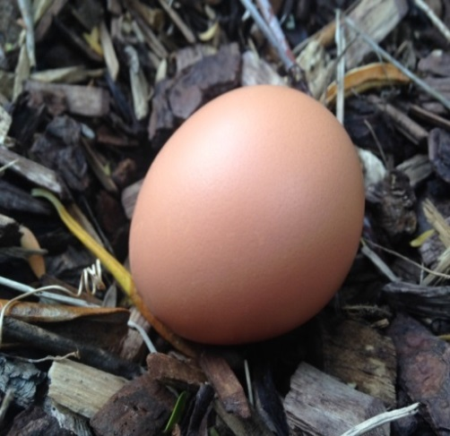
Exploring science language: developing literacy
The example below shows the use of a ‘heptaverse’ (seven-lined text) template to work with scientific vocabulary related to life cycles.
Literacy applications
Line | Template | Student example
1 | What does the living thing start as? | egg
2 | Size /shape /colour of (line 1 object) | brown-speckled, oval
3 | Three things that (line 1 living thing) does (ending in “ing”) - description of where it does it and how it is done | resting, waiting, expecting – a twiggy nest protects
4 | How does (line 1 object) change into (line 7) object? | breaking through a cracked shell into a new world…
5 | Three things that (line 7 living thing) does (ending in “ing”) – description of where it does it and how it is done | stumbling, exploring, stretching – the fresh air welcomes
6 | Size /shape /colour of (line 7 living thing) | fluffy, yellow
7 | What does (line 1) become? | chicken

Slide 39
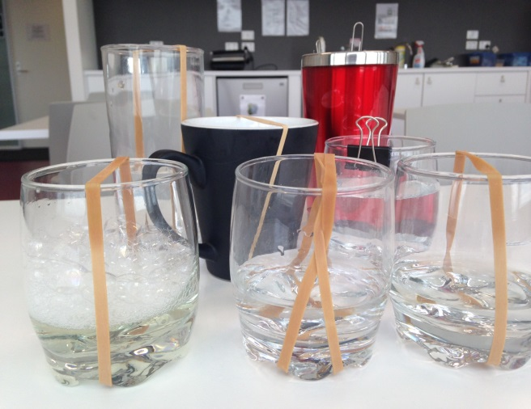
Links across learning areas: Science and Music
Class concert
Students:
self-select to construct a wind, percussion or string instrument from household materials (empty or full food cans; bottles or jars; pots; pans; rubber bands; string; combs; hammers; cardboard tubes etc)
work in a ‘wind’, ‘percussion’ or ‘string’ group to test materials and the sounds they produce, sharing ideas and reflecting/ providing comments about each others’ findings, and to construct their own final instrument
form a ‘band’ of at least four members, name their group, select a nursery rhyme or folk song to play, and prepare for a class concert (may be presented to other F-2 classes, or as part of a parent/family night).
Set of student-constructed string instruments
Levels F-2 Science: Light and sound are produced by a range of sources and can be sensed
Levels 1-2 Music: Sing and play instruments to improvise, compose and practise a repertoire of chants, songs and rhymes, including those used by cultural groups in the local community

Slide 40
Cross-peer learning: science links to music
Class concert
Levels F-2 students:
self-select to construct a wind, percussion or string instrument from household materials (empty or full food cans; bottles or jars; pots; pans; rubber bands; string; combs; hammers; cardboard tubes etc)
work in a ‘wind’, ‘percussion’ or ‘string’ group to test materials and the sounds they produce, sharing ideas and reflecting/ providing comments about each others’ findings, and to construct their own final instrument
form a ‘band’ of at least four members, name their group, select a nursery rhyme or folk song to play, and prepare for a class concert
Levels 7-8 students:
use oscilloscopes to explore sound wave patterns produced by a variety of musical instruments
differentiate between sounds produced by wind/ percussion/ string instruments
work with Year F-2 students as wind/ percussion/ string experts in preparation for a class concert
Set of student-constructed string instruments
Levels F-2 Science: Light and sound are produced by a range of sources and can be sensed
Levels 1-2 Music: Sing and play instruments to improvise, compose and practise a repertoire of chants, songs and rhymes, including those used by cultural groups in the local community
Levels 7-8 Science: The properties of sound can be explained by a wave model

Slide 41
STEM learning in schools
“STEM education is a term used to refer collectively to the teaching of the disciplines within its umbrella – science, technology, engineering and mathematics – and also to a cross-disciplinary approach to teaching that increases student interest in STEM-related fields and improves students’ problem solving and critical analysis skills.”
National Stem School Education Strategy
Education Council, 2015

Slide 42
Curriculum opportunities for STEM
The Victorian Curriculum F-10 is based on eight learning areas and four capabilities: STEM directly involves a number of these learning areas and capabilities
Learning areas | Capabilities
English | Critical and Creative Thinking
Mathematics | Personal and Social Capability
Science | Intercultural Capability
Health and Physical Education | Ethical Capability
Humanities and Social Sciences (History, Geography, Civics and Citizenship; Business and Economics)
Languages
The Arts
Technologies (Design Technologies, and Digital Technologies)
The Office of the Chief Scientist has produced a list of STEM resources ‘STEM Programme Index 2016’ at
https://www.teachermagazine.com.au/files/SPI2016.pdf

Slide 43
Scientific method | Technology – design thinking | Engineering process | STEM
Ask a question | Design brief: client needs, purpose, target audience, context and constraints | Define the problem | Ask
Background research | Research – information is collected for inspiration, investigation and analysis | Background research
 |  | Specify requirements
Formulate a hypothesis | Generation of ideas – application of research, information and inspiration when creating design ideas | Brainstorm, evaluate and choose a solution | Imagine
 |  |  | Plan
Test with an experiment
 | Development of concepts | Develop and prototype a solution | Create
Troubleshoot procedures and improve | Refinement | Test solution and improve | Evaluate and improve
Analyse data and conclusions
Communicate | Resolution of presentations | Communicate results | Communicate

Slide 44
Crabitats – STEM across the primary years
Task: Students design and construct "crabitats" (homes for crabs) and evaluate how effective they are re crabs utilising them - then modify designs based on data.
Level of complexity can be added by including design challenges such as including automated functions such as feeding, temperature control.
Level | Biological sciences content descriptions
F-2 | Living things…live in different places where their basic needs, including food, shelter and water, are met
3-4 | Different living things…depend on each other and the environment to survive
5-6 | The growth and survival of living things are affected by the physical conditions of their environment
STEM student learning outcomes
Science | Technology | Engineering | Mathematics
I can identify the elements a living things gets from its habitat | I can use a digital camera to document the hermit crab's daily activity | I can use the engineering design process to build a hermit crab habitat | I can use a tally chart, a bar graph and a pictograph to record data
Critical and creative thinking: I can give reasons and provide evidence for my decisions

Slide 45
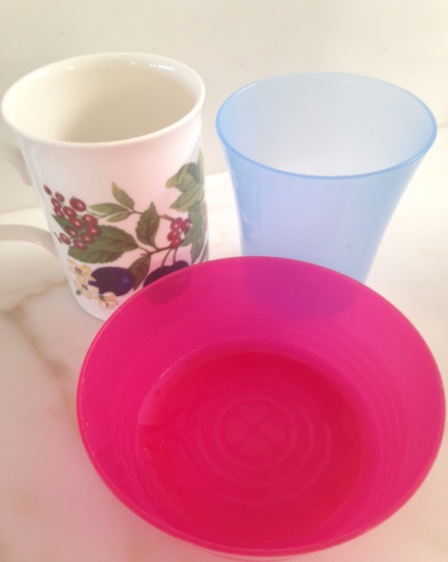
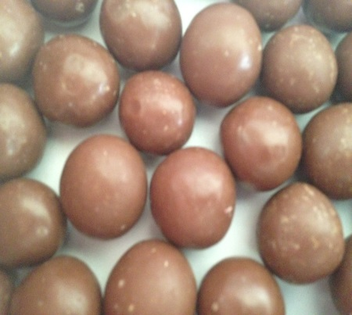
STEM-ifying Science How is Goldilocks linked to STEM?
Goldilocks wanted porridge that was not too hot and not too cold. Is there an ideal temperature at which to eat porridge …or… chocolate?
STEM
Acronym = Science + Technology + Engineering + Mathematics
Science enables an understanding of the concepts involved in the issue, mathematics enables quantification of the concepts and engineering and technology enable solutions to be generated
Operationalised in schools: a goal of STEM is to provide students with real-world problems
STEM includes the “Critical and Creative thinking” capability
Goldilocks wanted a chair that was not too big and not too small. Is there an ideal chair size…or bowl or cup size?

Slide 46
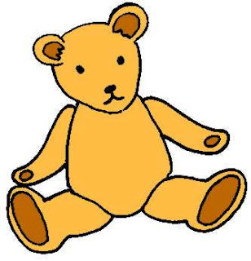
Goldilocks STEM activity
Challenge: Using only paper and tape can you build a chair that supports a stuffed toy?
Key skills:
creative thinking
critical thinking
decision making
evaluation
problem solving
scientific experimentation
synthesis
Outcomes:
physical product
criterion-based performance report
Extension: Can you build a chair that adjusts to rag dolls of different heights so that their feet can touch the ground?

Slide 47
CSIRO: Scientists and Mathematicians in Schools program http://www.scientistsinschools.edu.au/index.htm
Program overview: a flexible program managed by CSIRO where flexible partnerships between STEM professionals and teachers provide access to real-world, contemporary STEM experiences.
Showcase: More than a bunch of facts (Goulbourn Street Primary School)
Students learn how to conduct scientific investigations through activities such as making butter, balloon-powered cars or concrete, investigating Newton's laws or analysing a crime scene. They change variables, make predictions, test ideas and designs, measure outcomes, record results, formulate conclusions and present and discuss the results.
The teacher discusses with the scientist the science content she has planned for each upcoming term and indicates the focus curriculum areas. They share ideas and the scientist plans his activities so they follow naturally supporting what else the teacher is covering in the classroom.
Scientist: “The students now see science is a process not just a bunch of facts. They have actually found out new information and done investigations using the scientific process. Their curiosity has been valued and encouraged. They now have some tools by which they can do their own investigations and find out new cool stuff.”
Teacher: “I am learning along with the children. I now have a group of children who are so excited, they are buzzing!”
Students: “We might become famous scientists now because we are doing science all the time!”

Slide 48
Models of science delivery:
could they be relevant in your school situation?
Source: The New Basics: Big data reveals the skills young people need for the New Work Order, Foundation for Young Australians, fya.org.au, 2016

Slide 49
Model 1: Frankston High School
Entrepreneurship and innovation in a Victorian school
Program description:
Innovating in the 21st century – a Year 9/10 course giving students 4 hours per week to build their own start-up
Students design and execute a project that contributes to the good of the school, local or global community
Focus on work futures and required skills: team building, collaboration, productivity techniques and mindfulness

Slide 50
Model 2: Matthew Moss High School (UK)
Project-based learning in a UK school
Program description:
My World curriculum – allowing Year 7/8 student teams to work one day per week on a research project:
Teachers first introduce a challenge, which can vary from launching an egg as high as possible and returning it to Earth without breaking or responding to a natural disaster, to investigating histories of migration
Students then gather information about the topic, write a research proposal and, after the proposal is approved by the teacher, conduct the research throughout the school year.

Slide 51
Model 3: Breidablikk Lower Secondary School
Business partnerships with school in Norway
Program description:
‘Building and Living’ – a 3-year practical building project:
Students build houses on a 1:20 scale
Students play the role of builder, gardener, electrician, bank employee, real estate agent and others
To this end, the school co-operates with representatives of different businesses
Students use the same digital tools that architects use, and houses are connected to electricity and furnished with handmade furniture
All designs must be environmentally sustainable

Slide 52
Model 4: Atelier of Ideas, Center for Studies on Design at Monterrey (Mexico)
Business partnerships with university in Mexico
Program description:
‘Real-world’ project-based learning for students:
College cooperates with enterprises and institutions that submit “real-world” projects that student teams complete – from brainstorming to final evaluation
Instructors act as counsellors in this process
Three major steps:
Project design – coming up with a plan to bring the project to fruition
Collaborative work – working together to optimise the process and the outcomes; and
Evaluation – by the teacher, peers, the individual student and the external agency that came up with the project proposal.

Slide 53
Where to now? (Managing the new curriculum)
What works now? How does it fit within our science curriculum? Within our whole school curriculum?
What could/should be different? Where are the ‘gaps’? What other delivery models would work in our school? What educational outcomes would our faculty/school like to achieve?
Who are the enablers/blockers for your school? Who could be brought ‘on board’ to support desired changes? How can parents/community be more connected with what our school delivers? How can we engage with the ‘disengaged’?

Slide 54
Contact
For queries related to Science, contact:
Maria James
Science Curriculum Manager
Email: james.maria.m@edumail.vic.gov.au
Telephone: (03) 9032 1722

