Slide 1
Introducing
Victorian Curriculum - Towards Foundation
Levels A to D

Slide 2
Agenda
Theme 1: Why a curriculum specifically designed for for students with disabilities is included in the Victorian Curriculum
  Time for questions
Theme 2: Using the Towards Foundation Levels A to D
  Diversity of Learners
  Reporting
  Resources
  Time for questions

Slide 3
Poll

Slide 4
Why curriculum matters!
Curriculum is a statement of the purpose of schooling
Curriculum is, “the common set of knowledge and skills that are required by all students for life-long learning, social development and active and informed citizenship”
The Victorian Curriculum F–10 has been designed on the assumption that it is a statement of the common set of learning, not the whole-school teaching and learning program for every school.
Curriculum is a continuum and supports every student to learn. To this end, the Victorian Curriculum F–10 includes Towards Foundation - Levels A to D for students with disabilities.

Slide 5
Disability Standards for Education
  The Disability Standards for Education 2005 (the Standards):
  clarify the obligations of education and training providers and seek to ensure that students with disability can access and participate in education on the same basis as other students.
  were formulated under the Disability Discrimination Act 1992 and came into effect in August 2005.

Slide 6
Disability Standards
What the Standards do?
A primary objective of the Standards is to make rights and responsibilities in education and training easier to understand. The Standards cover enrolment, participation, curriculum development, accreditation and delivery, student support services and elimination of harassment and victimisation.
Each part of the Standards sets out the:
rights of students with disability in relation to education and training to help people understand what is fair and reasonable
the legal obligations or responsibilities of education providers
measures that may be implemented to comply with the requirements.

Slide 7
Disability Standards
Education providers have three main types of obligations. They must:
  consult
  make reasonable adjustments
  eliminate harassment and victimisation.
Consultation
  Education providers must consult in order to understand the impact of a student's disability and to determine whether any adjustments or changes are needed to assist the student.
Reasonable adjustments
  The Standards set out a process whereby education providers can meet the obligation to make reasonable adjustments where necessary.
  An adjustment is a measure or action taken to assist a student with disability to participate in education and training on the same basis as other students.

Slide 8
Disability Standards
Education providers are required only to make reasonable adjustments
Schools can draw upon a broad range of resources to provide reasonable adjustments – including resources, materials and programs that may be in the form of targeted funding through a disability program, ongoing school funding or a redirection of general school resources to address the needs of students with disability.
Other options
Include support through student services and allied health staff, specialist and targeted curriculum material and use of expertise within the school or network.

Slide 9
National Curriculum Review – Recommendation
The special circumstances of students with disability needs better attention than it has received in the past. We recommend that ACARA reinvigorate the momentum that had been established in this area with further research and a deep consultation with special education experts, plus trials in schools of the approach which has been taken with ‘towards Level 1’ in AusVELS in Victoria which has been highly commended to us.
Recommendation 10
ACARA, guided by special education experts, improve the inclusivity of the Australian Curriculum by more appropriately addressing the needs of students with disability, particularly those working towards the Foundation level.

Slide 10
Questions

Slide 11
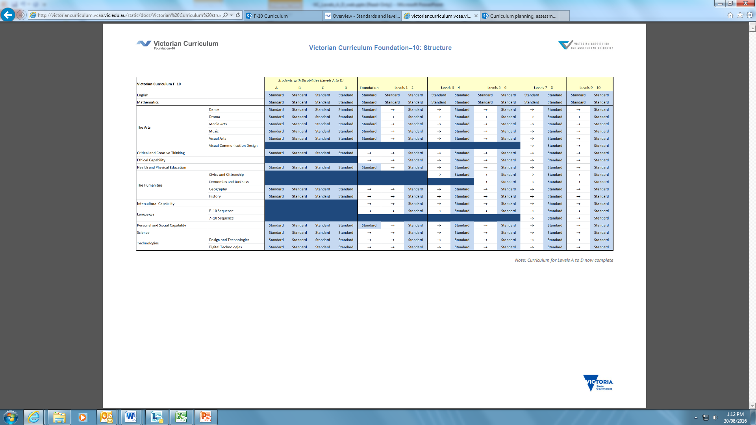
The curriculum continuum
Victorian Curriculum continuum extends seamlessly from Levels A – D and F – 10
http://victoriancurriculum.vcaa.vic.edu.au/overview/curriculum-design/standards-and-levels

Slide 12
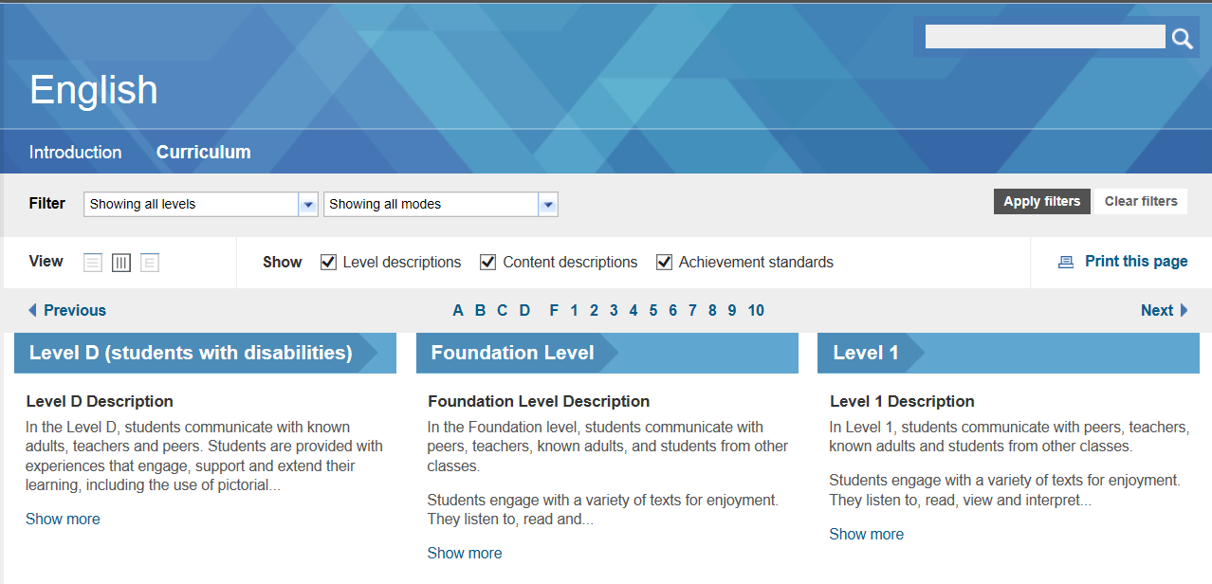

Slide 13
Diversity of Learners
The objectives of the Victorian Curriculum are the same for all students. The curriculum offers flexibility for teachers to tailor their teaching in ways that provide rigorous, relevant and engaging learning and assessment opportunities for students with disabilities.
Most students with disabilities can engage with the curriculum provided the necessary adjustments are made to the complexity of the curriculum content and to the means through which students demonstrate their knowledge, skills and understanding.
For some learners, making adjustments to instructional processes and to assessment strategies enables students to achieve educational standards commensurate with their peers.

Slide 14
Diversity of Learners
For other students, teachers will need to make appropriate adjustments to the complexity of the curriculum content, focusing instruction on content different to that taught to others in their age group. It follows that adjustments will also need to be made to how the student’s progress is monitored, assessed and reported.
For a small percentage of students with disabilities, their learning will be well below the Victorian Curriculum Foundation standards. Most of these students have a significant intellectual disability. ‘Towards Foundation Level Victorian Curriculum’ provides this cohort of students with access to curriculum content and standards that enables students to move toward the learning described at Foundation level

Slide 15
Diversity of Learners
The ‘Towards Foundation Level Victorian Curriculum’ is integrated directly into the curriculum and is referred to as ‘Levels A to D’.
Levels A to D focus on progressing students from a pre-intentional to intentional engagement in learning. They support students to develop their independence as they explore, participate and engage in the world around them. As students progress through these levels, the amount of support decreases as they proceed towards becoming independent learners.
‘Levels A to D’ are not associated with any set age or year level that links chronological age to cognitive progress

Slide 16
Poll

Slide 17


Slide 18

Abilities Based Learning and Education Support is a set of resources to support teaching and learning for students with disabilities and additional learning needs.

Slide 19
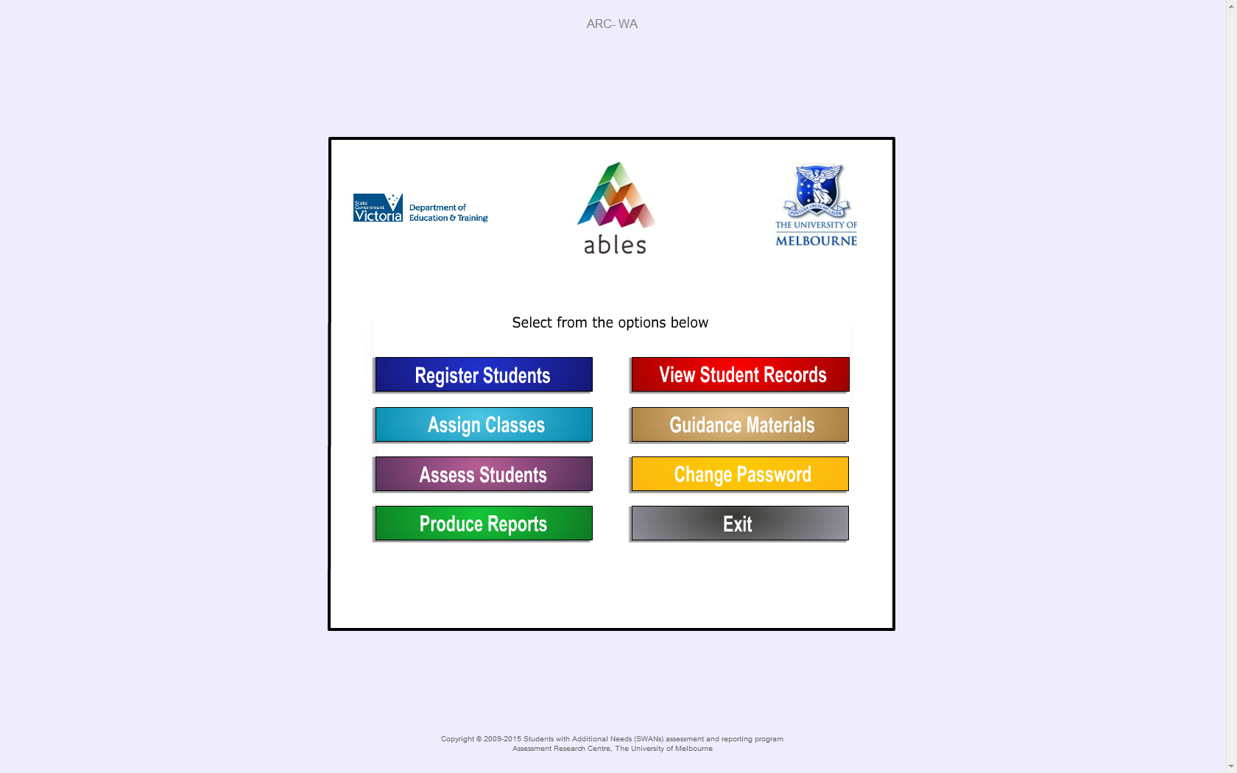

Slide 20
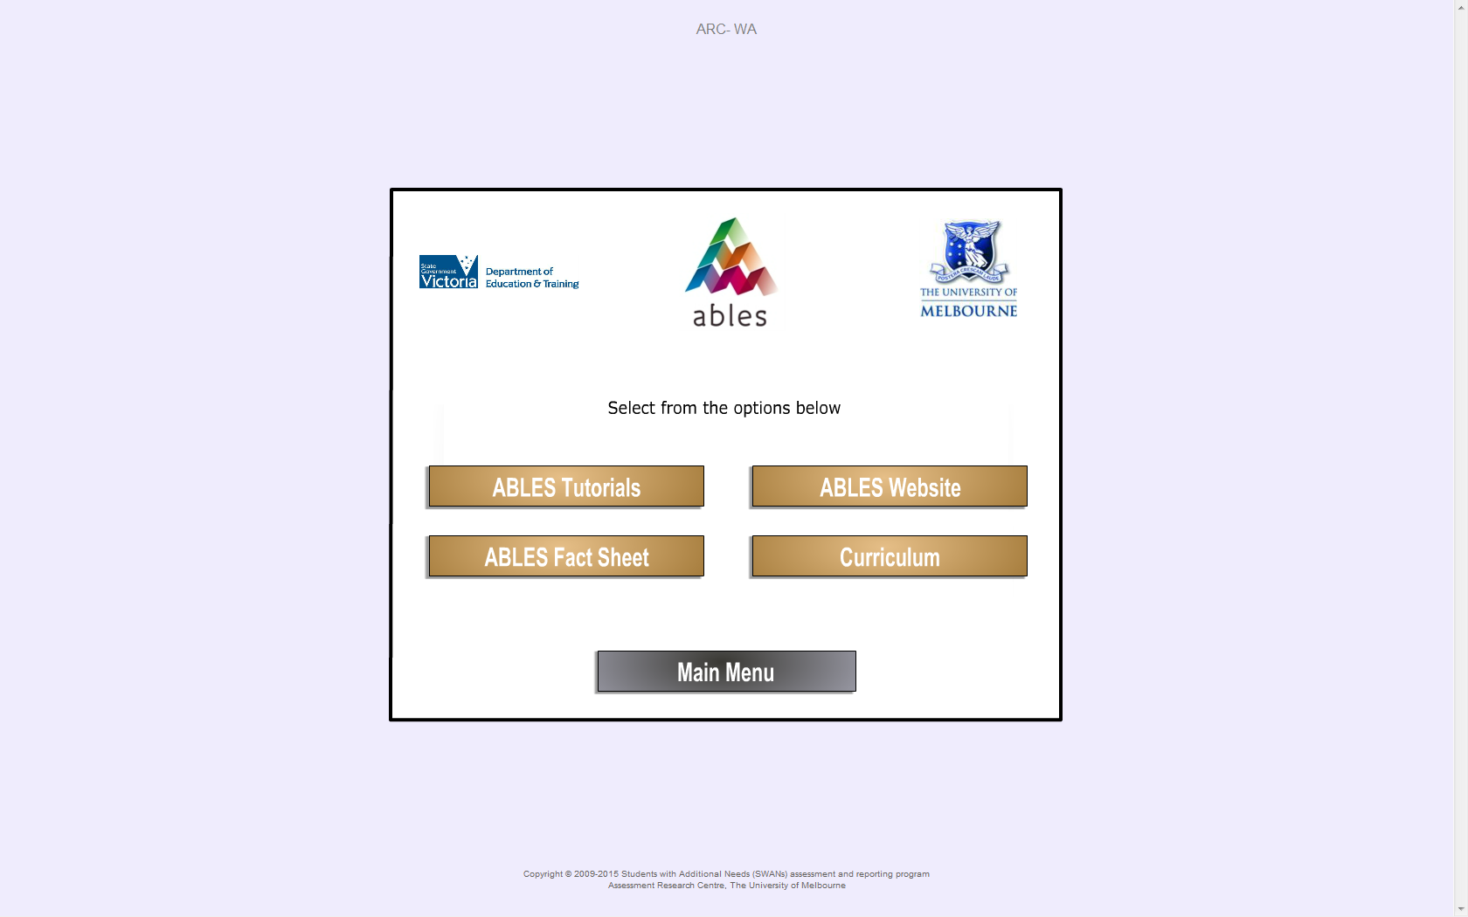

Slide 21
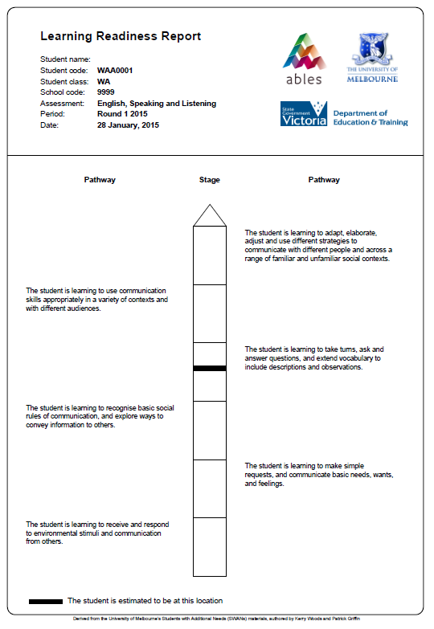
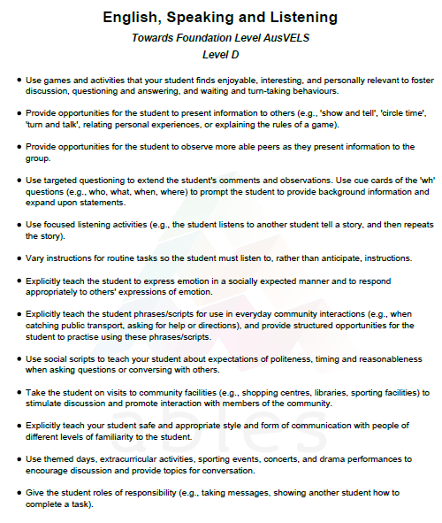

Slide 22
Learning progress (six months) for students in a special education class
Where on the pathway are my students working?
How much progress have they made?
Did some make more progress than others? Why?

Slide 23
Reporting
VRQA requirement:
  A school must ensure that there is ongoing assessment, monitoring and recording of each student’s performance and provide each student and parent with access to accurate information about the student’s performance. Access to information must include at least two written reports to parents per year.
Most parents and students want a report that provides an objective measure of student achievement against a scale that presents clear information about learning progress.
.. Given the range of variables, schools should have the capacity to report against both what has been taught and, where appropriate, against individual learning targets rather than against the same nominal norm-referenced standard across all learning areas…
Schools have the flexibility to choose, in partnership with their school community, the way in which they will report student achievement. There will no longer be a single mandated report format.

Slide 24
Questions

Slide 25
Resources
Victorian Curriculum site - Diversity of Learners tab including pre-intentional to intentional definitions
http://victoriancurriculum.vcaa.vic.edu.au/overview/diversity-of-learners
AusVELS Students with Disabilities Guidelines
http://ausvels.vcaa.vic.edu.au/static/docs/AusVELS-SWD-guidelines.pdf
ABLES
http://www.education.vic.gov.au/school/teachers/teachingresources/diversity/Pages/ables.aspx

Slide 26
Location / Contact details
VCAA websites
Victorian Curriculum F-10
http://victoriancurriculum.vcaa.vic.edu.au
Victorian Curriculum F-10 Resources and Support
http://www.vcaa.vic.edu.au/Pages/foundation10/viccurriculum/viccurr-resources.aspx
Curriculum Planning Resources:
http://curriculumplanning.vcaa.vic.edu.au/home
Queries
Email: vcaa.f10.curriculum@edumail.vic.gov.au
Sharon Foster – 90321680
Email – foster.sharon.a@edumil.vic.gov.au
Karen Underwood – 90971058
Underwood.karen.k@edumail.vic.gov.au

