Slide 1
Victorian Curriculum: Focus on Economics and Business (Secondary)

Slide 2
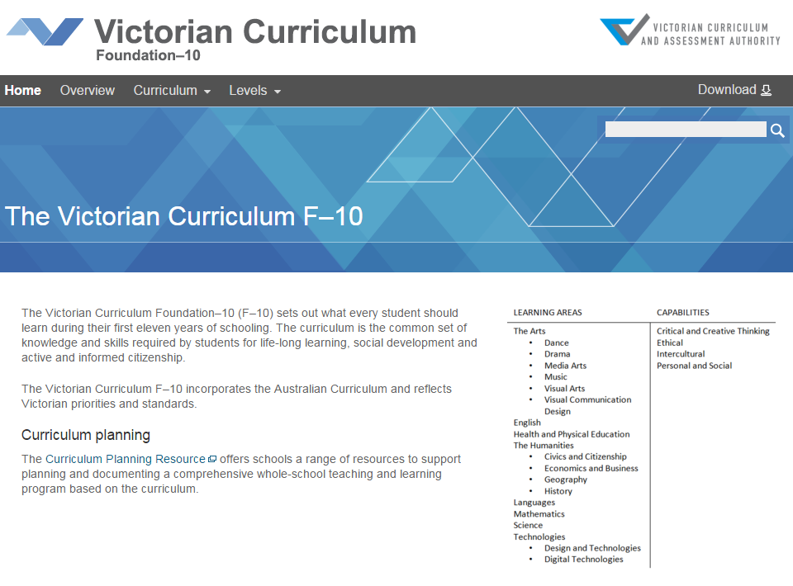
Agenda
Rationale and aims
Focus
Contemporary issues
Structure
Achievement standards
Website navigation
Sample activity
http://victoriancurriculum.vcaa.vic.edu.au/

Slide 3
Rationale
Learning in Economics and Business will develop knowledge, understanding and skills that will encourage and enable students to participate in, and actively contribute to the economy and business activities.

Slide 4
Where is Economics and Business placed in the curriculum?
The Humanities includes:
Civics and Citizenship
Economics and Business
Geography
History
The Economics and Business curriculum is written for Levels 5 – 10.

Slide 5
Aims
The Economics and Business curriculum aims to develop students’:
enterprising behaviours and capabilities that are transferable into life, work and business opportunities and contribute to the development and prosperity of individuals and society
understanding of the ways society allocates limited resources to satisfy needs and wants, and how they participate in the economy as consumers, workers and producers
understanding of the work and business environments within the Australian economy and its interactions and relationships with the global economy, in particular the Asia region
reasoning and interpretation skills to apply economics and business concepts and theories to evaluate information they encounter, make informed decisions and use problem-solving skills to respond to economics and business issues and events
understanding of economics and business decision-making and its role in creating a prosperous, sustainable and equitable economy for all Australians
knowledge, understandings and skills that will enable them to participate actively and ethically in the local, national, regional and global economy as economically, financially and business-literate citizens.

Slide 6
Focus
Focus on decision making and making choices
Effects of individual decisions on themselves and others
Transferable knowledge, understandings and skills that inform and encourage them to participate in and contribute to the economy
Prosperous, sustainable and equitable Australian and global economies

Slide 7
Contemporary issues, events and case studies
The curriculum is intended to be taught through relevant contexts which will help students make the connection between their classroom learning and contemporary issues and events that are occurring in their local area, Australia and the world

Slide 8
Structure
Strands
Resource allocation and making choices: the decision making as to how available, limited resources can be best used to satisfy society’s unlimited needs and wants
The business environment: the ways businesses operate in markets to respond to opportunities and changing circumstances and conditions.
Consumer and financial literacy: making responsible and informed decisions about consumer issues and managing money and assets, and the effect of these decisions on individuals, family and community.
Work and work futures: the nature of work and the work environment and its contribution to individual and collective wellbeing.
Enterprising behaviours and capabilities: developing students’ the behaviours and capabilities that enable them to participate actively in the economy, now and in the future.
Reasoning and interpretation: economic and business decision making and thinking.

Slide 9
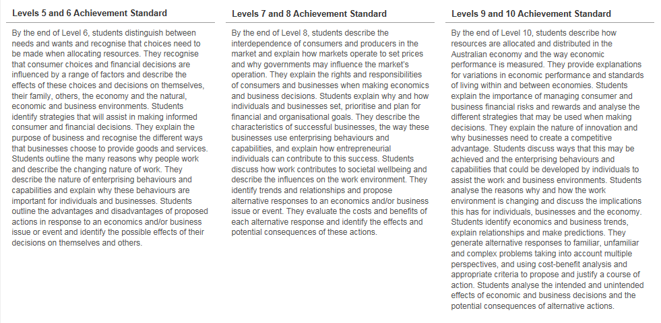
Achievement standards
The first achievement standard for Economics and Business is at Level 6, and then at Level 8 and Level 10.

Slide 10
Enterprising behaviours and capabilities
Integrated across the levels
Students are encouraged to be adaptable, demonstrate initiative, solve problems and take leadership roles.
In a constantly changing world, enterprising behaviours and capabilities provide individuals with skills to manage change.

Slide 11
Key change from AusVELS
The Victorian Curriculum – Economics and Business does not incorporate vocational pathways, education and training requirements, or skills and strategies for transition to employment and further education and training.
The Victorian Careers Curriculum Framework (Dept of Education, Sept 2013) provides a scaffold for schools to develop localised and customised quality career development programs.

Slide 12
Victorian Curriculum website
http://www.vcaa.vic.edu.au/Pages/index.aspx

Slide 13
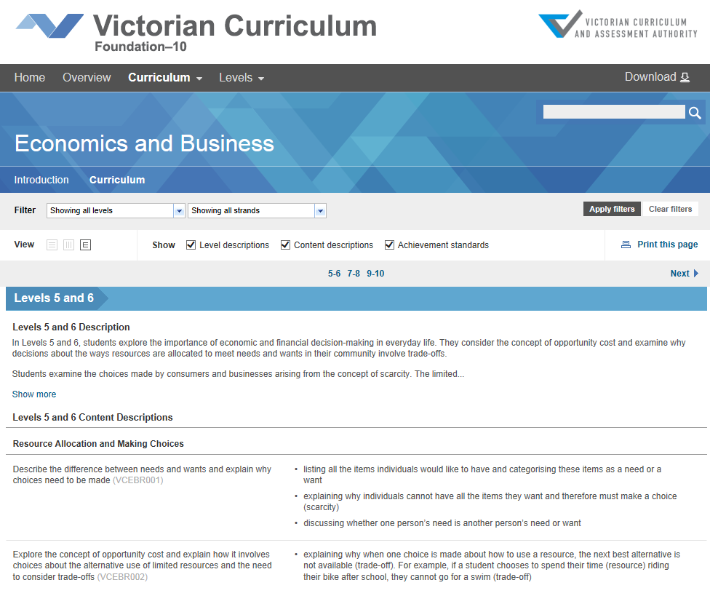
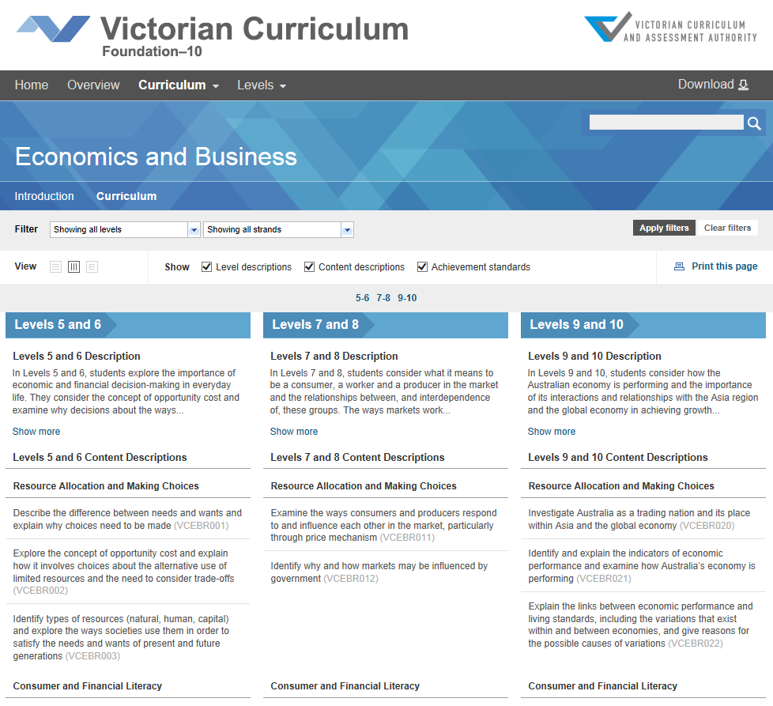
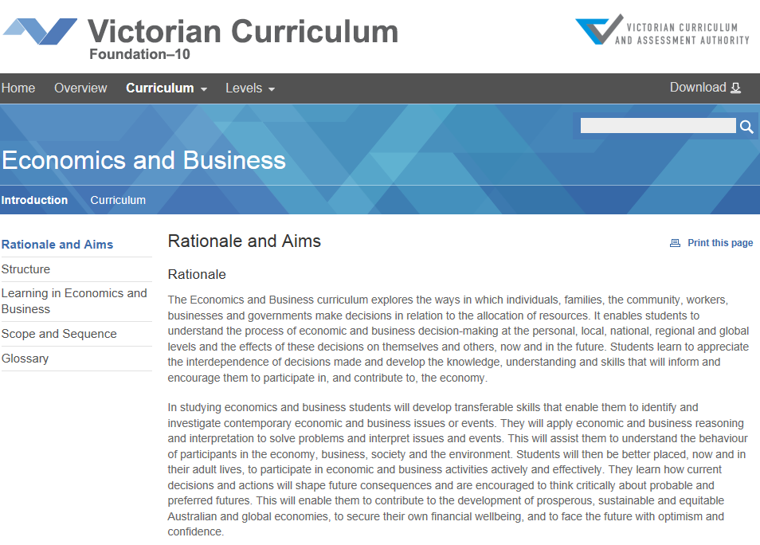
Victorian Curriculum website

Slide 14
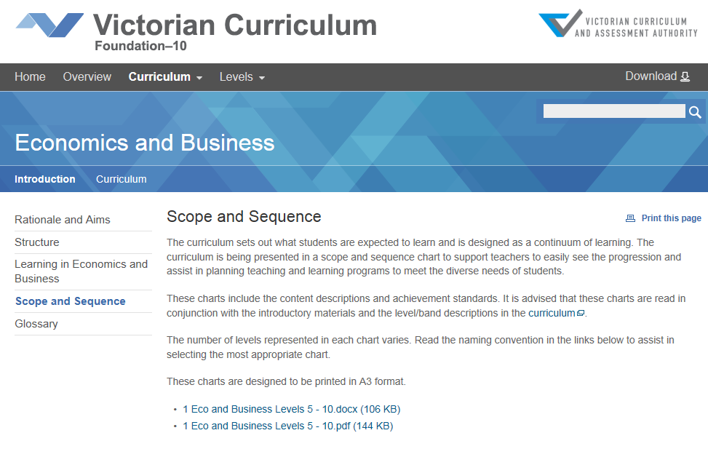
Scope and Sequence Levels 5-10

Slide 15
Strands
While each strand has content descriptions, (‘what’ must be taught),
they should not be considered as a checklist.
The teaching and learning program for EB should integrate the content descriptions into ‘topics’/units of work. (‘how’ the curriculum is delivered.)

Slide 16
Linking curriculum and teaching and learning activities

Slide 17
Sample activity - ‘Choconomics’
Students develop their understanding of:
the ways consumers and producers respond to each other in the market – price mechanism
influences on consumer decisions and choices
Australia as a trading nation
standards of living – material and non-material
In addition, students will practise enterprising behaviours and capabilities such as identifying opportunities, making decisions, and accepting challenges as well as developing their skills of reasoning and interpretation such as identifying trends and generating alternatives.

Slide 18
Choconomics
Activity: Students experience global trade at first hand through a simulation experiment based around trading small confectionary items in class. They investigate whether the act of ‘trading’ chocolate benefits their standard of living (ie happiness).
4 ‘zones’ in classroom, each bag in the zone has same items
Students rate their ‘happiness’ with their bag, teacher to record happiness level
Trade within the zone (limited)
Students rate happiness at this stage
Trade across all zones (global)
Students rate happiness
Look at trend in happiness – what has happened and why?

Slide 19
‘Choconomics’ – why trade?
Discussion
Opportunity cost
Influences on consumer choices
Rights and responsibilities of consumers and businesses
Making decisions and the effects of those decisions
The ways consumers and producers respond to each other in the market, price mechanism
Australia as a trading nation – who do we trade with and why
Standards of living – happiness (non-material)

Slide 20
Contact
Jennifer Quick
Curriculum Manager
Business and Economics
Telephone: 9032 1696
Mobile: 0400945973
Email: quick.jennifer.m@edumail.vic.gov.au

Slide 21
Contact details
VCAA websites
Victorian Curriculum
http://victoriancurriculum.vcaa.vic.edu.au/
AusVELS Curriculum
http://ausvels.vcaa.vic.edu.au/
AusVELS resources and implementation support:
http://www.vcaa.vic.edu.au/Pages/foundation10/curriculum/index.aspx
Curriculum Planning Resources:
http://curriculumplanning.vcaa.vic.edu.au/home
Contact details
Victorian Curriculum Manager Sharon Foster
Phone: (03) 9032 1680
Email: foster.sharon.a@edumail.vic.gov.au

