Slide 1
Unit 1 Applied computing Delivering the outcomes
2020–2024

Slide 2
Copyright
© Victorian Curriculum and Assessment Authority (VCAA) 2019.
VCAA presentations may be reproduced in accordance with the VCAA’s Copyright and Intellectual Property Policy, and as permitted under the Copyright Act 1968.
VCE is a registered trademark of the VCAA.

Slide 3
Unit 1 Applied computing

Slide 4
Overview
O1
Data analysis
O2
Programming
Unit 1
Applied computing

Slide 5
Delivering Unit 1 Outcome 1 Data analysis

Slide 6
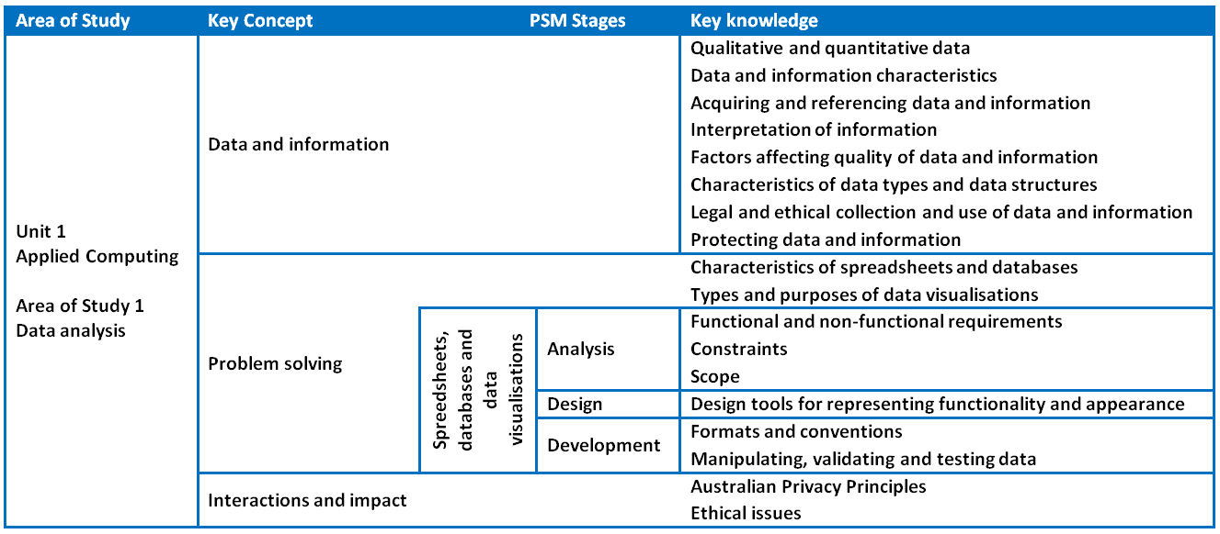
Unit 1 Outcome 1 – Background

Slide 7
Unit 1 Outcome 1 – Background
Students need to be able to:
interpret solution requirements and designs
acquire and reference data
analyse data and discuss relationships and patterns
use software (spreadsheets and databases) to create data visualisations
compare and interpret data visualisations.
Students can learn through:
theory and explanation of key knowledge
case studies
exercises in the use of software tools
class activities (including from Advice for teachers).

Slide 8
Unit 1 Outcome 1 – Planning questions
Some questions to consider when planning for Unit 1 Outcome 1:
How will you prepare your students for this outcome?
What do your students need to know about spreadsheets, databases and data visualisations?
What functions do they need to use? You could refer to the Software functions and tools document for Units 3 and 4 Data Analytics as a guide.
How will you bring the key knowledge and key skills together to develop an assessment task or assessment tasks that will meet requirements?
How long will you need to teach and assess this outcome?
Will you teach and assess spreadsheets separately?
Will you teach and assess databases separately?
Will you teach and assess data visualisations separately?
Will you teach all areas and assess in one task?

Slide 9
Unit 1 Outcome 1 – Suitable tasks
Some suitable assessment tasks could be:
A folio of exercises
spreadsheet, database and data visualisations exercises to develop skills
Software solutions
a spreadsheet solution, database solution and a data visualisation solution
Written report
a report that presents findings through software solutions
Presentation to present findings
a presentation to the class using video or PowerPoint to present findings to the class.

Slide 10
Unit 1 Outcome 1 – Sample task idea
One sample task idea could be:
Spreadsheet folios
create worksheets import and export data use a range of data types validate data create, edit and use charts sort and filter data perform calculations using a range of functions conditional formatting secure data
Database folios
create tables create relationships between tables (for RDBMS) use a range of data types validate data create, edit and use queries search and filter records perform calculations create and edit formatted reports sort records or index on different fields import and export data secure data
Data vis folios
create/select a range of shapes create/select a range of chart types use symbols/images/charts show relationships and patterns enter, edit and format text and other content use colour/shading use of animation in charts (showing movement or changes in response to user input).

Slide 11
Unit 1 Outcome 1 – Sample task idea
Another sample task idea could be:
Folio of exercises
A folio of exercises that includes: spreadsheets databases data visualisations
Software solution
Interpret teacher-provided solution requirements and designs, collect and manipulate data, analyse patterns and relationships, and develop data visualisations to present findings using: spreadsheets databases data visualisations

Slide 12
Delivering Unit 1 Outcome 2 Programming

Slide 13
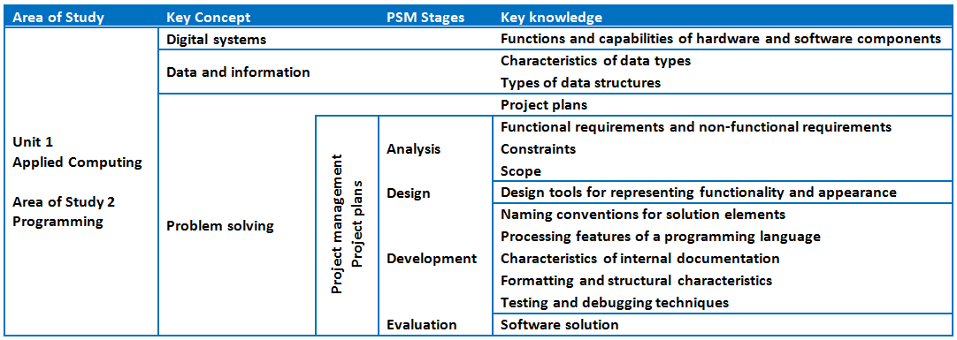
Unit 1 Outcome 2 - Background

Slide 14
Unit 1 Outcome 2 – Background
Students need to be able to:
analyse solution requirements
design software solutions
develop software solutions
test and debug the software solutions
evaluate the software solutions
develop project plans (individual project).
Students can learn through:
theory and explanation of key knowledge
case studies
programming exercises (developing skills)
class activities (including from Advice for teachers).

Slide 15
Unit 1 Outcome 2 – Planning questions
Some questions to consider when planning for Unit 1 Outcome 2:
How will you prepare your students for this outcome?
What do your students need to know about programming and managing a project?
What programming language will you use? Are you familiar with it?
What requirements do they need to meet? You could refer to the Programming requirements document for Units 3 and 4 Software Development as a guide.
How will you bring the key knowledge and key skills together to develop an assessment task that will meet requirements?
How long will you need to teach and assess this task?
time for theory
time for exercises
time to develop a solution.

Slide 16
Unit 1 Outcome 2 – Suitable tasks
Suitable tasks for preparing students could be:
A folio of exercises
a series of exercises that develops programming skills.
Some suitable assessment tasks could be:
Software solution
a task for students to develop a software solution
Written report
a report that presents a software solution
Presentation to present software solution
a presentation to the class using video or PowerPoint to present a software solution to the class.

Slide 17
Unit 1 Outcome 2 – Sample task idea
A sample task idea could be:
Folio of exercises
Folio of exercises that includes: an intro to the programming language the use of design tools variables and data types naming conventions data structures procedures and functions selection control structures repetition control structures data and file management internal documentation testing and debugging
Software solution
Software solution with appropriate processing features that includes: classes control structures functions instructions methods
Written report
Written report that includes: a project plan an analysis of solution requirements mock-ups and pseudocode detailed testing table evaluation of the efficiency and effectiveness of the software solution

Slide 18
Phil Feain Curriculum Manager, Digital Technologies Victorian Curriculum and Assessment Authority
Ph: (03) 9032 1724 feain.philip.a@edumail.vic.gov.au

