Slide 1
Unit 1 Applied computing Introduction
2020–2024

Slide 2
Copyright
© Victorian Curriculum and Assessment Authority (VCAA) 2019.
VCAA presentations may be reproduced in accordance with the VCAA’s Copyright and Intellectual Property Policy, and as permitted under the Copyright Act 1968.
VCE is a registered trademark of the VCAA.

Slide 3
Unit 1 Applied computing

Slide 4
Unit 1 Applied computing Overview
O1
Data analysis
O2
Programming
Unit 1
Applied computing

Slide 5
Unit 1 Outcome 1 Data analysis

Slide 6
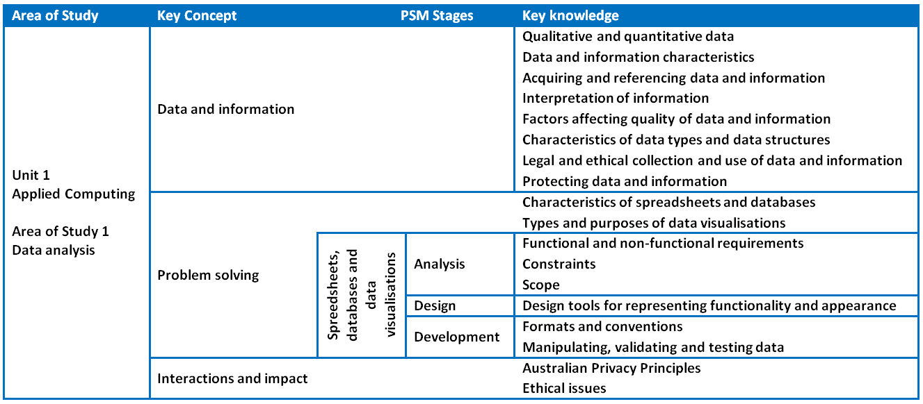
Unit 1 Outcome 1 Data analysis

Slide 7
Unit 1 Outcome 1 – Background Data analysis
Students should be able to:
interpret teacher-provided solution requirements and designs
collect and manipulate data
analyse patterns and relationships
develop data visualisations to present findings.
Students will create:
database solutions
spreadsheet solutions
data visualisations solutions.

Slide 8
Unit 1 Outcome 1 – Assessment Data analysis
Suitable tasks for assessment may be selected from the following:
a folio of exercises or software solutions and a written report
a presentation (oral, multimedia, visual) to present findings or software solutions.

Slide 9
Unit 1 Outcome 2 Programming

Slide 10
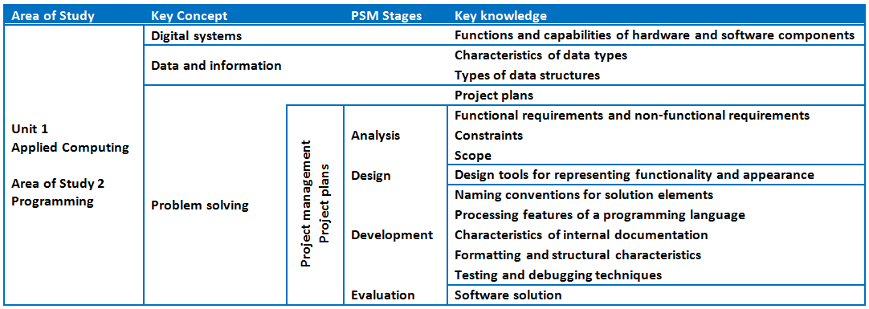
Unit 1 Outcome 2 Programming

Slide 11
Unit 1 Outcome 2 – Background Programming
Students should be able to:
interpret teacher-provided solution requirements
design, develop and evaluate a software solution using a programming language.
Individual project.

Slide 12
Unit 1 Outcome 2 – Assessment Programming
Suitable tasks for assessment may be selected from the following:
a folio of exercises or software solutions and a written report
a presentation (oral, multimedia, visual) to present findings or software solutions

Slide 13
Phil Feain Curriculum Manager, Digital Technologies Victorian Curriculum and Assessment Authority
Ph: (03) 9032 1724 feain.philip.a@edumail.vic.gov.au

