Slide 1
Unit 3 Software development Delivering the outcomes
2020–2024

Slide 2
Copyright
© Victorian Curriculum and Assessment Authority (VCAA) 2019.
VCAA presentations may be reproduced in accordance with the VCAA’s Copyright and Intellectual Property Policy, and as permitted under the Copyright Act 1968.
VCE is a registered trademark of the VCAA.

Slide 3
Unit 3 Software development

Slide 4
Overview
O1
Programming
O2
Analysis and design
Unit 3
Software development

Slide 5
Delivering Unit 3 Outcome 1 Programming

Slide 6
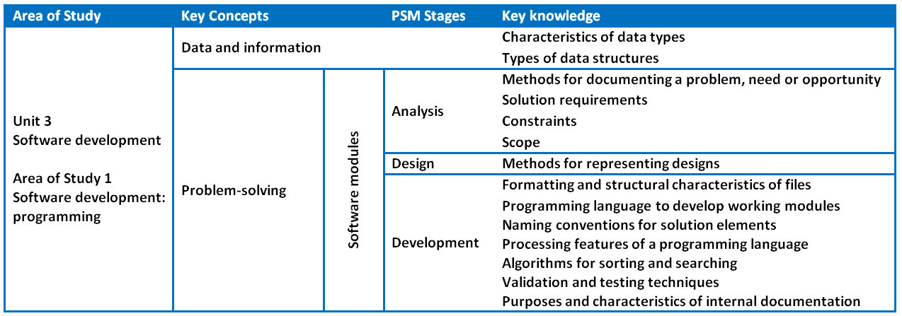
Unit 3 Outcome 1 – Background

Slide 7
Unit 3 Outcome 1 – Background
Students should be able to:
interpret teacher-provided solution requirements and designs
apply a range of functions and techniques
use a programming language to develop and test working software modules.
Software tools:
An appropriate programming language.
Assessment contribution and marks:
School-assessed Coursework for Unit 3 will contribute 10 per cent to the study score.
Total marks will be 100.
Assessment task:
SAC.
Respond to solution requirements and designs to create working modules.
Address VCAA performance descriptors.

Slide 8
Unit 3 Outcome 1 – Descriptors
Performance descriptors from the Advice for teachers (Very high):
All solution requirements and designs are interpreted accurately to developing working modules.
Comprehensive selection of relevant data types and data structures to develop working modules.
Comprehensive selection and use of relevant processing features of the programming language to develop all working modules.
Comprehensive justification and explanation of how the selection of appropriate processing features of the programming language are used to develop working modules.
Comprehensive use of relevant data validation techniques are applied efficiently and effectively to check the reasonableness of all input data.
Comprehensive use of test data is expressed in a testing table, with both expected and actual output stated, and showing detailed evidence of debugging.
All software modules include comprehensive internal documentation regarding the functioning of modules and use of selected processing features.

Slide 9
Unit 3 Outcome 1 – Planning questions
Some questions to consider when planning for Unit 3 Outcome 1:
How will you prepare your students for this outcome?
What do your students need to know about programming and creating working software modules? What programming language will they use?
What programming language requirements need to be met? Refer to the Programming requirements document for Software Development on the study page.
How long will you need to teach and assess this outcome?
Will you teach and assess the working modules separately?
Will you teach all the content and then assess the modules at the end?
How will you bring the key knowledge and key skills together to develop tasks that meet requirements?

Slide 10
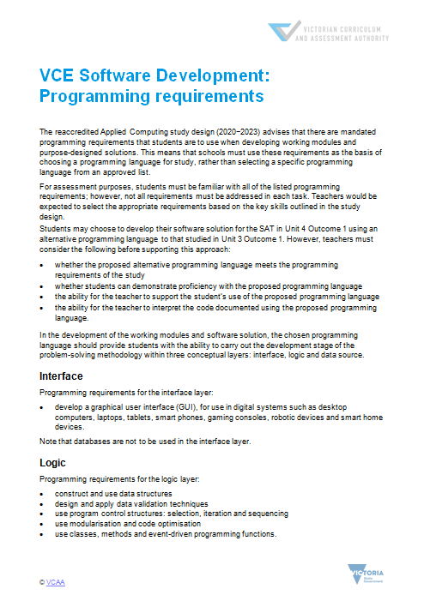
Programming requirements

Slide 11
Unit 3 Outcome 1 – Strategies
There are several possible strategies for delivering this outcome.
Strategy 1
Break the outcome into modules and teach and assess:
Module 1 – 1.5 weeks to prep and 0.5 weeks to assess
Module 2 – 1.5 weeks to prep and 0.5 weeks to assess
Module 3 – 1.5 weeks to prep and 0.5 weeks to assess
Module 4 – 1.5 weeks to prep and 0.5 weeks to assess
These could increase in content and level of difficulty.
Strategy 2
Teach the outcome over 5-6 weeks and assess modules at the end over 1.5-2 weeks.
Strategy 3
A combination of Strategy 1 or 2 while preparing for the SAT at the same time.

Slide 12
Unit 3 Outcome 1 – Task development
An approach for developing an assessment task could be:
Determine the number of modules that you require students to complete:
3-6 modules
Use the key knowledge, key skills, performance descriptors and Programming requirements to determine the required content within each module.
Determine a scenario or small case study that each module will address. Include:
functional and non-functional requirements
designs
Check that the task is accessible to students and can be completed in the required time. Do the task yourself.
Develop a marking scheme consistent with the key skills and the performance descriptors (100 marks).
Determine the weighting of the criteria within each module.

Slide 13
Unit 3 Outcome 1 – Commercial tasks
If using a commercial task:
Check the task against the outcome statement, key knowledge and key skills.
Only include content that is within the scope of the outcome.
The task it is to be significantly modified in terms of context and content.
Marking schemes also need to be checked to ensure accuracy and that they contribute to 100 marks.

Slide 14
Delivering Unit 3 Outcome 2 Analysis and design

Slide 15
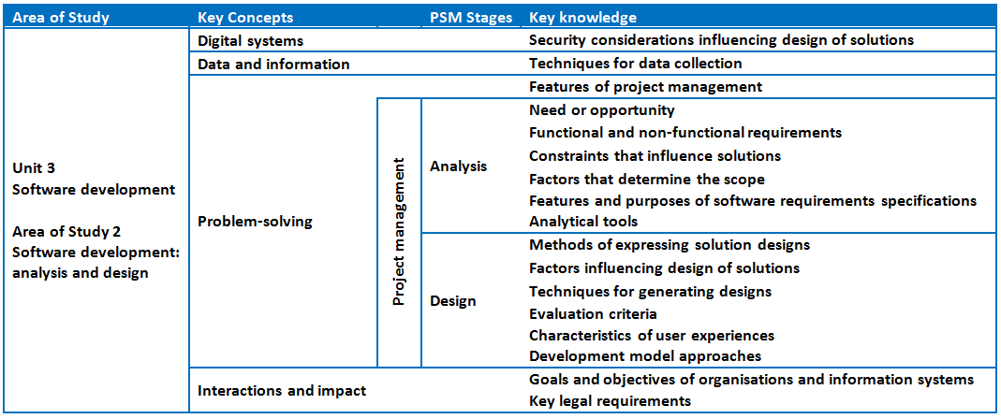
Unit 3 Outcome 2 – Background

Slide 16
Unit 3 Outcome 2 – Background
On completion of this unit the student should be able to:
analyse and document a need or opportunity
justify the use of an appropriate development model
formulate a project plan
generate alternative design ideas
represent the preferred solution design for creating a software solution.
Software tools:
Unified Modelling Language (UML) and UML tools to create use cases. Appropriate tool for documenting project plans.
Assessment contribution:
School-assessed Task for Unit 3 Outcome 2 and Unit 4 Outcome 1 will contribute 30 per cent to the study score.
Unit 3 Outcome 2 is worth 15 per cent.
SAT.
Address VCAA SAT criteria.

Slide 17
Unit 3 Outcome 2 – Planning questions
Some questions to consider when planning for Unit 3 Outcome 2:
How will you prepare your students for this outcome?
What do your students need to know about identifying a need or opportunity?
What will you need to know in order to approve their need or opportunity?
How will your students collect data and when will they do it?
Will the class use the same programming language for Unit 4 Outcome 1 or will students choose their own programming language?
What assessment criteria will they need to meet? Refer to the Administrative information for the SAT on the study page.
How will your students manage a project over months involving analysis and design?
How and when will you observe, authenticate and assess this task?
What model will you use for teaching and assessment?
Teaching and assessing each criterion – feedback between criterion.
Teaching while students complete Part 1 of the SAT and submit as one task – feedback on all criteria.

Slide 18
Unit 3 Outcome 2 – Need or opportunity
Identifying a need or opportunity:
Students need to identify a need or opportunity by themselves that can be solved as a software solution. This is not to be provided by teachers.
Students can reach out to relatives, local businesses or community groups to determine this.
This provides them with a client to seek feedback around their ideas throughout the process.
Teachers need to have a discussion with students about their ideas and how their software solution could be feasibly completed within the timeframe available.
Students should document their thinking to ensure that they and their teacher understands what they are expecting to complete.

Slide 19
Unit 3 Outcome 2 – SAT components
Project management:
Students will create, monitor and modify a project plan (Gantt chart) which outlines the tasks, sequencing, time allocation, dependencies, milestones and the critical path.
Analysis stage:
Students will:
collect data to inform the analysis of their need or opportunity
select and justify an appropriate development model
use analytical tools and techniques to diagrammatically depict the relationships between data, users and the digital systems that will involve the software solution
develop a software requirements specification (SRS) document to outline the proposed software solution.
Design stage:
Students will:
show evidence of design ideas by generating two or three design ideas for their proposed software solution
develop evaluation criteria to evaluate their design ideas and their software solution in Unit 4 Outcome 1
develop detailed designs of how the proposed software solution will appear and function.

Slide 20
Unit 3 Outcome 2 – Strategies
There are two possible strategies for delivering this outcome.
Strategy 1 – Milestones
For each criterion:
Teaching and learning – assessing – feedback (repeat).
Advantages – quick feedback for students and very effective for motivating students, particularly if they start off slow – better authentication.
Disadvantages – you need to be responsive and disciplined.
Strategy 2 – Submit all
Teaching and learning.
Students work on criteria and submit as one submission for assessment.
Advantages – less marking throughout the SAT.
Disadvantages – some students will struggle due to less feedback – possible issues with authentication – more concentrated marking in a busy time of Term 2.
Be aware of your VASS due date.

Slide 21
Unit 3 Outcome 2 – Commercial Instructions
If using commercial instructions:
They need to be modified as they can be very detailed and basically tell students what to do. This could be considered as undue assistance.
Check the task against the outcome statement, key knowledge and key skills.
Only include content that is within the scope of the outcome.
VCAA assessment criteria only to be used for assessment.

Slide 22
Phil Feain Curriculum Manager, Digital Technologies Victorian Curriculum and Assessment Authority
Ph: (03) 9032 1724 feain.philip.a@edumail.vic.gov.au

