Slide 1
Unit 3 Software development Introduction
2020–2024

Slide 2
Copyright
© Victorian Curriculum and Assessment Authority (VCAA) 2019.
VCAA presentations may be reproduced in accordance with the VCAA’s Copyright and Intellectual Property Policy, and as permitted under the Copyright Act 1968.
VCE is a registered trademark of the VCAA.

Slide 3
Unit 3 Software development

Slide 4
Unit 3 Software development Overview
O1
Programming
O2
Analysis and design
Unit 3
Software development

Slide 5
Unit 3 Outcome 1 Programming

Slide 6
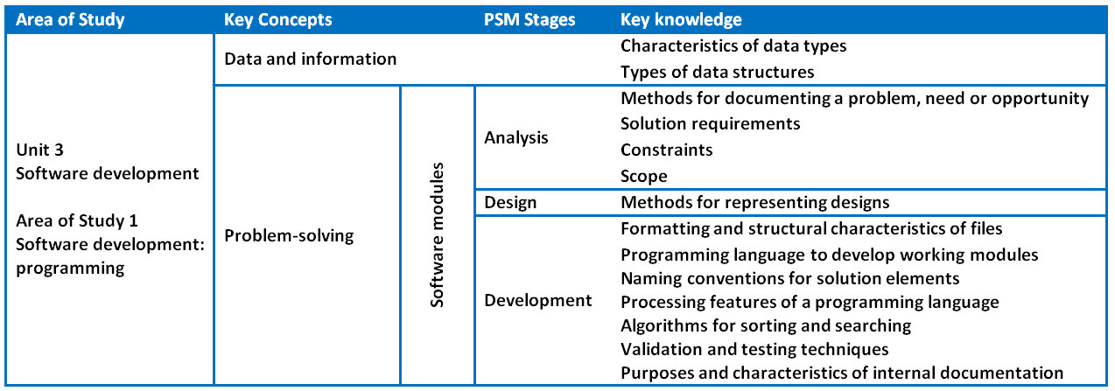
Unit 3 Outcome 1 (SAC) Programming

Slide 7
Unit 3 Outcome 1 (SAC) Programming
Outcome 1
Students should be able to:
interpret teacher-provided solution requirements and designs
apply a range of functions and techniques
use a programming language to develop and test working software modules.
Software tools
An appropriate programming language.
Assessment contribution and marks
School-assessed Coursework for Unit 3 will contribute 10 per cent to the study score.
Total marks will be 100.

Slide 8
Unit 3 Outcome 1 (SAC) Programming
Students will:
interpret solution requirements and designs
use a range of data types and data structures
use and justify a range of appropriate processing features
develop and apply suitable validation, testing and debugging techniques
use internal documentation.
Assessment task
SAC
Respond to solution requirements and designs to create working modules.
Address VCAA performance descriptors.

Slide 9
Unit 3 Outcome 2 Analysis and design

Slide 10
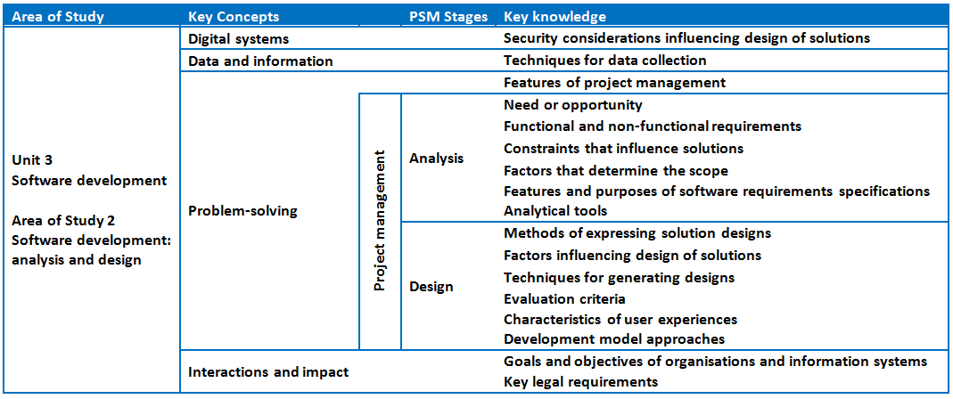
Unit 3 Outcome 2 (SAT Part 1) Analysis and design

Slide 11
Unit 3 Outcome 2 (SAT Part 1) Analysis and design
Outcome 2
On completion of this unit the student should be able to:
analyse and document a need or opportunity
justify the use of an appropriate development model
formulate a project plan
generate alternative design ideas
represent the preferred solution design for creating a software solution.
Software tools
Unified Modelling Language (UML) and UML tools to create use cases. Appropriate tool for documenting project plans.
Assessment contribution
School-assessed Task for Unit 3 Outcome 2 and Unit 4 Outcome 1 will contribute 30 per cent to the study score. Unit 3 Outcome 2 is worth 15 per cent.

Slide 12
Unit 3 Outcome 2 (SAT Part 1) Analysis and design
Students will:
collect and interpret data
select and justify the use of a development model
apply analysis tools and techniques
determine solution requirements, constraints and scope
document a software requirements specification
generate alternative design ideas
develop evaluation criteria to select designs
produce detailed designs
create, monitor and modify project plans.
Assessment task
SAT
Address VCAA SAT criteria.

Slide 13
Phil Feain Curriculum Manager, Digital Technologies Victorian Curriculum and Assessment Authority
Ph: (03) 9032 1724 feain.philip.a@edumail.vic.gov.au

