Slide 1
Unit 4 Software development Delivering the outcomes
2020–2024

Slide 2
Copyright
© Victorian Curriculum and Assessment Authority (VCAA) 2019.
VCAA presentations may be reproduced in accordance with the VCAA’s Copyright and Intellectual Property Policy, and as permitted under the Copyright Act 1968.
VCE is a registered trademark of the VCAA.

Slide 3
Unit 4 Software development

Slide 4
Overview
O1
Development and evaluation
O2
Software security
Unit 4
Software development

Slide 5
Delivering Unit 4 Outcome 1 Development and evaluation

Slide 6
Unit 4 Outcome 1 – Background

Slide 7
Unit 4 Outcome 1 – Background
On completion of this unit the student should be able to:
develop and evaluate a software solution that meets requirements
evaluate the effectiveness of the development model
assess the effectiveness of the project plan.
Software tools:
An appropriate programming language.
Appropriate tool for documenting project plans.
Assessment contribution:
School-assessed Task for Unit 3 Outcome 2 and Unit 4 Outcome 1 will contribute 30 per cent to the study score.
Unit 4 Outcome 1 is worth 15 per cent.
SAT.
Address VCAA SAT criteria.

Slide 8
Unit 4 Outcome 1 – Planning questions
Some questions to consider when planning for Unit 4 Outcome 1:
How will you prepare your students for this outcome?
What do your students need to know about developing and evaluating software solutions?
What assessment criteria will they need to meet? Refer to the Administrative information for the SAT on the study page.
How will your students identify what they planned in Unit 3 Outcome 2 can be achieved for Unit 4 Outcome 1? Can they actually develop the software solution?
How will your students manage the remaining project?
How and when will you observe, authenticate and assess this task?
What model will you use for teaching and assessment?
Teaching and assessing each criterion – feedback between criterion.
Teaching while students complete Part 2 of the SAT and submit as one task – feedback on all criteria.

Slide 9
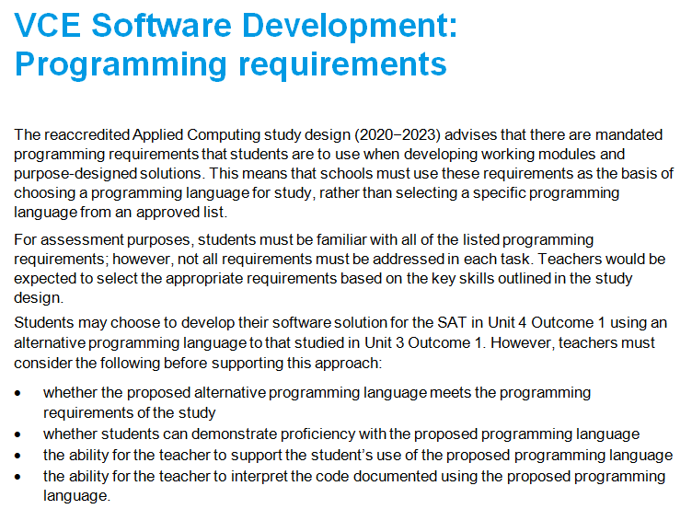
Programming requirements

Slide 10
Unit 4 Outcome 1 – SAT components
Project management:
Students will monitor, modify and annotate their project plan as they progress through the development and evaluation stages of the SAT.
Development stage:
Students will develop a software solution that includes:
appropriate processing features of the programming language, suitable data structures, procedures and techniques for handling and managing data and files, validation techniques and internal documentation of code
testing the solution to ensure it meets requirements
the design, conducting and documentation of usability tests.
Evaluation stage:
Students will:
evaluate the efficiency and effectiveness of the software solution using the evaluation criteria developed in Unit 3 Outcome 2
evaluate the effectiveness of the selected development model to develop the software solution
assess the effectiveness of the project plan in managing the project.

Slide 11
Unit 4 Outcome 1 – Strategies
There are two possible strategies for delivering this outcome. Like U3 O2.
Strategy 1 – Milestones
For each criterion:
Teaching and learning – assessing – feedback (repeat).
Advantages – quick feedback for students and very effective for motivating students, particularly if they start off slow – better authentication.
Disadvantages – you need to be responsive and disciplined.
Strategy 2 – Submit all
Teaching and learning.
Students work on criteria and submit as one submission for assessment.
Advantages – less marking throughout the SAT.
Disadvantages – some students will struggle due to less feedback – possible issues with authentication – more concentrated marking in a busy time of Term 3, possibly near the SAC.

Slide 12
Unit 4 Outcome 1 – Commercial Instructions
If using commercial instructions:
They need to be modified as they can be very detailed and basically tell students what to do. This could be considered as undue assistance.
Check the task against the outcome statement, key knowledge and key skills.
Only include content that is within the scope of the outcome.
VCAA assessment criteria only to be used for assessment.

Slide 13
Delivering Unit 4 Outcome 2 Software security

Slide 14
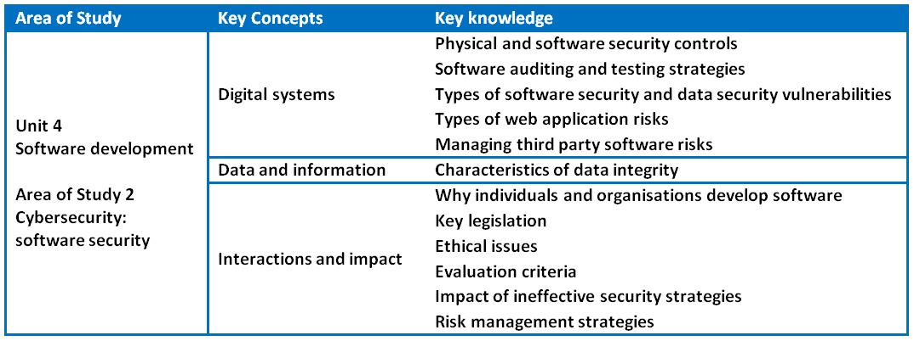
Unit 4 Outcome 2 – Background

Slide 15
Unit 4 Outcome 2 – Background
On completion of this unit the student should be able to:
respond to a teacher-provided case study
examine the current software development security strategies of an organisation
identify the risks and the consequences of ineffective strategies
recommend a risk management plan to improve current security practices.
Assessment contribution and marks:
School-assessed Coursework for Unit 4 will contribute 10 per cent to the study score.
Total marks will be 100.
Assessment task:
SAC
A case study with one of the following:
structured questions or written report or multimedia report
Address VCAA performance descriptors.

Slide 16
Unit 4 Outcome 2 – Descriptors
Performance descriptors from the Advice for teachers (Very high):
Comprehensive analysis and discussion of the current security controls used to protect software development practices and to protect software and data.
Comprehensive identification and discussion of the potential risks to software and data security.
Comprehensive set of relevant evaluation criteria to measure the effectiveness of the current security practices are proposed and applied.
Comprehensive understanding of the possible legal and ethical consequences of ineffective security practices.
Comprehensive recommendations are made and justified to improve the current security practices as part of an effective risk management plan.

Slide 17
Unit 4 Outcome 2 – Planning questions
Some questions to consider when planning for Unit 4 Outcome 2:
How will you prepare your students for this outcome?
What do your students know about security strategies, ineffective strategies and risk management?
How will you develop a case study? How will this look? When will you create it? What scenario or organisation will you have?
What samples of case studies can you find in the media and online?
How can your IT staff help you with this outcome? Make use of the support they can give you.
How long will you need to teach and assess this task? Keep in mind this often takes place in the last few weeks of Term 3.
How will you ensure that you develop an assessment task that meets requirements?
How will your students address the case study? Structured questions, report in written format or report in multimedia format?
This is not to be a test or an examination/practice examination.

Slide 18
Unit 4 Outcome 2 – Strategies
There are several possible strategies for delivering this outcome.
Strategy 1
Complete the SAT with about 4 weeks to go in Term 3 and then introduce the SAC. Have:
3 weeks for teaching and learning of the key knowledge
Assessment (case study) in the last week in a double period.
Strategy 2
Complete the SAT at the end of Term 3 and have students working on the SAC from early in Term 3. Students are working on both at the same time. Assess the SAC in the last week or two.
Strategy 3
Complete the SAT with about 2 weeks to go in Term 3 and then introduce the SAC. Have:
2 weeks before the holidays and 1 week after the holidays for teaching
Assessment in the second week of Term 4.

Slide 19
Unit 4 Outcome 2 – Task development
An approach for developing an assessment task could be:
Determine the task type with the case study:
structured questions
written report
report in multimedia format
Use the key knowledge, key skills and performance descriptors to determine the required content to be included in the case study.
Determine the structured questions or prompts required to address the case study.
Develop the case study and consider the following:
a fictitious organisation but real world with a level of complexity
the organisation needs to be currently developing software and have some security strategies in place
weaknesses within the security strategies and security risks to development practices
threats and vulnerabilities
areas for students to consider legal, and ethical issues
Develop a marking scheme consistent with the key skills and the performance descriptors (100 marks).
Complete the task yourself and determine how long students will need to complete the task.

Slide 20
Unit 4 Outcome 2 – Commercial tasks
If using a commercial task:
Check the task against the outcome statement, key knowledge and key skills.
Only include content that is within the scope of the outcome.
The task it is to be significantly modified in terms of context and content.
Marking schemes also need to be checked to ensure accuracy and that they contribute to 100 marks.

Slide 21
Phil Feain Curriculum Manager, Digital Technologies Victorian Curriculum and Assessment Authority
Ph: (03) 9032 1724 feain.philip.a@edumail.vic.gov.au

