Slide 1
VCE Chemistry
Implementation of VCE Study Design
Units 1 and 2: 2023 – 2027
Units 3 and 4: 2024 – 2027
Introduction and overview of Units 1 to 4
2021

Slide 2
Purpose
Outline implementation support resources
Explain the key requirements of the revised study design
Provide an overview of the content of VCE Chemistry
Consider VCE assessment principles in relation to assessment

Slide 3
VCE resources
VCE and VCAL Administrative Handbook 2023
VCE Chemistry Study Design 2023-2027

Slide 4
New study design support materials: updated webpages https://www.vcaa.vic.edu.au/curriculum/vce/vce-study-designs/Chemistry/Pages/Index.aspx
VCE Chemistry Study Design 2023-2027 (staged implementation)
VCE Chemistry support materials: planning advice; teaching and learning activities and plans; assessment advice
VCE examination specifications 2024-2027
VCE sample examination (available end of 2023)
Implementation videos: Introduction; Units 1&2; Units 3&4
Live Q&A sessions in 2022 for Units 1&2
Live Q&A sessions in 2023 for Units 3&4, with a special focus on assessment

Slide 5
Staged implementation
Units 1 & 2: 2023 – 2027
Units 3 & 4: 2024 – 2027

Slide 6
VCE Chemistry 2023-2027 Structure
Scope of study, Rationale, Aims
Cross-study specifications
4 Units
11 Areas of Study
Key Knowledge (and relevant Key Science Skills)
Terms used in this study
Assessment
1. Satisfactory completion- certification
2. Levels of achievement

Slide 7
Aims of VCE Chemistry (p 7)
Three specific aims for the study:
develop knowledge and understanding of matter and its interaction with energy, as well as key factors that affect chemical systems, to explain the properties, structures, reactions and related applications of materials in society
understand and use the language and methodologies of chemistry to solve qualitative and quantitative problems in familiar and unfamiliar contexts
develop knowledge and understanding of how chemical systems can be controlled to develop greener and more sustainable processes for the production of chemicals and energy while minimising any adverse effects on human health and the environment, with consideration of wastes as underutilised resources and/or feedstock for another process or product

Slide 8
Key Science Skills (pp 11&12)
Key Science Skills
Develop aim and questions, formulate hypotheses and make predictions
Plan and conduct investigations
Comply with safety and ethical guidelines
Generate, collate and record data
Analyse and evaluate data and investigation methods
Construct evidence-based arguments and draw conclusions
Analyse, evaluate and communicate scientific ideas
Contextualised for VCE Chemistry
Progressively higher demonstration of skill across Units 1 to 4
May focus on a specific skill, or a progression of skills in the context of an investigation
Deploy in different contexts

Slide 9
Overview of changes – key science skills
Eight scientific methodologies (p 13 of the study design)
‘Reliability’ replaced with ‘repeatability’ and ‘reproducibility’
Repeat experiments to evaluate the precision of data
Identification of outliers, and contradictory, provisional or incomplete data
Distinction between opinion, anecdote and evidence, and scientific and non-scientific ideas
Application of sustainability concepts to chemistry-based scenarios
Limitations of conclusions, including identification of further evidence required
Consideration of non-scientific factors related to decision-making: sociocultural; economic; political; legal and/or ethical factors
Use of a logbook as authentication of generated or collated data.

Slide 10
Integration of key knowledge and key science skills
Key science skills:
are not an ‘add on’ to the key knowledge
may be explicit in key knowledge
may be implicit, allowing flexibility for teachers to choose when/how to include in teaching and learning programs
Key science skill | Key knowledge examples of the inclusion of key science skills
Plot graphs involving two variables that show linear and non-linear relationships | Unit 1 Area of Study 1: the periodic table as an organizational tool to identify patterns and trends in …properties (electronegativity, first ionisation energy, metallic and non-metallic character and reactivity) of elements Unit 2 Area of Study 1: trends in the boiling points of Group 16 hydrides Unit 2 Area of Study 2: use of solubility graphs; effect of temperature on solubility Unit 3 Area of Study 1: energy profile diagrams; temperature-time graphs from solution calorimetry Unit 3 Area of Study 2: equilibrium temperature-time graphs; Faraday’s laws Unit 4 Area of Study 1: trends in physical properties within homologous series Unit 4 Area of Study 2: HPLC calibration curves

Slide 11
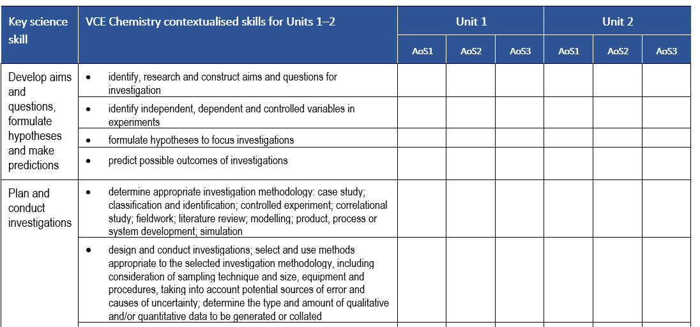
Key science skills planners
A planner for mapping Units 1 and 2 key science skills
Note: a separate planner is available for Units 3 and 4

Slide 12
Overview of changes – Units 1 to 4
Streamlining of content/contemporary applications:
Unit 1: shells/subshells; critical elements; melting points of metals; metal recycling/plastics recycling and circular economy; solubility tables and precipitation reactions; separation of mixtures; R_{f} values; plant-based biomass as a renewable source of organic compounds
Unit 2: ice/water density; natural vs commercial indicators; water of hydration; measuring gases; greenhouse gases
Unit 3: fuels/biofuels/foods; photosynthesis; cellular respiration; limiting reactants/reagents; fuel cell design; ‘green’ hydrogen
Unit 4: green chemistry production; purity; medicinal chemistry
Units 1 and 2 assessment – 16 suggested tasks (others are possible)
Units 3 and 4 assessment - 5 SAC tasks

Slide 13
Overview of changes – new inclusions
Cross study specifications:
- New sections: critical and creative thinking; ethical understanding; individual and collaborative scientific endeavour; Aboriginal and Torres Strait Islander knowledge, culture and perspectives
Terms used in this study:
data and measurement; measurement errors, uncertainty, significant figures and outliers
sustainability - sustainable development, green chemistry principles, linear and circular economies

Slide 14
Aboriginal and Torres Strait Islander knowledge
New resource:
Unit 1 Area of Study 1
Making bush soap from the acacia plant
Background information and practical activity
Saponins as amphiphilic molecules
Links to ‘polar and non-polar character with reference to the shape of the molecule’ (p. 24)
Saponin units form a micelle structure in water

Slide 15
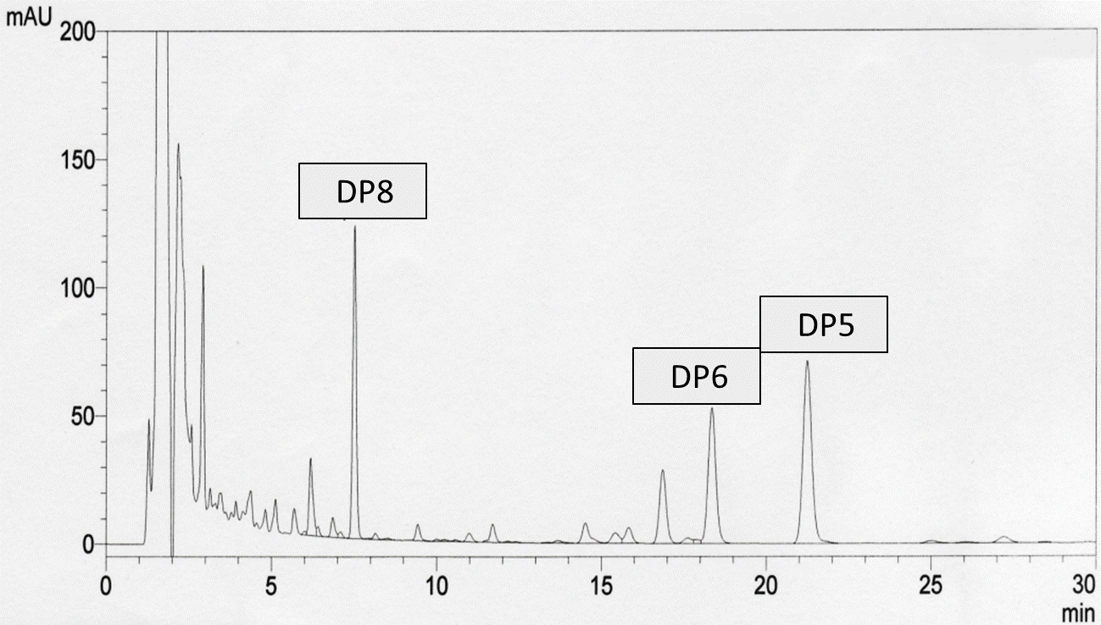
Kuuku l’yu medicinal plants project
New resource:
Unit 1 Area of Study 1
Unit 4 Area of Study 2
Set of PowerPoint slides and embedded videos of separation techniques that show the stages in the investigation of native plants for medicinal properties undertaken through an equitable partnership between Aboriginal researchers and Western scientific researchers
Includes data and procedural explanations from thin-layer chromatography, column chromatography; HPLC; NMR, IR and MS.
HPLC profile of Uncha leaf extract: The labelled peaks in the HPLC profile correspond to the active anti-inflammatory compounds which were able to be collected from the HPLC after separation

Slide 16
Sustainability: Sustainable Development Goals (p 20)
Goal | Examples of learning activities
Goal 9: Industry, innovation and infrastructure | Students make concrete from more sustainably sourced and compare their strength to concrete made from traditional feedstocks that are scarce in supply. Students relate the structure and properties of glass, plastics and waste concrete (demonstrating closed loop recycling) to their potential as a sustainable feedstock in concrete production. Students access secondary sources on the internet to investigate innovative processes for metal recycling from electronic devices, including hard-to-recover metals such as gold and silver. Students can compare these processes with crude, hazardous chemical processes using strong acids, utilised predominantly in low- and middle-income countries, leading to serious toxic residue build-up. Students can investigate the chemical processes underpinning the production of the so-called ‘colours of hydrogen’ (blue, green, brown and more), and relate this to ongoing efforts to produce hydrogen as a renewable feedstock for chemical and energy production without producing greenhouse gas emissions.

Slide 17
Sustainability: Green chemistry principles (p 21)
Principle | Examples of learning activities
Atom economy | Investigation of the atom economy of saponification
Catalysis | Experiment to show that Vitamin C can be used as a catalyst to speed up the decomposition of hydrogen peroxide
Design for degradation | Deliberate degradation of (excess light stimulation, abrasion, soaked in solutions) of common biodegradable and non-biodegradable single-use plastics sold in supermarkets
Design for energy efficiency | Extraction of essential oils (e.g., from lemons) and comparison of the energy requirements using traditional techniques, steam distillation and using novel approaches such as pressurised liquid CO₂
Designing safer chemicals | Make and test the effectiveness of less harmful sparklers, replacing the toxic barium nitrate with strontium nitrate as the oxidiser
Prevention of waste | Investigation of a ‘green’ version of a clock reaction using starch solution, Vitamin C in solution, 3% hydrogen peroxide, tincture of iodine and water
Use of renewable feedstocks | Students make absorbable medical sutures from renewable feedstocks, and compare their tensile strength and degradation with commercial other absorbable and non-absorbable sutures.

Slide 18
Sustainability: Linear ➔ circular economy (pp 21-22)
Circular economy components | Learning activities
Recycle / Re-purpose | Polylactic acid is an increasingly biodegradable polymer used in commercial products. However, rather than leaving it to degrade (albeit far faster than other non-biodegradable polymers), students can chemically convert the plastic material back to lactic acid form via simple base hydrolysis. A subsequent reaction step can form an antimicrobial cleaning solution of lactic acid, and its cleaning ability (wiping a dirty surface) can be compared to other non-green and green cleaning products. The pH of the depolymerised lactic acid could also be determined by titration against a strong base.
Re-make / Enrich | Making materials from mushrooms (or more specifically Mycelium —essentially mushroom roots) is an ideal example of ‘cradle to cradle design’ that students can replicate. With a suitable ‘starter’ material, students can grow their own mushroom-based material in a mould in just a few days. Students can then compare the strength of this material as a packaging material, compared to traditional lightweight non-biodegradable packaging such as polystyrene.

Slide 19
Scientific Investigation (p 13 – 15): asking questions; testing ideas; using evidence
Opportunities for teacher-facilitated, student-adapted and student-designed investigations across Units 1 – 4
Scientific investigation methodologies for 2023-2027 Study Design:
Case study
Classification and identification
Controlled experiment
Fieldwork
Literature review
Modelling
Product, process or system development
Simulation

Slide 20
Examples of scientific methodologies
Methodology | Example
Case study | Discuss the social and scientific issues involved in the utilisation of seaweed (macroalgae) as a biofuel (Unit 3 AoS1)
Classification and identification | Access the structures of a range of medicinal compounds and identify functional groups, including isomers and chiral centres which are attributed to their bioactivity (Unit 4, AoS2)
Controlled experiment | Determine the ideal temperature conditions to demonstrate that Vitamin C can be used as a catalyst to speed up the decomposition of hydrogen peroxide (Unit 4 AoS1)
Fieldwork | Organise a site tour to a polymer manufacturing or recycling plant and summarise processes and safety precautions (Unit 1 AoS2)
Literature review | Compare the global warming potentials for greenhouse gases CO2, CH4 and H2O and explain why the differences occur (Unit 2 AoS2)
Modelling | Produce an animation or physical model to illustrate why ice is less dense than liquid water (Unit 2 AoS1)
Product, process or system development | Formulate a biodegradable ink for use with recyclable paper (Unit 1 AoS1)
Simulation | Use a spreadsheet to manipulate data to illustrate the constancy of K_{c} at constant temperature (Unit 3 AoS2)
Refer to the Support materials on the VCAA website.
Learning materials have been tagged with relevant methodology

Slide 21
Practical work
Central component of learning and assessment
Includes activities such as laboratory experiments, fieldwork, simulations, modelling and other direct experiences described in the scientific investigation methodologies
A minimum of 10 hours of class time to be devoted to student practical activities and scientific investigations across Areas of Study 1 and 2 for Units 1 to 4.
A minimum of 7 hours to be devoted to Area of Study 3 in Units 1 and 2
A minimum of 10 hours to be devoted to the student-designed investigation in Unit 4, Area of Study 3.

Slide 22
Logbooks (p 14)
Logbook of practical activities maintained for each of Units 1 to 4 for recording, authentication and assessment purposes.
The presentation format of the logbook is a school decision and no specific format is prescribed. Its purposes may include:
reporting on an investigation or activity
responding to questions in a practical worksheet or problem-solving exercise
writing up an investigation as a formal report or as the basis of a scientific poster
providing a basis for further learning, for example, referenced in class discussions about demonstrations, activities or practical work

Slide 23
Data book
The current Data Book for the external examination will be reviewed along with the examination specifications and will be published in December 2023, after the 2023 VCE Chemistry examination has been sat by students
Consideration will be given to reducing the ‘memory load’ for students in examinations and will be benchmarked
Students should be encouraged to become familiar with the Data Book as part of their regular classes

Slide 24
Units 1 and 2 Structure
Unit titles | Area of Study titles
Unit 1: How can the diversity of materials be explained? | Area of Study 1: How do chemical structures of materials explain their properties and reactions? Area of Study 2: How are materials quantified and classified? Area of Study 3: How can chemical principles be applied to create a more sustainable future?
Unit 2: How do chemical reactions shape the natural world? | Area of Study 1: How do chemicals interact with water? Area of Study 2: How are chemicals measured and analysed? Area of Study 3: How do quantitative scientific investigations develop our understanding of chemical reactions?

Slide 25
Integrating Unit 1 options into Unit 1 ‘core’
Content in the Unit 1 Area of Study 3 options may be used to support learning in Unit 1 Areas of Study 1 and 2 and to provide students with ideas for further investigation, for example:
Unit 1 Area of Study 3 option | Unit 1 Area of Study 3 option question | Application
Option 1 Endangered elements in the periodic table | Should helium party balloons be banned? | Unit 1 AoS1: critical elements, e.g., helium
Option 2: Producing and using ‘greener’ polymers | Is the recycling of packaging using aluminium more sustainable than LDPE? | Unit 1 AoS1: metal recycling as an example of a circular economy Unit 1 AoS2: categorisation of plastics as plastic-based (…LDPE)
Option 3: The chemistry of Aboriginal and Torres Strait Islander peoples’ practices | Which plants are important to Aboriginal and Torres Strait Islander peoples? | Unit 1 AoS1: polar and non-polar character with reference to the shape of the molecule?
Option 4: The sustainability of a commercial product or material | To what extent have manufacturing processes become ‘greener? | Unit 1 AoS1: recycling processes for element recovery Unit 1 AoS2: innovations in polymer manufacture

Slide 26
Units 3 and 4 Structure
Unit titles | Area of Study titles
Unit 3: How can design and innovation help to optimise chemical processes? | Area of Study 1: What are the current and future options for supplying energy? Area of Study 2: How can the rate and yield of chemical reactions be optimised?
Unit 4: How are carbon-based compounds designed for purpose? | Area of Study 1: How are organic compounds categorised and synthesised? Area of Study 2: How are organic compounds analysed and used? Area of Study 3: How is scientific inquiry used to investigate the sustainable production of energy and/or materials?

Slide 27
Curriculum and assessment programs
Each school is different:
different contexts in which students operate
different circumstances in which schools are situated
Students will have different:
strengths and talents
available resources
Schools have flexibility in:
designing curriculum programs that meet the needs of their cohort and the context in which they are learning
developing assessment programs that are aligned to the VCE Chemistry Study Design and comply with VCE assessment principles.

Slide 28
Planning template
Whilst designed specifically for schools seeking to deliver a VCE study for the first time, the VCE Curriculum and Assessment Plans are a useful tool for all teachers in planning assessment.

Slide 29
Units 1-4 School-based Assessment
Two forms of assessment for each outcome:
Satisfactory completion of an outcome (S or N)
- Units 1-4
Levels of achievement
school-based in Units 1 and 2
School-assessed Coursework (SAC) moderated against external examination in Units 3 and 4)

Slide 30
VCE assessment principles
The VCE Assessment Principles state that assessment should be:
valid and reasonable
equitable
balanced
efficient

Slide 31
VCE Assessment principles
Valid
Equitable
fair and reasonable
designated task type
conducted under fair conditions for all students
clear instructions included
accessible to all students
doesn’t privilege or disadvantage certain groups of students
alternative tasks (if set) are comparable in scope and demand

Slide 32
VCE Assessment principles
Balanced
Efficient
variety of task types used
variety of conditions used
allow students to demonstrate different levels of achievement
suitable criteria, descriptors, rubrics or marking schemes used
representative parts of outcomes, key knowledge and key skills are assessed
minimum number of assessments
precision vs efficiency
minimise undue workload/stress on students
part of the regular teaching and learning program
avoid under or over assessment of the outcome
completed mainly in class and within a limited timeframe

Slide 33
Units 1 and 2 Assessment
Underpinned by VCE Assessment Principles
All assessments at Units 1 and 2 are school-based, including procedures for assessment of levels of achievement
List of 13 selected tasks to choose from for Unit 1 Outcomes 1 & 2 (pp 30-31)
List of selected tasks to choose from for Unit 2 Outcomes 1 & 2 (p 37)
If multiple tasks are selected for Outcome 1 and/or 2, they must be different
Same task cannot be selected more than once across Outcomes 1 and 2
Unit 1 Outcome 3: A response to a question involving the production or use of a selected material
Unit 2 Outcome 3: A report of a student-adapted or student-designed scientific investigation.

Slide 34
Examples of Units 1 and 2 assessment tasks
The Support materials on the VCE Chemistry study page include definitions and examples of assessment tasks and their management:
Assessment task type | Unit and AoS | Contexts
Application of chemistry to a real-life context | Unit 1 AoS1 | Open steel production
Problem-solving | Unit 1 AoS1 | Mystery ionic solids
Media analysis | Unit 1 AoS2 | Innovations in plastic recycling
Analysis and evaluation of an innovation | Unit 1 AoS2 | Nullarbor fibre
Critique of an experimental design, chemical process or apparatus | Unit 2 AoS1 | Galvanic cells
Fieldwork report | Unit 2 AoS1 | Water quality
Analysis and evaluation of primary data | Unit 2 AoS2 | Colorimetry
Report of a laboratory activity | Unit 2 AoS2 | Acids and bases

Slide 35
Units 3 and 4 Assessment
Unit 3 School-assessed Coursework: 20 per cent of study score
Unit 4 School-assessed Coursework: 30 per cent of study score
End-of-year examination: 50 per cent of study score
For Outcomes 1 and 2: Four designated School-assessed Coursework tasks in Units 3 and 4. Each task can only be selected once across Units 3 and 4.
For each task the time allocated should be approximately 50-70 minutes for a written and 10 minutes for a multimodal or oral presentation
For Outcome 3: communication of the design, analysis and findings of a student-designed and student-conducted scientific investigation through a structured scientific poster and logbook entries

Slide 36
Revised VCE Chemistry Assessment School-based Assessment tasks: Units 3 and 4, Outcomes 1 and 2
Outcome | Assessment tasks
Unit 3 Outcome 1 Supplying energy | comparison and evaluation of chemical concepts, methodologies and methods, and findings from at least two practical activities analysis and evaluation of primary and/or secondary data, including identified assumptions or data limitations, and conclusions problem-solving, including calculations, using chemistry concepts and skills applied to real-world contexts analysis and evaluation of a chemical innovation, research study, case study, socio-scientific issue or media communication
Unit 3 Outcome 2 Producing chemicals
Unit 3 Outcome 3 Organic properties and reactions
Unit 4 Outcome 1 Organic analysis and use

Slide 37
Examples of SAC task allocations across Units 3 and 4
Assessment task (SAC task) | Example of SAC task allocation across Units 3 and 4
Comparison and evaluation of chemical concepts, methodologies and methods, and findings from at least two practical activities | Unit 4 Area of Study 1: compare the findings from two different ways to measure viscosity of different liquids (‘marble dropped in jar of fluid’ vs ‘capillary tube’)
Analysis and evaluation of primary and/or secondary data, including identified assumptions or data limitations, and conclusions | Unit 3 Area of Study 2: analysis of data from class experiments related to Le Chatelier’s principle
Problem-solving, including calculations, using chemistry concepts and skills applied to real-world contexts | Unit 4 Area of Study 2: identification of an organic contaminant using experimental data including spectral analysis
Analysis and evaluation of a chemical innovation, research study, case study, socio-scientific issue or media communication | Unit 3 Area of Study 1: media analysis: improving lithium-ion batteries https://www.sciencedaily.com/releases/2022/05/220519103844.htm

Slide 38
New Unit 4 Outcome 3 Scientific poster format Maximum: 600 words 20 – 25% of space allocated to communicating main finding
Title as an investigation question Student name
Introduction Methodology and methods Results | Communication statement reporting the key finding of the investigation in response to the investigation question as a one-sentence summary | Discussion Conclusion
References and acknowledgments

Slide 39
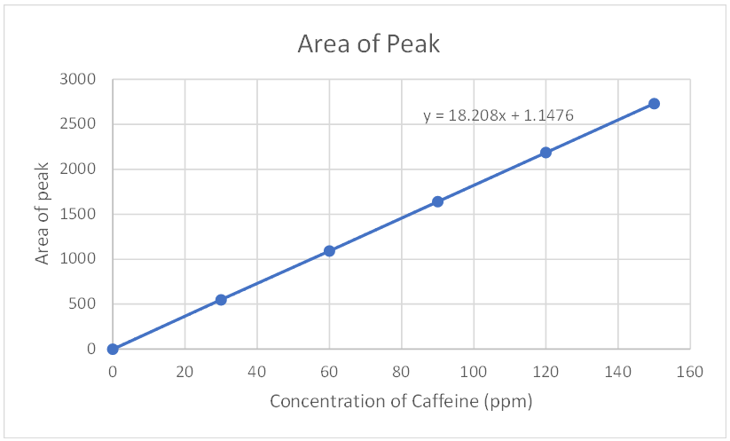
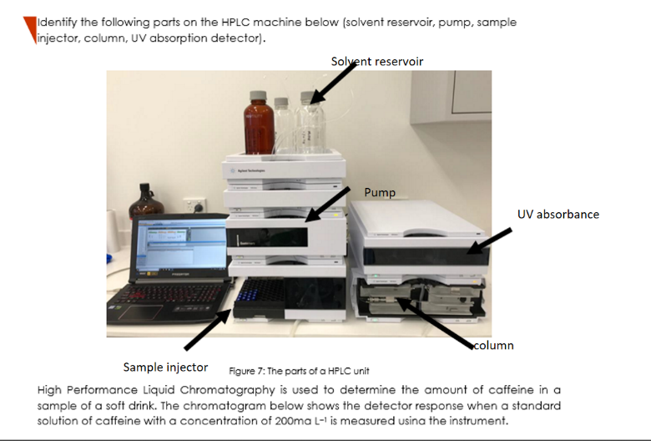
Are Aldi decaffeinated coffee pods completely caffeine free?!
Stu Dent
Introduction
NEWS FLASH:
Your decaffeinated coffee might not be completely caffeine free!!
(woahhhh!)
Read on for more…
According to the National Coffee Association (NCA), "Decaffeination removes about 97% or more of the caffeine in coffee beans. A typical cup of decaf coffee has about 2 mg of caffeine, compared to a typical cup of regular coffee, which has about 95 mg of caffeine".
My aim is to find whether Aldi decaffeinated coffee is completely caffeine free. My hypothesis is that there is a little bit of caffeine content found within the decaffeinated coffee pod, thus it is not completely caffeine free.
Methodology
Results
HPLC analysis:
Make standard solutions (150 ppm)
Measure standards in HPLC & create calibration curve
Prepare samples
Dilute samples to fit in the calibration curve
Measure samples in HPLC
Use calibration curve to interpolate caffeine concentration
Take into account dilution to find caffeine content of original sample
Discussion
I compared the caffeine content in Aldi coffee pods with four other caffeinated samples . I found that the decaffeinated sample had significantly less caffeine content than the other samples, which is to be expected given that it is 'decaffeinated’. These results support my hypothesis that there is in fact some caffeine content in decaffeinated coffee pods (10.65 mg in a 43 mL serve). There weren't any unexpected results in this experiment, given that the caffeine levels were significantly lower in decaffeinated coffee. However the experiment supported my hypothesis that decaffeinated coffee is not completely caffeine free. There were no errors with the method, as the HPLC analysis flowed smoothly and the results were collected efficiently and accurately.
Miss
Conclusion
The results indicate that my hypothesis is supported, given that there is in fact some caffeine content in decaffeinated coffee pods (10.65mg in a 43 mL serve, according to sample A from source 2). Therefore, decaffeinated coffee pods from Aldi are not completely caffeine free, and there is some caffeine content in decaffeinated coffee pods from Aldi, despite there being significantly less caffeine content than regular coffee pods.
HPLC machine used in caffeine experiment2: Calibration curve displaying HPLC results for caffeine standard solutions
References
Mr Tex Sapor, from Brandnew School, for assisting with the analysis
Ms T. Cha, for encouraging me to always check my calculations

Slide 40
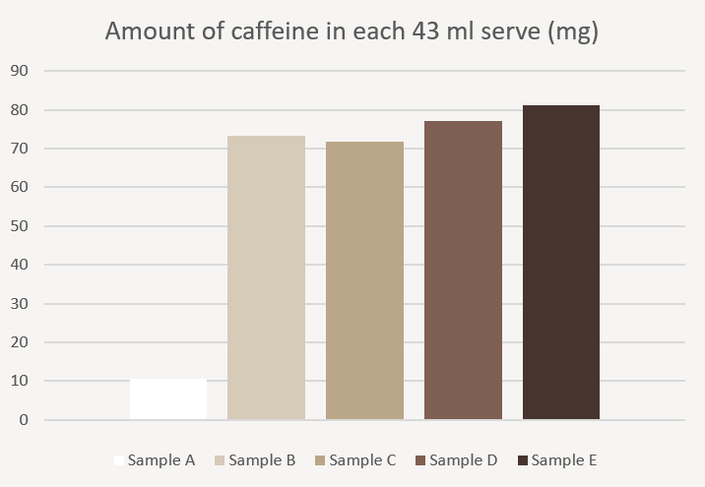
Is decaffeinated coffee truly caffeine-free?
Aim: to investigate whether "decaffeinated coffee" truly contains no caffeine, and if not, to what extent/proportion it is present compared to the other strength levels.
Hypothesis: If strength number determines caffeine content, then the decaf coffee will contain a small amount of caffeine, because extracting 100% of the caffeine from coffee beans is difficult and unrealistic.
Results:
The results derived show that decaf coffee does contain a very small amount of caffeine, however in comparison to the other samples, it is negligible.
Table 1 Composition of standard solutions
Your cup
of decaf might
be “caf”ed after all!
Caffeine stock (µL) | 0 | 200 | 400 | 600 | 800 | 1000
DI water (µL) | 1000 | 800 | 600 | 400 | 200 | 0
Caffeine (ppm) | 0 | 30 | 60 | 90 | 120 | 150
Table 2 HPLC results
Caffeine (ppm) | Retention time of peak (min) | Area of peak
0 | 0 | 0
30 | 2.686 | 550.092
60 | 2.693 | 1091.640
90 | 2.695 | 1639.954
120 | 2.698 | 2187.144
150 | 2.700 | 2731.944
But does that really matter? While decaf contains a small amount of caffeine, it’s not enough to affect you.
Table 3 Caffeine content data
Sample | Retention Time of Peak | Area of Peak | Concentration (ppm) diluted | Concentration (ppm) original | Amount of caffeine per serve (mg)
A | 2.714 | 226.592 | 12.381 | 247.62 | 10.65
B | 2.712 | 1554.962 | 85.333 | 1706.66 | 73.39
C | 2.712 | 1522.344 | 83.541 | 1670.82 | 71.85
D | 2.705 | 1634.897 | 89.723 | 1794.46 | 77.16
E | 2.704 | 1722.048 | 94.509 | 1890.18 | 81.28

Slide 41
VCE resources
Support materials on the VCAA study pages for VCE Chemistry
Administrative information for School-based Assessment
VCAA Bulletin and Notices to schools
School calendar and assessment policy
Statistical moderation reports
School-based assessment audit reports
School-based assessment coursework reports
Examination reports
The school teaching and learning program
Subscribe to VCAA notifications:

Slide 42
Contact
Maria James
Curriculum Manager, Science
 03 9059 5148
 Maria.James2@education.vic.gov.au

