Slide 1
VCE History 2022–2026
Examination Specifications and Sample Examinations 2022–2026

Slide 2
Examination specifications and sample examinations
These are published on the VCAA examinations pages.
Take the time to review, reflect and familiarise yourself and your students with the structure and types of question items.
If you have questions, please email me.

Slide 3
Key messages
Students will:
find the examination paper more accessible
find the examination paper easier to navigate
be able to use reading time to focus on comprehension of the sources that they will use
be able to show what they know from across both areas of study
have access to lower-order source comprehension questions
have a choice between two essays.

Slide 4
Sample examination
Important
The purpose of the sample examination is to illustrate:
the structure of the paper
the types of question items
the range of possible question items
the number of sources that may appear on a paper in a particular year
the source types and source forms on a paper in a particular year
the number of sources and questions that may vary from year to year
what may vary in different years.

Slide 5
What is staying the same?
Internal assessment will contribute to 50% of study score
External examination will contribute to 50% of study score
15 minutes reading time and 2 hours writing time
Examination will include source-based tasks (short answers questions and extended responses)
Examination will include an essay

Slide 6
What is changing?
The examination will:
be reduced from 80 marks to 70 marks
have a common structure across the three History exam papers
address student workload (length of sources, number of questions and options)
allow students to draw on knowledge across both areas of study
provide choice, where appropriate
focus on source use and extended pieces of writing
provide a range of cognitive demands (lower, medium and higher order) in source-based question items.

Slide 7
Examination paper structure
Section A – 50 marks
Section B – 20 marks
Source-based task for each context
Context 1 (Unit 3) 25 marks
Context 2 (Unit 4) 25 marks
Students answer questions on both contexts studied: one for Unit 3 and one for Unit 4
Essay
One essay question for each context studied in Units 3 and 4
Students write one essay on one context (Units 3 and 4)
Students have a choice between two essays for each context
Covers outcome 1 and/or 2

Slide 8
Section A – Historical Sources Questions
Number of sources in Section A
There will be 3 or 4 sources
Source selection will include:
a range of source types – primary sources (perspectives) and secondary sources (historical interpretation)
a range of source forms – texts and visual
sources that may span both areas of study
at least one of each of the following: a primary source (perspective), a secondary source (interpretation), and a primary or secondary visual source
Accumulative word length of sources within a context will be reasonable, within a range and will be consistent across contexts

Slide 9
Question item design
Question items will be aligned explicitly to the VCE History Study Design 2022–2026:
Key knowledge
Key skills
Note: Each of the key skills is informed by the characteristics of the study.

Slide 10
Section A – Historical Sources Questions
Number of questions in Section A
Question items focus on the study design’s key knowledge and key skills (Historical thinking concepts)
Questions will be ordered chronologically, not in mark value
Total 4 or 5 sub-part questions, with a total of 25 marks:
Lower order (3–5 marks total): 1 or 2 questions (list, identify, describe, outline)
Mid-range order (10–12 marks total): 2 or 3 questions (explain, compare, analyse,* evaluate*)
Higher order (8–10 marks total): 1 question (analyse, evaluate)
*This will be constrained/limited e.g. ‘Using sources 3 and 4 evaluate one cause … (5 marks)’

Slide 11
Examination paper structure
Section A – 50 marks
Section B – 20 marks
Source- based task for each context
Context 1 (Unit 3) 25 marks
Context 2 (Unit 4) 25 marks
Students answer questions on both contexts studied: one for Unit 3 and one for Unit 4
Essay
One essay question for each context studied in Units 3 and 4
Students write one essay on one context (Units 3 and 4)
Students have a choice between two essays for each context
Covers outcome 1 and/or 2

Slide 12
Section B – Essay
It is important to remember:
students may use knowledge and evidence from both areas of study when it is appropriate and relevant to responding to the question.

Slide 13
Essay Choice
Let the students decide

Slide 14
Essay criteria
The essay in Section B will be assessed against the following criteria:
construction of a coherent and relevant historical argument that addresses the specific demands of the essay question
demonstration of historical knowledge that is accurate and appropriate for the essay question
application of historical thinking concepts such as cause and consequence, continuity and change, and/or historical significance
use of sources as evidence to support a historical argument, including a range of primary sources, perspectives and historical interpretations.

Slide 15
Anna is studying Ancient History
Section A – Sources
(AOS1 and AOS2)
Section B – Essay
(AOS1 and/or AOS2)
Q1 Egypt (25 marks)
Q3 Rome (25 marks)
Q1 Egypt essay
OR
Q3 Rome essay
(20 marks)

Slide 16
Summary of changes

Slide 17
Examination weighting
50% of study score
For Section A – Sources tasks, marks will be somewhat balanced between Area of Study 1 and Area of Study 2 within a context – for example, AOS1 may be 13 marks and AOS2 12 marks. The difference would not be greater than 3 marks
Weighting between Unit 3 and Unit 4 will be dependent on student essay choice in Section B

Slide 18
Examination weighting
Section B essay will be weighted to one context, dependent on student choice
Section B essay may focus on one area of study* or be balanced between both areas of study
*Student will still be able to use relevant knowledge and evidence from both areas of study to respond to the question

Slide 19
Sample examination
Important
The purpose of the sample examination is to illustrate:
the structure of the paper
the types of question items
the range of possible question items
the number of sources that may appear on a paper in a particular year
the source types and source forms on a paper in a particular year
the number of sources and questions that may vary from year to year
what may vary in different years.

Slide 20
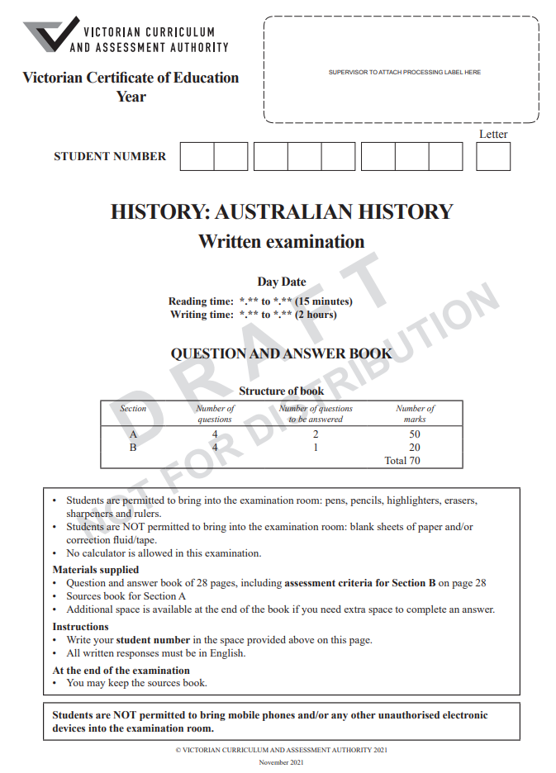
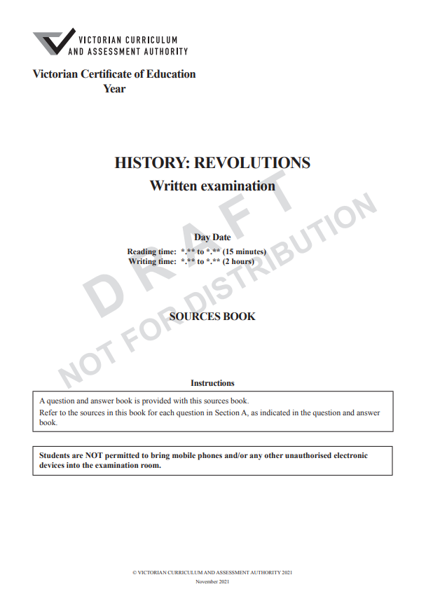
Examination Question and Answer book
Examination Source book

Slide 21
2022–2026 end-of-year Examination Paper
The end-of-year examination papers in a particular year will have:
Section A
the same number of sources for each context
the same number of question items in and across each context
Section B
consistent essay questions for each context.
The number of sources and the number of questions will vary in different years.

Slide 22
Sample examination
Familiarise yourself with all three sample examination papers: Ancient History, Australian History and Revolutions.
They provide a good representative sample of:
the types of question items and their design
the range of cognitive demands
source types and source forms.

Slide 23
Take the time to look at the sample examinations.

Slide 24
Gerry Martin
Curriculum Manager, History and Civics
T (03) 9032 1694
M 0428 039 083
E Gerard.Martin@education.vic.gov.au

