Slide 1
How to develop a modelling or problem-solving task
Mathematical Methods Unit 4
Functions, algebra and calculus

Slide 2
Copyright
The copyright in this PowerPoint presentation is owned by the Victorian Curriculum and Assessment Authority or in the case of some materials, by third parties.
No part may be reproduced by any process except in accordance with the provisions of the Copyright Act 1968 or with permission from the Copyright Officer at the Victorian Curriculum and Assessment Authority.

Slide 3
Introduction
This PowerPoint presentation and accompanying set of videos outline a process for developing a modelling or problem-solving task, and illustrate how this can be done using a sample task.
It also includes information on the purpose, nature and structure of a modelling or problem-solving task and indicates how a related assessment scheme could be devised.

Slide 4
Purpose of a modelling or problem-solving task
The purpose of this modelling or problem-solving task is for students to model a situation or solve a problem or set of related problems in some depth with respect to a particular context that involves the Functions and graphs, Algebra and Calculus areas of study and related concepts, skills and processes.
This will involve content covering a selection of:
Combined functions and their graphs, solving equations and systems of equations, differentiation, anti-differentiation and integration
Applied to theoretical/modelling or problem-solving in real life contexts, for example situations or scenarios involving:
stationary points, maxima and minima
distance and area
graphical models for a real-life scenario

Slide 5
Modelling and problem-solving
Mathematical modelling is a process of using mathematical constructs, structures and techniques to represent and describe a real-world context or system, in a simple and concise way that enables one to investigate features and characteristics of its behavior; analyse particular aspects or solve problems of interest; and to make predictions related to the context or system.
In mathematics problems are generated from issues, questions, conjectures and hypotheses arising from a range of contexts. New problems may arise in their own right, or as a variation, re-formulation, extension or generalisation of a known problem or class of problems.

Slide 6
A framework for modelling and problem-solving
Modelling and problem-solving are complementary processes, the following framework is from the International Mathematical Modeling Challenge (IM²C): https://www.immchallenge.org.au/supporting-resources/mathematical-modelling-framework .
Describe the real-world problem. Identify and understand the practical aspects of the situation.
Specify the mathematical problem. Frame the real-world scenario as an appropriate, related mathematical question(s).
Formulate the mathematical model. Make simplifying assumptions, choose variables, estimate magnitudes of inputs, justify decisions made.
Solve the mathematics.
Interpret the solution. Consider mathematical results in terms of their real-world meanings.
Evaluate the model. Make a judgment as to the adequacy of the solution to the original question(s). Modify the model as necessary and repeat the cycle until an adequate solution has been found.
Report the solution. Communicate clearly and fully your suggestions to address the real-world problem.

Slide 7
Nature of the modelling or problem-solving process
The following is a simple scheme for the modelling or problem-solving process:
A modelling or problem-solving task is to be of 2–3 hours duration over a continuous period of 1 week.

Slide 8
Structure of a modelling or problem-solving task
A task can be developed with several parts that draw on the framework and scheme:
Introduction of the context, scenario, situation or problem and familiarisation through simple examples.
Further development of a model or problem by generalisation, increased complexity or consideration of variation or special cases. Use of a model for analysis or problem solving strategies for finding solutions.
Evaluation of a model with discussion of limitations, refinement of a problem solving approach and interpretation of solutions in context.

Slide 9
Developing a task
There are four key aspects to developing a modelling or problem-solving task:
In this case a three part theoretical sample task will be developed.
1 | Choosing the context
2 | Identifying questions of interest
3 | Relating these questions and relevant concepts, skills and processes to the parts of the task
4 | Devising the assessment scheme

Slide 10
Video 1: Choosing the context and identifying questions of interest
Describe the context
Explain how the context was chosen (stimulus/background)
Identify questions of interest
Identify relevant information and source(s)
Give the task a title

Slide 11
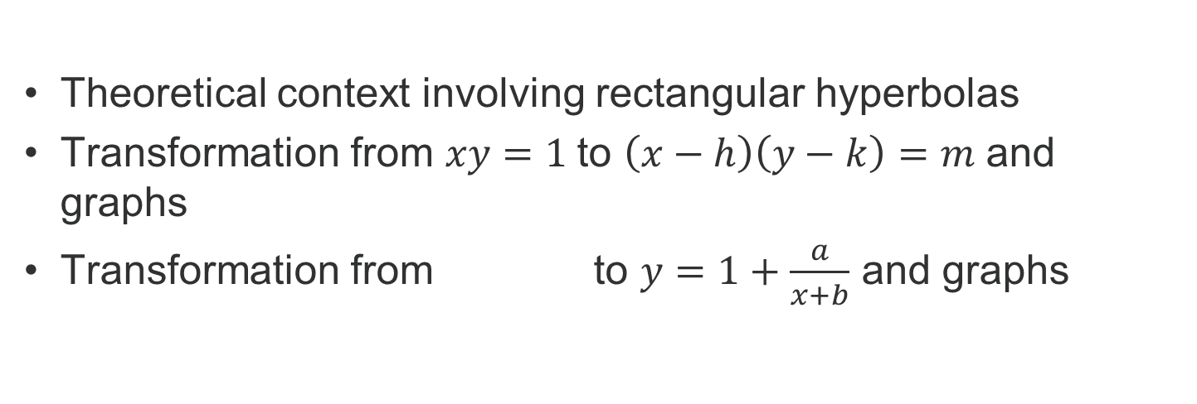
Video 1: Choosing the context and identifying questions of interest
Theoretical context involving rectangular hyperbolas
Transformation from $xy=1$to $\left(x−h\right)\left(y−k\right)=m$ and graphs
Transformation from to $y=1+\frac{a}{x+b}$ and graphs

Slide 12
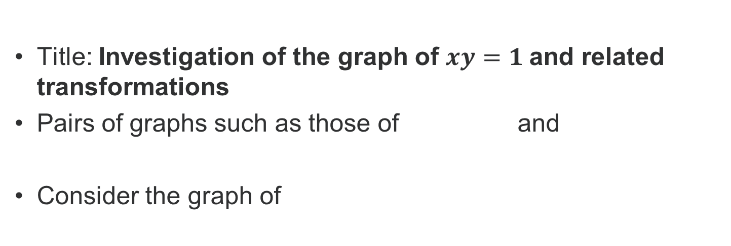
Video 1: Choosing the context and identifying questions of interest
Title: Investigation of the graph of $xy=1$and related transformations
Pairs of graphs such as those of and
Consider the graph of

Slide 13
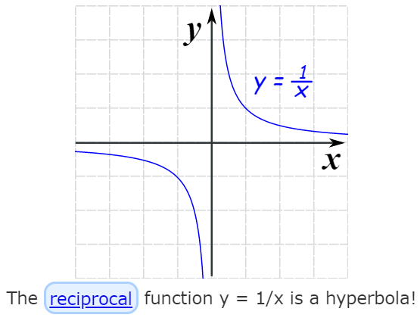
Video 1: Choosing the context and identifying questions of interest
Find the Equation of a Hyperbola Graph - VividMath.com
https://www.youtube.com/watch?v=Mx9-3WqFV6c
https://www.mathsisfun.com/geometry/hyperbola.html

Slide 14
Video 1: Identifying questions of interest
Questions of interest: stationary points, parameters, varying values, discontinuities, axis intercepts, asymptotes
For the hyperbola of the form for some constant m, where is the ‘centre’ ?
Where are the asymptotes? This hyperbola is seen in some sundials.

Slide 15
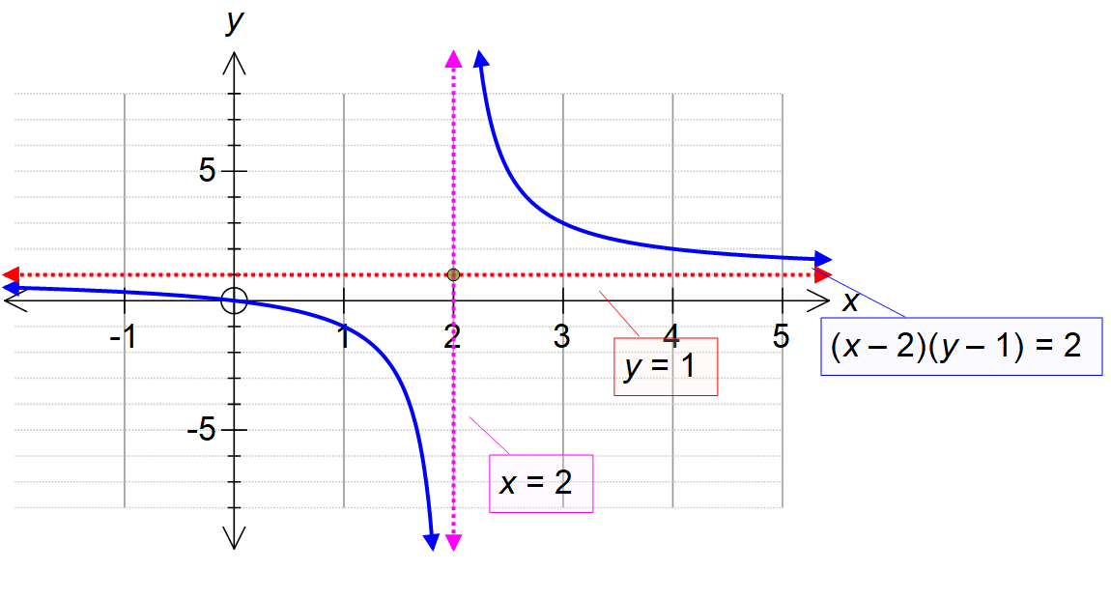
Video 1: Identifying questions of interest

Slide 16
Video 2: Task Part 1
State questions of interest and related analysis
What happens when the hyperbola is translated/reflected/dilated?
What happens to the rule of the function?
Does the graph have stationary points or points of inflection?
What is the behaviour of tangents and perpendicular lines to the graph?
What is the area under the graph over different intervals?
What is the maximum or minimum distance from a point to the graph?

Slide 17
Video 2: Task Part 1
Identify relevant content
Transformations and mapping
Varying parameters
Any stationary points or points of inflection
Tangents and perpendicular lines
Area under the graph over an interval
Distance from a point to the graph
Any maxima or minima

Slide 18
Video 2: Task Part 1
The rectangular hyperbola of the form or has two asymptotes and which are perpendicular to each other
It has two symmetric branches reflected over the line
It has no stationary points or points of inflection

Slide 19
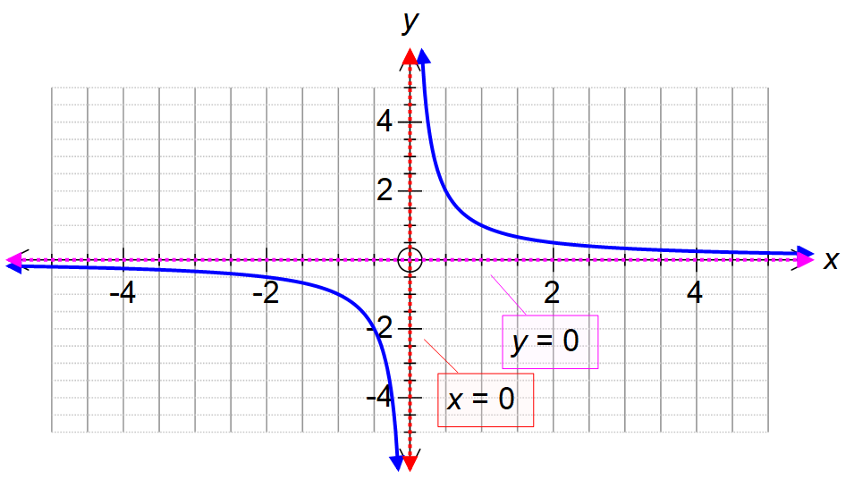
Video 2: Task Part 1

Slide 20
Video 2: Task Part 1
Written version of Part 1
Consider and re-express in the form
Draw its graph stating the domain and range and identifying any key features.
b. Similarly analyse the graph of

Slide 21
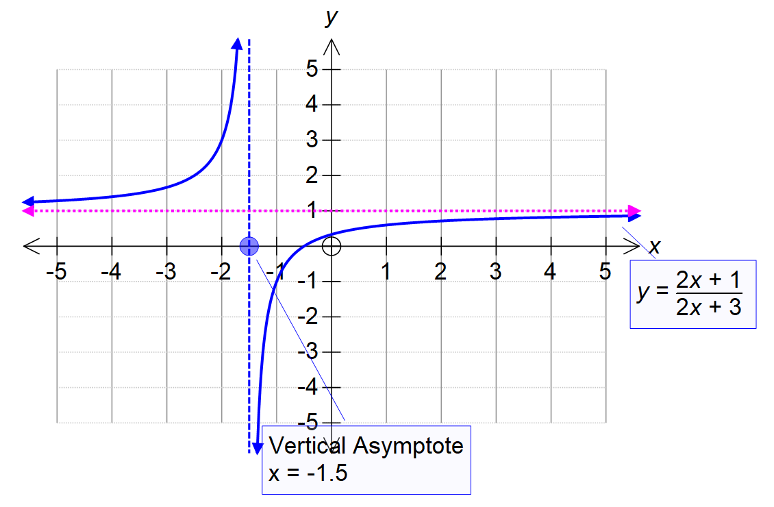
Video 2: Task Part 1
Written version of Part 1

Slide 22
Video 2: Task Part 1
c. Compare and contrast the graphs of and
d. Similarly consider and explore the three cases where

Slide 23
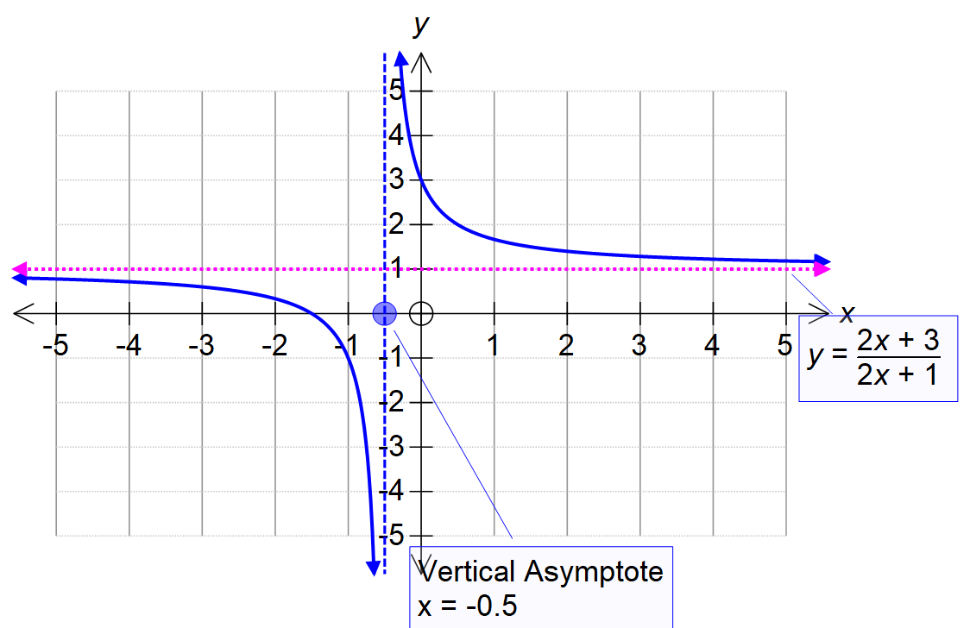
Video 2: Task Part 1

Slide 24
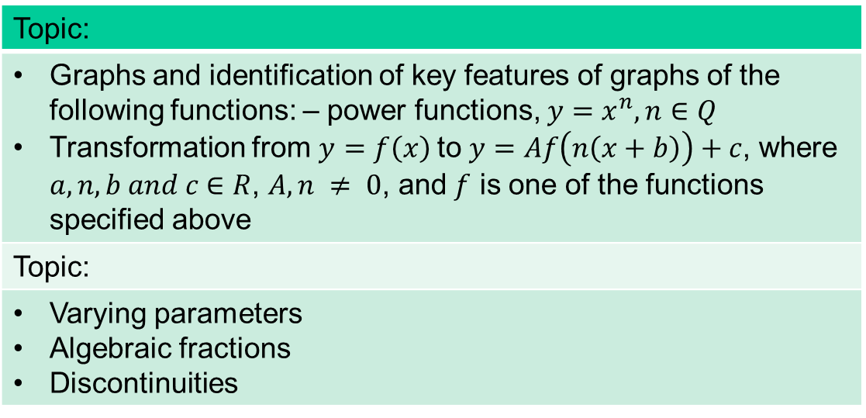
Video 2: Task Part 1 – indicative content
Map indicative content by topic and dot point
Topic:
Graphs and identification of key features of graphs of the following functions: – power functions, $y=x^{n},n∈Q$ Transformation from $y=f\left(x\right)$to $y=Af\left(n\left(x+b\right)\right)+c$, where $a,n,b and c$∈ $R$, $A, n ≠ 0$, and $f$ is one of the functions specified above
Topic:
Varying parameters Algebraic fractions Discontinuities

Slide 25
Video 3: Task Part 2
Identify questions of interest
State related analysis
Identify relevant content
Show written version of Part 2

Slide 26
Video 3: Task Part 2
Identifying questions of interest
Questions of interest: varying parameter values, areas of discontinuity
Investigation of graphs of the form
For the hyperbola of the form for some constant m, the ‘centre’ of the hyperbola is at the point where are positive reals

Slide 27
Video 3: Task Part 2
Identify relevant content
Composite functions
Stationary points and points of inflection
Tangents and perpendicular lines
Area under the graph
Distance from a point to the graph
Maxima or minima

Slide 28
Video 3: Task Part 2
Written version of Part 2
Change the coefficient of x, what happens?
Graph stating the domain and range and identifying any key features
b. Similarly analyse the graph of

Slide 29
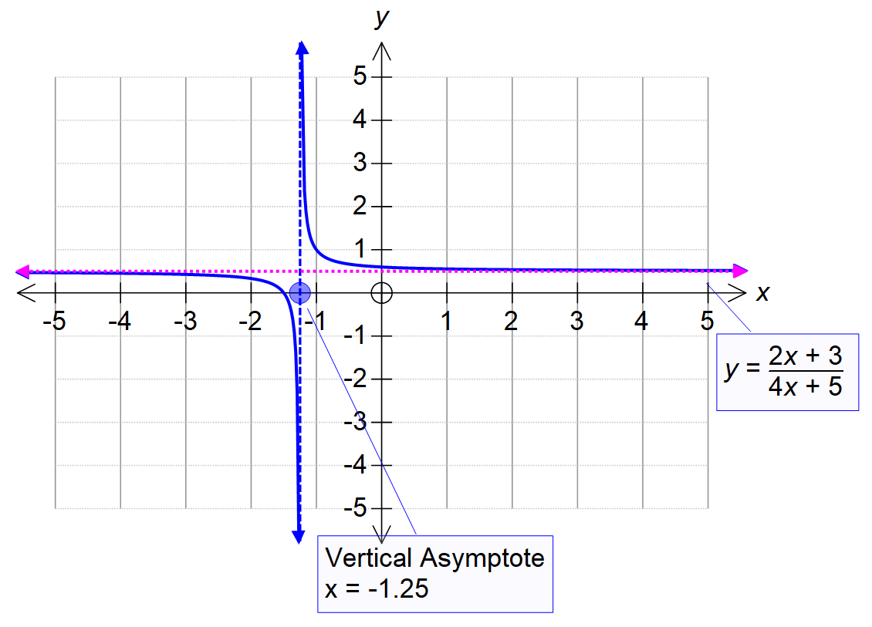
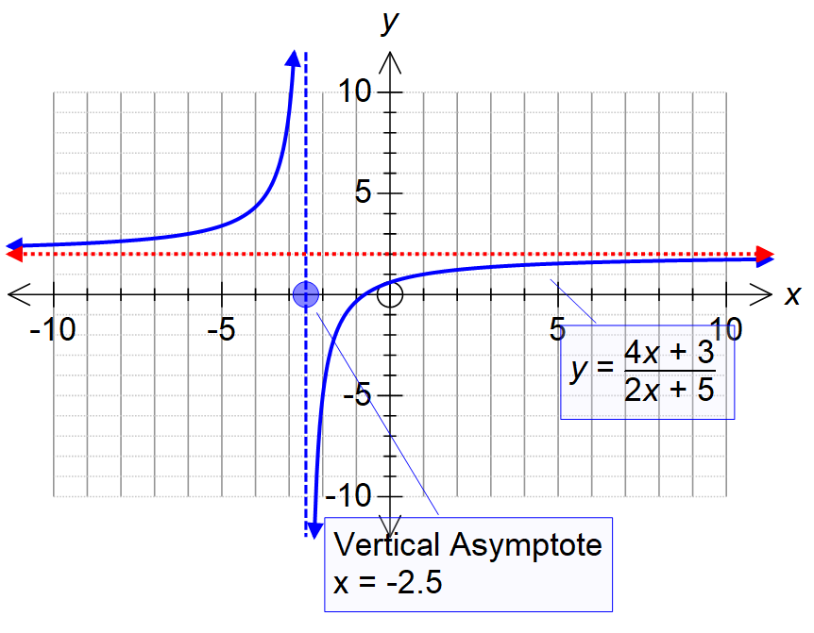
Video 3: Task Part 2

Slide 30
Video 3: Task Part 2
c. Similarly consider
Explore the three cases of

Slide 31

Video 3: Task Part 2 composite functions possible extension
d. Let where D is the maximal domain of $f$such that the
composite function exists.
Analyse the graph of the composite function.

Slide 32
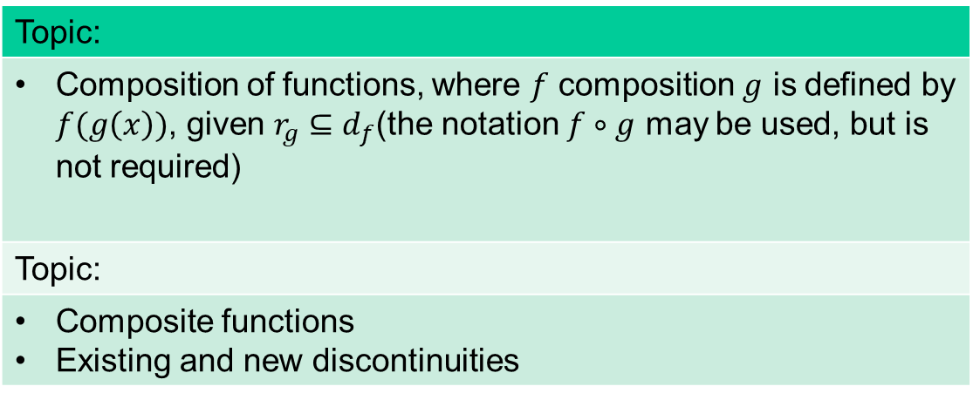
Video 3: Task Part 2 – indicative content
Topic:
Composition of functions, where $f$ composition $g$ is defined by $f(g\left(x\right))$, given $r_{g}⊆d_{f}$(the notation $f∘g$ may be used, but is not required)
Topic:
Composite functions Existing and new discontinuities

Slide 33
Video 4: Task Part 3
State questions of interest and related analysis
Identify relevant content
Show written version of Part 3
In mathematics problems are generated from issues, questions, conjectures and hypotheses arising from a range of contexts. New problems may arise in their own right, or as a variation, re-formulation, extension or generalisation of a known problem or class of problems.

Slide 34
Video 4: Task Part 3
Identifying questions of interest
Questions of interest: distance to a point, area between the hyperbola and the horizontal axis over a given interval, max/min contexts
Investigation of graphs of the form
For the hyperbola of the form for some constant m, where the ‘centre’ of the hyperbola is at the point where are positive reals

Slide 35
Video 4: Task Part 3
Identify relevant content
Distance from a point to the graph
Distance between points on opposite branches of the graph
Maxima and minima for distance problems

Slide 36
Video 4: Task Part 3
Consider
a. Find in terms of the variables, the distance from the origin to some point on the graph
b. Hence find the maximum and minimum distance from the origin to some point on the graph

Slide 37
Video 4: Task Part 3
Consider
c. Find in terms of the variables, the distance from the vertex of one branch to some point on the symmetric branch
d. Hence find the maximum and minimum distance from the vertex of one branch to some point on the symmetric branch
e. Explore which of maximum and minimum distances exist

Slide 38
Video 4: Task Part 3 – indicative content
Topic:
Application of differentiation to graph sketching and identification of key features of graphs…identification of local maximum/minimum values over an interval and application to solving problems, and identification of interval endpoint maximum and minimum values
Topic:
Maximum and minimum distance from the origin. Maximum and minimum distance between symmetric branches

Slide 39
Video 5: Assessment
Use the following table to map mark weightings for the parts of the task with respect to the outcomes.
Marking schemes, criteria, rubrics or descriptors can be used to assess student work.
 | Outcome 1 | Outcome 2 | Outcome 3
Marks | 8 | 10 | 7
Part 1 | 3 | 2 | 2
Part 2 | 3 | 3 | 2
Part 3 | 2 | 5 | 3

Slide 40
Outcome 1: aspects of the task related to criteria
Criterion 1: 0 – 3 marks
Appropriate use of mathematical conventions, symbols and terminology
Application of mathematical conventions in graphs …
Criterion 2: 0 – 3 marks
Definition and explanation of key concepts
Construction of mathematical expressions involving concepts such as asymptotes, symmetry, derivatives, maxima and minima …
Criterion 3: 0 – 2 marks
Accurate use of mathematical skills and techniques
Use of mathematical routines and procedures involving algebra, functions, calculus to obtain results. …

Slide 41
Outcome 2: aspects of the task related to criteria
Criterion 1: 0 – 2 marks
Identification of important information, variables and constraints
Choice of suitable variables and constants for the development of mathematics related to various aspects of a given context. …
Criterion 2: 0 – 3 marks
Application of mathematical ideas and content from the specified areas of study
Use of specific and general formulations of concepts and mathematical content …
Criterion 3: 0 – 5 marks
Analysis and interpretation of results
Generation of inferences from analysis to draw conclusions related to the context for investigation …

Slide 42
Outcome 3: aspects of the task related to criteria
Criterion 1: 0 – 2 marks
Appropriate selection and effective use of technology
Relevant and appropriate selection and use of technology, or a function of the selected technology for the mathematical context being considered ……….
Criterion 3: 0 – 5 marks
Application of technology
Use and interpretation of the relation between graphical and symbolic forms of information produced by technology about functions and equations and the corresponding features of those functions or equations ………

Slide 43
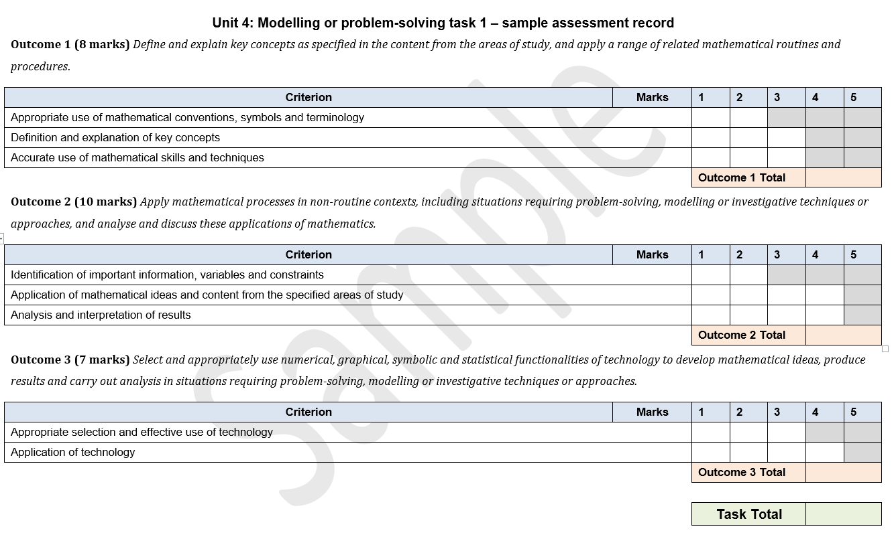
Sample assessment record

Slide 44
Resources
A set of sample tasks is provided in the Advice for teachers section of the study website.
The task constructed in this video has been included in this set of sample tasks.

