Slide 1
How to develop an application task
Specialist Mathematics
Unit 3

Slide 2
Copyright
The copyright in this PowerPoint presentation is owned by the Victorian Curriculum and Assessment Authority or in the case of some materials, by third parties.
No part may be reproduced by any process except in accordance with the provisions of the Copyright Act 1968 or with permission from the Copyright Officer at the Victorian Curriculum and Assessment Authority.

Slide 3
Introduction
This PowerPoint presentation and the accompanying set of videos outline a process for developing an application task, and illustrate how this can be done by creating a sample task.
It also includes information on the purpose, nature and structure of an application task and indicates how a related assessment scheme could be devised.

Slide 4
Purpose of the application task
The purpose of the application task is for students to conduct a mathematical investigation with respect to questions of interest for a given context.
For Specialist Mathematics this will be an investigation of a practical or theoretical context involving content from two or more areas of study.
Students apply the process of using mathematical constructs, structures, concepts, processes and skills to represent and explore aspects of a situation or context in a way that enables one to investigate characteristics, features and behaviour of systems and objects related to the context.

Slide 5
Nature of the application task
A mathematical investigation of a practical or theoretical context involving content from two or more areas of study.
The application task is to be of 4–6 hours duration over a continuous period of 1–2 weeks.

Slide 6
Structure of the application task
The application task has three components of increasing complexity:
1 | Introduction of the context through specific cases or examples
2 | Consideration of general features of the context
3 | Variation or further specification of assumptions or conditions involved in the context to focus on a particular feature or aspect related to the context

Slide 7
Developing a task
There are four key aspects to developing an application task:
1 | Choosing the context
2 | Identifying questions of interest
3 | Relating these questions and relevant concepts, skills and processes to the three components of the task
4 | Devising an assessment scheme

Slide 8
Video 1: Choosing the context and identifying questions of interest
Describe the context
Explain how the context was chosen (stimulus/background)
Identify questions of interest
Identify relevant, assumptions, variables, functions, relations, parameters, constraints, conditions and source(s) of information as applicable
Give the task a title

Slide 9
Starting points
VCAA Bulletin Supplement 2 No. 184 December 2002
VCAA Bulletin Supplement 1 No. 9 December 2003
VCAA Bulletin Supplement 2 No. 21 December 2004
Specialist Maths SAC Resource

Slide 10
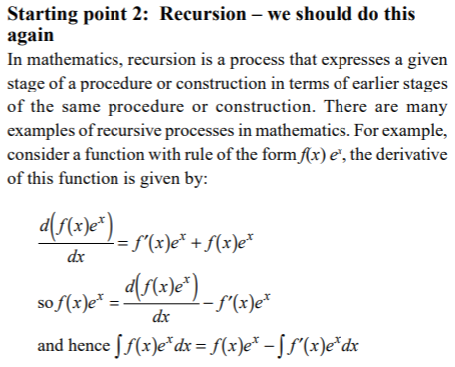
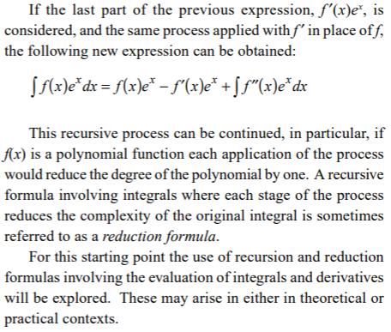
Extract from previous VCAA Bulletin

Slide 11
Reduction formulas for integration
Introduction
A context such as the following can be used to investigate the use of recursion to develop reduction formulas for integration. Recursion is a process that expresses a given stage of a procedure or construction in terms of earlier stages of the same procedure or construction. There are many examples of recursive processes in mathematics.
In calculus, a reduction formula for integration can be used to successively reduce the complexity of an integral involving a natural number parameter.

Slide 12
This investigation will involve differentiation, and integration of combined functions, the development of recursive formulas and the graphing of functions, their derivative and anti-derivative functions, and the identification and analysis of key features and relations between these functions and their graphs.
Where parameters are involved in the specification of the rule of a family of functions, formulas, relations key features of graphs should be determined with respect to these parameters and different types of graphs classified.

Slide 13
Video 2: Component 1
Identify context, assumptions, variables, functions, relations, parameters, constraints and conditions
State questions of interest and related analysis
Identify relevant content
State analysis required for this component and specify parts of the task for this component

Slide 14
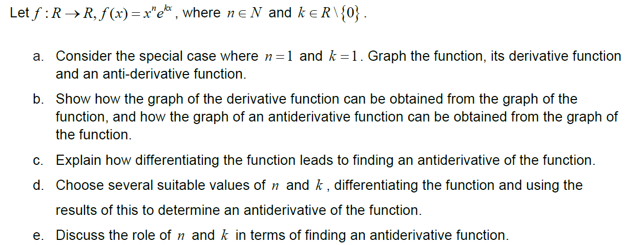
Component 1

Slide 15
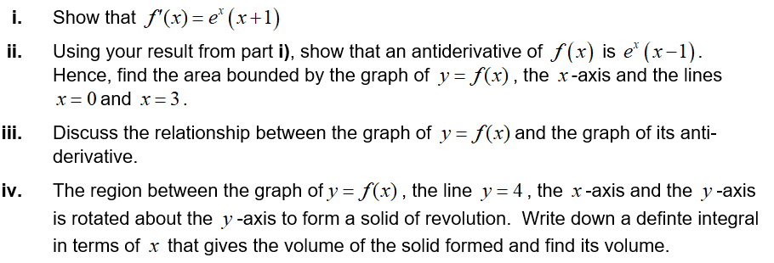
Some possible scaffolding questions

Slide 16
Component 1 – indicative content
Map indicative content by topic and dot point, some examples:
Topic: Graphs of rational functions
sketch graphs and describe behaviour of specified functions and relations with/without the assistance of technology clearly identifying their key features
Topic: Calculus
Techniques of finding derivatives of explicit functions Techniques of finding anti-derivatives of functions Relationship between the graph of a function and the graphs of its anti-derivative functions

Slide 17
Video 3: Component 2
Identify context, assumptions, variables, functions, relations, parameters, constraints and conditions
State questions of interest and related analysis
Identify relevant content
State analysis required for this component and specify parts of the task for this component

Slide 18
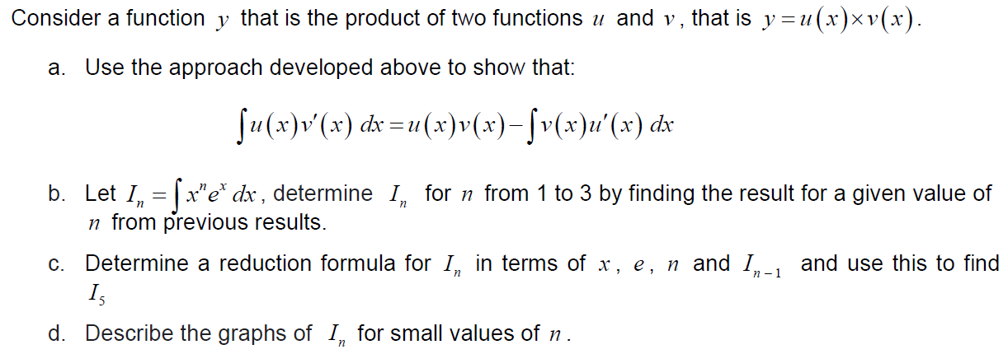
Component 2

Slide 19
Some possible other questions

Slide 20
Component 2 – indicative content
Map indicative content by topic and dot point, some examples:
Topic: Anti-differentiation and integration
give mathematical formulations of specific and general cases used to derive results for analysis within a given application context give mathematical formulations of specific and general cases used to derive results for analysis within a given application context …

Slide 21
Video 4: Component 3
Identify context, assumptions, variables, functions, relations, parameters, constraints and conditions
State questions of interest and related analysis
Identify relevant content
State analysis required for this component and specify parts of the task for this component

Slide 22
Component 3

Slide 23
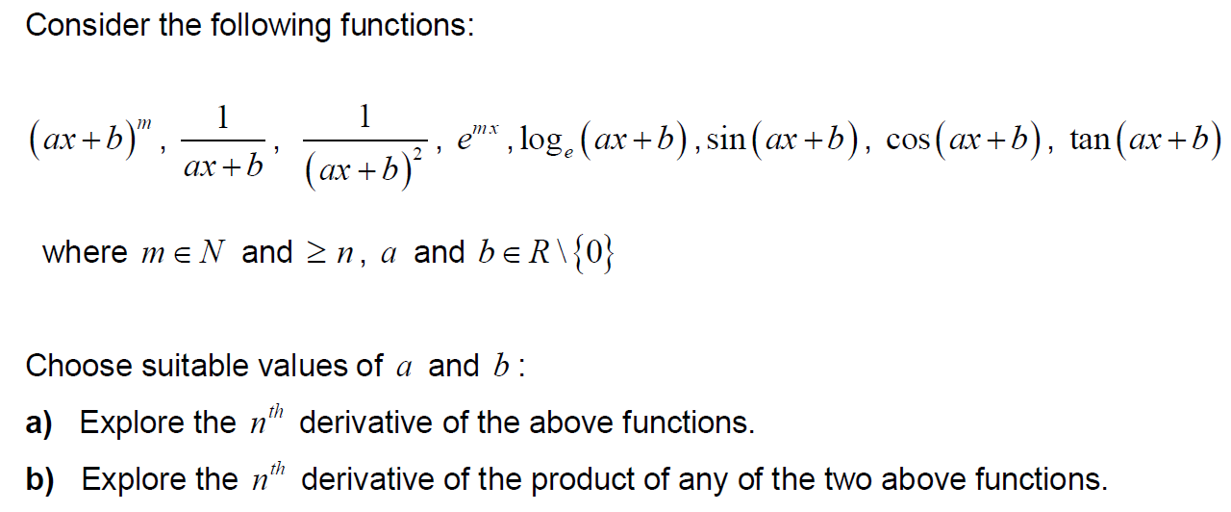
Or exploring Successive Differentiation

Slide 24
Component 3 – indicative content
Map indicative content by topic and dot point, some examples:
Topic: Graphs of rational functions
produce symbolic expressions and families of graphs using technology, which support general analysis in investigative contexts • use appropriate domain and range specifications to illustrate key features of graphs of functions and relations …
Topic: Anti-differentiation and integration
apply suitable constraints and conditions, as applicable, to carry out required computations …

Slide 25
Video 5: Assessment
Use the following table to map mark weightings for the components of the task with respect to the outcomes.
Marking schemes, criteria, rubrics or descriptors can be used to assess student work.
Further details of the Performance Criteria for the Application task is provided on VCAA website.
 | Outcome 1 | Outcome 2 | Outcome 3
Marks | 15 | 20 | 15
Component 1 | 8 | 5 | 3
Component 2 | 4 | 9 | 5
Component 3 | 3 | 6 | 7

Slide 26
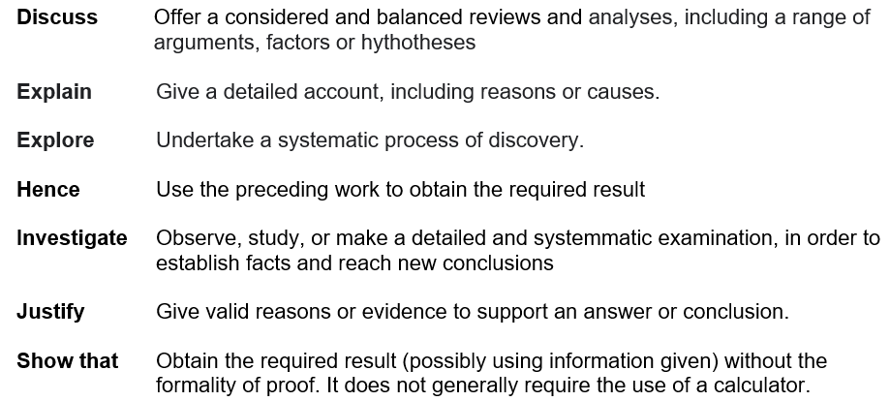
Some actions with descriptions

Slide 27
Some expectations
When graphs are drawn (sketched or plotted as applicable):
- the maximal domain and range identified
- key features such as axis intercepts, asymptotes, stationary points,
points of inflection and symmetry identified
Units should be clearly specified and consistently used, where appropriate
Correct use of mathematical conventions/notation

Slide 28
Outcome 1: aspects of the task related to criteria
Criterion 1: 0 – 3 marks
Appropriate use of mathematical conventions, symbols and terminology
Application of mathematical conventions in graphs …
Criterion 2: 0 – 6 marks
Definition and explanation of key concepts
Construction of mathematical expressions involving concepts such as derivatives, anti-derivatives and integrals …
Criterion 3: 0 – 6 marks
Accurate use of mathematical skills and techniques
Use of mathematical routines and procedures involving algebra, functions, calculus to obtain results. …

Slide 29
Outcome 2: aspects of the task related to criteria
Criterion 1: 0 – 4 marks
Appropriate use of mathematical conventions, symbols and terminology
Choice of suitable variables and constants for the development of mathematics related to various aspects of a given context. ….
Criterion 2: 0 – 8 marks
Definition and explanation of key concepts
Use of specific and general formulations of concepts and mathematical content ….
Criterion 3: 0 – 8 marks
Accurate use of mathematical skills and techniques
Generation of inferences from analysis to draw conclusions related to the context for investigation ….

Slide 30
Outcome 3: aspects of the task related to criteria
Criterion 1: 0 – 6 marks
Appropriate selection and effective use of technology
Relevant and appropriate selection and use of technology, or a function of the selected technology for the mathematical context being considered …
Criterion 2: 0 – 9 marks
Application of technology
Use and interpretation of the relation between graphical and symbolic forms of information produced by technology about functions and equations and the corresponding features of those functions or equations …

Slide 31
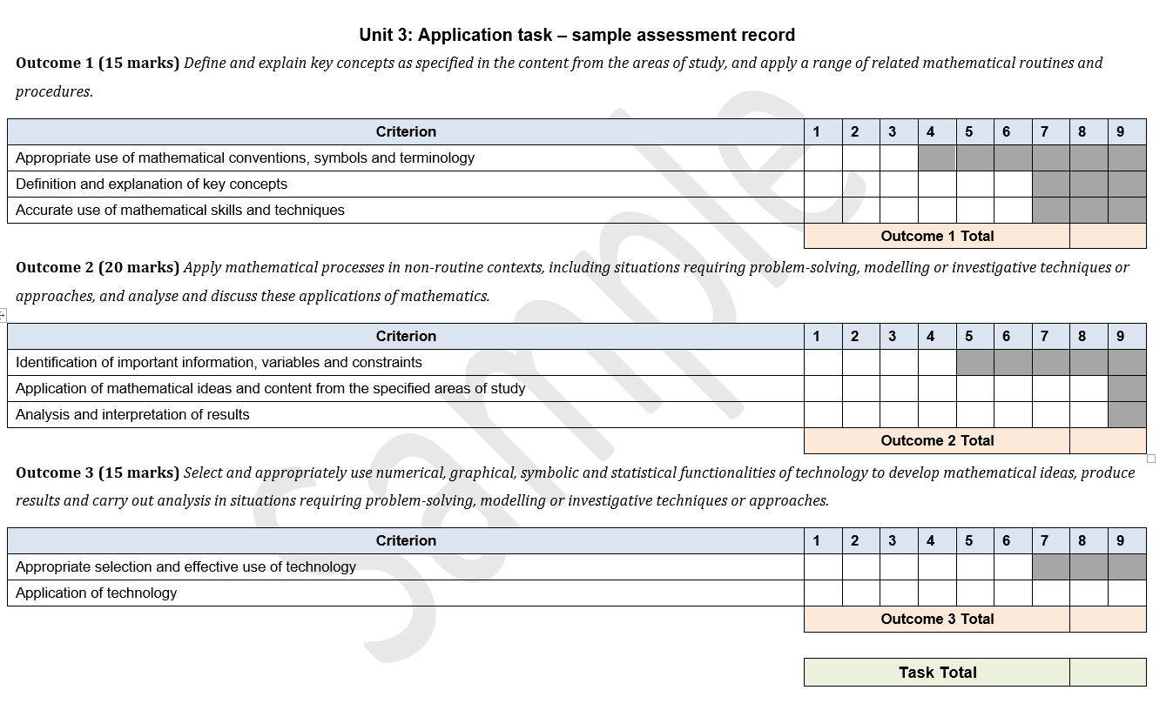
Sample assessment record

Slide 32
Resources
A set of sample applications tasks is provided in the Advice for teachers section of the study website.
The application task developed in this video has been included in the set of sample tasks.

