Slide 1
VCE Physics
Implementation of VCE Study Design
Units 1 and 2: 2023 – 2027
Units 3 and 4: 2024 – 2027
Introduction and overview of Units 1 to 4
2021

Slide 2
Purpose
Outline implementation support resources
Explain the key requirements and major changes of the revised study design
Consider VCE assessment principles in relation to assessment

Slide 3
VCE resources
VCE and VCAL Administrative Handbook
VCE Physics Study Design 2023-2027

Slide 4
New study design support materials: updated webpages https://www.vcaa.vic.edu.au/curriculum/vce/vce-study-designs/physics/Pages/Index.aspx
VCE Physics Study Design 2023-2027 (staged implementation)
VCE Physics support materials: planning advice; teaching and learning activities and plans; assessment advice
VCE examination specifications 2024-2027
VCE sample examination (available end of 2023)
Implementation videos: Introduction; Units 1&2; Units 3&4
Live Q&A sessions in 2022 for Units 1&2
Live Q&A sessions in 2023 for Units 3&4, with a special focus on assessment

Slide 5
Staged implementation
Units 1 & 2: 2023 – 2027
Units 3 & 4: 2024 – 2027

Slide 6
VCE Physics 2023-2027 Structure
Scope of study, Rationale, Aims
Cross-study specifications
4 Units
11 Areas of Study
Key Knowledge (and relevant Key Science Skills)
Terms used in this study
Assessment
1. Satisfactory completion- certification
2. Levels of achievement
Characteristics of this study

Slide 7
Overview of changes – key science skills
Eight scientific methodologies (p 13 of the study design)
‘Reliability’ replaced with ‘repeatability’ and ‘reproducibility’
Extrapolate to determine graph intercepts of significance
Construct linearised graphs and identify intercepts of significance
Error bars constructed from provided information e.g., 25 ± 2 m sec⁻²
Identify outliers, and contradictory, provisional or incomplete data
Distinguish between opinion and evidence, and scientific and non-scientific ideas
Consideration of non-scientific factors related to analysis and evaluation of physics-related societal issues: social; economic; legal; and political

Slide 8
Overview of changes – new inclusions
Cross study specifications:
- New sections: critical and creative thinking; ethical understanding; individual and collaborative scientific endeavour; Aboriginal and Torres Strait Islander knowledge, culture and perspectives
Characteristics of the study:
Use of verbs in key knowledge – cognitive triangle
Treatment of data: tables and graphs
Terms used in this study:
Terms for force
New sections: measurement terms; measurement errors, uncertainty, significant figures and outliers

Slide 9
Overview of changes – Units 1 to 4
Streamlining of content:
Unit 1 reduced, including ‘origins of atoms’, ‘particle physics’ and some ‘thermodynamics/climate science’ reconfigured as options
Significant ‘electromagnetic radiation’ from Unit 4 moved to Unit 1
Unit 2 options increased in number but decreased in scope
Increased cohesion of relativity – placed in Unit 4 to link with ‘light and matter’
Units 1 and 2 assessment – 16 suggested tasks (others are possible)
Units 3 and 4 assessment reduced to 5 mandated SAC tasks

Slide 10
Aims of VCE Physics (p 7 of study design)
Two specific aims for the study:
apply physics models, theories and concepts to describe, explain, analyse and make predictions about diverse physical phenomena
understand and use the language and methodologies of physics to solve qualitative and quantitative problems in familiar and unfamiliar contexts

Slide 11
Key Science Skills (p 11&12)
Key Science Skills
Develop aim and questions, formulate hypotheses and make predictions
Plan and conduct investigations
Comply with safety and ethical guidelines
Generate, collate and record data
Analyse and evaluate data and investigation methods
Construct evidence-based arguments and draw conclusions
Analyse, evaluate and communicate scientific ideas
Contextualised for VCE Physics
Progressively higher demonstration of skill across Units 1 to 4
May focus on a specific skill, or a progression of skills in the context of an investigation
Deploy in different contexts

Slide 12
Integration of key knowledge and key science skills
Key science skills:
are not an ‘add on’ to the key knowledge
may be explicit in key knowledge
may be implicit, allowing flexibility for teachers to choose when/how to include in teaching and learning programs
Key science skill | Key knowledge examples of the inclusion of key science skills
Construct linearised graphs and identify the significance of the gradient (using relationships relevant to the ley knowledge outlined in the areas of study | Unit 1 Area of Study 1 Calculate the wavelength, frequency, period and speed of waves using… Unit 1 Area of Study 3 Investigate and apply theoretically and practically concepts of current, resistance, potential difference… Unit 2 Area of Study 1 Analyse graphically, numerically and algebraically, straight-line motion under constant acceleration… Unit 3 Area of Study 1 Investigate and apply theoretically and practically the concept of work done by a force…

Slide 13
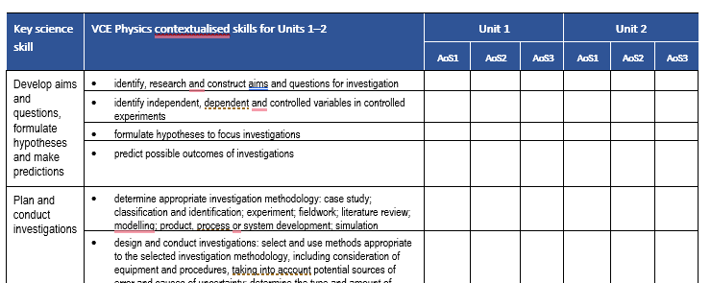
Key science skills planners
A planner for mapping Units 1 and 2 key science skills
Note: a separate planner is available for Units 3 and 4

Slide 14
Scientific Investigation (p 13 – 15): asking questions; testing ideas; using evidence
Opportunities for teacher-facilitated, student-adapted and student-designed investigations across Units 1 – 4
Scientific investigation methodologies for 2023-2027 Study Design:
Case study
Classification and identification
Experiment
Fieldwork
Literature review
Modelling
Product, process or system development
Simulation

Slide 15
Examples of scientific methodologies
Methodology | Example
Case study | The ‘monkey and the hunter’ problem
Classification and identification | Compare emission and absorption spectra for selected elements
Experiment | Investigate the nature of friction forces between two surfaces
Fieldwork | Use a spectrometer to observe star light
Literature review | Explain how a Geiger counter works
Modelling | Make a model of a fuse
Product, process or system development | Develop a fluid lens system with an adjustable focus
Simulation | Investigate collisions between objects
Refer to the Support materials on the VCAA website.
Learning materials have been tagged with relevant methodology

Slide 16
Practical work
Central component of learning and assessment
Includes activities and investigations such as laboratory experiments, fieldwork, simulations, modelling and other direct experiences described in the scientific investigation methodologies
Increased time allocated to practical work:
A minimum of 15 hours for student practical work across Unit 1 and Unit 3 (approx. 5 hours for each area of study)
A minimum of 10 hours for student practical work in Unit 2, Areas of Study 1 and 2
A minimum of 5 hours for student practical work across Unit 4, Area of Study 1
A minimum of 7 hours for the student investigation Unit 2, Area of Study 3
A minimum of 10 hours for the student-designed investigation in Unit 4, Area of Study 2.

Slide 17
Logbooks (p 14)
Logbook of practical activities maintained for each of Units 1 to 4 for recording, authentication and assessment purposes.
The presentation format of the logbook is a school decision and no specific format is prescribed. Its purposes may include:
reporting on an investigation or activity
responding to questions in a practical worksheet or problem-solving exercise
writing up an investigation as a formal report or as the basis of a scientific poster
providing a basis for further learning, for example, referenced in class discussions about demonstrations, activities or practical work

Slide 18
Formula sheet
The current formula sheet for the external examination will be reviewed along with the examination specifications and will be published in December 2023, after the 2023 VCE Physics examination has been sat by students
Students should be encouraged to become familiar with the formula sheet as part of their regular classes
Development of students’ A3 pre-written notes for the external examination has been strongly supported by VCE Physics teachers

Slide 19
Units 1 and 2 Structure
Unit titles | Area of Study titles
Unit 1: How is energy useful to society? | Area of Study 1: How are light and heat explained? Area of Study 2: How is energy form the nucleus utilised? Area of Study 3: How can electricity be used to transfer energy?
Unit 2: How does physics help us to understand the world? | Area of Study 1: How is motion understood? Area of Study 2: How does physics inform contemporary issues and applications in society (18 options)? Area of Study 3: How do physicists investigate questions?

Slide 20
Integrating Unit 2 options into Units 1 and 2 ‘core’
Content in the Unit 2 Area of Study 1 options may be used to support learning in Units 1 and 2 and to provide students with ideas for further investigation, for example:
Unit 2 Area of study 2 option | Application
2.1 How does physics explain climate change? | Unit 1 AoS1: Comparison of the total energy across the electromagnetic spectrum emitted by objects at different temperatures
2.10 How do instruments make music? | Unit 1 AoS1: Sound as the transmission of energy via longitudinal pressure waves
2.6 How is radiation used to maintain human health? | Unit 1 AoS2: Relationship between properties of α, β and γ radiation and their uses in medical applications
2.12 How can AC electricity charge a DC device? | Unit 1 AoS3: Transformers, diodes, capacitors, heat and light sensors
2.4 How do forces act on the human body? | Unit 2 AoS1: Suitability of different materials for use in structures
2.5 How do forces act on the human body? | Unit 2 AoS1: Calculation of stress and strain for bone and muscle

Slide 21
Units 3 and 4 Structure
Unit titles | Area of Study titles
Unit 3: How do fields explain motion and electricity? | Area of Study 1: How do physicists explain motion in two dimensions? Area of Study 2: How do things move without contact? Area of Study 3: How are fields used in electricity generation?
Unit 4: How have creative ideas and investigation revolutionised thinking? | Area of Study 1: How has understanding about the physical world changed? Area of Study 2: How is scientific inquiry used to investigate fields, motion or light?

Slide 22
Curriculum and assessment programs
Each school is different:
different contexts in which students operate
different circumstances in which schools are situated
Students will have different:
strengths and talents
available resources
Schools have flexibility in:
designing curriculum programs that meet the needs of their cohort and the context in which they are learning
developing assessment programs that are aligned to the VCE Physics Study Design and comply with VCE assessment principles.

Slide 23
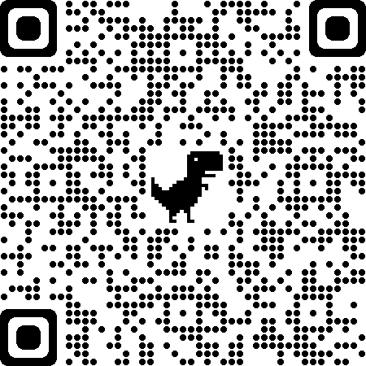
Planning template
Whilst designed specifically for schools seeking to deliver a VCE study for the first time, the VCE Curriculum and Assessment Plans are a useful tool for all teachers in planning assessment.

Slide 24
Units 1-4 School-based Assessment
Two forms of assessment for each outcome:
Satisfactory completion of an outcome (S or N)
- Units 1-4
Levels of achievement
school-based in Units 1 and 2
School-assessed Coursework (SAC) moderated against external examination in Units 3 and 4

Slide 25
Integrity and Authentication
The integrity of VCE Assessments is of a paramount concern to maintain the integrity of the VCE qualification:
teachers and schools need to develop and implement robust authentication strategies to ensure that the student’s submitted work is clearly their own
For VCE Physics most assessments are conducted under test conditions
Effective schools will build a culture of integrity and trust underpinned by teaching and learning practices of ongoing formative assessment to gather knowledge and evidence of student abilities and achievement.

Slide 26
VCE assessment principles
The VCE Assessment Principles state that assessment should be:
valid and reasonable
equitable
balanced
efficient

Slide 27
VCE Assessment principles
Valid
Equitable
fair and reasonable
designated task type
conducted under fair conditions for all students
clear instructions included
accessible to all students
doesn’t privilege or disadvantage certain groups of students
alternative tasks (if set) are comparable in scope and demand

Slide 28
VCE Assessment principles
Balanced
Efficient
variety of task types used
variety of conditions used
allow students to demonstrate different levels of achievement
suitable criteria, descriptors, rubrics or marking schemes used
representative parts of outcomes, key knowledge and key skills are assessed
minimum number of assessments
precision vs efficiency
minimise undue workload/stress on students
part of the regular teaching and learning program
avoid under or over assessment of the outcome
completed mainly in class and within a limited timeframe

Slide 29
Units 1 and 2 Assessment
Underpinned by VCE Assessment Principles
All assessments at Units 1 and 2 are school-based, including procedures for assessment of levels of achievement
List of 16 selected tasks for Unit 1 Outcomes 1, 2 and 3 (p 28)
List of 16 selected tasks for Unit 2 Outcomes 1 and 2 (p 49)
If multiple tasks are selected for Unit 1 Outcomes 1, 2 and/or 3, or Unit 2 Outcomes 1 and/or 2, they must be different
Same task cannot be selected more than once across Outcomes 1 and 2
Unit 2 Outcome 3: A report of a practical investigation (student-designed or student-adapted) using an appropriate format, for example, a scientific poster, practical report, oral communication or digital presentation.

Slide 30
Examples of Units 1 and 2 assessment tasks
The Support materials on the VCE Physics study page include 10 examples of assessment tasks and their management:
Assessment task type | Unit and AoS | Contexts
Comparison of two scientific models | Unit 1 AoS1 | Models of refraction: Newton & Huygens
 | Unit 1 AoS3 | Models of electric current in a circuit
Design, build, test and evaluate a device | Unit 1 AoS1 | Design a ‘thermos’
Media analysis | Unit 1 AoS1 | Light pollution; magma power
 | Unit 1 AoS2 | Nuclear power
Real-world physics applications | Unit 1 AoS1 | Analysis of provided data from a climate model
Reflective annotations of practical activities | Unit 1 AoS1 | Stations: Thermal physics & waves and light
Report of a laboratory activity | Unit 2 AoS1 | Newton’s second law of motion

Slide 31
Units 3 and 4 Assessment
Unit 3 School-assessed Coursework: 30 per cent of study score
Unit 4 School-assessed Coursework: 20 per cent of study score
End-of-year examination: 50 per cent of study score
For Unit 3 Outcomes 1, 2 and 3 and Unit 4 Outcome 1: Four designated School-assessed Coursework tasks. Each task can only be selected once across Units 3 and 4.
For each task the time allocated should be approximately 50 minutes for a written and 5 minutes for a multimodal or oral presentation
For Unit 4 Outcome 2: communication of the design, analysis and findings of a student-designed and student-conducted scientific investigation through a structured scientific poster and logbook entries

Slide 32
Revised Units 3 and 4 VCE Physics Assessment School-based Assessment tasks: Unit 3 Outcomes 1, 2 and 3 & Unit 4 Outcome 1
Outcome | Assessment tasks
Unit 3 Outcome 1 2-D motion | application of physics concepts to explain a model, theory, device, design or innovation analysis and evaluation of primary and/or secondary data, including data plotting, identified assumptions or data limitations, and conclusions problem-solving, applying physics concepts and skills to real-world contexts comparison and evaluation of two solutions to a problem, two explanations of a physics phenomenon or concept, or two methods and/or findings from practical activities
Unit 3 Outcome 2 Field models
Unit 3 Outcome 3 Electricity generation
Unit 4 Outcome 1 Changed ideas

Slide 33
Examples of SAC task allocations across Units 3 and 4
Assessment task | Teacher 1 | Teacher 2
Application of physics concepts to explain a model, theory, device, design or innovation | Unit 3 Area of Study 2: Application of physics concepts to the operation of devices and innovations including: geostationary satellites; motors; microphones; loudspeakers; and particle accelerators. | Unit 4 Area of Study 1: Evaluate the evolution of physics understanding of light and matter through the application of wave and particle models to historic experimental results
Analysis and evaluation of primary and/or secondary data, including data plotting, identified assumptions or data limitations, and conclusions | Unit 4 Area of Study 1: Analysis and evaluation of data obtained from experiments that investigate the nature of light and matter, specifically: the photoelectric effect, interference patterns; and absorption and emission spectra. | Unit 3 Area of Study 3: Analysis a data base for the effect of length and resistance of power lines on power delivery with and without the use of transformers.
Problem-solving, applying physics concepts and skills to real-world contexts | Unit 3 Area of Study 3: Application of physics concepts to the real-world context of electricity generation and distribution in Victoria. | Unit 3 Area of Study 1: Analyse and evaluate a case study of a video of a current sport event involving projectile motion to determine a value of acceleration due to gravity.
Comparison and evaluation of two solutions to a problem, two explanations of a physics phenomenon or concept, or two methods and/or findings from practical activities | Unit 3 Area of Study 1: Analysis of the motion of projectiles using both constant acceleration equations and conservation of energy, including consideration of the effects of air resistance. | Unit 3 Area of Study 2: Compare the nature of Earth’s gravitational and magnetic fields in terms of nature (static or changing, and as uniform or non-uniform) shape, direction and strength.

Slide 34
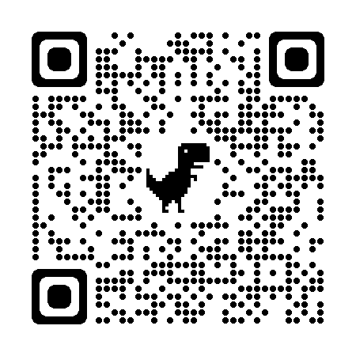
New Unit 4 Outcome 2 Scientific poster format Maximum: 600 words 20 – 25% of space allocated to communicating main finding
Title as an investigation question Student name
Introduction Methodology and methods Results | Communication statement reporting the key finding of the investigation in response to the investigation question as a one-sentence summary | Discussion Conclusion
References and acknowledgments

Slide 35
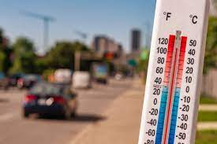
VCE Physics scientific poster example Unit 1 Area of study 1
How does road surface colour affect heat absorption? Stu Dent
Introduction Methodology and methods Results |  | Black surfaces absorb more heat than brown or white surfaces, having implications for choice of colour for road surfaces in response to climate change | Discussion Conclusion
References and acknowledgments

Slide 36
VCE resources
Support materials on the VCAA study pages for VCE Physics
Administrative information for School-based Assessment
VCAA Bulletin and Notices to schools
Statistical moderation reports
School-based assessment audit reports
School-based assessment coursework reports
Examination reports
School calendar and assessment policy
The school teaching and learning program
Subscribe to VCAA notifications:

Slide 37
Contact
Maria James
Curriculum Manager, Science
 03 9059 5148
 Maria.James2@education.vic.gov.au

