Slide 1
Introducing History

Slide 2
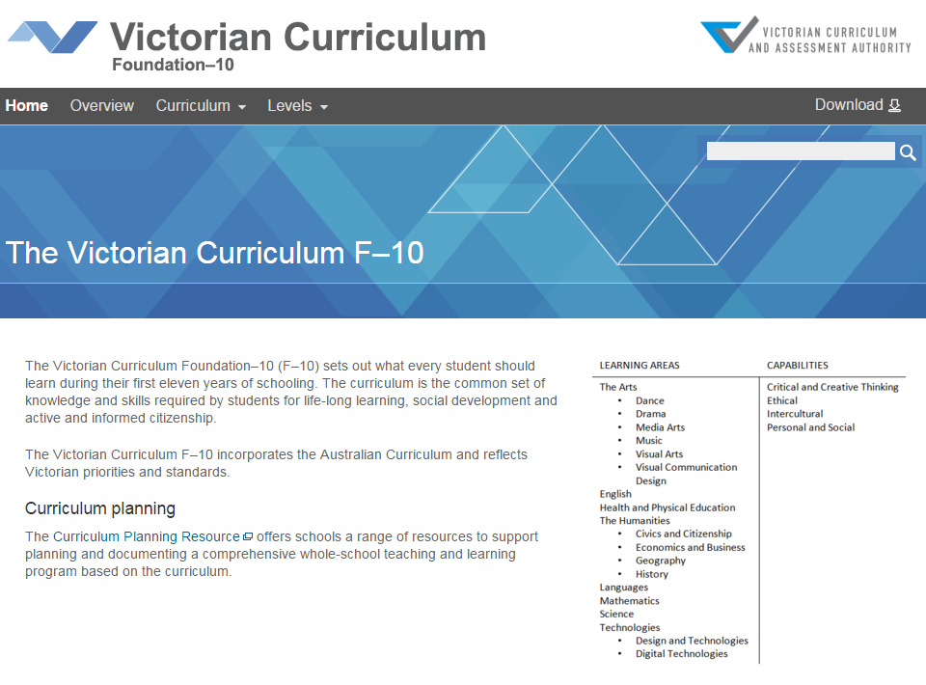
Victorian Curriculum F–10
Released in September 2015 as a central component of the Education State
Provides a stable foundation for the development and implementation of whole-school teaching and learning programs
The Victorian Curriculum F–10 incorporates the Australian Curriculum and reflects Victorian priorities and standards
http://victoriancurriculum.vcaa.vic.edu.au/

Slide 3
Aims
History aims to ensure that students develop:
interest in, and enjoyment of, historical study for lifelong learning and work, including their capacity and willingness to be informed and active citizens
knowledge, understanding and appreciation of the past and the forces that shape societies, including Australian society
understanding and use of historical concepts and skills, including sequencing chronology, using historical sources as evidence, identifying continuity and change, analysing cause and effect and determining historical significance
capacity to undertake historical inquiry, including skills in the analysis and use of sources, and in explanation and communication of arguments.

Slide 4
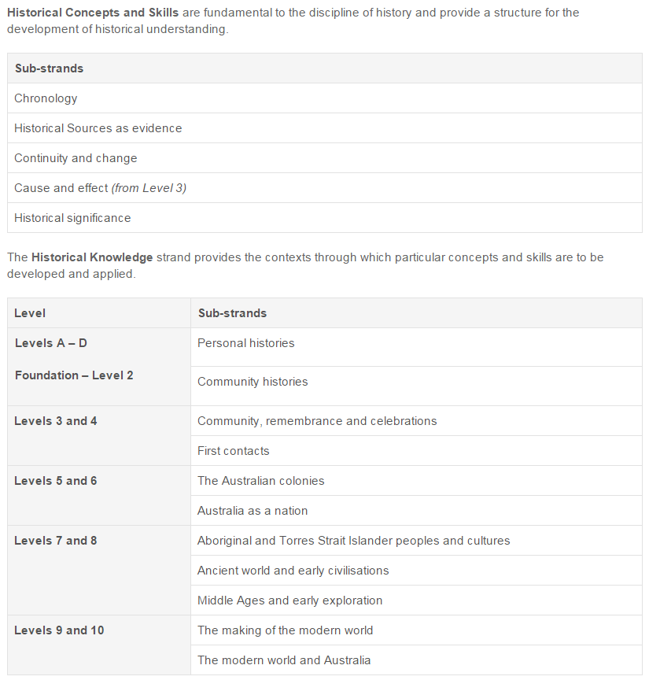
Structure
Structure: Strands and sub-strands
Achievement standards
The first achievement standard at Foundation – Level 2 and then at Levels 4, 6, 8 and 10.
A curriculum for students with disabilities is provided in this learning area.

Slide 5
Key messages
The curriculum is designed in two level bands of learning, not single levels as in AusVELS. This provides more flexibility when designing the teaching and learning programs.
The historical concepts and skills have been refined and been made more specific.
The first achievement standard is at Level 2.
New content description display for Levels 7–10
In the Historical Knowledge strand levels 7-8 and 9-10, teachers will find a set of common content descriptions that apply to a range of context choices.
Displaying elaborations for Levels 7–10
In the Historical Knowledge strand in levels 7-8 and 9-10, teachers will elect to show or hide elaborations related to their context choice.
An annotated example is available here: http://victoriancurriculum.vcaa.vic.edu.au/static/docs/History%20structure%20annotation.pdf
Reporting progress in History
These changes do cause a break in reporting data and student progress as the teaching program moves from AusVELS History to the Victorian Curriculum F–10 History

