Slide 1
Cause and Effect
Levels 7 to 10

Slide 2
Introduction
Provocation
Cause and Effect the curriculum context
Cause and Effect in Victorian Curriculum History
Cause and Effect in the continuum of learning
Towards the classroom
Examples of practice
Conclusion

Slide 3
History does not happen through a series of events acting on each other in a linear chain leading to an ultimate event. Nor does history happen through a series of factors acting in isolation towards a key event. History as it happens is an infinitely tangled web of cause and effect, or reinforcement and negation. Events are of course multi-causal, but also multi-consequential.
James Woodcock, ‘Does the linguistic release the conceptual?’
Notes:
Woodcock, J 2005, ‘Does the linguistic release the conceptual? Helping Year 10 to improve their causal reasoning’, Teaching History, No. 119, p. 2

Slide 4
Cause and Effect in Victorian Curriculum History

Slide 5
Victorian Curriculum History
Skill/Concept
Historical Knowledge
Achievement Standard
Learning in History

Slide 6
Learning in History
‘Students identify chains of cause and effect to examine how and why things happened in the past. In so doing, they identify different kinds of causes, including social, political, economic, short-term catalysts or triggers and long-term trends. They may organise causes and effects using chronology and examine the role of individuals and movements in shaping, promoting and resisting change.
Narratives are a good starting point for identifying significant causes. Students can use timelines to map and organise events, people, ideas, movements and turning points to identify links between causes and effects and to distinguish between long-term (trends) and short-term (triggers) causes of events.’
Victorian History Curriculum, Leaning in History: Analysing Cause and Effect
Notes:
Victorian History Curriculum, Leaning in History: Analysing Cause and Effect’ https://victoriancurriculum.vcaa.vic.edu.au/the-humanities/history/introduction/learning-in-history

Slide 7
Achievement Standard
Levels 7 and 8 Achievement Standard
By the end of Level 8, students identify and explain patterns of change and continuity over time. They analyse the causes and effects of events and developments. They identify the motives and actions of people at the time. Students evaluate the significance of individuals and groups and how they were influenced by the beliefs and values of their society.
Levels 9 and 10 Achievement Standard
By the end of Level 10, students refer to significant events, the actions of individuals and groups, and beliefs and values to identify and evaluate the patterns of change and continuity over time. They analyse the causes and effects of events and developments and explain their significance. They explain the context for people’s actions in the past. Students evaluate the significance of events and analyse the developments from a range of perspectives.
Notes:
The highlighted statements are the explicit articulation of the skill in the Achievement Standard for this band.

Slide 8
Historical Concepts and Skills: Cause and Effect
Levels 7 and 8
Analyse the causes and effects of significant events that caused change and/or a decline over the period (VCHHC103)
Levels 9 and 10
Analyse the long term causes, short term triggers and the intended and unintended effects of significant events and developments (VCHHC127)

Slide 9
Connections
Cause and Effect connects with:
other Historical Concepts and Skills
instructional terms.
Levels 7 and 8
Analyse the causes and effects of significant events that caused change and/or a decline over the period (VCHHC103)

Slide 10
Connections: your turn
Levels 9 and 10
Analyse the long term causes, short term triggers and the intended and unintended effects of significant events and developments (VCHHC127)
Identify:
other Historical Concepts and Skills
instructional terms.
Notes:
Other Historical Concepts and Skills: Historical Significance
Instructional terms: analyse

Slide 11
Continuum of learning
Levels 5 and 6
Levels 7 and 8
Achievement Standard
students identify and describe change and continuity and explain the causes and effects of change on society.
Historical Concepts and Skills
Explain the causes of significant events that shaped the Australian colonies, contributed to Australian Federation and the effects of these on Aboriginal and Torres Strait Islander peoples and migrants (VCHHC086)
Achievement Standard
They analyse the causes and effects of events and developments. They identify the motives and actions of people at the time.
Historical Concepts and Skills
Analyse the causes and effects of significant events that caused change and/or a decline over the period (VCHHC103)
Level 9 and 10
Achievement Standard
They analyse the causes and effects of events and developments and explain their significance. They explain the context for people’s actions in the past.
Historical Concepts and Skills
Analyse the long term causes, short term triggers and the intended and unintended effects of significant events and developments (VCHHC127)
Notes:
Discussion question – How can we design a task that can scaffold for students operating over a wide range of achievement levels? What would that look like?

Slide 12
Historical Knowledge
Australia at war (1914 – 1945): World War I
Causes of World War I, the reasons why men enlisted to go to war, and how women contributed in the war effort (VCHHK139)
Significant places where Australians fought and explore their perspectives and experiences in these places (VCHHK140)
Effects of World War I, with a particular emphasis on the changes and continuities brought to the Australian home front and society (VCHHK142)
Significance of World War I to Australia’s international relationships in the twentieth century, with particular reference to the Britain, the USA and Asia (VCHHK143)
Notes:
This is an example of where the Historical Concepts and Skills intersect with Historical Knowledge. There is more Historical Knowledge in the Victorian Curriculum beyond this example.

Slide 13
Historical Knowledge
What are my students excelling at when I teach them about Cause and Effect?
What are my students struggling with with I teach them about Cause and Effect?
Notes:
Consider the Historical Knowledge presented on the previous slide.
Reflect on your own programming and practice; what do your students excel at and what do they struggle with?
How could you address what they are struggling with and enhance what they are excelling at?

Slide 14
Towards the classroom

Slide 15
Towards the classroom
Levels 7 and 8
At Levels 7 and 8 students develop their understanding that a historical event is the result of multiple causes and leads to a range of effects. They might trace how an invention, conflict or disease led to the advancement or decline of a society by examining long- and short-term effects.
Even though students are studying the ancient world and the middle ages, there are opportunities for them to show the lasting effects these cultures have had on their own lifestyles in relation to agriculture, education, innovation and the movement of peoples.

Slide 16
Towards the classroom
Levels 9 and 10
At Levels 9 and 10 students are asked to consider long-term causes and short-term triggers, and to understand how these interact with each other to cause change. Students come to realise that even moments of apparently sudden disruption often have causes that built up over a long period.
The concept of unintended effects adds weight to the historical decisions and actions that students learn about. Even choices made with good intentions can have widespread negative impacts, either immediately or in the long term.

Slide 17
Indicative examples
By the end of Level 8:
By the end of Level 10:
students use timelines to identify patterns of change over time
students use timelines to identify sequences of causation and consequences
students explain broad patterns over large time periods in a written response
students use timelines to identify significant events in the life of key individuals.
students use timelines to map broad patterns of change over time
students use timelines to link sequences of causation and consequences to historical events
students demonstrate an understanding of the sequence of events in structured written responses
students use timelines to identify significant events in the life of key individuals.

Slide 18
Language of Cause and Effect
Long-term
Cause
Reason
Contribution
Trigger
Intended
Causation
Impact
Effect
Consequence
Short-term
Unintended
Outcome
Change
Rate
Social
Political
Environmental
Extent
Multicausal
Notes:
Language of Cause and Effect
The language of Cause and Effect is broad and has crossover with other Historical Concepts and Skills, such as Change and Continuity and Historical Significance. Understanding and effective use of this language can enable students to develop more nuanced interpretations of causational factors and the effects of historical developments. Teachers are encouraged to model the use of this vocabulary.

Slide 19
Classroom ideas
Levels 7 and 8
Levels 9 and 10
Identify events that contributed to or were the result of key historical events and map them on timeline.
Identify the causes of a specific historical event and rank them in terms of their significance in causing said event.
Produce a structured written response that analyses the significant events that caused change and/or the decline of an ancient society.
Identify short-term triggers, long-term causes and trigger events for a significant historical event or development and map them on a timeline.
Rank the significance of intended and unintended consequences of a specific historical event.
Produce a structured written response that analyses the causes or effects of a particular historical event.

Slide 20
Example of practice
Levels 7 and 8

Slide 21
Context
2
In most school settings, Year 7 will see students from a range of primary schools coming together into your class. Start with activities that ensure all students have good conceptual understanding and practical skills when it comes to cause and effect.
At Levels 7 and 8, students begin to consider the idea of contested history and the way in which historical interpretations of an event or individual might differ. This extends to historians disagreeing about the major causes of an event or trend, or the degree of impact that a particular individual had. Therefore, at this level, students must use evidence to form their own judgment about the relative importance of different causal factors relating to their ancient or middle age society, and the scale or impact of the effects they can observe.
The following slides contain a sample activity that illustrates one way of approaching Cause and Effect at this level.

Slide 22
Activity
3
Key question: What caused the fall of the Western Roman Empire?
Activity:
Use the following slides to step students through an activity to determine the cause of this complex historical event.
Use Levels 7 and 8: Cause and Effect Student Handouts 1, 2 and 3.

Slide 23
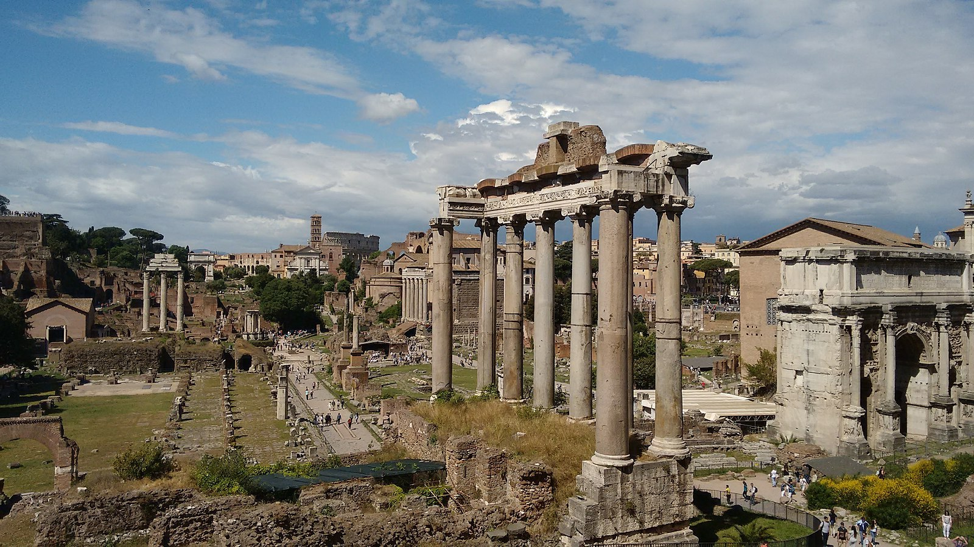
4
What were the causes and effects of the fall of the Western Roman Empire?
Notes:
The purpose of this activity is to help students understand the concept of cause and effect, and to develop their capacity to analyse and describe these accurately.
This activity is accompanied by three Student Handouts:
Student Handout 1: Causes of the fall of the Western Roman Empire
Student Handout 2: Effects of the fall of the Western Roman Empire
Student Handout 3: Fishbone diagram template.
Image attribution
Image Title: View of the Roman Forum from Via di Monte Tarpeo
Image Creator: Marcel Robelin
Source: https://commons.wikimedia.org/wiki/File:Forum_Romain_05_2017.jpg
License: Creative Commons Attribution Share Alike 4.0

Slide 24
The causes and effects of significant events do not only shape a society in positive ways but can also lead to negative change within, or even the decline of, a society.
5

Slide 25
For centuries, ancient Rome was a great power in the Mediterranean region and spreading across Europe, northern Africa and western Asia. Yet eventually the Western Roman Empire failed at the end of the fifth century AD. There was no single factor that led to the decline of Rome but many causes.
Causes
6
Create a fishbone diagram showing the causes of the fall of the Western Roman Empire.
To complete the diagram, use information in Levels 7 and 8: Cause and Effect – Student Handout 1.

Slide 26
The fishbone diagram, sometimes called the cause-and-effect diagram or the Ishakawa diagram (after the man who invented it), is a simple graphic organiser that is very useful to historians.
Using a fishbone diagram
7

Slide 27
8
Why use a fishbone diagram?
A fishbone diagram:
allows you to see all the possible causes of an event at the same time
can show you the relationship between varying causes
can help you brainstorm ideas.

Slide 28
Sample causes of the fall of the Western Roman Empire
9
Military factors
Economic factors
Political factors
Population factors
Causes that were in place a long time before the fall
??????
Causes building up to the fall
???????
??????
Causes just before the fall
Fall of Western Rome
???????
?????
?????
?????
?????
?????
?????
?????
Notes:
An example of a completed fishbone graph can be found on the next slide.
Activity
1. Provide students with Levels 7 and 8: Cause and Effect – Student Handout 1 (Causes of the fall of the Western Roman Empire).
2. Provide students with Levels 7 and 8: Cause and Effect – Student Handout 3 (Fishbone diagram template).
3. Ask students to complete the fishbone diagram.
Differentiated learning:
Support: This task could be completed as a class by reading the information together and completing the fishbone graph on the whiteboard.
Extension: Students could rate the relative importance of the different factors (e.g. were military factors more significant than economic factors?) with an explanation of their reasoning.

Slide 29
Economic issues and problems with slavery
Barbarian invasions
Civil war and political turmoil
10
Barbarians within
Six major civil wars over four hundred years
Increase of non-Roman soldiers in the army
Goths and Visigoths attack Roman territory
Increasing taxation and inflation
Gap between rich and poor increased
Political and economic instability
Fewer slaves leads to agricultural and commercial decline
The city of Rome is sacked by Visigoths and then Vandals
Less loyalty to the empire
The rich start to abandon the cities
Fall of Western Rome
Roman people became more interested in the hereafter
Increased spending on military
Fewer soldiers and fewer people to support society
Undermined imperial authority
No money for upkeep of infrastructure
Defeat the Romans in three major battles
Population decimated by disease
Christianity
Overexpansion
Plague and disease
The rise of the Sassanid empire
Notes:
Example of a completed fishbone graph.

Slide 30
The fall of the Western Roman Empire had an enormous impact on Europe. Historians used to describe the 500 or so years following the end of the Western Roman Empire as the ‘Dark Ages’. There were many changes in European society over this period.
Effects
Effects of the fall of the Western Roman Empire:
Create a concept map showing the effects of the fall of the Western Roman Empire.
Use information from Levels 7 and 8: Cause and Effect – Student Handout 2.
11

Slide 31
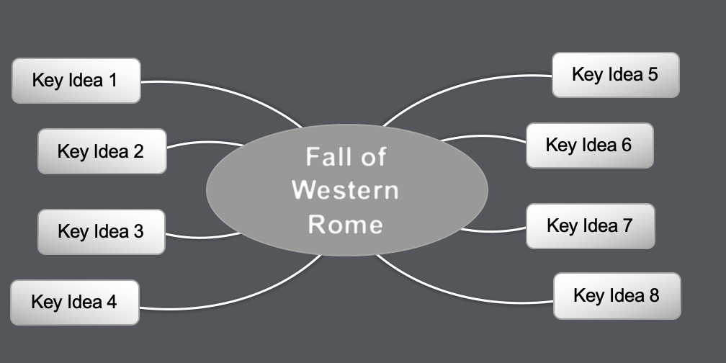
Using a concept map
12
The concept map is another graphic organiser that is useful for you to use as a historian.
It allows you to organise information and make connections between the main idea and other information.

Slide 32
Effects of the fall of the Western Roman Empire
13
Key Idea 5
Key Idea 1
Fall of Western Rome
Key Idea 6
Key Idea 2
Key Idea 7
Key Idea 3
Key Idea 8
Key Idea 4
Notes:
Activity
1. Provide students with Levels 7 and 8: Cause and Effect – Student Handout 2 (Effects of the fall of the Western Roman Empire).
2. Ask students to complete a concept map about the effects of the fall of the Western Roman Empire using handout.
3. Lead your students in a class discussion about how they would rank the effects from most significant to least. Ask your students to give explanations for their choices.
Differentiated learning
Support: Both activities could be completed as a class by reading the information together and completing the fishbone graph and the concept map on the whiteboard.
Extension: Your students could seek additional evidence to add further detail to both their fishbone diagrams and their concept maps, with an emphasis on drawing the information from reliable sources.

Slide 33
Example of practice
Levels 9 and 10

Slide 34
Context
2
It can be a cognitively uncomfortable experience to think about the intricate web of cause and effect that has played out in the past. The ‘butterfly effect’ of long-term, unintended consequences that might be said to result from one decision can seem overwhelming to students.
However, analysing cause and effect can also be a profoundly rewarding experience. Students perceive the cycle of human motivations and their consequences, or the pattern of environmental and social factors that always lead to upheaval. The past ceases to be full of things that just ‘happened’ and starts to feel understandable and, to a degree, knowable.
The following slides contain a sample activity that illustrates one way of approaching Cause and Effect at this level.

Slide 35
Activity
3
Key question: What was the cause and effects of the Petrov Affair?
Activity:
Use the following slides to step students through an activity to determine the causes and effects of this complex historical event.
Use the external links provided.
Notes:
External links:
https://www.nma.gov.au/defining-moments/resources/petrov-affair
https://petrov.moadoph.gov.au/index.html

Slide 36
Vocabulary
4
Communism
Soviet Union
Defect
Cold War
KGB
ASIO
Royal Commission
Australian Labor Party
Democratic Labor Party
Liberal Party
Espionage
Notes:
Vocabulary
Your students will need to understand these words in order to engage fully with this activity. After finding out which words the students already understand, you might wish to ask the students to look up these words and share their meanings. These words could then be added to a word wall or a shared glossary on their LMS.
Communism – a philosophical, social, political and economic movement based upon the idea of communal ownership of property and resources.
Soviet Union – the Union of Soviet Social Republics (USSR) was a communist state comprising Russia and a number of surrounding countries.
Defector – someone who leaves their country and ideals in favour of an opposing country or ideal.
Cold War – A period of political tension between the Soviet Union and the United States and their allied countries following World War II, beginning in 1947 and ending in 1991.
KGB – Komitet Gosudarstvennoy Bezopasnosti, which means Committee for State Security, it was both the secret police and the intelligence agency for the Soviet Union.
ASIO – Australian Security Intelligence Agency.
Royal Commission – an inquiry into an issue appointed by the Crown at the request of the government.
Australian Labor Party – the ALP, a major centre-left wing political party, founded in 1901.
Democratic Labor Party – the DLP, a left-wing political party founded in 1955, when it split away from the ALP.
Liberal Party – a major centre-right Australian political party, founded in 1944.

Slide 37
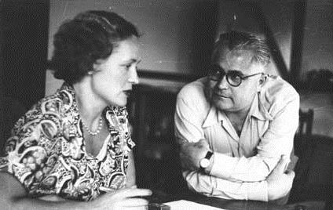
Cause and Effect: the Petrov Affair
5
Notes:
Image attribution
Title: Vladimir and Evdokia Petrov in the safe house on Sydney’s North Shore, 1954
Creator: Australian Security Intelligence Organization
Source: National Archives of Australia A6285, 11
License: This work is licensed to the NAA.

Slide 38
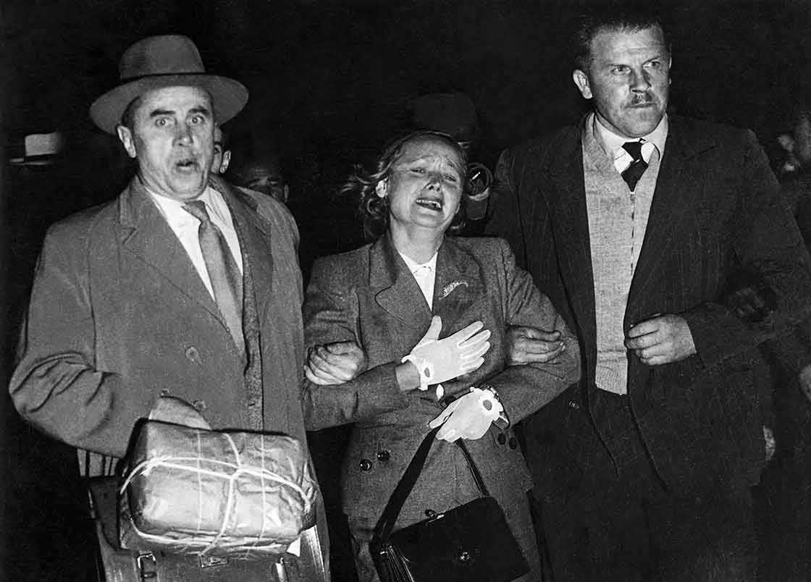
6
Vladimir and Edvokia Petrov were Russian KGB operatives who were assigned to the Soviet embassy in Canberra in 1951. On 3 April 1954, Vladimir Petrov defected to Australia. The ensuing Royal Commission into Espionage was to have a profound effect on the Australian political landscape for decades to come.
Notes:
Activity
Provide your students with the following resources:
https://www.nma.gov.au/defining-moments/resources/petrov-affair
https://petrov.moadoph.gov.au/index.html
Direct your students to create three tables, each with three columns.
Your students are to label the columns of Table 1: ‘Short-term causes’, ‘Long-term causes’ and ‘Evidence’.
Your students are to label the columns of Table 2 and Table 3: ‘Short-term effects’, ‘Long-term effects’ and ‘Evidence’.
Use Table 2 for identifying the effects of the event on the Petrovs.
Use Table 3 for identifying the effects of the event on the Australian political landscape.
Ask students to read the information on each website and complete the three tables.
See if there is consensus or disagreement among students’ answers, and then facilitate discussion to tease out the way students arrived at their answers.
Image attribution
Title: Evdokia Petrov being ‘escorted’ across the tarmac at Mascot Airport, Sydney, 1954
Creator: Royal Commission on Espionage
Source: National Archives of Australia A6201, 62
License: This work is licensed to the NAA.

Slide 39
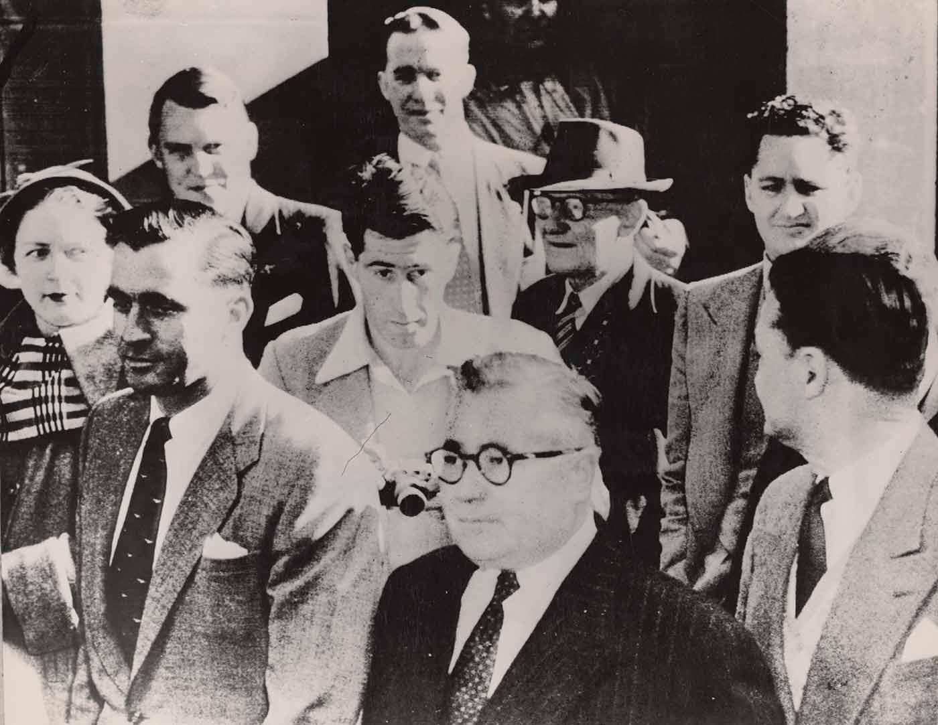
7
Activity:
Analyse the short-term and long-term causes of the Petrov Affair.
Analyse the short-term and long-term effects on:
the Petrovs
the Australian political landscape.
Provide evidence to support your answers.
Notes:
Differentiated learning
Support: Students could complete the tables in pairs or as a small group under teacher guidance.
Extension: Some students could be given other, more advanced, sources to use to complete their tables.
Image attribution
Title: Vladimir Petrov (centre front) attends third hearing of Royal Commission on Espionage in Melbourne, 5 July 1954.
Creator: Keystone Press Agency
Source: National Library of Australia
License: This work is out of copyright.

Slide 40
Conclusion

Slide 41
Discussion points
In your teaching plan for Levels 7 and 8 History, are there lessons or activities where you focus explicitly on cause and effect?
How are you currently assessing whether students can demonstrate an understanding of this concept?
Are you starting to move students at this level beyond describing and explaining cause and effect, and into analysing?
If some of your students do not seem familiar with the historical thinking concept of cause and effect, could you explore examples of cause and effect in their own lives first to help them understand the concept?
Are there any examples of cause and effect in television, film or pop culture that you could use as a lesson starter?
Which new vocabulary words can you introduce to enable students to discuss the concept of cause and effect?
What style of note-taking or concept mapping would be most suited to helping students organise their information on cause and effect?
How do we design activities that cater for a wide range of learners?
Notes:
Individually or in groups, use these questions to reflect on your teaching. How do you approach teaching the concept of cause and effect? How might you approach it differently?

Slide 42
Reflection activity
Use the following thinking routine to reflect:
What excites you about these ideas?
What do you find worrisome?
What else do you need to know to take action?
What is your current stance or opinion on the ideas?

