Slide 1
Historical Significance
Levels 7 to 10

Slide 2
Introduction
Provocation
Historical Significance in the curriculum context
Historical Significance in Victorian Curriculum History
Historical Significance in the continuum of learning
Historical Significance in the classroom
Examples of practice
Conclusion

Slide 3
We have history precisely because the past is neither given nor fixed. Notoriously, people do not share assumptions about the significance of events, so the past cannot be treated as given. Moreover, it can never be fixed, because as new events occur they change the significance of what has already happened.
Peter Lee and Denis Shemilt, ‘A scaffold, not a cage: progression and progression models in history’
Notes:
Lee, P and Shemilt, D 2003, ‘A scaffold, not a cage: progression and progression models in history’, Teaching History, No. 113, p. 15

Slide 4
Historical Significance in Victorian Curriculum History

Slide 5
Victorian Curriculum History
Skill/Concept
Historical Knowledge
Achievement Standard
Learning in History

Slide 6
Learning in History
‘Historical significance concerns the importance that is assigned to particular aspects of the past. Determining historical significance involves making evaluative judgments about the past. To establish the historical significance of a trend, an event, an idea, an individual or a group, students use questions or criteria such as: How important was it to people who lived at that time? How many people were affected? How were people’s lives changed? How long lasting were the consequences? What is its legacy?’
Victorian History Curriculum, Learning in History: Determining Historical Significance
Notes:
Victorian History Curriculum, Learning in History: Determining Historical Significance, https://victoriancurriculum.vcaa.vic.edu.au/the-humanities/history/introduction/learning-in-history

Slide 7
Achievement Standard
Levels 7 and 8 Achievement Standard
By the end of Level 8, students identify and explain patterns of change and continuity over time. They analyse the causes and effects of events and developments. They identify the motives and actions of people at the time. Students evaluate the significance of individuals and groups and how they were influenced by the beliefs and values of their society. They evaluate different interpretations of the past.
Levels 9 and 10 Achievement Standard
By the end of Level 10, students refer to significant events, the actions of individuals and groups, and beliefs and values to identify and evaluate the patterns of change and continuity over time. They analyse the causes and effects of events and developments and explain their significance. They explain the context for people’s actions in the past. Students evaluate the significance of events and analyse the developments from a range of perspectives. They evaluate the different interpretations of the past and recognise the evidence used to support these interpretations.
Notes:
The highlighted statements are the explicit articulation of the skill in the Achievement Standard for this band.

Slide 8
Historical Concepts and Skills: Historical Significance
Levels 7 and 8
Evaluate the role and achievement of a significant individual, development and/or cultural achievement that led to progress (VCHHC104)
Levels 9 and 10
Evaluate the historical significance of an event, idea, individual or place (VCHHC128)

Slide 9
Connections
Chronology connects with:
historical content knowledge
instructional terms.
Levels 7 and 8
Evaluate the role and achievement of a significant individual, development and/or cultural achievement that led to progress (VCHHC104)

Slide 10
Continuum of learning
Levels 7 and 8
Achievement Standard
Students evaluate the significance of individuals and groups and how they were influenced by the beliefs and values of their society.
Historical Concepts and Skills
Evaluate the role and achievement of a significant individual, development and/or cultural achievement that led to progress (VCHHC104)
Levels 9 and 10
Achievement Standard
Students evaluate the significance of events and analyse the developments from a range of perspectives.
Historical Concepts and Skills
Evaluate the historical significance of an event, idea, individual or place (VCHHC128)
Levels 5 and 6
Achievement Standard Students evaluate the significance of individuals and groups and how they were influenced by the beliefs and values of their society.
Historical Concepts and Skills Evaluate the role and achievement of a significant individual, development and/or cultural achievement that led to progress (VCHHC104)
Notes:
Discussion question – How can we design a task that can scaffold for students operating over a wide range of achievement levels? What would that look like?

Slide 11
Historical Knowledge
Analyse Historical Significance as a skill in Australia at war (1914 – 1945): World War I
Australia at war (1914 – 1945): World War I
Causes of World War I, the reasons why men enlisted to go to war, and how women contributed in the war effort (VCHHK139)
Significant places where Australians fought and explore their perspectives and experiences in these places (VCHHK140)
Effects of World War I, with a particular emphasis on the changes and continuities brought to the Australian home front and society (VCHHK142)
Significance of World War I to Australia’s international relationships in the twentieth century, with particular reference to the Britain, the USA and Asia (VCHHK143)
Notes:
This is an example of where the Historical Concepts and Skills intersect with Historical Knowledge. There is more Historical Knowledge in the Victorian Curriculum beyond this example.

Slide 12
Historical Knowledge
Continue
Modify
Notes:
Consider the historical knowledge presented on the previous slide.
Reflect on your programming and teaching practice. What do you want to continue to do?

Slide 13
Towards the classroom

Slide 14
Towards the classroom
Levels 7 and 8
Students now consider historical significance in an international and ancient/medieval context. They understand that whether something is considered ‘historically significant’ is determined by a set of criteria. For example, the Rosetta Stone is a historically significant object because it allowed archaeologists to decipher hieroglyphics and learn more about Ancient Egyptian culture.
Students are required to evaluate the significance of individuals and developments, which means that they must review the historical evidence and apply their own judgment. In Levels 5 and 6, they were only required to explain the historical significance of individuals and groups.
The curriculum at this level also requires students to consider the idea of ‘progress’, or the advancement of human societies over time. ‘Progress’ implies change in a positive direction. In historical thinking, the opposite of ‘progress’ is ‘decline’.

Slide 15
Towards the classroom
Levels 9 and 10
The historical content descriptions refer to ‘significant places’ and ‘significant events’; teachers and students need to use criteria to select these. Other content descriptions require students to explore the ‘significance of’ an event, and this requires students to weigh the evidence and reach a judgment regarding whether this truly was an impactful or important event.
At Levels 9 and 10, students first demonstrate the capacity to evaluate historical significance. This is a very sophisticated skill. What makes something or someone matter, historically speaking? What makes something worth remembering and researching? On what basis do you include events in your narrative or leave them out?
Students show progression from Levels 7 and 8 when they discuss why historical significance is not a static concept, and that the perceived value of an event, idea or individual may change over time. Students evaluate historical significance by applying the criteria of importance, profundity, quantity, durability and relevance.

Slide 16
Indicative examples
By the end of Level 8:
By the end of Level 10:
students can identify significant individuals, developments or achievements in an ancient or medieval civilisation and explain why they were significant
students can explain the impact that these significant events had on the society of the time
students can support their arguments about significance with evidence from historical sources.
students can identify significant individuals, developments or achievements and evaluate their relative significance
students can analyse the impact that these significant events had at the time and afterwards
students can support their arguments about significance with evidence from historical sources.

Slide 17
Language of Historical Significance
Significant
Important
Determining
Judging
Evidence
Impact
Change
Rare
Consequence
Historical
Influence
Legacy
First
Evaluate
Explain
Argument
Identify
Judgements
Measure
Impact
Scale
Notes:
Language of Historical Significance
Your students will need to understand these words in order to engage fully with this activity. After finding out which words the students already understand, you might wish to ask the students to look up these words and share their meanings. Students might also be asked to create a tableau or act out a scene that conveys the meaning of each word. These words could then be added to a word wall or a shared glossary on their LMS.
It might be a good idea for you to have ready a list of precise definitions of these terms. If it is the first time that students are coming across them, the first definition they hear will stay with them and influence their future understanding.

Slide 18
Classroom ideas
Levels 7 and 8
Levels 9 and 10
Rank the significance of events as a cause or consequence and explain the reasoning.
Use a timeline to identify significant events in the life of a key individual.
Using sources as evidence, produce a written explanation of the significance of a historical event.
Rank the relative significance of events as a cause or consequence and explain the reasoning.
Use a timeline to identify significant events in the life of a key individual and select appropriate historical sources to substantiate the interpretations.
Produce a written explanation, using sources as evidence, that analyses the impact of an individual or event at that time and after.

Slide 19
Example of practice
Levels 7 and 8

Slide 20
Context
2
In most school settings, Year 7 will see students from a range of primary schools coming together into your class. Start with activities that ensure all students have good conceptual understanding and practical skills when it comes to determining historical significance.
The key elements that these activities might cover include:
clear explanations of the criteria that historians use to decide if something or someone is historically significant (e.g. their impact on the lives of large numbers of people)
examples of when historians have disagreed about whether something or someone is historically significant (e.g. when feminist historians started to explore the lives and achievements of women)
examples of when and why a community has changed its view of what is historically significant, such as the protections applied to sites of Aboriginal and Torres Strait Islander heritage.
The following slides contain a sample activity that illustrates one way of approaching Historical Significance at this level.

Slide 21
Activity
3
Key question: What makes an individual historically significant?
Activity:
Use the following slides to develop students’ ability to determine significance.
Have students complete the activities and questions provided.

Slide 22
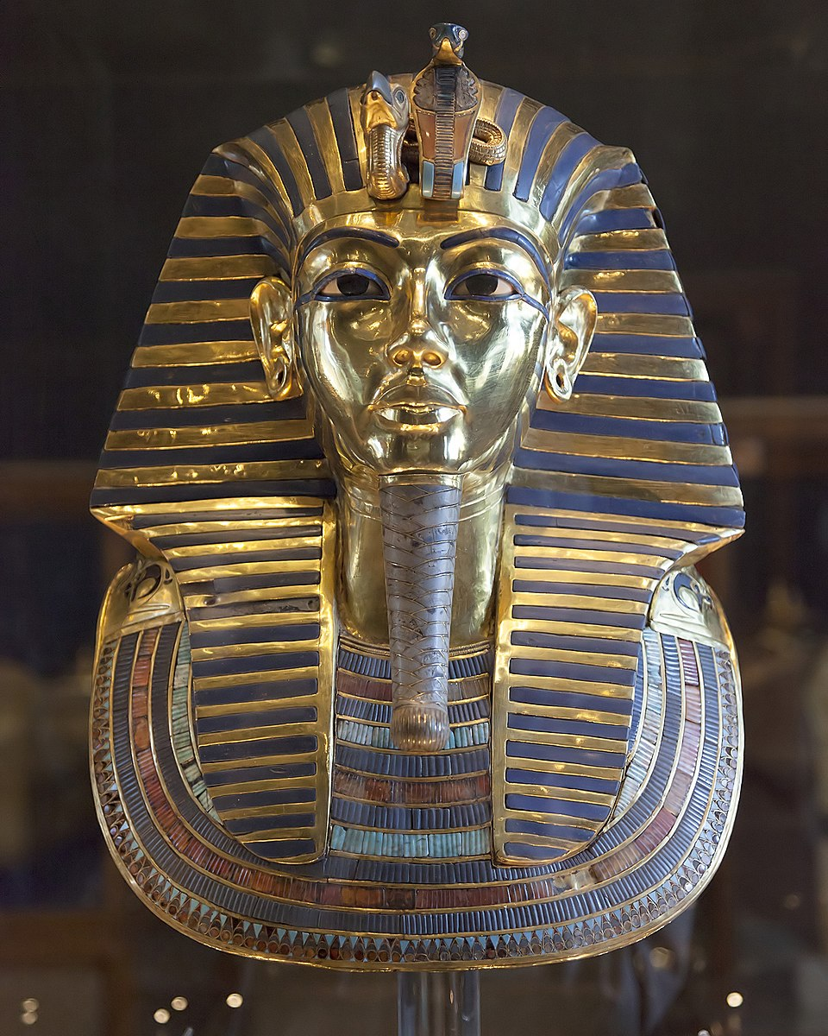
4
Determining historical significance
Activity
Notes:
The purpose of this activity is to help students understand the concept of historical significance, including the criteria they can use to determine whether something or someone they discover when they are studying history is ‘significant’ and should be mentioned in their projects and reports.
Image attribution
Image Title: The mask of Tutankhamun, c. 1327 BC
Creator: Unknown artist
Source: Egyptian Museum, Cairo
License: Creative Commons Attribution-Share Alike 3.0 Unported, 2.5 Generic, 2.0 Generic and 1.0 Generic license.

Slide 23
5
How do we identify individuals
who were historically significant in ancient Egypt?
Notes:
Activity 1
Ask students why they think we remember some individuals from history when the vast majority of people who lived then have faded from public memory and history books and articles.
Students might think of a range of criteria, including:
they did something really bad
there are lots of historical records about them because people at the time wrote about them (e.g. a king or queen, a person who led a city or an army). This is more likely to make an individual from ancient times ‘significant’, because we don’t have as many surviving records
they invented or discovered something important
they changed the way we think about things
they wrote, painted or built something famous
they were extremely good at something.
Use a Think/Pair/Share activity with your students so that they can create a list of criteria to enable them to evaluate individuals from ancient Egypt to enable them to make a judgment about their historical significance.
Remind your students that the questions they are designing are to enable them to use the sources about an individual to evaluate the historical significance of that individual.
Evaluate - the capability to make an informed judgment
An example of a set of criteria is provided in the following slides, which you can modify to reflect the students’ own set of criteria as you explore their ideas on historical significance with the group. The cultural background of your students could influence the criteria they apply.
Image attribution
Title: The Nefertiti Bust; 1352–1332 BC
Creator: Unknown artist
Source: Neues Museum, Berlin, Germany
License: This file is licensed under the Creative Commons Attribution-Share Alike 3.0 Unported, 2.5 Generic, 2.0 Generic and 1.0 Generic license.

Slide 24
6
What makes an individual historically significant?

Slide 25
7
Did the people who lived at that time think they were significant?

Slide 26
8
How many people’s lives were affected by them?

Slide 27
9
Were people’s lives greatly changed or affected by them?

Slide 28
10
Did the changes they made in the world have lasting consequences?

Slide 29
11
Can the impact of their life and actions still be felt today?

Slide 30
12
What is their legacy?

Slide 31
13
Do they represent something of significance to us today?

Slide 32
14
Who decides historical significance?

Slide 33
In what ways can the
consequences still be felt
today?
What is their legacy?
15
What makes this individual significant?
Activity 5.1
How long lasting were the consequences of their actions?
Who decides historical significance?
To what extent were people’s lives changed by them?
How significant were they to people who lived at that
time?
How many
people were affected by them?
Notes:
Image attribution
Title: The Nefertiti Bust; 1352–1332 BC
Creator: Unknown artist
Source: Neues Museum, Berlin, Germany
License: This file is licensed under the Creative Commons Attribution-Share Alike 3.0 Unported, 2.5 Generic, 2.0 Generic and 1.0 Generic license.

Slide 34
16
Evaluate and rank the significance of famous ancient Egyptians
Notes:
Activity 2
Divide your students into pairs or groups of three for this task.
Randomly assign each pair/group a historical figure from the list on the next slide.
Ask each pair/group to evaluate their assigned historical figure using the criteria they have developed.
Your students will need to research their assigned person using textbooks and the internet.
Each pair/group needs to be able to justify their evaluation of their assigned person.
Once each pair/group has finished their evaluation, facilitate a class discussion on the whiteboard to rank the importance of each historical figure. This can be represented on a ‘priority pyramid’ or a ‘wheel of significance’.
Encourage students to change their assessment if they want to after they have listened to other groups.
Differentiated Learning
Support: Give students a set of key internet search terms to help them with their research, such as ‘Hatshepsut importance’ etc.
Extension: Ask students to rank the individuals on the basis of the impact they had on the everyday lives of people at the time, and then again on the impact they had on future generations and civilisations.
Image attribution
Title: Head of Ramses II, Abu Simbel, Egypt
Creator: Unknown artist
Source: Hajor
License: Creative Commons Attribution-Share Alike 3.0 Unported license..
Image: Pharaoh Ramses II, Abu Simbel, Egypt

Slide 35
17
Imhotep
Khufu (Cheops)
Thutmose III
Amenhotep IV
Alexander the Great
Cambyses II
Cleopatra VII
Nefertiti
Ramses II
Tutankhamun
Snefru
Hatshepsut
List of historical figures from ancient Egypt

Slide 36
Example of practice
Levels 9 and 10

Slide 37
Activity
2
Key question: Why is the Holocaust historically significant?
Activity:
Use the following slides to develop students’ ability to determine significance.
Have students complete the activities and questions provided.

Slide 38
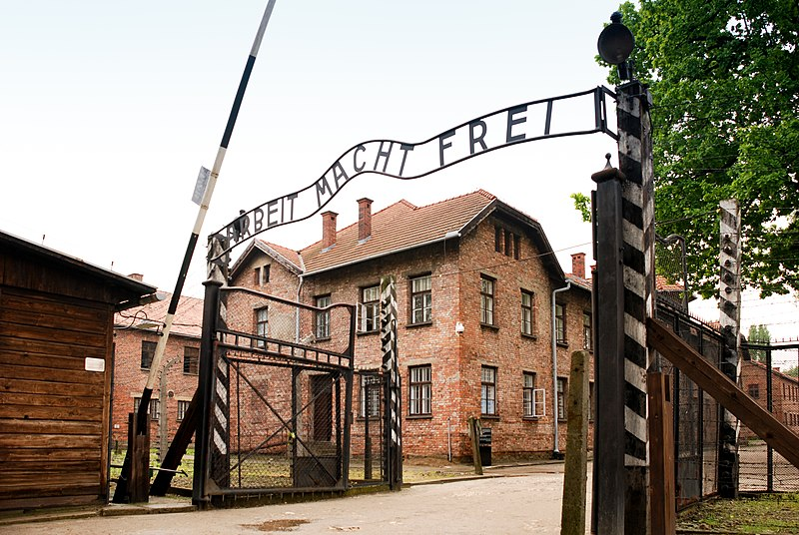
3
Determining historical significance
The Holocaust
Notes:
Caption: The gates of Auschwitz I, Poland. A German concentration camp between 1940 and 1945. Over 1.3 million Jewish people and other ‘undesirables’ were sent here where it is estimated at least 1.1 million of them were murdered. The wording over the gate says ‘Work sets you free’.
Image attribution
Title: German concentration camp, Auschwitz I (the main camp), Poland
Creator: xiquinhosilva
Source: Wikkicommons
License: This file is licensed under the Creative Commons Attribution 2.0 Generic license.

Slide 39
How do you decide what is historically important?
4
How do you measure the relevance of an event – then and now?
Activity 1
How do you decide the profundity, or the depth of impact, of an event?
How do you measure the durability of the impacts of an event?
How many people were affected by the event? Is the number of people affected important? Why?
Notes:
Activity 1
Use a Think/Pair/Share activity with your students to answer the questions on the slide so that they can develop a set of criteria for evaluating the historical significance of the Holocaust.
You can use Slides 5 to 9 to organise and record your students’ definitions.
Image attribution
Title: An Auschwitz prisoner’s clothing with the yellow Star of David to identify its wearer as Jewish.
Creator: Takk
Source: Wikkicommons
License: This file is licensed under the Creative Commons Attribution-Share Alike 3.0 Unported license.

Slide 40
5
What makes an event important?

Slide 41
6
What makes an event profound?

Slide 42
7
How many people need to be affected for an event to be considered significant?

Slide 43
8
How do you measure the durability of the impacts of an event?

Slide 44
9
How do you measure the relevance of an event – then and now?

Slide 45
10
Activity 2
Determine the historical significance of the Holocaust
Notes:
Activity 2
Divide your students into pairs or groups of three for this task.
Ask each pair/group to evaluate the historical significance of the Holocaust, using one of the criteria that you have just explored.
Your students will need to research the Holocaust, using textbooks and the internet.
Each pair/group needs to be able to justify their evaluation of the historical significance of the Holocaust.
Once each pair/group has finished their evaluation, facilitate a class discussion on the whiteboard to determine the historical significance of the Holocaust against each criteria.
Differentiated learning
Support: Give students a set of key research terms to help them with their research, such as ‘the Holocaust’, ‘the Final Solution’, ‘genocide’ and ‘ethnic cleansing’.
Extension: In completing the task, students could be asked to develop arguments for and against the position that the Holocaust is historically significant according to one of the criteria.
Image attribution
Title: Open burial pit at Belsen Concentration Camp, 15 April, 1945.
Creator: Lieutenant Alan Moore
Source: Australian War Memorial
License: This item is in the Public Domain
Image: Open burial pit at Belsen Concentration Camp, 15 April, 1945.

Slide 46
Conclusion

Slide 47
Discussion points
Are you asking students at this level to evaluate historical significance using the evidence and their own judgment?
Do your students discuss the relative importance of people and developments in the past?
Could reading and writing historical fiction help students determine the historical significance of a person, place, movement, event or object?
Which new vocabulary words can you introduce to help students discuss the concept of historical significance?
How can you use your school or local environment to initiate or enrich the teaching and learning of this concept? How is historical significance reflected in the physical environment around you (e.g. street names, honour boards, plaques and statues etc.)?
How do we design activities that cater for a wide range of learners?
Notes:
Individually or in groups, use these questions to reflect on your teaching. How do you approach teaching the concept of historical significance? How might you approach it differently?

Slide 48
Reflection activity
Use the following thinking routine to reflect:
What are three things I remember from this information?
What are two things I found interesting?
What is one question I have?

