Slide 1
Victorian Curriculum Mathematics F - 6 Algorithms unplugged
David Leigh-Lancaster
Curriculum Manager: Mathematics

Slide 2
Agenda
Terminology
A frequently asked question
Level 2 Activity
Level 3 Activity
Level 4 Activity
Level 5 Activity

Slide 3
Overview of session
This session will cover four examples of algorithms implemented through activities related to the content of the Victorian Curriculum Levels 2, 3, 4 and 5.
The activities are ‘unplugged’ - the use of digital technology is not required.
The activities cover some related content descriptions from the strands.

Slide 4
Some key terms and ideas
Algorithm
A well-defined set of instructions designed to perform a particular task or solve a type of problem.
Coding
A process by which algorithms are represented for implementation.
Platform The means by which an algorithm is implemented. This may be a mechanical device, a program running on a computer using a particular programming language, or an activity carried out by a person or robot.

Slide 5
Some key terms and ideas
Sequence
An ordered set of instructions or actions.
Decision
A process by which a selection or choice is made from a set of alternatives.
Iteration
The repetition of a process a specified number of times, or until a condition is satisfied.

Slide 6
A frequently asked question
For the new content on algorithms and coding, is it expected that a particular approach, platform or language is used?
No. Various approaches to developing and coding algorithms can be used and may involve natural language, structured language or pseudo-code or a formal programming language.
Algorithms can be implemented by acting out a script, using robots, and various technologies, software and applications. These should be employed as suits the level at which the student is working, and the nature of the activity or task.

Slide 7
Developing an algorithm
For each of the following activities we are looking to develop an algorithm for a particular class of problems.
The algorithm will be represented in written English (natural language) as a set of instructions, incorporating sequence, iteration and decision as applicable.
Alternative ‘unplugged’ representations include structured English and flowcharts (some links to sample resources for these are provided at the end of the presentation)
Resources: https://code.org/curriculum/unplugged and http://computingunplugged.org/activities

Slide 8
Level 2 Activity Counting coins
Problem 1
Consider a large collection of coins of the same denomination (or counters of the same colour), for example 5 cent coins.
Develop an algorithm for deciding whether there is an even or odd number of elements in the collection without counting.
Problem 2
Consider a large collection of coins of the same denomination (or counters of the same colour), for example 5 cent coins.
Develop an algorithm for finding the total value of the set of coins.
For information about Australian coins see: https://www.ramint.gov.au/circulating-coins

Slide 9
Level 2 Activity Counting coins
Apply repetition in arithmetic operations, including multiplication as repeated addition and division as repeated subtraction (VCMNA114)
Investigate number sequences, initially those increasing and decreasing by twos, threes, fives and ten from any starting point, then moving to other sequences (VCMNA103)
Recognise and represent multiplication as repeated addition, groups and arrays (VCMNA108)
Recognise and represent division as grouping into equal sets and solve simple problems using these representations (VCMNA109)
Investigate the conditions required for a number to be odd or even and identify odd and even numbers(VCMNA129)
Blue text: Algorithms and coding content description
Black text: Related content description

Slide 10
Level 2 Activity Counting coins
Investigations
You have collected a large tin of ‘spare change’ and it is now full. How would you determine the total value manually?
What are coin sorting machines, and how do they work?
What are coin counting machines and how do they work?
How do automatic banking coin deposit machines work?

Slide 11
Level 3 Activity Function machines
Problem 1
Devise a function machine that adds (or subtracts) a fixed amount onto (or from) an input
Problem 2
What happens when we repeatedly feed output from this function machine back into it as input?
Problem 3
Devise a function machine that combines the actions of an ‘add onto’ function machine with that of a ‘subtract from’ function machine. What does a combined function machine where the output the same as the input look like?
Problem 4
Devise a function machine that always outputs an odd number for any input.
Resources: http://www.amblesideprimary.com/ambleweb/mentalmaths/functionmachines.html and http://www.littlefishsw.co.uk/card/functionmachine.html and http://www.topmarks.co.uk/Flash.aspx?f=FunctionMachinev3

Slide 12
Level 3 Activity Function machines
A basic function machine diagram

Slide 13
Level 3 Activity Function machines
Use a function machine and the inverse machine as a model to apply mathematical rules to numbers or shapes (VCMNA139)
Describe, continue, and create number patterns resulting from performing addition or subtraction(VCMNA138)
Investigate number sequences, initially those increasing and decreasing by twos, threes, fives and ten from any starting point, then moving to other sequences (VCMNA103)
Blue text: Algorithms and coding content description
Black text: Related content description

Slide 14
Level 4 Activity Approximating areas
Problem
Approximate the area, in square units, of an irregular closed curve such as:

Slide 15
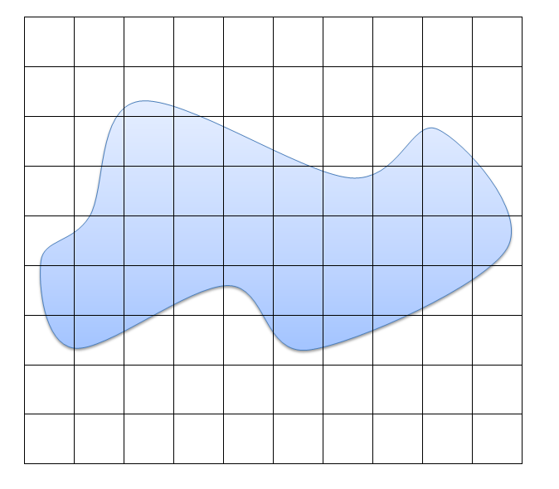
Level 4 Activity Approximating areas
Place a square grid over the shape

Slide 16
Level 4: Approximating areas
Before starting
Give a lower bound and an upper bound for the area of the shape.
Method
Consider the area of a single small square in the grid to be one square unit.
If a whole square or more than half a square in the grid is covered by the shape assign that square the value 1.
If a whole square or less than half a square in the grid is covered by the shape assign that square the value 0.
Total the assigned values, this is the approximation in square units for the area of the shape.

Slide 17
Level 4 Approximating areas
Problem
Devise an algorithm for this method, which could be applied to any shape of this sort with a suitable grid already superimposed.
Resource
http://www.had2know.com/househome/irregular-shape-area.html
Investigations
What is a planimeter?
How can Google Maps be used to measure area?

Slide 18
Level 4 Activity Approximating areas
Define a simple class of problems and solve them using an effective algorithm that involves a short sequence of steps and decisions (VCMNA164)
Measure, order and compare objects using familiar metric units of length, area, mass and capacity(VCMMG140)
Compare objects using familiar metric units of area and volume (VCMMG166)
Blue text: Algorithms and coding content description
Black text: Related content description

Slide 19
Level 5 Activity Random walk
Problem
How can we simulate a random walk? What would this look like?
Background
Use a 1 cm grid sheet of graph paper in landscape format, at the middle of the left hand side set a starting point, facing right.
Define a ‘step’ as a move one space forward and one space up or down, ending up facing as per the original direction. The overall direction of movement is from left to right, facing right after each step.
Decide whether to move up or down in each ‘step’ by tossing a coin, if the result is a head move ‘up’ if the result is a ‘tail’ move down.
To create a random walk repeat this process for specified number of ‘steps’.
Each steps starts from where the previous step finished.

Slide 20
Level 5 Activity Random walk
Use a grid to draw 5 random walks of 10 steps.
Two sets of results for the coin tosses are given below:
The walk for the first one is shown on the next slide
Investigation
Carry out a large number of random walks and comment on the distribution of endpoints.

Slide 21
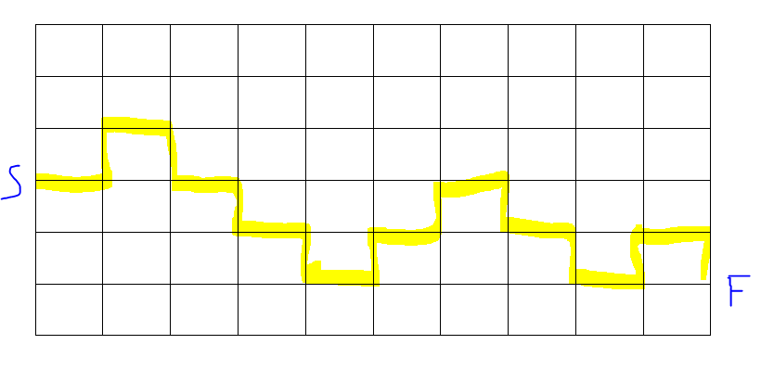
Level 5 Activity Random walk

Slide 22
Level 5 Activity Random walk
Resources
https://en.wikipedia.org/wiki/Random_walk
http://www.mit.edu/~kardar/teaching/projects/chemotaxis(AndreaSchmidt)/random.htm
http://demonstrations.wolfram.com/SimulatingTheSimpleRandomWalk/

Slide 23
Random walk Level 5 related content descriptions
Follow a mathematical algorithm involving branching and repetition (iteration) (VCMNA194)
Use a grid reference system to describe locations. Describe routes using landmarks and directional language (VCMMG199)
Conduct chance experiments, identify and describe possible outcomes and recognise variation in results(VCMSP147)
Identify events where the chance of one will not be affected by the occurrence of the other (VCMSP177)
List outcomes of chance experiments involving equally likely outcomes and represent probabilities of those outcomes using fractions (VCMSP203)
Blue text: Algorithms and coding content description
Black text: Related content description

Slide 24
Representing algorithms - Resources Structured English
https://www.techopedia.com/definition/28633/structured-english
http://www.w3computing.com/systemsanalysis/wr
https://en.wikipedia.org/wiki/Structured_Englishiting-structured-english/
http://it.toolbox.com/blogs/enterprise-solutions/guidelines-for-structured-english-in-documenting-specifications-15987

Slide 25
Representing algorithms - Resources Flowcharts
https://en.wikipedia.org/wiki/Flowchart
https://www.draw.io/www.smartdraw.com/flowchart/
https://www.sm
http://creately.com/diagram-type/flowchartartdraw.com/flowchart/

Slide 26
Contact
For queries related to the Victorian Curriculum Mathematics, please contact
VCAA Mathematics Curriculum Manager: Dr David Leigh-Lancaster leigh-lancaster.david.d@edumail.vic.gov.au
Telephone: (03) 9032 1690

