Slide 1
Introducing Visual Arts

Slide 2
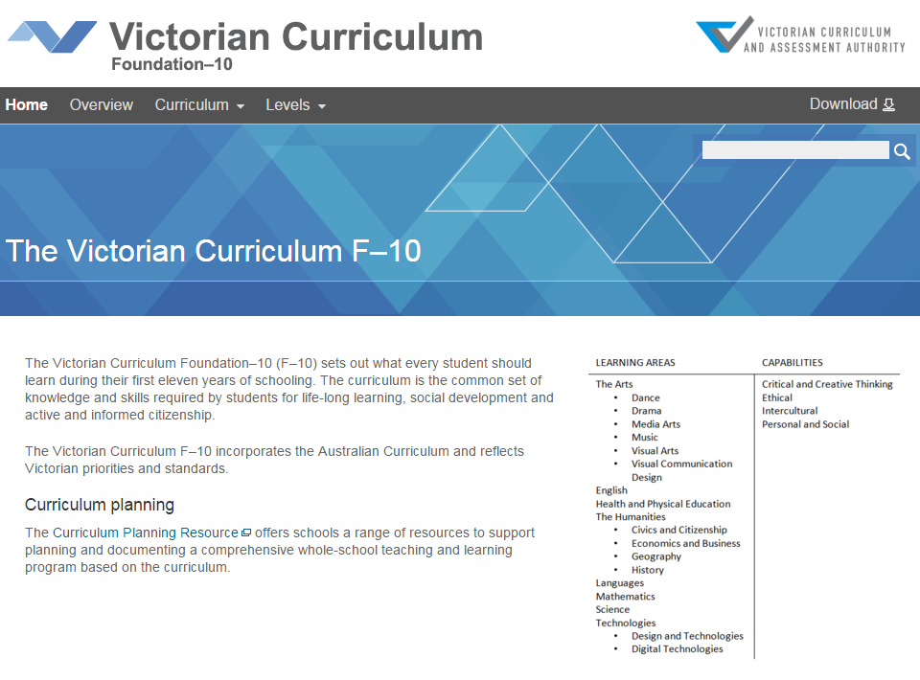
Victorian Curriculum F–10
Released in September 2015 as a central component of the Education State
Provides a stable foundation for the development and implementation of whole-school teaching and learning programs
The Victorian Curriculum F–10 incorporates the Australian Curriculum and reflects Victorian priorities and standards
http://victoriancurriculum.vcaa.vic.edu.au/

Slide 3
Aims
The Visual Arts curriculum aims to develop students’:
conceptual and perceptual ideas and expressions through design and inquiry processes
visual arts techniques, materials, processes and technologies
critical and creative thinking, using visual arts languages, theories and practices to apply aesthetic judgment
respect for and acknowledgement of the diverse roles, innovations, traditions, histories and cultures of artists, craftspeople, designers, curators, critics and commentators
respect for visual arts as social and cultural practices, including industry practices
confidence, curiosity, imagination and enjoyment and a personal aesthetic through engagement with visual arts making, viewing, discussing, analysing, interpreting and evaluating.

Slide 4
Structure
Strands
Explore and Express Ideas | Visual Arts Practices | Present and Perform | Respond and Interpret
Achievement standards
The first achievement standard is at Foundation and then at Levels 2, 4, 6, 8 and 10.
A curriculum for students with disabilities is provided in this learning area.

Slide 5
Key messages
Each Arts discipline is based on two overarching principles:
students learn as artist and as audience
students learn through making and responding
The addition of an achievement standard in Foundation reflects the advice in Victorian Curriculum F–10: Revised curriculum planning and reporting guidelines about the importance of the Arts in the early years of schooling
Students explore traditional, contemporary and evolving visual conventions used in artworks of diverse styles and composition. These may include combinations of the:
conventions such as composition and style, the art elements of line, shape, colour, tone, texture, form, sound, light and time
art principles of emphasis, movement, rhythm, unity, variety, space, repetition, balance, contrast and scale.

