Slide 1

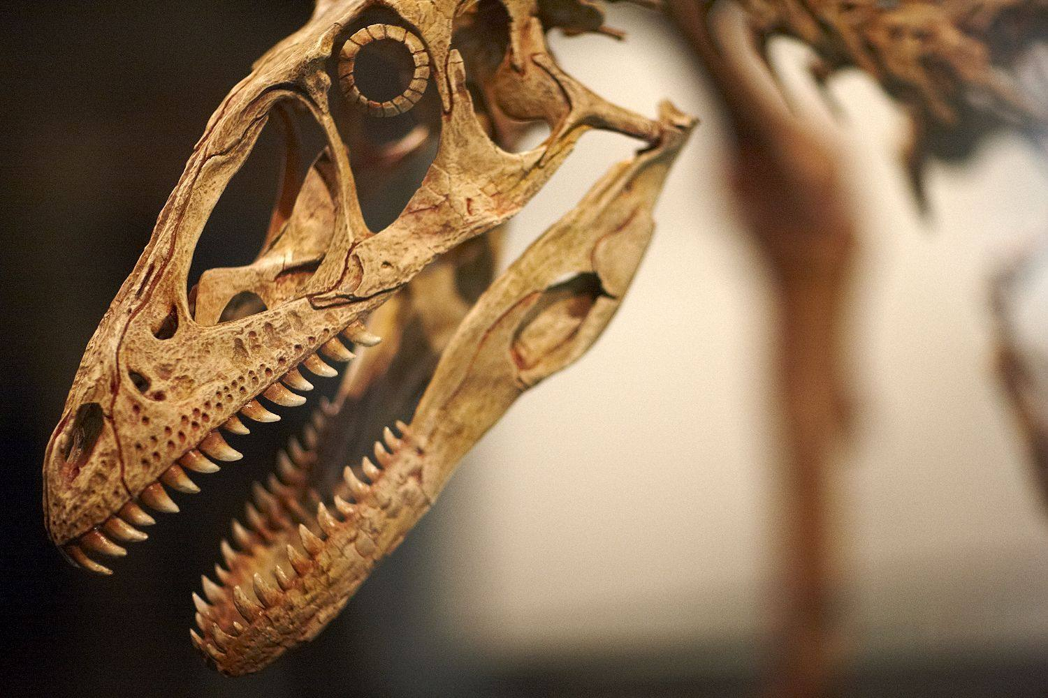
Where are dinosaurs in
Victorian Curriculum F–6 Science?
Using the context of ‘dinosaurs’ to teach science content and skills

Slide 2
Why aren’t ‘dinosaurs’ in the
Primary Science curriculum?
The Victorian Curriculum is based around knowledge and skills
‘Dinosaurs’ is a context through which scientific understanding, knowledge and skills may be developed at all levels of the Primary Curriculum
Planning teaching and learning activities requires consideration of:
  content descriptions
  achievement standards
  overarching ‘big ideas’ in science/key concepts in science:
    Patterns, order and organisation
    Form and function
    Stability and change
    Scale and measurement
    Matter and energy
    Systems

Slide 3
Dinosaurs were once ‘living things’
Band | Content description | Modified content description
F–2 | Living things have a variety of external features and live in different places where their basic needs, including food, shelter and water, are met | Dinosaurs have a variety of external features and live in different places where their basic needs, including food, shelter and water, are met
 | Living things grow, change and have offspring similar to themselves | Dinosaurs grow, change and have offspring similar to themselves
3–4 | Living things can be grouped on the basis of observable features and can be distinguished from non-living things and the environment to survive | Dinosaurs can be grouped on the basis of observable features and can be distinguished from non-living things and the environment to survive Dinosaurs can be distinguished from other living things
 | Different living things have different life cycles and depend on each other | Dinosaurs have different life cycles from butterflies/frogs and depend on each other and the environment to survive
5–6 | Living things have structural features and adaptations that help them to survive in their environment | Dinosaurs have structural features and adaptations that help them to survive in their environment
 | The growth and survival of living things are affected by the physical conditions of their environment | The growth and survival of dinosaurs are affected by the physical conditions of their environment

Slide 4
What do your students already know?
Where are your students on
a ‘learning continuum’?

Slide 5
15 dinosaur myths
Dinosaurs and humans lived at the same time.
All dinosaurs lived at the same time.
All dinosaurs were big.
All big reptiles were dinosaurs.
All dinosaurs were scaly.
All dinosaurs were green and brown.
Dinosaurs were slow and sluggish animals.
Dinosaurs were bad parents.
All dinosaurs became extinct.
Dinosaurs became extinct because mammals ate their eggs.
Dinosaurs were evolutionary failures.
An asteroid impact alone killed the dinosaurs.
We have found fossils from most of the dinosaur species.
Tyrannosaurus rex was a giant scavenger.
Tyrannosaurus rex stood upright.

Slide 6
Unpacking dinosaur myths: a curriculum planning perspective
Myth | Key science idea | Content description | Achievement standard
An asteroid impact alone killed the dinosaurs | Stability and change Matter and energy Systems | F–2: Living things … live in different places where their basic needs, including food, water and shelter, are met | F–2: … describe how different places meet the needs of living things
 |  | 3–4: Different living things … depend on each other and the environment to survive | 3–4: … describe relationships that assist the survival of living things
 |  | 5–6: The growth and survival of living things are affected by the physical conditions of their environment Sudden geological changes or extreme weather conditions can affect Earth’s surface | 5–6: … analyse how structural and behavioural adaptations of living things enhance their survival … predict and describe the effect of environmental changes on individual living things

Slide 7
How do we know which ancient creatures were dinosaurs?
Here are some basic rules you can use to determine which animals were dinosaurs.
Dinosaurs
lived between 250 and 65 million years ago
lived on land
had straight legs tucked under their body
were reptiles – but were probably warm-blooded!
Curriculum links: Compare the Biological Sciences sub-strand of the Science Understanding strand of the Science curriculum with the Reasoning strand of the Critical and Creative Thinking curriculum. How are they related when considering the question of whether a dinosaur was a reptile?

Slide 8
Key science idea:
Function relies on form

Slide 9
Deinonychus
deino = terrible
nychis = claws
A dinosaur’s name often tells you something about its structure.
A dinosaur’s structure tells you something about the dinosaur’s habits and survival mechanisms.
With thanks to Melbourne Museum for the image of Deinonychus

Slide 10
Deinonychus’ lifestyle
Carnivorous
Up to 3.4 metres in height
Single, razor-sharp, large, curved claw on each hind foot
? Claws to impress opposite sex
? Claws to climb trees
Covered with feathers
Used hind claws to disembowel prey
Jaws relatively weak
Not as fast-moving as other dinosaurs
? May have waited for their ‘dinner’ to bleed to death, rather than directly killing it
Nature of scientific evidence
F–2: Compare observations and predictions with those of others
3–4: Compare results with predictions, suggesting possible reasons for findings
5–6: Compare data with predictions and use as evidence in developing explanations

Slide 11
Dinosaur names
deino = terrible
sauros = lizard
cerato = horn
ops = face
pachy = thick
ornitho = bird-like
stegos = roof-like or plated
proto = first
tyranno = tyrant
rex = king
bronto = thunder
apate = deceit
pod = foot
ovi = eggs
rapere = to seize/rob
Examples:
Pachycephalosaurus = thick-headed lizard
Ornithopoda = bird feet
Stegosaurus = plated lizard
Triceratops = three-horn face
What would the following look like/how would they behave?
Apatosaurus
Brontosaurus
Oviraptor
Invent a ‘new’ dinosaur. Give it a name and draw its features.

Slide 12
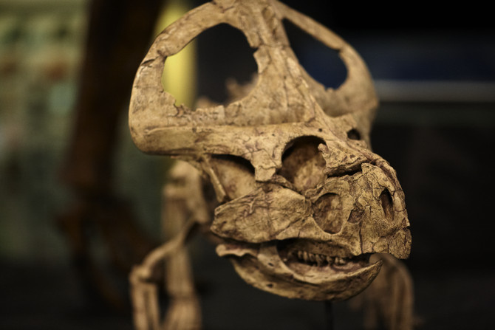
Protoceratops
What type of food did Protoceratops eat?
What is the evidence?
With thanks to Melbourne Museum for the image of Protoceratops

Slide 13
Protoceratops
It had small horns on the side of its head but a large frill on the back of its head. What could the frill have been used for?
What problems could the head frill have solved?
With thanks to Melbourne Museum for the image of Protoceratops

Slide 14
Protoceratops: structure and function
Herbivore
2 metres long (including tail)
About the size of a sheep
Small horns
Frill on the back of its head, larger in males than in females – possibly involved in courtship; possibly useful for dinosaurs to recognise own species; possibly used to establish social dominance in herd
Hundreds of fossils found in Central Asia; lived in groups on edges of lakes and rivers
Fossils include eggs and nests, newly hatched, teenagers and male and female adults
Head of young dinosaurs large in comparison to body (like other animals, including humans)

Slide 15
Designing the features of your dinosaur
Feature | Your preference | Why? | Sketch
Lives on land or in the air
Preferred climate/weather
Food choice (meat, vegetarian, vegan, gluten-free, FODMAP, everything)
Size (large, medium, small)
Colour
Walking pattern (on two or four legs; fast or slow; long or short steps; hopping, jumping or striding)
Leg description (long or short; slim, solid or powerful)
Type of feet (bird-like, lizard-like, number of toes)
Number of arms
Arm description (long or short; thin or thick)
Head size (large, medium, small)
Head features (horns, frills, spikes)
Body covering (feathers, fur, skin)
Body features (spikes, frills)
Other special features

Slide 16
Designing the features of Mariasaurus
Feature | Your preference
Lives on land or in the air | air
Preferred climate/weather | warm
Food choice (meat, vegetarian, vegan, gluten-free, FODMAP, everything) | meat and chocolate
Size (large, medium, small) | small
Colour | red and green
Walking pattern (on two or four legs; fast or slow; long or short steps; hopping, jumping or striding) | two legs, fast, jumping
Leg description (long or short; slim, solid or powerful) | springy
Type of feet (bird-like, lizard-like, number of toes) | bird-like
Number of arms | 2
Arm description (long or short; thin or thick) | Short, thin
Head size (large, medium, small) | large
Head features (horns, frills, spikes) | horns
Body covering (feathers, fur, skin) | feathers
Body features (spikes, frills) | frills
Other special features | solar panel in frills, face mask

Slide 17
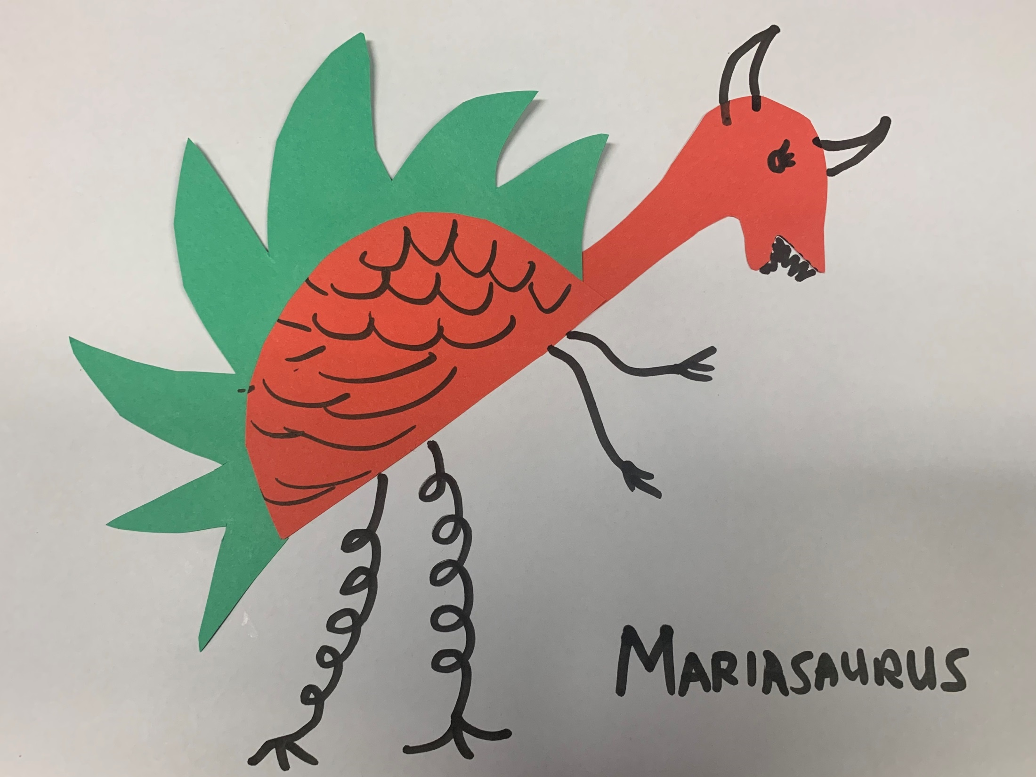
Flaps that rub together to communicate with friends, make music to attract mates or produce scary sounds to frighten predators
Red body and head to attract mates
Large head for good brain capacity
Horns to scare predators and help tear up food
Green frills to camouflage in trees
Retractable face mask to protect against poisonous gas release
Waterproof frills that wrap around body and protect from wind and rain
Fierce teeth and strong jaws to eat mostly meat
Long, warm tongue to melt chocolate quickly to eat, and to lick up water
Nimble hands to pick up food and help climb trees
Frills that can flap to stay cool in summer and wrap body to stay warm in winter
Feathers to fly into trees that provide shelter and regulate body temperature. Feathers could also help survival if a giant asteroid hits Earth
Solar panels lining frills to stay warm in winter
Spring-like legs to jump long distances and jump high to run away from predators

Slide 18
Scientific representations
Draw or construct a model of your designosaur, labelling its special features.
Annotate your model to show how your designosaur will:
  communicate with other animals
  defend itself from and/or attack other animals
  survive in its environment
  survive if global warming due to volcanic eruption and emission of huge quantities of carbon dioxide (CO₂) leads to significantly increased atmospheric temperatures and increased sea levels.
Could your dinosaur become your pet? Why/why not?
What is the biggest threat to your designosaur’s survival?
How could the design of your designosaur be improved so that it is better
able to survive?
Which class designosaur is yours most similar to?
  Of the two dinosaurs (yours and the one that it is most similar to), explain which one would be more likely to survive today.
  Compare your designosaur with one other designosaur and explain whether the two could successfully live in the same community.

Slide 19
Sample assessment rubric
Consider the purpose of the rubric: diagnostic, formative, summative or combination.
The rubric can relate to one curriculum level or may span several levels.
You can add rows that relate to relevant elements across the curriculum.
Illustration and explanation of how designosaur features help it to … | Very high | High | Medium | Low | Very low | Not shown
meet food needs
meet water needs
be protected from the weather
be protected from predators
interact successfully with other living things
attract mates
survive when the environment changes

Slide 20
Question: Which dinosaur would have the greatest chance of survival if it were alive today?
Curriculum links:
Which learning areas and capabilities relate to students investigating this question?
What learning activities and assessments would be appropriate to support learning in (a) single-level classes or (b) multilevel classes?

Slide 21
Data representations
in science

Slide 22
Graphing dinosaurs
Dinosaur data is easily accessed on the internet
Sample of data is shown in the table below
Generate questions, e.g. Is there a relationship between ‘X’ and ‘Y’? Were early dinosaurs larger than later dinosaurs? Are meat-eaters larger than vegetarians? What extra data needs to be collected?
Dinosaur | Infra-order | Height (metres) | Time range
Argentinosaurus | Sauropoda | 42 | late Jurassic to late Cretaceous
Compsognathus | Coelurosauria | 1 | late Jurassic to early Cretaceous
Massospondylus | Prosauropoda | 4 | late Triassic to early Jurassic
Oviraptor | Coelurosauria | 2 | late Cretaceous
Stegosaurus | Stegosauria | 8 | late Cretaceous
Triceratops | Ceratopsia | 8 | late Cretaceous
Tyrannosaurus rex | Coelurosauria | 14 | late Cretaceous
Velociraptor | Coelurosauria | 2 | mid Jurassic to late Cretaceous

Slide 23
Graphs and tables in science
Band | Asking questions | Making predictions | Representations
F–2 | Respond to and pose questions, and make predictions … | Compare observations and predictions with those of others | Use … provided tables to sort information
3–4 | With guidance, identify questions that can be investigated and predict what might happen | Compare results with predictions, suggesting possible reasons for findings | Use … tables and column graphs to represent data and to identify patterns and trends
5–6 | With guidance, pose questions to inform a scientific investigation, and predict what the findings of an investigation might be | Compare data with predictions and use as evidence in developing explanations | Construct and use … tables and graphs to record, represent and describe observations, patterns or relationships in data

Slide 24
Levels F–2: Scaffolded/provided graphs
provided bar graph scaffolds
may include lengths of familiar animals (koala, dog, kangaroo, cow, giraffe, elephant)
ANIMAL | LENGTH (m) | GRAPH
T. rex | 14 m | . | . | . | . | . | . | . | .
Compsognathus | 1 m | . | . | . | . | . | . | . | .
Maiasaura | 10 m | . | . | . | . | . | . | . | .
Iguanodon | 11 m | . | . | . | . | . | . | . | .
Ankylosaurus | 8 m | . | . | . | . | . | . | . | .
Apatosaurus | 30 m | . | . | . | . | . | . | . | .
Human child | 1 m
 |  | 4 m | 8 m | 12 m | 16 m | 20 m | 24 m | 28 m | 32 m

Slide 25
Dinosaur footprints: linking maths and science
Dinosaur footprints can be analysed in terms of:
length
width
shape
number of toes
size of heel impression
Task: Obtain an image of a dinosaur footprint and details about its dimensions. Suggest possibilities for what the dinosaur would have looked like, how it may have moved and how it may have behaved in its day-to-day activities.
Curriculum links: The scientific concept that ‘function relies to form’ can be investigated from a mathematical perspective.

Slide 26
Life cycles
Dinosaurs compared with
other living things

Slide 27
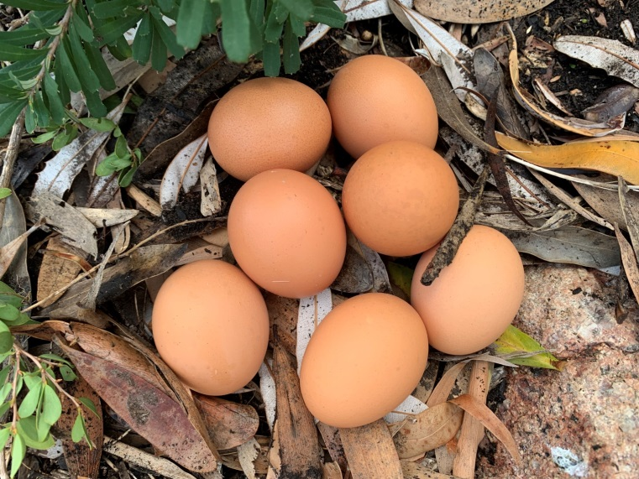
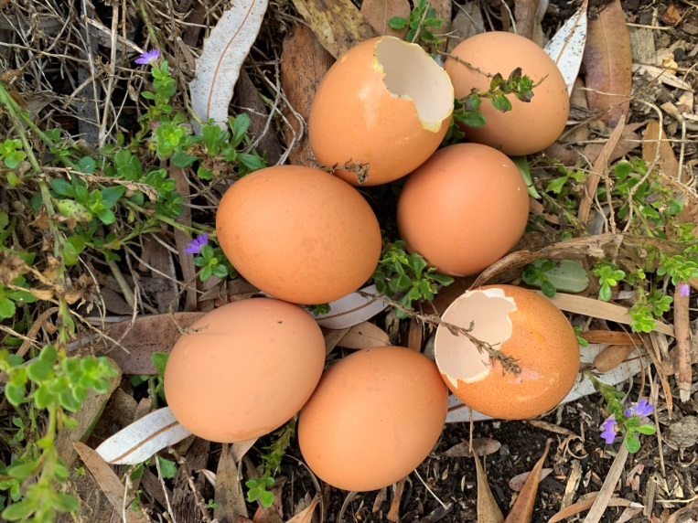
Life cycles of dinosaurs … and chickens
What will baby dinosaurs look like?
Science inquiry skills: Questioning and predicting
F–2: Respond to and pose questions, and make predictions about familiar objects and events
3–4: With guidance, identify questions in familiar contexts that can be investigated scientifically and predict what might happen based on prior knowledge
5–6: With guidance, pose questions to clarify practical problems or inform a scientific investigation, and predict what the findings of an investigation might be based on previous experiences or general rules

Slide 28
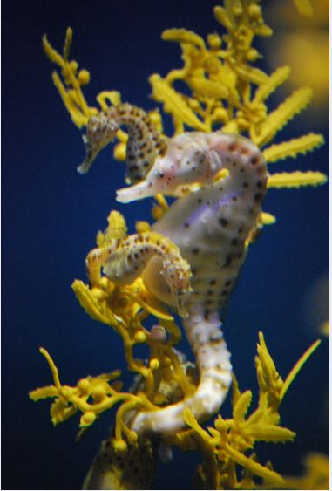
Butterflies, frogs and seahorses
Comparisons should be made between living things with different types of life cycles, including living things that may be familiar – as well as unfamiliar – to students
"Pregnant seahorse" by Kelly McCarthy is licensed under CC BY-SA 2.0
Levels 3–4: Different living things have different life cycles and depend on each other and the environment to survive
A female seahorse transfers her eggs to the male, which he
self-fertilises in his pouch

Slide 29
Branching out …
Other teaching ideas related to dinosaurs:
Archaeological digs: make a ‘fossil pit’ by adding different bones and fossilised teeth (for example, from birds, chickens, goats, kangaroos) and conduct an archaeological ‘dig’, including looking at the work of palaeontologists
Life cycles: put little dinosaurs (models/paper cut-outs) into papier-mâché eggs, break them open and ask students to match the babies to the parents, giving reasons for their decisions
Footprints: obtain scaled footprints of different dinosaurs and ask students to predict the size of dinosaurs and their method of walking, then compare to actual size and gait

Slide 30
Further information
Dinosaur
myth-busting

Slide 31
Myth: Dinosaurs and humans lived at the same time
Dinosaurs and humans coexist only in books, movies and cartoons.
The last dinosaurs (other than birds) died out in a mass extinction event about 65 million years ago.
The fossils of our earliest ancestors are only about 6 million years old.

Slide 32
Myth: All dinosaurs lived at the same time
Dinosaur communities were separated by both time and geography.
The ‘age of the dinosaurs’ (the Mesozoic era) included three consecutive geological time periods (the Triassic, Jurassic and Cretaceous periods) and different dinosaur species lived during each of these three periods. For example, Stegosaurus would have lived about 150 million years ago (late Jurassic period) and Tyrannosaurus evolved about 67 million years ago (Cretaceous period), just a few million years before the mass extinction event.
More time separates Stegosaurus and Tyrannosaurus than separates Tyrannosaurus from humans today.
At the beginning of dinosaur history there was one supercontinent on Earth, Pangea, with many dinosaur types spread across it; however, as Pangea broke apart, dinosaurs became scattered across Earth on separate continents, and new types of dinosaurs evolved separately in each geographical area.

Slide 33
Myth: All dinosaurs were big
Long-necked saurapods like Dreadnoughtus schrani could be as big as passenger aeroplanes.
Triceratops and Stegosaurus were about as tall as a two-storey building.
Tyrannosaurus rex was about 14 metres long and 4 metres high.
Oviraptor was the size of an adult human.
The horned dinosaur Protoceratops was the size of a sheep.
Velociraptor was the size of a golden retriever (and was scaled up in the movie Jurassic Park).
Hesperonychus was a cat-sized raptor.
Tianyulong was a rabbit-sized plant-eater.
Parvicursor was a quail-sized insect-eater.

Slide 34
Myth: All big reptiles were dinosaurs
All true dinosaurs were terrestrial animals.
Flying reptiles like pterosaurs (including pterodactyls) and marine reptiles (such as plesiosaurs, pliosaurs, mosasaurs and icthyosaurs) were not dinosaurs, although they lived during the same time period and suffered the same fate in the mass extinction event.
Modern birds did not descend from pterosaurs: birds’ ancestors were small, feathered terrestrial dinosaurs.
Although crocodiles, alligators, birds and dinosaurs all evolved from the same common ancestor (Archosauria), crocodiles/alligators diverged from birds/dinosaurs about 240 million years ago.
Crocodiles and alligators diverged from each other about 100 million years ago.

Slide 35
Myth: All dinosaurs were scaly
Because dinosaurs were related to crocodiles and lizards, most people thought that they must all be scaly.
Many dinosaurs preserve scaly impressions – duckbills, horned dinosaurs, sauropods and armoured dinosaurs.
In the 1970s some palaeontologists wondered whether some dinosaurs might have been feathered, like their bird relatives.
Sinosauropteryx (found in 1997) – small carnivorous dinosaur – was covered in soft, fuzzy down.
Since 1997, feathers have been discovered on plant-eating ornithopods, fanged heterodontausaurs and many families of carnivorous dinosaurs, including Tyrannosauridae (this means that T. rex may have had feathers, not scales!)
Feathers would have helped dinosaurs regulate their body temperature, especially small dinosaurs e.g. velociraptors.

Slide 36
Myth: All dinosaurs were green and brown
Studies of dinosaur scales and feathers have revealed traces of melanin (the same pigment that gives colour to lizard scales, bird feathers and our skin and hair).
Dinosaurs came in wide variety of colours, including black, white and ginger.
Some dinosaur feathers had an iridescent sheen.
Many dinosaurs were boldly patterned with spots and stripes, white bellies and dark backs.
Some of the dinosaurs’ patterns may have evolved as camouflage, to help dinosaurs hide from predators and prey.
Bright colours and conspicuous patterns may have served to attract potential mates (like a peacock attracts mates).
Sinosauropteryx probably had a striped brown tail and a raccoon-like bandit mask.

Slide 37
Myth: Dinosaurs were slow and sluggish animals
Early palaeontologists thought that dinosaurs must have been slow and sluggish to have lost the ‘evolutionary race’ to birds and mammals.
Modern studies find no evidence that dinosaurs were laggards, lazily dragging their tails behind them.
Some dinosaurs moved fast, like the raptor dinosaurs, and some were slow, like the big long-necked dinosaurs.
Most dinosaurs were probably as mobile as large, modern mammals.
Meat-eating dinosaurs were active predators that probably lay down and rested after a meal,
The fossilised four-chambered heart of a hadrosaur, more like the heart of a bird or mammal than the heart of a modern reptile, indicates an active bird-like metabolism and warm-bloodedness.
Tyrannosaurus rex probably did not go much faster than a jogging human, due to the stress running would have put on its massive foot bones.

Slide 38
Myth: Dinosaurs were bad parents
Most reptiles bury their eggs and walk away, leaving their offspring to fend for themselves. This parenting approach is risky since the eggs have little protection – a sea turtle lays thousands of eggs over its lifespan but just a few grow up.
Dinosaurs were once thought to bury their eggs and walk away.
Living dinosaur relatives – birds and crocodiles – guard their eggs and their young, and so it is reasonable to think that dinosaurs also guarded their eggs.
When expeditions to the Gobi Desert found a dinosaur atop a clutch of eggs, it was assumed to have died while plundering the nest and was therefore named Oviraptor, meaning ‘egg thief’; when more skeletons were found above egg nests, sitting on them like brooding birds, it was concluded that oviraptors were guarding their eggs, not eating them.

Slide 39
Myth: All dinosaurs became extinct
Theory of extinction: asteroid striking Earth in Mexico
A few small feathered dinosaurs, probably fewer than a dozen species, survived (small flying cousins of Tyrannosaurus rex and Velociraptor, and the direct descendants of the carnivorous dinosaurs) and evolved into tens of thousands of bird species.

Slide 40
Myth: Dinosaurs became extinct because mammals ate their eggs
Dinosaurs co-existed with mammals for about 150 million years.
Although dinosaur nests were vulnerable, the most dangerous predators were probably smaller dinosaurs.
Most mammals of the time were probably too small to eat the eggs of large dinosaurs.

Slide 41
Myth: Dinosaurs were evolutionary failures
Stereotype: Dinosaurs were dim-witted, slow-moving uninteresting animals that just sat around waiting to become extinct.
Dinosaur extinction was blamed on dinosaurs’ failure to adapt to a changing environment.
Dinosaurs were diverse for more than 100 million years, with fossils found in North and South America, Asia, Europe, Africa and Antarctica.
Our own species, Homo sapiens, has existed for only about 200,000 years; our first ancestors appeared
7 million years ago.

Slide 42
Myth: An asteroid impact alone killed the dinosaurs
A layer of iridium-rich rock marks the impact 65 million years ago of a 10-km-wide asteroid in shallow water, covering what is now Mexico’s Yucatán peninsula, forming a 180-km-wide crater.
There is no convincing evidence that any non-bird dinosaurs survived the aftermath of the impact.
Although the impact itself could only have killed the dinosaurs in the immediate vicinity of the impact site, it also produced devastating after-effects, including giant tsunamis, rain that may have been as acidic as battery acid, and clouds of dust that darkened and cooled the globe for months or even decades.
Another theory suggests that before the impact, dinosaur numbers were already decreasing due to falling sea levels and volcanic eruptions.
A combination of these factors probably wiped out the dinosaurs.

Slide 43
Myth: We have found fossils from most of the dinosaur species
Over 700 species of dinosaurs have been found.
Currently, we know of about 10,000 species of modern avian dinosaurs, or birds.
Reportedly, one new dinosaur species is found each week.
As more countries are opening their borders to palaeontologists, more fossils are being found.

Slide 44
Myth: Tyrannosaurus rex was a giant scavenger
It was once thought that Tyrannosaurus rex was a giant scavenger, lazily roaming around eating carcasses that other predators had killed.
Researchers have found Triceratops bones with Tyrannosaurus rex bite marks that had healed up.
‘Evolution doesn’t produce a bus-sized animal with a bathtub-sized head and 50-some railroad spike teeth that can crush bone just so that animal can walk around picking up dead carcasses.’
Steve Brusatte, The Rise and Fall of the Dinosaurs:
A New History of a Lost World, 2018

Slide 45
Myth: Tyrannosaurus rex stood upright
Museums often built Tyrannosaurus rex models in an upright position with their tails on the ground.
Movies generally depicted Tyrannosaurus rex in an upright, aggressive position, like Godzilla.
Tyrannosaurus rex held their bodies horizontally.

Slide 46
VCAA contact
Maria James
Curriculum Manager, Science
Email: james.maria.m@edumail.vic.gov.au
Telephone: 9032 1722

Slide 47
With thanks to Melbourne Museum for the images of Deinonychus and Protoceratops
Authorised and published by the Victorian Curriculum and Assessment Authority
Level 7, 2 Lonsdale Street
Melbourne VIC 3000
© Victorian Curriculum and Assessment Authority 2019
No part of this publication may be reproduced except as specified under the Copyright Act 1968 or by permission from the VCAA. Excepting third-party elements, schools may use this resource in accordance with the VCAA educational allowance. For more information go to: www.vcaa.vic.edu.au/Pages/aboutus/policies/policy-copyright.aspx.
The VCAA provides the only official, up-to-date versions of VCAA publications. Details of updates can be found on the VCAA website: www.vcaa.vic.edu.au.
This publication may contain copyright material belonging to a third party. Every effort has been made to contact all copyright owners. If you believe that material in this publication is an infringement of your copyright, please email the Copyright Officer: vcaa.copyright@edumail.vic.gov.au
Copyright in materials appearing at any sites linked to this document rests with the copyright owner/s of those materials, subject to the Copyright Act. The VCAA recommends you refer to copyright statements at linked sites before using such materials.
At the time of publication the hyperlinked URLs (website addresses) in this document were checked for accuracy and appropriateness of content; however, due to the transient nature of material placed on the web, their continuing accuracy cannot be verified.
The VCAA logo is a registered trademark of the Victorian Curriculum and Assessment Authority.

