Slide 1
VCE Units 3 and 4 Geography
The ‘ins and outs’ of school-based assessment
29 November 2024

Slide 2
Session aims
Today…
Build an understanding of assessment requirements in line with the VCE Geography Study Design and the VCE assessment principles.
Future…
Encourage innovation by sharing ideas and strategies for each task type at Units 3 and 4.

Slide 3
Assessment is a core component of VCE
VCE assessment incorporates tasks to show satisfactory understanding of an outcome, school-assessed coursework (SACs) and the exam.
Teachers and schools are responsible for designing, delivering and assessing tasks to show a satisfactory understanding of an outcome and SACs. These should:
Fit the requirements of the current study design and VCAA assessment principles
Be unique to the school and designed to fit the needs of the student cohort
Integrate Key Knowledge and Key Skills
Draw on contemporary contexts

Slide 4
Satisfactory completion of an outcome
Satisfactory completion of an outcome is distinct from the assessment of levels of achievement through School-assessed Coursework (SAC) tasks
Tasks should incorporate a range of geography key knowledge and key skills to cater for different cognitive levels
Students can redeem a result of an outcome from an ‘N’ to an ‘S’ up until the day results are due in VASS
Tasks could include
class work, fieldwork activities, textbook activities, worksheets, tests,
oral presentations or structured discussions
At the beginning of each outcome, students should be informed of the tasks required to satisfactorily complete the outcome

Slide 5
School-assessed Coursework
School-assessed coursework (SAC) is graded and used to differentiate student performance
Allow for authentication of student work
Completed mainly in class within the nominated timeframe
Allow consistent judgement for all students of the subject within the school
Elicit a spread of results

Slide 6
What do I need to do?
Study Design requirements for Units 3 & 4 Geography
Unit 3
Unit 4
Outcome 1
Outcome 2
Outcome 1
Outcome 2
40% - Analysis of geographic data and any one or a combination of the following:
- a research report
- a case study
- a multimedia presentation
50% - Fieldwork report
10% - Structured questions
40% - Analysis of geographic data and any one or a combination of the following:
- a research report
- a case study
- a multimedia presentation
60% - A research report OR case studies

Slide 7
What do I need to do?
Each task must incorporate a representative sample of key knowledge and key skills
Note: Although students must meet all elements of each outcome to be awarded an ‘S’, a representative sample of the outcome is sufficient to determine student performance in a SAC task.
Note: It is helpful to use a copy of the Study Design to map the assessment for the Outcome

Slide 8

Example of mapping assessments and outcomes
 | Satisfactory understanding | Scored task (SAC)
KEY KNOWLEDGE / SKILL (e.g. the spatial distribution of present-day global land cover, including forest, grassland, tundra, bare lands and wetlands, as well as the land covered by ice and water)
KEY KNOWLEDGE / SKILL (e.g. the natural characteristics of glaciers and ice sheets, and forests)
KEY KNOWLEDGE / SKILL
KEY KNOWLEDGE / SKILL
KEY KNOWLEDGE / SKILL
KEY KNOWLEDGE / SKILL

Slide 9
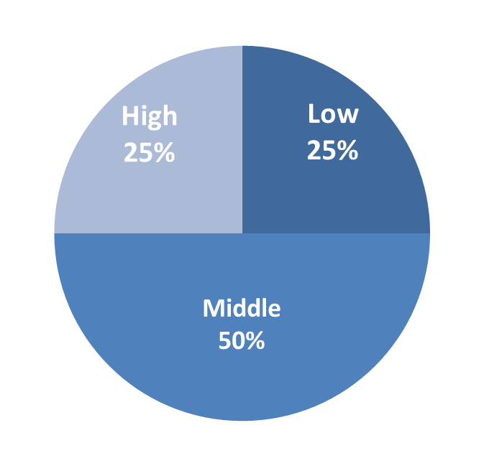
What do I need to do?
Create tasks that elicit a spread of results
multiple entry points to allow accessibility for all students
differentiated item difficulty to extend the top end and engage the low end
25-50-25 rule of thumb for overall item cognitive difficulty
Notes:
* Difficulty is relative for each individual cohort of students

Slide 10
What do I need to do?
Identify and follow the task commands
Each task type has embedded command terms
e.g. Analysis and evaluation of generated primary and/or secondary data
e.g. Analysis and comparison of two or more case studies
The task must clearly align with these commands
Refer to the VCAA Glossary of Command Terms

Slide 11
VCE Assessment Principles
Valid and Reasonable
Equitable
Balanced
Efficient

Slide 12
What do I need to do?
VCE Assessment Principles – Valid and Reasonable
The task fits the requirements of the Study Design
The task covers a representative sample of key knowledge and key skills from the outcome to enable student performance to be differentiated
Students have been provided with necessary information prior to the SAC and on the SAC itself (this includes outcome details, type of task, conditions of task, and the contribution to the final outcome score)

Slide 13
What do I need to do?
VCE Assessment Principles – Equitable
If commercial tasks are being used, they must be carefully checked to ensure they meet task requirements AND be significantly modified to ensure that any prior access to the task would not provide an advantage to a student and therefore disadvantage others
The task does not privilege, or disadvantage certain groups based on gender, culture, physical ability, socioeconomic status or geographical location
If students are offered a choice of task, or there are different tasks provided to classes, then these are comparable in scope and demand
The task does not allow for drafting or undue teacher assistance

Slide 14
What do I need to do?
VCE Assessment Principles – Balanced
A range of question types with varying cognitive demand to ensure student performance can be differentiated (the 25-50-25 rule of thumb)
The mark allocations accurately reflect the question difficulty
Students have been provided with appropriate information on how the task will be assessed
If VCAA performance descriptors are being used then these have been carefully checked and modified, to ensure that they fit the nature of the task
The mark allocation aligns with the Study Design and any rounding does not influence student ranking

Slide 15
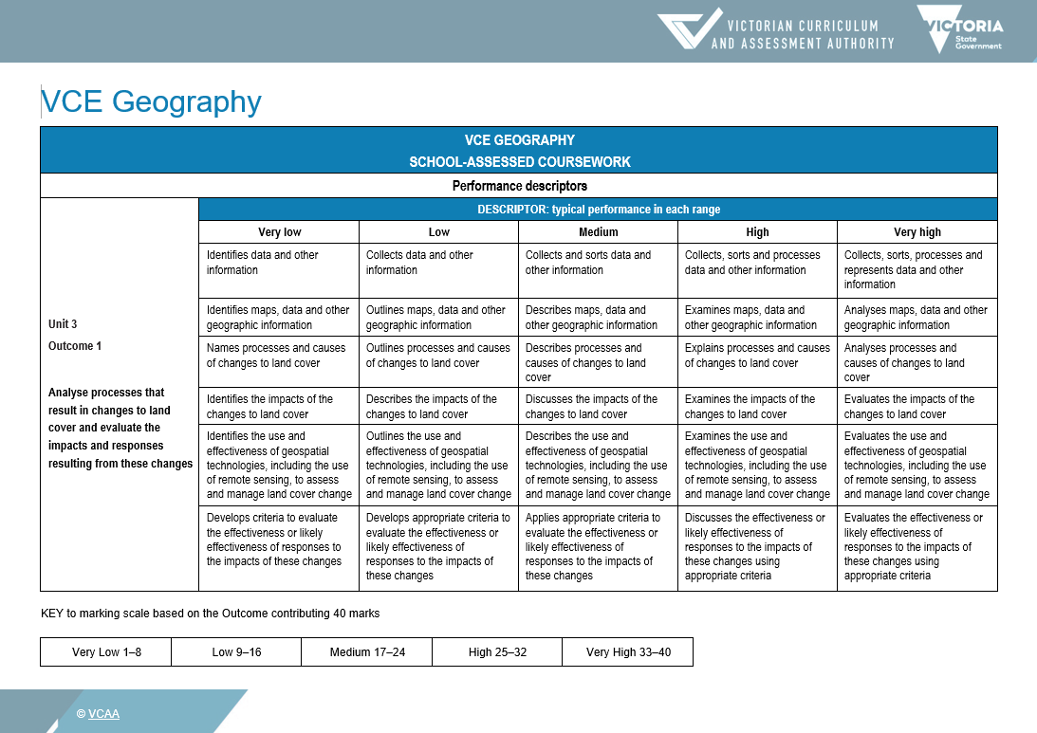

Slide 16
What do I need to do?
VCE Assessment Principles – Efficient
The tasks are not over-assessing students
The tasks do not generate undue stress on students regarding the timing of the tasks with one another
The tasks can reasonably be completed in the nominated timeframe

Slide 17
VCE Assessment Principles
Valid and Reasonable
Equitable
Balanced
Efficient

Slide 18
Why should I change in 2025?
Innovation and change…
Increases authentication
Keeps topics contemporary and relevant
Sets students up for the exam – exposing them to novel contexts
Helps ensure each task meets the requirements of the current Study Design and the VCE assessment principles

Slide 19
What do I need to do?
Study Design requirements for Units 3 & 4
Unit 3
Unit 4
Outcome 1
Outcome 2
Outcome 1
Outcome 2
40% - Analysis of geographic data AND any one or a combination of the following:
- a research report
- a case study
- a multimedia presentation
50% - Fieldwork report
10% - Structured questions
40% - Analysis of geographic data AND any one or a combination of the following:
- a research report
- a case study
- a multimedia presentation
60% - A research report OR case studies

Slide 20
What makes a good research report?
DO
Substantially completed in class
DO NOT
Undue assessment burden
Scaffolded (25-50-25)
Constrained parameters
Uses appropriate geographical data
No accessible entry points
Assess every Key Knowledge and Key Skill
Use unmodified VCAA performance descriptors

Slide 21
What makes a good case study?
DO
Contemporary context
DO NOT
No accessible entry points
Assesses relevant key knowledge and key skills
Integrates appropriate geographical data
Substantially completed in class
Scaffolded (25-50-25)
Assess every Key Knowledge and Key Skill
Use unmodified VCAA performance descriptors
Dated context

Slide 22
What makes a good multimedia presentation?
DO
Constrained parameters
DO NOT
No accessible entry points
10 minutes = 1000-word equivalent
Use of geographical data
Scaffolded (25-50-25)
Assesses relevant key knowledge and key skills
Assess every Key Knowledge and Key Skill
Use unmodified VCAA performance descriptors
Too long or too short
Assess aspects outside the bounds of the Study Design (e.g. oral presentation skills)

Slide 23
What makes a good Fieldwork assessment?
DO
Assesses relevant key knowledge and key skills
DO NOT
No accessible entry points
Allows for an accurate ranking of student performance
Expects use of geographical primary data
Scaffolded (25-50-25)
Assess every Key Knowledge and Key Skill
Use unmodified VCAA performance descriptors
Undue burden
Informed by the VCAA Fieldwork Report template

Slide 24
What makes good structured questions?
DO
Appropriate for the weighting (10% of Unit 3)
DO NOT
Lengthy
Uses appropriate command terms
Scaffolded (25-50-25)
Assess every Key Knowledge and Key Skill
No entry points

Slide 25
Good assessment will…
Incorporate cross-marking and/or moderation
Tailor the assessment criteria/descriptors/rubrics/marking schemes to the task
  Note: If the VCAA performance descriptors are used then these should be modified to fit the task
If using a marking scheme, ensure it is detailed and includes a clear breakdown of mark allocation
Clearly differentiate student performance

Slide 26
VCE resources
VCE Administrative Handbook
VCE Geography Study Design
VCAA Geography support materials
VCAA VCE webpage

Slide 27
Contact
Ashley Keith Pratt
Curriculum Manager, Humanities
🕿 0407 279 470
🖂 ashley.pratt@education.vic.gov.au
📬 vcaa.vce.curriculum@education.vic.gov.au

