Slide 1
VCE Art Creative Practice
Unit 3
School-assessed Task

Slide 2
Acknowledgement
The Victorian Curriculum and Assessment Authority proudly acknowledges and pays respect to Victoria’s Aboriginal and Torres Strait Islander communities and their rich and enduring cultures.
We acknowledge Aboriginal and Torres Strait Islander people as Australia’s first peoples and as the Traditional Owners and custodians of the lands and waters on which we rely. We pay respect to Elders past and present of the lands where we conduct our work and recognise their ongoing contributions as the first educators on the land now known as Victoria.

Slide 3
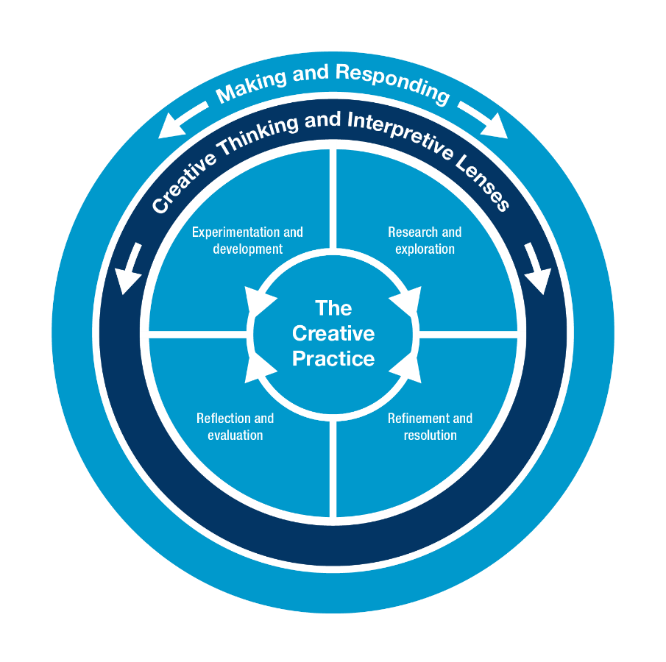
VCE Art Creative Practice Study specifications: Creative Practice
research and investigation
experimentation and development
refinement and resolution
reflection and evaluation.
Inquiry learning
Experiential learning
Project based learning
Notes:
Slide 3 outlines the Creative Practice which is the key concept that underpins the study design. Student learning is focused on Inquiry, Experiential and Project based learning. All three learning approaches are reflected in the four stages of the Creative Practice.

Slide 4
VCE Art Creative Practice Study specifications: Interpretive Lenses
Through Making and Responding
Structural Lens
Personal Lens
Cultural Lens
The Structural Lens informs the analysis and interpretation of an artwork, and its relationship with the artist and viewer or audience, through the investigation of the use of art elements and art principles, and the application of materials, techniques and processes. It also considers the stylistic qualities and symbolism evident in the artwork, and the context in which artists work and in which artworks are presented or viewed.
The Personal Lens informs the analysis and interpretation of an artwork through the investigation of the personal feelings, beliefs and life experiences of the artist, viewer or audience.
The Cultural Lens informs the analysis and interpretation of an artwork through the investigation of social, historical and cultural influences and representations.
Notes:
This slide shows the three interpretive lenses that underpin for the analysis and interpretation of artworks across Art Creative Practice. Students apply these lenses in their art making and art and study of artworks. Teachers can use the key information from each Interpretive Lens to formulate questions that can be applied in interpretation and analysis.

Slide 5
VCE Art Creative Practice Study specifications: Study Terms
Art elements
Art principles
Art forms
Context
Critique
Influences and inspiration
Visual language
Body of Work
Contemporary artworks and artists
Notes:
This is a list of key terms that underpin all Areas of Study. The Study Design has definitions on pages 17 and 18. Teachers should teach this material to their students at the start of Units 3 and 4.

Slide 6
VCE Art Creative Practice Unit 3 and 4 Assessment Weightings
Areas of Study | Assessment Type | Weighting
Unit 3 Area of Study 1 Unit 3 Area of Study 2 Unit 4 Area of Study 1 Unit 4 Area of Study 2 | School-assessed Task | 60 percent
Unit 4 Area of Study 3 | School-assessed Coursework | 10 percent
End-of-year examination | External assessment | 30 percent
Notes:
The study has three Graded Assessments. The School-assessed Task, assessed by the School, and moderated by the written external examination is waited at 60 percent of the study score.

Slide 7
VCE Art Creative Practice Unit 3: Investigation, ideas, artworks and the Creative Practice
Inquiry and Project-based learning
Exploration, experimentation and investigation as a starting point for a Body of Work
Select and apply Interpretive Lenses
Understand and use the Creative Practice
Artistic practice and artworks based on personal interest
Production of a finished work to contribute to the Body of work
Area of Study | Outcome
Area of Study 1 Research and exploration Resolution, presentation and critique | On completion of this unit the student should be able to develop personal ideas using research that examines one artwork and the practice of an artist and produce at least one finished artwork using the Creative Practice.
Area of Study 2 Personal investigation using the creative practice. | On completion of this unit the student should be able to apply and explore ideas and an area of personal interest using the Creative Practice.

Slide 8
Art Creative Practice Unit 4: Interpreting, resolving and presenting artworks and the Creative Practice
Project based and inquiry learning
Refinement and resolution of a Body of Work
Use of Creative Practice and Interpretive Lenses
Area of Study | Outcome
Area of Study 1 Documentation and critique of the Creative Practice | On completion of this unit the student should be able to document their use of Creative Practice and present a critique to inform the refinement and resolution of a Body of Work.
Area of Study 2 Resolution and presentation of a Body of Work | On completion of this unit the student should be able to use the Creative Practice to resolve and present a Body of Work.

Slide 9
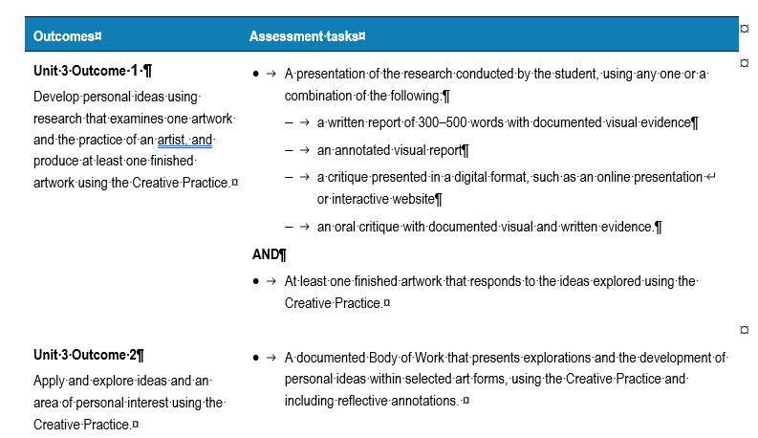
Unit 3 School-assessed Task
Page 37 VCE Art Creative Practice study design

Slide 10
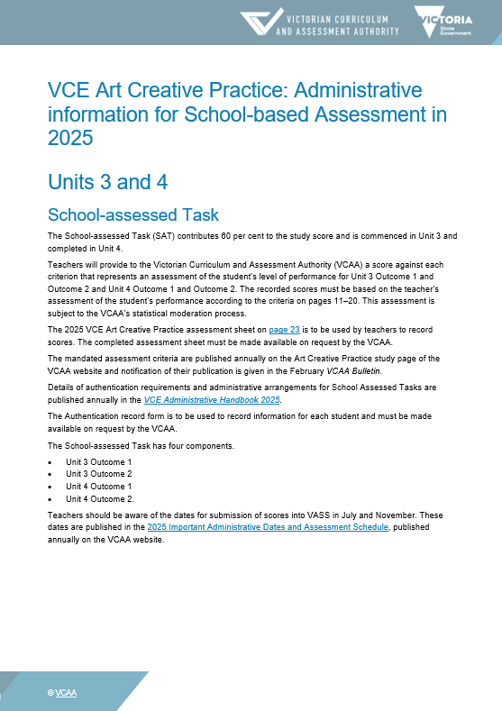
Administrative information for School-based assessment
Scope and nature of task
Assessment criteria, descriptors and evidence
Authentication material
Scoring sheet
Sample only

Slide 11
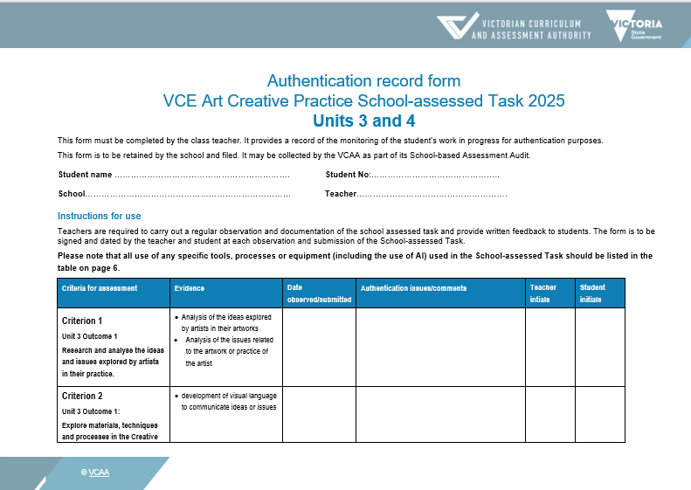
Authentication
Plan observations of student work and keep a record.
Student and teacher date and sign each Authentication.
Sample only

Slide 12
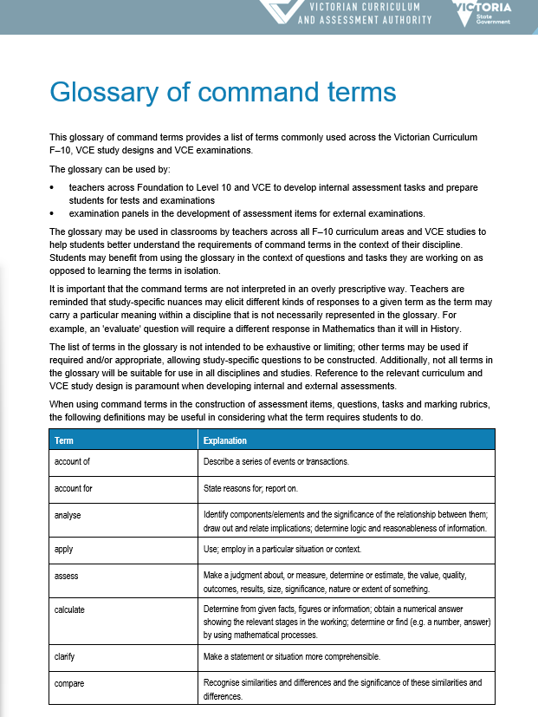
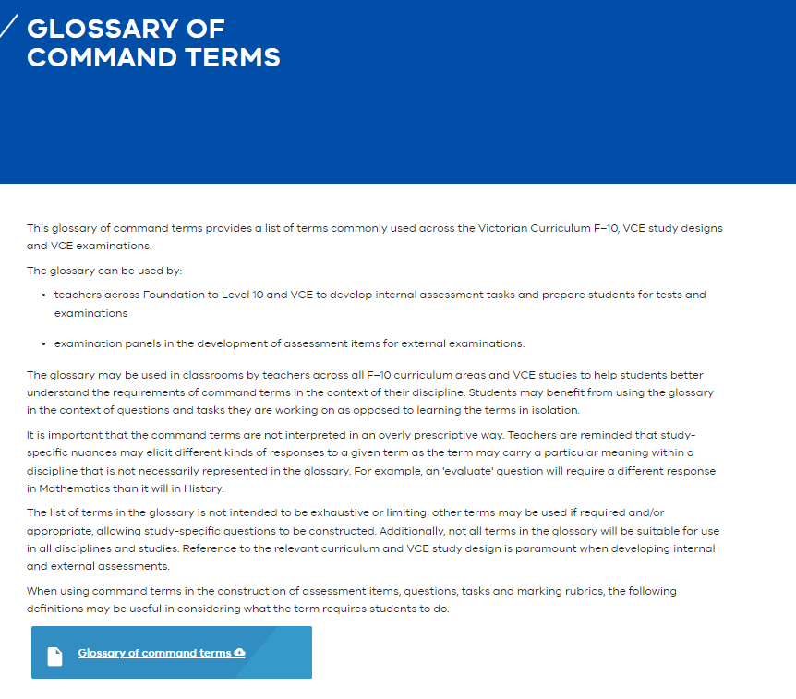
Glossary of command terms The same terms are used in SAT criteria and descriptors
Pages - Glossary of command terms (eduweb.vic.gov.au)

Slide 13
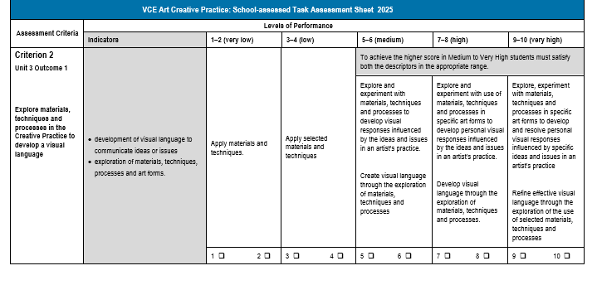
Assessment Criteria example
High: Command terms
Explore and experiment
Develop
Criterion 2:
Explore
Develop
Materials, techniques and processes
Creative Practice
Visual language
Sample only
Very High: Command terms
Explores and refines
Specific ideas and issues
INDICATORS
Visual language
Communication of ideas or issues
Exploration of materials, techniques, processes and artforms

Slide 14
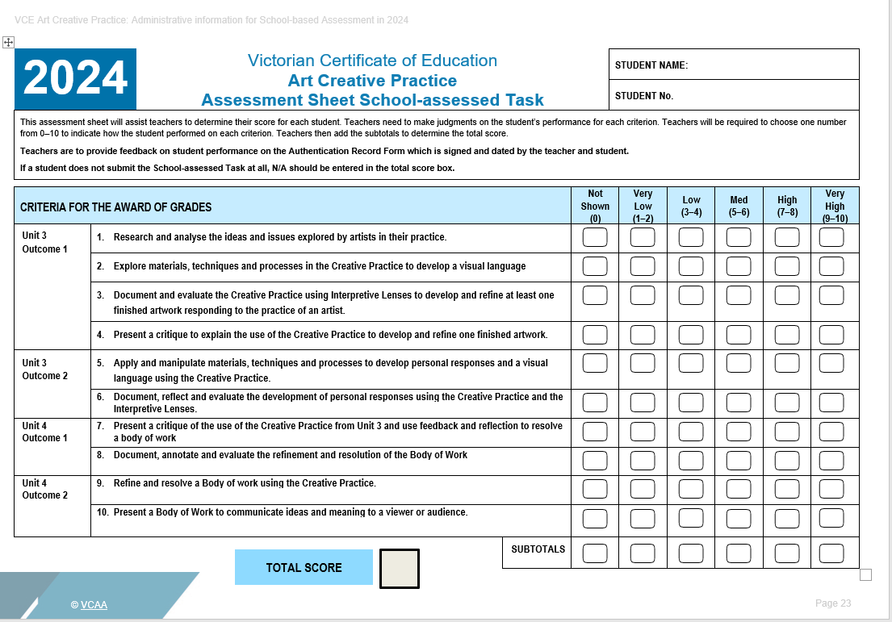
Assessment Sheet
Sample only

Slide 15
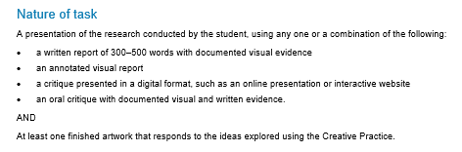
Administration information: Unit 3 Outcome 1 Scope and Nature of task
Describes the task
Describes the scope of assessment for the task
Scope of task
Research, Exploration, Documentation, Resolution and presentation, critique
Source: VCE Art Creative Practice: Administrative Information for School-based assessment

Slide 16
Unit 3 Outcome 1 task
On completion of this unit the student should be able to develop personal ideas using research that examines one artwork and the practice of an artist and produce at least one finished artwork using the Creative Practice.
Research
Exploration
Documentation
Resolution and Presentation
Critique
Finished artwork

Slide 17
Unit 3 Area of Study 1: Investigation and presentation - Resolution, presentation and critique
Outcome 1 | On completion of this unit the student should be able to develop personal ideas using research that examines one artwork and the practice of an artist and produce at least one finished artwork using the Creative Practice.
Key Knowledge | ideas and related issues explored by artists in their artworks the use of selected materials, techniques, processes and art forms throughout the Creative Practice the ways visual language is used to communicate ideas or issues the use of materials, techniques and processes in art forms to develop effective visual language the selection of appropriate Interpretive Lenses throughout the Creative Practice methods used to document, reflect upon and evaluate the use of the Creative Practice to develop and refine artworks methods used to present a critique of the use of the Creative Practice and finished artworks

Slide 18
Unit 3 Area of Study 1: Investigation and presentation - Resolution, presentation and critique
Outcome 1 | On completion of this unit the student should be able to develop personal ideas using research that examines one artwork and the practice of an artist and produce at least one finished artwork using the Creative Practice.
Key Skills | research and analyse the ideas explored by artists in their artworks research and analyse issues related to the artwork or practice of the artist use selected materials, techniques, processes and art forms throughout the Creative Practice develop and critically evaluate visual language to communicate ideas or issues explore and document the use of materials, techniques and processes to develop effective visual language select and apply the appropriate Interpretive Lenses throughout the Creative Practice explore, document, reflect on and evaluate the use of the Creative Practice to develop and refine an artwork, using appropriate written and visual material apply appropriate methods to present a critique of the use of the Creative Practice and the finished artworks

Slide 19
VCE Art Creative Practice
Unit 3 Area of Study 1: Investigation and presentation - Research and exploration
Learning structure | Area of Study 1 is the starting point for Units 3 and 4 for the school-assessed Task. Students may want to select a theme or topic for their Body of Work. They can develop a broad theme by using a mind mapping activity The Creative Practice should be unpacked and the points listed. Each component can structure the School-assessed Task and provide the scaffold for Project-based learning. The points in each component could be framed as a series of questions Students can select a group of artists that have a similar practice or artists that explore similar ideas and issues in their work as a starting point. They then select one artist to explore further. Students can develop their own theme or ideas based on this research for Area of Study 2. The questions from the Interpretive Lenses can be unpacked and used as markers for an investigation

Slide 20
VCE Art Creative Practice
Unit 3 Area of Study 1: Investigation and presentation - Resolution, presentation and critique
Learning structure | Students can refine their work by evaluating it using a series of open ended questions. These could be then used to scaffold the critique. Before the critique is presented, students may develop a series of questions that will provide them with feedback so they can expand on their ideas for Area of Study 2. The questions could also provide the students with ideas for the change in direction of their work for Area of Study 2. The relationships between artist’s intentions, artwork, audience and context could be explored throughout Area of Study 1 to frame the investigation. This could also provide a framework for the critique.

Slide 21
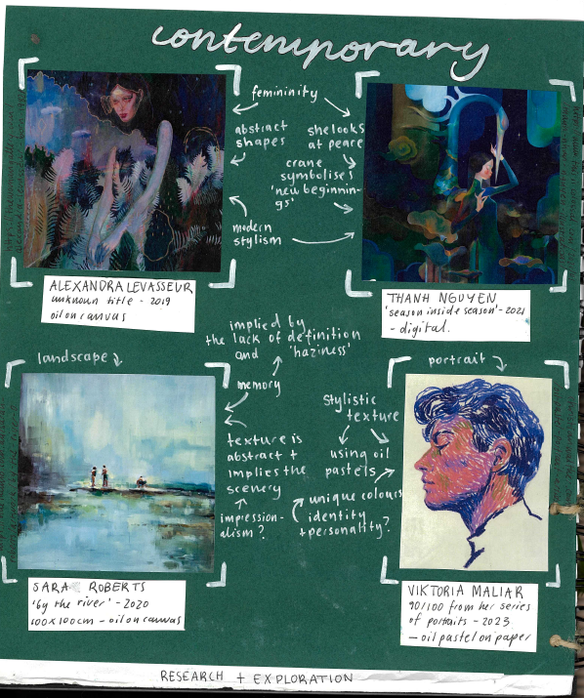
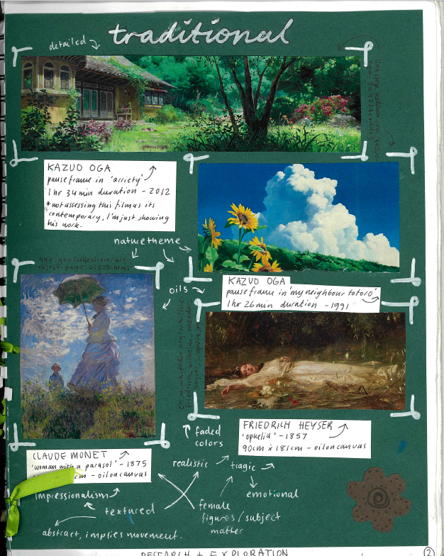
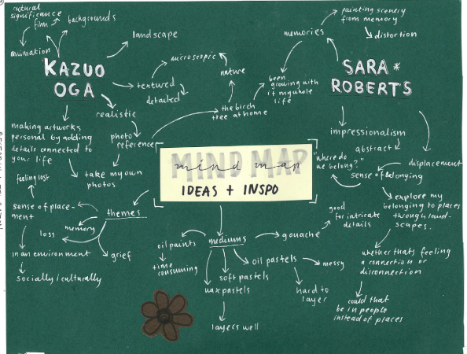
Student sample - research
Lili Hodgson
Notes:
Lili researched a range of artworks from different periods of time and cultures, investigating the ideas and issues represented in the artworks. She annotated the main ideas in an overview of images. From her research Lili generated a rough overview of their ideas using a brainstorm map

Slide 22
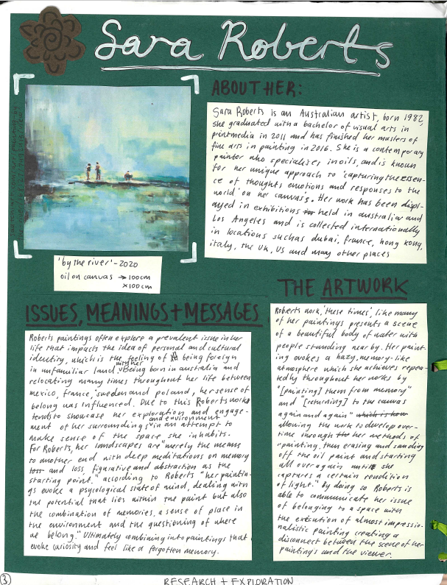
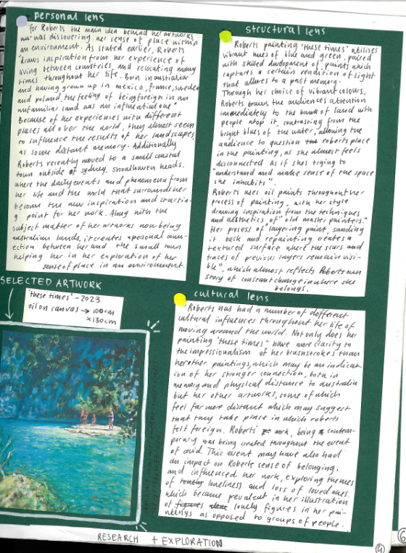
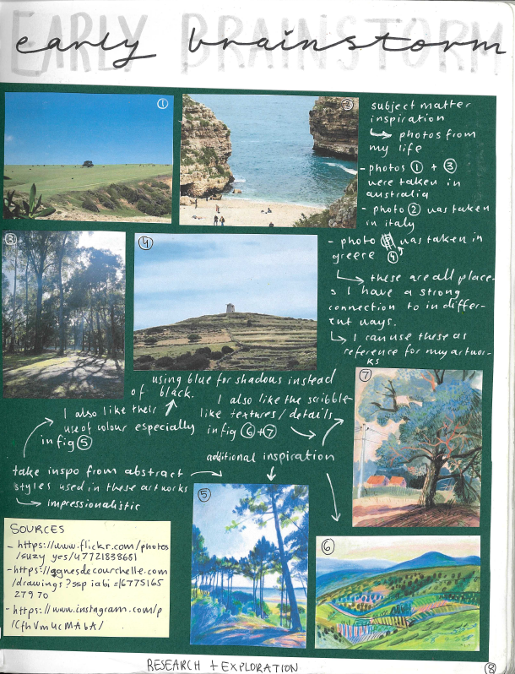
Student sample - Report
Lili Hodgson
Notes:
Lili analysed the work of three artists applying each Interpretive Lens. From her analysis she then completed a brainstorm to explore ideas and subject matter in her own artworks. This is an example of one artwork analysis and brainstorm.

Slide 23
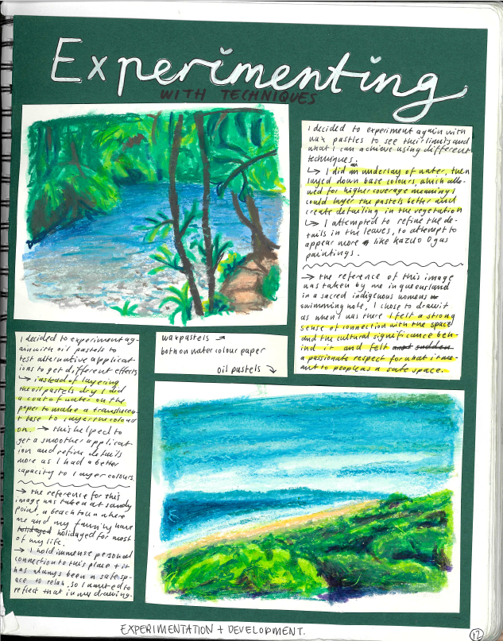
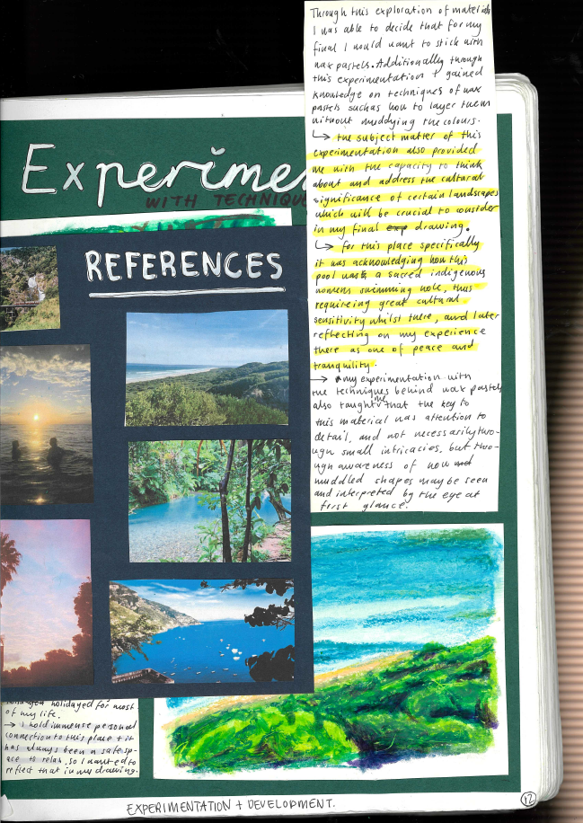
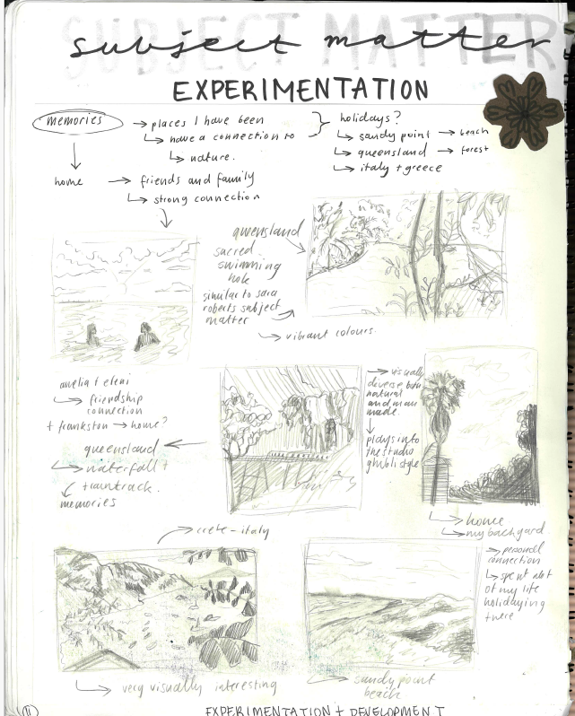
Student sample - experimentation
Lili Hodgson
Notes:
Lili commenced the exploration of her final artwork by creating a mind map of the ideas and inspiration from the research of her two artists.
She then created small thumbnail sketches as a personal response. She took photographs as a source. Her annotations describe her personal response to the images.

Slide 24
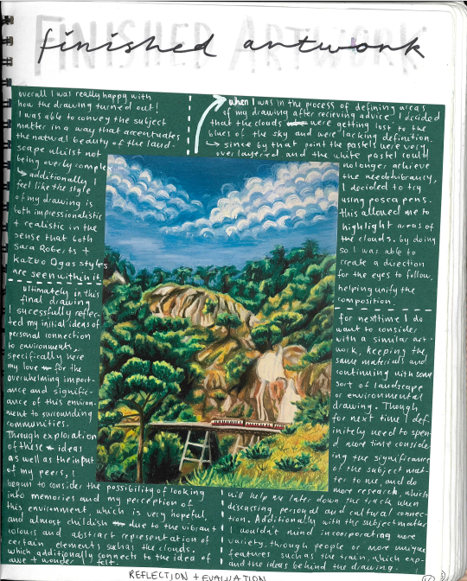
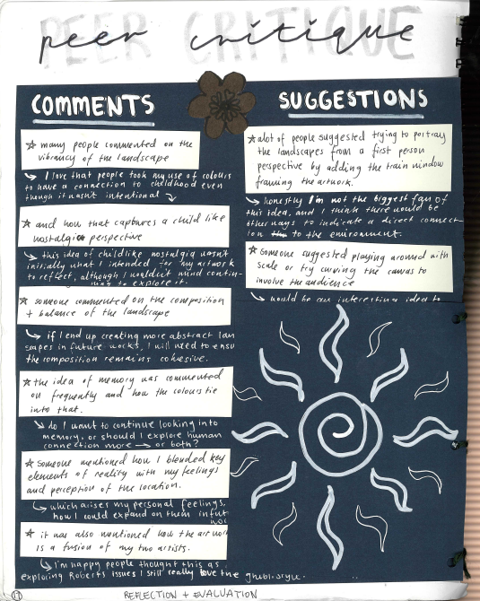
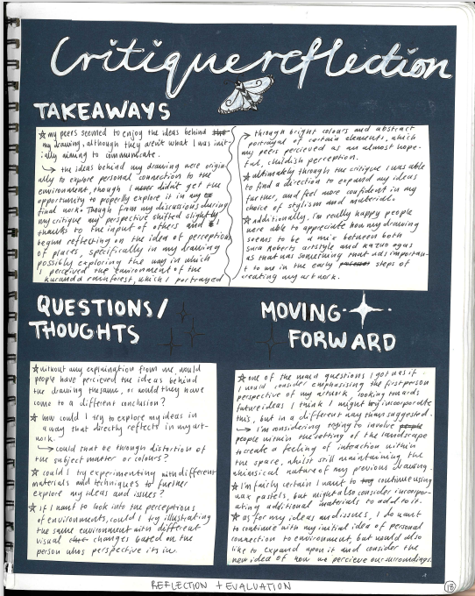
Student sample – finished artwork and critique
Lili Hodgson
Notes:
Lilli presented her artwork in a critique. She presented a range of comments that she gathered and reflected upon. From the ‘Peer critique’ she wrote a reflection on the comments, developed further questions about her work, and made some recommendations for the next stage of her Creative Practice.

Slide 25


Administration information: Unit 3 Outcome 2 Scope and Nature of task
Describes the task
Describes the scope of assessment for the task
Source: VCE Art Creative Practice: Administrative Information for School-based assessment

Slide 26
Unit 3 Outcome 2 task
Personal responses
Exploration
Development
Documentation and reflective annotations
On completion of this unit the student should be able to apply and explore ideas and an area of personal interest using the Creative Practice.

Slide 27
VCE Art Creative Practice
Unit 3 Area of Study 2: Personal investigation using the Creative Practice
Outcome 2 | On completion of this unit the student should be able to apply and explore ideas and an area of personal interest using the Creative Practice.
Key Knowledge | the use of selected materials, techniques, processes and art forms throughout the Creative Practice the use of the Creative Practice to explore and experiment with ideas, materials, techniques and processes characteristics of visual language that communicates personal ideas the use of the Creative Practice to develop ideas, materials, techniques and processes the selection of the appropriate Interpretive Lenses throughout the Creative Practice methods used to document the use of the Creative Practice the use of art terminology in analysis, reflection and evaluation

Slide 28
VCE Art Creative Practice
Unit 3 Area of Study 2: Personal investigation using the Creative Practice
Outcome 2 | On completion of this unit the student should be able to apply and explore ideas and an area of personal interest using the Creative Practice.
Key Skills | use selected materials, techniques, processes and art forms throughout the Creative Practice apply, document and critically reflect on the use of the Creative Practice to develop personal responses explore and develop visual language that communicates personal ideas manipulate and apply materials, techniques and processes in selected art forms to develop personal responses select and apply the appropriate Interpretive Lenses throughout the Creative Practice document and annotate, using visual material and written material, to critically reflect on and evaluate the use of the Creative Practice apply art terminology in analysis and critically reflective and evaluative annotations

Slide 29
VCE Art Creative Practice – Unit 3
Area of Study 2: Personal investigation using the Creative Practice
Learning structure | The evaluation and feedback from the Critique in Area of Study 1 can provide the direction for further exploration, development and refinement of the Body of Work. A series of questions can be used to direct the student exploration. The Creative Practice should be revisited and revaluated. Students should revisit the components and focus on specific aspects of the Creative Practice that will inform their inquiry. The points in each component could be framed as a series of questions to structure their inquiry. Students consider the relationships that were established between the intentions of their practice, the artworks they produced, the ideas represented and how the artworks were viewed and interpreted by an audience. In this Area of Study students develop their personal visual language. As a starting point they may establish the characteristics of their visual language, and this can lead the inquiry.

Slide 30
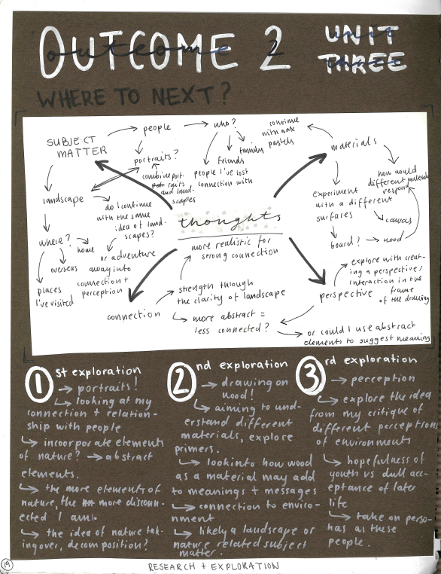
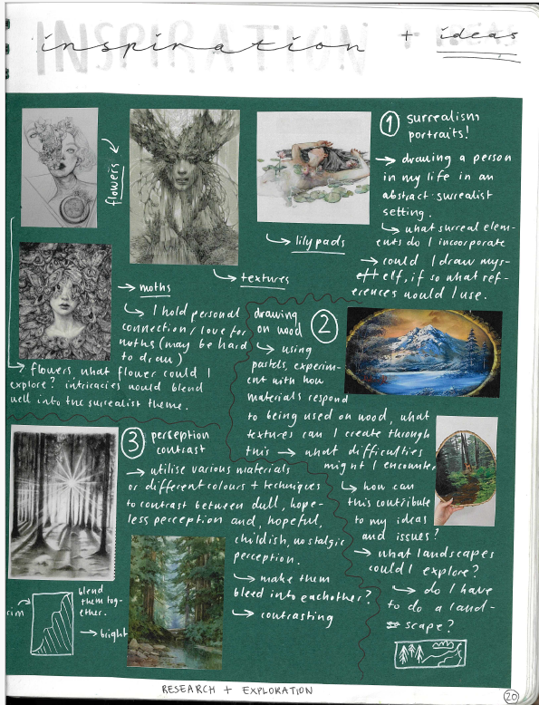
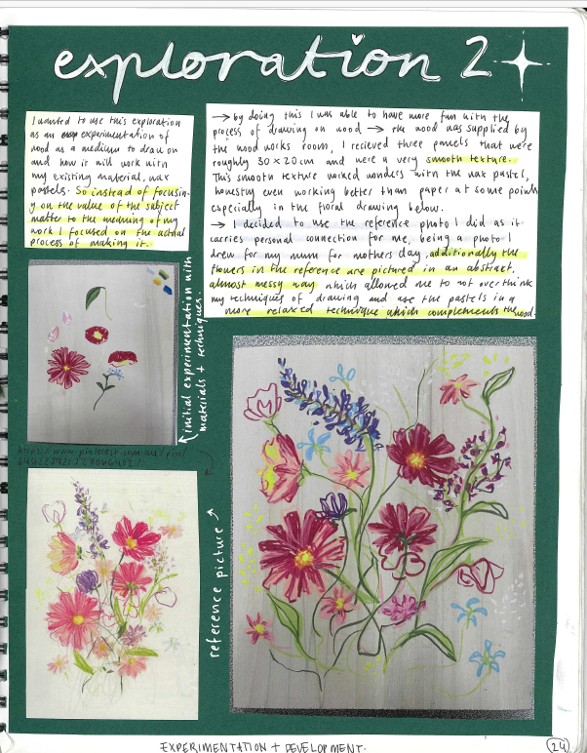
Student sample – inspiration and exploration
Notes:
After the critique, Lili then explored her key ideas and themes further. She used additional inspiration and created a set of personal responses to the research.

Slide 31
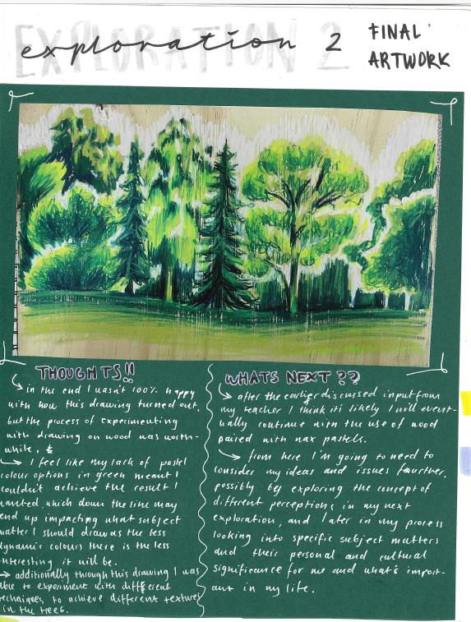
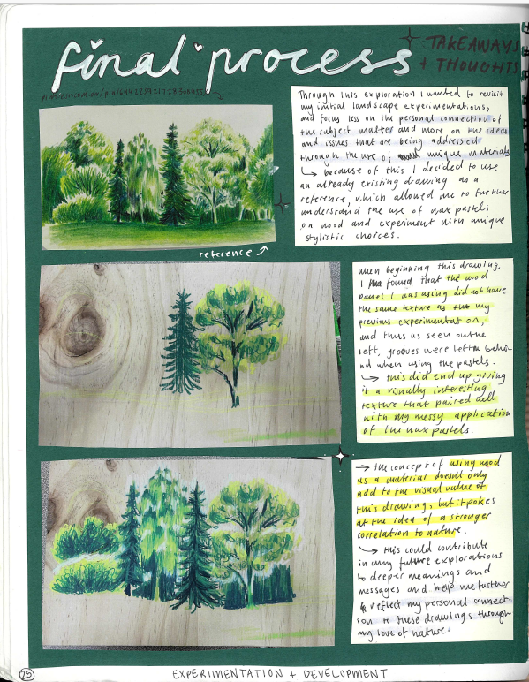
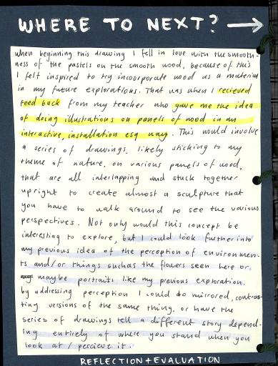
Student sample – personal response
Notes:
Lilli created a series of artworks that she reflected upon for her critique. She documented the process and the exploration of each work. She reflected on her final work and what she intended to expand on further in Unit 4. She discussed her use of visual language to communicate her ideas referring to the materials and techniques. She discussed the ideas that she would develop and unit for and her selection of subject matter. Overall Lilli completed four small works by the end of Unit 3.

Slide 32
Contact
Dr Kathryn Hendy-Ekers
Curriculum Manager – Visual Arts, Visual Communication Design and Media
E: Kathryn.Hendy-Ekers@education.vic.gov.au
T: 9059 5147
M: 0438471513

Slide 34
