Slide 1
VCE Art Creative Practice 2023
Unit 4 School-Assessed Task

Slide 2
Acknowledgement
The Victorian Curriculum and Assessment Authority proudly acknowledges and pays respect to Victoria’s Aboriginal and Torres Strait Islander communities and their rich and enduring cultures.
We acknowledge Aboriginal and Torres Strait Islander people as Australia’s first peoples and as the Traditional Owners and custodians of the lands and waters on which we rely. We pay respect to Elders past and present of the lands where we conduct our work and recognise their ongoing contributions as the first educators on the land now known as Victoria.

Slide 3
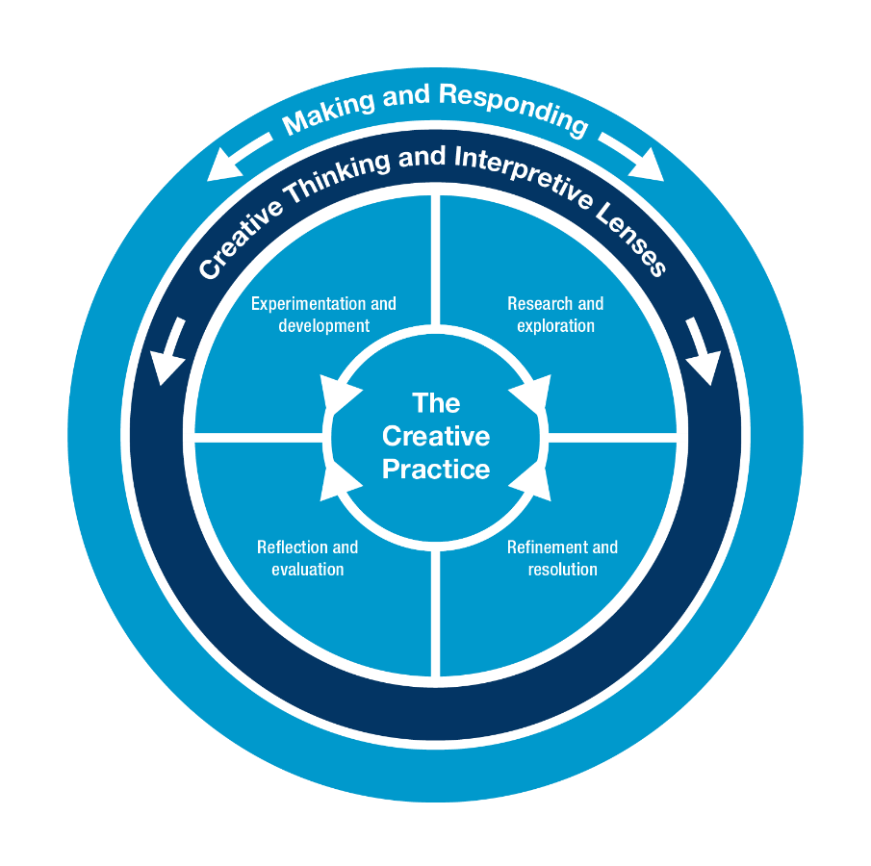
VCE Art Creative Practice Study specifications: The Creative Practice
research and investigation
experimentation and development
refinement and resolution
reflection and evaluation.
Inquiry learning
Experiential learning
Project based learning

Slide 4
VCE Art Creative Practice Study specifications: Interpretive Lenses
Through Making and Responding
Structural Lens
Personal Lens
Cultural Lens
The Structural Lens informs the analysis and interpretation of an artwork, and its relationship with the artist and viewer or audience, through the investigation of the use of art elements and art principles, and the application of materials, techniques and processes. It also considers the stylistic qualities and symbolism evident in the artwork, and the context in which artists work and in which artworks are presented or viewed.
The Personal Lens informs the analysis and interpretation of an artwork through the investigation of the personal feelings, beliefs and life experiences of the artist, viewer or audience.
The Cultural Lens informs the analysis and interpretation of an artwork through the investigation of social, historical and cultural influences and representations.

Slide 5
VCE Art Creative Practice Study specifications: Study Terms
Art elements
Art principles
Art forms
Contexts
Critique
Influences and inspiration
Visual language
Body of Work
Contemporary artists and artworks

Slide 6
VCE Art Creative Practice Unit 3 and 4 Assessment Weightings
Areas of Study | Assessment Type | Weighting
Unit 3 Area of Study 1 Unit 3 Area of Study 2 Unit 4 Area of Study 1 Unit 4 Area of Study 2 | School-assessed Task | 60 percent
Unit 4 Area of Study 3 | School-assessed Coursework | 10 percent
End-of-year examination | External assessment | 30 percent

Slide 7
VCE Art Creative Practice Unit 3: Investigation, ideas, artworks and the Creative Practice
Inquiry and Project-based learning
Exploration, experimentation and investigation as a starting point for a Body of Work
Select and apply Interpretive Lenses
Understand and use the Creative Practice
Artistic practice and artworks based on personal interest
Production of a finished work to contribute to the Body of work
Area of Study | Outcome
Area of Study 1 Research and exploration Resolution, presentation and critique | On completion of this unit the student should be able to develop personal ideas using research that examines one artwork and the practice of an artist and produce at least one finished artwork using the Creative Practice.
Area of Study 2 Personal investigation using the creative practice. | On completion of this unit the student should be able to apply and explore ideas and an area of personal interest using the Creative Practice.

Slide 8
Art Creative Practice Unit 4: Interpreting, resolving and presenting artworks and the Creative Practice
Project based and inquiry learning
Refinement and resolution of a Body of Work
Use of Creative Practice and Interpretive Lenses
Area of Study | Outcome
Area of Study 1 Documentation and critique of the Creative Practice | On completion of this unit the student should be able to document their use of Creative Practice and present a critique to inform the refinement and resolution of a Body of Work.
Area of Study 2 Resolution and presentation of a Body of Work | On completion of this unit the student should be able to use the Creative Practice to resolve and present a Body of Work.

Slide 9
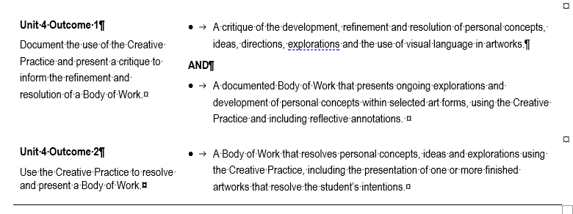
Unit 4 School-assessed Task
Page 37 VCE Art Creative Practice study design

Slide 10
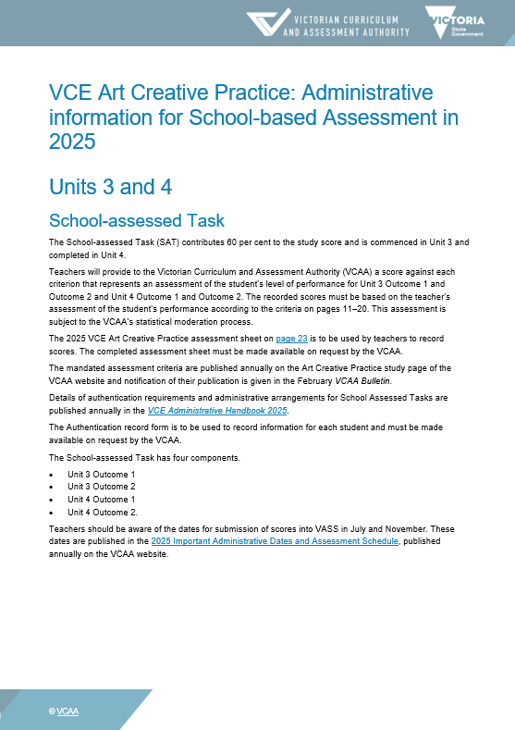
Administrative information for School-based assessment
Scope and nature of task
Assessment criteria, descriptors and evidence
Authentication material
Scoring sheet
Sample only

Slide 11
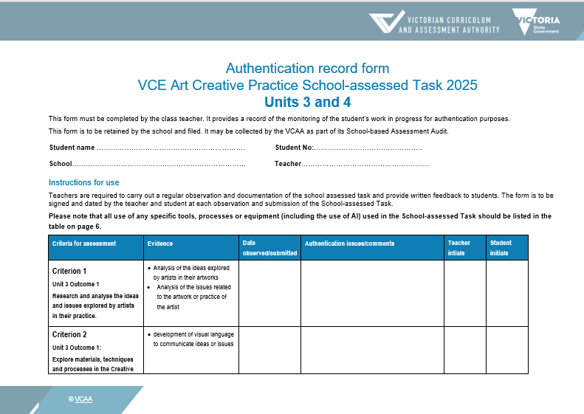
Authentication
Plan observations of student work and keep a record.
Student and teacher date and sign each Authentication.
Sample only

Slide 12
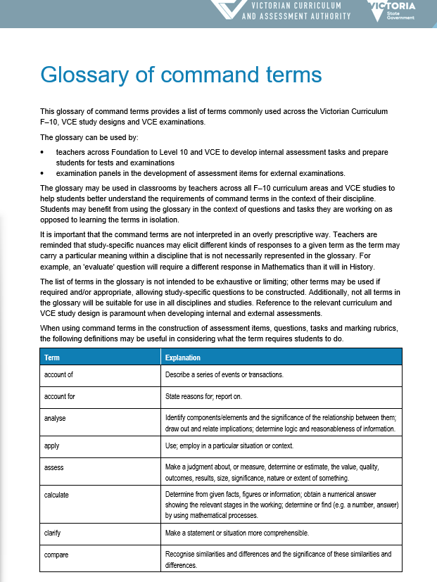
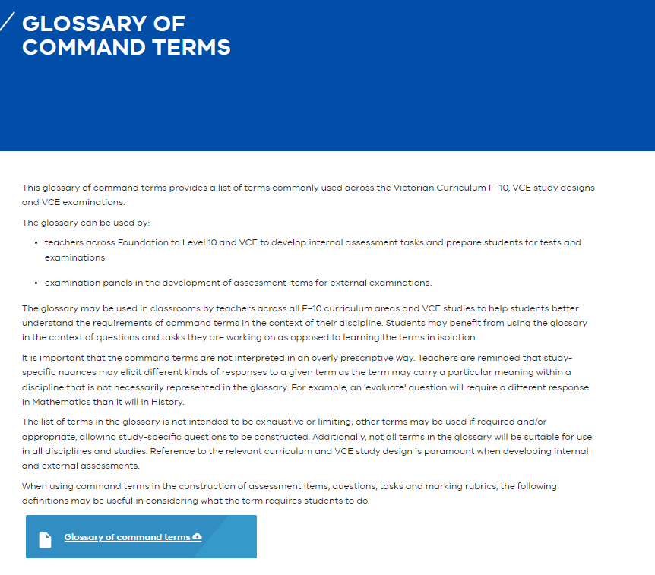
Glossary of command terms The same terms are used in SAT criteria and descriptors
Pages - Glossary of command terms (eduweb.vic.gov.au)

Slide 13
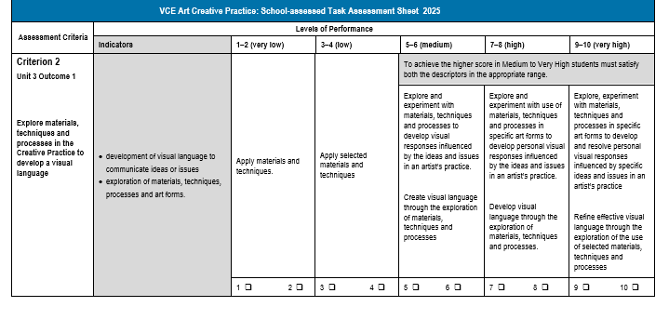
Assessment Criteria example
High: Command terms
Explore and experiment
Develop
Criterion 2:
Explore
Develop
Materials, techniques and processes
Creative Practice
Visual language
Sample only
Very High: Command terms
Explores and refines
Specific ideas and issues
INDICATORS
Visual language
Communication of ideas or issues
Exploration of materials, techniques, processes and artforms
Notes:
This slide e

Slide 14
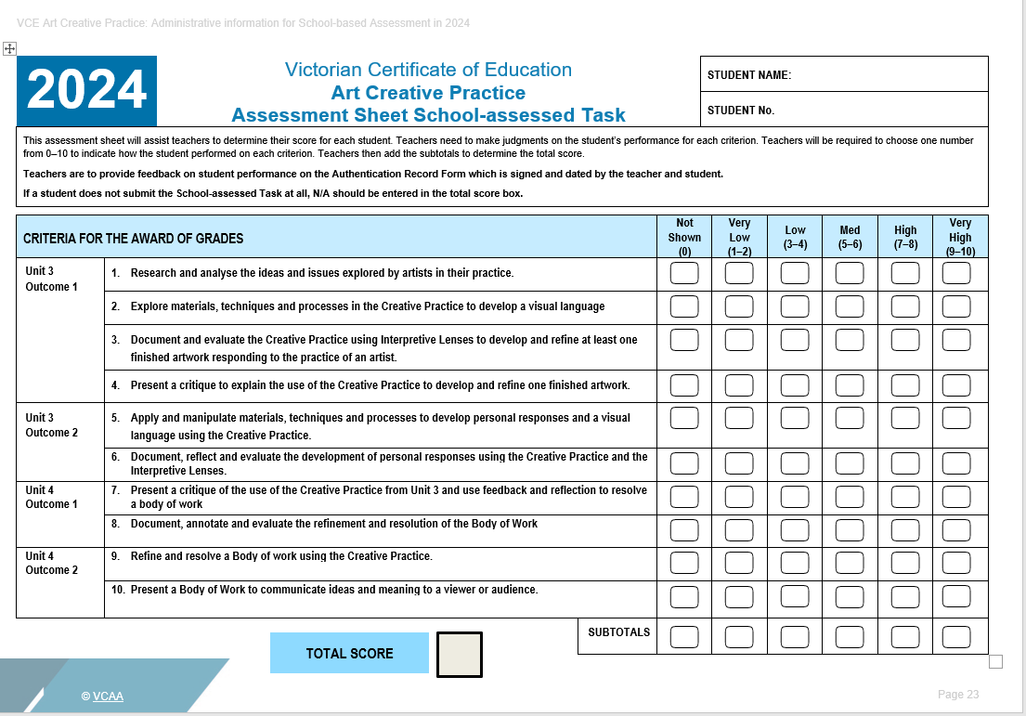
Assessment Sheet
Sample only

Slide 15

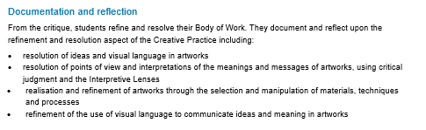
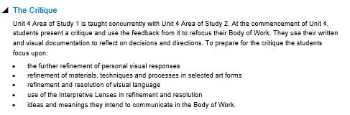
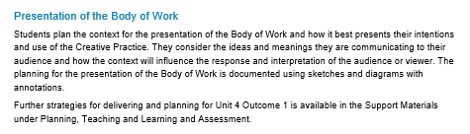
Administration information: Unit 4 Outcome 1 Scope and Nature of task
Describes the task
Describes the scope of assessment for the task
VCE Administrative Advice for School-based Assessment: Art Creative Practice

Slide 16
Unit 4 Outcome 1 task
Development, refinement and resolution
Personal ideas, concepts, directions and explorations
Documentation and reflection
Body of work
Critique
Visual language
On completion of this unit the student should be able to document the use of Creative Practice and present a critique to inform the refinement and resolution of a Body of Work.

Slide 17
Unit 4 Area of Study 1: Documentation and critique of the Creative Practice
Outcome 1 | On completion of this unit the student should be able to document the use of the Creative Practice and present a critique to inform the refinement and resolution of a Body of Work.
Key Knowledge | methods used to evaluate and document the refinement and resolution of personal visual responses throughout the Creative Practice methods used to evaluate and document the refinement of materials, techniques and processes in selected art forms throughout the Creative Practice methods used to evaluate and document the refinement and resolution of visual language in personal responses the selection of the appropriate Interpretive Lenses throughout the Creative Practice methods used to present and critique the use of the Creative Practice feedback and reflection used to refine and resolve a Body of Work art terminology used in critical reflection

Slide 18
Unit 4 Area of Study 1: Documentation and critique of the Creative Practice
Outcome 1 | On completion of this unit the student should be able to document the use of the Creative Practice and present a critique to inform the refinement and resolution of a Body of Work.
Key Skills | evaluate and document the refinement and resolution of personal responses throughout the Creative Practice evaluate and document the use of the Creative Practice to refine materials, techniques and processes in selected art forms to resolve a Body of Work document the refinement and effective resolution of visual language to communicate ideas in personal responses select and apply the appropriate Interpretive Lenses to document the use of the Creative Practice present a critique of the use of the Creative Practice use feedback and reflection to resolve a Body of Work document, annotate and evaluate the refinement and resolution of the Body of Work, using appropriate written and visual material apply art terminology in critically reflective annotations throughout the Creative Practice

Slide 19
Art Creative Practice Unit 4
Area of Study 1: Documentation and critique of the Creative Practice
Learning structure ideas | Unit 4 Area of Study 1 and 2 are linked and students should consider the direction, resolution and refinement of their Body of Work using components of the Creative Practice to scaffold their inquiry. The Interpretive Lenses can be used to direct their inquiry and to research additional artists and artworks that will inform their practice. Students must consider the inclusion of additional artworks and artists, and how these will expand their ideas, their practice, and refine and resolve their Body of work. The students may use the questions from the Interpretive Lenses to evaluate their progress. The Interpretive Lenses can also structure the critique. Area of Study 1 is the opportunity for students to revisit their documentation and evaluation of their practice and how they are communicating ideas using visual language. They can consider how they will structure the documentation and evaluation leading up to the presentation of their Body of Work. A series of questions based on the Interpretive Lenses and components of the Creative Practice will assist them to document their practice

Slide 20
Art Creative Practice Unit 4
Area of Study 1: Documentation and critique of the Creative Practice
Learning structure | The critique is an integral component of Area of Study 1 and students will need to prepare their critique, so they have the opportunity to further refine and resolve their Body of Work. As part of the process of refinement and resolution, students need to consider how they will respond to the feedback they receive from their critique and how it will assist in communicating their ideas leading up to the presentation of their Body of Work. Students should consider how they will demonstrate their responses to the feedback from the critique and the further refinements they make to their Body of Work. Throughout Unit 4 students must demonstrate critical and reflective annotations in their work. Components of the Creative Practice and the questions from the Interpretive Lenses can be used to structure questions that will assist the students with to critically analyse their practice and artworks as well as the practices and artworks of others.

Slide 21
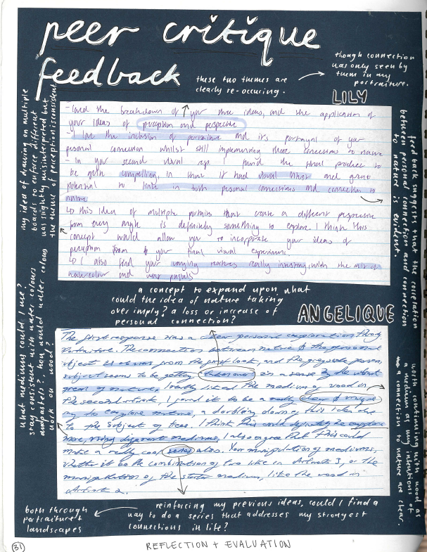
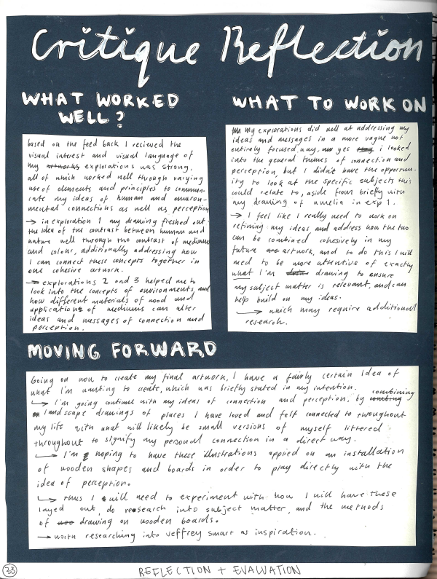
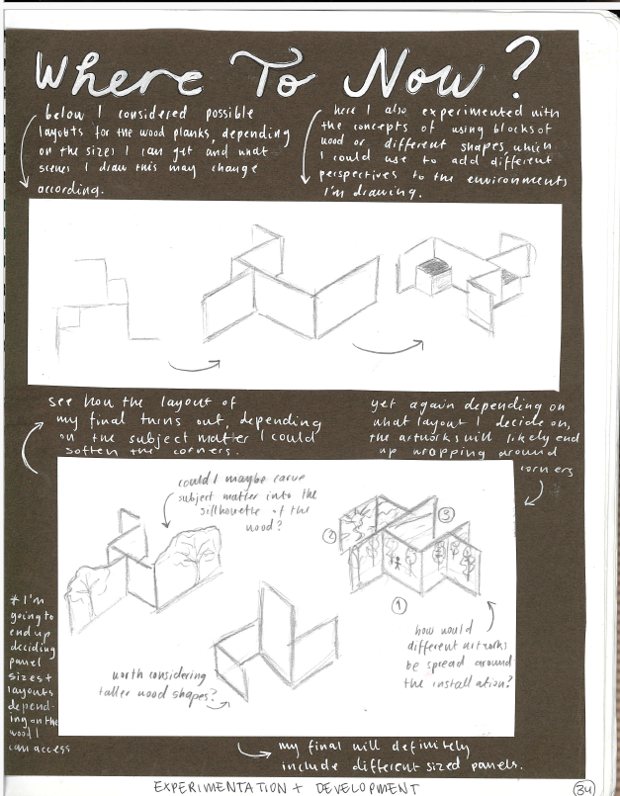
Student sample Feedback and reflection
Lili Hodgson
Notes:
Lili collated the feedback from her critique and then highlighted key points to reflect upon. She focused on her use of visual language to communicate ideas and which of those could be expanded upon in Unit 4. She then summarised these points and reflected on them to develop a plan to develop her Body of Work in Unit 4.

Slide 22
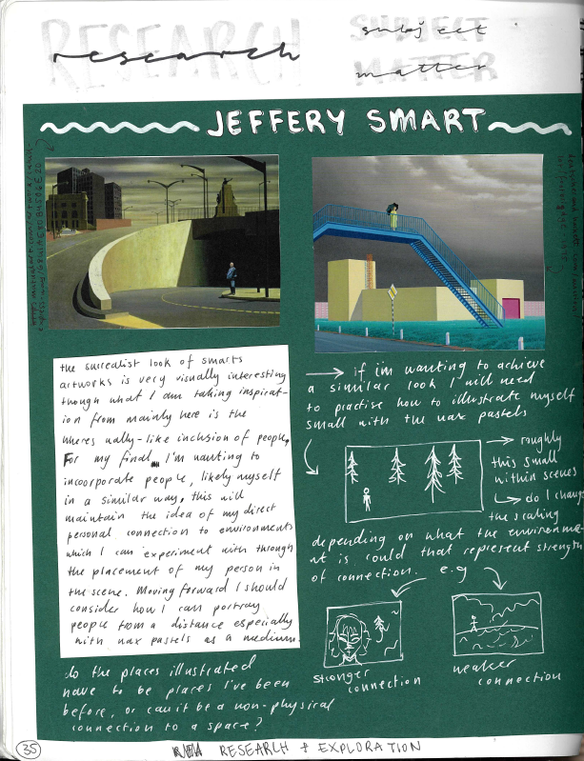
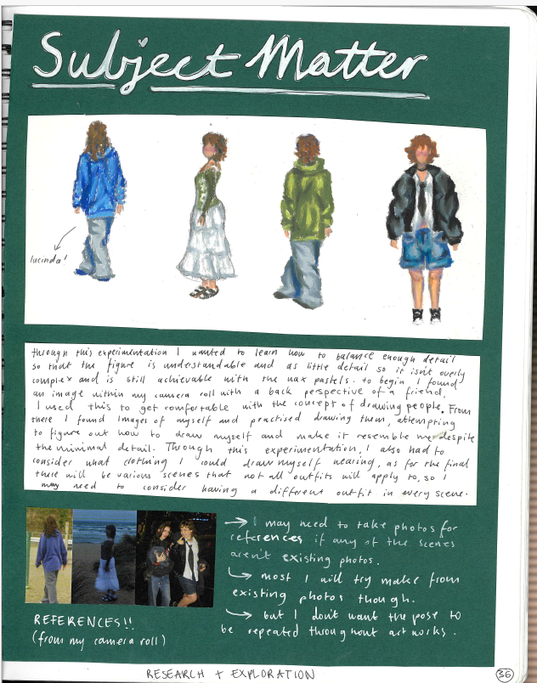
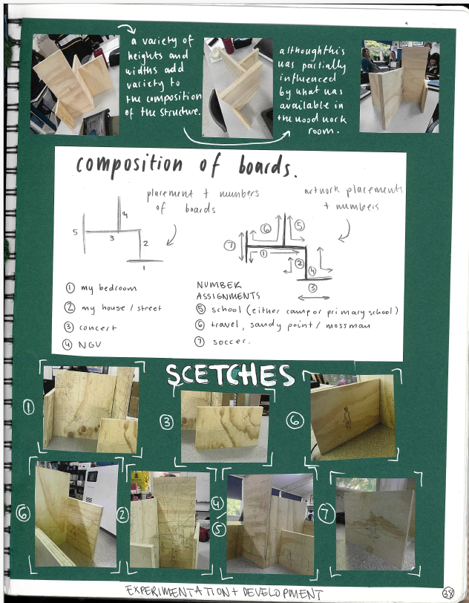
Student samples – development
Lili Hodgson
Notes:
From the reflection Lili completed research of her artist and her subject matter. She then commenced documenting the development of her final artworks and the presentation of her body of work.

Slide 23

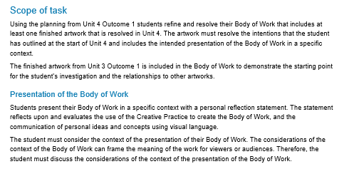
Administrative information: Unit 4 Outcome 2 Scope and Nature of task
Describes the task
Describes the scope of assessment for the task
VCE Administrative Advice for School-based Assessment: Art Creative Practice

Slide 24
Unit 4 Outcome 2 task
Resolution
Presentation
Personal ideas, concepts and explorations
Body of work
Context
One finished artwork
On completion of this unit the student should be able to use the Creative Practice to resolve and present a body of work.

Slide 25
Unit 4 Area of Study 2: Resolution and presentation of a body of work
Outcome 2 | On completion of this unit the student should be able to use the Creative Practice to resolve and present a Body of Work.
Key Knowledge | the use of materials, techniques and processes in selected artforms throughout the Creative Practice the use of the Creative Practice to resolve ideas in a Body of Work the refinement of skill using materials and techniques in selected art forms to resolve ideas in a Body of Work methods to refine and resolve visual language to communicate personal ideas in a Body of Work the use of the appropriate Interpretive Lenses throughout the Creative Practice the ways the presentation and context of a Body of Work can effectively communicate ideas and meaning to a viewer or audience

Slide 26
Unit 4 Area of Study 2: Resolution and presentation of a body of work
Outcome 2 | On completion of this unit the student should be able to use the Creative Practice to resolve and present a Body of Work.
Key Skills | refine and resolve the use of materials, techniques and processes in selected art forms using the Creative Practice resolve ideas in a Body of Work using the Creative Practice refine the use of materials and techniques in selected art forms to resolve ideas in a Body of Work refine and resolve visual language to communicate personal ideas in a Body of Work select and apply the appropriate Interpretive Lenses throughout the Creative Practice present a Body of Work in a specific context to communicate ideas and meaning to a viewer or audience evaluate how the presentation and context of a Body of Work effectively communicates ideas and meaning to a viewer or audience

Slide 27
Art Creative Practice Unit 4
Area of Study 2: Resolution and presentation of a body of work
Learning structure ideas | The structure of the critique will assist the students to further refine their ideas, practice and Body of Work. The critique will provide students with feedback to expand their practice and Body of Work. Therefore, the structure of the critique can inform the refinement and resolution of the Body of Work. Students could revisit these relationships to evaluate their Body of Work and the effective communication of their ideas and meaning to an audience. The connections between their intentions and the interpretation of the audience are aspects that they can critically evaluate Components of the Creative Practice and the Interpretive Lenses can structure the critique, further refinement and resolution, and the presentation of the Body of Work and the selection of the context of the presentation. The questions of the Interpretive Lenses and the points under each component of the Creative Practice will assist students to structure their critique.

Slide 28
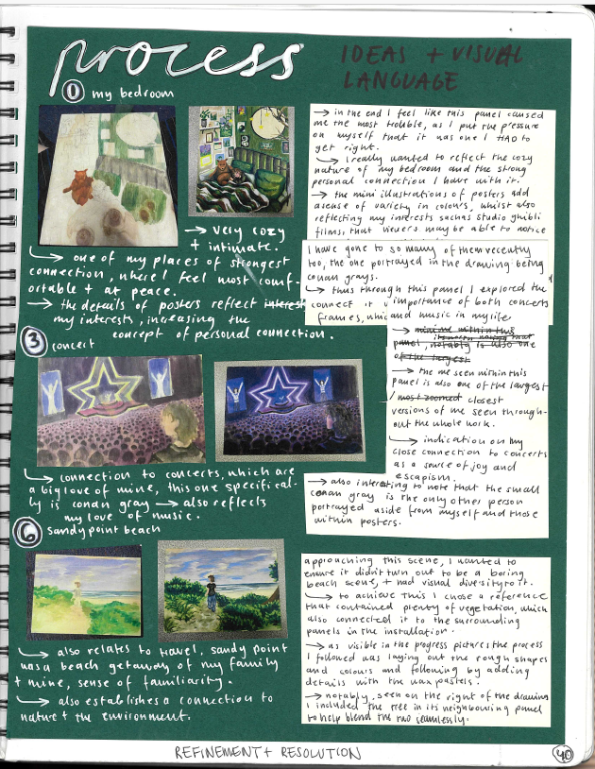
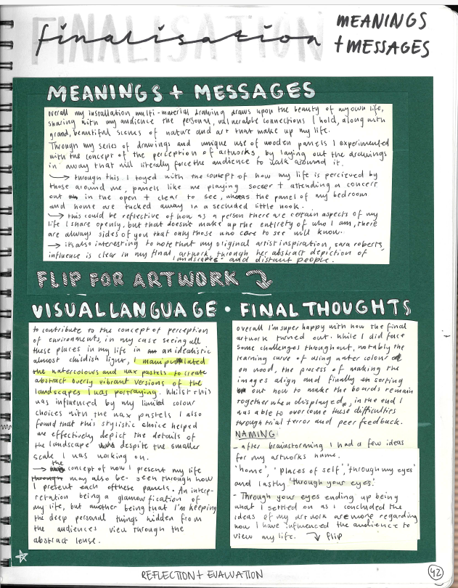
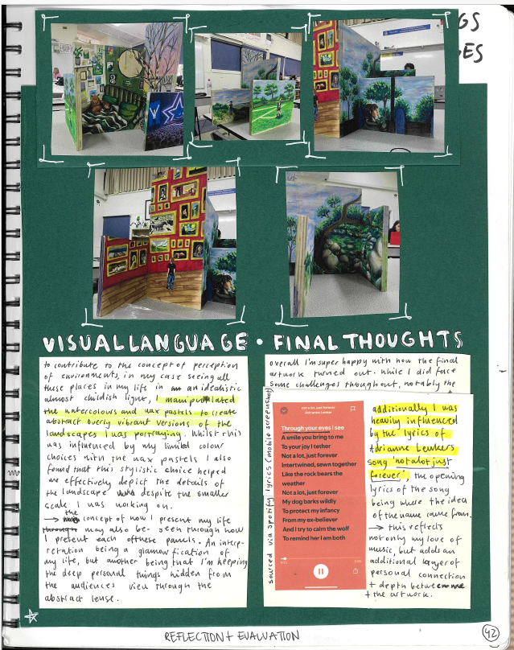
Student sample Refinement and resolution
Lili Hodgson
Notes:
Lili has documented the process of refinement of her final artwork focusing on the use of the Interpretive Lenses and Visual language. These are sample pages from the process.

Slide 29
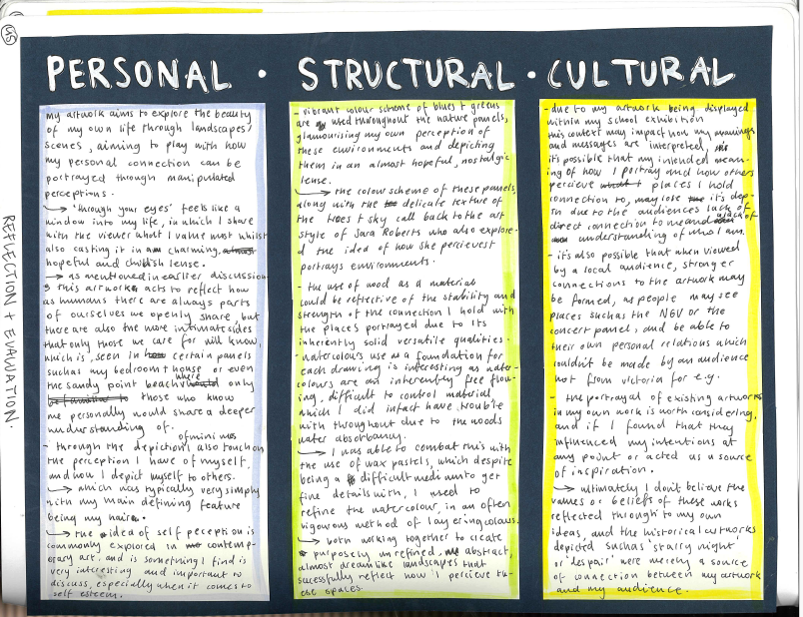
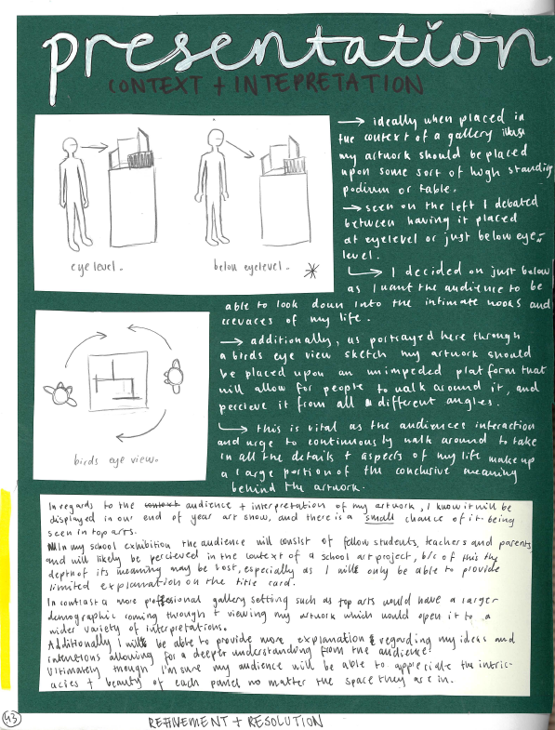
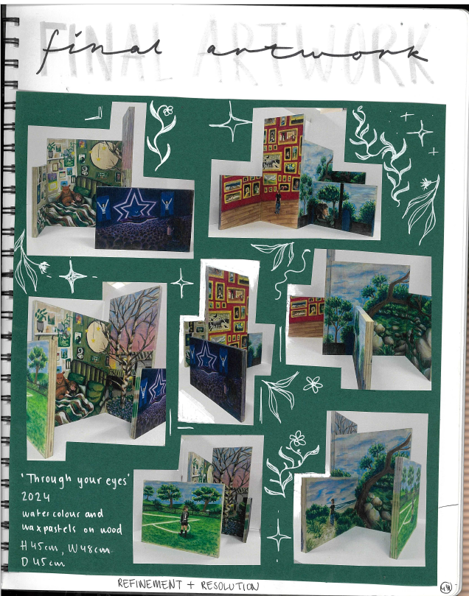
Student sample Presentation and evaluation
Lili Hodgson
Notes:
The student has considered the presentation of the Body of Work, evidence of the Body of Work and evaluation using the Interpretive lenses.

Slide 30
Contact
Dr Kathryn Hendy-Ekers
Curriculum Manager – Visual Arts, Visual Communication Design and Media
E: Kathryn.Hendy-Ekers@education.vic.gov.au
T: 9059 5147
M: 0438471513

Slide 32


