Slide 1
VCE Art Making and Exhibiting
Unit 3 School-assessed Task

Slide 2
Acknowledgement
The Victorian Curriculum and Assessment Authority proudly acknowledges and pays respect to Victoria’s Aboriginal and Torres Strait Islander communities and their rich and enduring cultures.
We acknowledge Aboriginal and Torres Strait Islander people as Australia’s first peoples and as the Traditional Owners and custodians of the lands and waters on which we rely. We pay respect to Elders past and present of the lands where we conduct our work and recognise their ongoing contributions as the first educators on the land now known as Victoria.

Slide 3
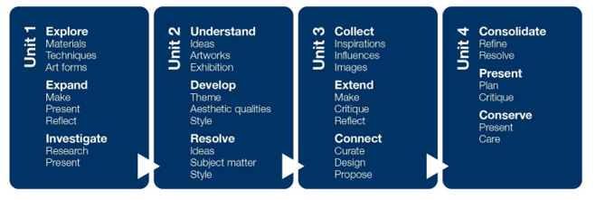
VCE Art Making and Exhibiting Study specifications
Explore
Expand
Investigate
Understand
Develop
Resolve
Collect
Extend
Connect
Consolidate
Present
Conserve

Slide 4
VCE Art Making and Exhibiting Study specifications: Making artworks
Making artworks
Artforms
Techniques
Processes
Materials
Aesthetic qualities
Art elements and Art Principles
Visual Language
Ideas and meaning
Explore
Expand
Investigate
Understand
Develop
Resolve
Collect
Extend
Connect
Consolidate
Present
Conserve

Slide 5
VCE Art Making and Exhibiting Study specifications: Exhibiting artworks
Exhibition design
Curation
Conservation
Planning and producing the layout and design of the exhibition and planning the ‘flow’ of the exhibition, including sight lines, spatial relationships, viewer interaction and interpretation. Includes the creation of display furniture, selection of fixtures and use of lighting.
Determining the theme or story to be told in an exhibition. Curation includes the selection of artworks, writing the introduction to the exhibition, deciding where artworks will be placed, the designing of viewer interaction and interpretation, and the preparation of condition reports of artworks.
Planning, organising and undertaking the preservation and conservation of materials and objects in private, public and community collections, including art galleries, museums, other exhibition spaces and site-specific spaces.

Slide 6
VCE Art Making and Exhibiting Study specifications: Exhibiting artworks
Exhibition design
Curation
Conservation
Explore
Expand
Investigate
Understand
Develop
Resolve
Collect
Extend
Connect
Consolidate
Present
Conserve
Museums
Galleries
Other exhibition spaces
Site specific spaces

Slide 7
VCE Art Making and Exhibiting Study specifications: Study Terms
Art elements
Art principles
Art forms
Contexts
Critique
Influences and inspiration
Visual language
Aesthetic qualities

Slide 8
Art Making and Exhibiting Unit 3: Collect, extend and connect
Art making in a selected art form using materials, techniques and processes based on an exploration of contexts, subject matter, ideas and visual language
Documentation of art making in the visual diary
Presentation of a critique of art making and art works
Research into the planning and presentation of an exhibition including the role of a curator.
Area of Study | Inquiry focus
Area of Study 1 | Collect – inspiration, influences and images How do artists use selected art forms and ideas to create visual language?
Area of Study 2 | Extend – make, critique and reflect How are ideas, reflection and feedback used in art making to develop artworks?
Area of Study 3 | Connect – curate, design and propose How are artworks selected and presented for exhibition?

Slide 9
Art Making and Exhibiting Unit 3:Collect, extend and connect
Area of Study | Outcome | Assessment
Area of Study 1 Collect – inspiration, influences and images | On completion of this unit the student should be able to collect information from artists and artworks in specific art forms to develop subject matter and ideas in their own art making. | School-assessed Task
Area of Study 2 Extend – make, critique and reflect | On completion of this unit the student should be able to make artworks in specific art forms, prepare and present a critique, and reflect on feedback.
Area of Study 3 Connect – curate, design and propose | On completion of this unit the student should be able to research and plan an exhibition of the artworks of three artists. | School-assessed Coursework

Slide 10
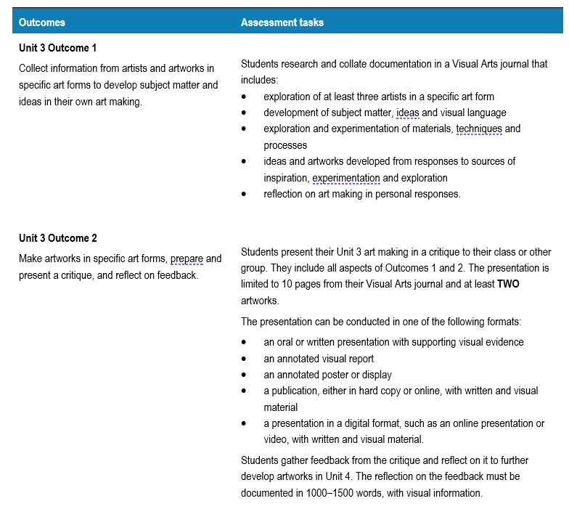
Unit 3 School-assessed Task
Page 39 Art Making and Exhibiting Study Design

Slide 11
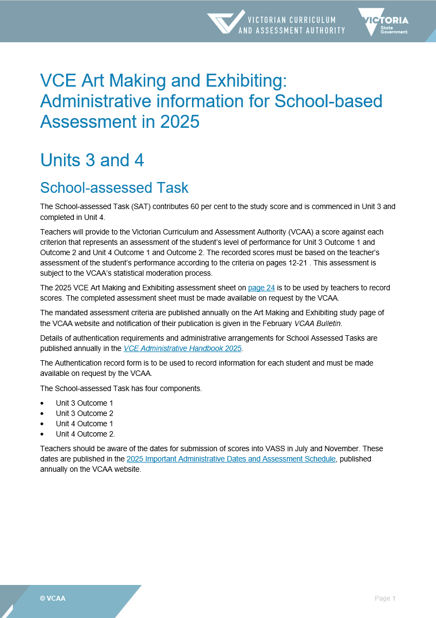
Administrative information for School-based assessment
Scope and nature of task
Assessment criteria, descriptors and evidence
Authentication material
Scoring sheet
Sample only

Slide 12
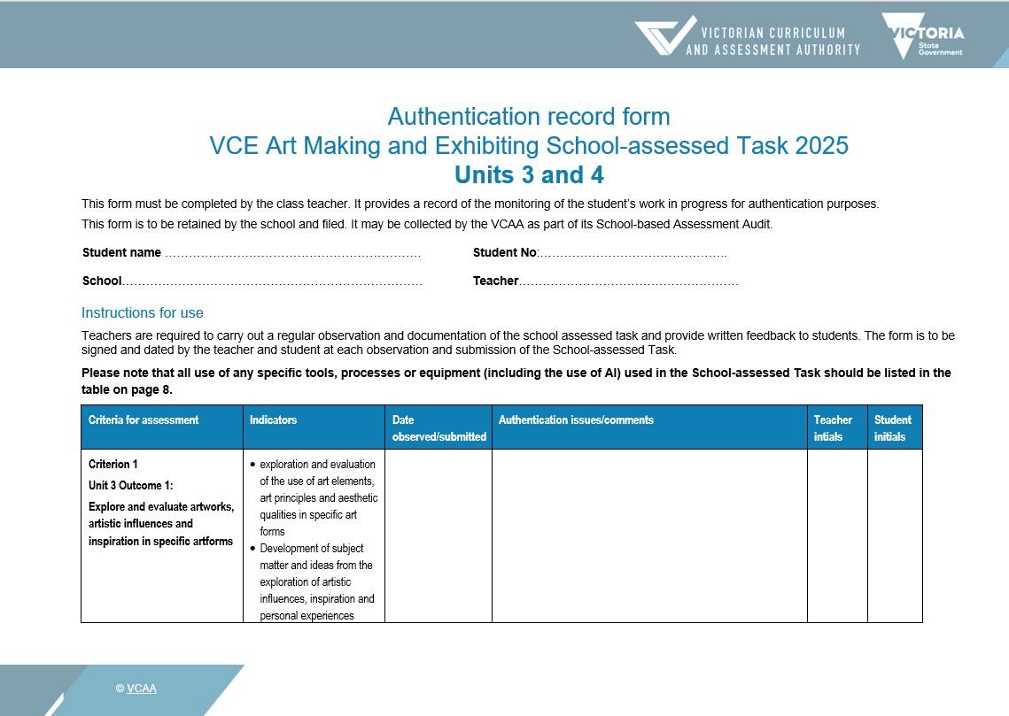
Authentication
Plan observations of student work and keep a record.
Student and teacher date and sign each Authentication.
Sample only

Slide 13
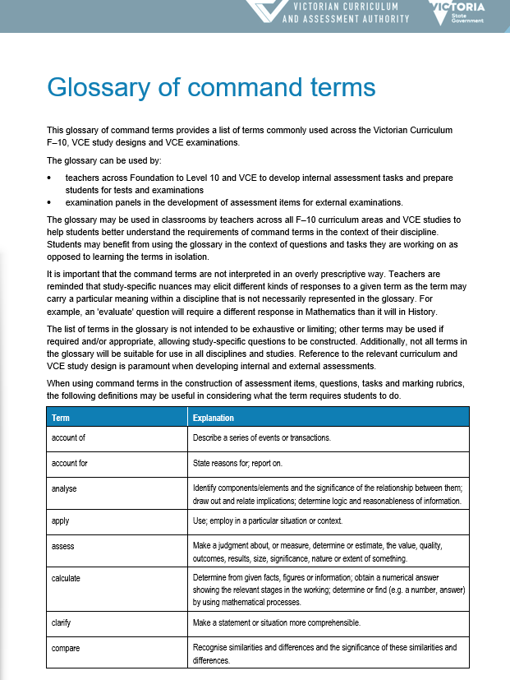
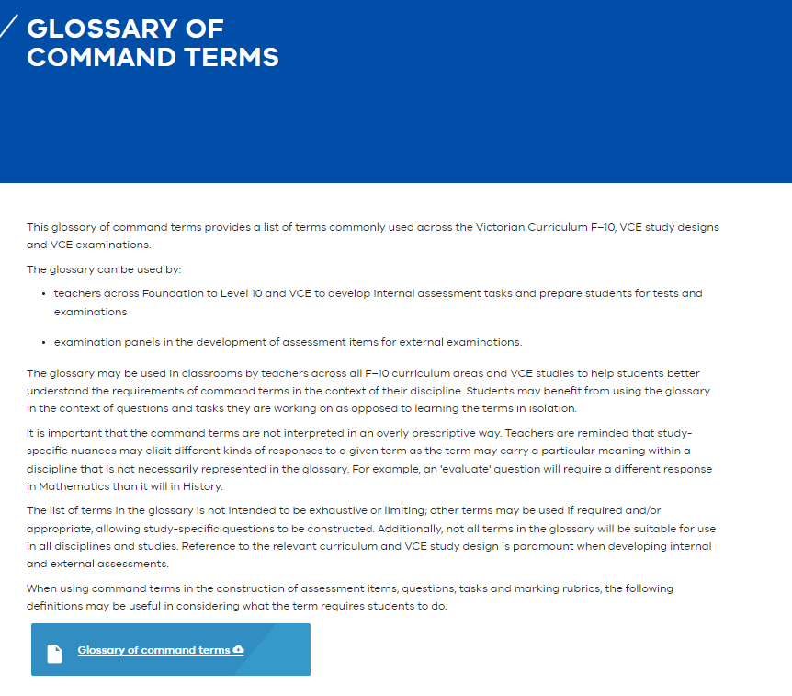
Glossary of command terms The same terms are used in SAT criteria and descriptors
Pages - Glossary of command terms (eduweb.vic.gov.au)

Slide 14
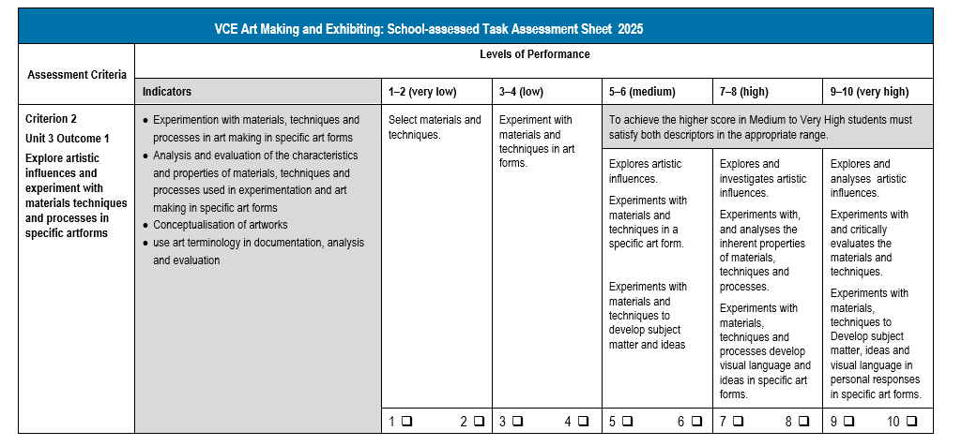
Assessment Criteria example
High: Command terms
Explore and investigate
Analyses
Sample only
Very High: Command terms
Explores and analyses
Critically evaluates
Specific art forms
CRITERION 3:
Explore
Experiment
INDICATORS
Specific art forms
Experimentation with materials, techniques and processes
Analysis and evaluation the characteristics and properties
Conceptualisation of art works
Use of art terminology

Slide 15
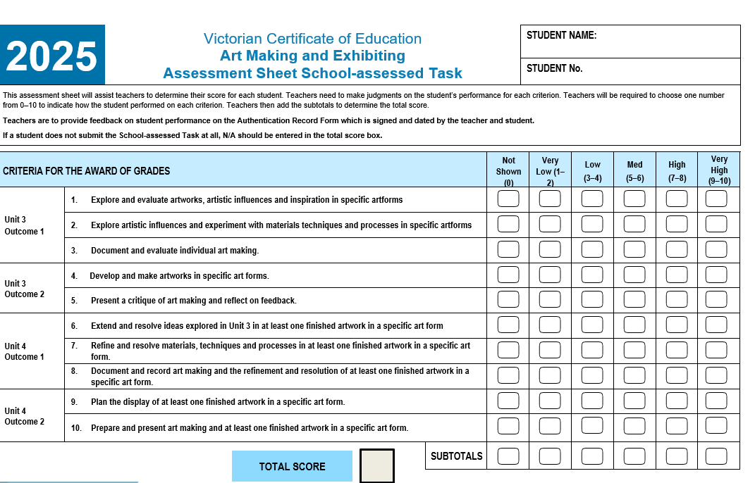
Assessment Sheet School-assessed Task
Sample only

Slide 16
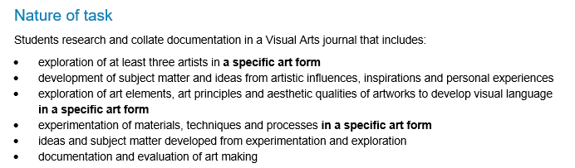
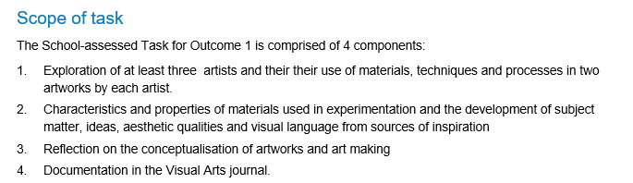
Administration information: Unit 3 Outcome 1 Scope and Nature of task
Describes the task
Describes the scope of assessment for the task
Source: VCE Art Making and Exhibiting: Administrative Information for School-based assessment

Slide 17
Unit 3 Outcome 1 task
On completion of this unit the student should be able to collect information from artists and artworks in specific art forms to develop subject matter and ideas in their own artmaking.
Information on artists and artworks
Specific art forms
Subject matter and ideas

Slide 18
Unit 3 Area of Study 1: Collect – inspirations, influences and images
Outcome 1 | On completion of this unit the student should be able to collect information from artists and artworks in specific art forms to develop subject matter and ideas in their own art making.
Key Knowledge | the use of art elements, art principles and aesthetic qualities in artworks in specific art forms how subject matter and ideas are developed from artistic influences, inspirations and personal experiences methods used to communicate ideas using visual language the inherent characteristics and properties of materials used in experimentation and art making in specific art forms techniques and processes used in art making in specific art forms methods used to conceptualise artworks and document individual art making art terminology in the documentation and evaluation of art making

Slide 19
Unit 3 Area of Study 1: Collect – inspirations, influences and images
Outcome 1 | On completion of this unit the student should be able to collect information from artists and artworks in specific art forms to develop subject matter and ideas in their own art making.
Key Skills | explore, evaluate and document the use of art elements, art principles and aesthetic qualities in specific art forms develop subject matter and ideas from the exploration of artistic influences, inspiration and personal experiences experiment with materials, techniques and processes in art making in specific art forms document the development of ideas and visual language in individual artworks in specific art forms identify and analyse the connections between influences, sources of inspiration and personal experiences identify, analyse and evaluate the characteristics and properties of materials used in experimentation and art making in specific art forms identify, analyse and evaluate the use of techniques and processes in specific art forms identify, analyse and evaluate the use of visual language in artworks conceptualise artworks and document, reflect on and evaluate individual art making in a Visual Arts journal use art terminology in documentation, analysis and evaluation

Slide 20
VCE Unit 3 Art Making and Exhibiting
Area of Study 1: Collect – inspirations, influences and images
Learning structure | How do artists use selected art forms and ideas to create visual language? What are my selected art forms? What techniques and processes will I investigate? What artists and artworks will I investigate? What is visual language and how is it used to communicate ideas? How do I conceptualise my ideas? How do I use my investigation of artists and artworks to inform my art making?

Slide 21
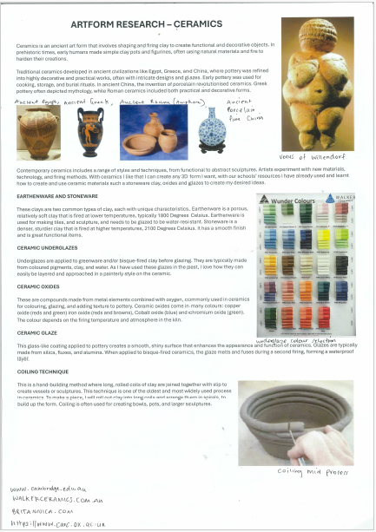
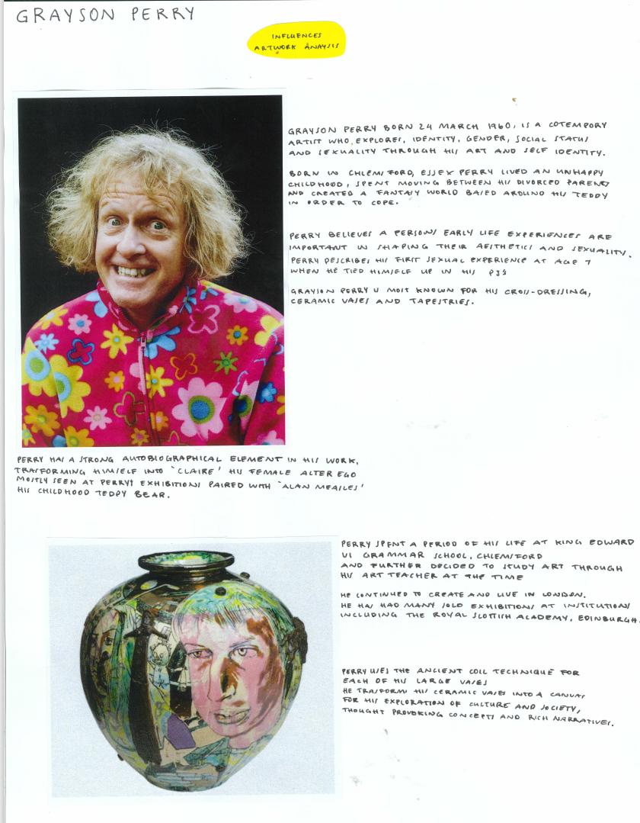
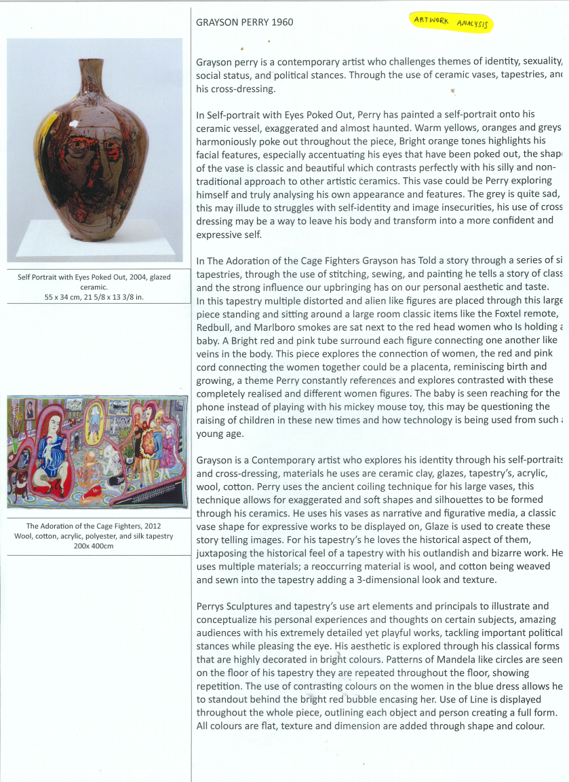
Student sample - Research
Owen Mueller
Notes:
This is one of two art forms that Owen researched, documenting the use of materials, techniques, and processes. He investigated the characteristics of the materials and their application in each art form.
Both art forms are historical, and Owen investigated art works in their historical context investigating the materials and techniques that were used in the period in which they were made. He then compared them with more contemporary techniques.
Owen critically evaluated the art forms to develop his own ideas and subject matter based on the artworks he researched.

Slide 22
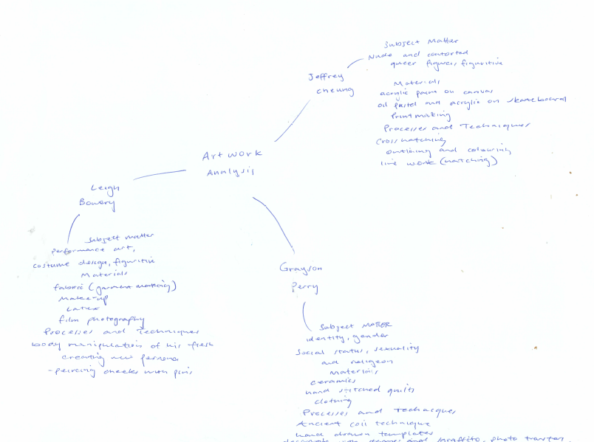
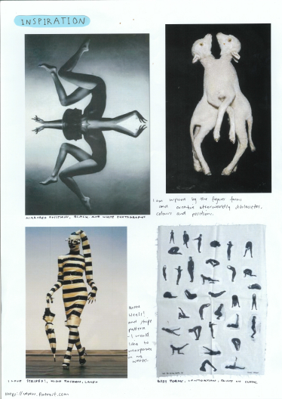
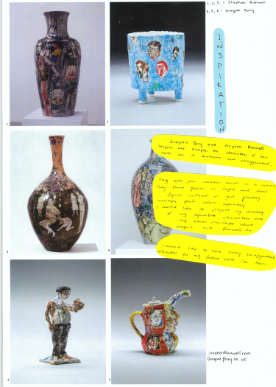
Student sample Exploration of ideas
Owen Mueller
Notes:
Owen brainstormed a range of artworks and focused on the human body as his subject matter. The selection of his subject matter and the artworks was inspired by the artforms and ideas of the three artists he researched.

Slide 23
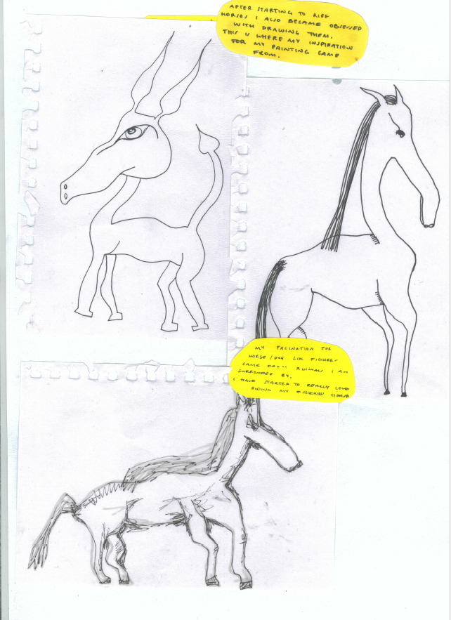
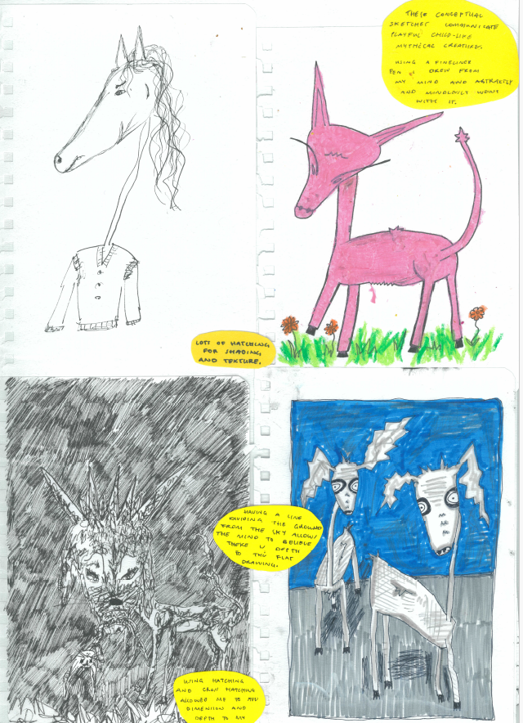
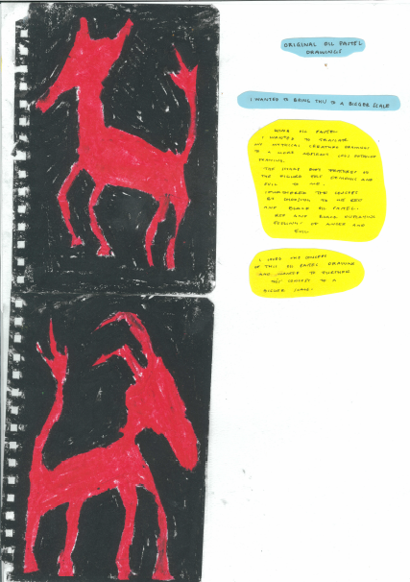
Student sample Exploration of materials and techniques
Owen Mueller
Notes:
The development for one of Owen’s artworks started with some drawings of horses. He developed the subject matter further and trialed different materials and techniques. He selected the pastel drawing because he liked the sharp approach (aesthetic qualities). He discussed how he was enlarging it on a larger scale. He referred to materials, techniques and processes and how the subject matter was developed. Owen also demonstrated an understanding of visual language to represent his ideas and communicate meaning in the art works.

Slide 24
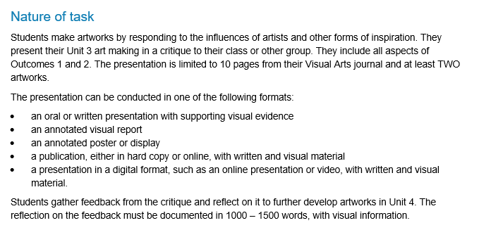
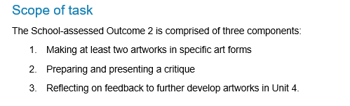
Administrative information: Unit 3 Outcome 2 Scope and Nature of task
Describes the task
Describes the scope of assessment for the task
Source: VCE Art Making and Exhibiting: Administrative Information for School-based assessment

Slide 25
Unit 3 Outcome 2 task
Artworks
Specific art forms
Prepare and present a critique
Reflect on feedback
On completion of this unit the student should be able to make artworks in specific art forms, prepare and present a critique, and reflect on feedback.

Slide 26
VCE Unit 3 Art Making and Exhibiting
Area of Study 2: Extend – make, critique and reflect | Unit 1:
Outcome 2 | On completion of this unit the student should be able to make artworks in specific art forms, prepare and present a critique, and reflect on feedback.
Key knowledge | the contribution of influences, exploration, responses and reflection in the planning and making of artworks in specific art forms influences of artists, and other forms of inspiration, on subject matter, ideas, techniques and style in individual artworks in specific art forms development of subject matter and ideas, and use of visual language in artworks materials, techniques and processes used to make artworks in specific art forms methods used to document and evaluate art making methods used to prepare and present a critique how to use feedback to revise and further develop artworks in specific art forms art terminology and visual language used in the documentation, presentation, reflection and evaluation of artworks and art making.

Slide 27
VCE Unit 3 Art Making and Exhibiting
Area of Study 2: Extend – make, critique and reflect | Unit 1:
Outcome 2 | On completion of this unit the student should be able to make artworks in specific art forms, prepare and present a critique, and reflect on feedback.
Key skills | make artworks in specific art forms based on influences, exploration, responses and reflection demonstrate and explain the materials, techniques and processes used to make artworks in specific art forms develop subject matter, ideas, techniques and style in artworks by responding to the influences of artists and other forms of inspiration develop visual language in artworks to represent ideas and to communicate meaning document and describe the development of subject matter and ideas in artworks by responding to the influences of artists and other forms of inspiration progressively document and evaluate art making prepare and present a critique describing and evaluating the making of artworks document and reflect on feedback from a critique to revise and further develop artworks use art terminology and visual language in documentation, presentation, reflection and evaluation of artworks and art making

Slide 28
VCE Unit 3 Art Making and Exhibiting
Area of Study 2: Extend – make, critique and reflect
Learning structure | How are ideas, reflection and feedback used in art making to develop artworks? What influences and forms of inspiration will I extend upon? Why have I selected them? What ideas will I expand upon and why? How does the experimentation and exploration I have completed contribute to the artworks? How will I develop my visual language? What materials, techniques and processes will I explore further and why? How will I document and evaluate my art making? What do I need to do to prepare for and present my critique?

Slide 29
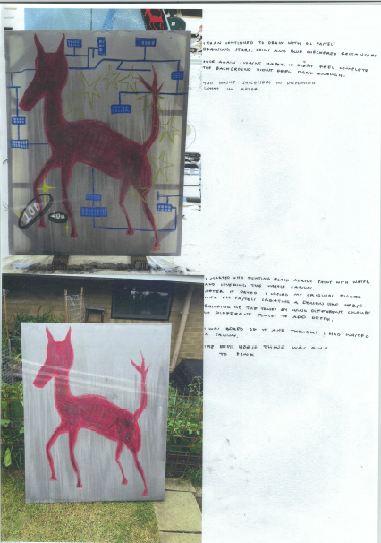
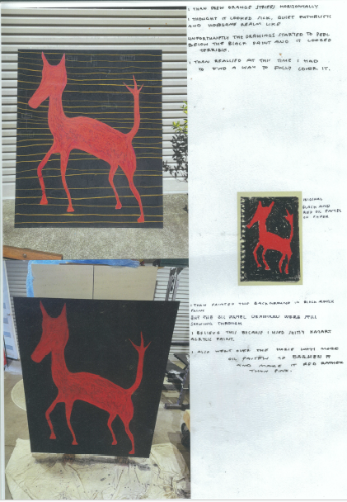
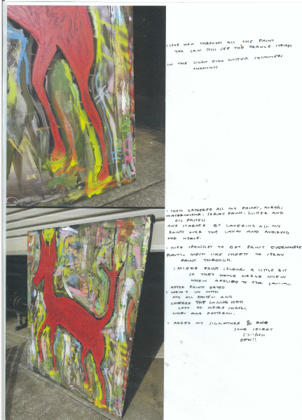
Student sample – making artworks
Owen Mueller
Notes:
Owen continued to develop one artwork from his exploration of subject matter and materials. He focused on a combination of drawing and painting, by documenting the application of materials and techniques to convey meaning in his work. He also considered visual language.

Slide 30
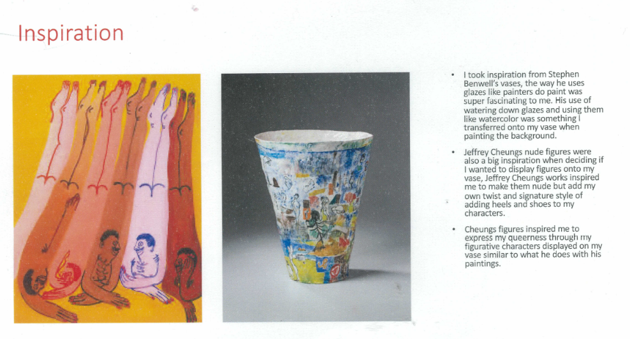
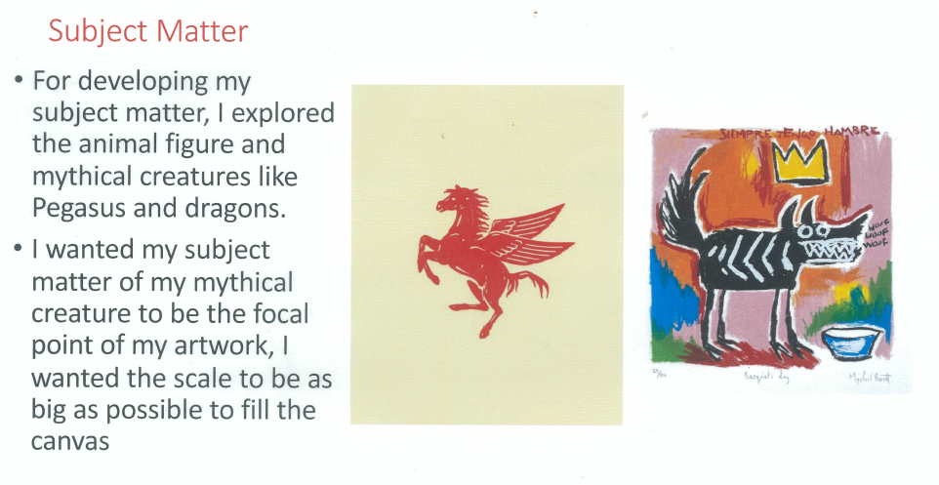
Student sample - critique
Owen Mueller
Notes:
In his critique Owen evaluated how he developed two artworks. The inspiration for his artworks was based on his research of his artists and he also discussed his depiction of subject matter, and the materials, techniques, and processes he used to make the artworks.

Slide 31
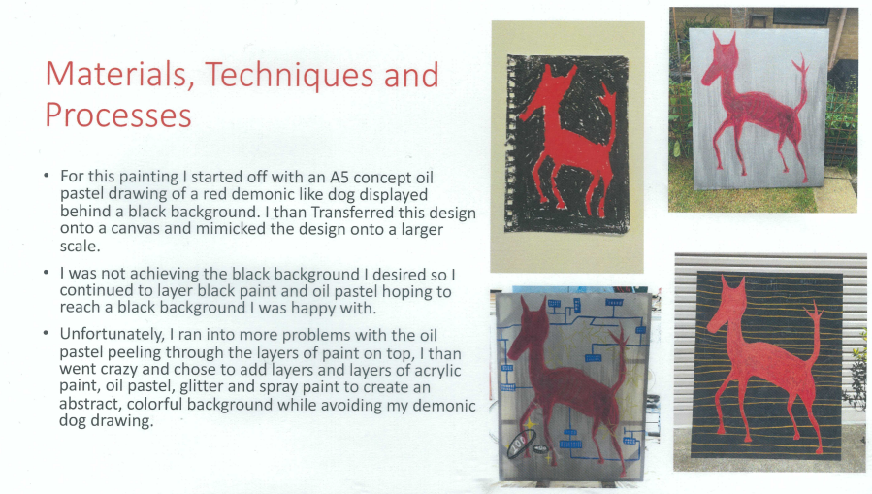
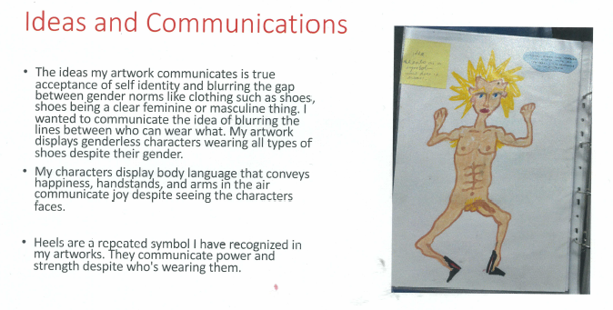
Student sample - critique
Owen Mueller
Notes:
Owen also evaluated the processes he used to create the artworks, and the ideas he was intending to express in his work using visual language (art elements and principles, materials, techniques, and processes).

Slide 32
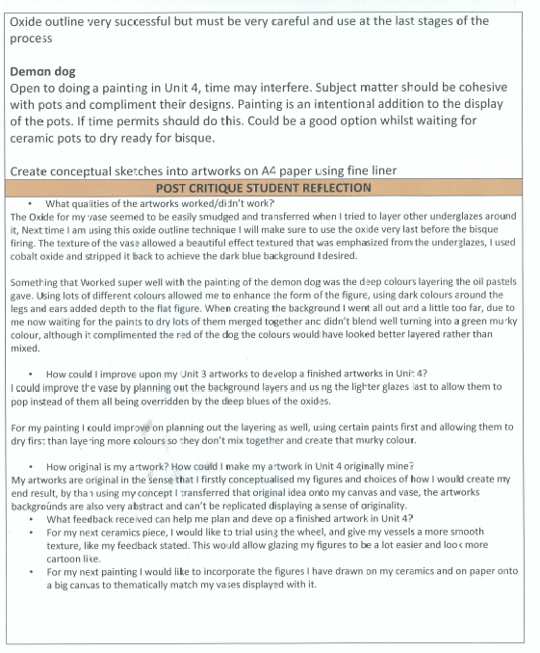

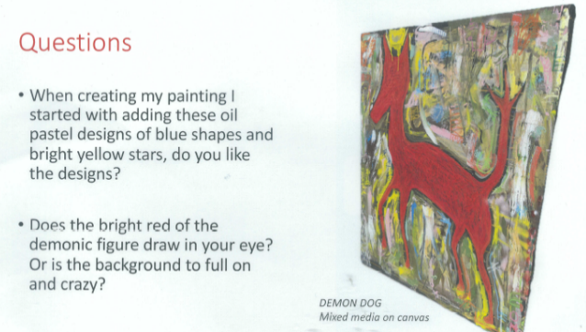
Student sample - feedback
Owen Mueller
Notes:
He developed some specific questions for feedback based on visual language and how communicated meanings and messages. To expand on his ideas and artmaking for Unit 4 Owen reflected on both artworks with three key questions. He evaluated how his work reflected his person ideas, what did not work, and what he could improve on Unit 4. To reflect on the feedback from his peers, who had responded to the same three questions, Owen he used a PMI (Plus, Minus, Interesting) model.

Slide 33
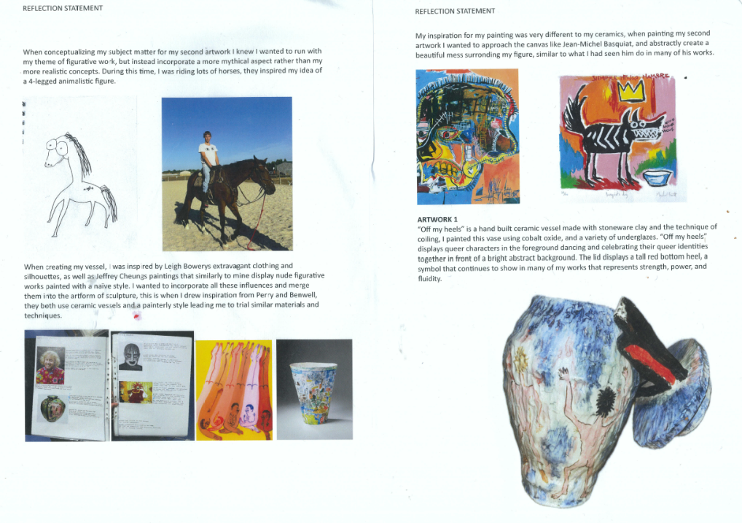
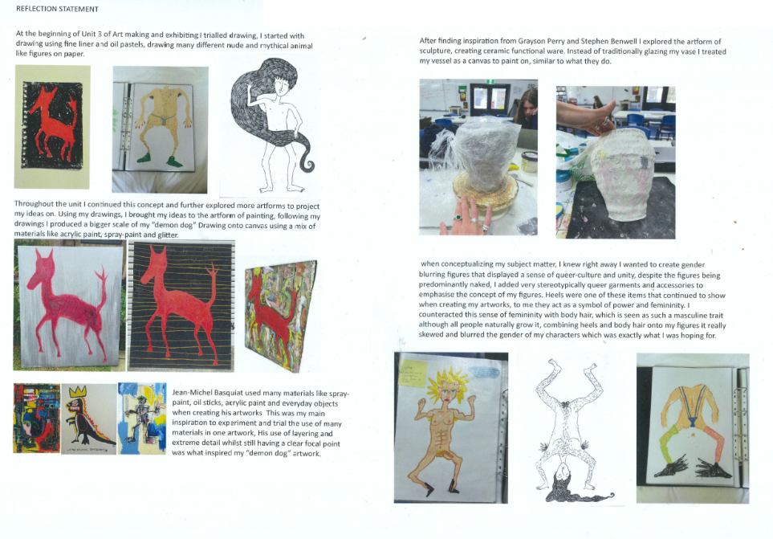
Student sample - reflection
Owen Mueller
Notes:
Before commencing Unit 4, Owen reflected further on the critique and discussed the artworks he would make. He identified his personal inspiration, the artworks that inspired him and how he would develop two artworks in different art forms in Unit 4 using materials, techniques and processes.

Slide 34
Contact
Dr Kathryn Hendy-Ekers
Curriculum Manager – Visual Arts, Visual Communication Design and Media
E: Kathryn.Hendy-Ekers@education.vic.gov.au
T: 9059 5147
M: 0438471513

Slide 36


