Slide 1
VCE Art Making and Exhibiting
Unit 4 School-Assessed Task

Slide 2
Acknowledgement
The Victorian Curriculum and Assessment Authority proudly acknowledges and pays respect to Victoria’s Aboriginal and Torres Strait Islander communities and their rich and enduring cultures.
We acknowledge Aboriginal and Torres Strait Islander people as Australia’s first peoples and as the Traditional Owners and custodians of the lands and waters on which we rely. We pay respect to Elders past and present of the lands where we conduct our work and recognise their ongoing contributions as the first educators on the land now known as Victoria.

Slide 3
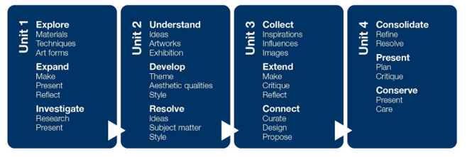
VCE Art Making and Exhibiting
Study specifications
Explore
Expand
Investigate
Understand
Develop
Resolve
Collect
Extend
Connect
Consolidate
Present
Conserve

Slide 4
VCE Art Making and Exhibiting
Study specifications: Making artworks
Making artworks
Artforms
Techniques
Processes
Materials
Aesthetic qualities
Art elements and Art Principles
Visual Language
Ideas and meaning
Explore
Expand
Investigate
Understand
Develop
Resolve
Collect
Extend
Connect
Consolidate
Present
Conserve

Slide 5
Study specifications: Exhibiting artworks
VCE Art Making and Exhibiting
Exhibition design
Curation
Conservation
Planning and producing the layout and design of the exhibition and planning the ‘flow’ of the exhibition, including sight lines, spatial relationships, viewer interaction and interpretation. Includes the creation of display furniture, selection of fixtures and use of lighting.
Determining the theme or story to be told in an exhibition. Curation includes the selection of artworks, writing the introduction to the exhibition, deciding where artworks will be placed, the designing of viewer interaction and interpretation, and the preparation of condition reports of artworks.
Planning, organising and undertaking the preservation and conservation of materials and objects in private, public and community collections, including art galleries, museums, other exhibition spaces and site-specific spaces.

Slide 6
Study specifications: Exhibiting artworks
VCE Art Making and Exhibiting
Exhibition design
Curation
Conservation
Explore
Expand
Investigate
Understand
Develop
Resolve
Collect
Extend
Connect
Consolidate
Present
Conserve
Museums
Galleries
Other exhibition spaces
Site specific spaces

Slide 7
VCE Art Making and Exhibiting
Study specifications: Study Terms
Art elements
Art principles
Art forms
Contexts
Critique
Influences and inspiration
Visual language
Aesthetic qualities

Slide 8
VCE Art Making and Exhibiting
Unit 4: Consolidate, present and conserve
Consolidation and extension of ideas from Unit 3 in art making
Use of the Unit 3 critique to broaden ideas and art making
Resolution and refinement
Presentation of finished artworks from art making
Research into the presentation, conservation and care of artworks
Area of Study | Inquiry focus
Area of Study 1 | Consolidate – refine and resolve How do artists refine and resolve artworks?
Area of Study 2 | Present – plan and critique How are ideas presented in finished artworks on exhibition?
Area of Study 3 | Conserve – present and care What role does conservation and care have in the presentation of artworks?

Slide 9
Art Making and Exhibiting
Unit 4:Consolidate, present and conserve
Area of Study | Outcome | Assessment
Area of Study 1 Consolidate – refine and resolve | On completion of this unit the student should be able to refine and resolve at least one finished artwork in a specific art form and document the materials, techniques and processes used in art making. | School-assessed Task
Area of Study 2 Present – plan and critique | On completion of this unit the student should be able to plan and display at least one finished artwork in a specific art form, and present a critique.
Area of Study 3 Conserve – present and care | On completion of this unit the student should understand the presentation, conservation and care of artworks, including the conservation and care of their own artworks. | School-assessed Coursework

Slide 10
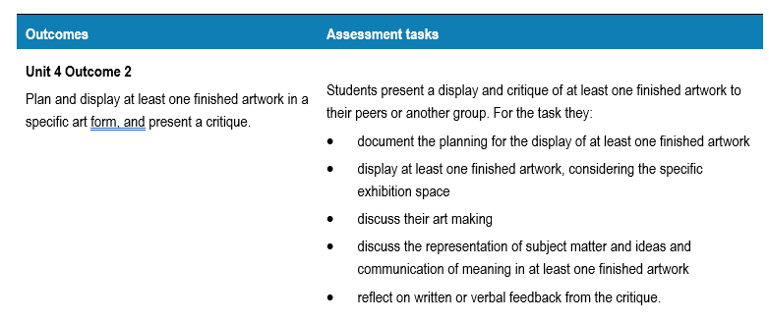
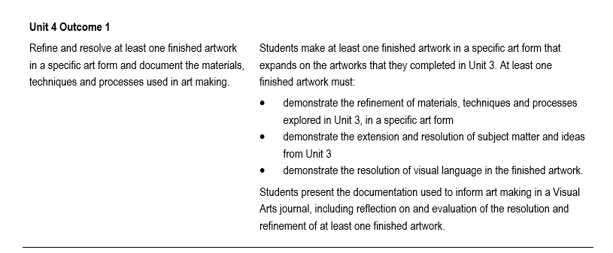
Unit 4 School-assessed Task

Slide 11
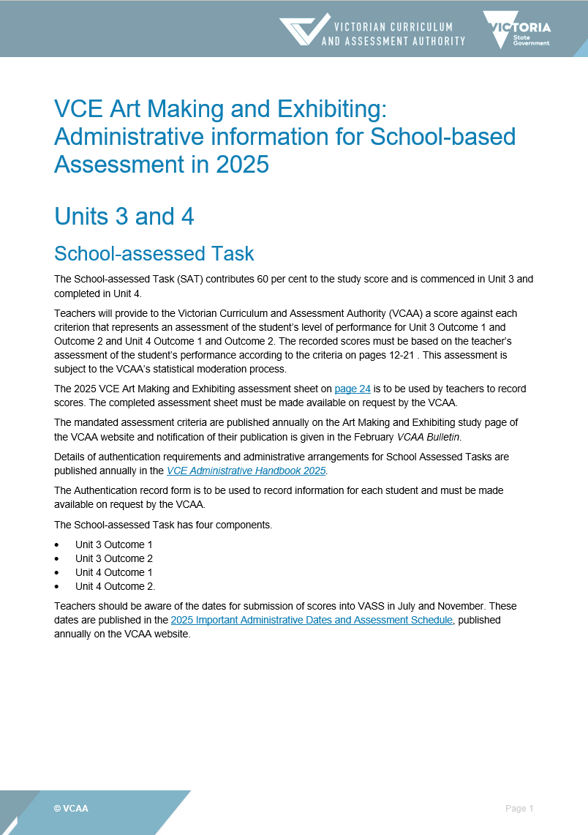
Administrative information for School-based assessment
Scope and nature of task
Assessment criteria, descriptors and evidence
Authentication material
Scoring sheet
Sample only

Slide 12
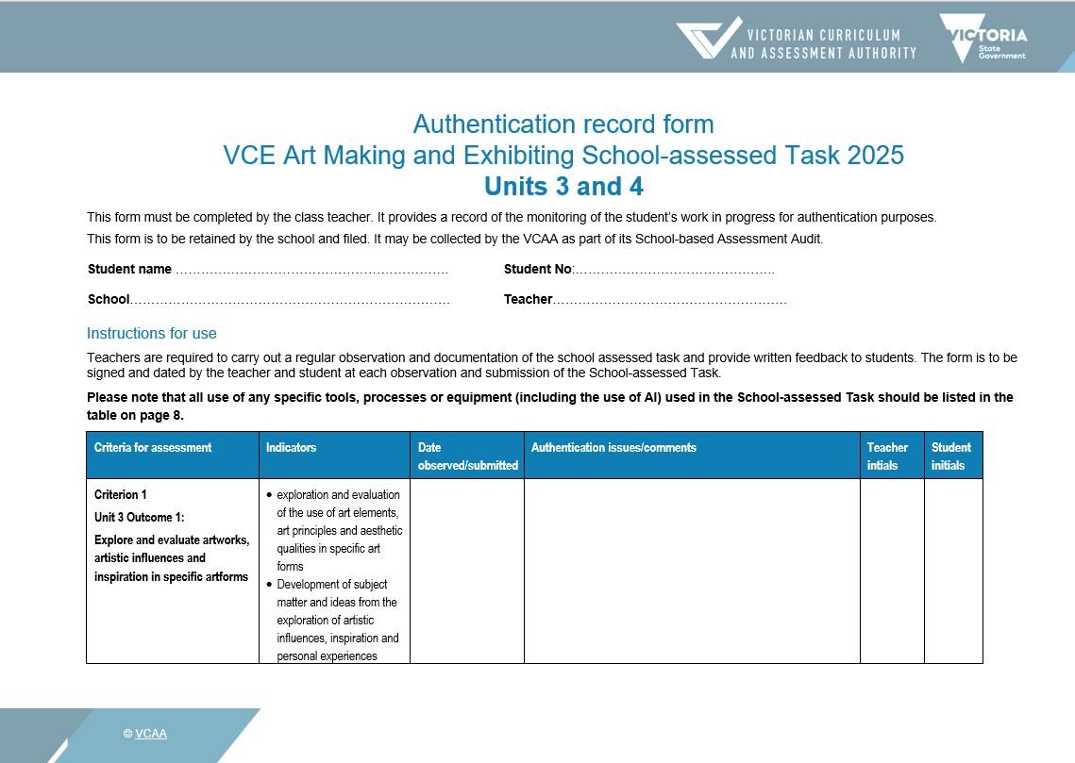
Authentication
Plan observations of student work and keep a record.
Student and teacher date and sign each Authentication.
Sample only

Slide 13
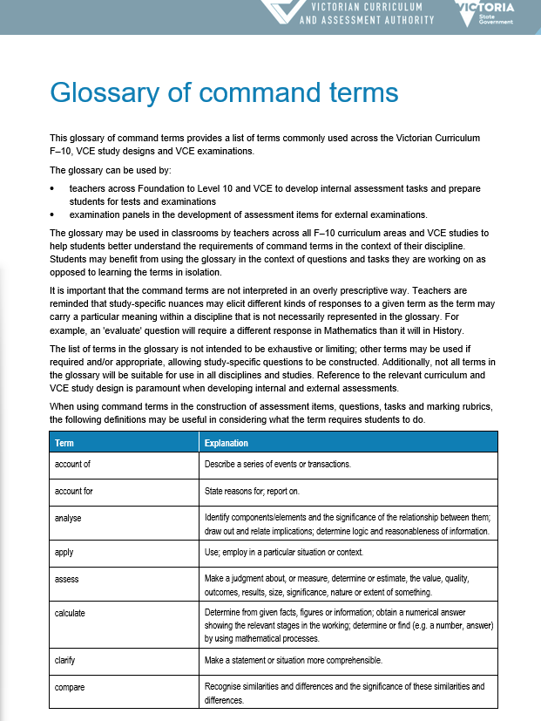
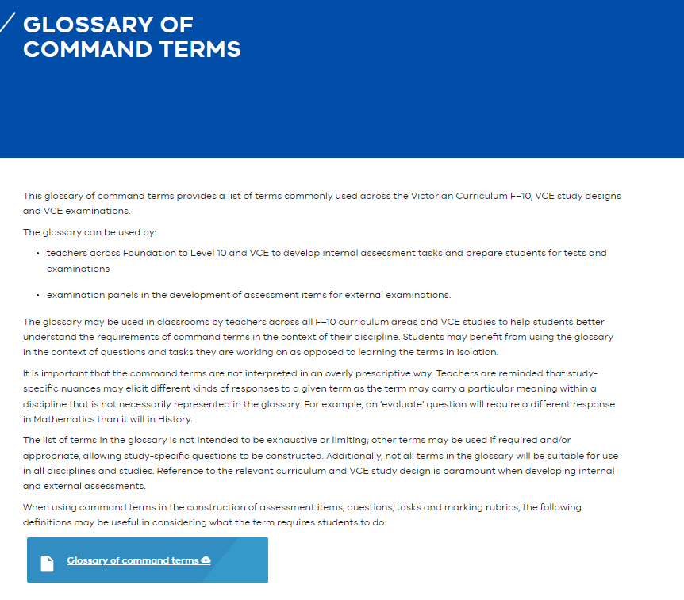
Glossary of command terms
The same terms are used in SAT criteria and descriptors
Pages - Glossary of command terms (eduweb.vic.gov.au)

Slide 14
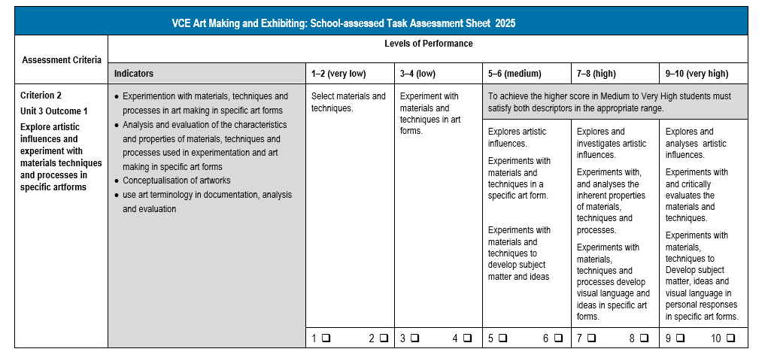
Assessment Criteria example
High: Command terms
Explore and investigate
Analyses
Sample only
Very High: Command terms
Explores and analyses
Critically evaluates
Specific art forms
CRITERION 3:
Explore
Experiment
INDICATORS
Specific art forms
Experimentation with materials, techniques and processes
Analysis and evaluation the characteristics and properties
Conceptualisation of art works
Use of art terminology

Slide 15
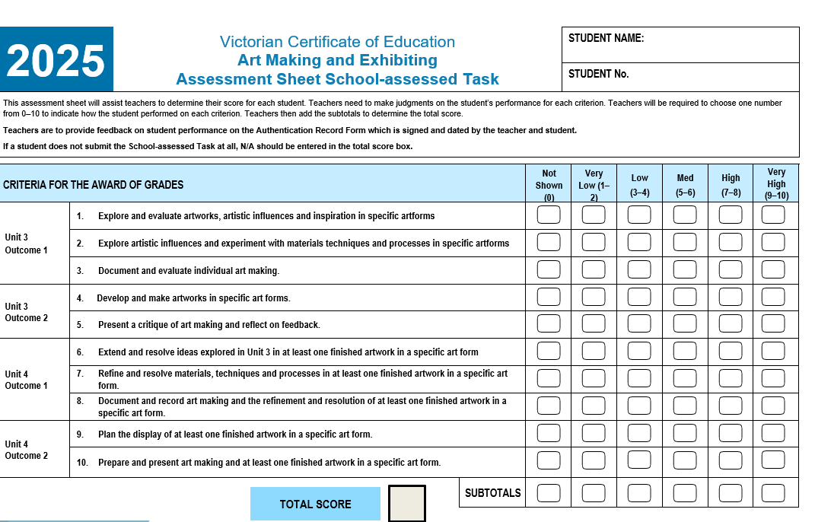
Assessment Sheet School-assessed Task
Sample only

Slide 16
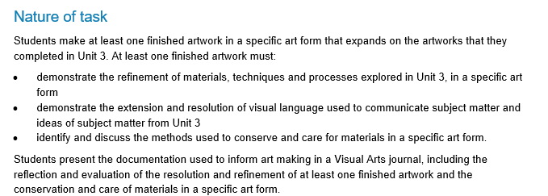
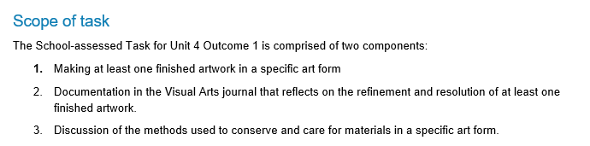
Administration information: Unit 4 Outcome 1
Scope and Nature of task
Describes the task
Describes the scope of assessment for the task
Source: VCE Art Making and Exhibiting: Administrative Information for School-based assessment

Slide 17
Unit 4 Outcome 1 task
On completion of this unit the student should be able to refine and resolve at least one finished artwork in a specific artform and document the materials, techniques and processes used in art making.
Making of at one finished artwork in a specific art form
Documentation on the refinement and resolution
Methods used to conserve and care for materials.

Slide 18
Art Making and Exhibiting Unit 4
Area of Study 1: Consolidate – refine and resolve | Unit 1:
Outcome | On completion of this unit the student should be able to refine and resolve at least one finished artwork in a specific art form and document the materials, techniques and processes used in art making
Key knowledge | methods used to extend and resolve subject matter and ideas in artworks methods used to refine and resolve visual language in artworks the application of materials, techniques and processes to refine at least one finished artwork in a specific art form methods used to progressively document and record art making and the resolution and refinement of at least one finished artwork in a specific art form methods used to reflect and evaluate how subject matter and ideas are extended from Unit 3 and resolved in at least one finished artwork in a specific art form methods used to reflect on and evaluate the materials, techniques and processes used to make at least one finished artwork in a specific art form terminology used in the reflection and evaluation of art making and the refinement and resolution of at least one finished artwork in a specific art form methods used to conserve and care for the materials used in a specific art form terminology used to discuss the conservation and care of materials used in a specific art form

Slide 19
Art Making and Exhibiting Unit 4
Area of Study 1: Consolidate – refine and resolve | Unit 1:
Outcome | On completion of this unit the student should be able to refine and resolve at least one finished artwork in a specific art form and document the materials, techniques and processes used in art making.
Key skills | extend and resolve ideas explored in Unit 3 in at least one finished artwork refine and resolve visual language in at least one finished artwork refine the use of materials, techniques and processes explored in Unit 3 to make at least one finished artwork in a specific art form progressively document and record art making and the resolution and refinement of at least one finished artwork in a specific art form reflect on and evaluate the expansion and resolution of ideas from Unit 3 in at least one finished artwork in a specific art form reflect on and evaluate the resolution of visual language used to communicate subject matter and ideas in at least one finished artwork in a specific art form reflect on and evaluate the use of materials, techniques and processes to make at least one finished artwork in a specific art form apply terminology in the reflection and evaluation of art making and the refinement and resolution of at least one finished artwork in a specific art form identify and discuss the methods used to conserve and care for materials used in a specific art form apply terminology in the discussion of the conservation and care of materials used in a specific art form

Slide 20
VCE Art Making and Exhibiting Unit 4
Unit 4 Area of Study 1: Consolidate – refine and resolve
Learning structure | How do artists refine and resolve artworks? What ideas from Unit 3 will I expand upon in Unit 4? How will I demonstrate the connections between artworks in Unit 3 and the finished artwork in Unit 4? How will I refine materials and techniques in a selected art form? How will I resolve subject matter and visual language in my finished artwork? How will I reflect on my art making in the visual journal?

Slide 21
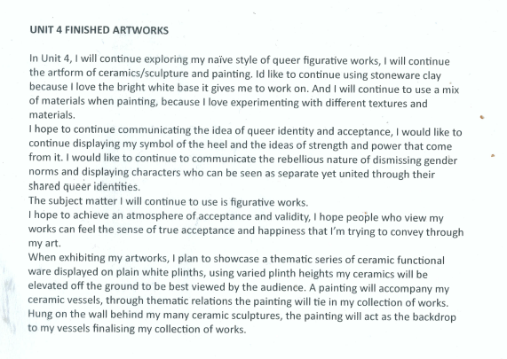
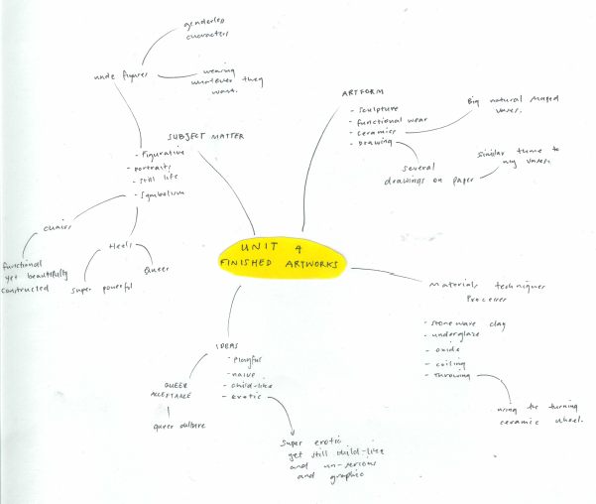
Student sample – Idea expansion
Owen Mueller
Notes:
Owen reflected on the Critique from Unit 3 and synthesised his ideas in a brainstorming map.

Slide 22
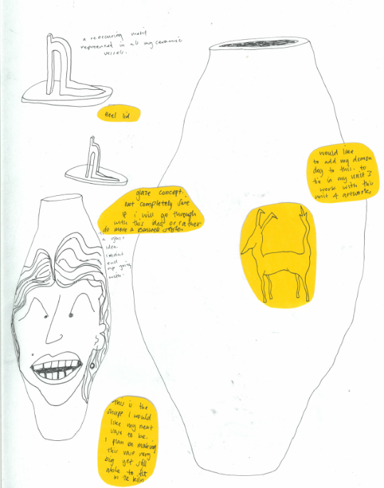
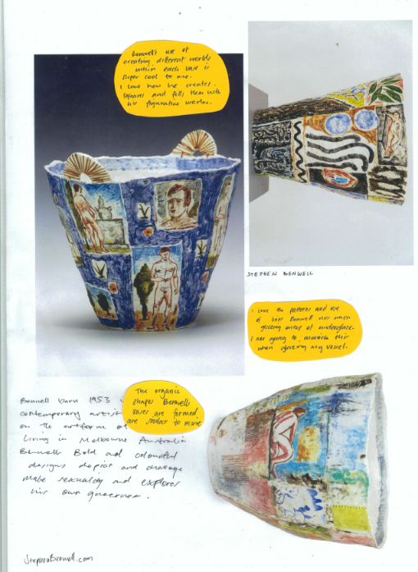
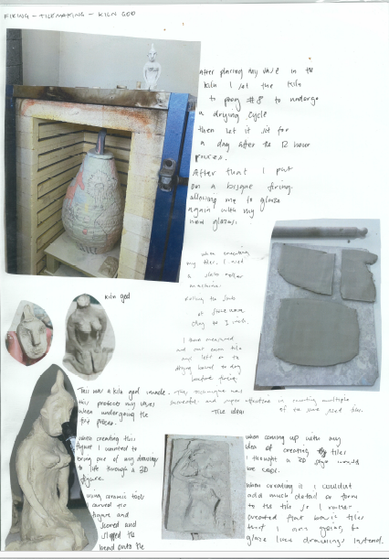
Student sample
Exploration of materials
Owen Mueller
Notes:
He then returned to his inspiration to further resolve his ideas and subject matter.
Drawing on his ideas, ceramics and paintings from Unit 3, Owen sketched out some ideas for a ceramic work. He used his exploration of ceramic techniques to design the vessel and the subject matter from his paintings to design the form and the surface decoration.

Slide 23
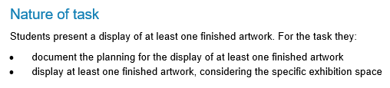
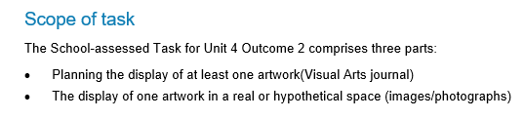
Administration information: Unit 4 Outcome 2
Scope and Nature of task
Describes the task
Describes the scope of assessment for the task
Source: VCE Art Making and Exhibiting: Administrative Information for School-based assessment

Slide 24
Unit 4 Outcome 2 task
On completion of this unit the student should be able to plan and display at least one finished artwork in a specific art form and present a critique.
Documentation of characteristics of art spaces
Planning the display of one artwork
Display of at least one finished artwork

Slide 25
VCE Art Making and Exhibiting Unit 4
Area of Study 2: Present – plan and critique | Unit 1:
Outcome | On completion of this unit the student should be able to plan and display at least one finished artwork in a specific art form, and present a critique.
Key knowledge | characteristics of the display of artworks in a specific space methods used to display finished artworks methods used to plan and document the display of finished artworks methods used to prepare and present a critique of art making and at least one finished artwork in a specific art form methods used to critically evaluate art making in a critique methods used to explain decisions made throughout art making in a critique methods used to present the representation of subject matter and ideas and the communication of meaning in at least one finished artwork in a specific art form art terminology used in discussion and evaluation of the presentation of a finished artwork in a specific art form and art making in a critique

Slide 26
VCE Art Making and Exhibiting Unit 4
Area of Study 2: Extend – make, critique and reflect | Unit 1:
Outcome | On completion of this unit the student should be able to plan and display at least one finished artwork in a specific art form, and present a critique.
Key skills | research and discuss the characteristics of specific exhibition spaces research and discuss the display of artworks in specific exhibition spaces plan and document the display of at least one finished artwork in a specific art form in a specific space present and evaluate at least one finished artwork in a specific art form in a critique prepare and present a critique of art making critically evaluate art making in a critique explain decisions made throughout art making in a critique present and explain the representation of subject matter and ideas and the communication of meaning in at least one finished artwork in a specific art form apply art terminology used in discussion and evaluation of the presentation of at least one finished artwork in a specific art form and art making in a critique

Slide 27
Art Making and Exhibiting Unit 4
Area of Study 2: Present – plan and critique
Learning structure | How are ideas presented in finished artworks on exhibition? Where am I going to display my finished artwork? How will I plan and document my presentation? What do I need to do to prepare for the critique? How will I evaluate my art making and my decisions in the critique? How will I represent my subject matter and ideas to communicate meaning in my finished artwork What art terminology do I need to know to discuss and evaluate my finished artworks?

Slide 28
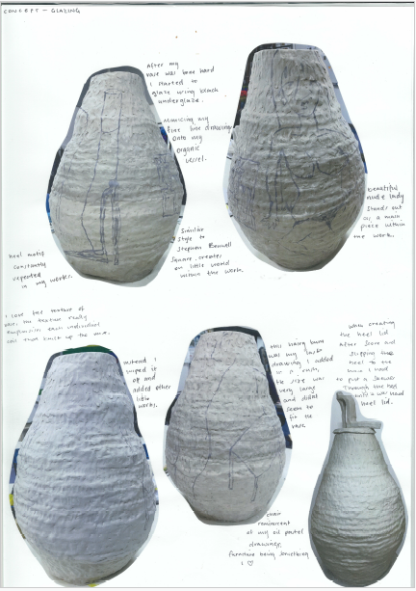
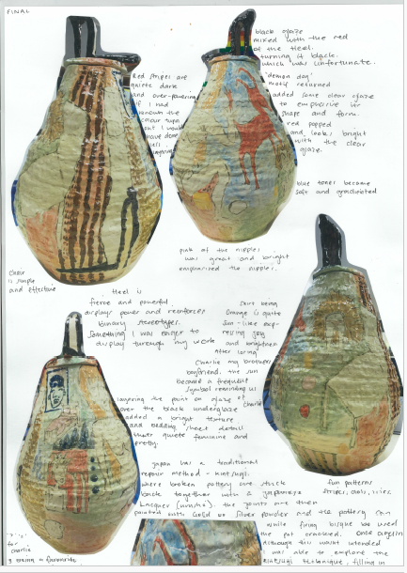
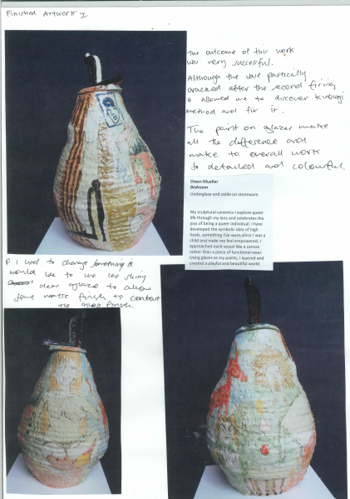
Student sample
Refinement and resolution
Owen Mueller
Notes:
Owen refined the materials, techniques, and processes for one of the ceramic vessels that he made as a final artwork. He documented each step in the process from hand building to firing. The annotations explain the development of the work and the expansion of ideas from Unit 3.

Slide 29
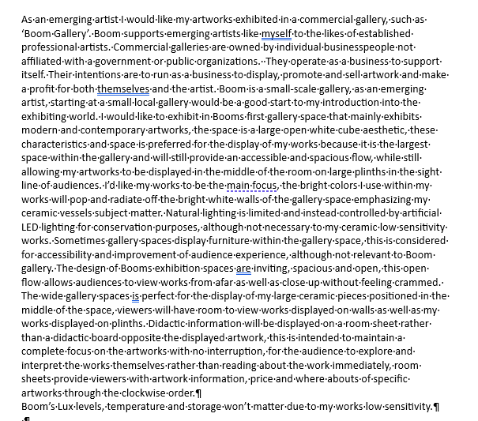
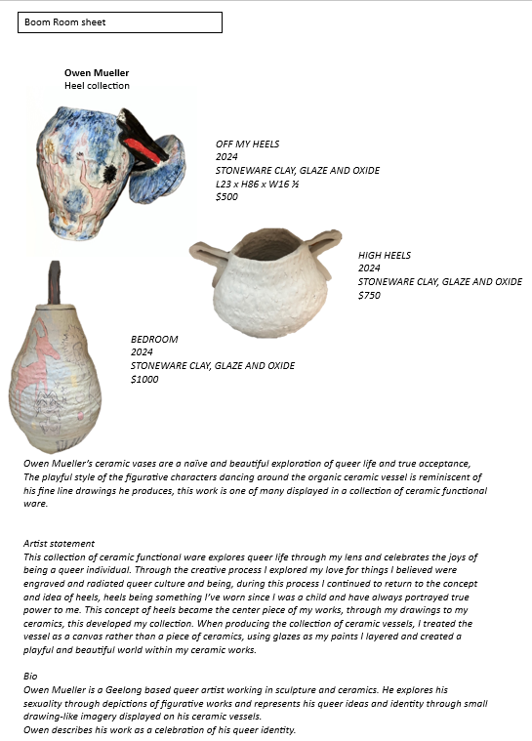
Student sample – Exhibition planning
Owen Mueller
Notes:
To plan the exhibition of his final artworks, Owen researched an exhibition space that he felt would best suit the presentation of his artwork. He analysed the presentation of work in the space and the conservation of the artwork.
Owen also investigated how information was provided for individual artworks and he wrote an artist statement for his artworks. The statement explains the ideas, why he selected Ceramics as an art form, and how his subject matter and use of visual language communicates his ideas and meanings for an audience.

Slide 30
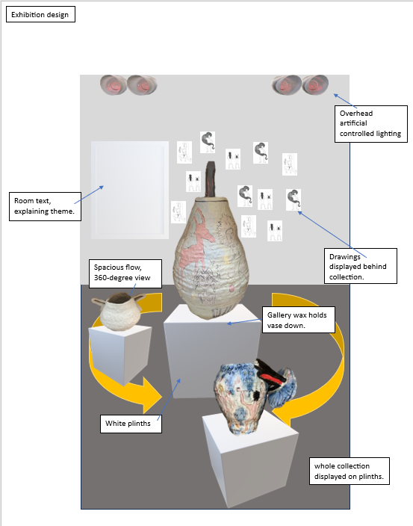
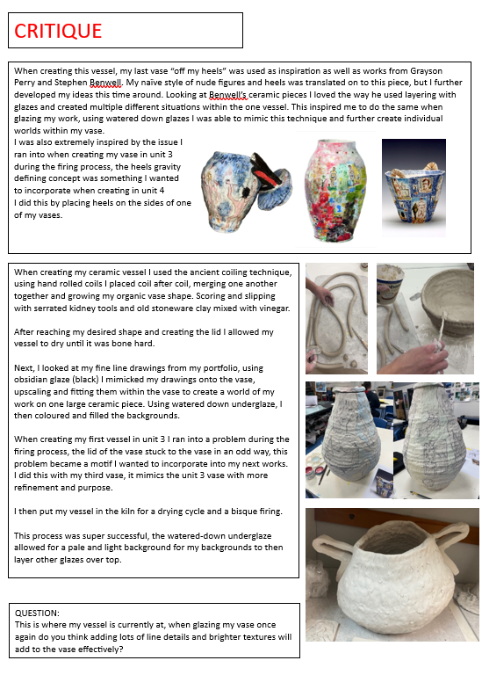
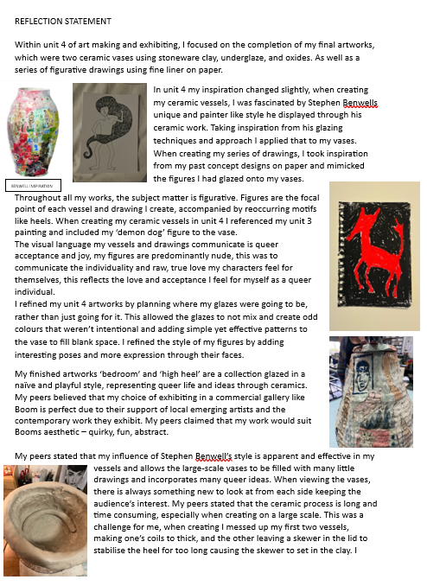
Student sample
Presentation, critique and reflection
Owen Mueller
Notes:
Owen presented his final artworks in a critique. He included an image of the artworks in an exhibition space with annotations to explain lighting, movement of viewers, placement of plinths, and the positioning of artworks and room text on the walls.
His critique was accompanied by written documentation and images. Owen explained his inspiration, use of materials, techniques and processes for the specific art form, and how he used visual language to communicate ideas and meaning for the audience.
Before he finally refined his artworks, Owen asked for feedback from his peers on the decoration of his vessel and the techniques he intended to use to refine it. He then produced a final reflection.

Slide 31
Contact
Dr Kathryn Hendy-Ekers
Curriculum Manager – Visual Arts, Visual Communication Design and Media
E: Kathryn.Hendy-Ekers@education.vic.gov.au
T: 9059 5147
M: 0438471513

Slide 33
