Slide 1
VCE Data Analytics
School-assessed Task
Video 2
SAT Authentication
Notes:
Hello and welcome to this VCE Data Analytics on-demand video for the School-assessed Task.
The purpose of this video is to support teachers with understanding the authentication of the SAT for Data Analytics.
My name is Phil Feain and I am the Curriculum Manager for Digital Technologies with the VCAA.

Slide 2
Acknowledgement
The Victorian Curriculum and Assessment Authority proudly acknowledges and pays respect to Victoria’s Aboriginal and Torres Strait Islander communities and their rich and enduring cultures.
We acknowledge Aboriginal and Torres Strait Islander people as Australia’s first peoples and as the Traditional Owners and custodians of the lands and waters on which we rely. We pay respect to Elders past and present of the lands where we conduct our work and recognise their ongoing contributions as the first educators on the land now known as Victoria.
Notes:
Before I start, I would like to present the Acknowledgement of Country.
The Victorian Curriculum and Assessment Authority proudly acknowledges and pays respect to Victoria’s Aboriginal and Torres Strait Islander communities and their rich and enduring cultures.
We acknowledge Aboriginal and Torres Strait Islander people as Australia’s first peoples and as the Traditional Owners and custodians of the lands and waters on which we rely.
We pay respect to Elders past and present of the lands where we conduct our work and recognise their ongoing contributions as the first educators on the land now known as Victoria.

Slide 3

Agenda
Authentication
Authentication record form
Using the Authentication record form
Notes:
This presentation will involve the following topics:
Authentication
Authentication record forms
And using the Authentication record forms.

Slide 4

Authentication
Comply with authentication requirements
Be aware of the requirements for the
School-assessed Task.
(Administrative information for School-based Assessment, p.18)
Notes:
Authentication is an important part of the SAT in ensuring all student work is their own.
Teachers are reminded of the need to comply with the authentication requirements specified in the Assessment: School-based Assessment section of the VCE Administrative Handbook. This is important to ensure that ‘undue assistance [is] not … provided to students while undertaking assessment tasks’.
Teachers must be aware of the following requirements for the authentication of VCE Applied Computing: Data Analytics School-assessed Task.

Slide 5
Authentication
The SAT is based on Unit 3 Outcome 2 and Unit 4 Outcome 1.
Fill out the Authentication record form and provide the student with feedback.
Undue assistance should not occur at any time.
(Administrative information for School-based Assessment, p.18)
Notes:
The body of work created for the SAT is based on work developed and completed in Unit 3 Outcome 2 and Unit 4 Outcome 1.
Teachers are required to fill out the Authentication record form and provide the student with feedback on their progress at each observation.
Undue assistance should not occur at any time during the development of the body of work, and teachers need to be vigilant. Students are required to demonstrate development of their thinking and working practices. Teachers are reminded that it is not appropriate to provide ‘detailed advice on, corrections to, or actual reworking of students’ work’.

Slide 6
Authentication
Teachers must sight and monitor the development and documentation of the student’s thinking and working practices throughout.
Students should be encouraged to complete their work at school.
(Administrative information for School-based Assessment, p.18)
Notes:
Teachers must sight and monitor the development and documentation of the student’s thinking and working practices throughout the unit to authenticate the work as the student’s own. Students must acknowledge the source of materials and information used to support the development of their work.
Students should be encouraged to complete their work at school. Where students use external service providers, their documentation should demonstrate ongoing progress throughout the SAT.

Slide 7
Authentication
Teachers must plan and use observations of student work … to monitor and record each student’s progress.
Authentication procedures must be followed for all student work in relation to this SAT.
(Administrative information for School-based Assessment, p.18)
Notes:
During the generation of the software solution, teachers must plan and use observations of student work in order to monitor and record each student’s progress as part of the authentication process. Teachers must ensure that all source and reference material, all use of non-school (home, outsourced) resources and any external assistance (for example, tutors) are acknowledged on the Authentication record form. If a student acknowledges using external resources or receiving external assistance, the teacher should record complete details as an attachment to the Authentication record form.
Teachers are reminded that the authentication procedures must be followed for all student work in relation to this SAT. The School-based Assessment Audit includes the inspection of Authentication record forms.

Slide 8
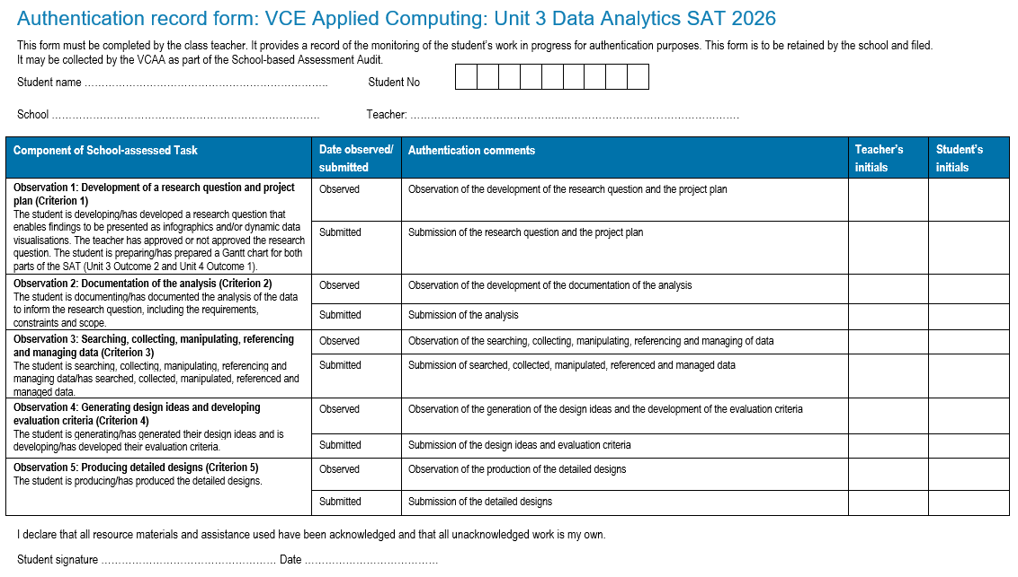
Unit 3 Authentication record form
(Administrative information for School-based Assessment, p.19)
Notes:
This is a screen-shot of the Unit 3 Authentication record form for Data Analytics.
Student details are to be provided at the top of the form.
In the table are spaces for the teacher to:
state the date of the observation and submission of each of the components of the SAT
comment on the observation and the submission of each of the components
and sign their initials for each observation and submission.

Slide 9
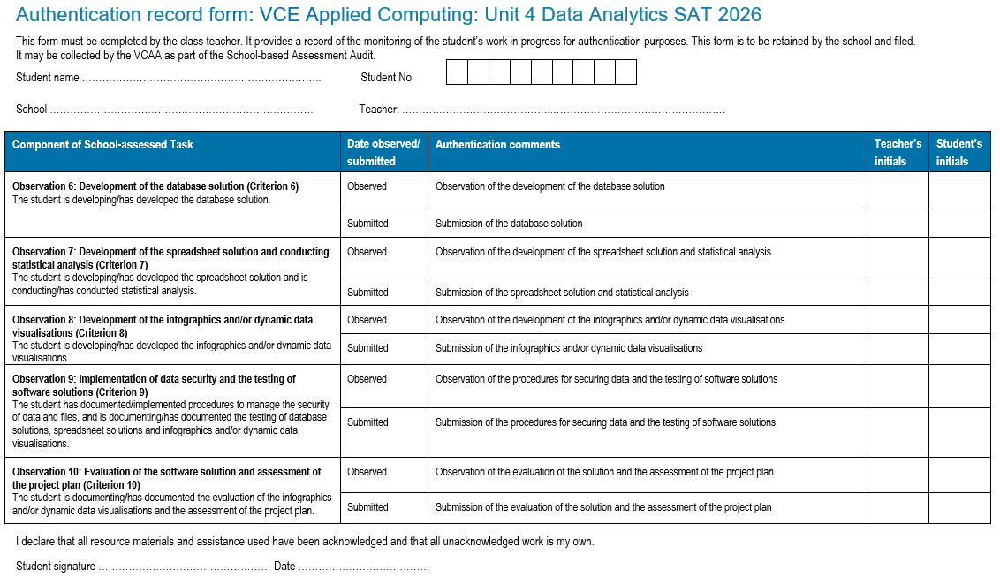
Unit 4 Authentication record form
(Administrative information for School-based Assessment, p.20)
Notes:
This is a screen-shot of the Unit 4 Authentication record form for Data Analytics.
The same process is to be followed by both teachers and students as in Unit 3.

Slide 10
Using the Authentication record form
Regularly observe student work during the life of the SAT
Have an idea of marks when making an observation
Ensure a student’s work is their own.
Notes:
When using the Authentication record form:
Regularly observe student work during the life of the SAT
some teachers use one class a week to do this formally
use the VCAA Authentication record form and update with comments from observations as you go – these can be requested as part of the audit process
both you and the student are to sign and date your initials for each observation at the time of the observation
Have an idea of how many marks a student has achieved for each criterion when making an observation – keep a record of this for yourself only – you should have an idea of a score for students if work is lost or not submitted on time.
Ensure a student’s work is their own – they are to sign and date the declaration at the bottom of each Authentication record form.

Slide 11
Contact the Curriculum Manager
vcaa@education.vic.gov.au or + 61 3 9032 1629
© Victorian Curriculum and Assessment Authority 2025
The copyright in this PowerPoint presentation is owned by the Victorian Curriculum and Assessment Authority or in the case of some materials, by third parties. No part may be reproduced by any process except in accordance with the provisions of the Copyright Act 1968 or with permission from the Copyright Officer at the Victorian Curriculum and Assessment Authority.

Slide 12
Notes:
Don’t speak leave for 3 secs.

