Slide 1
VCE Data Analytics
School-assessed Task
Video 1
Background to the SAT
Notes:
Hello and welcome to this VCE Data Analytics on-demand video for the School-assessed Task.
The purpose of this video is to support teachers with understanding the background to the SAT for Data Analytics.
My name is Phil Feain and I am the Curriculum Manager for Digital Technologies with the VCAA.

Slide 2
Acknowledgement
The Victorian Curriculum and Assessment Authority proudly acknowledges and pays respect to Victoria’s Aboriginal and Torres Strait Islander communities and their rich and enduring cultures.
We acknowledge Aboriginal and Torres Strait Islander people as Australia’s first peoples and as the Traditional Owners and custodians of the lands and waters on which we rely. We pay respect to Elders past and present of the lands where we conduct our work and recognise their ongoing contributions as the first educators on the land now known as Victoria.
Notes:
Before I start, I would like to present the Acknowledgement of Country.
The Victorian Curriculum and Assessment Authority proudly acknowledges and pays respect to Victoria’s Aboriginal and Torres Strait Islander communities and their rich and enduring cultures.
We acknowledge Aboriginal and Torres Strait Islander people as Australia’s first peoples and as the Traditional Owners and custodians of the lands and waters on which we rely.
We pay respect to Elders past and present of the lands where we conduct our work and recognise their ongoing contributions as the first educators on the land now known as Victoria.

Slide 3

Agenda
Administrative information for School-based Assessment
Nature and scope of the task
Assessment criteria
Authentication
Assessment sheet
Marking
Commercial instructions
Notes:
This presentation will involve the following topics:
The Administrative information for School-based Assessment
The nature and scope of the task
The assessment criteria
Authentication
The assessment sheet
Marking
and issues around the use of commercial instructions.

Slide 4
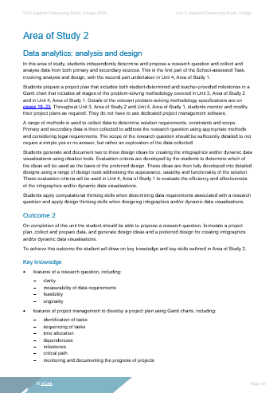

Study design from 2025
Notes:
The first essential resource is the Applied Computing Study Design.
The study design is now accredited from 2025.
You need to be familiar with this document for Data Analytics.
It details the:
Terms used in the study
Problem-solving methodology
Areas of study
Outcomes
Key knowledge
Key skills
School-based assessment including SACs and SAT
and the examination.

Slide 5

Administrative information for
School-based Assessment
Notes:
The Administrative information for School-based Assessment contains information relevant to the SAT as well as the authentication and assessment of the SAT.
This document is updated every year.
Content included for both the U3 O2 and U4 O1 outcomes are:
Details regarding the SAT
the Nature of the task
the Scope of the task
Assessment criteria (1–10) rubrics
Authentication of the SAT
Authentication record form
and the Assessment sheet.
Keep in mind that you should only be referring to the current year’s Administrative information.

Slide 6
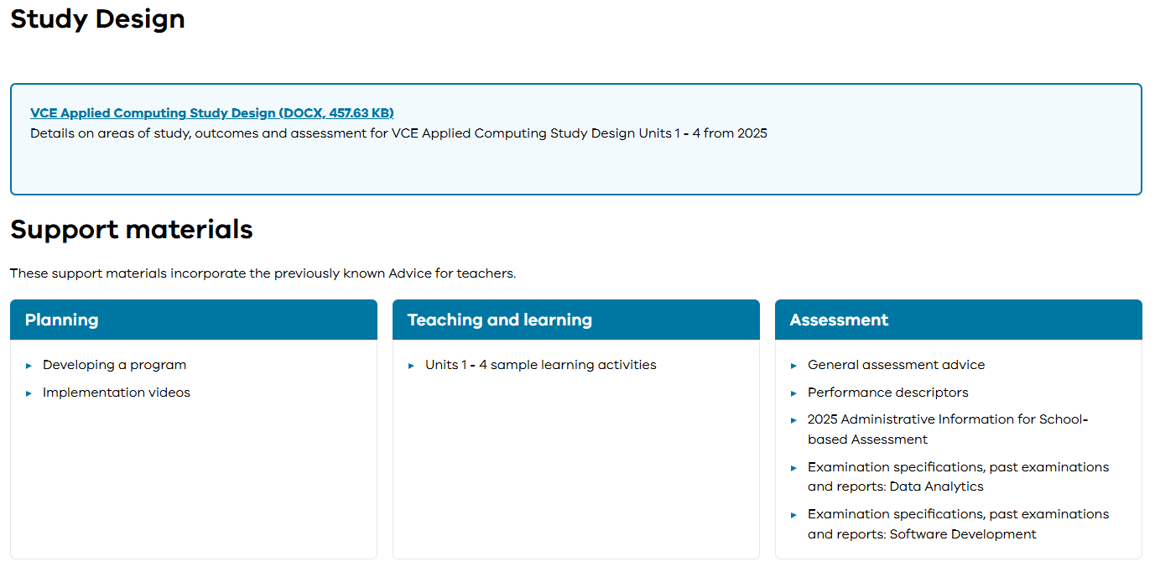
Support material
Notes:
We also have the Support material which replaces the Advice for teachers.
This now sits on the Applied Computing study page.
This support material was developed to support teachers with content and resources to assist them with the SAT including:
Developing a program
Units 3 and 4 sample learning activities
Units 3 and 4: Data Analytics – School-assessed Task (SAT)
and the Administrative information for School-based Assessment (SAT Criteria).

Slide 7
Other important resources
Assessment Schedule
To be used in conjunction with Important Administrative Dates.
VCE Administrative Handbook
A comprehensive guide for principals, teachers and administrators.
Notes:
Two other important resources are the:
Assessment Schedule which provides dates for when scores need to be submitted to VASS for SACs and SATs
and the VCE Administrative Handbook which outlines the rules, regulations and policies governing the delivery of the VCE.

Slide 8
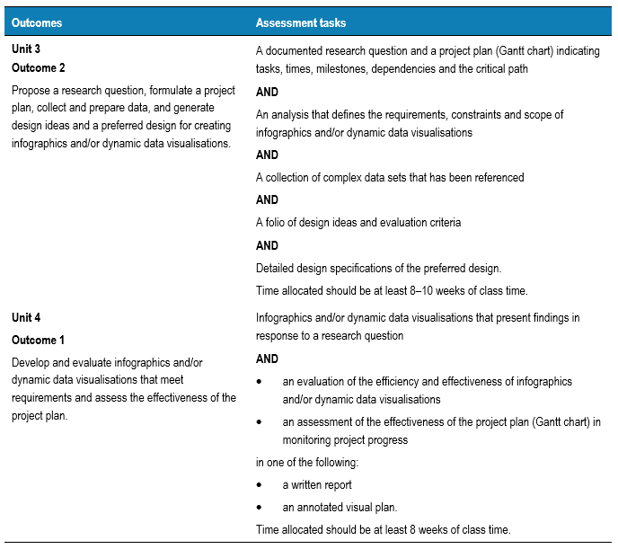
School-assessed Task
(Study design, p.51)
Notes:
This slide shows an overview of the School-assessed task for Unit 3 Outcome 2 and Unit 4 Outcome 1.
Keep in mind that the School-assessed Task contributes 30 per cent to the study score.

Slide 9
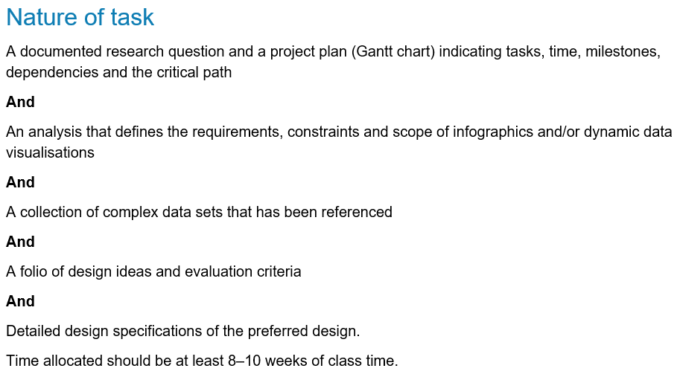
Nature of the task – Unit 3 Outcome 2
(Administrative information for
School-based Assessment, p.2)
Notes:
The nature of the task for Unit 3 Outcome 2 is stated in the study design and in the Administrative information for School-based Assessment. It involves:
A documented research question and a project plan (Gantt chart) indicating tasks, time, milestones, dependencies and the critical path
And
An analysis that defines the requirements, constraints and scope of infographics and/or dynamic data visualisations
And
A collection of complex data sets that has been referenced
And
A folio of design ideas and evaluation criteria
And
Detailed design specifications of the preferred design.
Time allocated should be at least 8–10 weeks of class time.

Slide 10
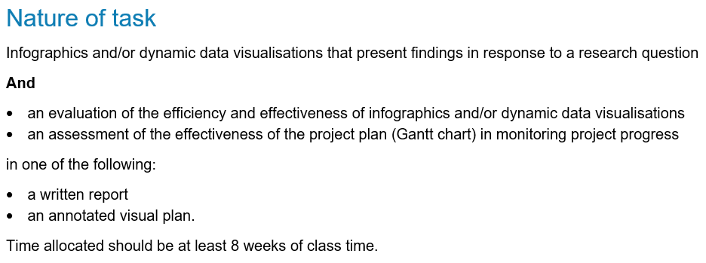
Nature of the task – Unit 4 Outcome 1
(Administrative information for
School-based Assessment, p.5)
Notes:
The nature of the task for Unit 4 Outcome 1 is stated in the study design and in the Administrative information for School-based Assessment. It involves:
Infographics and/or dynamic data visualisations that present findings in response to a research question
And
an evaluation of the efficiency and effectiveness of infographics and/or dynamic data visualisations
an assessment of the effectiveness of the project plan (Gantt chart) in monitoring project progress
in one of the following:
a written report
or an annotated visual plan.
Time allocated should be at least 8 weeks of class time.

Slide 11

Scope of the task – Unit 3 Outcome 2
Research question and project plan
Analysis
Searching, collecting, manipulating, referencing and managing data
Design ideas and developing evaluation criteria
Detailed designs
Notes:
The tasks that students will complete for Unit 3 Outcome 2 are:
Development of a research question and project plan
Documentation of the analysis
Searching, collecting, manipulating, referencing and managing data
Generating design ideas and developing evaluation criteria
and Producing detailed designs

Slide 12
Scope of the task – Unit 4 Outcome 1
Database solution
Spreadsheet solution and conducting statistical analysis
Infographics and/or dynamic data visualisations
Data security and the testing of software solutions
Evaluation of the solution and assessment of the project plan
Notes:
The tasks that students will complete for Unit 4 Outcome 1 are:
Development of the database solution
Development of the spreadsheet solution and conducting statistical analysis
Development of the infographics and/or dynamic data visualisations
Implementation of data security and the testing of software solutions
and the Evaluation of the solution and assessment of the project plan

Slide 13
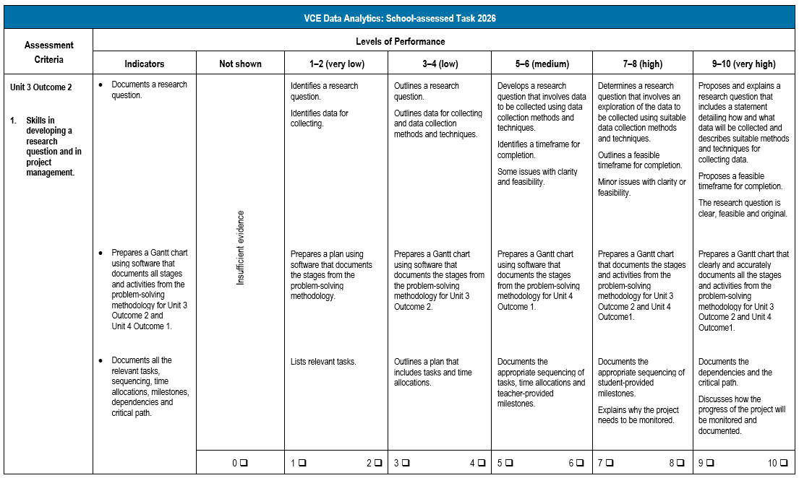
Assessment criteria
(Administrative information for
School-based Assessment, p.8)
Notes:
There are ten assessment criteria in total for the Data Analytics SAT.
For Unit 3 Outcome 2 there are five criteria labelled 1–5.
For Unit 4 Outcome 1 there are five criteria labelled 6–10.
This is an example of Criterion 1.
Notice it includes the:
Assessment criteria
Indicators for what is to be completed
Descriptors for each of the indicators and levels of performance going horizontally across the rubric
And notice the Levels of performance that range from 0 – 10 marks.
Teachers are to use these assessment criteria only for marking the SATs.

Slide 14

Authentication
Comply with authentication requirements.
Be aware of the requirements for the School-assessed Task.
(Administrative information for School-based Assessment, p.18)
Notes:
Authentication procedures need to be followed for the SAT.
Teachers are reminded of the need to comply with the authentication requirements specified in the Assessment: School-based Assessment section of the VCE Administrative Handbook. This is important to ensure that ‘undue assistance [is] not … provided to students while undertaking assessment tasks’.
Make sure you have a copy of the current year’s VCE Administrative Handbook with you when planning for authentication.
Teachers must be aware of the requirements for the authentication of VCE Applied Computing: Data Analytics School-assessed Task.

Slide 15
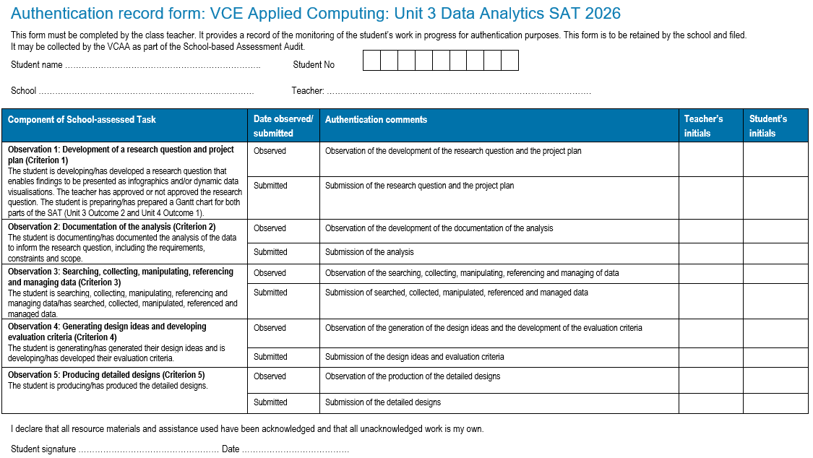
Authentication record form
(Administrative information for School-based Assessment, p.19)
Notes:
- This is a screen-shot of the Unit 3 Authentication record form for Data Analytics.
- Student details are to be provided at the top of the form.
- In the table are spaces for the teacher to:
state the date of the observation and submission of each of the components of the SAT
comment on the observation and the submission of each of the components
and sign their initials for each observation and submission.
- Students are also required to sign their initials for each observation and submission.
- At the completion of the unit students are to sign and date the declaration that all resource materials and assistance used have been acknowledged and that all unacknowledged work is their own.
- The Authentication record form should be updated for each observation and submission during the lifetime of the SAT.
- There is a similar form for Unit 4.
Authentication record forms can be requested as part of the audit process by the VCAA.

Slide 16
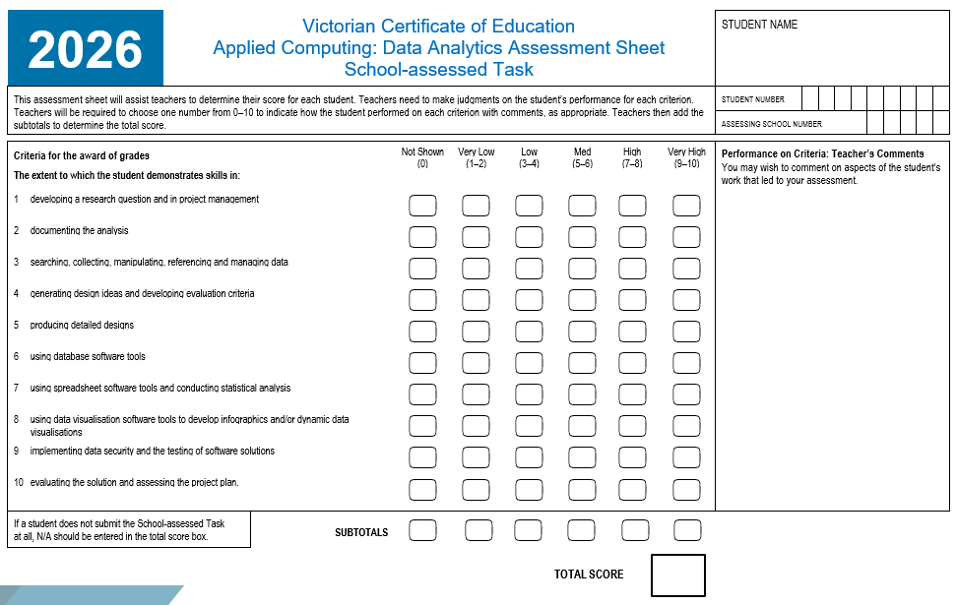
Assessment sheet
(Administrative information for School-based Assessment, p.21)
Notes:
This is the Assessment Sheet for scores to be added and submitted through VASS.
Notice the scores for each level of performance for each criterion needs to be provided as well as a total score.

Slide 17
Marking
Only use the rubrics from the current year’s Administrative information for
School-based Assessment (Data Analytics)
Be aware of the difference between 0 and NA.
Notes:
The following points about marking need to be considered:
Use the rubrics from the current year’s Administrative information for School-based Assessment – Data Analytics
Mark the rubrics holistically, not statistically
Consider how you mark and the effect on statistical moderation on those marks
Late submission – this is a school-based decision with some flexibility.
The awarding of a 0 instead of an NA can affect the statistical moderation of your class results.
NA is to be awarded when a criterion or group of is not observed and not submitted – you can award a mark if observed and not submitted
and 0 is to be awarded when the work is submitted but does not meet the descriptors – however, students still need to be able to achieve an S.

Slide 18
Commercial instructions
Concerns
Commercial instructions need to be checked
Detailed instructions could constitute undue assistance
Incorrect rubrics/out-of-date rubrics can be used or modified versions used.
Recommendations
Check all instructions
Use only VCAA criteria from the Administrative information for the current year.
Notes:
In this slide I am going to discuss some concerns and recommendations around the use of commercial instructions for the School-assessed Task.
There are several concerns:
Teachers using commercial instructions without checking them against the study design – Instructions can include content outside the scope of the outcome.
Detailed instructions that could constitute undue assistance. Instructions shouldn’t tell students what to do step-by-step throughout the whole task.
And incorrect rubrics being used or modified versions of VCAA rubrics being used for the SAT.
The VCAA recommends that schools:
Check all instructions against the outcome statement, key knowledge and key skills.
And use only VCAA criteria from the Administrative information for the current year.

Slide 19
Contact
vcaa@education.vic.gov.au or + 61 3 9032 1629
© Victorian Curriculum and Assessment Authority 2025
The copyright in this PowerPoint presentation is owned by the Victorian Curriculum and Assessment Authority or in the case of some materials, by third parties. No part may be reproduced by any process except in accordance with the provisions of the Copyright Act 1968 or with permission from the Copyright Officer at the Victorian Curriculum and Assessment Authority.

Slide 20
Notes:
Don’t speak leave for 3 secs.

