Slide 1
VCE Data Analytics
School-assessed Task
Video 3
SAT Criteria 1–5
Notes:
Hello and welcome to this VCE Data Analytics on-demand video for the School-assessed Task.
The purpose of this video is to support teachers with understanding Criteria 1 to 5 of the SAT for Data Analytics.
My name is Phil Feain and I am the Curriculum Manager for Digital Technologies with the VCAA.

Slide 2
Acknowledgement
The Victorian Curriculum and Assessment Authority proudly acknowledges and pays respect to Victoria’s Aboriginal and Torres Strait Islander communities and their rich and enduring cultures.
We acknowledge Aboriginal and Torres Strait Islander people as Australia’s first peoples and as the Traditional Owners and custodians of the lands and waters on which we rely. We pay respect to Elders past and present of the lands where we conduct our work and recognise their ongoing contributions as the first educators on the land now known as Victoria.
Notes:
Before I start, I would like to present the Acknowledgement of Country.
The Victorian Curriculum and Assessment Authority proudly acknowledges and pays respect to Victoria’s Aboriginal and Torres Strait Islander communities and their rich and enduring cultures.
We acknowledge Aboriginal and Torres Strait Islander people as Australia’s first peoples and as the Traditional Owners and custodians of the lands and waters on which we rely.
We pay respect to Elders past and present of the lands where we conduct our work and recognise their ongoing contributions as the first educators on the land now known as Victoria.

Slide 3

Agenda
Nature of task
Scope of the task
Criteria 1–5
Notes:
This presentation will involve the following topics:
The nature of the task
The scope of the task
And Criteria 1 to 5.

Slide 4
Unit 3 Outcome 2
On completion of this unit the student should be able to propose a research question, formulate a project plan, collect and prepare data, and generate design ideas and a preferred design for creating infographics and/or dynamic data visualisations.
(Study design, p.40)
Notes:
Before we discuss the nature of the task we need to look at the outcome statement.
The Unit 3 Outcome 2 statement says:
On completion of this unit the student should be able to propose a research question, formulate a project plan, collect and prepare data, and generate design ideas and a preferred design for creating infographics and/or dynamic data visualisations.

Slide 5
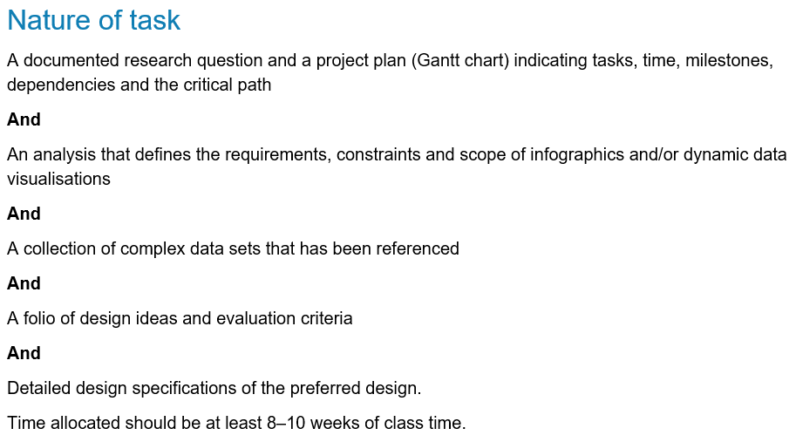
Nature of task
(Administrative information for
School-based Assessment, p.2)
Notes:
The nature of the task for Unit 3 Outcome 2 is stated in the study design and in the Administrative information for School-based Assessment. It involves:
A documented research question and a project plan (Gantt chart) indicating tasks, time, milestones, dependencies and the critical path
And
An analysis that defines the requirements, constraints and scope of infographics and/or dynamic data visualisations
And
A collection of complex data sets that has been referenced
And
A folio of design ideas and evaluation criteria
And
Detailed design specifications of the preferred design.
Time allocated should be at least 8–10 weeks of class time.

Slide 6
Development of a research question
Criterion 1 assesses students’ skills in developing a research question and in project management.
Students will document a research question.
(Administrative information for
School-based Assessment, p.2)
Notes:
Criterion 1 assesses students’ skills in developing a research question and in project management.
Students will document a research question.
Teachers should have discussions with their students regarding their research question and have a process for approving the research question before students commence their project plan.
Students are encouraged to document their ideas to convince their teacher that they will be able to develop the infographics and/or dynamic data visualisations.
and Students are to generate their own research questions.

Slide 7
Development of a project plan
Students will:
prepare a Gantt chart for Unit 3 Outcome 2 and Unit 4 Outcome 1 (both parts of the SAT)
document all the relevant tasks, sequencing, time allocations, milestones, dependencies and critical path.
(Administrative information for
School-based Assessment, p.2)
Notes:
Students will
prepare a Gantt chart using an appropriate software tool that documents all the stages and the activities of the problem-solving methodology for Unit 3 Outcome 2 and Unit 4 Outcome 1 (both parts of the SAT)
need to document all the relevant tasks, sequencing, time allocations, milestones, dependencies and critical path.
The evidence from this task is observed through Observation 1 and assessed through Criterion 1.
and Once the project plan has been developed, it needs to be monitored, modified and annotated during the life of the project (both Unit 3 Outcome 2 and Unit 4 Outcome 1).
It will then be assessed as part of Criterion 10 in Unit 4 Outcome 1.

Slide 8
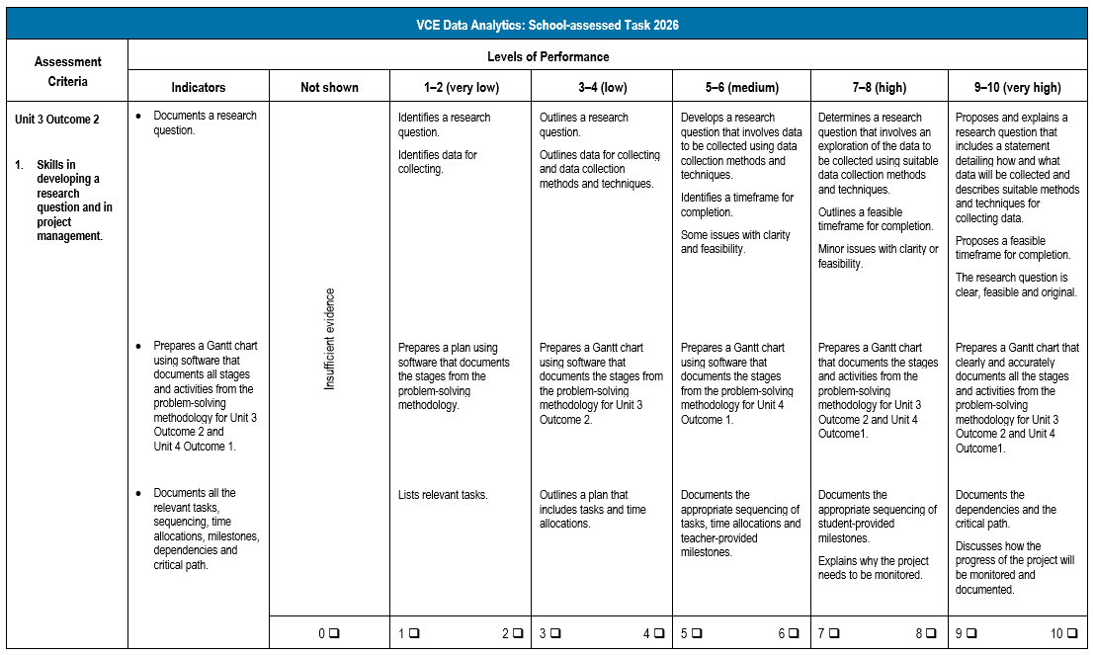
Criterion 1
(Administrative information for
School-based Assessment, p.8)
Notes:
Looking now at the rubric for Criterion 1.
Criterion 1 involves:
Skills in developing a research question and in project management.
This criterion has the following three indicators:
Documents a research question.
Prepares a Gantt chart using software that documents all stages and activities from the problem-solving methodology for Unit 3 Outcome 2 and Unit 4 Outcome 1.
and Documents all the relevant tasks, sequencing, time allocations, milestones, dependencies and critical path.
The levels of performance are used to determine a mark out of ten for the criterion.

Slide 9
Documentation of the analysis
Criterion 2 assesses students’ skills in documenting the analysis.
Students document the data they have collected and used to inform the analysis of the research question.
(Administrative information for
School-based Assessment, p.3)
Notes:
Criterion 2 assesses students’ skills in documenting the analysis.
Students will document the data they have collected and used to inform the analysis of the research question.
Students will need to document the:
methods and techniques they have used to collect the data and reference how the data collected meets the characteristics of data integrity
and the functional and non-functional requirements, constraints and scope of the infographics and/or dynamic data visualisations.
Students will document evidence of their critical and creative thinking through critical analysis, the use of questions and follow-up questions to clarify the development of the solution requirements, constraints and scope.
and The evidence from this task is observed through Observation 2 and assessed through Criterion 2.

Slide 10
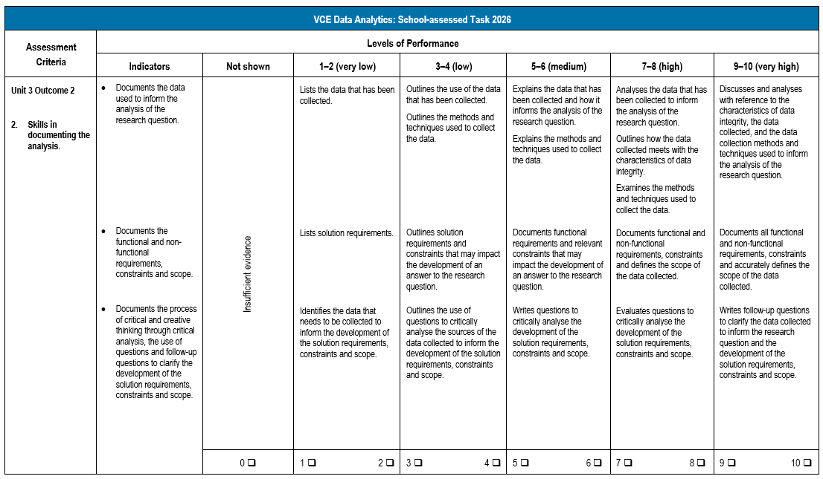
Criterion 2
(Administrative information for
School-based Assessment, p.9)
Notes:
Looking now at the rubric for Criterion 2.
Criterion 2 involves:
Skills in documenting the analysis.
This criterion has the following three indicators:
Documents the data used to inform the analysis of the research question.
Documents the functional and non-functional requirements, constraints and scope.
and Documents the process of critical and creative thinking through critical analysis, the use of questions and follow-up questions to clarify the development of the solution requirements, constraints and scope.
The levels of performance are used to determine a mark out of ten for the criterion.

Slide 11
Searching, collecting, manipulating, referencing and managing data
Criterion 3 assesses students’ skills in searching, collecting, manipulating, referencing and managing data.
Students:
will acquire data sets from primary and secondary sources
prepare the quantitative and qualitative data for manipulation
then document a plan for managing their data and files.
(Administrative information for
School-based Assessment, p.3)
Notes:
Criterion 3 assesses students’ skills in searching, collecting, manipulating, referencing and managing data.
Students:
will acquire data sets from primary and secondary sources using appropriate data acquisition methods
prepare the quantitative and qualitative data for manipulation using data types and data structures and reference the primary and secondary data sources using the APA referencing system
and then document a plan for managing their data and files.
The evidence from this task is observed through Observation 3 and assessed through Criterion 3.

Slide 12
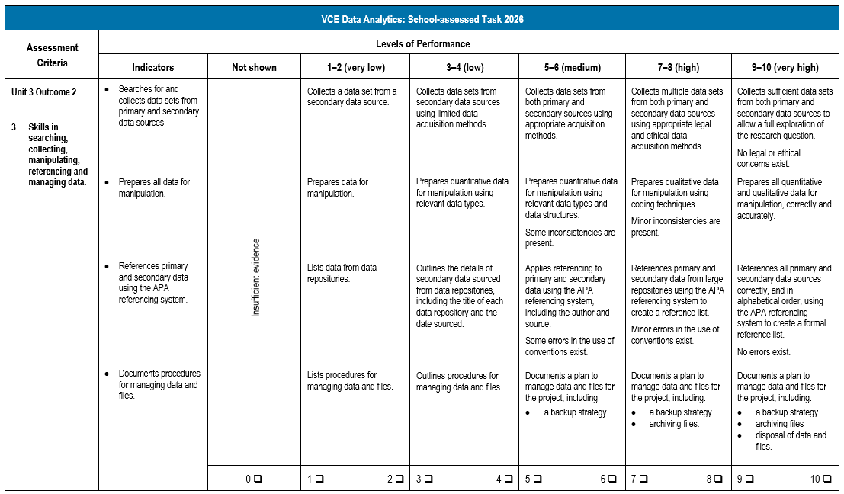
Criterion 3
(Administrative information for
School-based Assessment, p.10)
Notes:
Looking now at the rubric for Criterion 3.
Criterion 3 involves:
Skills in searching, collecting, manipulating, referencing and managing data.
This criterion has the following four indicators:
Searches for and collects data sets from primary and secondary data sources.
Prepares all data for manipulation.
References primary and secondary data using the APA referencing system.
and Documents procedures for managing data and files.
The levels of performance are used to determine a mark out of ten for the criterion.

Slide 13
Generating design ideas and developing evaluation criteria
Criterion 4 assesses students’ skills in generating design ideas and developing evaluation criteria.
Students generate design ideas for the database, spreadsheet and infographics and/or dynamic data visualisations.
They develop evaluation criteria for their design ideas and the infographics and/or dynamic data visualisations.
(Administrative information for
School-based Assessment, p.3)
Notes:
Criterion 4 assesses students’ skills in generating design ideas and developing evaluation criteria.
Students will generate design ideas for the database, spreadsheet and infographics and/or dynamic data visualisations solutions.
and Design ideas are to be annotated to explain the appearance and functionality of the software solutions.
They will also develop evaluation criteria for their design ideas and the infographics and/or dynamic data visualisations solutions.
Evaluation criteria will reference the functional and non-functional requirements for the design ideas and be used to measure the efficiency and effectiveness of the infographics and/or dynamic data visualisations solutions in Criterion 10.
and Students will then need to justify which of the design ideas should be further developed into detailed designs.
The evidence from this task is observed through Observation 4 and assessed through Criterion 4.

Slide 14
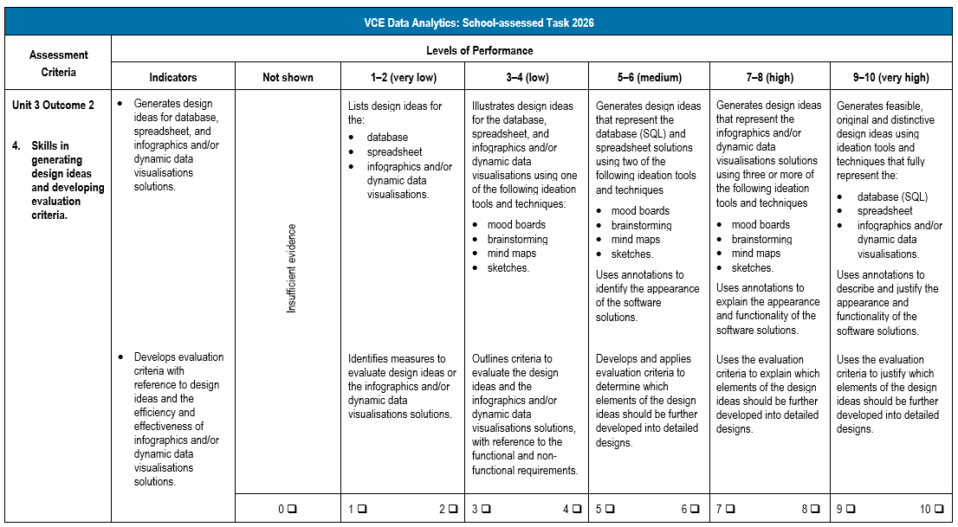
Criterion 4
(Administrative information for
School-based Assessment, p.11)
Notes:
Looking now at the rubric for Criterion 4.
Criterion 4 involves:
Skills in generating design ideas and developing evaluation criteria.
This criterion has the following two indicators:
Generates design ideas for database, spreadsheet, and infographics and/or dynamic data visualisations solutions.
and Develops evaluation criteria with reference to design ideas and the efficiency and effectiveness of infographics and/or dynamic data visualisations solutions.
The levels of performance are used to determine a mark out of ten for the criterion.

Slide 15
Producing detailed designs
Criterion 5 assesses students’ skills in producing detailed designs.
Students will:
produce detailed designs
document the use of design principles.
(Administrative information for
School-based Assessment, p.3-4)
Notes:
Criterion 5 assesses students’ skills in producing detailed designs.
Students will:
produce their detailed designs for the database, spreadsheet and infographics and/or dynamic data visualisations solutions
document the use of design principles that influence the appearance and functionality of the detailed designs.
and Students will document evidence of their critical and creative thinking throughout the process of generating their design ideas using the solution requirements and the detailed designs
The evidence from this task is observed through Observation 5 and assessed through Criterion 5.

Slide 16
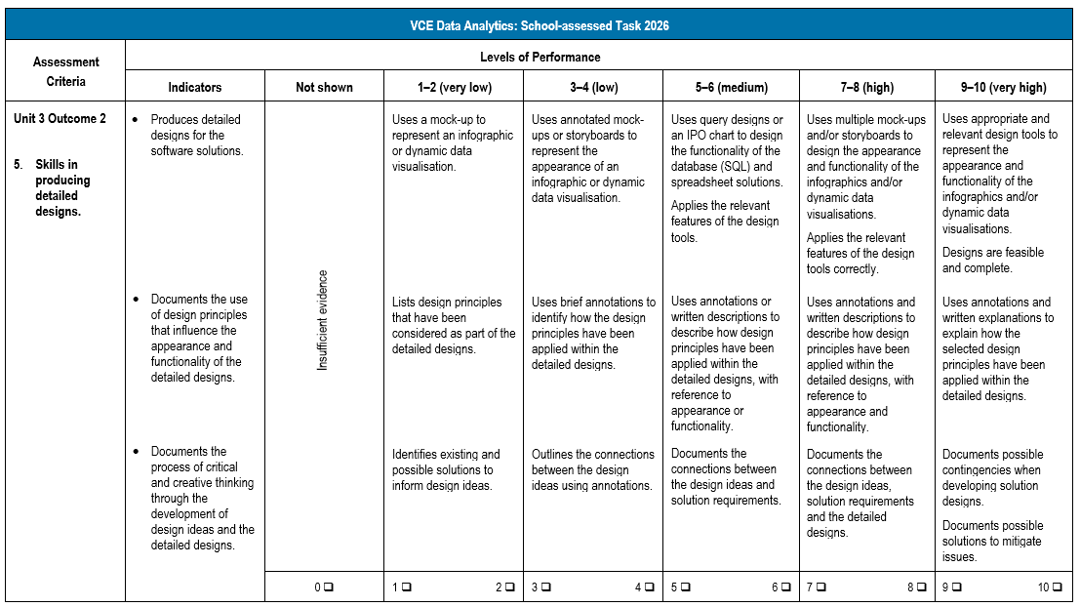
Criterion 5
(Administrative information for
School-based Assessment, p.12)
Notes:
Looking now at the rubric for Criterion 5.
Criterion 5 involves:
Skills in producing detailed designs.
This criterion has the following three indicators:
Produces detailed designs for the software solutions.
Documents the use of design principles that influence the appearance and functionality of the detailed designs.
and Documents the process of critical and creative thinking through the development of design ideas and the detailed designs.
The levels of performance are used to determine a mark out of ten for the criterion.

Slide 17
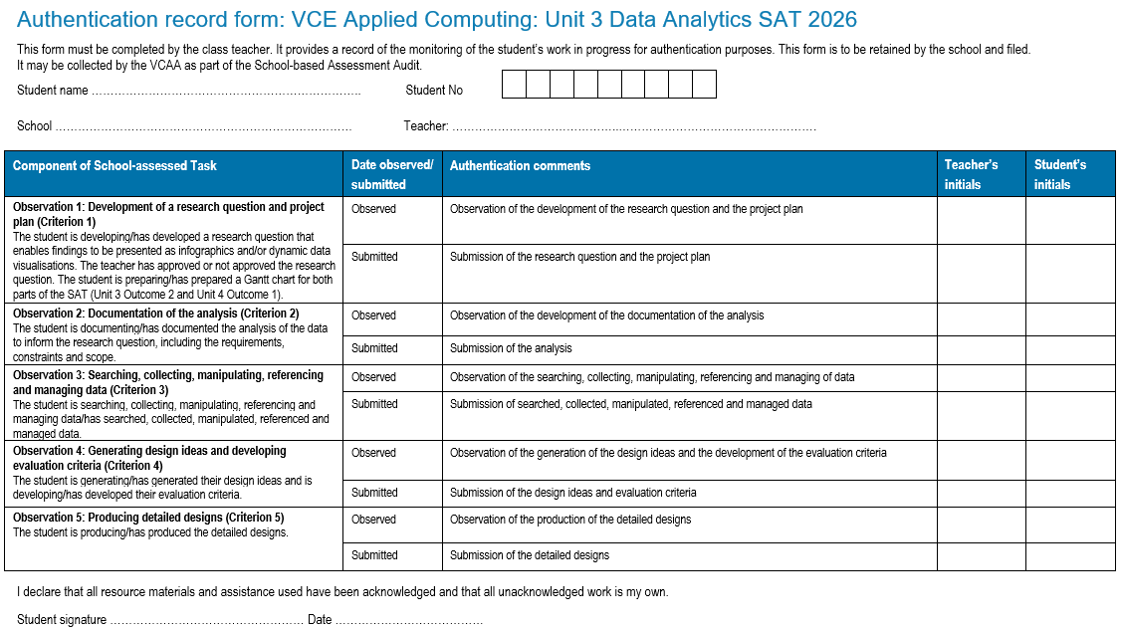
Authentication
(Administrative information for
School-based Assessment, p.19)
Notes:
Teachers should monitor students’ progress on a regular basis and use the Authentication record form to record this information.
The authentication process and feedback are clearly identified on this form so that teachers can provide feedback at various stages of the process.
It is recommended that students back up files with copies of work in progress using, for example, an external drive, network drive or secure cloud storage.

Slide 18
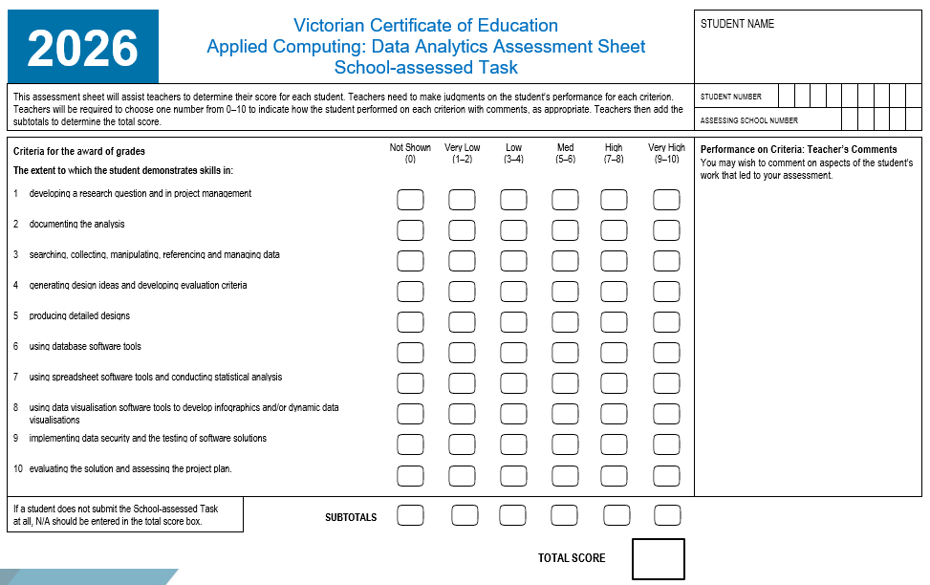
Assessment
(Administrative information for
School-based Assessment, p.21)
Notes:
This is the Assessment Sheet for scores to be added and submitted for Criterion 1 through to Criterion 5 in VASS for Unit 3 Outcome 2.
A score of 0 to 10 is to be provided for each of the criterion.
NA can also be awarded when an individual criterion is not observed or submitted.
You also need to be aware of Ns and Ss for Unit 3 Outcome 2.
If a student receives an N for Unit 3 Outcome 2 you need to follow the redemption process for them to work towards an S before commencing Unit 4 Outcome 1.

Slide 19
Issues identified after marking Unit 3 Outcome 2
At the completion of Unit 3 Outcome 2 students may experience issues.
These may have a negative effect on the development of their database, spreadsheet and infographics and/or dynamic data visualisations solutions in Unit 4 Outcome 1.
(Administrative information for
School-based Assessment, p.4)
Notes:
At the completion of Unit 3 Outcome 2 students may experience issues that will have a negative effect on the development of their database, spreadsheet and infographics and/or dynamic data visualisations solutions in Unit 4 Outcome 1.
Teachers can provide feedback on the quality of the detailed designs, however, the adjustments must be initiated by the student and not directed by the teacher.
While students can make changes to their detailed designs, they will not be reassessed and their original score will stand.

Slide 20
Contact the Curriculum Manager
vcaa@education.vic.gov.au or + 61 3 9032 1629
© Victorian Curriculum and Assessment Authority 2025
The copyright in this PowerPoint presentation is owned by the Victorian Curriculum and Assessment Authority or in the case of some materials, by third parties. No part may be reproduced by any process except in accordance with the provisions of the Copyright Act 1968 or with permission from the Copyright Officer at the Victorian Curriculum and Assessment Authority.

