Slide 1
VCE Data Analytics
School-assessed Task
Video 4
SAT Criteria 6–10
Notes:
Hello and welcome to this VCE Data Analytics on-demand video for the School-assessed Task.
The purpose of this video is to support teachers with understanding Criteria 6 to 10 of the SAT for Data Analytics.
My name is Phil Feain and I am the Curriculum Manager for Digital Technologies with the VCAA.

Slide 2
Acknowledgement
The Victorian Curriculum and Assessment Authority proudly acknowledges and pays respect to Victoria’s Aboriginal and Torres Strait Islander communities and their rich and enduring cultures.
We acknowledge Aboriginal and Torres Strait Islander people as Australia’s first peoples and as the Traditional Owners and custodians of the lands and waters on which we rely. We pay respect to Elders past and present of the lands where we conduct our work and recognise their ongoing contributions as the first educators on the land now known as Victoria.
Notes:
Before I start, I would like to present the Acknowledgement of Country.
The Victorian Curriculum and Assessment Authority proudly acknowledges and pays respect to Victoria’s Aboriginal and Torres Strait Islander communities and their rich and enduring cultures.
We acknowledge Aboriginal and Torres Strait Islander people as Australia’s first peoples and as the Traditional Owners and custodians of the lands and waters on which we rely.
We pay respect to Elders past and present of the lands where we conduct our work and recognise their ongoing contributions as the first educators on the land now known as Victoria.

Slide 3

Agenda
Nature of task
Scope of the task
Criteria 6–10
Notes:
This presentation will involve the following topics:
The nature of the task
The scope of the task
And Criteria 6 to 10.

Slide 4
Unit 4 Outcome 1
On completion of this unit the student should be able to develop and evaluate infographics and/or dynamic data visualisations that meet requirements and assess the effectiveness of the project plan.
(Study design, p.45)
Notes:
Before we discuss the nature of the task we need to look at the outcome statement.
The Unit 4 Outcome 1 statement says:
On completion of this unit the student should be able to develop and evaluate infographics and/or dynamic data visualisations that meet requirements and assess the effectiveness of the project plan.

Slide 5
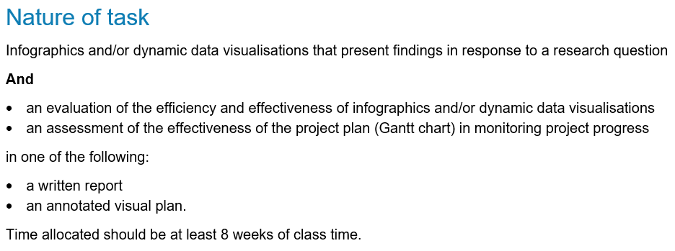
Nature of task
(Administrative information for
School-based Assessment, p.5)
Notes:
The nature of the task for Unit 4 Outcome 1 is stated in the study design and in the Administrative information for School-based Assessment. It involves:
Infographics and/or dynamic data visualisations that present findings in response to a research question
And
an evaluation of the efficiency and effectiveness of infographics and/or dynamic data visualisations
an assessment of the effectiveness of the project plan (Gantt chart) in monitoring project progress
in one of the following:
a written report
or an annotated visual plan.
Time allocated should be at least 8 weeks of class time.

Slide 6
Development of the database solution
Criterion 6 assesses students’ skills in using database software tools.
Students use a database software to store and manipulate data and apply validation techniques.
(Administrative information for School-based Assessment, p.5)
Notes:
Criterion 6 assesses students’ skills in using database software tools.
Students will use a database software tool to store and manipulate data and apply appropriate validation techniques.
They are to use a range of database functions, including the creating of queries using SQL functions to extract data from the database.
In order to develop the database solution, students are required to use appropriate software tools to manipulate data that meets the prescribed list of software tools and functions, and outcome-specific requirements of the study.
and The evidence from this task is observed through Observation 6 and assessed through Criterion 6.

Slide 7
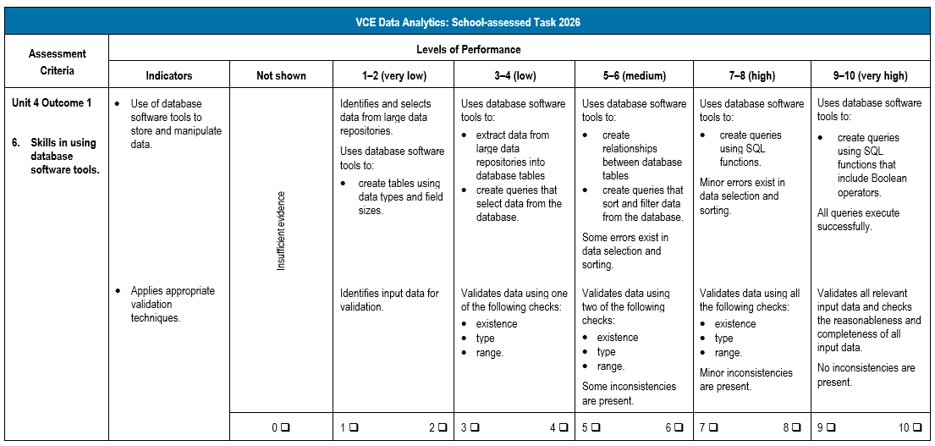
Criterion 6
(Administrative information for School-based Assessment, p.13)
Notes:
Looking now at the rubric for Criterion 6.
Criterion 6 involves:
Skills in using database software tools.
This criterion has the following two indicators:
Use of database software tools to store and manipulate data.
and Applies appropriate validation techniques.
The levels of performance are used to determine a mark out of ten for the criterion.

Slide 8
Development of the spreadsheet solution and conducting statistical analysis
Criterion 7 assesses students’ skills in using spreadsheet software tools and in conducting statistical analysis.
Students use spreadsheet software to store, manipulate and cleanse data, apply validation techniques and conduct statistical analysis.
(Administrative information for School-based Assessment, p.5)
Notes:
Criterion 7 assesses students’ skills in using spreadsheet software tools and in conducting statistical analysis.
Students will use spreadsheet software tools to store, manipulate and cleanse data, apply appropriate validation techniques and conduct statistical analysis to identify trends, relationships and patterns.
In order to develop the spreadsheet solution, students are required to use appropriate software tools to manipulate data that meets the prescribed list of software tools and functions, and outcome-specific requirements of the study.
and The evidence from this task is observed through Observation 7 and assessed through Criterion 7.

Slide 9
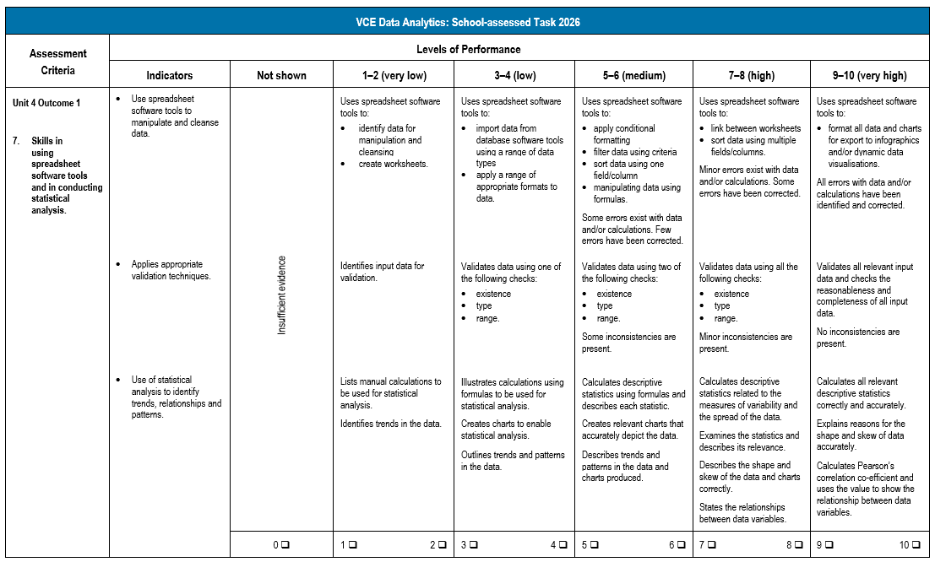
Criterion 7
(Administrative information for
School-based Assessment, p.14)
Notes:
Looking now at the rubric for Criterion 7.
Criterion 7 involves:
Skills in using spreadsheet software tools and in conducting statistical analysis.
This criterion has the following three indicators:
Use spreadsheet software tools to manipulate and cleanse data.
Applies appropriate validation techniques.
and Use of statistical analysis to identify trends, relationships and patterns.
The levels of performance are used to determine a mark out of ten for the criterion.

Slide 10
Development of the infographics and/or dynamic data visualisations
Criterion 8 assesses students’ skills in using data visualisation software tools to develop infographics and/or dynamic data visualisations.
Students use data visualisation software to create infographics and/or dynamic data visualisations, and apply validation and verification techniques.
(Administrative information for
School-based Assessment, p.6)
Notes:
Criterion 8 assesses students’ skills in using data visualisation software tools to develop infographics and/or dynamic data visualisations.
Students will use data visualisation software tools to create infographics and/or dynamic data visualisations, and apply appropriate validation and verification techniques.
and In order to develop the infographics and/or dynamic data visualisations, students are required to use appropriate software tools to manipulate data that meets the prescribed list of software tools and functions, and outcome-specific requirements of the study.
Students will document evidence of their critical and creative thinking through the modification of their designs and the evaluation criteria, and the development of the infographics and/or dynamic data visualisations as part of the Development stage in Criterion 8.
and The evidence from this task is observed through Observation 8 and assessed through Criterion 8.

Slide 11
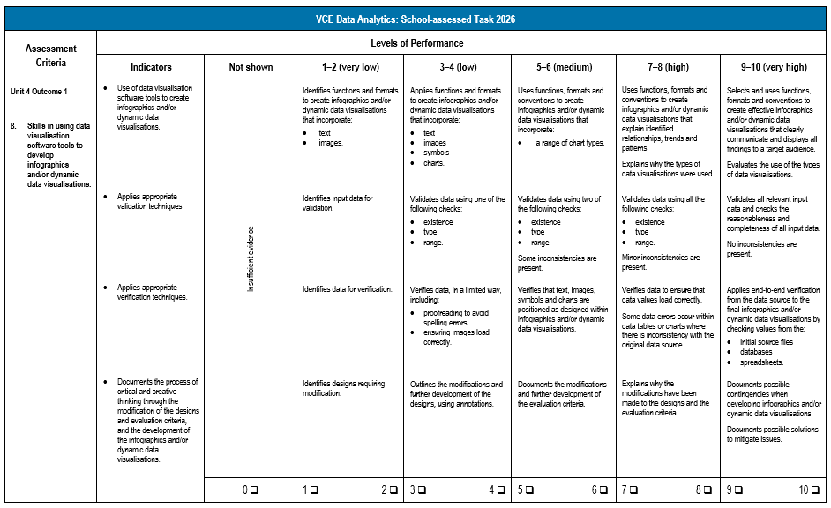
Criterion 8
(Administrative information for
School-based Assessment, p.15)
Notes:
Looking now at the rubric for Criterion 8.
Criterion 8 involves:
Skills in using data visualisation software tools to develop infographics and/or dynamic data visualisations.
This criterion has the following four indicators:
Use of data visualisation software tools to create infographics and/or dynamic data visualisations.
Applies appropriate validation techniques.
Applies appropriate verification techniques.
and Documents the process of critical and creative thinking through the modification of the designs and evaluation criteria,
and the development of the infographics and/or dynamic data visualisations.
The levels of performance are used to determine a mark out of ten for the criterion.

Slide 12
Implementation of data security and the testing of software solutions
Criterion 9 assesses students’ skills in implementing data security and the testing of software solutions.
Students will:
document procedures to manage the security of data and files
implement these procedures
use testing tables to document testing.
(Administrative information for
School-based Assessment, p.6)
Notes:
Criterion 9 assesses students’ skills in implementing data security and the testing of software solutions.
Students will:
document the procedures to manage the security of data and files
then implement these procedures
and use testing tables to document the testing of the database, spreadsheet and infographics and/or dynamic data visualisations solutions using suitable testing techniques and test data.
The evidence from this task is observed through Observation 9 and assessed through Criterion 9.

Slide 13
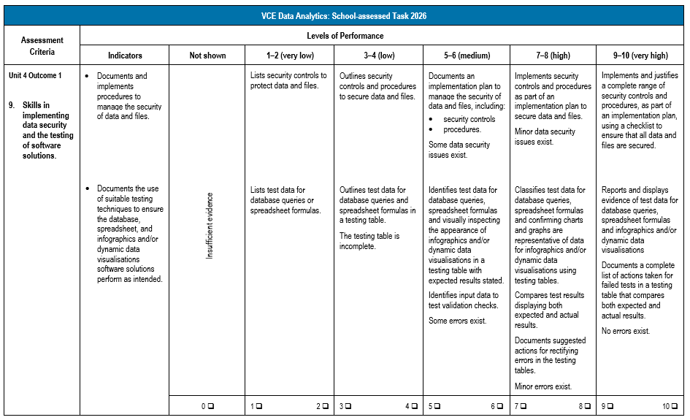
Criterion 9
(Administrative information for
School-based Assessment, p.16)
Notes:
Looking now at the rubric for Criterion 9.
Criterion 9 involves:
Skills in implementing data security and the testing of software solutions.
This criterion has the following two indicators:
Documents and implements procedures to manage the security of data and files.
and Documents the use of suitable testing techniques to ensure the database, spreadsheet, and infographics and/or dynamic data visualisations software solutions perform as intended.
The levels of performance are used to determine a mark out of ten for the criterion.

Slide 14
Evaluation of the software solution and assessment of the project plan
Criterion 10 assesses students’ skills in evaluating the solution and assessing the project plan.
Students:
document the evaluation of the efficiency and effectiveness of the infographics and/or dynamic data visualisations
propose an evaluation strategy.
(Administrative information for
School-based Assessment, p.6)
Notes:
Criterion 10 assesses students’ skills in evaluating the solution and assessing the project plan.
Students will document the evaluation of the efficiency and effectiveness of the infographics and/or dynamic data visualisations using the evaluation criteria developed in Criterion 4.
This includes the extent to which it meets the functional and non-functional requirements.
Students will then propose an evaluation strategy to be conducted in the future.
Students will document evidence of their critical and creative thinking through the evaluation of the process they followed through the analysis, design and development stages and discuss improvements that could be made to the infographics and/or dynamic data visualisations as part of the Evaluation stage in Criterion 10.
Students will document the modifications made to the initial project plan throughout the duration of the project and then assess the effectiveness of the project plan.
and The evidence from this task is observed through Observation 10 and assessed through Criterion 10.

Slide 15
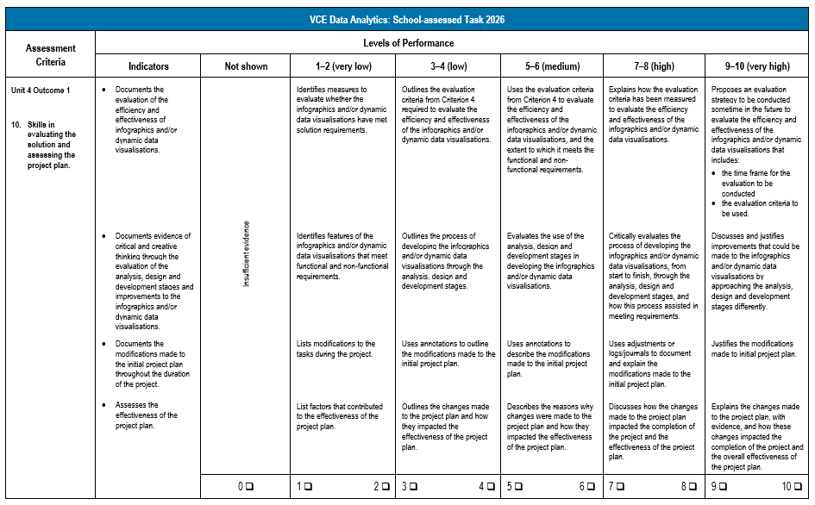
Criterion 10
(Administrative information for
School-based Assessment, p.17)
Notes:
Looking now at the rubric for Criterion 10.
Criterion 10 involves:
Skills in evaluating the solution and assessing the project plan.
This criterion has the following four indicators:
Documents the evaluation of the efficiency and effectiveness of infographics and/or dynamic data visualisations.
Documents evidence of critical and creative thinking through the evaluation of the analysis, design and development stages and improvements to the infographics and/or dynamic data visualisations.
Documents the modifications made to the initial project plan throughout the duration of the project.
and Assesses the effectiveness of the project plan.
The levels of performance are used to determine a mark out of ten for the criterion.

Slide 16
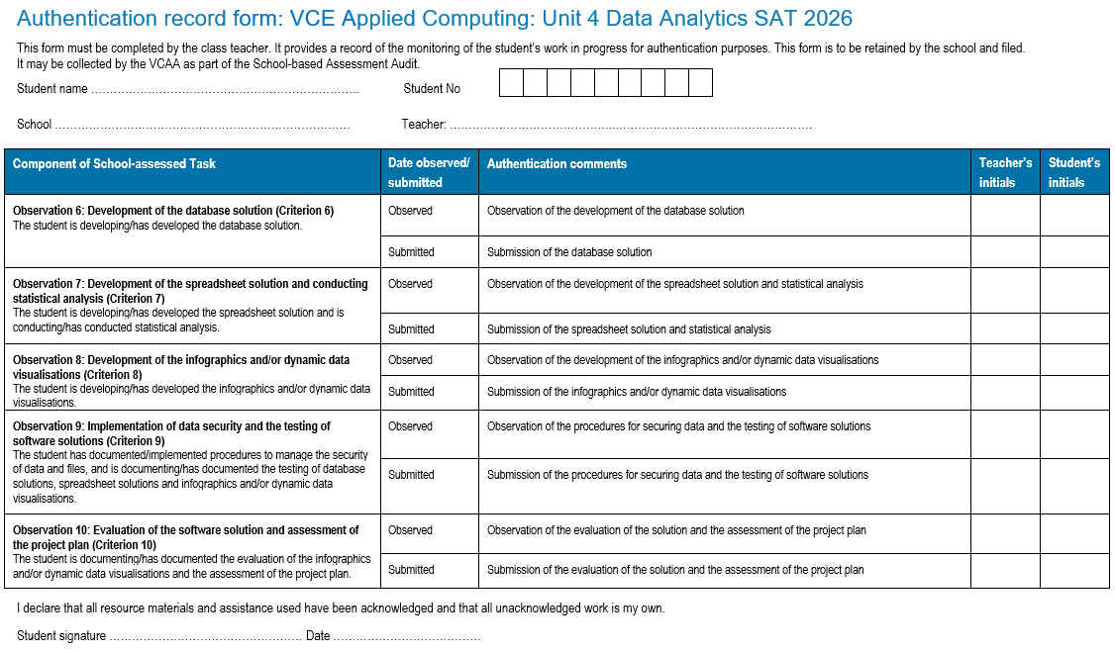
Authentication
(Administrative information for School-based Assessment, p.20)
Notes:
Teachers should monitor students’ progress on a regular basis and use the Authentication record form to record this information.
The authentication process and feedback are clearly identified on this form so that teachers can provide feedback at various stages of the process.
It is recommended that students back up files with copies of work in progress using, for example, an external drive, network drive or secure cloud storage.

Slide 17
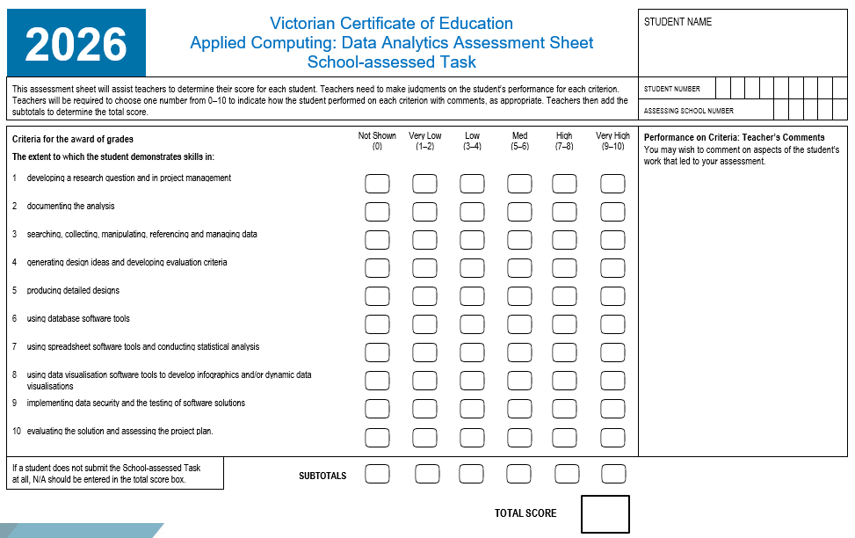
Assessment
(Administrative information for School-based Assessment, p.21)
Notes:
This is the Assessment Sheet for scores to be added and submitted for Criterion 6 through to Criterion 10 in VASS for Unit 4 Outcome 1.
A score of 0 to 10 is to be provided for each of the criterion.
NA can also be awarded when an individual criterion is not observed or submitted.
You also need to be aware of Ns and Ss for Unit 4 Outcome 1. If a student receives an N for Unit 4 Outcome 1 you need to follow the redemption process for them to work towards an S as soon as you can after the outcome.

Slide 18
Contact the Curriculum Manager
vcaa@education.vic.gov.au or + 61 3 9032 1629
© Victorian Curriculum and Assessment Authority 2025
The copyright in this PowerPoint presentation is owned by the Victorian Curriculum and Assessment Authority or in the case of some materials, by third parties. No part may be reproduced by any process except in accordance with the provisions of the Copyright Act 1968 or with permission from the Copyright Officer at the Victorian Curriculum and Assessment Authority.

