Slide 1

VCE Media
Professional learning
On-Demand video
School-assessed Task
Authentication processes

Slide 2
Acknowledgement
The Victorian Curriculum and Assessment Authority proudly acknowledges and pays respect to Victoria’s Aboriginal and Torres Strait Islander communities and their rich and enduring cultures.
We acknowledge Aboriginal and Torres Strait Islander people as Australia’s first peoples and as the Traditional Owners and custodians of the lands and waters on which we rely. We pay respect to Elders past and present of the lands where we conduct our work and recognise their ongoing contributions as the first educators on the land now known as Victoria.

Slide 3

Purpose
VCE Administrative handbook information.
Authentication information for the School-assessed task.
Authentication information provided to students.
The Authentication Record Form.
Authentication and Generative AI
Assistance and Authentication
Notes:
In this OnDemand video I will be explaining to you the background of the School-assessed Task, where to find key documents, and how to provide information to your students for the task, how to authenticate and how to assess the task.

Slide 4
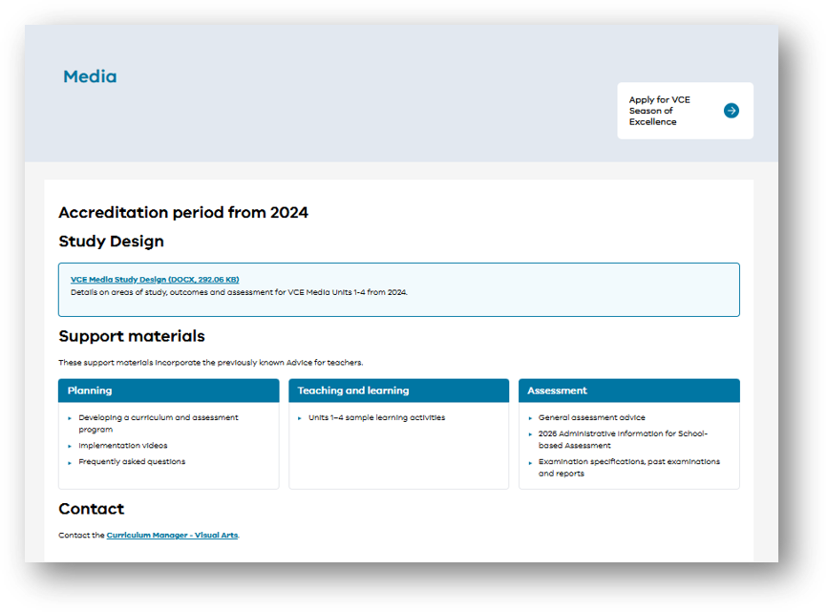
Notes:
Please always refer to the VCAA website. On each study page you will find the key documents. Do not rely on other sources of information or from previous versions of documents.
Please bookmark this page. For Art Creative Practice, in order to Authenticate student work, you must adhere to the Study Design and the Administrative information for School-based assessment

Slide 5
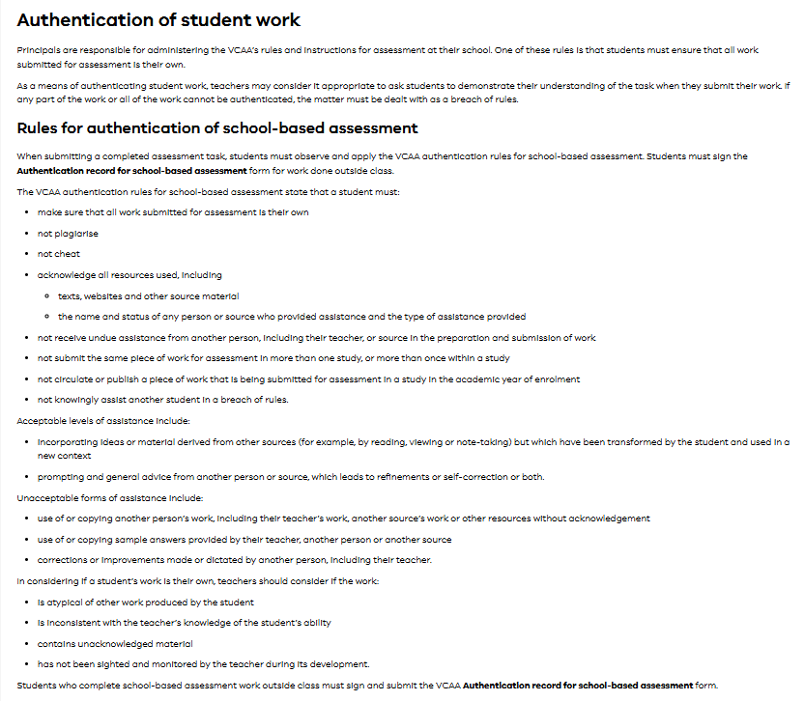
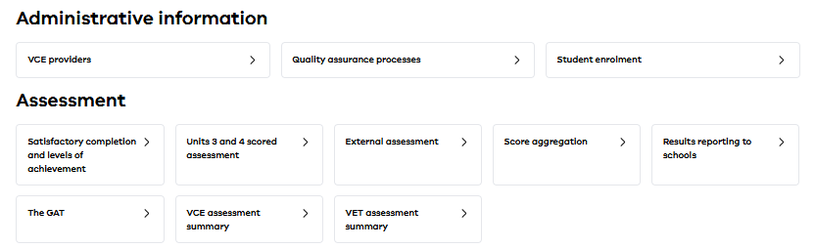
Administrative handbook
Notes:
The VCE Administrative handbook has general information about Authentication of School-based assessment.

Slide 6
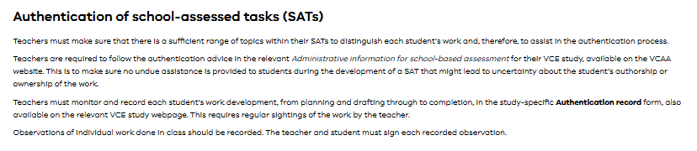
VCE Administrative handbook
Notes:
Specific information for the School-assessed Task from the VCE Administrative handbook. This is the information that the VCE coordinator would read.
Teachers must:
Monitor and record the development of work – all stages of the SAT.
Record it on the Authentication Record Form
Plan observations of work done in class.

Slide 7
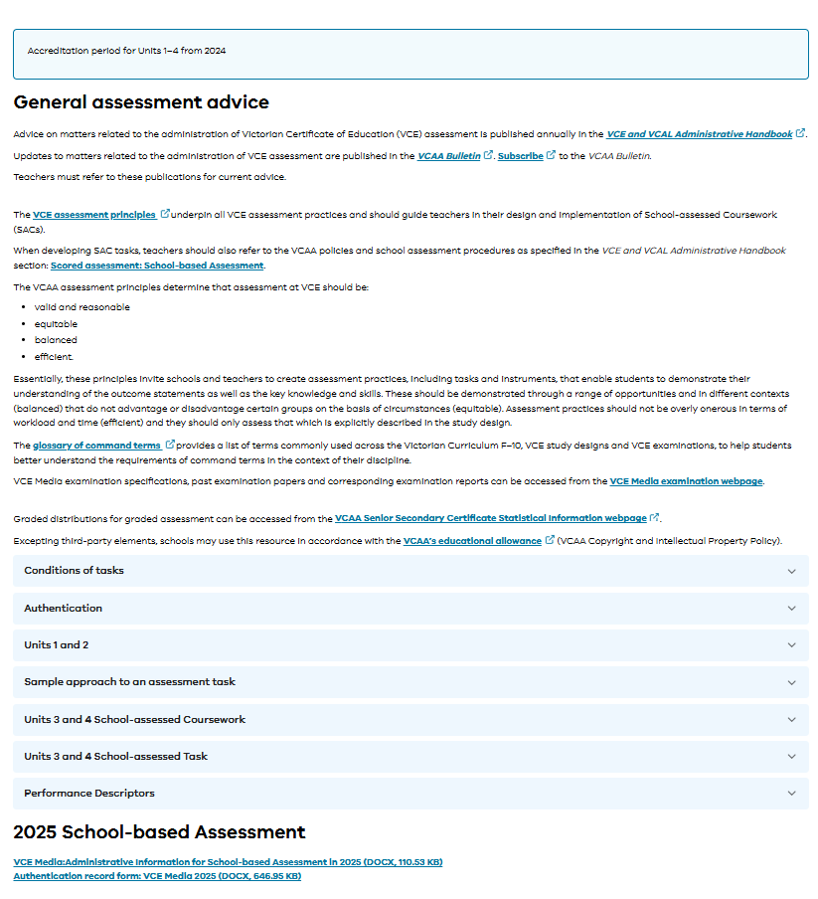
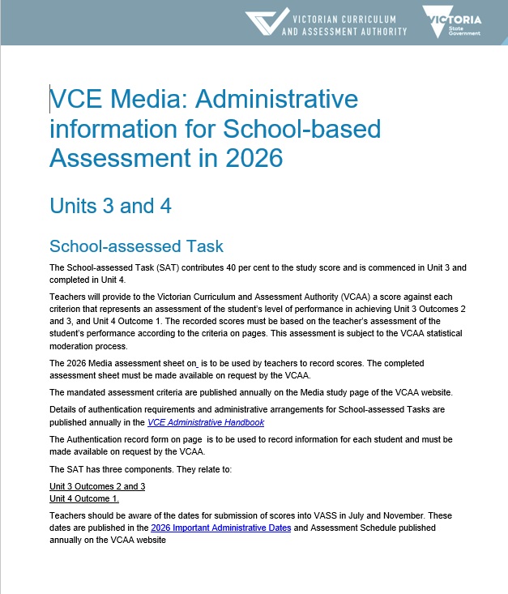
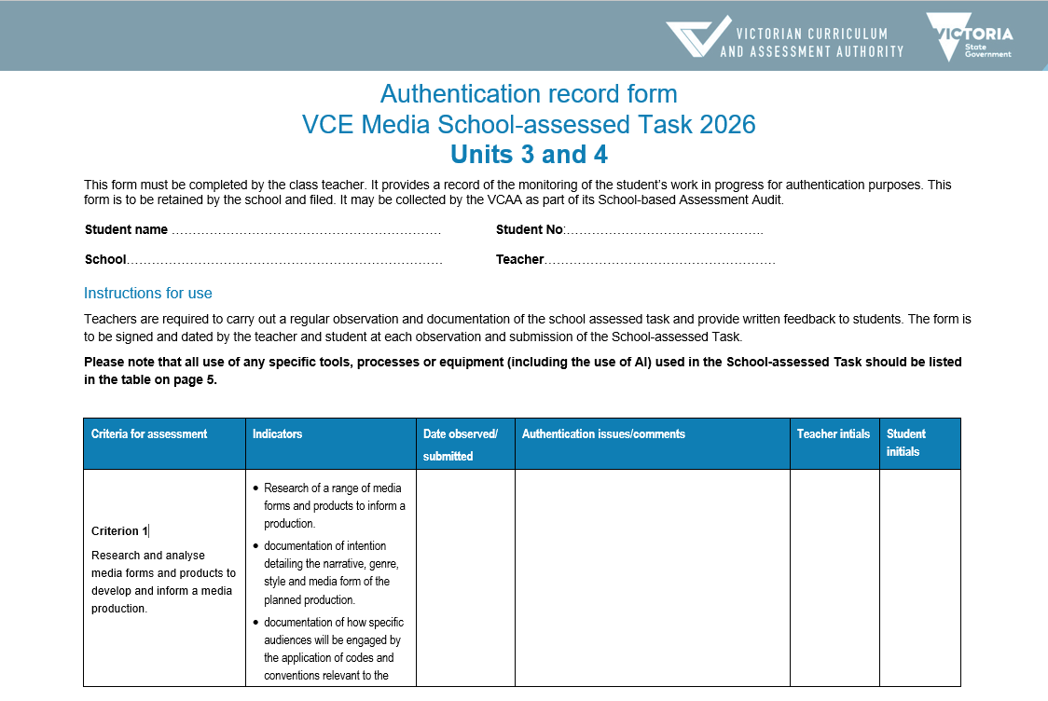
Administrative advice for School-based assessment
Notes:
The Administrative Advice for School-based assessment provides the assessment conditions for the task. The advice contains information about the scope and nature of the task, and authentication information. Alongside the study design and Administration Handbook, it is a key Administration document for all studies with a School-assessed Task. You will find that the information aligns with the information in the Administrative Handbook.

Slide 8

VCE assessment
Assessment is an integral part of teaching and learning that at the senior secondary level:
identifies opportunities for further learning
describes student achievement
provides the basis for the award of a certificate.
Notes:
Assessment is an integral part of teaching and learning that at the senior secondary level:
identifies opportunities for further learning
describes student achievement
provides the basis for the award of a certificate (i.e. VCE).

Slide 9




Principles of VCE assessment
Valid and reasonable
Balanced
Efficient
Equitable
Notes:
The four key principles underpinning all VCE assessment practice ensure that the assessment instruments enable judgments to be made about demonstration of the outcomes and levels of achievement fairly, in a balanced way and without adverse effects on the curriculum or for the education system.
Assessment should be acceptable to stakeholders – including students, schools, government and the community. The system for assessing the progress and achievement of students must be accessible, effective, equitable, reasonable and transparent.
Therefore, there are four key principals of VCE assessment
VCE assessment should be, valid and reasonable, equitable, balanced and efficient.

Slide 10
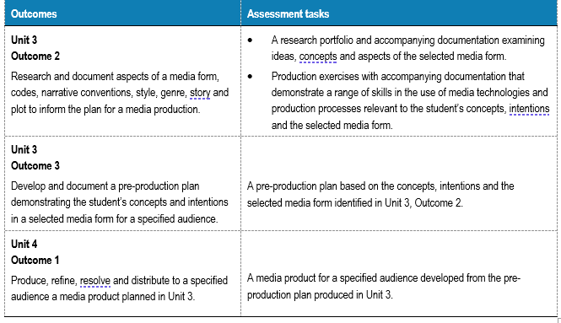
Information provided for School-assessed Tasks
Provide the students with the following:
A summary addressing the three outcomes of the task drawn from the VCE study design.
A timeline of the School-assessed Task with observations and feedback.
Authentication procedures for the School-assessed Task
Detailed examples of key knowledge and skills
Assessment information about the school assessed task.
Notes:
To address the principles of VCE assessment for the School-assessed Task students should be provided with all the necessary information from the Study Design and administrative documents. These documents are written for the teacher and it is up to the teacher to reinterpret them for the students.
On the screen you can see the listed assessment tasks from the VCE Media study design (page 35) that are for the three outcomes associated with the school-assessed task. It is the schools responsibility to provide the following information to support students to achieve the key knowledge and skills of each outcome for the task:
A summary addressing the three outcomes of the task drawn from the VCE study design.
A timeline of the School-assessed Task with observations and feedback.
Authentication procedures for the School-assessed Task
Detailed examples of key knowledge and skills
Assessment information about the school assessed task.

Slide 11
SAT Mandatory information for students
Assessment information
Authentication
Task
information
Notes:
In summary there are three key pieces of information to give students for the SAT to meet the requirements of the VCE Assessment Principles.
Information about the task such as the key knowledge and skills, outcome requirements and what they will be assessed on.
How the students are assessed – such as a breakdown of assessment criteria, indicators and descriptors in language the students understand and including visual examples of what standards look like
Information about how you will authenticate the task – what the students can use, timelines for observation and how feedback on the task will be provided to them.

Slide 12
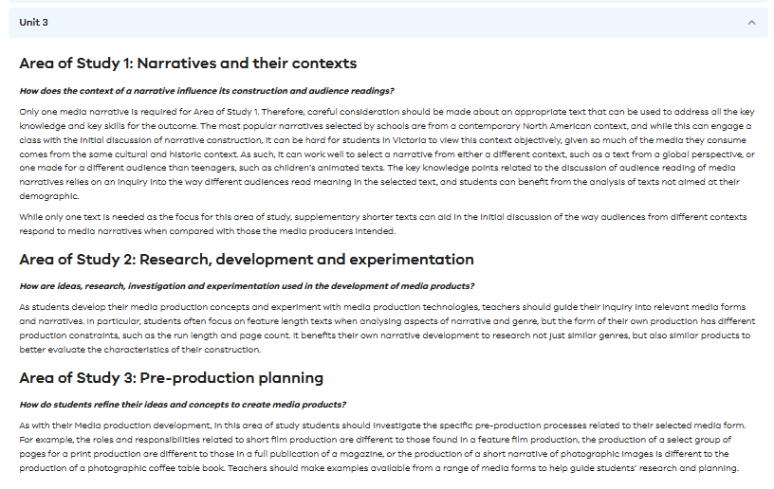
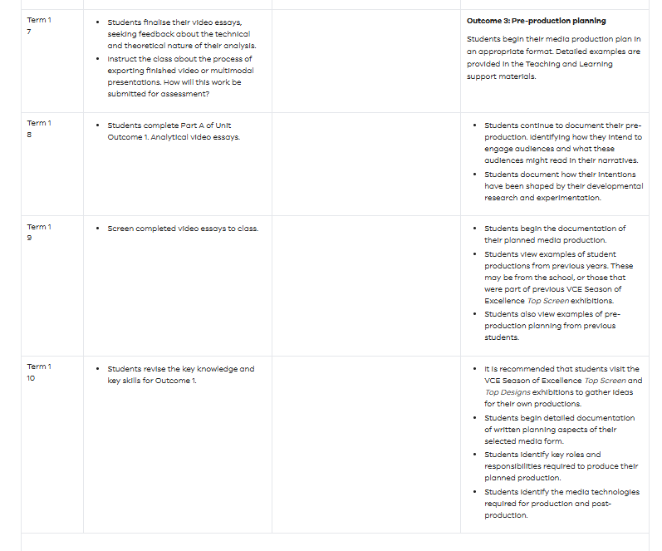
Summary and timeline
Notes:
The following are examples of where you can find an overview and timeline for each outcome of the SAT. These are published in the Planning section in the Support Materials on the Study Design page ‘Timeline of Teaching Units 1-4.’ Planning - Victorian Curriculum and Assessment Authority
These can be used as a guide for your own planning.

Slide 13
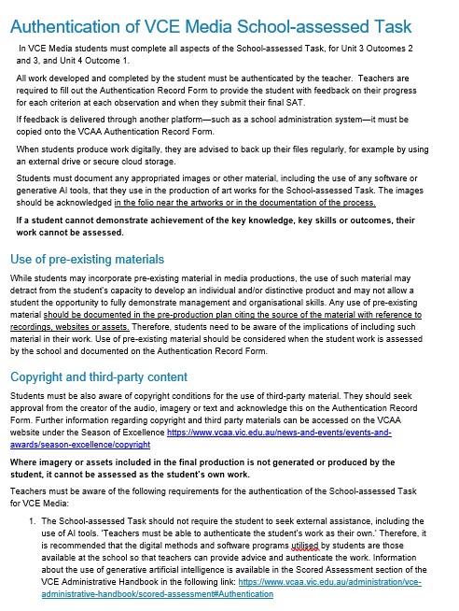
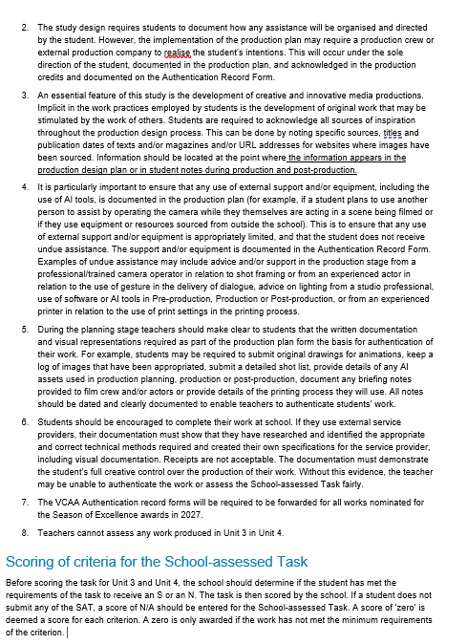
Authentication
Notes:
The school must read the information regarding authentication for the students and then put in place a system for authentication of the task. The teacher must fill out the authentication record form with comments at each authentication point, that the student and teacher must sign. Schools have different methods of working with these forms and providing information to students.
Authentication information is provided in the Administrative Information for School-based Assessment for Media’ which is updated and published annually. This year the information regarding Authentication is on page ??
The Authentication Record Form is also updated each year and published on the VCE Media study design page.

Slide 14
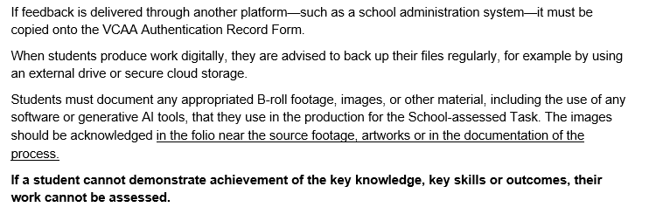
Authentication – digital work
Notes:
It is important in Media that all files are backed up to a secure cloud or school system, that ensures that the SAT documents cannot be edited.
In particular in Media, the research and any additional footage used in the production has the source noted next to it.

Slide 15
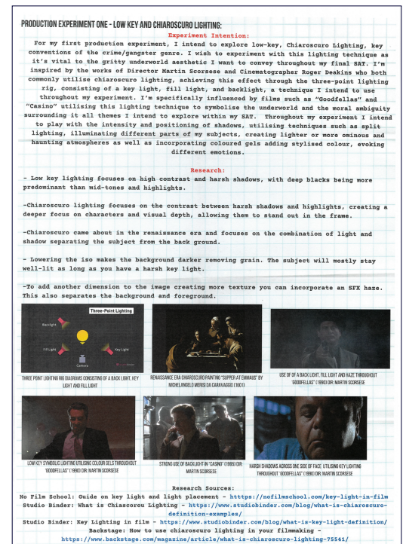

VCAA Annotated Folio pages 2025
Notes:
These are some examples of production experiments where the student has indicated the source image.

Slide 16
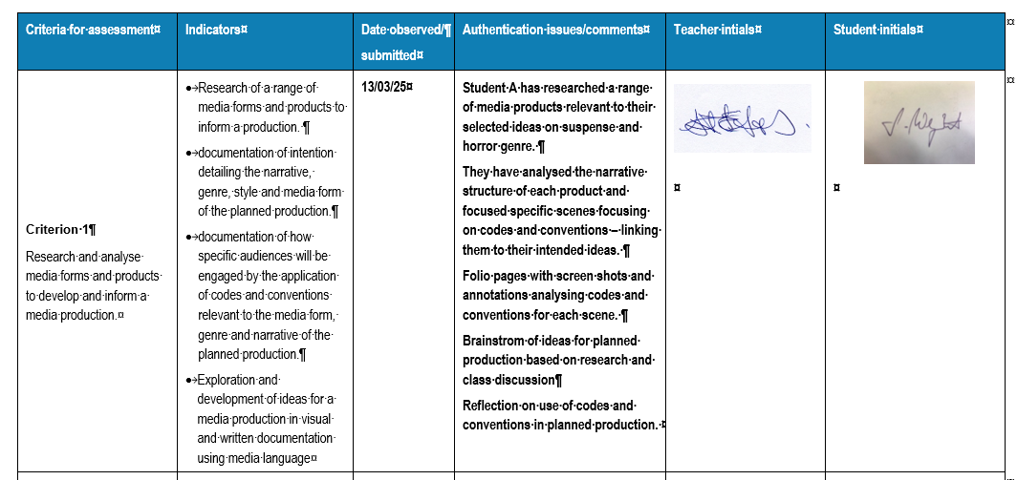
Filling out the Authentication Record Form
Notes:
Here is an example filling out the Authentication Record Form from a teacher with the date, information, teacher and student signature. The teacher has additional information stored on the school learning management system.

Slide 17
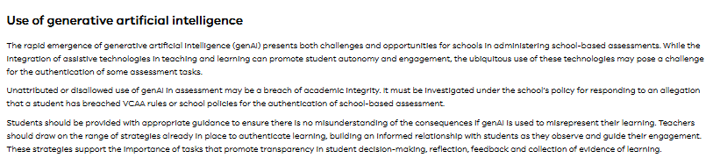
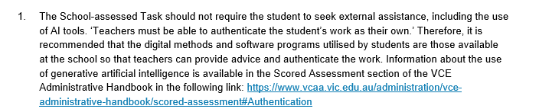
Generative AI
Notes:
These pieces of information are from the SBA document for Media and the VCE and VCAL Handbook.
In Media the use of Generative AI should be authenticated in the following:
Research
Script development and treatment
Annotations
In production and post-production (particularly with digital software)

Slide 18
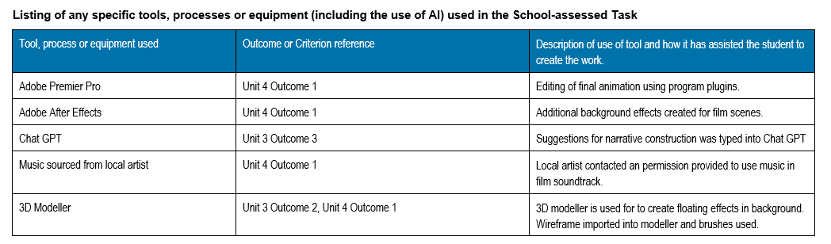
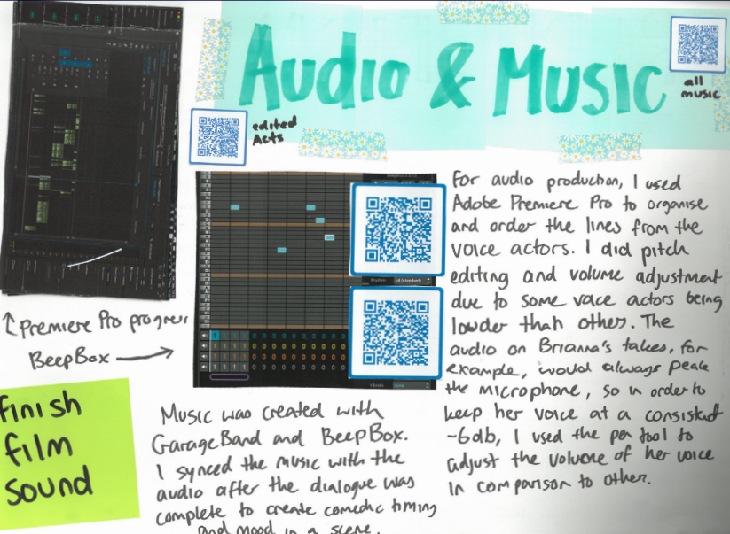
Generative AI
Mia Sattler, Top Screen 2025
Notes:
Here is an example of the Authentication Record Form filled out with programs and how they have been used in the Media production. On the right hand side of the slide you can see how the student has provided QR codes to the use of audio in the product and annotated how they have used Premier Pro in their animation.

Slide 19
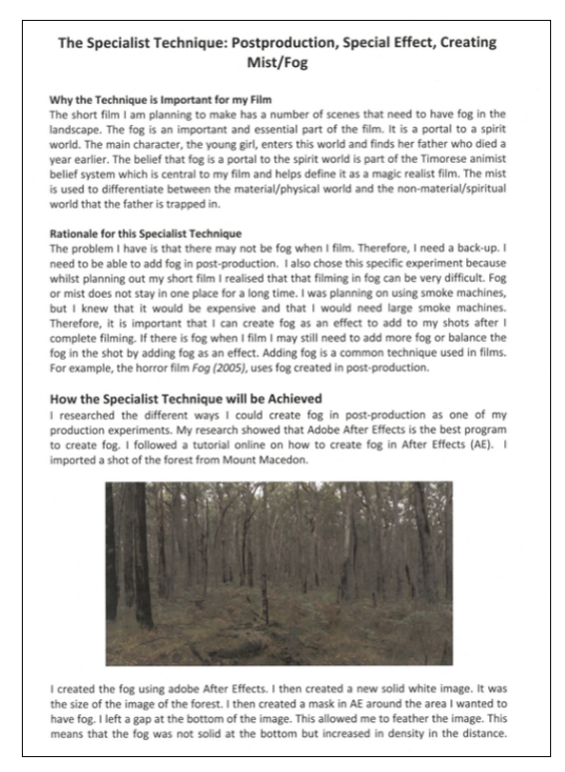
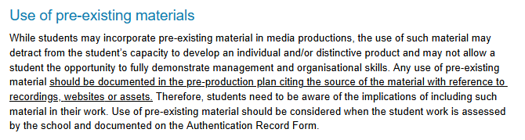
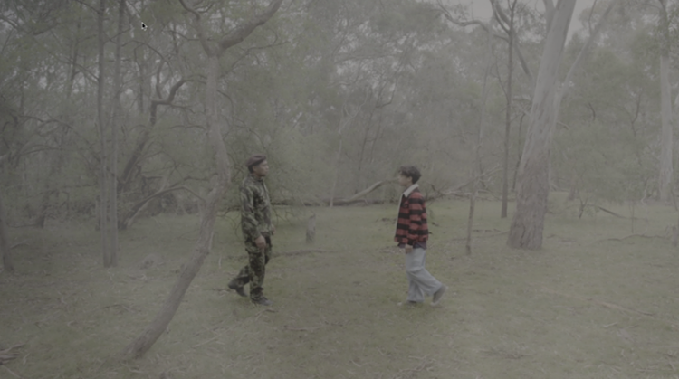
Pre-existing materials
Thicia Acquisto, Top Screen 2025
Notes:
If the student is using pre existing equipment or materials this also needs to be documented on the Authentication Record Form and in the Production folio. Generally the authentication serves a dual purpose to document production. In this case the student has discussed how they developed a special effect using After Effects as part of their production diary.

Slide 20
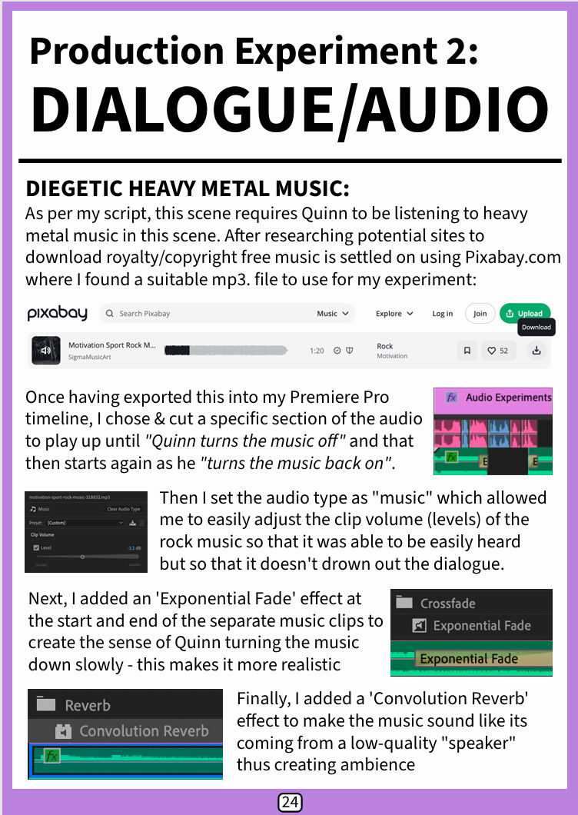
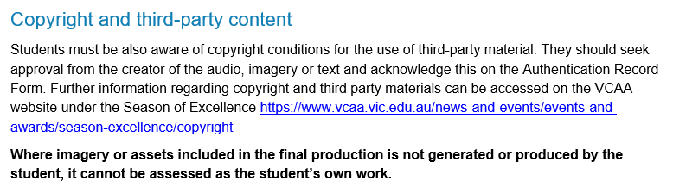
Copyright
Dari Justin, Top Screen 2025
Notes:
Copyright is a key component in VCE Media. If the student is using third party materials including audio, images or text. They must seek permission for its use from the provider of the third party material. There is additional information in the Season of Excellence, and the Copyright conditions are different for this program, than for the School-assessed Task. However, if the material is not generated by the student it cannot be assessed. In the example of the screen here the student accessed a copyright free music site to download an audio file. They then edited the file for their own production. Therefore the only component that can be assessed is the edited file.

Slide 21
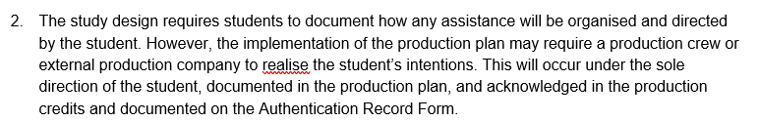
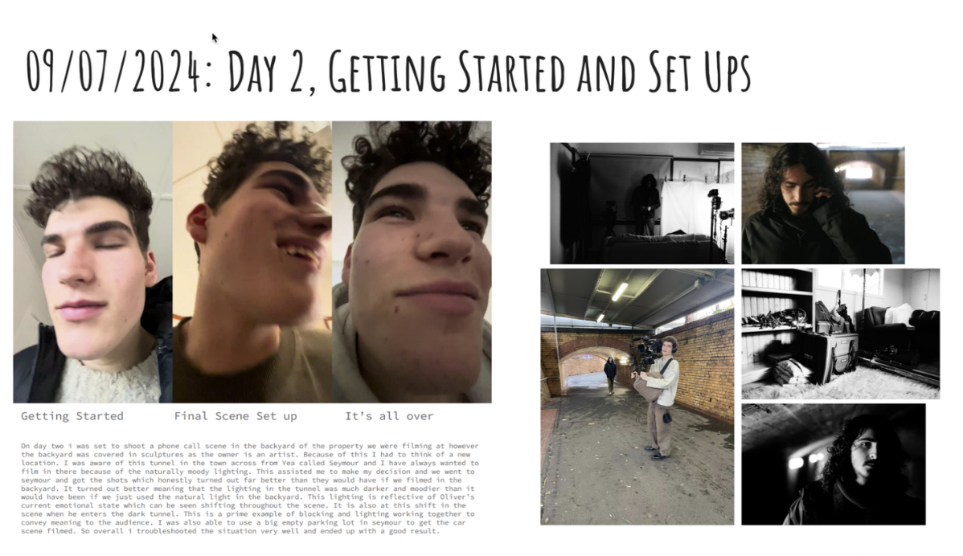
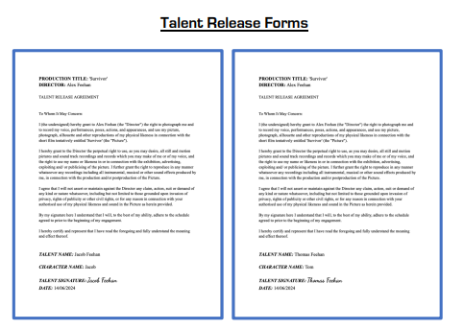
Assistance
Perry Moon, Top Screen 2025
Alex Feehan, Top Screen 2025
Notes:
Students must acknowledge any additional support to make their production on the production design plan. Here are two examples of the student documenting the use of this assistance. One is in the production journal and the second is through a Talent Release Form.

Slide 22
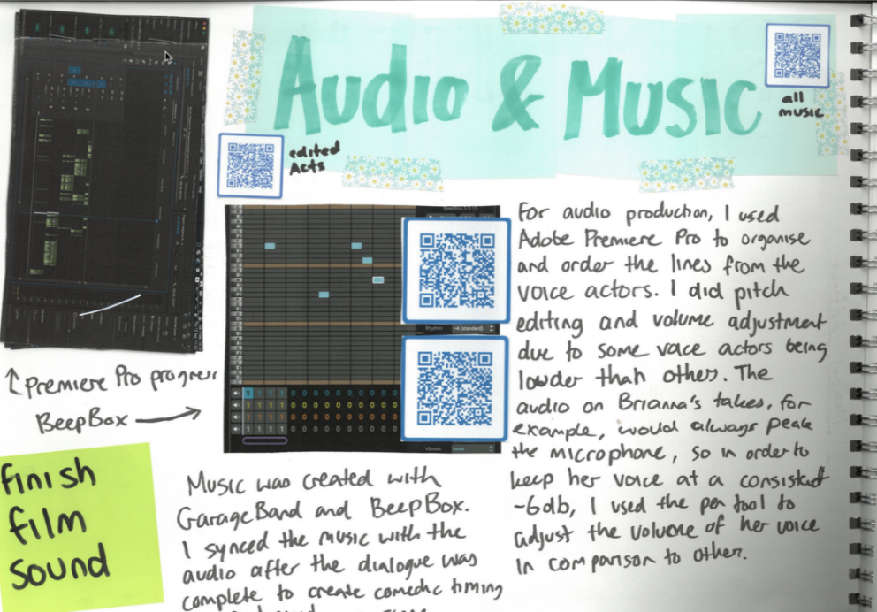
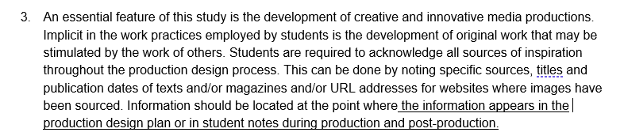
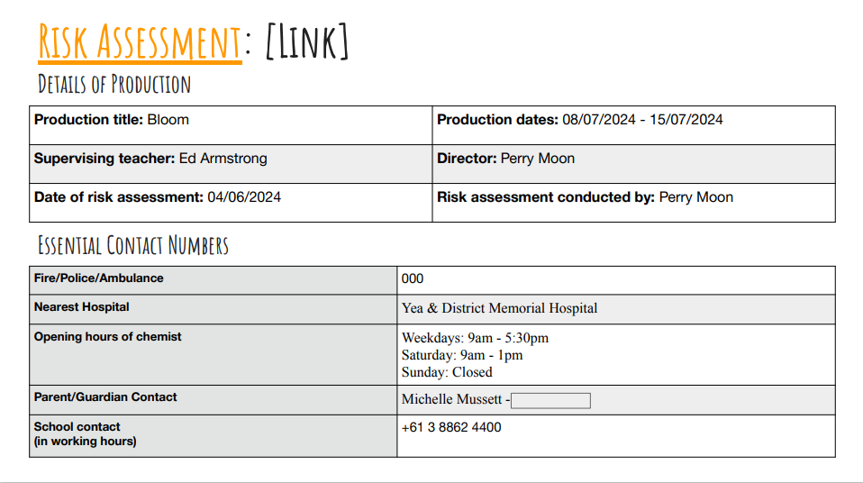
Assistance
Mia Sattler, Top Screen 2025
Perry Moon, Top Screen 2025
Notes:
As mentioned in the use of pre-existing materials, students must acknowledge any sources in all aspects of the production including in research, the production plan and in the production journal. Here you can see two examples of the acknowledgement. One in the use of audio, and the second in the use of additional services such as Ambulance/Police/Fire during filming.

Slide 23
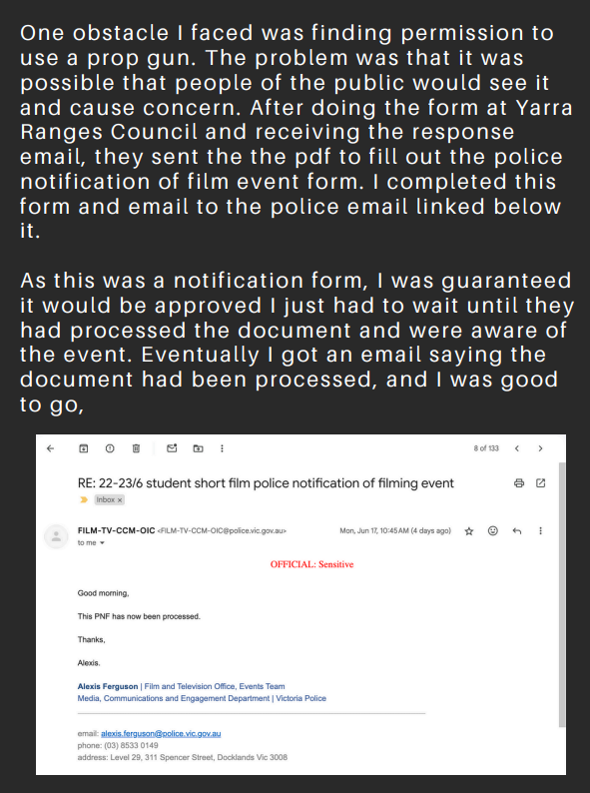
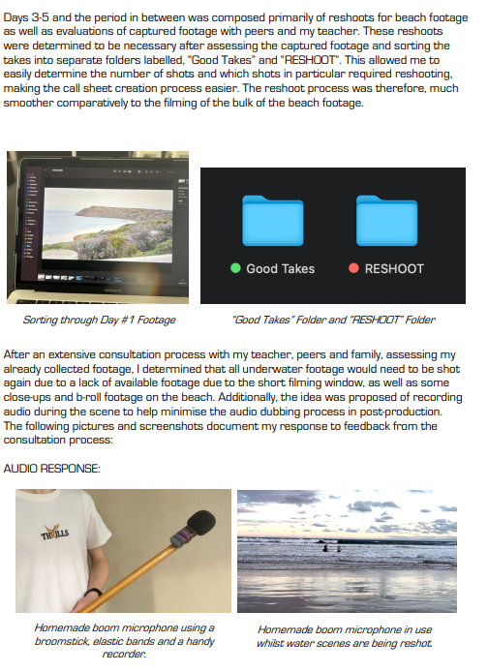
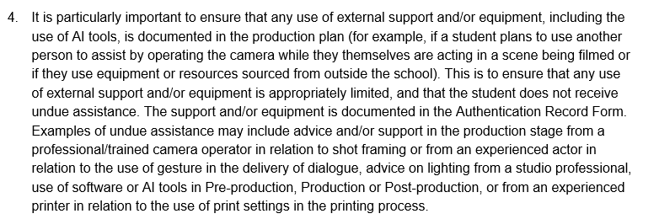
Assistance
Jackson Betram, Top Screen 2025
Alex Feehan, Top Screen 2025
Notes:
Students need to document in the production plan the use of technical expertise and equipment. It must be documented on the ARF. Here are two examples of permission to use a mock fire arm and the use of a home made boom and audio effects in the production journal.

Slide 24
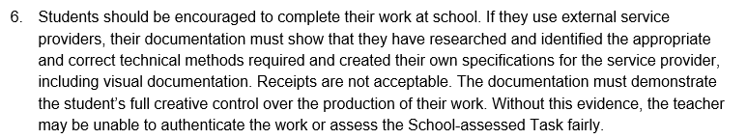
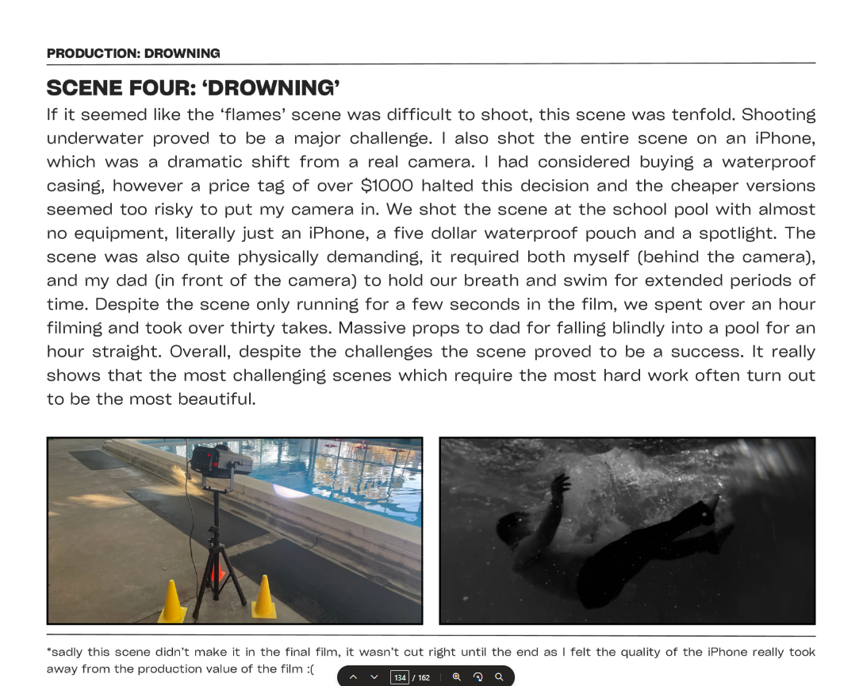
Assistance
Alex Feehan, Top Screen 2025
Notes:
If the student is using an external provider, such as a printer or publisher for their work, they must document the use of the expertise of the specialist to ensure that the teacher can document the work as the student’s own. In this case, the student has documented in the production journal how the underwater scenes in their production was filmed.

Slide 25
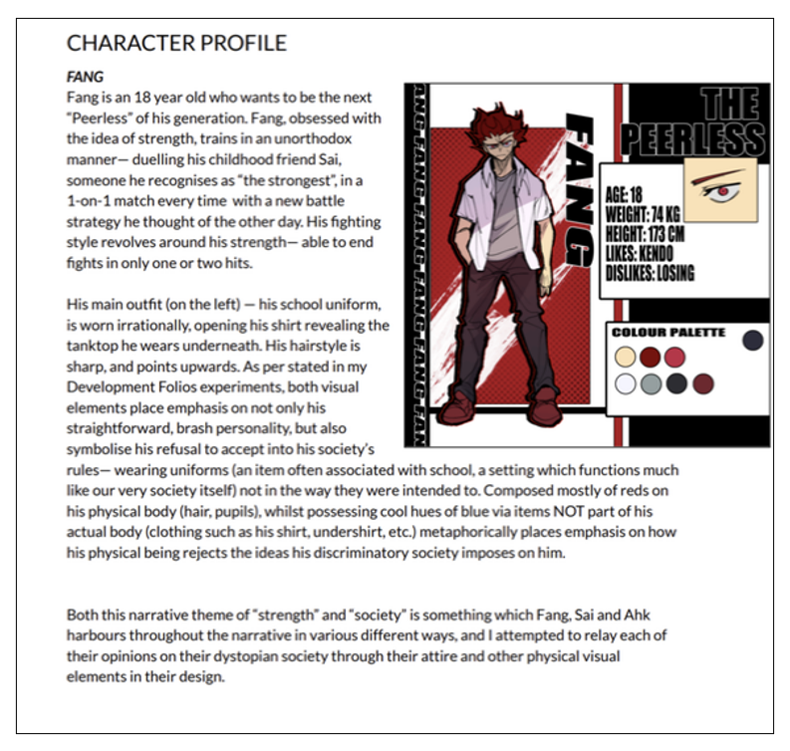
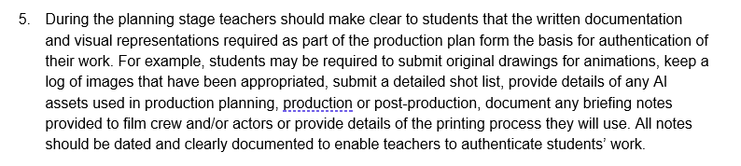
Assistance
Matthew Jung, Top Screen 2025
Notes:
If students must produce story boards in written or visual form to support the authentication of their work. A story board accompanies a shot list and includes details for all scenes. In the case of animations this can include the development of characters and the colour conventions for the work.

Slide 26
Contact us:
vcaa@education.vic.gov.au or +61 3 9032 1629
© Victorian Curriculum and Assessment Authority 2025 The copyright in this PowerPoint presentation is owned by the Victorian Curriculum and Assessment Authority or in the case of some materials, by third parties. No part may be reproduced by any process except in accordance with the provisions of the Copyright Act 1968 or with permission from the Copyright Officer at the Victorian Curriculum and Assessment Authority.
Notes:
Please send any enquires related to the VCAA to the general email and it will be forwarded to the relevant contact person. This ensures your enquiry is promptly replied to by the appropriate person and bookmark our website.
“”Please note, it is encouraged that CM’s direct messages to the VCAA contacts**

Slide 28
Notes:
Post survey to be created as needed

