Slide 1

VCE Art Making and Exhibiting
Professional learning
On-Demand video
Assessing the School-assessed Task

Slide 2
Acknowledgement
The Victorian Curriculum and Assessment Authority proudly acknowledges and pays respect to Victoria’s Aboriginal and Torres Strait Islander communities and their rich and enduring cultures.
We acknowledge Aboriginal and Torres Strait Islander people as Australia’s first peoples and as the Traditional Owners and custodians of the lands and waters on which we rely. We pay respect to Elders past and present of the lands where we conduct our work and recognise their ongoing contributions as the first educators on the land now known as Victoria.

Slide 3

Purpose
Information provided to students for the School-assessed Task
Information provided to students about the assessment of the School-assessed Task
Updates to assessment information for the School-assessed Task in 2026.
Notes:
In this OnDemand video I will be explaining to you the background of the School-assessed Task, where to find key documents, and how to provide information to your students for the task, how to authenticate and how to assess the task.

Slide 4
Mandatory information for students
Assessment information
Authentication
Task
information
Notes:
In summary there are three key pieces of information to give students for the SAT to meet the requirements of the VCE Assessment Principles.
Information about the task such as the key knowledge and skills, outcome requirements and what they will be assessed on.
How the students are assessed – such as a breakdown of assessment criteria, indicators and descriptors in language the students understand and including visual examples of what standards look like
Information about how you will authenticate the task – what the students can use, timelines for observation and how feedback on the task will be provided to them.

Slide 5
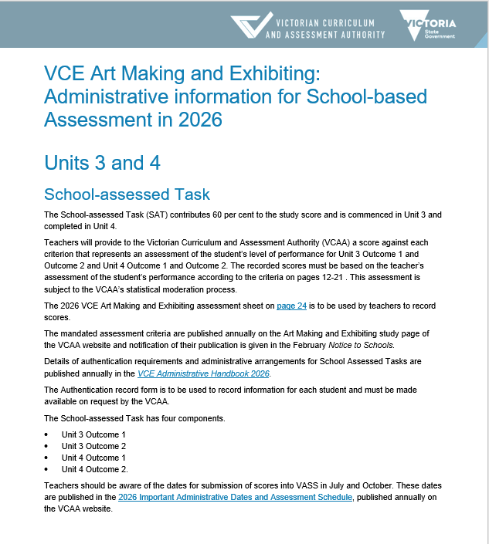
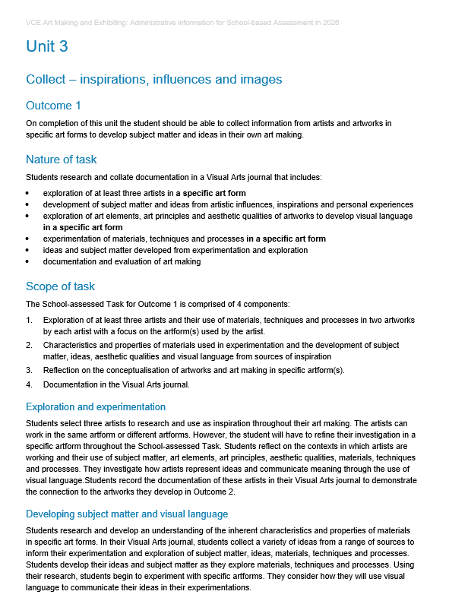
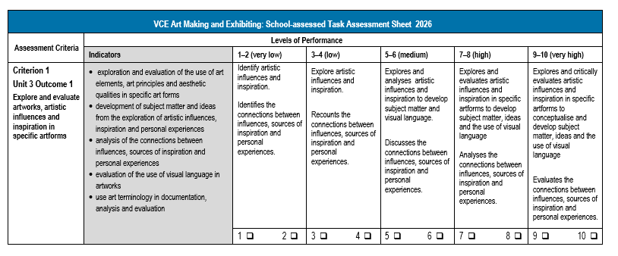
Assessment of the task
Notes:
The VCAA provides the assessment criteria and performance descriptors for the SAT. Unlike School-assessed Coursework, where teachers can develop their own tasks and rubrics, the Scope of the task and the levels of performance are set by the VCAA. When students are given information about the activities in the task, they also must be provided with the information about how it is assessed. Similarly, to the Study Design, the assessment advice is written in language for the teacher, and it must be unpacked for the students.
In Art Making and Exhibiting, there are 8 assessment criteria that are related to the key knowledge and skills for the outcome. The outcome is always listed above the criterion.
The indicators for assessment: the components the teacher is assessing is listed on the left hand side in the grey column.
The teacher then assesses the student work based on the evidence in the indicators.

Slide 6
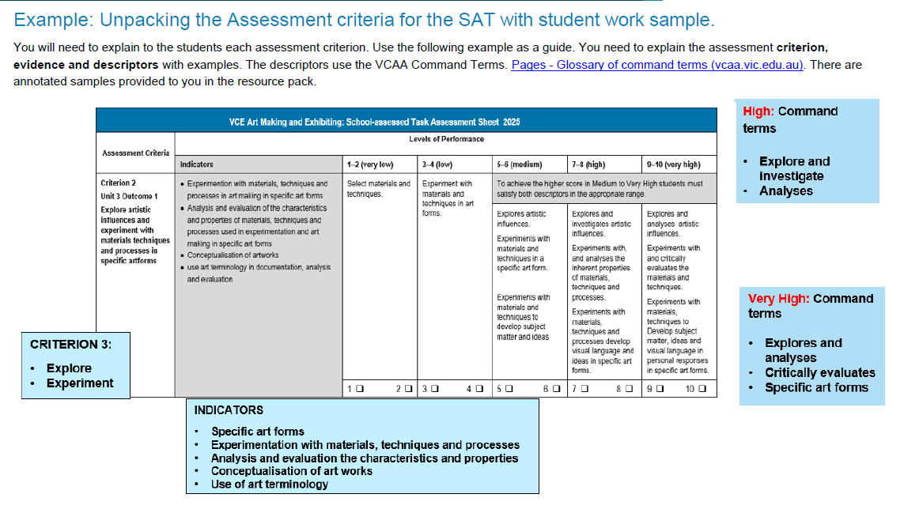
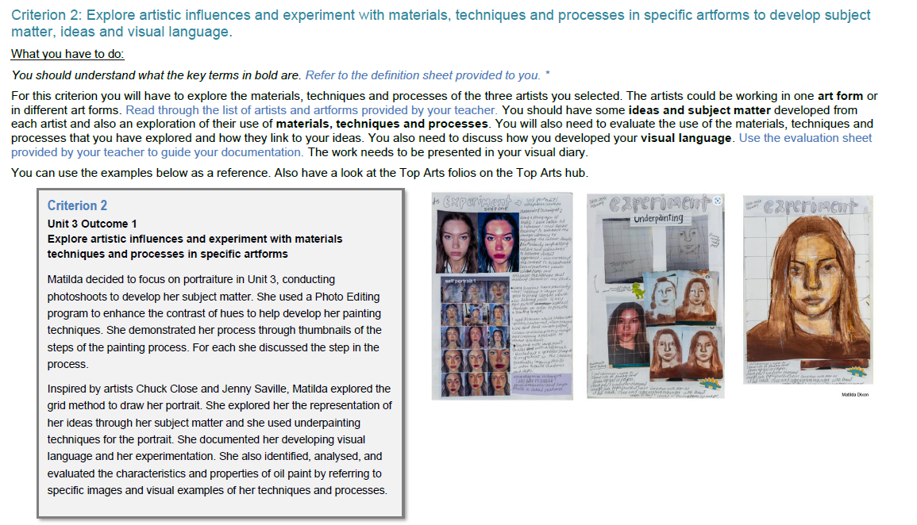
Assessment criteria
Notes:
To ensure that assessment is equitable and valid, teachers need to unpack the criterion, indicators and level of assessment in language the students understand. They might write a description of what the students need to achieve, and provide student work demonstrating a high level of achievement. In this slide, the assessment criteria, descriptors and indicators are summarised, and the students are provided with some examples of achievement from past student folios with annotations. These examples are resources on the Art Making and Exhibiting study design page that are presented with an annotation of student achievement. A resource document can be developed that is housed on a Learning management system to support the students throughout the year. Please note, that as the criterion, indicators and descriptors are updated each year, the material needs to be updated annually.

Slide 7
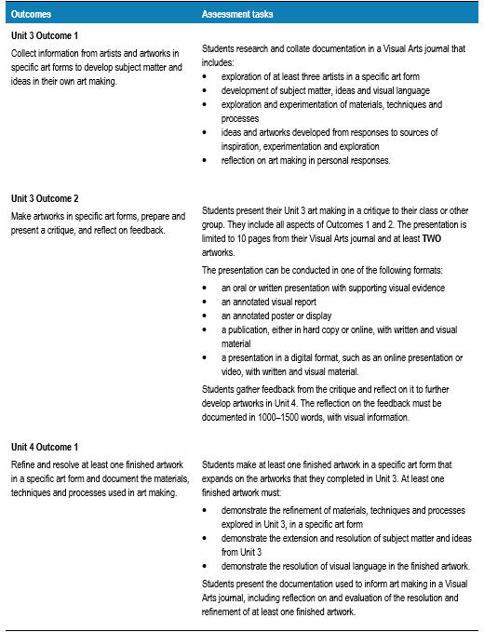
School-assessed Task
VCE Art Making and Exhibiting study design, Page 42

Slide 8
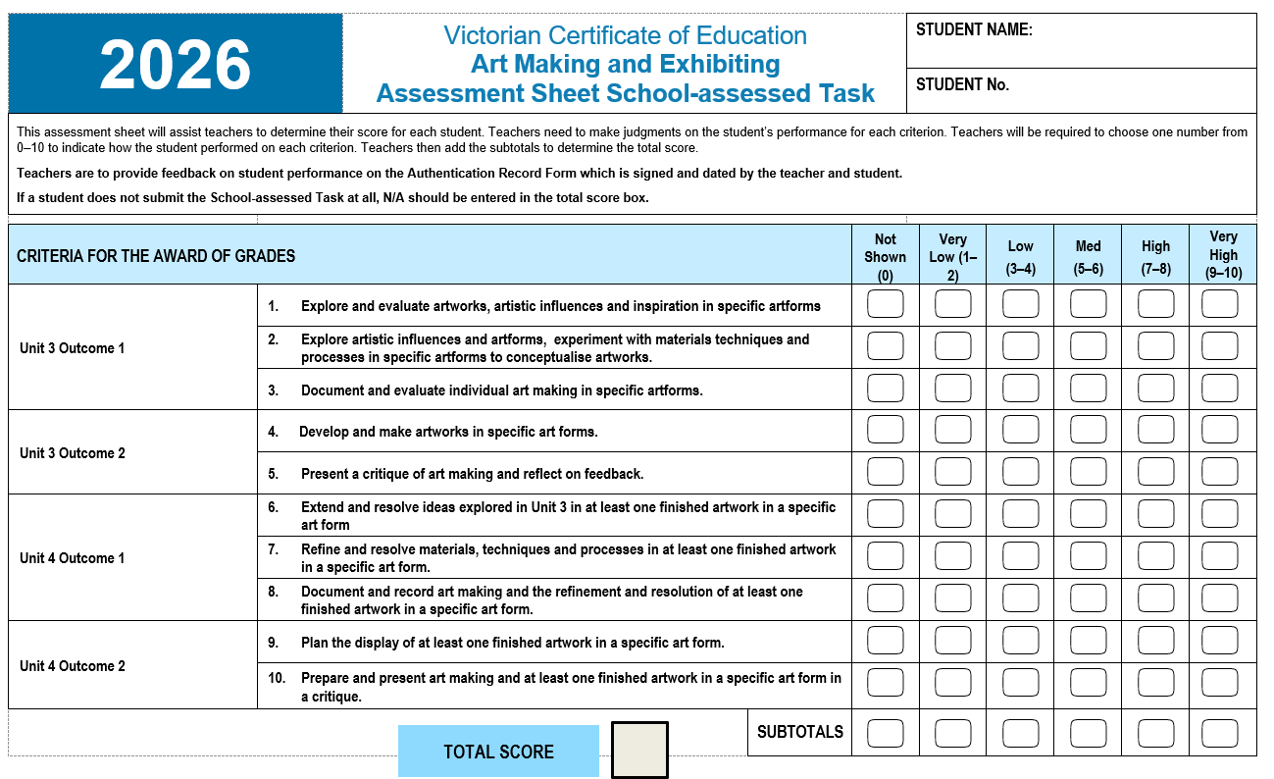
Notes:
This is the assessment sheet where you can record the final school scores for students. However, in addressing the VCE assessment principles, students should receive feedback on their performance in each Criterion. This feedback can be placed on the authentication record form. If the feedback is given in another form, such as a School-assessment system, this feedback should be copied and pasted into the Authentication Record Form.

Slide 9
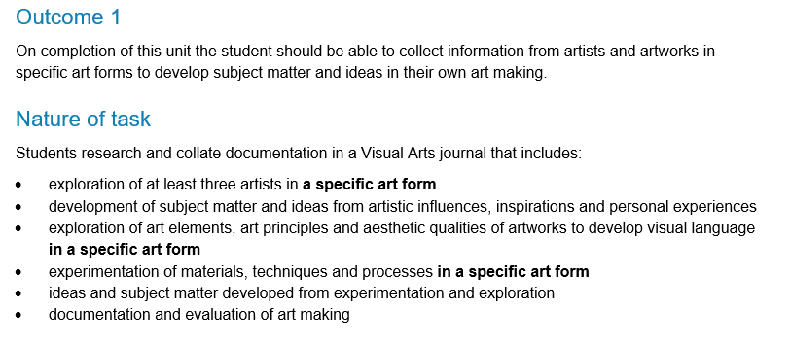
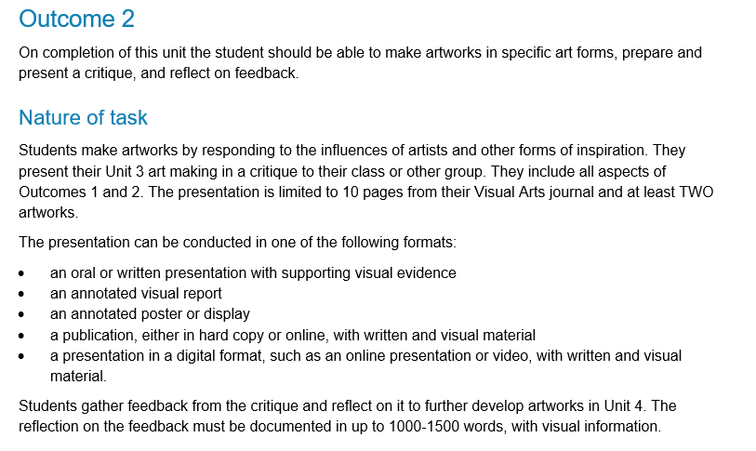
Nature of task
Unit 3
Notes:
The nature of the task is mandatory and is outlined in the study design. This is the assessment item and contain the indicators for each criterion.

Slide 10
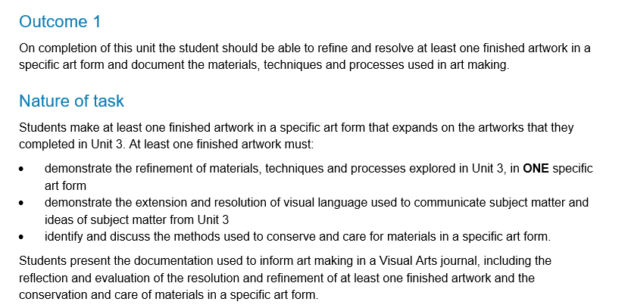
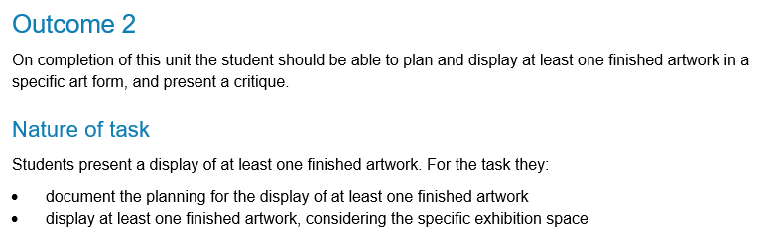
Nature of task
Unit 4
Notes:
The nature of the task is mandatory and is outlined in the study design. This is the assessment item and contain the indicators for each criterion.

Slide 11
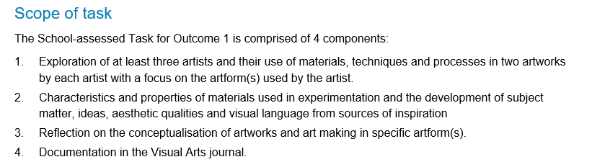
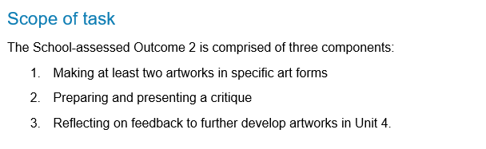
Scope of task
Unit 3 Outcome 1
Unit 3 Outcome 2
Notes:
The scope of the task outlines the extent of the assessment. Anything outside the scope of the task cannot be assessed.

Slide 12
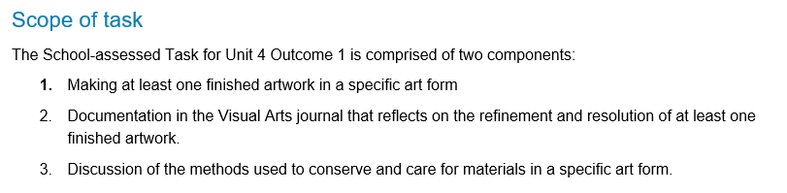
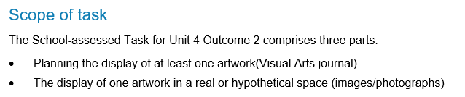
Scope of task
Unit 4 Outcome 1
Notes:
The scope of the task outlines the extent of the assessment. Anything outside the scope of the task cannot be assessed.

Slide 13
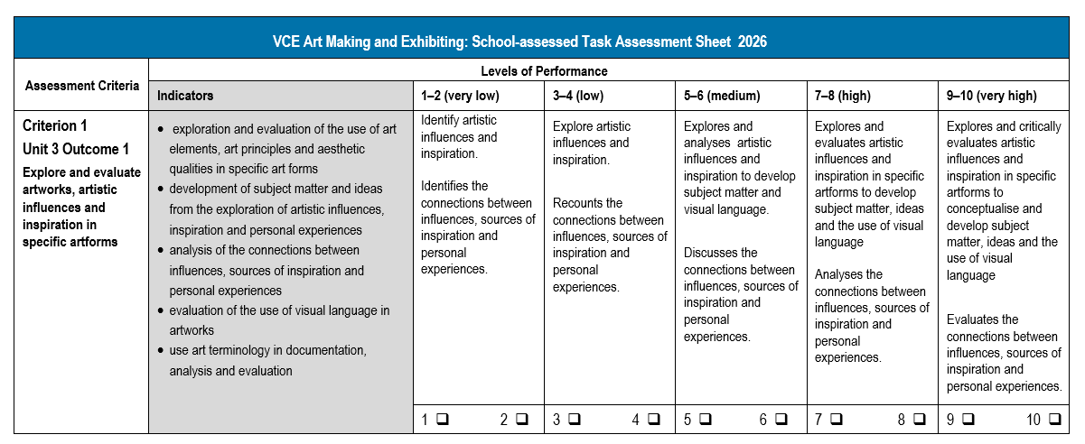
Criterion 1
Updates
Descriptors are focused on collecting and analysing inspiration
The conceptualisation of artworks has been removed.
Notes:
Changes to the criterion are highlighted in red. Changes to descriptors and indicators are highlighted in blue.
Criterion 1 now focuses on collecting and analysing inspiration prior to conceptualising artworks.

Slide 14
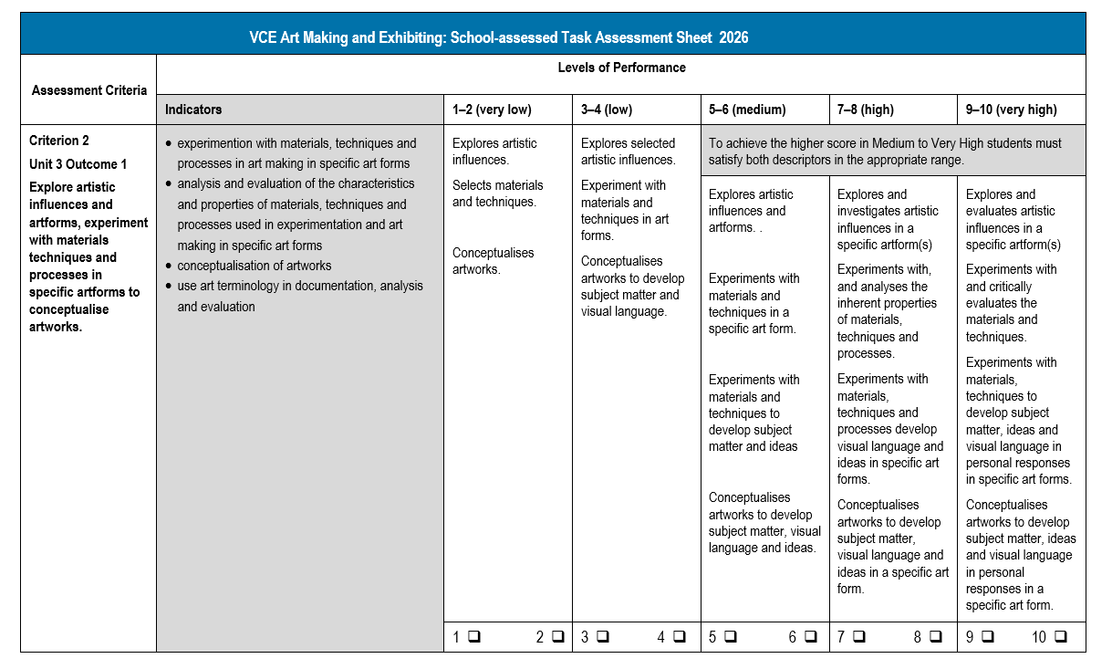
Criterion 2
Updates
The criterion now focuses on the conceptualisation of artworks from exploration and experimentation
There is a focus on specific artforms.
Notes:
Criterion 2 now focuses on the conceptualisation of artworks from the exploration of artforms, and experimentation of materials, techniques and processes in a specific art form. The artwork is then conceptualised based the exploration and experimentation. This places the experimentation of the art form at the forefront of the conceptualisation of artworks.

Slide 15
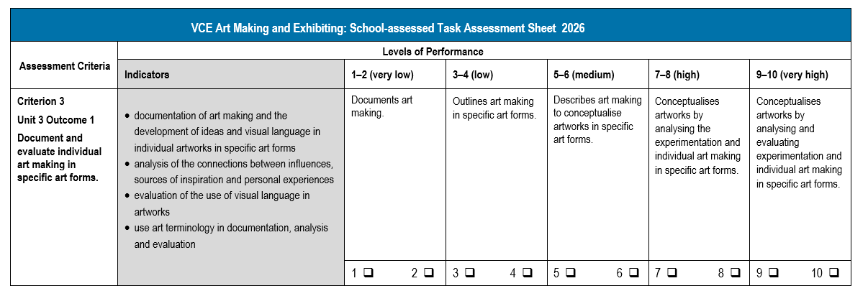
Criterion 3
Updates
The criterion focuses on art making in specific artforms.
Notes:
Criterion 3 relates to documentation, however the documentation of artmaking must focus on the art form.

Slide 16
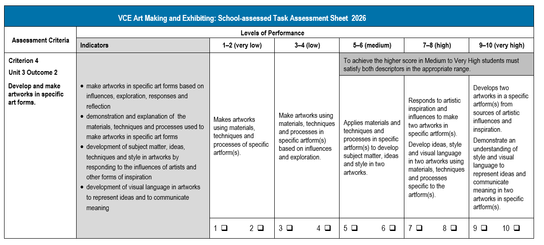
Criterion 4
Updates
Several artforms can be explored, but they must relate to the research for Outcome 1
Finished artworks are not required.
Notes:
There has been no change to Criterion 4 but it is essential that students focus on developing and making artworks in a specific art form. The artform(s) is added as students may in Unit 3 explore a number of artforms, particularly at the higher levels. The artworks should be related to the artists researched in Unit 3 Outcome 1.

Slide 17
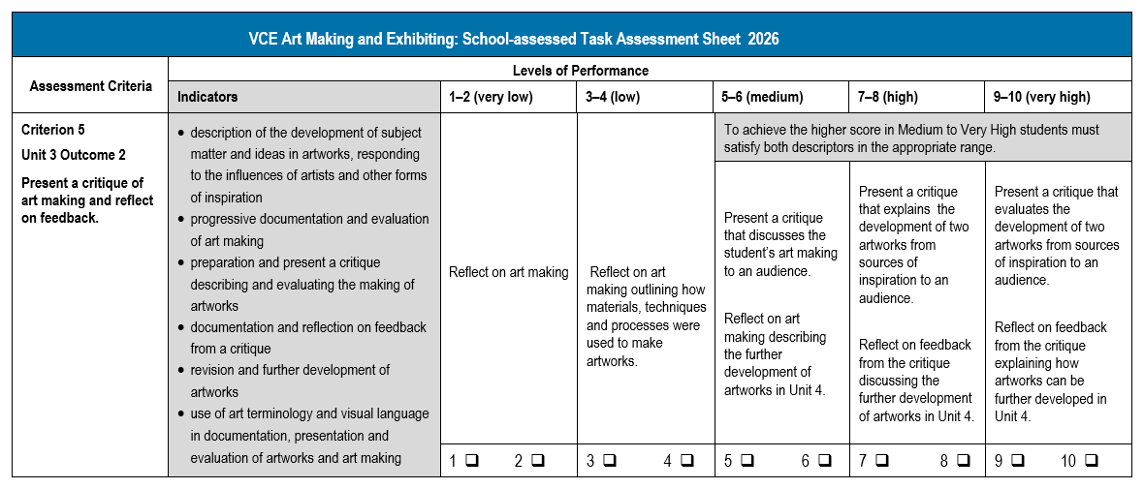
Criterion 5
Updates
A critique must be presented and reflected upon to explain how the artworks will be developed in Unit 4.
Notes:
Students must present a critique at the end of Unit 3. They must receive feedback, reflect on it, and discuss how their artworks will be further developed in Unit 4.

Slide 18
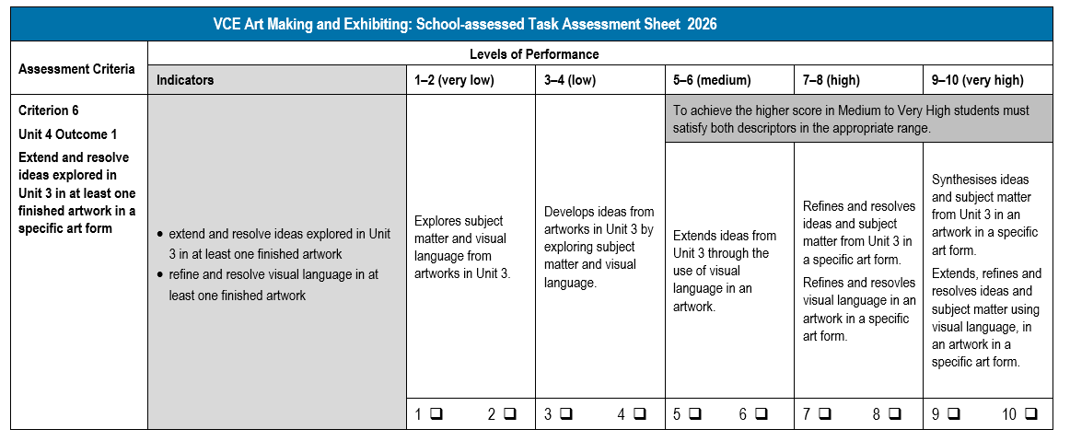
Criterion 6
Updates
Stronger link between Unit 3 and Unit 4
Ideas, subject matter and visual language in a specific artform.
Notes:
In Unit 4 Outcome 1 students must demonstrate how the artworks they make in Unit 4, link to Unit 3 including the refinement and resolution of ideas, subject matter and visual language in a specific artform.

Slide 19
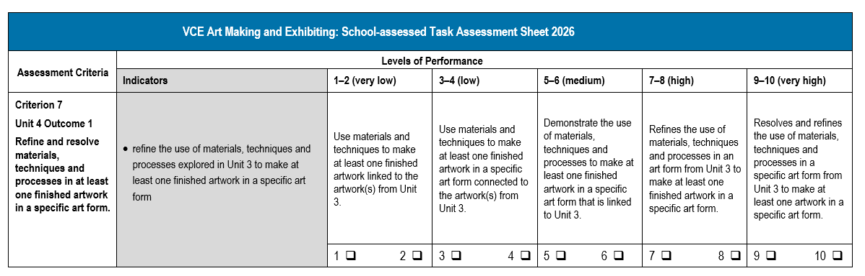
Criterion 7
Updates
Link between Unit 3 and Unit 4
Refinement of materials, techniques and processes in a specific art form.

Slide 20
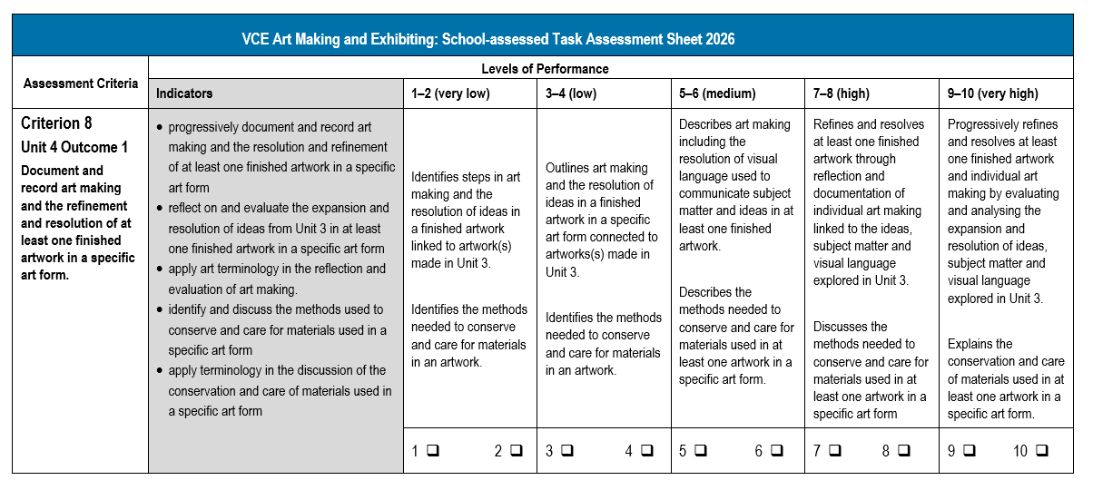
Criterion 8
Updates
‘Conservation and care of a specific art form’ have been added to the indicators
Descriptors have been adjusted so students meet requirements of the task.
Notes:
In Criterion 8 students are assessed on their documentation and reflection of the resolution and refinement of their artwork. Conservation and care of the specific art form have been moved to Criterion 8 from Criterion 9.
Students must discuss the conservation and care of their specific art form and avoid generalised conservation information.

Slide 21
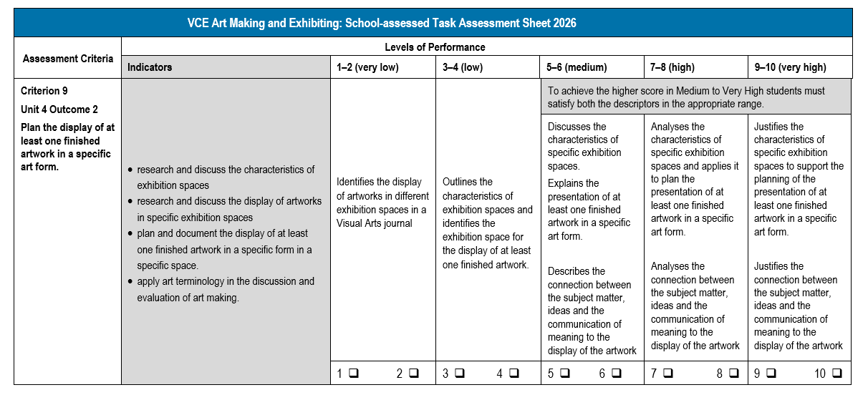
Criterion 9
Updates
Focus on the research of exhibition spaces
Plan and document the display of an artwork in a specific art form.
Notes:
Criterion 9 has been adjusted to allow students to research specific exhibition spaces and discuss the presentation of their own artwork based on their research. There must be evidence of the research, and the planned display of the artwork in the Visual Arts Journal.

Slide 22
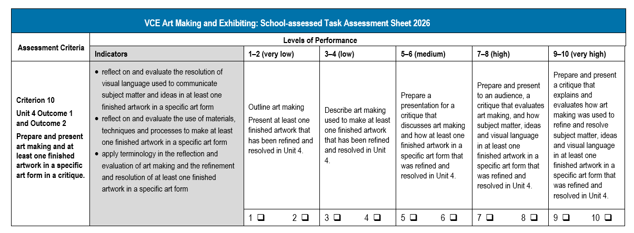
Criterion 10
Updates
Students must present a critique
The artwork must be refined and resolved as a finished work.
Notes:
Criterion 10 has been adjusted to stipulate that there must be evidence of a Critique in the Visual Arts Journal. To meet the requirements of the task, the students must conduct a critique of a refined and resolved artwork.

Slide 23
Contact us:
vcaa@education.vic.gov.au or +61 3 9032 1629
© Victorian Curriculum and Assessment Authority 2025
The copyright in this PowerPoint presentation is owned by the Victorian Curriculum and Assessment Authority or in the case of some materials, by third parties. No part may be reproduced by any process except in accordance with the provisions of the Copyright Act 1968 or with permission from the Copyright Officer at the Victorian Curriculum and Assessment Authority.
Notes:
Please send any enquires related to the VCAA to the general email and it will be forwarded to the relevant contact person. This ensures your enquiry is promptly replied to by the appropriate person and bookmark our website.
“”Please note, it is encouraged that CM’s direct messages to the VCAA contacts**

