Slide 1

VCE Media
Professional learning
On-Demand video
Assessing the School-assessed Task

Slide 2
Acknowledgement
The Victorian Curriculum and Assessment Authority proudly acknowledges and pays respect to Victoria’s Aboriginal and Torres Strait Islander communities and their rich and enduring cultures.
We acknowledge Aboriginal and Torres Strait Islander people as Australia’s first peoples and as the Traditional Owners and custodians of the lands and waters on which we rely. We pay respect to Elders past and present of the lands where we conduct our work and recognise their ongoing contributions as the first educators on the land now known as Victoria.

Slide 3

Purpose
Information provided to students for the School-assessed Task
Information provided to students about the assessment of the School-assessed Task
Updates to assessment information for the School-assessed Task in 2026.
Notes:
In this OnDemand video I will be explaining to you the background of the School-assessed Task, where to find key documents, and how to provide information to your students for the task, how to authenticate and how to assess the task.

Slide 4
SAT Mandatory information for students
Assessment information
Authentication
Task
information
Notes:
In summary there are three key pieces of information to give students for the SAT to meet the requirements of the VCE Assessment Principles.
Information about the task such as the key knowledge and skills, outcome requirements and what they will be assessed on.
How the students are assessed – such as a breakdown of assessment criteria, indicators and descriptors in language the students understand and including visual examples of what standards look like
Information about how you will authenticate the task – what the students can use, timelines for observation and how feedback on the task will be provided to them.

Slide 5

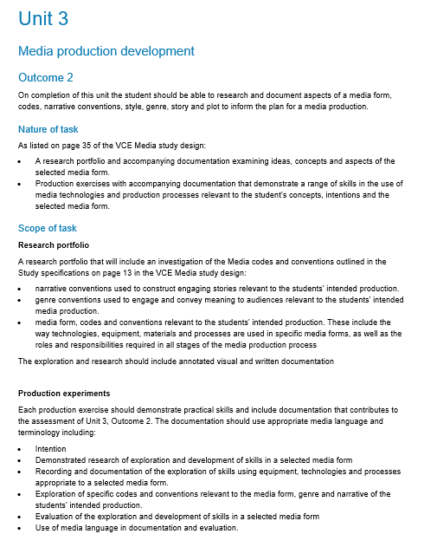
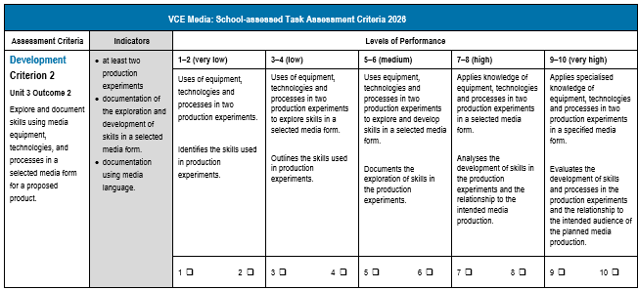
Assessment of the task
Notes:
The VCAA provides the assessment criteria and performance descriptors for the SAT. Unlike School-assessed Coursework, where teachers can develop their own tasks and rubrics, the Scope of the task and the levels of performance are set by the VCAA. When students are given information about the activities in the task, they also must be provided with the information about how it is assessed. Similarly, to the Study Design, the assessment advice is written in language for the teacher, and it must be unpacked for the students.
In Media, there are 8 assessment criteria that are related to the key knowledge and skills for the outcome. The outcome is always listed above the criterion.
The indicators for assessment: the components the teacher is assessing is listed on the left hand side in the grey column.
The teacher then assesses the student work based on the evidence in the indicators.

Slide 6
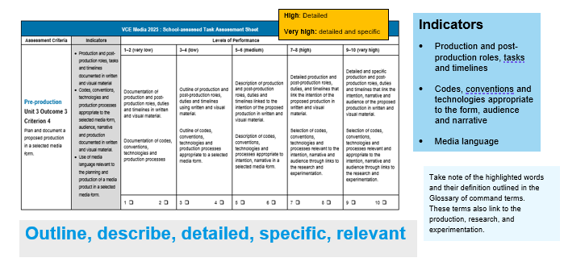
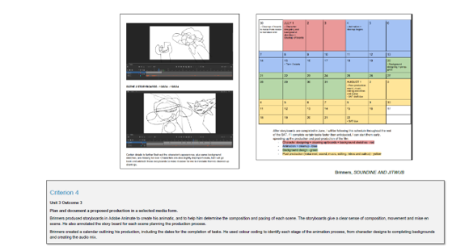
Assessment criteria
Notes:
To ensure that assessment is equitable and valid, teachers need to unpack the criterion, indicators and level of assessment in language the students understand. They might write a description of what the students need to achieve, and provide student work demonstrating a high level of achievement. In this slide, the assessment criteria, descriptors and indicators are summarised, and the students are provided with some examples of achievement from past student folios with annotations. These examples are resources on the Media study design page that are presented with an annotation of student achievement. A resource document can be developed that is housed on a Learning management system to support the students throughout the year. Please note, that as the criterion, indicators and descriptors are updated each year, the material needs to be updated annually.

Slide 7
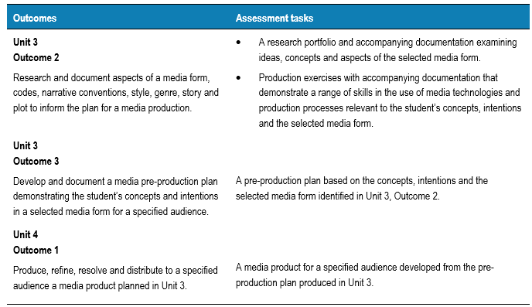
School-assessed Task
(VCE Media study design, page 36)
Notes:
The tasks for each outcome are clearly outlined in the study design on page 36.

Slide 8
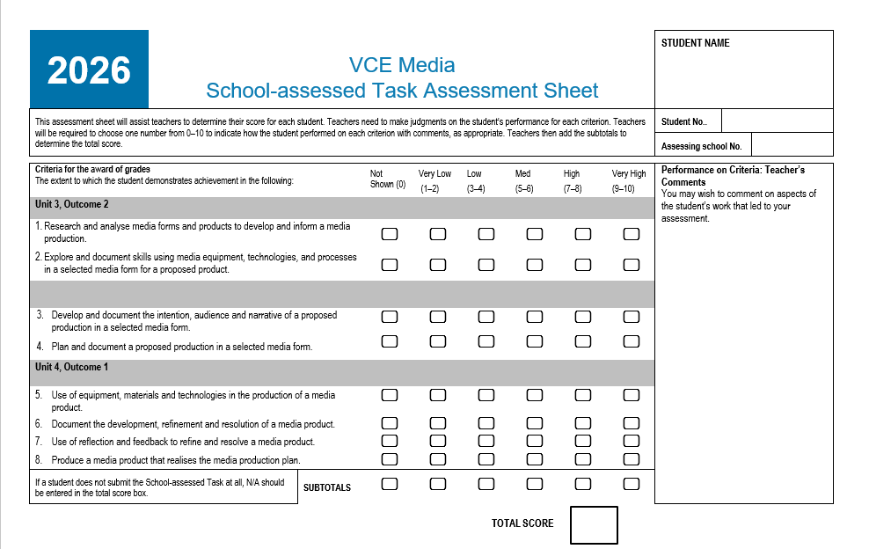
Notes:
This is the assessment sheet where you can record the final school scores for students. However, in addressing the VCE assessment principles, students should receive feedback on their performance in each Criterion. This feedback can be placed on the authentication record form. If the feedback is given in another form, such as a School-assessment system, this feedback should be copied and pasted into the Authentication Record Form.

Slide 9
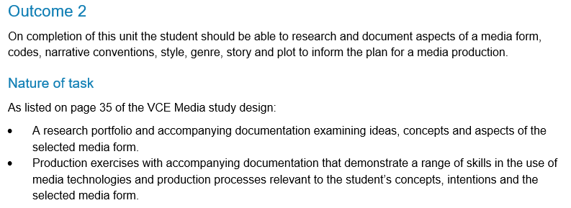
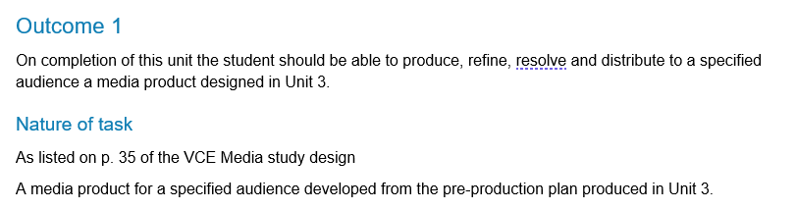
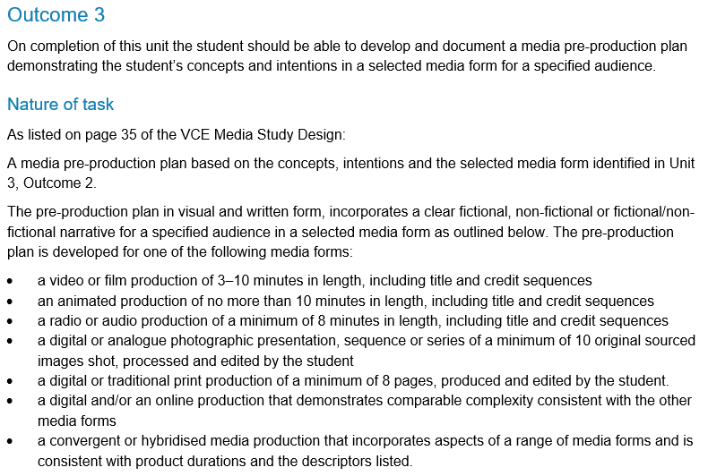
Nature of task
Unit 3
Unit 4
Notes:
The nature of the task is mandatory and is outlined in the study design.

Slide 10
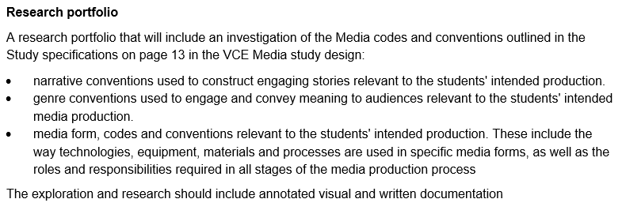
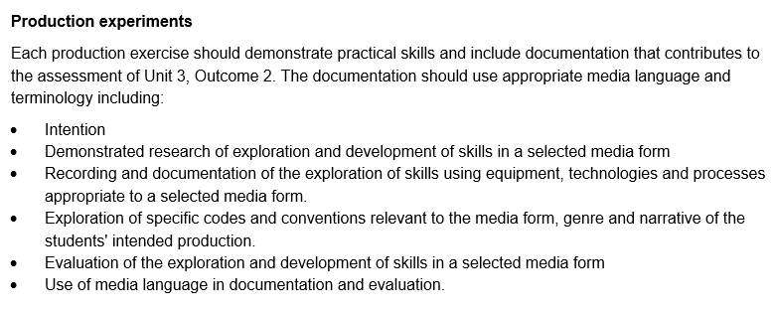
Scope of task
Unit 3 Outcome 2
Notes:
The scope of the task describes what can be assessed. This is developed alongside the Key Knowledge and Skills of each outcome associated with the SAT in the study design.

Slide 11
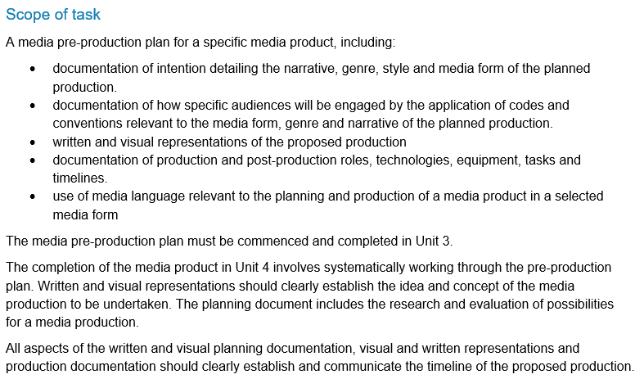
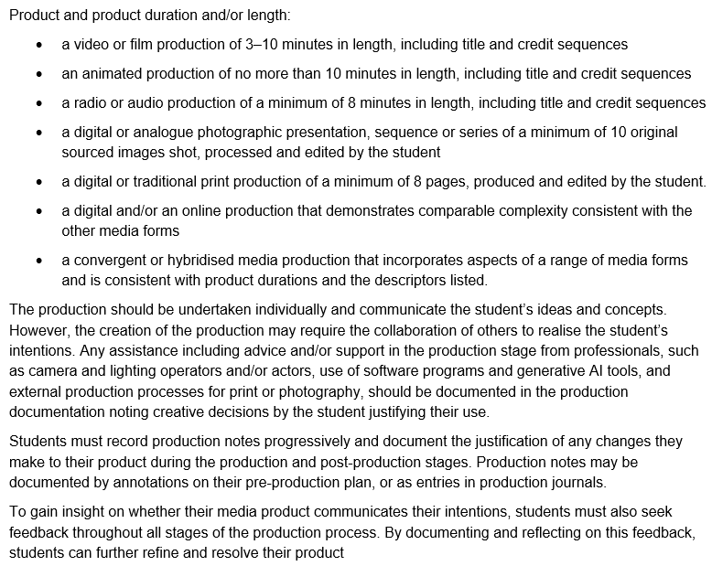
Scope of task
Unit 3 Outcome 3
Unit 4 Outcome 1
Notes:
The scope of the task describes what can be assessed. This is developed alongside the Key Knowledge and Skills of each outcome associated with the SAT in the study design.

Slide 12
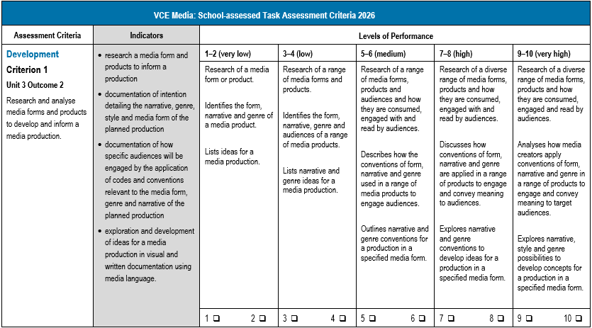
Criterion 1
Updates
Indicators include research to inform a media product, documentation of narrative, genre and style
Documentation of how audiences are engaged
Command terms and taxonomy across descriptors.
Notes:
The updates to criterion, indicators and descriptors are highlighted in blue.
In Criterion 1, the indicators now include research of a media form investigating narrative, genre, style and audience.
The command terms across the descriptor levels have been adjusted to reflect the taxonomy in the VCAA Command Terms.

Slide 13
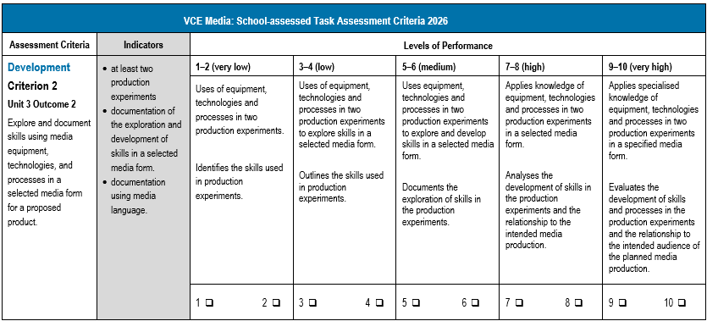
Criterion 2
Updates
Descriptors relate to the exploration of skills in the use of equipment, technologies and processes in two production experiments
Evaluation of the development of skills and the relationship to the audience of the planned production.
Notes:
In criterion 2, the descriptors have been updated to refer to two production experiments.
At the High and Very High students must document the development of skills and processes in production experiments and the audience of the planned production so that the production experiments link specifically to the student’s planned production.

Slide 14
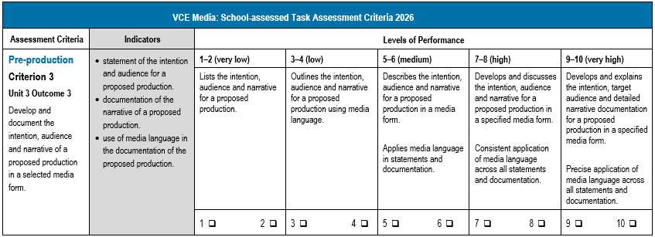
Criterion 3
Updates
Descriptors include references to media language in the documentation
Command terms at High and Very high have been updated.
Notes:
The production design should include the use of media language so therefore references to specific media language have been added at the higher levels.
The command terms also describe the level of achievement in the application of media language.

Slide 15
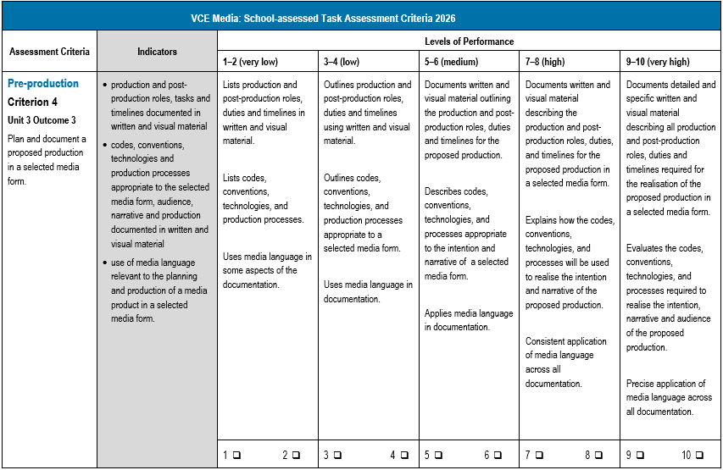
Criterion 4
Updates
Descriptors refer to the following:
Visual and written material
Codes, conventions, technologies and processes
Media language in documentation
Reference specifically to the intention of the proposed production.
Notes:
Details have been added to the descriptors to link to the indicator referring to visual and written material, codes and conventions, technologies, processes. The application of media language is now assessed. All documentation must refer to the intention of the proposed production.

Slide 16
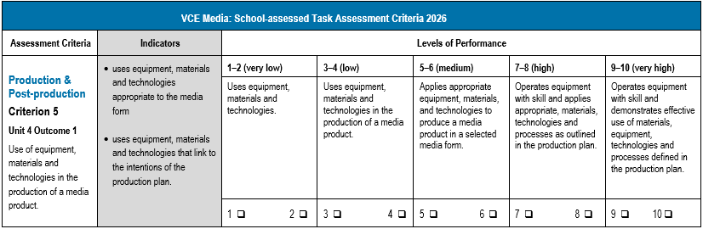
Criterion 5
Updates
Descriptors link to the equipment, materials, technologies and processes described in the production plan.
Notes:
In Criterion 5 the application of materials, equipment, technologies and processes must link to the production plan.

Slide 17
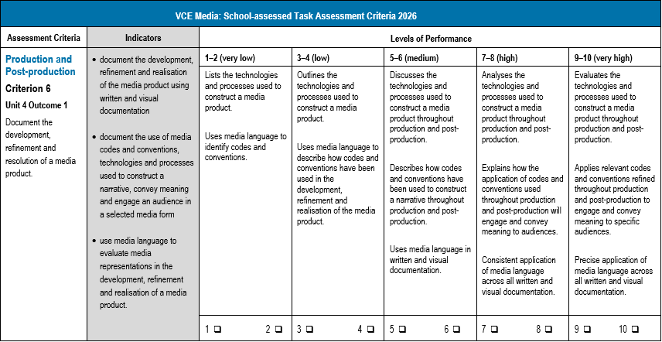
Criterion 6
Updates
Descriptors refer specifically to achievement of the indicators in the documentation of the media product
References to technologies and processes in media production and post-production
Codes and conventions are aligned with audience engagement and the communication of meaning.
Specific references to media languages.
Notes:
In Criterion 6 changes have been made to the visual and written materials, codes, conventions, technologies and processes. Media language must be specific to the production across the production documentation. All documentation must refer to the intention of the proposed production.

Slide 18
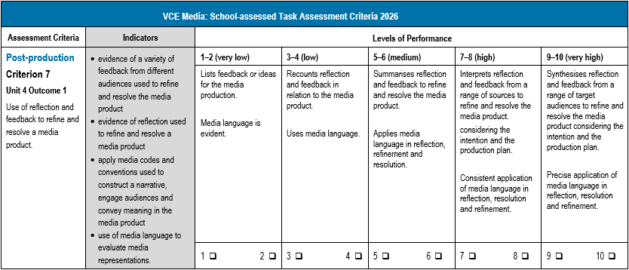
Criterion 7
Updates
Feedback from different audiences is reflected upon and to refine and resolve the media product
The reflection must be documented
Media language is used to reflect upon the resolution and refinement of the media product.
Notes:
There is more of an emphasis on documentation in Criterion 7 where students must document their reflection in relation to the feedback they have received. They must discuss the further refinement and reflection that they have undertaken in response to the feedback to refine and resolve the media product. The application of media language is defined.

Slide 19
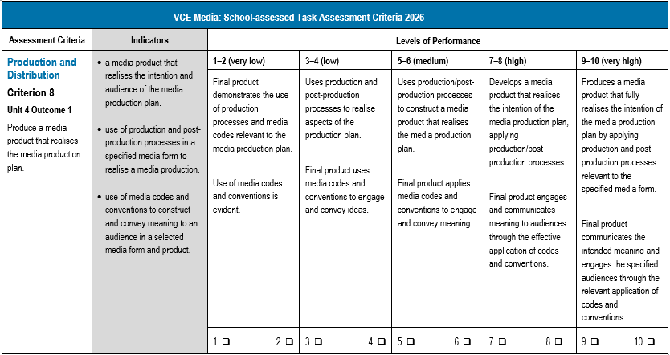
Criterion 8
Updates
The final product is specifically linked to the production plan
The use of media codes and conventions to engage audiences and convey meaning.
Notes:
The descriptors link the product to the intended production and the documentation of the production plan.

Slide 20
Contact us:
vcaa@education.vic.gov.au or +61 3 9032 1629
© Victorian Curriculum and Assessment Authority 2025
The copyright in this PowerPoint presentation is owned by the Victorian Curriculum and Assessment Authority or in the case of some materials, by third parties. No part may be reproduced by any process except in accordance with the provisions of the Copyright Act 1968 or with permission from the Copyright Officer at the Victorian Curriculum and Assessment Authority.
Notes:
Please send any enquires related to the VCAA to the general email and it will be forwarded to the relevant contact person. This ensures your enquiry is promptly replied to by the appropriate person and bookmark our website.
“”Please note, it is encouraged that CM’s direct messages to the VCAA contacts**

