Slide 1

VCE Media
Professional learning
On-Demand video
Background to the School-assessed Task

Slide 2
Acknowledgement
The Victorian Curriculum and Assessment Authority proudly acknowledges and pays respect to Victoria’s Aboriginal and Torres Strait Islander communities and their rich and enduring cultures.
We acknowledge Aboriginal and Torres Strait Islander people as Australia’s first peoples and as the Traditional Owners and custodians of the lands and waters on which we rely. We pay respect to Elders past and present of the lands where we conduct our work and recognise their ongoing contributions as the first educators on the land now known as Victoria.

Slide 3

Purpose
Developing school-based assessment for the School-assessed Task
Information provided to students for the School-assessed Task
Authentication information for the School-assessed task.
Information provided to students to assess the School-assessed Task
Notes:
In this OnDemand video I will be explaining to you the background of the School-assessed Task, where to find key documents, and how to provide information to your students for the task, how to authenticate and how to assess the task.

Slide 4
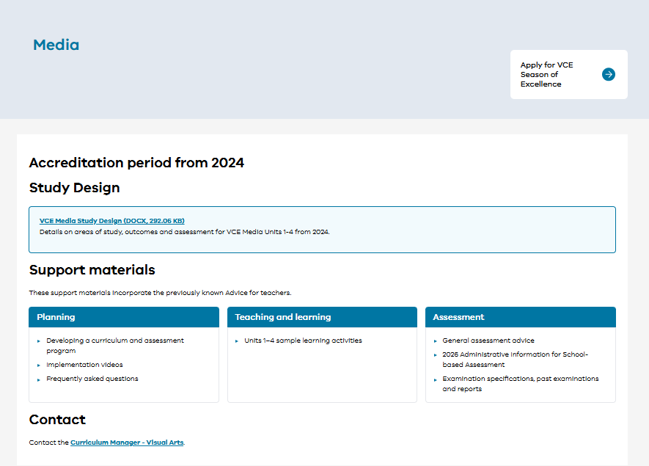
Notes:
Please always refer to the VCAA website. On each study page you will find the key documents. Do not rely on other sources of information or from previous versions of documents.
Please bookmark this page. I have highlighted key areas in red such as the Study Design, developing a program and general assessment advice for the task.

Slide 5

Current VCAA study design
VCE study designs have an accreditation ‘from’ year but no longer have an expiry year
Reviews will still be undertaken – teachers will be advised when a study undergoes review
Newly accredited study designs will be published in the year prior to implementation for the purpose of familiarisation.
Notes:
VCE study designs have an accreditation ‘from’ year but no longer have an expiry year. Reviews will still be undertaken – teachers will be advised when a study undergoes review. Moreover, newly accredited study designs will be published in the year prior to implementation for the purpose of familiarisation.
Reviews will still be undertaken but not according to the strict cycle beforehand.

Slide 6
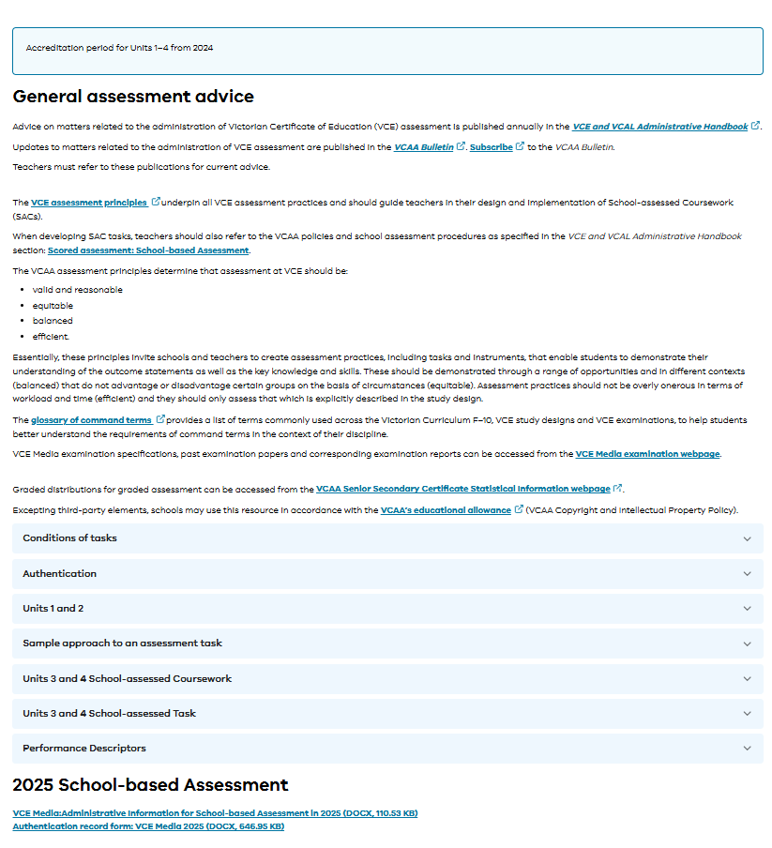
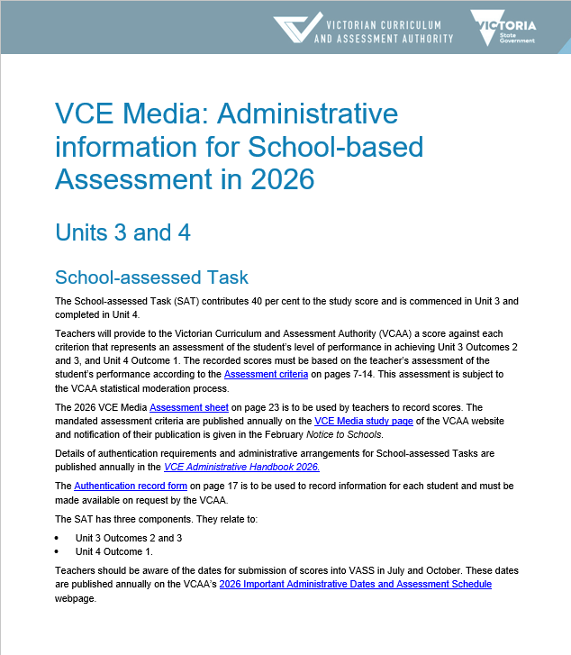
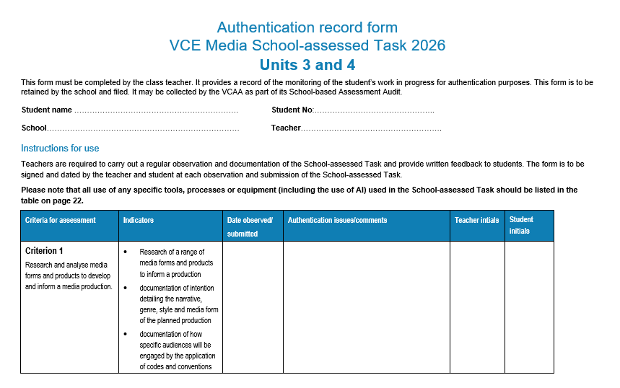
Administrative advice for School-based assessment
Notes:
The Administrative Advice for School-based assessment provides the assessment conditions for the task. The advice contains information about the scope and nature of the task, and authentication information. Alongside the study design and Administration Handbook, it is a key Administration document for all studies with a School-assessed Task. You will find that the information aligns with the information in the Administrative Handbook.

Slide 7
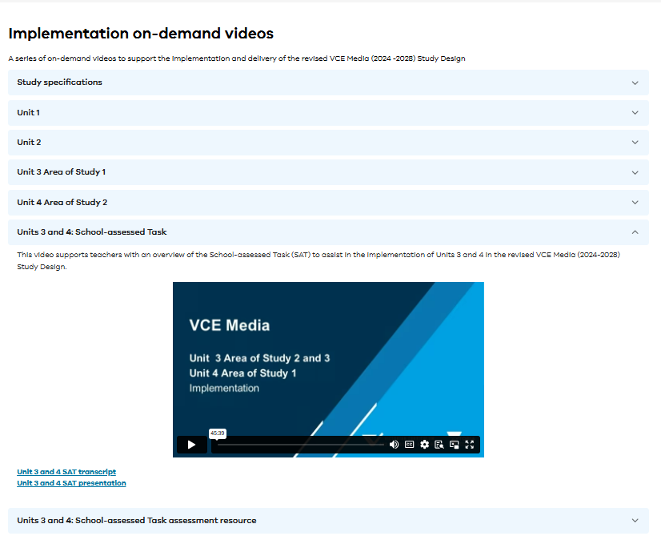
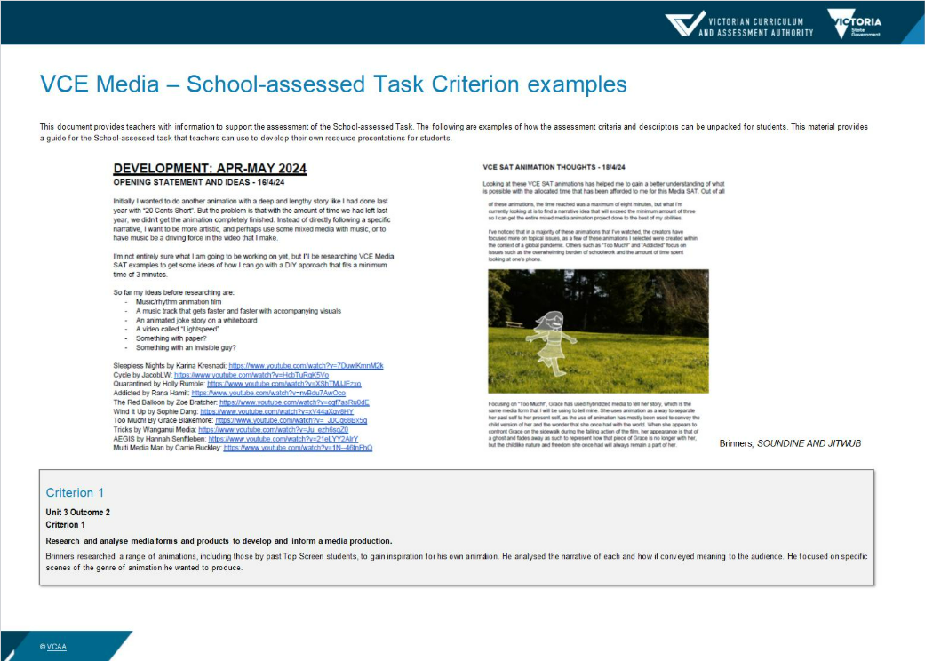
Professional learning and support
Notes:
There are a range of resources that will also help you plan the School-assessed Task, such as this OnDemand video. These are linked to the Planning section under Support materials on the Study Design page. There are a series of on-demand videos that explain each unit of Media as well as the School-assessed Task. On the same page are annotated pages of student work illustrating each Criterion of the SAT. There is a short statement that explains how the student has demonstrated achievement of the criterion indicators.
2025Media_SAT_AssessmentResource.docx
VCE Media - Victorian Curriculum and Assessment Authority

Slide 8
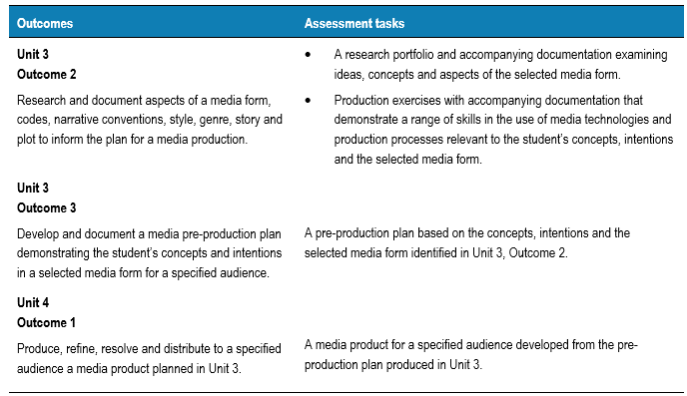
Information provided for School-assessed Tasks
Provide the students with the following:
A summary addressing the three outcomes of the task drawn from the VCE study design.
A timeline of the School-assessed Task with observations and feedback.
Authentication procedures for the School-assessed Task
Detailed examples of key knowledge and skills
Assessment information about the school assessed task.
Notes:
To address the principles of VCE assessment for the School-assessed Task students should be provided with all the necessary information from the Study Design and administrative documents. These documents are written for the teacher and it is up to the teacher to reinterpret them for the students.
On the screen you can see the listed assessment tasks from the VCE Media study design (page 35) that are for the three outcomes associated with the school-assessed task. It is the schools responsibility to provide the following information to support students to achieve the key knowledge and skills of each outcome for the task:
A summary addressing the three outcomes of the task drawn from the VCE study design.
A timeline of the School-assessed Task with observations and feedback.
Authentication procedures for the School-assessed Task
Detailed examples of key knowledge and skills
Assessment information about the school assessed task.

Slide 9
SAT Mandatory information for students
Assessment information
Authentication
Task
information
Notes:
In summary there are three key pieces of information to give students for the SAT to meet the requirements of the VCE Assessment Principles.
Information about the task such as the key knowledge and skills, outcome requirements and what they will be assessed on.
How the students are assessed – such as a breakdown of assessment criteria, indicators and descriptors in language the students understand and including visual examples of what standards look like
Information about how you will authenticate the task – what the students can use, timelines for observation and how feedback on the task will be provided to them.

Slide 10
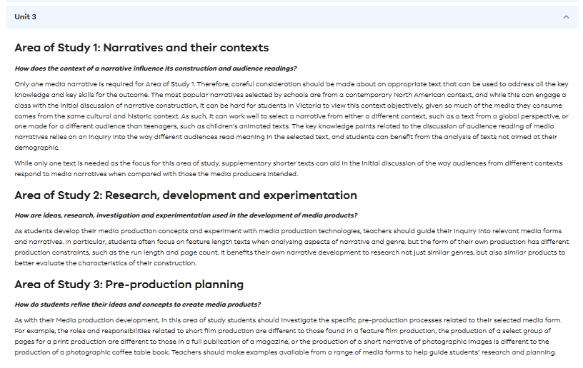
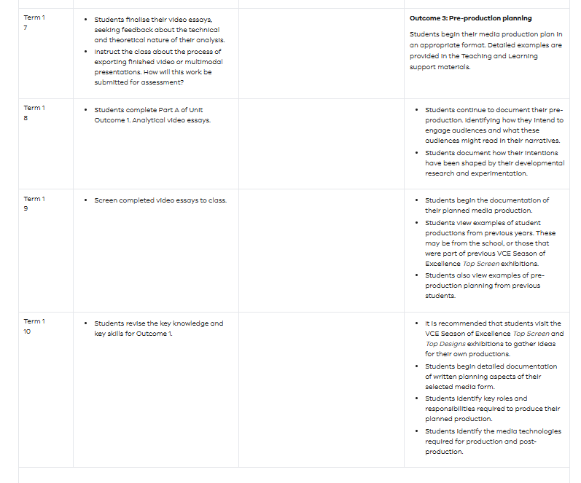
Summary and timeline
Notes:
The following are examples of where you can find an overview and timeline for each outcome of the SAT. These are published in the Planning section in the Support Materials on the Study Design page ‘Timeline of Teaching Units 1-4.’ Planning - Victorian Curriculum and Assessment Authority
These can be used as a guide for your own planning.

Slide 11
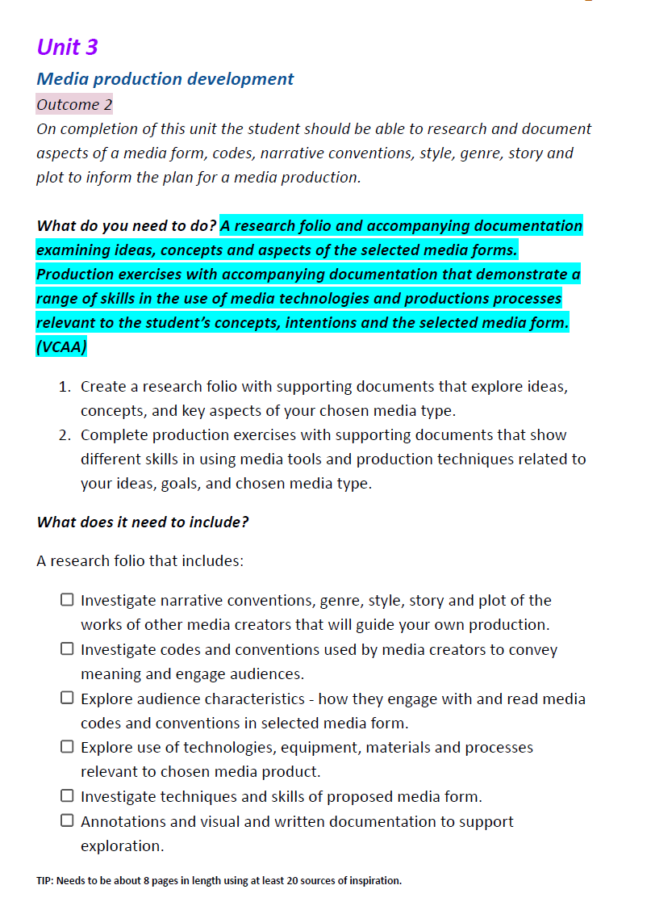
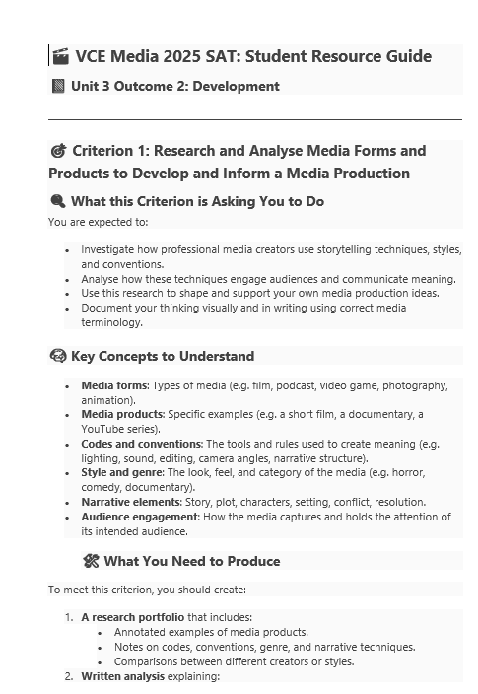
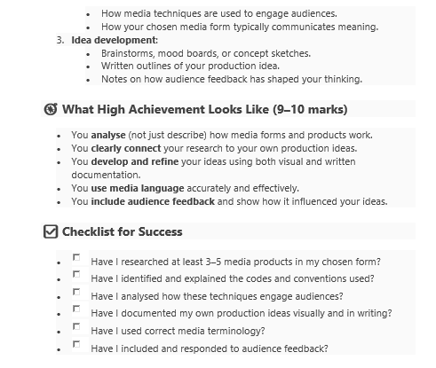
Summary and timeline
Notes:
Here are some examples of an overview key components of the School-assessed Task information for students. The teacher has unpacked the Study Design and Administrative documents and provided a clear breakdown for students.

Slide 12
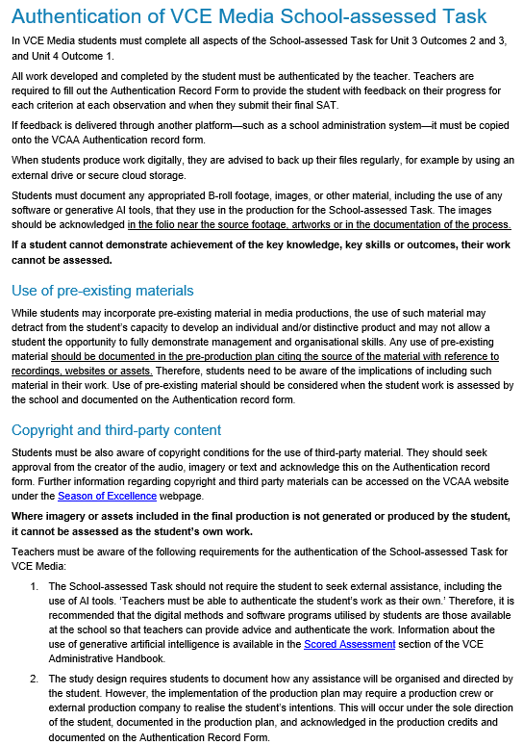
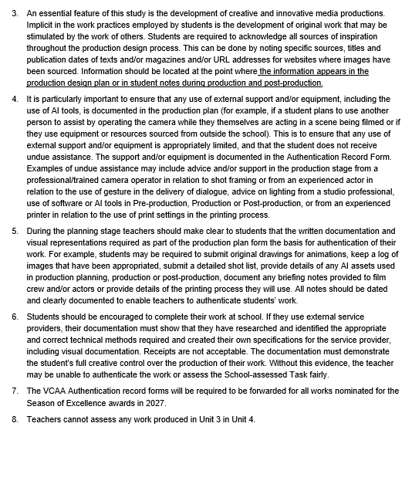
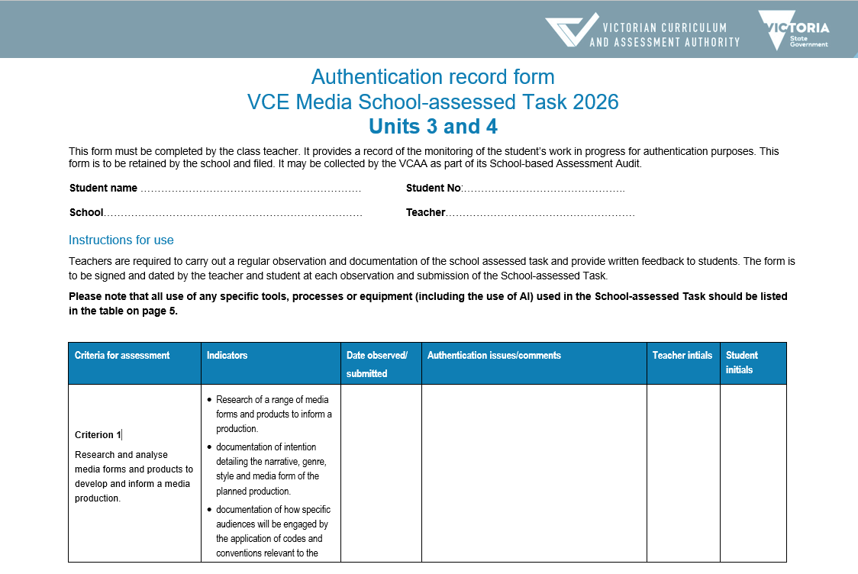
Authentication
Notes:
The school must read the information regarding authentication for the students and then put in place a system for authentication of the task. The teacher must fill out the authentication record form with comments at each authentication point, that the student and teacher must sign. Schools have different methods of working with these forms and providing information to students.
Authentication information is provided in the Administrative Information for School-based Assessment for Media’ which is updated and published annually. This year the information regarding Authentication is on page ??
The Authentication Record Form is also updated each year and published on the VCE Media study design page.

Slide 13
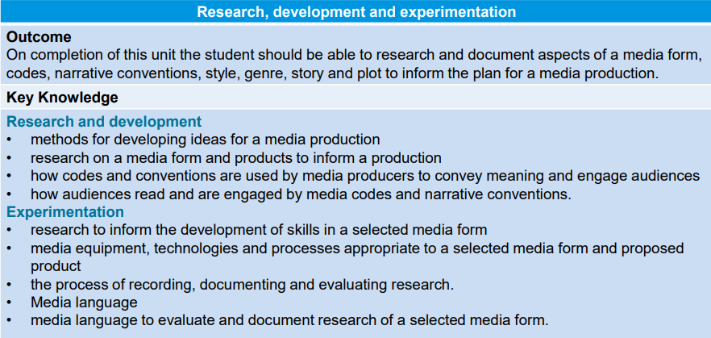
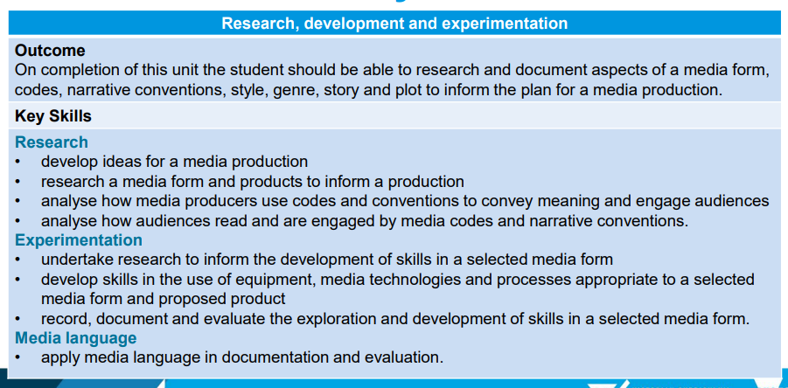
Key Knowledge and skills
Unit 3 Area of Study 2
Notes:
Students need to have an understanding of how they will achieve the key knowledge and skills of the outcomes for the SAT. The study design is written in language for the teacher, and they must unpack the information for their students and provide them with teaching and learning activities that will help them achieve the outcome and the task. You can provide the students with the key knowledge and skills from the study design, but you must unpack the skills and ensure that the students understand the command terms.
Here are the breakdown of the key knowledge and skills for Unit 3 Outcome 2.

Slide 14
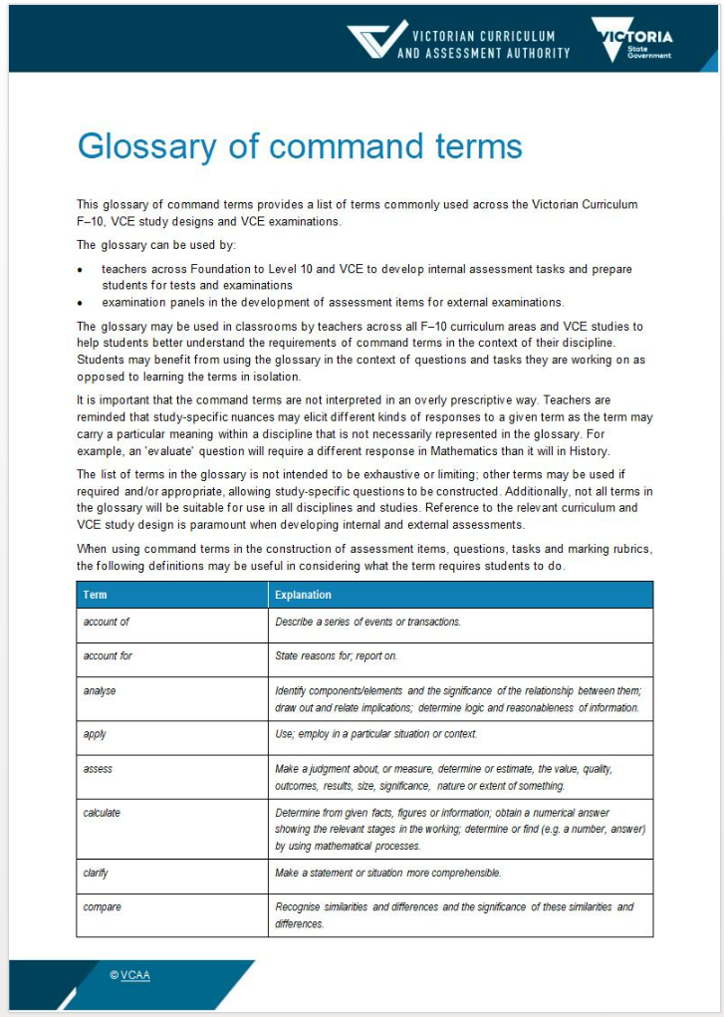
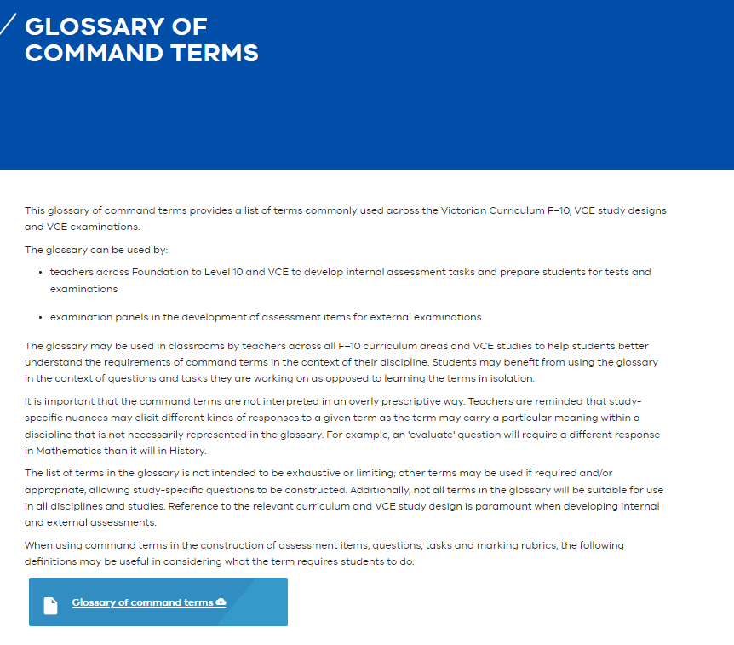
Glossary of command terms
  The same terms are used in SAT criteria and descriptors
Notes:
To assist you there are several documents to use. There is the glossary of command terms that you can use with the students so they understand what type of activity is related to the key knowledge and skills. Each skill, and the descriptors for the SAT criterion use these command terms.

Slide 15
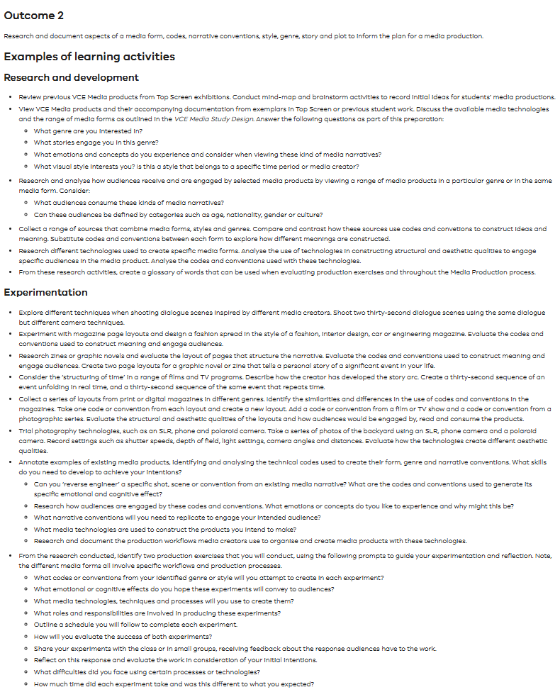
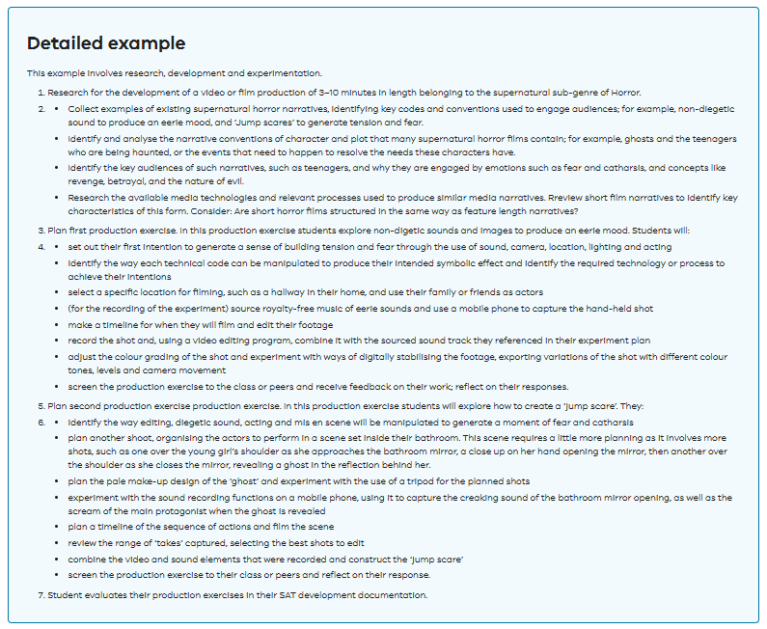
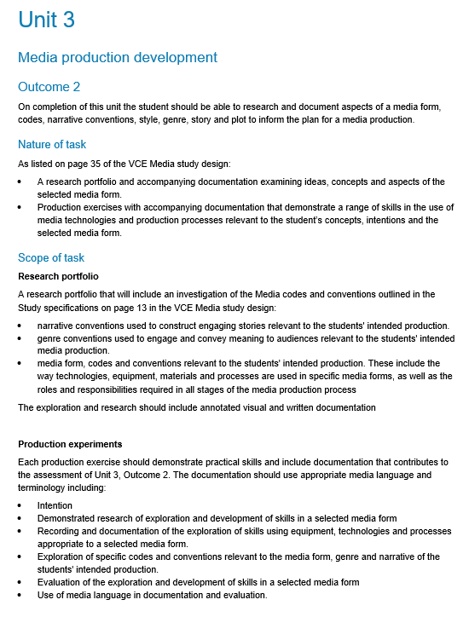
Teaching and Learning
Notes:
Under the support materials; the teaching and learning materials have samples of different activities to use to teach the key knowledge and key skills. In the Administrative advice, the Scope and Nature of the task can also give the students a clear idea of the expectations for the task. For all SAT studies, the Nature of the task is listed in the Study Design. The Scope unpacks the key elements of the task so you can plan your task accordingly and provide students with the steps to complete the task.

Slide 16
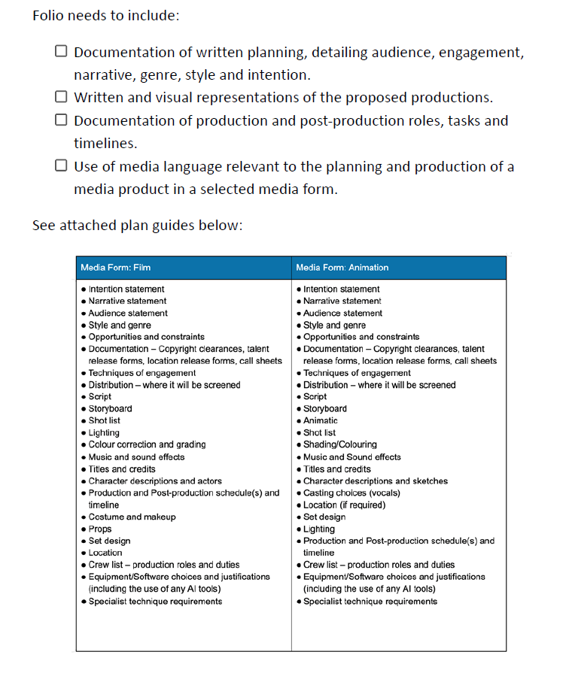
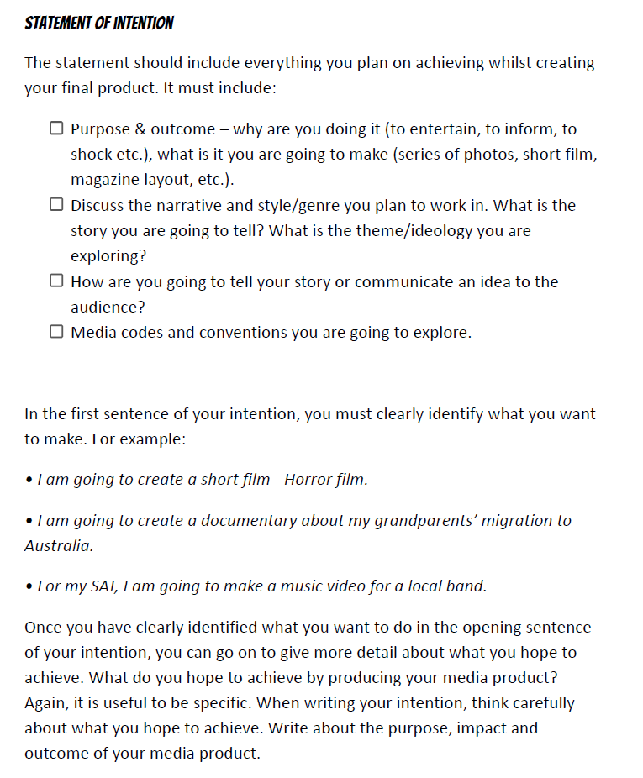
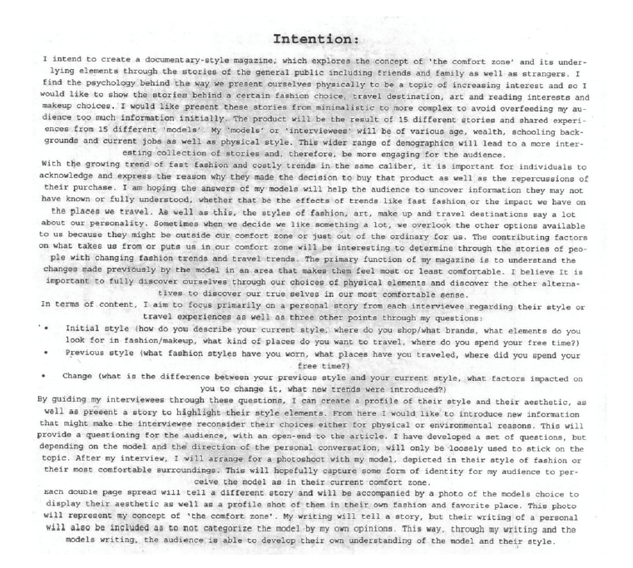
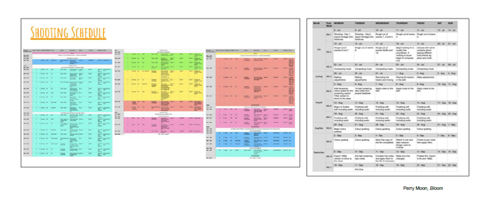
Information provided to students
Notes:
Here is an example of some information with student work samples to illustrate the activities that students can undertake. It is important that you are providing your students with direct instruction in multiple forms so they can refer back to the information over the period of the SAT. Remember it is a task that spans both Units 3 and 4 so it is important they can draw on the information as they work through the outcomes.
This is an example from a teacher of how they provide the information about the key knowledge and skills of the task with visual examples. These documents are for the planning of the media product with examples of a written intention, a shooting schedule and documented timeline.

Slide 17
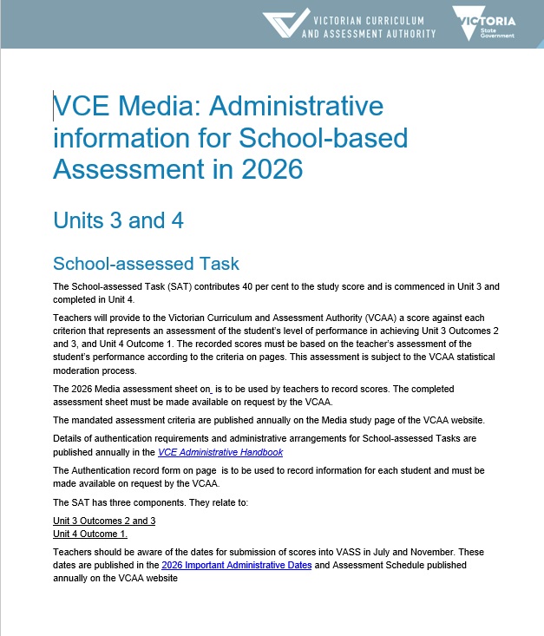
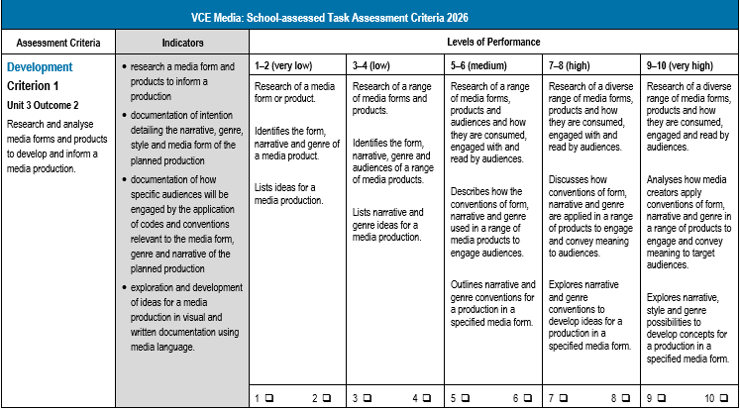
Assessment of the task
Notes:
The VCAA provides the assessment criteria and performance descriptors for the SAT. Unlike School-assessed Coursework, where teachers can develop their own tasks and rubrics, the Scope of the task and the levels of performance are set by the VCAA. When students are given information about the activities in the task, they also must be provided with the information about how it is assessed. Similarly, to the Study Design, the assessment advice is written in language for the teacher, and it must be unpacked for the students.
In Media, there are 8 assessment criteria that are related to the key knowledge and skills for the outcome. The outcome is always listed above the criterion.
The indicators for assessment: the components the teacher is assessing is listed on the left hand side in the grey column.
The teacher then assesses the student work based on the evidence in the indicators.

Slide 18
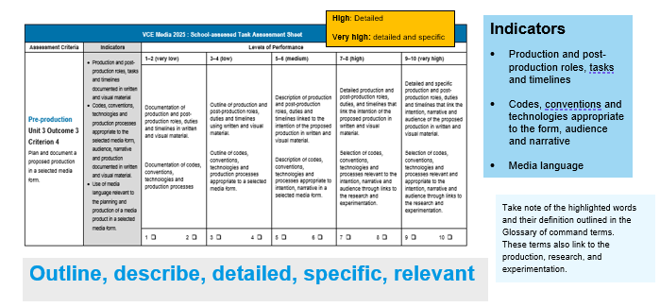
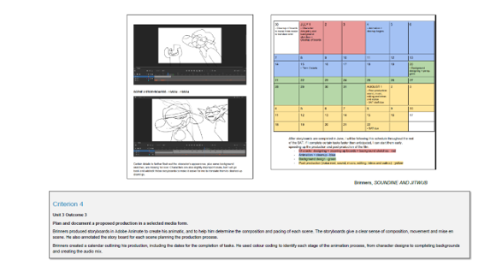
Assessment criteria
Notes:
To ensure that assessment is equitable and valid, teachers need to unpack the criterion, indicators and level of assessment in language the students understand. They might write a description of what the students need to achieve, and provide student work demonstrating a high level of achievement. In this slide, the assessment criteria, descriptors and indicators are summarised, and the students are provided with some examples of achievement from past student folios with annotations. These examples are resources on the Media study design page that are presented with an annotation of student achievement. A resource document can be developed that is housed on a Learning management system to support the students throughout the year. Please note, that as the criterion, indicators and descriptors are updated each year, the material needs to be updated annually.

Slide 19
Contact us:
vcaa@education.vic.gov.au or +61 3 9032 1629
© Victorian Curriculum and Assessment Authority 2025
The copyright in this PowerPoint presentation is owned by the Victorian Curriculum and Assessment Authority or in the case of some materials, by third parties. No part may be reproduced by any process except in accordance with the provisions of the Copyright Act 1968 or with permission from the Copyright Officer at the Victorian Curriculum and Assessment Authority.
Notes:
Please send any enquires related to the VCAA to the general email and it will be forwarded to the relevant contact person. This ensures your enquiry is promptly replied to by the appropriate person and bookmark our website.
“”Please note, it is encouraged that CM’s direct messages to the VCAA contacts**

