Slide 1
VCE Software Development
School-assessed Task
Video 3
SAT Criteria 1–5
Notes:
Hello and welcome to this VCE Software Development on-demand video for the School-assessed Task.
The purpose of this video is to support teachers with understanding Criteria 1 to 5 of the SAT for Software Development.
My name is Phil Feain and I am the Curriculum Manager for Digital Technologies with the VCAA.

Slide 2
Acknowledgement
The Victorian Curriculum and Assessment Authority proudly acknowledges and pays respect to Victoria’s Aboriginal and Torres Strait Islander communities and their rich and enduring cultures.
We acknowledge Aboriginal and Torres Strait Islander people as Australia’s first peoples and as the Traditional Owners and custodians of the lands and waters on which we rely. We pay respect to Elders past and present of the lands where we conduct our work and recognise their ongoing contributions as the first educators on the land now known as Victoria.
Notes:
Before I start, I would like to present the Acknowledgement of Country.
The Victorian Curriculum and Assessment Authority proudly acknowledges and pays respect to Victoria’s Aboriginal and Torres Strait Islander communities and their rich and enduring cultures.
We acknowledge Aboriginal and Torres Strait Islander people as Australia’s first peoples and as the Traditional Owners and custodians of the lands and waters on which we rely.
We pay respect to Elders past and present of the lands where we conduct our work and recognise their ongoing contributions as the first educators on the land now known as Victoria.

Slide 3

Agenda
Nature of task
Scope of the task
Criteria 1–5
Notes:
This presentation will involve the following topics:
The nature of the task
The scope of the task
And Criteria 1 to 5.

Slide 4
Unit 3 Outcome 2
On completion of this unit the student should be able to document a problem, need or opportunity, formulate a project plan, document an analysis, and generate design ideas and a preferred design for creating a software solution.
(Study design, p.56)
Notes:
Before we discuss the nature of the task we need to look at the outcome statement.
The Unit 3 Outcome 2 statement says:
On completion of this unit the student should be able to document a problem, need or opportunity, formulate a project plan, document an analysis, and generate design ideas and a preferred design for creating a software solution.

Slide 5
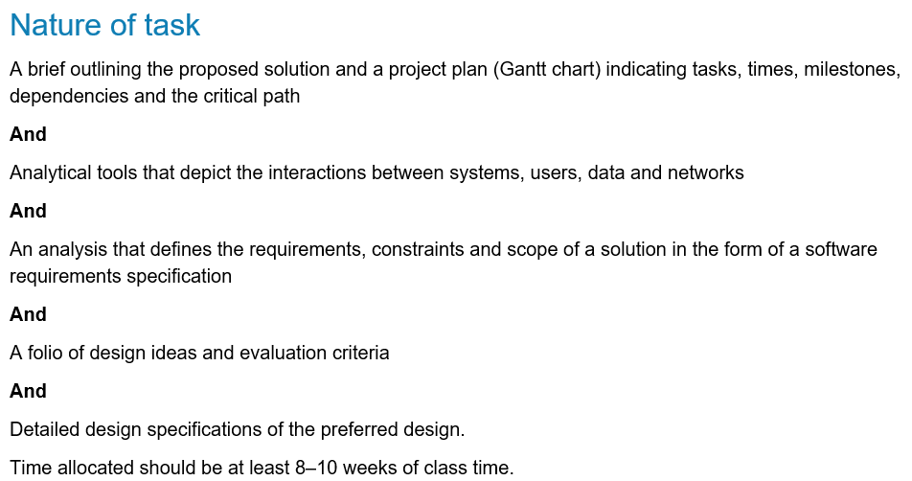
Nature of task
(Administrative information for
School-based Assessment, p.2)
Notes:
The nature of the task for Unit 3 Outcome 2 is stated in the study design and in the Administrative information for School-based Assessment. It involves:
A brief outlining the proposed solution and a project plan (Gantt chart) indicating tasks, times, milestones, dependencies and the critical path
And
Analytical tools that depict the interactions between systems, users, data and networks
And
An analysis that defines the requirements, constraints and scope of a solution in the form of a software requirements specification
And
A folio of design ideas and evaluation criteria
And
Detailed design specifications of the preferred design.
Time allocated should be at least 8–10 weeks of class time.

Slide 6
Development of a brief
In preparation for the SAT students will need to be able to identify a real-world problem, need or opportunity.
Criterion 1 assesses students’ skills in developing a brief and in project management.
Students will need to prepare a brief that documents their problem, need or opportunity.
(Administrative information for
School-based Assessment, p.2)
Notes:
In preparation for the SAT students will need to be able to identify a real-world problem, need or opportunity that can be developed as a software solution for a client or potential users.
Criterion 1 assesses students’ skills in developing a brief and in project management.
Students will need to prepare a brief that documents their problem, need or opportunity.
Teachers should have discussions with their students regarding their problem, need or opportunity and to have a process for approving the brief before students commence their project plan.
and Students are encouraged to document their ideas to convince their teacher that they will be able to develop a software solution.

Slide 7
Development of a project plan
Students will:
prepare a Gantt chart for Unit 3 Outcome 2 and Unit 4 Outcome 1 (both parts of the SAT)
document all the relevant tasks, sequencing, time allocations, milestones, dependencies and critical path.
(Administrative information for
School-based Assessment, p.2-3)
Notes:
Students will:
prepare a Gantt chart using an appropriate software tool that documents all the stages and the activities of the problem-solving methodology for Unit 3 Outcome 2 and Unit 4 Outcome 1 (both parts of the SAT)
need to document all the relevant tasks, sequencing, time allocations, milestones, dependencies and critical path.
The evidence from this task is observed through Observation 1 and assessed through Criterion 1.
and Once the project plan has been developed, it needs to be monitored, modified and annotated during the life of the project (both Unit 3 Outcome 2 and Unit 4 Outcome 1).
It will then be assessed as part of Criterion 10 in Unit 4 Outcome 1.

Slide 8
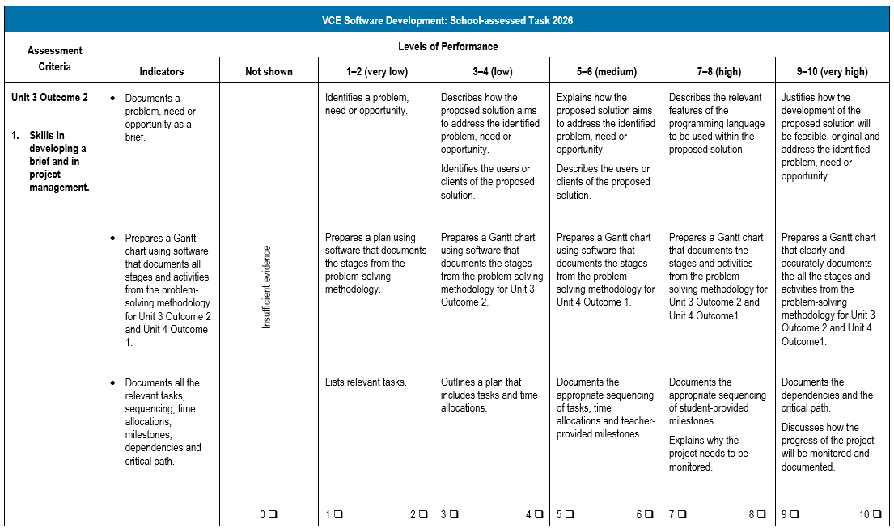
Criterion 1
(Administrative information for
School-based Assessment, p.8)
Notes:
Looking now at the rubric for Criterion 1.
Criterion 1 involves:
Skills in developing a brief and in project management.
This criterion has the following three indicators:
Documents a problem, need or opportunity as a brief.
Prepares a Gantt chart using software that documents all stages and activities from the problem-solving methodology for Unit 3 Outcome 2 and Unit 4 Outcome 1.
and Documents all the relevant tasks, sequencing, time allocations, milestones, dependencies and critical path.
The levels of performance are used to determine a mark out of ten for the criterion.

Slide 9
Documentation of the analysis
Criterion 2 assesses students’ skills in documenting the analysis.
Students collect and prepare data for analysis.
The data collected and the analytical tools will assist in the development of a software requirements specification in Criterion 3.
(Administrative information for
School-based Assessment, p.3)
Notes:
Criterion 2 assesses students’ skills in documenting the analysis.
Students are required to collect and prepare data for analysis using appropriate data collection methods.
The data collected will enable students to document the relevant features of the selected analytical tools and depict the relationships between the data, users and systems.
and The process of data collection may involve students communicating back-and-forth with their clients or potential users.
The data collected and the analytical tools will assist in the development of a software requirements specification in Criterion 3.
and The evidence from this task is observed through Observation 2 and assessed as part of Criterion 2.

Slide 10
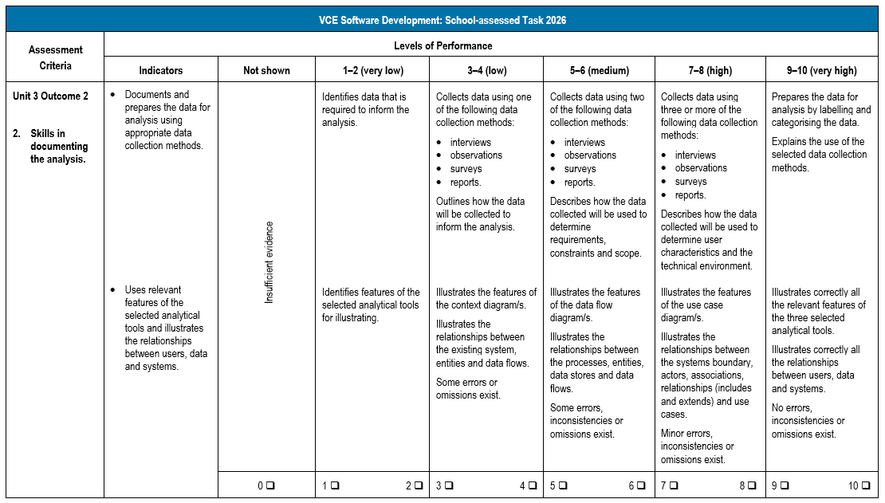
Criterion 2
(Administrative information for
School-based Assessment, p.9)
Notes:
Looking now at the rubric for Criterion 2.
Criterion 2 involves:
Skills in documenting the analysis.
This criterion has the following two indicators:
Documents and prepares the data for analysis using appropriate data collection methods.
and Uses relevant features of the selected analytical tools and illustrates the relationships between users, data and systems.
The levels of performance are used to determine a mark out of ten for the criterion.

Slide 11
Development of a software requirements specification
Criterion 3 assesses students’ skills in documenting a software requirements specification.
Students document the functional and non-functional requirements, constraints and scope as well as the user characteristics and the technical environment for the proposed software solution.
(Administrative information for
School-based Assessment, p.3)
Notes:
Criterion 3 assesses students’ skills in documenting a software requirements specification.
Students will document the functional and non-functional requirements, constraints and scope as well as the user characteristics and the technical environment for the proposed software solution.
The software requirements specification is to be presented as a formal document.
and the Analytical tools developed in Criterion 2 are to be included in the appendix of the software requirements specification.
Students will document evidence of their critical and creative thinking using questions and follow-up questions to clarify the development of the solution requirements.
and The evidence from this task is observed through Observation 3 and assessed through Criterion 3.

Slide 12
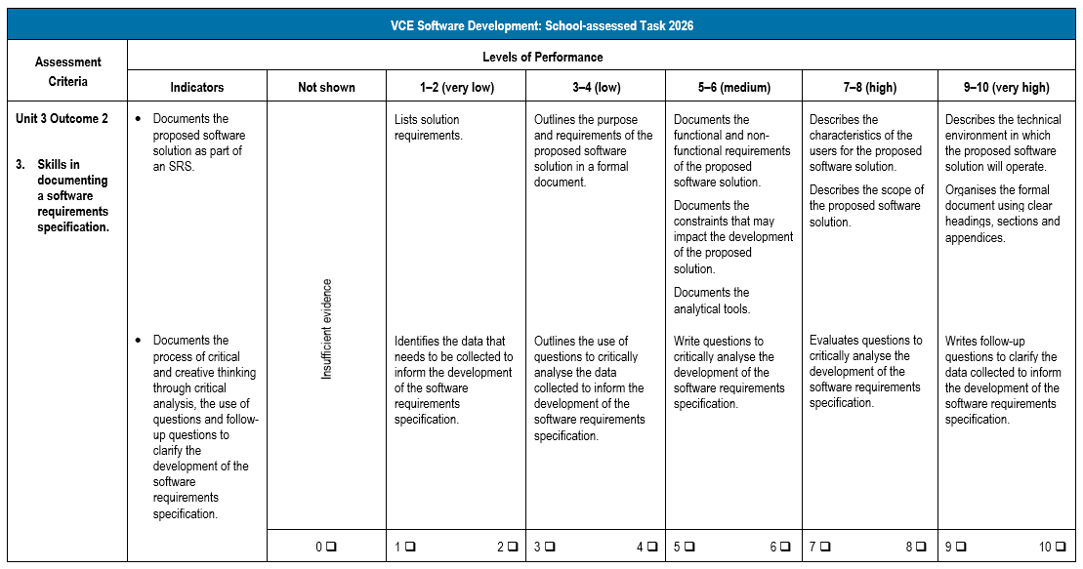
Criterion 3
(Administrative information for
School-based Assessment, p.10)
Notes:
Looking now at the rubric for Criterion 3.
Criterion 3 involves:
Skills in documenting a software requirements specification.
This criterion has the following two indicators:
Documents the proposed software solution as part of an SRS.
and Documents the process of critical and creative thinking through critical analysis, the use of questions and follow-up questions to clarify the development of the software requirements specification.
The levels of performance are used to determine a mark out of ten for the criterion.

Slide 13
Generating design ideas and developing evaluation criteria
Criterion 4 assesses students’ skills in generating design ideas and developing evaluation criteria.
Students generate design ideas for the software solution.
They develop evaluation criteria for their design ideas and the software solution.
(Administrative information for
School-based Assessment, p.3)
Notes:
Criterion 4 assesses students’ skills in generating design ideas and developing evaluation criteria.
Students will generate design ideas for the software solution using a range of ideation tools.
and Design ideas are to be annotated to explain the appearance and functionality of the software solution.
They will develop evaluation criteria for their design ideas and the software solution. Evaluation criteria will reference the functional and non-functional requirements for the design ideas and be used to measure the efficiency and the effectiveness of the software solution in Criterion 10.
and Students will need to justify which of the elements of the design ideas should be further developed into detailed designs.
The evidence from this task is observed through Observation 4 and assessed through Criterion 4.

Slide 14
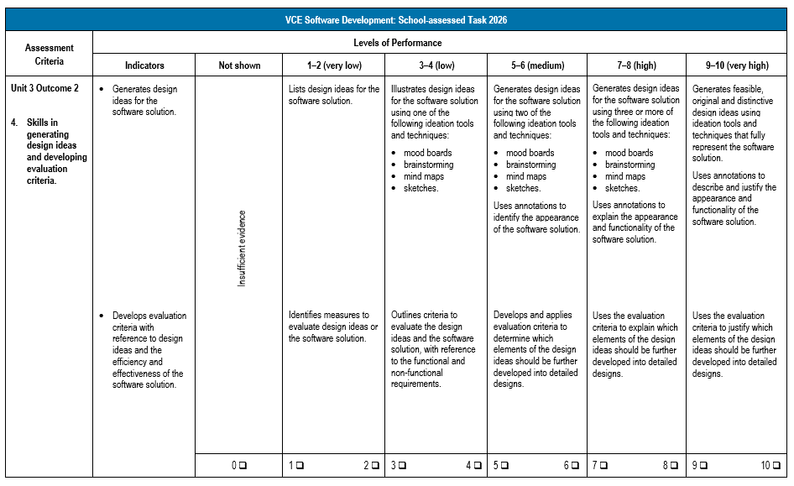
Criterion 4
(Administrative information for
School-based Assessment, p.11)
Notes:
Looking now at the rubric for Criterion 4.
Criterion 4 involves:
Skills in generating design ideas and developing evaluation criteria.
This criterion has the following two indicators:
Generates design ideas for the software solution.
and Develops evaluation criteria with reference to design ideas and the efficiency and effectiveness of the software solution.
The levels of performance are used to determine a mark out of ten for the criterion.

Slide 15
Producing detailed designs
Criterion 5 assesses students’ skills in producing detailed designs.
Students will:
produce their detailed designs
document the use of design principles.
(Administrative information for
School-based Assessment, p.3-4)
Notes:
Criterion 5 assesses students’ skills in producing detailed designs.
Students will:
produce their detailed designs for the software solution using a range of design tools
document the use of design principles that influence the appearance and functionality of the detailed designs as well as the characteristics of user experience that affect the detailed designs.
Students will document evidence of their critical and creative thinking through the development of design ideas, solution requirements and the detailed designs
The evidence from this task is observed through Observation 5 and assessed through Criterion 5.

Slide 16
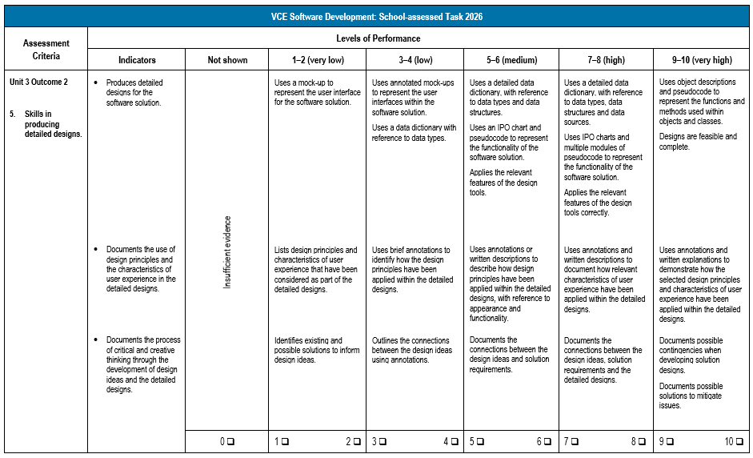
Criterion 5
(Administrative information for
School-based Assessment, p.12)
Notes:
Looking now at the rubric for Criterion 5.
Criterion 5 involves:
Skills in producing detailed designs.
This criterion has the following three indicators:
Produces detailed designs for the software solution.
Documents the use of design principles and the characteristics of user experience in the detailed designs.
and Documents the process of critical and creative thinking through the development of design ideas and the detailed designs.
The levels of performance are used to determine a mark out of ten for the criterion.

Slide 17
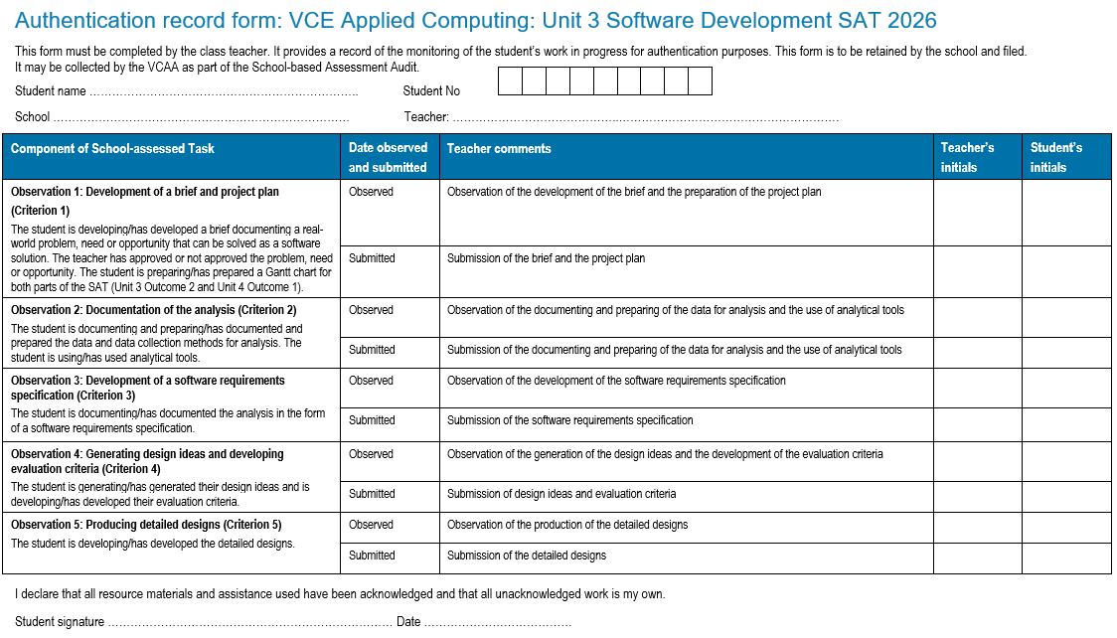
Authentication
(Administrative information for
School-based Assessment, p.19)
Notes:
Teachers should monitor students’ progress on a regular basis and use the Authentication record form to record this information.
The authentication process and feedback are clearly identified on this form so that teachers can provide feedback at various stages of the process.
It is recommended that students back up files with copies of work in progress using, for example, an external drive, network drive or secure cloud storage.

Slide 18
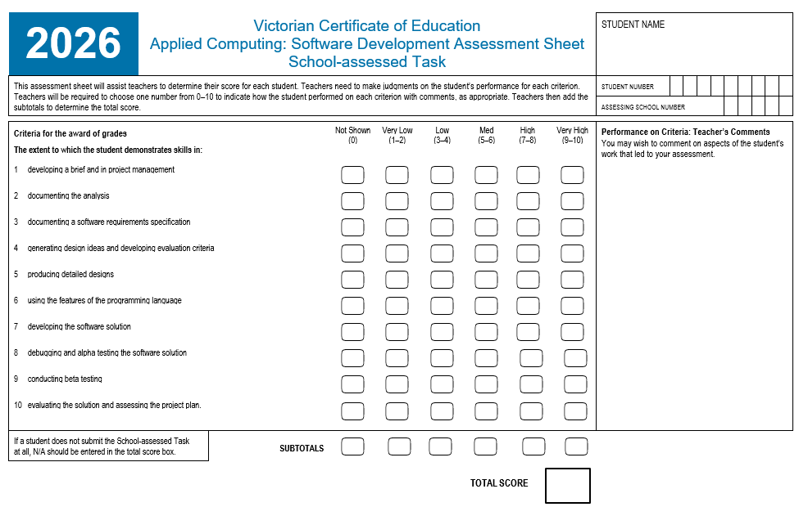
Assessment
(Administrative information for
School-based Assessment, p.21)
Notes:
This is the Assessment Sheet for scores to be added and submitted for Criterion 1 through to Criterion 5 in VASS for Unit 3 Outcome 2.
A score of 0 to 10 is to be provided for each of the criterion.
NA can also be awarded when an individual criterion is not observed or submitted.
You also need to be aware of Ns and Ss for Unit 3 Outcome 2.
If a student receives an N for Unit 3 Outcome 2 you need to follow the redemption process for them to work towards an S before commencing Unit 4 Outcome 1.

Slide 19
Issues identified after marking Unit 3 Outcome 2
At the completion of Unit 3 Outcome 2 students may experience issues.
These may have a negative effect on the development of their database, spreadsheet and infographics and/or dynamic data visualisations solutions in Unit 4 Outcome 1.
(Administrative information for
School-based Assessment, p.4)
Notes:
At the completion of Unit 3 Outcome 2 students may experience issues that will have a negative effect on the development of their software solution in Unit 4 Outcome 1.
Teachers can provide feedback on the quality of the designs, however, the adjustments must be initiated by the student and not directed by the teacher.
While students can make changes to their designs they will not be reassessed and their original score will stand.

Slide 20
Contact us:
vcaa@education.vic.gov.au or +61 3 9032 1629
© Victorian Curriculum and Assessment Authority 2025
The copyright in this PowerPoint presentation is owned by the Victorian Curriculum and Assessment Authority or in the case of some materials, by third parties. No part may be reproduced by any process except in accordance with the provisions of the Copyright Act 1968 or with permission from the Copyright Officer at the Victorian Curriculum and Assessment Authority.
Notes:
Please send any enquires related to the VCAA to the general email and it will be forwarded to the relevant contact person. This ensures your enquiry is promptly replied to by the appropriate person and bookmark our website.
“”Please note, it is encouraged that CM’s direct messages to the VCAA contacts**

