Slide 1
VCE Software Development
School-assessed Task
Video 4
SAT Criteria 6–10
Notes:
Hello and welcome to this VCE Software Development on-demand video for the School-assessed Task.
The purpose of this video is to support teachers with understanding Criteria 6 to 10 of the SAT for Software Development.
My name is Phil Feain and I am the Curriculum Manager for Digital Technologies with the VCAA.

Slide 2
Acknowledgement
The Victorian Curriculum and Assessment Authority proudly acknowledges and pays respect to Victoria’s Aboriginal and Torres Strait Islander communities and their rich and enduring cultures.
We acknowledge Aboriginal and Torres Strait Islander people as Australia’s first peoples and as the Traditional Owners and custodians of the lands and waters on which we rely. We pay respect to Elders past and present of the lands where we conduct our work and recognise their ongoing contributions as the first educators on the land now known as Victoria.
Notes:
Before I start, I would like to present the Acknowledgement of Country.
The Victorian Curriculum and Assessment Authority proudly acknowledges and pays respect to Victoria’s Aboriginal and Torres Strait Islander communities and their rich and enduring cultures.
We acknowledge Aboriginal and Torres Strait Islander people as Australia’s first peoples and as the Traditional Owners and custodians of the lands and waters on which we rely.
We pay respect to Elders past and present of the lands where we conduct our work and recognise their ongoing contributions as the first educators on the land now known as Victoria.

Slide 3

Agenda
Nature of task
Scope of the task
Criteria 6–10
Notes:
This presentation will involve the following topics:
The nature of the task
The scope of the task
And Criteria 6 to 10.

Slide 4
Unit 4 Outcome 1
On completion of this unit the student should be able to develop and evaluate a software solution that meets requirements and assess the effectiveness of the project plan.
(Study design, p.62)
Notes:
Before we discuss the nature of the task we need to look at the outcome statement.
The Unit 4 Outcome 1 statement says:
On completion of this unit the student should be able to develop and evaluate a software solution that meets requirements and assess the effectiveness of the project plan.

Slide 5
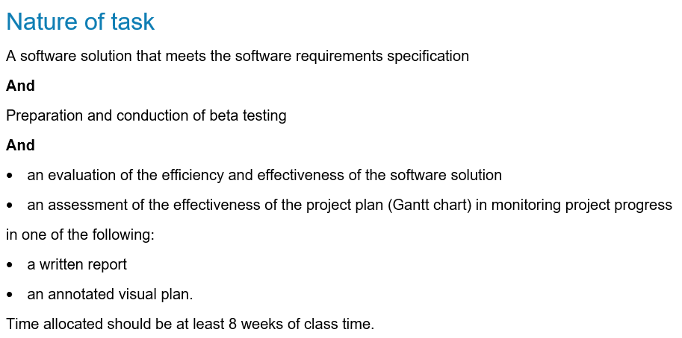
Nature of task
(Administrative information for
School-based Assessment, p.5)
Notes:
The nature of the task for Unit 4 Outcome 1 is stated in the study design and in the Administrative information for School-based Assessment. It involves:
A software solution that meets the software requirements specification
And
Preparation and conduction of beta testing
And
an evaluation of the efficiency and effectiveness of the software solution
an assessment of the effectiveness of the project plan (Gantt chart) in monitoring project progress
in one of the following:
a written report
or an annotated visual plan.
Time allocated should be at least 8 weeks of class time.

Slide 6
Development of the software solution
Criterion 6 assesses students’ skills in using the features of the programming language to develop the software solution.
(Administrative information for
School-based Assessment, p.5)
Notes:
Criterion 6 assesses students’ skills in using the features of the programming language to develop the software solution.
In order to develop the software solution students are required to use an appropriate programming language that meets the prescribed list of software tools and functions, and outcome specific requirements of the study.
Students will also use a range of appropriate data types, data structures and data sources.
and The evidence from this task is observed through Observation 6 and assessed through Criterion 6.

Slide 7
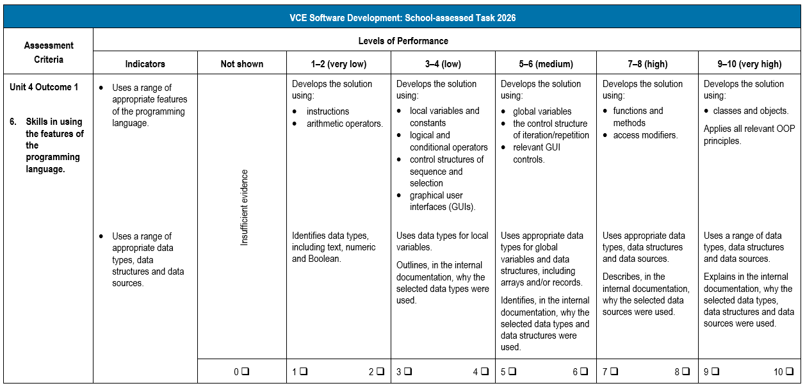
Criterion 6
(Administrative information for
School-based Assessment, p.13)
Notes:
Looking now at the rubric for Criterion 6.
Criterion 6 involves:
Skills in using the features of the programming language.
This criterion has the following two indicators:
Uses a range of appropriate features of the programming language.
and Uses a range of appropriate data types, data structures and data sources.
The levels of performance are used to determine a mark out of ten for the criterion.

Slide 8
Development of the software solution
Criterion 7 assesses students’ skills in developing the software solution.
Students naming conventions, write internal documentation and apply validation techniques.
(Administrative information for
School-based Assessment, p.5)
Notes:
Criterion 7 assesses students’ skills in developing the software solution.
Students will apply suitable naming conventions, write internal documentation and apply appropriate validation techniques.
and The evidence from this task is observed through Observation 7 and assessed through Criterion 7.

Slide 9
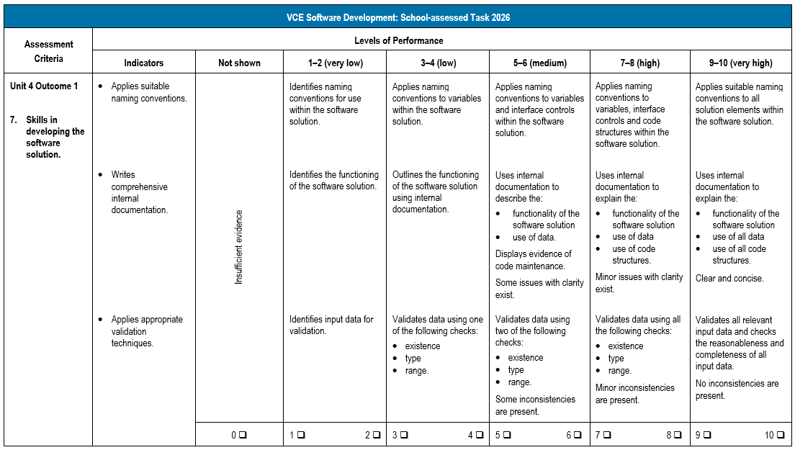
Criterion 7
(Administrative information for
School-based Assessment, p.14)
Notes:
Looking now at the rubric for Criterion 7.
Criterion 7 involves:
Skills in developing the software solution.
This criterion has the following three indicators:
Applies suitable naming conventions.
Writes comprehensive internal documentation.
and Applies appropriate validation techniques.
The levels of performance are used to determine a mark out of ten for the criterion.

Slide 10
Debugging and alpha testing of the software solution
Criterion 8 assesses students’ skills in debugging and alpha testing the software solution.
Students document the debugging and testing techniques.
(Administrative information for
School-based Assessment, p.5-6)
Notes:
Criterion 8 assesses students’ skills in debugging and alpha testing the software solution.
Students will document the use of debugging and testing techniques to ensure their software solution functions as expected.
Students will document evidence of their critical and creative thinking through the modification of designs, evaluation criteria and the development of the software solution as part of the Development stage in Criterion 8.
and The evidence from this task is observed through Observation 8 and assessed through Criterion 8.

Slide 11
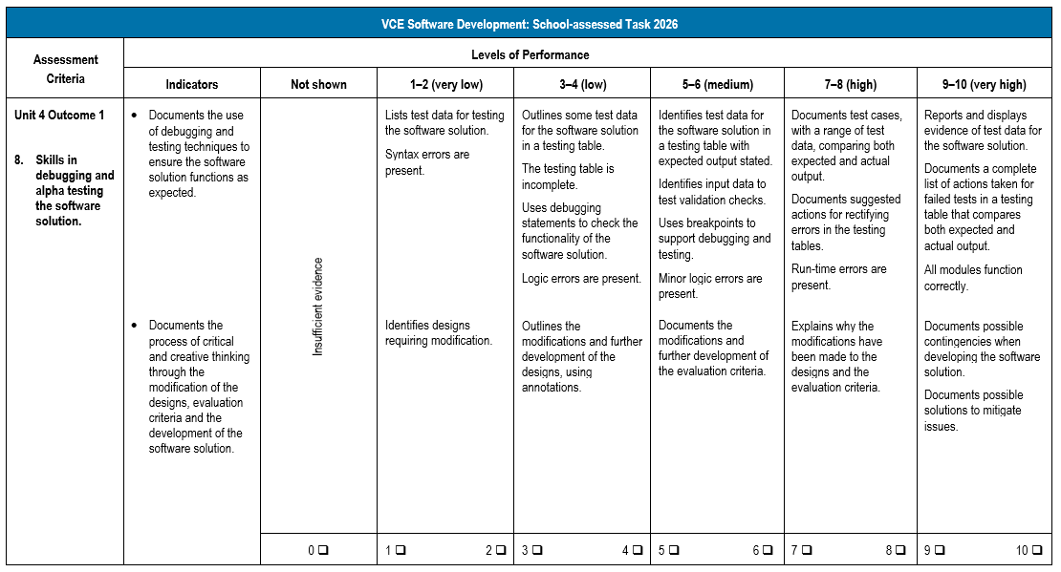
Criterion 8
(Administrative information for
School-based Assessment, p.15)
Notes:
Looking now at the rubric for Criterion 8.
Criterion 8 involves:
Skills in debugging and alpha testing the software solution.
This criterion has the following two indicators:
Documents the use of debugging and testing techniques to ensure the software solution functions as expected.
and Documents the process of critical and creative thinking through the modification of the designs, evaluation criteria and the development of the software solution.
The levels of performance are used to determine a mark out of ten for the criterion.

Slide 12
Beta testing
Criterion 9 assesses students’ skills in conducting beta testing.
Students will:
document the preparation of a beta testing plan and test scenarios
conduct the beta testing
document the results
use the results to make recommendations for modifications or make actual modifications.
(Administrative information for
School-based Assessment, p.6)
Notes:
Criterion 9 assesses students’ skills in conducting beta testing.
Students will document the preparation of a beta testing plan and test scenarios and then conduct the beta testing.
After performing the beta testing with their clients or potential users, students will document the results.
and Students will use the results of the beta testing to make recommendations for modifications to the software solution.
Students could choose to make modifications to the software solution or to document the actual modifications they would make to the software solution in a written report.
and The evidence from this task is observed through Observation 9 and assessed through Criterion 9.

Slide 13
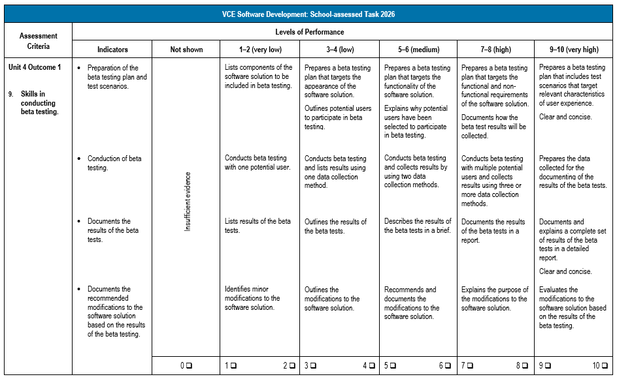
Criterion 9
(Administrative information for
School-based Assessment, p.16)
Notes:
Looking now at the rubric for Criterion 9.
Criterion 9 involves:
Skills in conducting beta testing.
This criterion has the following four indicators:
Preparation of the beta testing plan and test scenarios.
Conduction of beta testing.
Documents the results of the beta tests.
and Documents the recommended modifications to the software solution based on the results of the beta testing.
The levels of performance are used to determine a mark out of ten for the criterion.

Slide 14
Evaluation of the software solution and assessment of the project plan
Criterion 10 assesses students’ skills in evaluating the software solution and assessing the project plan.
Students:
document the evaluation of the efficiency and effectiveness of the software solution
propose an evaluation strategy.
(Administrative information for
School-based Assessment, p.6)
Notes:
Criterion 10 assesses students’ skills in evaluating the software solution and assessing the project plan.
Students will document the evaluation of the efficiency and effectiveness of the software solution using the evaluation criteria developed in Criterion 4.
This includes the extent to which it meets the functional and non-functional requirements.
and Students will then propose an evaluation strategy to be conducted in the future.
Students will also need to document evidence of their critical and creative thinking through the evaluation of the process they followed through the analysis, design and development stages and discuss improvements that could be made to the software solution as part of the Evaluation stage in Criterion 10.
Students will document the modifications made to the initial project plan throughout the duration of the project and then assess the effectiveness of the project plan.
and The evidence from this task is observed through Observation 10 and assessed through Criterion 10.

Slide 15
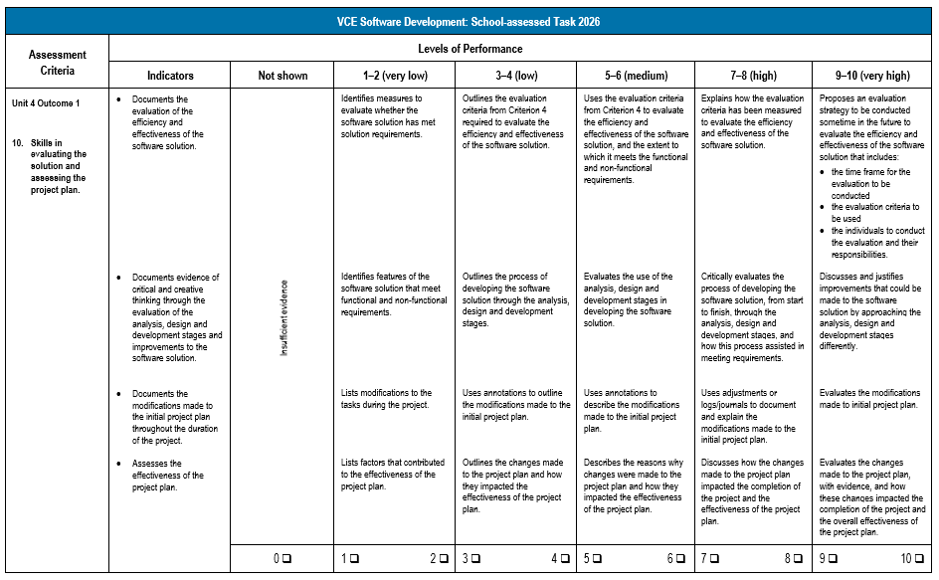
Criterion 10
(Administrative information for
School-based Assessment, p.17)
Notes:
Looking now at the rubric for Criterion 10.
Criterion 10 involves:
Skills in evaluating the solution and assessing the project plan.
This criterion has the following four indicators:
Documents the evaluation of the efficiency and effectiveness of the software solution.
Documents evidence of critical and creative thinking through the evaluation of the analysis, design and development stages and improvements to the software solution.
Documents the modifications made to the initial project plan throughout the duration of the project.
and Assesses the effectiveness of the project plan.
The levels of performance are used to determine a mark out of ten for the criterion.

Slide 16
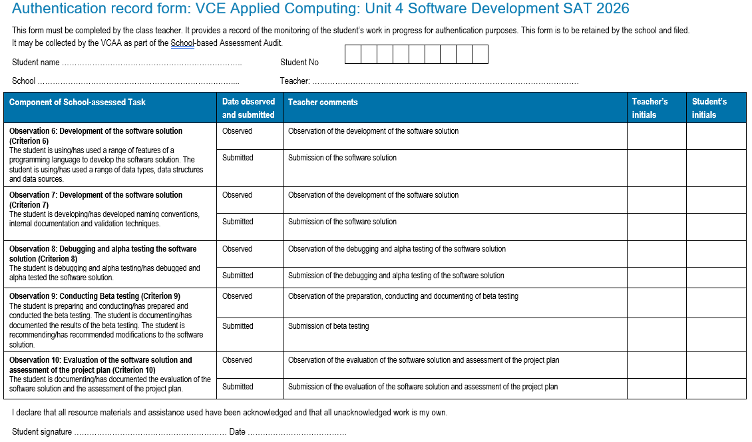
Authentication
(Administrative information for
School-based Assessment, p.20)
Notes:
Teachers should monitor students’ progress on a regular basis and use the Authentication record form to record this information.
The authentication process and feedback are clearly identified on this form so that teachers can provide feedback at various stages of the process.
and It is recommended that students back up files with copies of work in progress using, for example, an external drive, network drive or secure cloud storage.

Slide 17
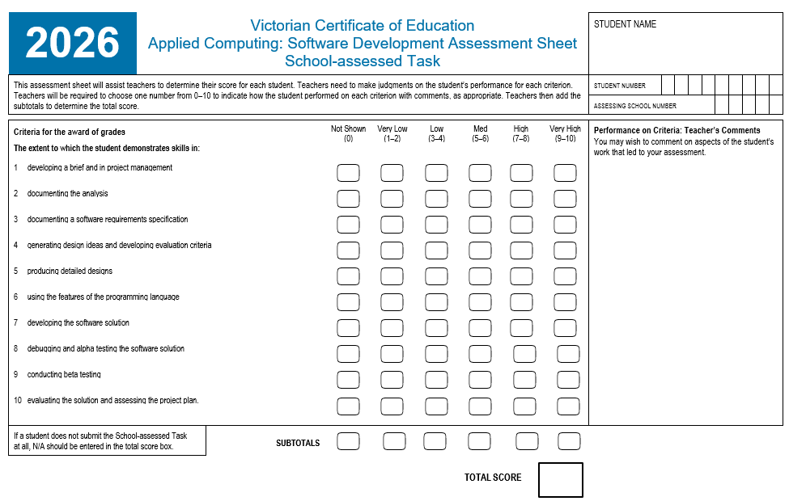
Assessment
(Administrative information for
School-based Assessment, p.21)
Notes:
This is the Assessment Sheet for scores to be added and submitted for Criterion 6 through to Criterion 10 in VASS for Unit 4 Outcome 1.
A score of 0 to 10 is to be provided for each of the criterion.
NA can also be awarded when an individual criterion is not observed or submitted.
You also need to be aware of Ns and Ss for Unit 4 Outcome 1.
If a student receives an N for Unit 4 Outcome 1 you need to follow the redemption process for them to work towards an S as soon as you can after the outcome.

Slide 18
Contact us:
vcaa@education.vic.gov.au or +61 3 9032 1629
© Victorian Curriculum and Assessment Authority 2025
The copyright in this PowerPoint presentation is owned by the Victorian Curriculum and Assessment Authority or in the case of some materials, by third parties. No part may be reproduced by any process except in accordance with the provisions of the Copyright Act 1968 or with permission from the Copyright Officer at the Victorian Curriculum and Assessment Authority.
Notes:
Please send any enquires related to the VCAA to the general email and it will be forwarded to the relevant contact person. This ensures your enquiry is promptly replied to by the appropriate person and bookmark our website.
“”Please note, it is encouraged that CM’s direct messages to the VCAA contacts**

Slide 20
Post-event survey QR code

