Slide 1
VCE Leaders Briefings
Joanne Watkins
Manager, VCE Curriculum Unit
February 2026

Slide 2
Acknowledgement
The Victorian Curriculum and Assessment Authority proudly acknowledges and pays respect to Victoria’s Aboriginal and Torres Strait Islander communities and their rich and enduring cultures.
We acknowledge Aboriginal and Torres Strait Islander people as Australia’s first peoples and as the Traditional Owners and custodians of the lands and waters on which we rely. We pay respect to Elders past and present of the lands where we conduct our work and recognise their ongoing contributions as the first educators on the land now known as Victoria.

Slide 3

Key points to be covered
Updates to the Victorian Certificate of Education:
  Revisions to the VCAA audit program in 2026
  Changes to the VCE Administrative Handbook for 2026
  New Study Designs in 2026
  Highlights from the VCE Administrative Handbook

Slide 4

2026 VCAA audit program
The VCAA audit program will be significantly revised
in 2026. It will consist of 2 components:
  Administrative audit
  Subject-specific audit for VCE studies, including Vocational Major studies, and VCE VET scored programs, and VPC studies.
The changes are intended to streamline the audit process and reduce the administrative burden of the audit on schools.

Slide 5




Administrative audit
The purpose of the VCE Administrative audit is to protect the integrity and quality of the VCE certificate by ensuring that providers understand and implement VCAA administrative requirements as stated in the VCE Administrative Handbook.

Slide 6

Administrative audit: 2026 focus areas
Information provided to students about VCAA and school rules and processes for the VCE.
School documentation outlining school expectations about development, delivery, and security for School Based Assessments.
School policy for allowing students to redeem ‘N’ outcomes.
School policy for managing breaches of School-based assessment authentication and examination rules (for VCE providers).

Slide 7
Administrative audit: 2026 key dates
Term 1, Week 8 - Schools informed by email that the VCE Administrative Audit will open in Term 2, Week 1. Detailed information will be provided about the evidence required for submissions.
Term 2, Week 1 - Administrative Audit opens - schools upload required evidence demonstrating compliance.
Term 2, Week 2 - Administrative Audit closes and submissions are reviewed.
Term 2, Week 8 (week prior to GAT) - Administrative Audit outcomes delivered to schools, including any rectifications that may be required prior to Unit 4 delivery.
Schools
informed
of changes
to audit
for 2026
Audit
Outcomes
Delivered
week prior
to GAT
Call to
Action
week 8
Admin
Audit
open
week 1
Admin
Audit
closes
week 2
Term 1: 27 January – 7 April
Term 2: 20 April – 27 June
Term 3: 13 July – 19 September
Term 4: 5 October – 18 December

Slide 8
Principal Agreement
From 2026, VCE providers will submit an ‘Agreement to deliver the VCE’ at the end of Term 3 each year.
Principals will be required to sign an agreement that outlines their responsibilities when delivering the VCE in the given Victorian academic year.
Admin
Audit
Open
week 1
Admin
Audit
Close
week 2
Audit Outcomes
Delivered week
prior to GAT
2027
Admin Handbook
release
2027
Principal
Agreement
due
2027
Enrolments open
Term 1: 27 January – 7 April
Term 2: 20 April – 27 June
Term 3: 13 July – 19 September
Term 4: 5 October – 18 December

Slide 9
Subject-specific audit 2026
The second component will audit the delivery of VCE studies, including Vocational Major studies, VCE VET scored programs and VPC studies.
One common process and one single submission date for all certificates in Term 4, 2026 (timing to be confirmed).
The intention is to ensure schools have developed their curriculum and assessment documents for the academic year at the time of the audit.
Further information regarding the subject-specific stage of the audit
program, including timing, will be provided to schools in Term 2, 2026.

Slide 10
Summary of Changes to VCE Administrative Handbook 2026
Improved clarity of language across the Handbook, specifically in relation to
VCE Language eligibility*
Addition of an ‘Exceptional circumstances’ section for VCE Languages to align with the English as an Additional Language (EAL) structure
Clarification of the English requirements for eligibility for the VCE and VCE VM
Addition of the 'Student Achievement Profile (SAP) summary' section
Addition of further information to support schools in managing score amendments
VCE checklists have been updated to maintain consistency of language with
updated content
*No new eligibility criteria have been introduced; existing information has been consolidated and reorganised to provide clearer guidance for schools.

Slide 11
Summary of Changes to VCE Administrative Handbook 2026
Removal of content related to the Victorian Student Number (VSN)
Removal of legacy text related to exemptions from small-group partnerships
Reordering of content and removal of duplication of content to enhance structure and readability.
*Please ensure you check the VCE Administrative Handbook 2026 and summary of changes on the VCAA website carefully.

Slide 12

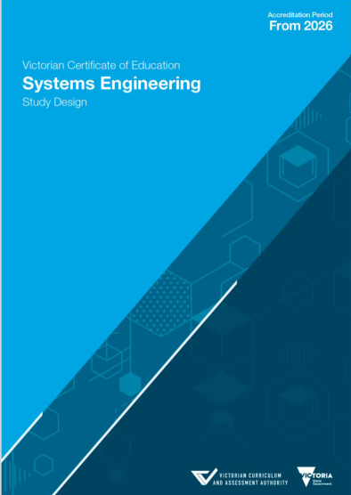
Study Designs new in 2026
Systems Engineering from 2026
AUSLAN (Units 1 & 2) from 2026

Slide 13
Entry to VCE studies
There are no prerequisites for entry into studies at Units 1, 2 and 3
For some studies it is recommended that students complete either or both Units 1 and 2 or demonstrate equivalent experience before attempting Unit 3
Only students undertaking the VCE VM program can be enrolled in VCE VM Literacy
(VCE Administrative Handbook, p.4 & 7)
VCE units
No prerequisite
Unit 1
Unit 2
Unit 3 prerequisite
Unit 4
Unit 3
Schools cannot create barriers to entry that are outside of the VCAA’s requirements for completion of the VCE

Slide 14

Satisfactory Completion
At the beginning of the academic year, schools must provide students with clear written details of both the VCAA’s rules and the school’s rules and procedures.
For all VCE units, schools must specify in writing all set work (learning activities) and assessment (including school-based assessment) that a student must complete to achieve an S for a unit and the conditions under which the work is to be done.
(VCE Administrative Handbook, p.28-29)

Slide 15
School-based Assessment
Provides evidence that contributes to the determination of achievement of outcomes and completion of a unit.
Determines a student’s level of achievement in Units 3 and 4.
VCE units
VCE VM and VPC
Teachers make 2 separate judgements:
- S or N outcome - separate from the decision that assesses a student's level of achievement
- Level of achievement - used for the calculation of a study score and contributes towards an ATAR.
Teachers make a judgement about an S or N outcome for a Unit
(VCE Administrative Handbook Page 69)

Slide 16
Satisfactory Completion
A teacher’s judgement on whether the student has satisfactorily achieved the outcomes for a study must be consistent for all students. This includes those who are being assessed for levels of achievement in the study and those who are not.
(VCE Administrative Handbook, p.28-29)

Slide 17
Feedback to students
After assessment tasks are submitted and marked, teachers should provide students:
  feedback
  initial school-based assessment score for individual SACs
  a copy of completed school-based assessments
When providing initial scores, teachers must advise students that their scores may change following statistical moderation.
(VCE Administrative Handbook, Page 73-75)

Slide 18
Redeeming Outcomes
If, in the teacher’s judgement, work submitted by a student is incomplete or does not meet the requirements for satisfactory completion, the teacher must provide further and alternative opportunities for the student to demonstrate satisfactory completion. These opportunities may include class work, homework, or additional tasks or discussions.
(VCE Administrative Handbook, p.70)

Slide 19

Ranking
  Is not an additional step for your assessment
  Is organic and fluid
  Is across cohorts not individual classes
  Can change after each assessment
  Schools should not apply any additional ranking processes after initial school-based assessment results have been calculated.
  (VCE Administrative Handbook, p.73)

Slide 20
Completion of VCE units without the calculation of a study score
Schools are encouraged to support all students to undertake scored assessment.
This option should only be applied in response to individual student need, and not as an alternative VCE program for a cohort of students.
Students who complete VCE units with or without a study score are required to:
  be assessed for satisfactory completion
  participate in school-based assessment for levels of achievement
(VCE Administrative Handbook, Page 13-14)

Slide 21
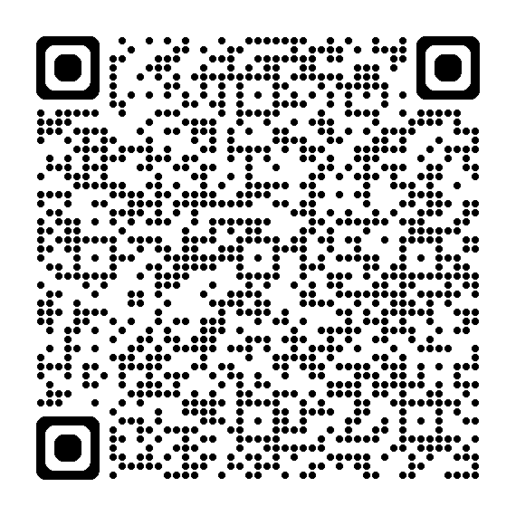
Special Provision
The decision on whether to approve special provision for classroom learning or School-based Assessment is a school decision.
Schools may approve special provision for classroom learning or School-based Assessments to enable students with a disability, illness, impairment or a personal circumstance to demonstrate what they know, and to participate in classroom learning and/or School-based Assessments.
(VCE Administrative Handbook, Page 31)

Slide 22
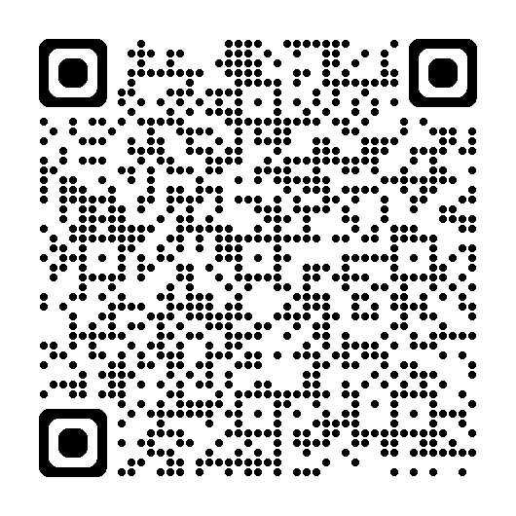
Special Examination Arrangements
Special Examination Arrangements applications are made to the VCAA through the student’s school and must be endorsed by the principal.
(VCE Administrative Handbook, Page 31 and 115)

Slide 23
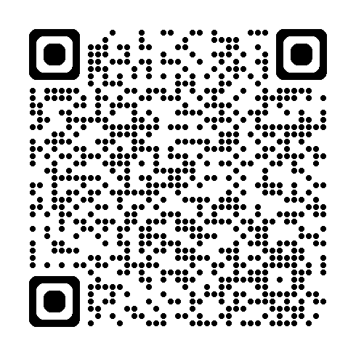
Key Dates for 2026 Term 1 and 2
Keep up-to-date with important administrative dates over the year, by referring to the VCAA website

Slide 24
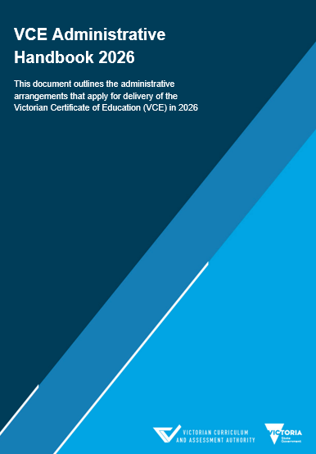
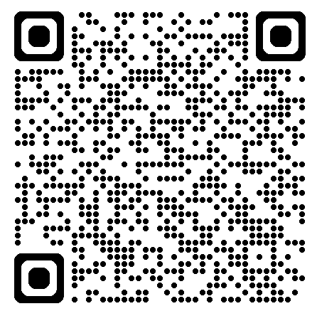
Key resources
VCE Assessment Principles
VCE Administrative Handbook
VCE Study Designs
Important Admin Dates
Support Material
School based assessment reports
Statistical moderation
Statistical information
Exam reports

Slide 25
Supporting teachers delivering VCE studies across 2026
VCE Leaders can support teachers by ensuring that they:
  are using the appropriate study design and correct text list, if relevant
  have completed and implemented the VCE teachers' checklist
  have reviewed the support materials provided for each VCE study, and examination materials, if relevant
  have clearly documented the set work and assessment tasks that students will be required to complete for satisfactory completion of each outcome
  have clearly documented the assessment task/s as specified in the study design
  have contacted the VCAA if they are unsure about any of the requirements of the study design or how a particular outcome or assessment should be assessed.

Slide 26
Contact the VCAA VCE Curriculum Unit
VCE Curriculum
vcaa.vce.curriculum@education.vic.gov.au
© Victorian Curriculum and Assessment Authority 2026
The copyright in this PowerPoint presentation is owned by the Victorian Curriculum and Assessment Authority or in the case of some materials, by third parties. No part may be reproduced by any process except in accordance with the provisions of the Copyright Act 1968 or with permission from the Copyright Officer at the Victorian Curriculum and Assessment Authority.

