Slide 1
VCE Mathematical Methods
Implementing the 2023-2027 study design

Slide 2


Slide 3
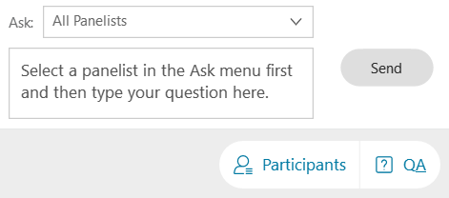
Asking Questions

Slide 4
General Outline
Brief background and new structure of VCE Mathematics 2023-2027
Outline of VCE Mathematical Methods Units 1 – 4 revisions
Discuss Investigations for Unit 1&2 leading to SACs in Unit 3&4
Address some FAQs
(If time runs out, my contact details will be supplied)

Slide 5
The Study Design 2023-2027
Result of a thorough consultation and review process
Published in February 2022
VRQA accredited from 2023 until 2027
VCAA undertake ongoing monitoring of study design implementation over the life of the study design
VCAA support the implementation of the study design through an implementation program that includes webinars, on-demand videos, support materials and resources that provide guidance around study design awareness and clarification, sample course structures, suggested learning activities and sample investigations

Slide 6
VCE Mathematics studies 2023 - 2027
From 2023 there are four completely prescribed Units 1 – 4 VCE Mathematics studies:
Foundation Mathematics General Mathematics
Mathematical Methods Specialist Mathematics
In each sequence, Units 1 and 2 contain assumed knowledge and skills for Units 3 and 4. Mathematical Methods Units 1 and 2 also contain assumed knowledge and skills for Specialist Mathematics Units 3 and 4.
Specialist Mathematics Units 3 and 4 assumes concurrent study, or previous completion, of Mathematical Methods Units 3 and 4.

Slide 7
Mathematical Methods Units 1 & 2
The 2023 – 2027 Mathematical Methods study design prescribes the content for each of Unit 1 and Unit 2. The content for Unit 3&4 is combined.
Unit 1 and 2 Areas of Study
  Functions, relations and graphs
  Algebra, number and structure
  Calculus
  Data analysis, probability and statistics

Slide 8
Mathematical Methods Unit 1
REVISED Areas of Study:
U1_AOS1: Topic: Functions relations and graphs (dot-point 2)
Points of inflection (including non-stationary)
U1_AOS2: Topic: Algebra, number and structure (dot-point 5)
Matrix representation no longer necessary for transformations
U1_AOS4: Topic: Data analysis, probability and statistics
Random variables and the distribution of results of experiments

Slide 9
Mathematical Methods Unit 1
Revised Key Knowledge and Key skills:
U1_OC1 Key knowledge
Explicit mention of vertical and horizontal asymptotes as key features of graphs
Clarification of properties for probability
U1_OC2 Key knowledge
Key elements of algorithm design: sequencing, decision making, repetition including pseudocode
U1_OC2 Key skills
identify important information, variables, constraints and other key features to the investigation of various questions in a given context
U1_O3 Key knowledge
The role of computational thinking in problem solving and mathematical investigations
The purpose and effect of sequencing, decision-making and repetition statements

Slide 10
Mathematical Methods Units 1
Assumed Student facility:
U1_AOS1: Topic: Functions, relations and graphs
Review of coordinate geometry
Use of vertical line test to determine a function (as a sub-set of relations)
U1_AOS2: Algebra, number and structure
Inverse functions no longer appear in the AoS description, however, they remain in the key skills as a form of transformation

Slide 11

Mathematical Methods Unit 1
Removed/deleted:
U1_AOS1: Topic: Functions, relations and graphs
Graphs of polynomials of degree greater than 4, however, still implicitly present
U1_AOS2: Algebra
Expansion of , however, still implicitly present (power forms defined in AoS1)
U1_O1 Key skills
Equations and by hand sketching of graphs of circles in the Cartesian plane (beyond operational knowledge of the unit circle in Unit 2)

Slide 12
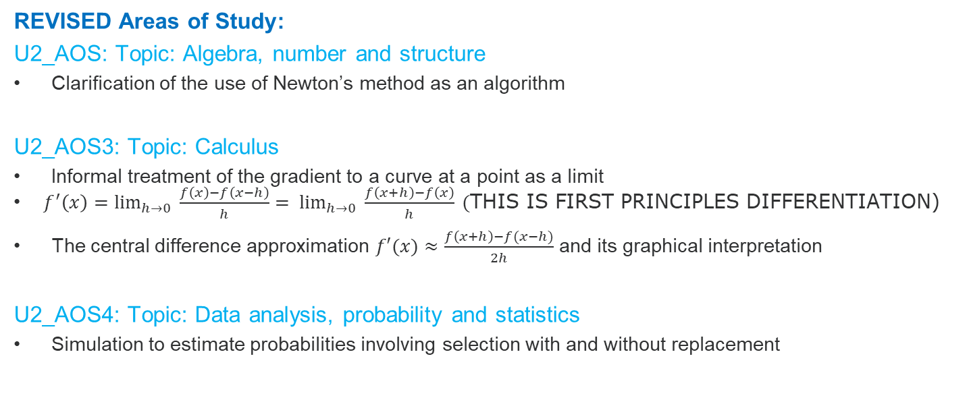
Mathematical Methods Unit 2
REVISED Areas of Study:
U2_AOS: Topic: Algebra, number and structure
Clarification of the use of Newton’s method as an algorithm
U2_AOS3: Topic: Calculus
Informal treatment of the gradient to a curve at a point as a limit
$f^{′}\left(x\right)=\lim_{h→0} \frac{f\left(x\right)−f\left(x−h\right)}{h}= \lim_{h→0} \frac{f\left(x+h\right)−f\left(x\right)}{h}\text{ (}\text{THIS} \text{IS} \text{FIRST} \text{PRINCIPLES} \text{DIFFERENTIATION}\text{)}$
The central difference approximation $f′(x)≈\frac{f\left(x+h\right)−f(x−h)}{2h}$ and its graphical interpretation
U2_AOS4: Topic: Data analysis, probability and statistics
Simulation to estimate probabilities involving selection with and without replacement

Slide 13
Mathematical Methods Unit 2
REVISED Key Knowledge and Key skills:
U2_OC1 Key knowledge
Emphasis on the unit circle and explicit mention of asymptotes as key features of graphs
The central difference approximation
U2_O2 Key knowledge
Key elements of algorithm design: sequencing, decision making, repetition, including use of pseudocode.
U2_O3 Key knowledge
The role of computational thinking in problem solving and mathematical investigations
The purpose and effect of sequencing, decision-making and repetition statements

Slide 14
Mathematical Methods Unit 2
Assumed Student facility:
U2_AOS1: Topic: Functions, relations and graphs
Review of basic trigonometric ratios (SOHCAHTOA and applications)
Measures of turn or rotation, degree to radian conversion
Removed/deleted:
U2_AOS3: Topic: Calculus
Graphical and numerical approaches to approximating the gradient function
Notations of derivative and first principles approach to derivatives
Solving simple problems involving straight line motion
Karnaugh maps?? (Still a required technique)

Slide 15
Mathematical Methods Units 3 & 4
Areas of Study:
Functions, relations and graphs
Algebra, number and structure
Calculus
Data analysis, probability and statistics

Slide 16
Mathematical Methods Units 3 & 4
REVISED Areas of Study:
AOS1: Topic: Functions and graphs
Closer highlighting of ‘key features’ of the graphs of the prescribed functions
AOS2: Topic: Algebra, number and structure
Numerical solutions of polynomial equations (Newton’s method)
Broader options of composite function nomenclature: (fog)(x)=f(g(x))
AOS3: Topic: Calculus
Key features of graphs now includes points of inflection
Area approximations using the trapezium rule
AOS4: Topic: Data Analysis, Probability and Statistics
Expanding the use of simulations to illustrate variations in CI dependant upon the point sample

Slide 17
Mathematical Methods Units 3 & 4
ASSUMED background knowledge and skills:
AOS2: Topic: Algebra
Review of algebra of polynomials and equating coefficients
AOS3: Topic: Calculus
Review of average and instantaneous rates of change, tangents and derived function

Slide 18
Mathematical Methods Unit 3&4
Revised Key Knowledge and Skills:
U3/4_OC1 Key knowledge
Introduction of the trapezium rule, explicit mention of vertical and horizontal (not oblique) asymptotes, Newton’s method algorithm
U3/4_OC2 Key knowledge
Specific and general formulations of concepts used to derive results
Key elements of algorithm design: sequencing, decision making, repetition including pseudocode
U3/4_OC2 Key skills
Identify important information, variables, constraints and other key features of investigations
Use algorithms, patterns, models and simulation to solve problems in a given context
U3/4_OC3 Key knowledge/key skills
The role of computational thinking in problem solving and mathematical investigations
The purpose and effect of sequencing, decision-making and repetition statements

Slide 19
Mathematical Methods Units 3 & 4
No longer present:
AOS1: Topic: Algebra
Simple functional relations
(Matrices for) transformations of functions
AOS3: Topic: Calculus
Identification of intervals over which a function is constant
Identification of the maximum rate of increase or decrease
Specified contexts for definite integrals (i.e. basic kinematics, cumulative growth
AOS4: Topic: Data analysis, probability and statistics
Median of a continuous random variable

Slide 20
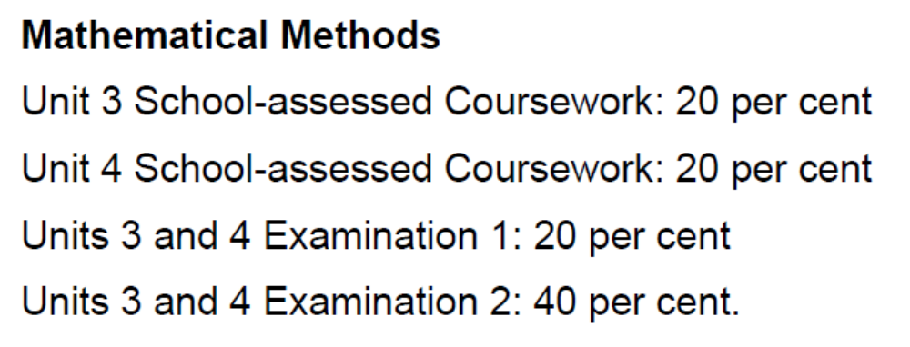
Mathematical Methods Units 3 – 4
In Units 3&4, the assessment weighting used to calculate the final study score has been slightly re-adjusted (p. 12 in 2023-2027 study design)

Slide 21
Mathematical Investigation Units 1 & 2
For each unit:
• This comprises one to two weeks of investigation into one or two practical or theoretical contexts or scenarios based on content from areas of study and application of key knowledge and key skills for the outcomes.
• Investigation is to be incorporated in the development of concepts, skills and processes for the unit, and can be used to assess the outcomes.

Slide 22
Mathematical Investigation Units 1 & 2
There are three components to mathematical investigation:
Formulation: overview of the context or scenario, and related background, including historical or contemporary background as applicable, and the mathematisation of questions, conjectures, hypotheses, issues or problems of interest.
Exploration: investigation and analysis of the context or scenario with respect to the questions of interest, conjectures or hypotheses, using mathematical concepts, skills and processes, including the use of technology and application of computational thinking.
Communication: summary, presentation and interpretation of the findings from the mathematical investigation and related applications.

Slide 23
Mathematical Investigation Units 1 & 2
Can be implemented in a variety of ways to meet requirements:
as an investigative learning activity or activities
as an assessment task or tasks
a combination of the above
Time range 1 to 2 weeks:
Minimum one longer activity/task, or two shorter activities/tasks over the equivalent of 1 week duration
Up to 2 weeks, a suitable combination, for example, two longer activities/tasks, one longer and two shorter activities tasks, three medium activities/tasks, four shorter activities/tasks

Slide 24
Mathematical Investigation Units 1 & 2
Provides a natural and effective context for addressing Outcome 2 and Outcome 3
Can be used to support computational thinking and experimentation
Is one of the assessment task types listed for Units 1 and 2
Provides preparation for the application, problem solving and modelling tasks in Specialist Mathematics Units 3 and 4.

Slide 25
Sample Investigation topic
Introduction
This task involves students modelling an approximate tidal pattern for a chosen coastal town and to explore the effect rising sea levels might have on their chosen location, with consideration of the increased reach of high tide.
Students are encouraged to use online elevation maps and predictive maps to help them assess the potential impact of rising sea levels; several relevant links are provided below.
Australian tide information: https://tides.willyweather.com.au/
Elevation Finder Map: https://www.freemaptools.com/elevation-finder.htm
Interactive maps indicating potential impact of rising sea levels:

Slide 26
SACs in Units 3 & 4 – Application Task
Outcomes | Marks allocated | Assessment task
Outcome 1 Define and explain key concepts as specified in the content from the areas of study and apply a range of related mathematical routines and procedures. | 15 | Application task A function and calculus-based mathematical investigation of a practical or theoretical context involving content from two or more areas of study, with the following three components of increasing complexity: introduction of the context through specific cases or examples consideration of general features of the context variation or further specification of assumption or conditions involved in the context to focus on a particular feature or aspect related to the context
Outcome 2 Apply mathematical processes in non-routine contexts, including situations with some open-ended aspects requiring investigative, modelling or problem-solving techniques or approaches, and analyse and discuss these applications of mathematics. | 20
Outcome 3 Apply computational thinking and use numerical, graphical, symbolic and statistical functionalities of technology to develop mathematical ideas, produce results and carry out analysis in situations requiring investigative, modelling or problem-solving techniques or approaches. | 15

Slide 27
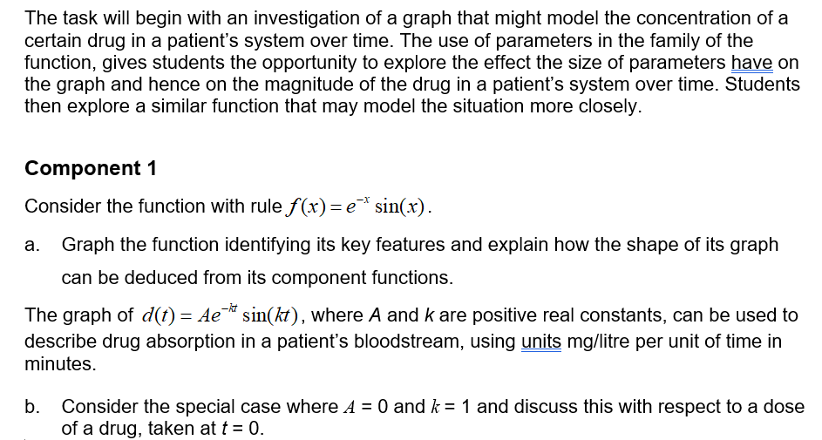
SACs in Units 3 & 4 - Application

Slide 28
Pseudocode
Introduction
Pseudocode is a tool for representing algorithms without the use of a particular programming language and related syntax.
It is written in a combination of plain English and common symbols, and describes, in a detailed step-by-step manner, the processes used in the algorithm.
An example for finding the smaller of two numbers a and b
Algorithm: minimum of two numbers
input a, b
if a ≤ b then
print a
else
print b
end if

Slide 29

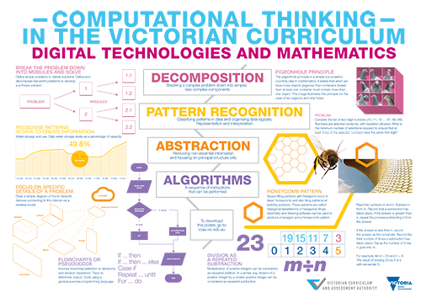
Computational Thinking
Decomposition
  Break down the problem into simpler, less complex components
Pattern Recognition
  Classify patterns in data and organizing data logically
  Representation and interpretation
Abstraction
  Removing non essential information and focusing on principal structure only
Algorithms
  A sequence of instructions that can be performed
  Link is HERE.

Slide 30
Some FAQs
  Will Support material be available and when?
  Will sample SACs be published by VCAA?
  Will pseudocode be examinable?
  Has the SAC structure (effectively) changed?
  What does “algorithmic” thinking “look” like?
  What is the role of “computational” thinking?

Slide 31
Contact
Michael MacNeill – Curriculum Manager, Mathematics
Victorian Curriculum and Assessment Authority
Level 7, 2 Lonsdale Street, Melbourne 3000, Victoria
T +61 3 7022 5538 M 0438 602 765
Email: Michael.MacNeill@education.vic.gov.au

