Slide 1
VCE Specialist Mathematics
Implementing the 2023-2027 study design

Slide 2


Slide 3
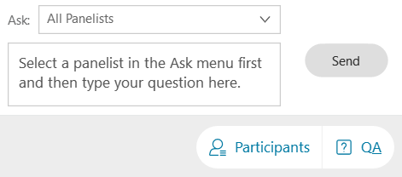
Asking Questions

Slide 4
General Outline
Brief background and new structure of VCE Mathematics 2023-2027
Outline of VCE Specialist Mathematics Units 1 – 4 revisions
Discuss Investigations for Unit 1&2 leading to SACs in Unit 3&4
Address some FAQs
(If time runs out, my contact details will be supplied)

Slide 5
The Study Design 2023-2027
Result of a thorough consultation and review process
Published in February 2022
VRQA accredited from 2023 until 2027
VCAA undertake ongoing monitoring of study design implementation over the life of the study design
VCAA support the implementation of the study design through an implementation program that includes webinars, on-demand videos, support materials and resources that provide guidance around study design awareness and clarification, sample course structures, suggested learning activities and sample investigations

Slide 6
VCE Mathematics studies 2023 - 2027
From 2023 there are four completely prescribed Units 1 – 4 VCE Mathematics studies:
Foundation Mathematics General Mathematics
Mathematical Methods Specialist Mathematics
In each sequence, Units 1 and 2 contain assumed knowledge and skills for Units 3 and 4. Mathematical Methods Units 1 and 2 also contain assumed knowledge and skills for Specialist Mathematics Units 3 and 4.
Specialist Mathematics Units 3 and 4 assumes concurrent study, or previous completion, of Mathematical Methods Units 3 and 4.

Slide 7
Specialist Mathematics Units 1 & 2
The 2023 – 2027 Specialist Mathematics study design prescribes the content for each of Unit 1&2 and combines the content for Unit 3&4.
Unit 1 Areas of Study
  Algebra, number and structure
  Discrete mathematics
Unit 2 Areas of Study
  Algebra, number and structure
  Space and measurement
  Functions, relations and graphs
  Data analysis, probability and statistics

Slide 8
Specialist Mathematics Units 1 & 2
New:
U1_AOS1: Topic: logic and algorithms
Binary number systems
Algorithms, computational thinking and pseudocode
U1_AOS2: Topic: Sequences and series
First order linear recurrence relations
Adjusted focus:
U1_AOS2: Topic: Matrices (arithmetic and elementary)
U2_AOS1: Topic: Distribution of sums of DRVs (from U3&4)
U2_AOS2: Topic: Trigonometry (explicit content descriptions)
U2_AOS2: Topic: Vectors in the plane (application to kinematics)

Slide 9
Specialist Mathematics Units 1 & 2
Moved into Unit 1&2 from Unit 3&4:
U2_AOS3: Topic: complex numbers
Introductory and elementary work on complex numbers
U2_AOS4: Topic: functions, relations and graphs
Rational functions linked to partial fractions
inverse circular functions
absolute value

Slide 10
Specialist Mathematics Units 1 & 2
Removed/deleted:
Prescribed topics: AOS4: Topic: geometry in the plane and proof
(only sine, cosine rule, arc, segments, sectors remain)
Prescribed topics: AOS5: Topic: graphs on non-linear relations
(polar/parametric graphs of relations like limacon, cycloid, … gone)
Other topics: AOS5: Topic: kinematics
(one dot point in vectors as an application of kinematics)
Other topics: AOS6: Topic Simulation, sampling and distributions
(Simulation and sample proportions gone)

Slide 11
Specialist Mathematics Units 3 & 4
Areas of Study:
Discrete mathematics
Functions, relations and graphs
Algebra, number and structure
Calculus
Space and measurement
Data analysis, probability and statistics

Slide 12
Specialist Mathematics Units 3 & 4
New:
AOS1: Topic: logic and proof
Conjecture, implications, deduction, quantifiers, induction
AOS4: Topic: Differential calculus and integral calculus
Integration by parts, surface area of solids, arc length by parametric
AOS4: Topic: Differential equations
Logistic differential equation
AOS5: Topic: Vectors
Cross product
AOS5: Topic: Vector and cartesian equations
All dot points

Slide 13
Specialist Mathematics Units 3 & 4
Adjusted focus:
AOS6: Topic: distribution of linear combinations of random variables
More explicit content descriptions
AOS6: Topic: hypothesis testing
More explicit content descriptions
Removed/deleted:
AOS5: Topic: Mechanics

Slide 14
Mathematical Investigation Units 1 & 2
For each unit:
• This comprises one to two weeks of investigation into one or two practical or theoretical contexts or scenarios based on content from areas of study and application of key knowledge and key skills for the outcomes.
• Investigation is to be incorporated in the development of concepts, skills and processes for the unit, and can be used to assess the outcomes.

Slide 15
Mathematical Investigation Units 1 & 2
There are three components to mathematical investigation:
Formulation: overview of the context or scenario, and related background, including historical or contemporary background as applicable, and the mathematisation of questions, conjectures, hypotheses, issues or problems of interest.
Exploration: investigation and analysis of the context or scenario with respect to the questions of interest, conjectures or hypotheses, using mathematical concepts, skills and processes, including the use of technology and application of computational thinking.
Communication: summary, presentation and interpretation of the findings from the mathematical investigation and related applications.

Slide 16
Mathematical Investigation Units 1 & 2
Can be implemented in a variety of ways to meet requirements:
as an investigative learning activity or activities
as an assessment task or tasks
a combination of the above
Time range 1 to 2 weeks:
Minimum one longer activity/task, or two shorter activities/tasks over the equivalent of 1 week duration
Up to 2 weeks, a suitable combination, for example, two longer activities/tasks, one longer and two shorter activities tasks, three medium activities/tasks, four shorter activities/tasks

Slide 17
Mathematical Investigation Units 1 & 2
provides a natural and effective context for addressing Outcome 2 and Outcome 3
can be used to support computational thinking and experimentation
is one of the assessment task types listed for Units 1 and 2
provides preparation for the application, problem solving and modelling tasks in Specialist Mathematics Units 3 and 4.

Slide 18
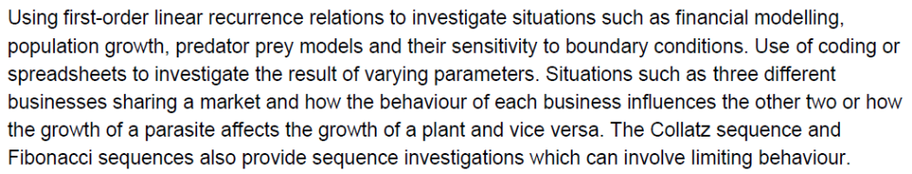
Sample Investigation topic

Slide 19
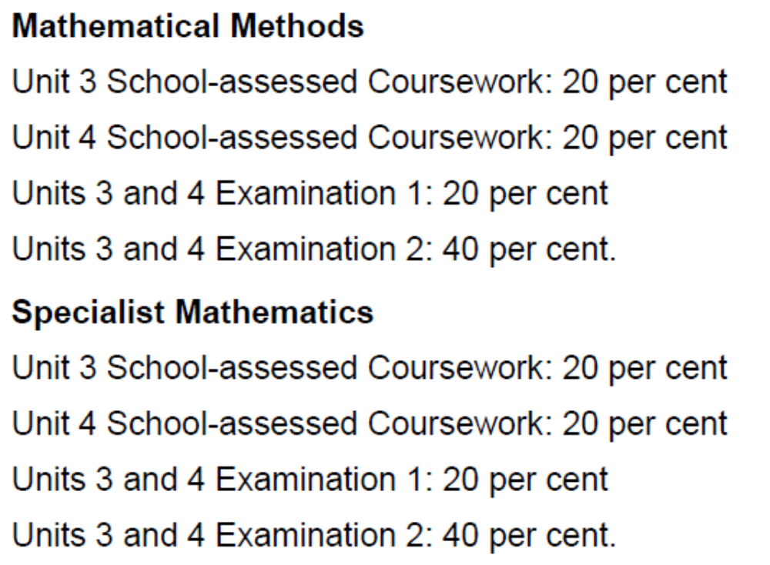
Specialist Mathematics Units 3 – 4
In Units 3&4, the assessment weighting used to calculate the final study score has been slightly re-adjusted (p. 12 in 2023-2027 study design)

Slide 20
SACs in Units 3 & 4 – Application Task
Outcomes | Marks allocated | Assessment task
Outcome 1 Define and explain key concepts as specified in the content from the areas of study and apply a range of related mathematical routines and procedures. | 15 | Application task A mathematical investigation of a practical or theoretical context involving content from two or more areas of study, with the following three components of increasing complexity: introduction of the context through specific cases or examples consideration of general features of the context variation or further specification of assumption or conditions involved in the context to focus on a particular feature or aspect related to the context.
Outcome 2 Apply mathematical processes in non-routine contexts, including situations with some open-ended aspects requiring investigative, modelling or problem-solving techniques or approaches, and analyse and discuss these applications of mathematics. | 20
Outcome 3 Apply computational thinking and use numerical, graphical, symbolic and statistical functionalities of technology to develop mathematical ideas, produce results and carry out analysis in situations requiring investigative, modelling or problem-solving techniques or approaches. | 15

Slide 21
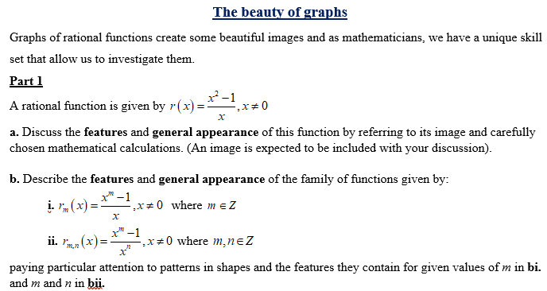
SACs in Units 3 & 4 - Application

Slide 22
Pseudocode
Introduction
Pseudocode is a tool for representing algorithms without the use of a particular programming language and related syntax.
It is written in a combination of plain English and common symbols, and describes, in a detailed step-by-step manner, the processes used in the algorithm.
An example for finding the smaller of two numbers a and b
Algorithm: minimum of two numbers
input a, b
if a ≤ b then
print a
else
print b
end if

Slide 23

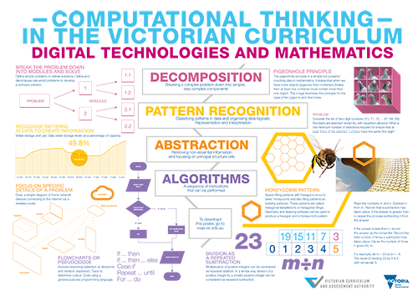
Computational Thinking
Decomposition
  Break down the problem into simpler, less complex components
Pattern Recognition
  Classify patterns in data and organizing data logically
  Representation and interpretation
Abstraction
  Removing non essential information and focusing on principal structure only
Algorithms
  A sequence of instructions that can be performed
  Link is HERE.

Slide 24
Some FAQs
  Will Support material be available and when?
  Will sample SACs be published by VCAA?
  Will pseudocode be examinable?
  Has the SAC structure (effectively) changed?
  What does “algorithmic” thinking “look” like?
  What is the role of “computational” thinking?

Slide 25
Some FAQs
  The extent to which logic and proof should be taught?
  Expected notation for logic and proofs?

Slide 26
Contact
Michael MacNeill – Curriculum Manager, Mathematics
Victorian Curriculum and Assessment Authority
Level 7, 2 Lonsdale Street, Melbourne 3000, Victoria
T +61 3 7022 5538 M 0438 602 765
Email: Michael.MacNeill@education.vic.gov.au

