Slide 1
VCE History 2022–2026
Approaches to developing an Assessment Task

Slide 2
Purpose
Familiarise with School-assessed Coursework tasks
VCE Assessment Principles
Approaches to developing assessment tasks
Assessment Conditions and Authentication

Slide 3
School-based assessment
Purpose:
determine a student’s level of achievement
can provide evidence that contributes to the determination of achievement of outcomes and completion of a unit
The decision about satisfactory completion of a unit is distinct from the assessment of levels of achievement.

Slide 4
VCE History 2022-2026
Scope of Study, Rationale and Aims
Characteristics of the Study
Outcomes
Key Knowledge and Key Skills
Units of Study
SACs
Assessment Tasks

Slide 5
Assessment tasks
Units 1 and 2 | Units 3 and 4
Suitable tasks for assessment in this unit may be selected from the following: a historical inquiry an essay evaluation of historical sources short-answer questions extended responses a multimedia presentation. Where teachers allow students to choose between tasks they must ensure that the tasks they set are of comparable scope and demand. | Each of the following four assessment tasks must be completed over Units 3 and 4: a historical inquiry evaluation of historical sources extended responses an essay. Teachers may choose to select one or more assessment tasks for each outcome. The assessment tasks may be undertaken in any order.

Slide 6
School-based assessment
Units 1 & 2
Units 3 & 4
Two separate decisions reported to the VCAA
1. S or N
2. Level of achievement (SAC Score)
Assessment tasks created and set by school
S or N reported to VCAA

Slide 7
Developing School- assessed coursework (SAC)
is derived from designated assessment task types specified in the study design
is developed and administered to meet needs of the student cohort
monitors student work and progress within the cohort
provides important feedback to individual students

Slide 8
VCE assessment
Valid
Equitable
Balanced
Efficient
Notes:
https://www.vcaa.vic.edu.au/curriculum/vce/Pages/VCEPoliciesandGuidelines.aspx

Slide 9
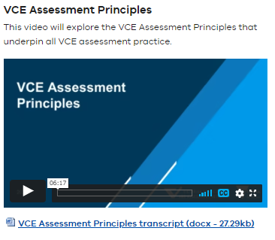
For more information
VCE Assessment Principles
This video will explore the VCE Assessment Principles that underpin all VCE assessment practice.
Notes:
https://www.vcaa.vic.edu.au/news-and-events/professional-learning/VCE/Pages/VCEBriefings2021.aspx

Slide 10
For more information
Five teachers discuss their work addressing the requirement that VCE assessments should be valid and reasonable; equitable; balanced; efficient and be able to be authenticated
Notes:
https://www.vcaa.vic.edu.au/assessment/vce-assessment/School-basedAssessment/Pages/School-based-Assessment-Teacher-videos.aspx

Slide 11
Developing SACs
VCE Assessment Principles
Authentication Procedures (VCE/VCAL Handbook)
Advice for Teachers
Student Cohort/School Context
Study Design: Outcome, Key Knowledge and Key Skills
Study Design Assessment tasks
Assessment Tools – Performance Descriptors

Slide 12
Developing SACs
Include a cover sheet that sets out the conditions of the SAC
minimise reading
place stimulus material and other information close to the item
stimulus, if included, must be used in the response
place easier items earlier in the task where possible
use a range of assessment types (use a taxonomy, SOLO, Blooms etc. to ensure a spread of responses)
make sure the typical student can finish the SAC in the time available
VCE History assessment tasks should not exceed 90 mins per Outcome *

Slide 13
Developing SACs
25-50-25 rule of thumb
high / medium / lower order thinking
multiple entry points
accessibility
differentiate
extend the top end

Slide 14
Developing a SAC Plan (Plan 1)
Unit 3
Unit 4
Outcome 1
Historical Inquiry
Outcome 2
Evaluation of historical sources
Outcome 1
Essay
Outcome 2
Extended responses

Slide 15
Developing a SAC Plan (Plan 2)
Unit 3
Unit 4
Outcome 1
Historical Inquiry
Research (10 Marks)
Collecting/organising and evaluating historical sources (20 Marks)
Essay (20 Marks)
Outcome 2
Part A: Evaluation of historical sources (25 Marks)
Part B: Essay (25 Marks)
Outcome 1
Part A: Extended Responses X2 (20 Marks)
Part B: Essay 1 (30 Marks)
Outcome 2
Part A: Evaluation of historical sources (30 Marks)
Part B: Extended Response (20 Marks)

Slide 16
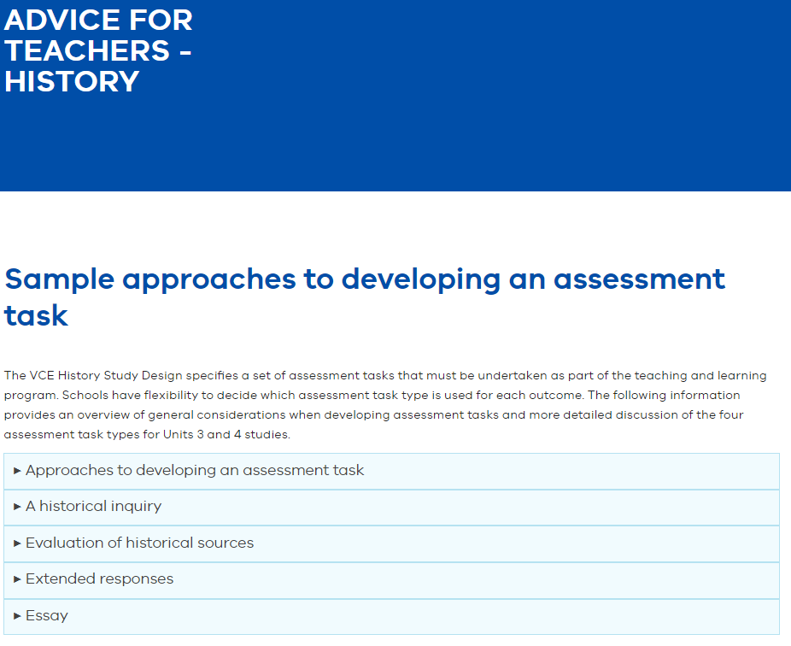
Advice for teachers - History

Slide 17
Historical inquiry
Focuses on the process of historical investigation
Development a historical argument
Student cantered and teacher directed
Involves three stages: Planning, Investigating and writing up.

Slide 18
Evaluation of historical sources
Identification
Attribution
Contextualisation
Close analysis
Corroboration
Narration
Argumentation

Slide 19
Evaluation of historical sources
Select 4-7 sources
Provide a range of:
source types - primary sources (perspectives) and secondary sources (historical interpretation)
source forms – texts and visual
Always include source citations
Provide contextual information of each source if required
Gloss words where needed

Slide 20
Evaluation of historical sources
Source question items should:
Use the language of key knowledge and key skills
Use historical thinking concepts
Include a range of cognitive demands such as:
25% Lower order - list, identify, describe, outline
50% Mid-range order - explain, compare,
35% Higher order – discuss, analyse, evaluate, to what extent
Weight items according to the question demand

Slide 21
Extended Responses
Question design includes:
Combination of explanatory, analytical and evaluative questions - explain, compare, analyse, evaluate, discuss
Use historical thinking concepts
Focus on key knowledge and skills
Responses should include
Brief introductory sentence and contention and a brief conclusion
Two or three key discussion points
Supported by evidence (primary and secondary sources)

Slide 22
Essay
Question design includes:
analyse, evaluate, discuss, to what extent
open-ended
Use historical thinking concepts
Use a prompt such as a historian's quote

Slide 23
Essay
Responses should include
structured piece of writing – introduction, body paragraphs and conclusion
Develop and sustain a historical argument that addresses the outcome
Select and deploy historical sources as evidence to establish and support key arguments
Use historical thinking concepts and skills to explain, analyse or evaluate the ideas and discussion points

Slide 24
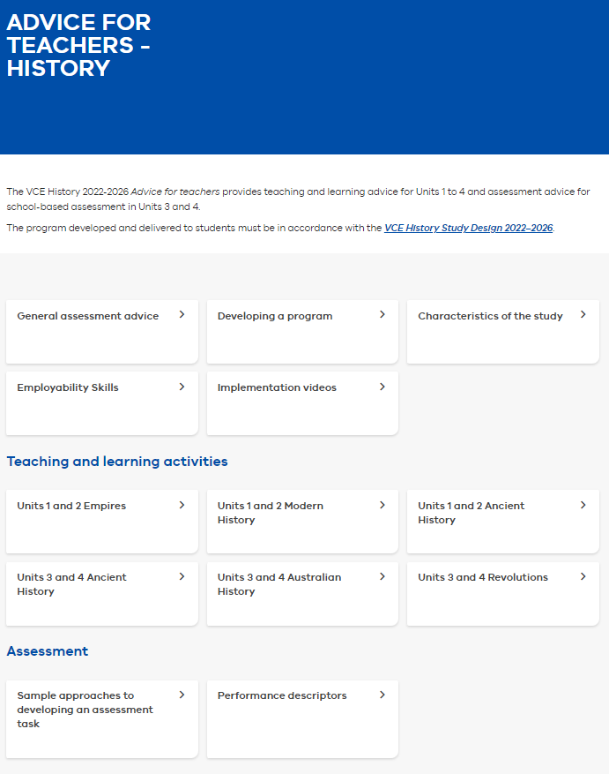
Advice for teachers - History

Slide 25
Authentication

Slide 26
Authentication
School policies and processes must be in place.
to ensure that student work submitted for assessment is their own
most work for assessment should be done in class
assessment undertaken across periods of time or outside of class time must be monitored
student’s progress recorded through to completion.
work is regularly sighted
records are kept
Authentication Record for School-based Assessment form is used (available from VASS)

Slide 27
Authentication strategies
Timetable all classes to sit for a SAC task at the same time.
Offer different sources or questions items for each class within the same task type.
use mainly class time to complete task
be familiar with each student’s work
regular sightings of student work
record of student progress

Slide 28
Commercially-produced tasks
Responsibility of the school and teacher:
check that a commercially-produced task is compliant with VCAA requirements.
ensure authentication of student work.
Commercially-produced tasks MUST be adapted.
School-assessed Coursework tasks need to be UNIQUE to each individual school

Slide 29
VCAA VCE School-based Assessment Audit

Slide 30
VCE School-based Assessment Audit
The Purpose of the VCAA VCE School based audit is to ensure:
monitoring and quality assurance
the integrity of student school-based assessments
compliance with VCE assessment principles, VCE and VCAL Administrative Handbook and the relevant study design.

Slide 31
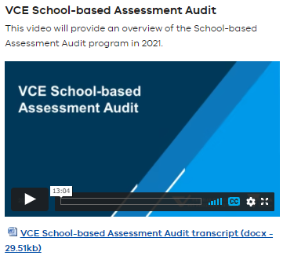
For more information
VCE School-based Assessment Audit
Watch the On-demand video - VCE School-based Assessment Audit
Notes:
https://www.vcaa.vic.edu.au/news-and-events/professional-learning/VCE/Pages/VCEBriefings2021.aspx

Slide 32
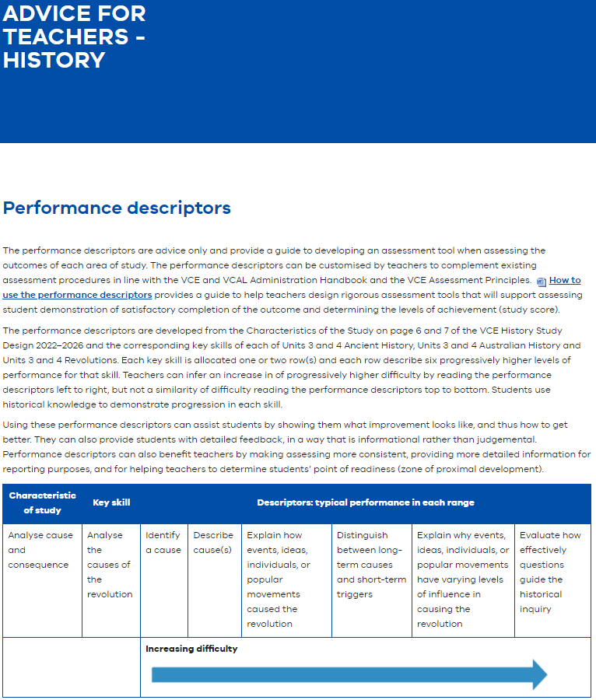
Performance Descriptors
Notes:
https://www.vcaa.vic.edu.au/curriculum/vce/vce-study-designs/history/advice-for-teachers/Pages/PerformanceDescriptors.aspx

Slide 33
VCE resources
VCE and VCAL Administrative Handbook
VCE History Study Design 2022-2026
Advice for Teachers
VCE Assessment Principles

Slide 34
Gerry Martin
Curriculum Manager, History and Civics
T (03) 9032 1694
M 0428 039 083
E Gerard.Martin@education.vic.gov.au

