Slide 1
Global Politics 2018-2023
Unit 3 and 4

Slide 2
At a glance
The VCE Global Politics 2018-2023 replaces the interim Global Politics Unit 3 and 4 2016-2017.
Minimal changes have been made with some minor changes to key knowledge.

Slide 3
Change to Key Skills Unit 3 & 4
2016-17 | 2018-2023
research and synthesise contemporary evidence to draw conclusions. | use contemporary examples and case studies to support explanations, points of view and arguments.
In Unit 3&4 changes to the cognitive development of the skills

Slide 4
Key Terms and Concepts
Must be explicitly taught
Advice for Teachers will have a glossary for Units 1-4
In Unit 3 and 4 they are examinable

Slide 5
Case Studies
“VCE Global Politics is a contemporary study and focus must be on examples and case studies from within the last 10 years. However, contemporary issues and events may need to be contextualised for students and this may require some investigation prior to this timeframe.” Study Design
Teaching in 2022- Cases Studies from 2012 onwards
Teaching in 2020- case studies from ??? Onwards

Slide 6
Assessment
School-assessed Coursework tasks have changed
To ensure authentication of students work:
Commercially purchased SAC’s must always be modified
SAC’s used from previous years must always be modified
It is the teachers responsibility to ensure that their SAC’s authenticate the Study Design

Slide 7
Assessment
The exam specifications will be published early 2018 and will include a sample exam.
In 2018, the examination will reflect changes in the 2018 -2023 Unit 3 and 4 Australian Politics Study Design.
The sample examination will be updated to reflect the changes in the Study Design.

Slide 8
Unit 3 Global Actors
AOS 1: Global Actors
AOS 2: Power in the Asia-Pacific

Slide 9
Key Terms and Concepts
All terms and concepts in the Key Knowledge must:
Taught and learned
Applied
Linked
Key Skills states that students must be able to:
“define and explain key global politics terms and use them in the appropriate context”
All terms are examinable
The Advice for Teachers will include a glossary.
Notes:
Linked between the outcomes

Slide 10
U3 AOS1 Outcome
Unit AOS1 2016-2017 | Unit AOS1 2018-2023
…. the student should be able to evaluate the power of key global actors in the twenty-first century and assess the extent to which they achieve their aims. | …. the student should be able to evaluate the power of key global actors and assess the extent to which they achieve their aims and are able to challenge state sovereignty
Key Knowledge
change from challenges to “the impact on state sovereignty of:…”
Changing borders to “contested borders”
WTO is no longer included as a IGO
Notes:
Changing borders is still in the blurb.

Slide 11
Unit 3.1
General Advice
Sets the groundwork for understanding rest of the course: do not rush it
Read the pre-blurb and ensure it is understood; examinable and contains important explanatory material – source of key terms and questions
Websites of different global actors as a starting point for knowledge
Useful websites – sign up to email alerts, file relevant emails for later use: Council Foreign Relations, Foreign Policy, Guardian Australia, Ajplus for short videos; AIIA lecture series, The Economist weekly

Slide 12
Unit 3.1
General Advice
Update T&L task of media file: students establish twitter account and must follow 10 different relevant global actors; select 30 different tweets and explain why relevant to studies
Excursions: Sea Shepherd in Williamstown; NGO offices in Melbourne – guest speakers; model UN assembly;
short-answer questions (1-8 marks) on each global actor

Slide 13
Unit 3.1
Overview of changes
Intergovernmental organisations IGOs (not IGGs)
No WTO
UN, IMF and ICC
Useful starting point is their websites; aims; how they work; good examples of successful work;
Criticism of these organisations helps to evaluate their power and impact
SD pre-blurb: ‘manage and facilitate relations between states through their processes, protocols and legal arrangements. Students consider the ways these IGOs also have the capacity to challenge state sovereignty’

Slide 14
IGO Cartoon
Notes:
In SAC development use cartoons…..

Slide 15
Unit 3.1
T&L idea - UN
In pairs students given one cartoon (such as the one previous)
Devise 3 questions based on this cartoon that increase in difficulty
NB: students will need a list of instructional verbs to assist them
Students devise marking criteria for the questions – looking at the Chief Assessor report will help students to understand the marking process
Students write ‘model’ answers based on criteria … often leads to tweaking of questions and criteria
Submit responses for marking
Revision exercise: distribute pairs cartoons & questions to the rest of the class to complete

Slide 16
Unit 3.1
Non state actors – Potential case studies
Greenpeace
Daesh
Crucial aspects to cover
Aims
Roles
Power
Ability to challenge state sovereignty
Writing task – ‘Evaluate to what extent one non-state actor is able to challenge state sovereignty.’

Slide 17
Unit 3.1
TNC
Choose ONE TNC only
Walmart
Aims
Roles
Power
Ability to challenge state sovereignty
Do not limit to operations in simply one state
Ensure evaluation of power is balanced: do some good!
SD pre-blurb: ‘exploitative of host states, and by others as drivers of progress, skills and innovation’
Notes:
Volkswagen is also a good TNC – because students can also examine how states can regulate and bring legal power against TNCs, such as the US and EU actions in relation to the emissions scandals.

Slide 18
Unit 3.1
States
Aims, Role, Power
Ability to challenge state sovereignty
Russia and Ukraine
US in Syria
Learning activity
Using the US and Syria as a case study, ask students to identify the following
Areas where sovereignty is challenged
Areas where sovereignty is not challenged
Why are some areas able to be challenged and others not (teaching analysis – how and why)

Slide 19
Unit 3.1
Regional Groupings
Specific ability to impact state sovereignty
NATO
EU
Arab League
Notes:
PG –might want to flag to teachers that regional groupings like NATO can be seen to enhance sovereignty – especially in the case of Baltic states concerned about Russia … whereas EU can be seen to diminish sovereignty…

Slide 20
Unit 3.1
Contested Borders
Specific ability to impact state sovereignty
Sudan
Ukraine
Kashmir
South China Sea
Will require some context (pre ten year limit)
Student answers must be based on events from within the last ten years
Notes:
PG – maritime border between Aust and East Timor – offers an opportunity to return to in 3.2

Slide 21
Unit 3.1
Issues that require multilateral resolution
Libya
Syria
Sovereign debt crisis
North Korea’s nuclear programme
Any situation where one or two states are unable to find a resolution
These situations will often include challenges to sovereignty
These case studies should be chosen from case studies you are already undertaking
Notes:
PG - North Korea – is a link to 4.1

Slide 22
Unit 3.1 – Final thoughts
Double up wherever possible
Use aspects from 3.1 in other areas of study
Focus your teaching on assisting the students to:
Assess to the outcome
Demonstrate the key knowledge
Teach the key skills explicitly

Slide 23
U3 AOS2 Outcome
Unit AOS1 2016-2017 | Unit AOS1 2018-2023
…. the student should be able to analyse and evaluate types of power as used by a specific Asia-Pacific state in the region in pursuit of its national interests. | …. the student should be able to analyse and evaluate the effectiveness of the use of various types of power by a specific Asia-Pacific state in pursuit of its national interests.

Slide 24
Key Knowledge and Skills AOS2
Key Terms
nation and state are now in AOS1
National interests can be global – not only regional in focus (Eg. China trade and development in Africa, Australia seeking a closer relationship with the UK (post-BREXIT?)
When studying regional relationships. Must use the listed Asia-Pacific states in the Study Design p. 32
Differing interpretations may depend on factors such as cultural identity, international relationships and state security

Slide 25
Unit 3.2
For whichever state you choose, you must have:
Examples of:
hard and soft power
Military power
Economic power (trade and aid)
Political power
Diplomatic power
Cultural power (usually soft power)
Students must still examine types of power AND foreign policy instruments
Evaluate the relative importance

Slide 26
Unit 3.2 - Suggestions
Collate a booklet of recent articles relating to each type of power and FP instrument
Provide context for actions
Locate sources and examples that facilitate evaluative comment
Success
Failure
Types of power and national interests do not exist in isolation

Slide 27
Unit 3.2 - China
Diplomatic power
Global agreements (Climate)
North Korea sanctions and statements
Role in UNSC regarding Syria
Military power
South China Sea actions
Aircraft carriers
Missiles facing Taiwan

Slide 28
Unit 3.2 - Australia
Cultural Power
G’day USA program
Koala Diplomacy
International Students
Military Power
US alliance
US troops in Darwin
Training with USS carrier groups
$26bn spending increase on defence
Support of US in Iraq and Syria

Slide 29
Unit 3.2 - USA
Diplomatic power
Role in the UN
Approach to the UN
Application of veto
Drafting of UNSC resolutions
Relationships with allies (South Korea, Japan, Australia)
Military power
Syria & Iraq
Role in Asia and South China Sea
Increase in defence spending and nuclear capability

Slide 30
Final thoughts
Focus your teaching on assisting the students to:
Assess to the outcome
Demonstrate the key knowledge
Teach key skills explicitly
Factors that shape the national interests
Differing interpretations of the national interest

Slide 31
Unit 4 Global Challenges
AOS 1: Ethical issues and debates
AOS 2: Global crisies

Slide 32
U4 AOS1 Outcome
Unit AOS1 2016-2017 | Unit AOS1 2018-2023
…. the student should be able to evaluate two global ethical issues from a range of perspectives, and analyse the effectiveness of global actors’ responses to these issues. | …. the student should be able to analyse the debates relating to TWO global ethical issues, and evaluate the effectiveness of global actors’ responses to these issues
Cognitive change in the outcome statement.

Slide 33
Key Knowledge AOS1
Key terms - “international law” now only relevant term
“International law encompasses a wide range of rules that might be seen to govern the actions of states in international relations such as treaties, declarations, bilateral and multilateral agreements and even decisions made by bodies such as the UN Security Council.”
Teachers MUST be vigilant about choice of international law
Selected law must enable students to demonstrate the KK and KS in addition to address the ethical debates
Changes in the ethical debates for each issue.

Slide 34
Key Skills U4 AOS1
2016-17 | 2018-2023
define and explain key global politics terms and use them in the appropriate context analyse treaties relating to two ethical issues evaluate ethical debates surrounding two ethical issues analyse the effectiveness of responses by global actors to two ethical issues research and synthesise contemporary evidence to support arguments. | define and explain key global politics terms and use them in the appropriate context analyse international law relating to TWO ethical issues analyse ethical debates surrounding TWO ethical issues, including the concepts of realism and cosmopolitanism evaluate the effectiveness of responses by global actors to TWO ethical issues use contemporary examples and case studies to support explanations, points of view and arguments

Slide 35
Unit 4.1
Key Terms: realism, cosmopolitanism, justice and ethics.
Realism
Realism is the ideology that the global political arena is made up of individual states and every state acts in its own national interests to ensure its sovereignty. Any cooperation made by states with other global actors is only to further their own national interests.
Cosmopolitanism
Cosmopolitanism is the ideology that humanity is one single community, regardless of state, culture or levels of economic development. All humans are equal and should be treated equally and global actors should act with this motivation.

Slide 36
Unit 4.1 – International Laws
Possible Human Rights laws
Convention on the Rights of the Child
Convention against Torture
Convention on the Elimination of all forms of Discrimination Against Women
International Covenant on Economic, Social and Cultural Rights
International Covenant on Civil and Political Rights
International Covenant on the Elimination of all forms of Racial Discrimination
European Convention on Human Rights
Notes:
PG - See comment in email about the use of the term ‘possible…laws’

Slide 37
Unit 4.1
CEDAW case study
Where has CEDAW had an impact?
What impact has it had?
How have various global actors responded to it?
What are the differing perspectives to it from global actors?
What are the challenges to achieving universal application of CEDAW?
Address ethical debates – direct link to cultural challenges to the universality of human rights

Slide 38
Unit 4.1 – International Laws
Possible People Movement laws
Convention relating to the Status of Refugees
Convention against Transnational Organised Crime (which includes Protocol to Prevent, Suppress, and Punish Trafficking in Persons, Especially Women and Children; and the Protocol against the Smuggling of Migrants by Land, Air, and Sea)
Council of Europe Convention on Action against Trafficking in Human Beings

Slide 39
Unit 4.1
1951 Convention relating to the status of refugees case study
Where has the 1951 Convention had an impact?
What impact has it had?
How have various global actors responded to it?
What are the differing perspectives to it from global actors?
What are the challenges to achieving universal application of the Convention?
Direct link with obligations to asylum seekers and other refugees versus national interests including border security

Slide 40
Unit 4.1 – International Laws
Possible Development Laws
International Covenant on Economic, Social and Cultural Rights (particularly articles 11 - 15)
Convention on the Elimination of all forms of Discrimination Against Women (particularly article 14)
Convention on the Rights of the Child (particularly article 32)
Convention on Environmental Impact Assessment In a Transboundary Context

Slide 41
Unit 4.1
Where has the CRC (Article 32 – Child labour) had an impact?
What impact has it had?
How have various global actors responded to it?
What are the differing perspectives to it from global actors?
What are the challenges to achieving universal application of the CRC?
Direct link to differing strategies for poverty alleviation

Slide 42
Unit 4.1 – International Laws
Possible Arms Control Laws
Arms Trade Treaty
Convention on the Prohibition of the Development, Production Stockpiling and Use of Chemical Weapons and on their Destruction
Convention on the Prohibition of the Use, Stockpiling, Production and Transfer of Anti-Personnel Mines and on their Destruction
Treaty on the Non-Proliferation of Nuclear Weapons

Slide 43
Unit 4.1
Where has the NPT had an impact?
What impact has it had?
How have various global actors responded to it?
What are the differing perspectives to it from global actors?
What are the challenges to achieving universal application of the CRC?
Direct link to differing approaches to non-state proliferation
Notes:
Non-state proliferation – can be examined through Obama’s Nuclear Security Summits drawing on UN resolutions (international law)

Slide 44
Learning task
Students consider two perspectives on the NPT
USA (Cosmo?)
There should be no nuclear proliferation
Only the P5 should possess nuclear capability
All other states must not pursue nuclear capability
This guarantees international security
North Korea (Realist)
North Korea is under threat by a nuclear power
Requires nuclear weapons to defend sovereignty
US not upholding their obligations under NPT
Students must find evidence and examples to support this difference of opinion relating to international security versus state security

Slide 45
Points to note
Case studies must be selected that allow for analysis of the ethical debates
Students should investigate opposing views in relation to the chosen international laws
For all ethical issues, ensure students can present BOTH sides using examples
Link all responses to realist and cosmopolitan perspectives

Slide 46
U4 AOS2 Outcome
Unit AOS1 2016-2017 | Unit AOS1 2018-2023
…. the student should be able to explain two contemporary global crises and evaluate the effectiveness of responses to these. | …. the student should be able to analyse TWO contemporary global crises and evaluate the effectiveness of global actors’ responses to these
Cognitive change in the outcome statement.

Slide 47
Key Knowledge AOS2
Removal of “….and proposed solutions…” (2016-17)
Change from difficulties to “challenges in achieving effective resolutions”
Responses from relevant global actors and their effectiveness

Slide 48
Key Skills AOS2
2016-17 | 2018-2023
define and explain key global politics terms and use them in the appropriate context explain the key aspects of two global crises analyse causes of, and responses to, two global crises evaluate the effectiveness of proposed solutions and difficulties in achieving effective resolution to two global crises research and synthesise contemporary evidence to draw conclusions. | define and explain key global politics terms and use them in the appropriate context explain the causes of, and responses to, TWO global crises analyse the key aspects of TWO global crises evaluate the effectiveness of responses to TWO global crises by relevant global actors analyse the challenges to achieving effective resolution to TWO global crises use contemporary examples and case studies to support explanations, points of view and arguments

Slide 49
Unit 4.2 – Armed conflict
Syria
Why has this conflict come about?
What are the various responses?
What are the roadblocks to resolution?
How effective have efforts from global actors been achieving an effective resolution?
How does this case study relate to the key aspects?

Slide 50
Unit 4.2 – Learning task
Students to investigate intervention in the Syrian civil war by:
Russia
USA
Iran
Kurdish groups
Present how effective these interventions were in bring about a resolution
Collate list of ‘challenges to resolution’ from this process

Slide 51
Unit 4.2 - Terrorism
Daesh (NST) & Syrian Government (ST)
Why has terrorism occurred?
What are the various responses?
What are the roadblocks to resolution?
How effective have efforts from global actors been achieving an effective resolution?
How does this case study relate to the key aspects?
Terrorism as an instrument of state policy – directly linked to Assad government intent and responses to the issue of Daesh terrorism

Slide 52
Unit 4.2 – Climate change
Why has this crisis come about?
What are the various responses?
International cooperation (UNFCCC)
Unilateralism (eg China, USA, Germany)
What are the roadblocks to resolution?
How effective have efforts from global actors been achieving an effective resolution?
How do the chosen case studies relate to the key aspects?
How have national interests been both effective and ineffective and finding a resolution to climate change?

Slide 53
Unit 4.2 – Learning task
What are the various responses to Climate Change?
International cooperation (UNFCCC and most recent agreements – eg Paris COP 2015)
Unilateralism
to prevent consequences (eg China or Germany
to maintain economic interests (eg China and USA)
to adapt to consequences (USA, China compared to Kiribati)
These cases allow students to evaluate the effectiveness of responses and also how they reflect the challenges to resolving the crisis of Climate Change.

Slide 54
Unit 4.2 – Economic Instability
Greek Sovereign Debt Crisis
Why has this crisis come about?
What are the various responses?
What are the roadblocks to resolution?
How effective have efforts from global actors been achieving an effective resolution?
How does this case study relate to the key aspects?
EU playing a role as stabilisers of global economy
Wary of ten year time frame – focus on events within that window

Slide 55
Assessment
Unit 3 and 4 2016-2017 | Unit 3 and 4 2018-2023
a multimedia presentation a case study an essay a report a test structured questions short-answer questions an extended response. | For each outcome, select one or more of the following: a multimedia presentation a case study an essay a report short-answer questions an extended response

Slide 56
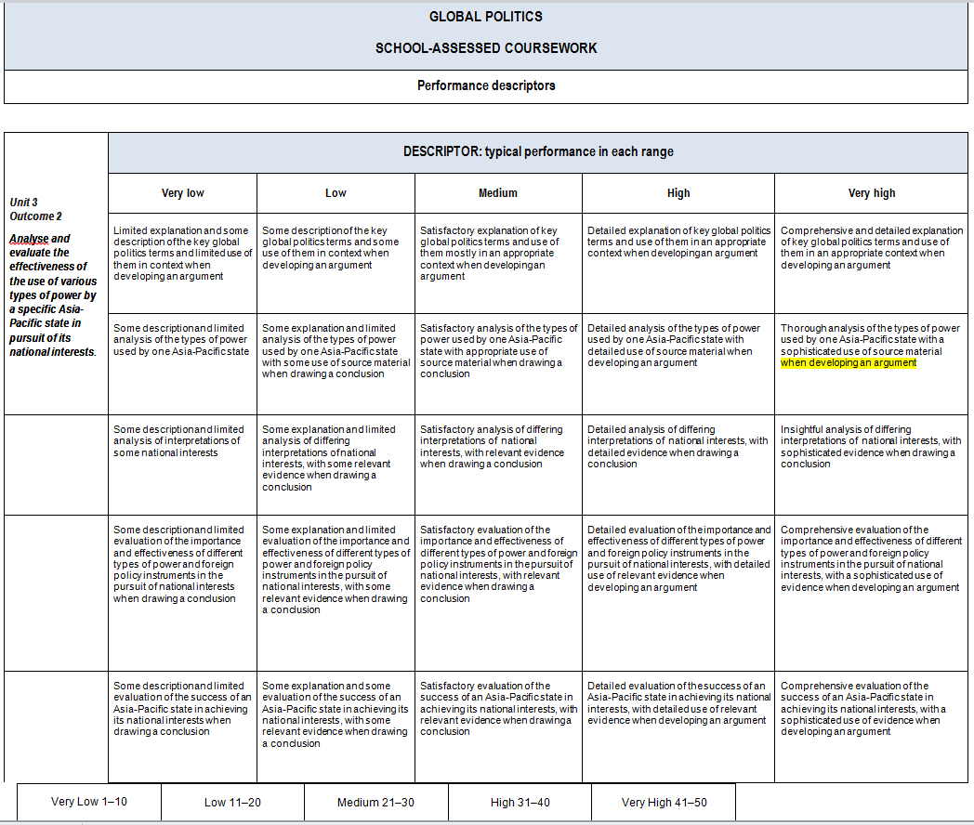
Rubrics
Notes:
Rubrics can be modified

Slide 57
Questions

Slide 58
Contact
Gerry Martin- Curriculum Manager (History and Civics)
Telephone: 61 3 9032 1694
Mobile: 04 428 039 083
e-mail: martin.gerard.f@edumail.vic.gov.au

