Slide 1
Linking Design and Technologies and the Capabilities
Monica Bini, VCAA Capabilities Curriculum Manager
Leanne Compton, VCAA Design and Technologies Curriculum Manager
Notes:
Welcome
Acknowledgement of Country
We have a mixture of primary and secondary teachers with us today, and we will use a range of examples to represent this diverse group.
There will be time for questions at the end – we will finish by 4:50pm.
(questions at 4:40pm)

Slide 2
Objectives
To gain insight into:
identifying strong links between Design and Technologies programs and the capabilities
teaching and assessing the capabilities through Design and Technologies

Slide 3
Design and Technologies Capabilities
Key aim: learn how to transfer the knowledge and skills from Design and Technologies to new situations
Problem-solvers
Innovative thinkers
Collaborators
Human-centred
Environment-centred
Critical and Creative Thinking
Personal and Social Capability
Ethical Capability
Intercultural Capability
Notes:
Design and Technologies make a significant contribution to the development of the four Victorian Curriculum Capabilities.
One of the aims of the Design and Technologies curriculum is for students to learn how to transfer their knowledge and skills from Design and Technologies to new situations, which is critical to developing a capability.
Transfer of knowledge and skills needs to be scaffolded for many students. They generally will not learn how to use what they have learnt through Design and Technologies for life in general without some guidance.

Slide 4
Capabilities Design and Technologies
Critical and Creative Thinking
Personal and Social Capability
Ethical Capability
Intercultural Capability
Critically analyse and respond to design challenges
Factors that inform design processes
How people in Design and Technologies fields contribute to society
Capabilities contribute discrete knowledge and skills
Notes:
At the same time, the capabilities contribute discrete knowledge and skills that support Design and Technologies.
There is a feedback loop that in turn develops student understanding of these discrete knowledge and skills through experience gained in the application of these discrete knowledge and skills in the context of Design and Technologies.

Slide 5
Planning
Planning
Shared language
Capabilities knowledge and skills
Learning area knowledge and skills
Challenge
What are next steps in learning?
Notes:
Teaching explicitly is the key to teaching and assessing the capabilities and requires identifying and unpacking a capability’s knowledge and skills, which are found in each relevant capability’s content descriptions. Capabilities content descriptions are generic and abstract and need to be given life and meaning in appropriate contexts.
Students are explicitly introduced to capabilities knowledge and skills in learning area contexts. They apply capabilities knowledge and skills to a learning area context and then reflect on this application to nuance their understanding and progress their knowledge and skills. This more nuanced understanding is then applied in the future.
Building skills in capabilities works best when there is a ‘Goldilocks’ challenge: not too hard and not too easy. For example, learning strategies to help students be adaptable is something that can be taught easily enough, but buy-in from students and rich learning conversations will only occur when students are challenged in a way that really requires them to be adaptable.
Creating challenge begins with knowing students and with familiarity with the curriculum. It also involves the teacher having good knowledge of the curriculum area to have the confidence to then work with student needs.
In terms of assessment, explicit teaching builds shared language that enables you to provide feedback to students and for the student to be able to understand it.
The achievement standards define the quality of learning that is expected at that standard.
Shared language, together with the achievement standard that the student is progressing towards, enables you to set clear expectations of what the work should contain. It allows student thinking to be more transparent, allowing you to collect evidence of their thinking. This is important in the capabilities. Students should be demonstrating in a given context that they understand and can apply the knowledge and skills that they have been taught and ideally there should be more than one opportunity to do this, so that you make an on-balance judgement over a period of time.
Having a learning continuum supports you in identifying student progression and to identify the next steps in student learning, which in turn informs teaching and learning strategies to get there.
We will now look at each of the Capabilities in turn.

Slide 6
Critical and Creative Thinking
Critical and Creative Thinking strands | Questions and Possibilities: Effective questioning Processes and techniques to develop ideas | Reasoning: Compose, analyse and evaluate arguments and reasoning | Meta-Cognition: Strategies to understand, manage and reflect on: thinking problem-solving learning
Design and Technologies and Critical and Creative Thinking mutually support students to … | generate innovative design ideas | critique and communicate designed solutions | manage and reflect on the application of design and systems thinking to generate a designed solution
Notes:
Here we can see an overview of the relationship between Critical and Creative Thinking and Design and Technologies.
Broadly speaking, if students are going to be working on generating design ideas, there might be a link to the Critical and Creative Thinking Questions and Possibilities strand. If something about a design solution is contested or debated, typically for and against, then there might be a link to the Reasoning strand. Intentional and explicit management and reflection of design and systems thinking might link to the Meta-Cognition strand.
Many of you are probably thinking ‘will link’ but if students already know the capabilities content and have a good level of skill you may not need to explicitly teach new capabilities knowledge and skills but rather continue to apply, consolidate and reflect on background knowledge.
When we say ‘linking’ to Critical and Creative Thinking what we mean is working with students to help them develop their critical and creative thinking in general, that is, to help them see how Design and Technologies contributes to this, and/or identifying the discrete knowledge and skills in the capability that will support Design and Technologies.
Let’s look at an example.

Slide 7
CCT example, Levels 7 and 8
 | Design and Technologies | Critical and Creative Thinking
Content description | Generate, develop and test design ideas, plans and processes using appropriate technical terms and technologies including graphical representation techniques (VCDSCD050) | Consider a range of strategies to represent ideas and explain and justify thinking processes to others (VCCCTM040)
Achievement standard extract | By the end of Level 8, students create and adapt design ideas, make considered decisions and communicate to different audiences using appropriate technical terms and a range of technologies and graphical representation techniques. | By the end of Level 8, students use a range of strategies to represent ideas and explain and justify thinking processes to others.
Notes:
Imagine that a teacher is planning for a unit that will include students having to represent and discuss ideas. Is there a link between Critical and Creative Thinking and Design and Technologies regarding this?
A relevant Design and Technologies Levels 7 and 8 content description is:
Generate, develop and test design ideas, plans and processes using appropriate technical terms and technologies and including graphical representation techniques (VCDSCD050).
A relevant Critical and Creative Thinking content description is:
Consider a range of strategies to represent ideas and explain and justify thinking processes to others (VCCCTM040).
Both curriculum areas help students to explain and justify their representations to others and to use their knowledge of graphical representation techniques to communicate to audiences.
Design and Technologies can help students understand how to represent ideas. Critical and Creative Thinking prompts teachers to guide students to understand representation as a strategy and to focus on the strategic thinking involved as part of their lesson planning.
Here teachers often say that good teachers would do this anyway, without prompting from Critical and Creative Thinking. This is a good sign of a strong link between the curriculum areas! It is contingent though on the Design and Technologies content description here being unpacked in a particular way. Linking to Critical and Creative Thinking helps to ensure that everyone is a good teacher, but also more subtly, helps with whole school planning. In this case, Year 9 and 10 teachers can easily be aware that this link has been made in Years 7 and 8 and all classes in Years 7 and 8 would be treated the same way.
So, in general, capabilities can help to shape how Design and Technologies is unpacked to then help learning in Design and Technologies, but also help develop the capability.

Slide 8
Students represent thinking processes using visual models and language. (5 and 6) | Students use a range of strategies to represent ideas and explain and justify thinking processes to others (7 and 8) | They practice and apply learning strategies, (5 and 6) | They evaluate the effectiveness of a range of learning strategies and select strategies that best meet the requirements of a task. (7 and 8 | Students identify, articulate, analyse and reflect on their own and others thinking processes (9 and 10)
Consider a range of strategies to represent ideas and explain and justify thinking processes to others (VCCCTM040)
I can use a range of graphical representation techniques |  | I know the strengths and limitations of techniques; I can discuss these with others; and I can use my knowledge to communicate to audiences | I can evaluate techniques used and identify strengths and ways to improve
Notes:
Here we see the underlying content description in the middle of the table and the relevant aspects of the achievement standards at the top, with some suggested ‘I can’ statements that reflect the achievement standards along the continuum as shown.
Students would be taught different techniques to create graphical representations, such as SCAMPER, SketchUp or PMIs. Part of the teaching would include building student knowledge of the strengths and limitations of the technique, which is then applied in context to develop their critical and creative thinking. This would, of course, also involve the unpacking of relevant Design and Technologies content descriptions.

Slide 9
Teaching strategies
Consider a range of strategies to represent ideas and explain and
justify thinking processes to others (VCCCTM040)
What is explicitly taught | Alignment to achievement standards | Aligned learning activities
Different techniques for graphical representation Strategic thinking - Strengths and limitations | Using techniques (5 and 6) Explain and justify (7 and 8) Reflect (9 and 10) | Practise constructing graphical representations Design challenges where more than one kind of representation would work, leading to a need for discussion and communication and reflection
Notes:
In terms of assessment, you are providing opportunities for students to demonstrate their knowledge of graphical representations, and their strategic use. Evidence for this would be found in the discussion they undertake and their reflection and evaluation, as well as in the graphical representation itself.
The skill is in applying that knowledge to different challenges and problems within a given challenge, and in the practical rendering of techniques involved.
Underpinning all this is explicit teaching.

Slide 10
Personal and Social Capability
Personal and Social Capability strands | Self-Awareness and Management: Regulate, manage and monitor their emotions Interpret and assess their personal characteristics | Social Awareness and Management: Participate in positive, safe and respectful relationships Critique societal constructs and discrimination Negotiate and collaborate
Design and Technologies and Personal and Social Capability mutually support students to … | develop knowledge and skills to work independently and show initiative | develop skills for collaborative problem-solving and to critique societal constructs when creating and communicating designed solutions
Notes:
Design and Technologies has a strong focus on problem-solving and by nature provides rich opportunities for collaboration.
When creating and communicating designed solutions, depending on the situation, it might be necessary to critique societal constructs. The most obvious one is stereotypes, for example wood being for boys and fabric for girls.

Slide 11
They persist with tasks when faced with challenges and adapt their approach when first attempts are not successful. (3 and 4) | They describe the influence that personal qualities and strengths have on achieving success. They undertake some extended tasks independently and describe task progress. (5 and 6) | They practice and apply learning strategies, (5 and 6) | They evaluate the effectiveness of a range of learning strategies and select strategies that best meet the requirements of a task. (7 and 8 | They reflect on strategies to cope with difficult situations and are able to justify their choice of strategy demonstrating knowledge of resilience and adaptability. (7 and 8)
Describe what it means to be confident, adaptable and persistent and why these attributes are important in dealing with new or challenging situations (VCPSCSE027) Identify the skills for working independently and describe their performance when undertaking independent tasks (VCPSCSE028)
I know how to change the way I do things and try again |  | I know why adaptability is important and can describe progress with reference to how I adapted | I can link coping with challenge to adaptability and evaluate my choices
Notes:
This example is from Personal and Social Capability strand on self-awareness and management, and the sub-strand concerned with development of resilience. It targets Levels 5 and 6.
Here again we see the underlying content description in the middle and the relevant aspects of the achievement standards at the top.
Knowing how to adapt and how to evaluate and reflect on attempts to be adaptable is learnt in the context of Design and Technologies. How to adapt in engineering will be different to food specialisations, but the importance of being adaptable is something they have in common. This supports students in recognising the general value of the importance of adaptability, and its essential role in meeting any challenge helps to develop the capability in general.

Slide 12
Teaching strategies
Describe what it means to be confident, adaptable and persistent and why these attributes are important in dealing with new or challenging situations (VCPSCSE027)
Identify the skills for working independently and describe their performance when undertaking independent tasks (VCPSCSE028)
What is explicitly taught | Alignment to achievement standards | Aligned learning activities
Ways to adapt The role and importance of adaptation and its link to resilience The relationship between adaptation and goals | Using ways to adapt (3 and 4) Describing progress with reference to adaptability (5 and 6) Reflect (7 and 8) | Shorter challenges requiring different ways to adapt Design challenges where unexpected things happen, requiring adaptation; and requirement to describe progress and reflect
Notes:
Here, the trick is to try to give opportunities where every student has to adapt.
One way to do this might be to introduce unexpected changes that then require adaptation. You could introduce some new data on user needs or on what we know about the cost or sustainability of materials.
Leanne speaks – e.g. fabric sells out or there are supply chain issues.

Slide 13
Ethical Capability
Ethical Capability strands | Understanding Concepts Understanding and applying key concepts and ideas to: ethical issues outcomes principles and values | Decision Making and Actions Ways to respond to ethical problems Factors that influence ethical decision-making and action Application to different contexts
Design and Technologies and Ethical Capability mutually support students to … | identify ethical issues in a range of contexts relevant to design and technologies, and analyse stakeholder perspectives | analyse the economic, environmental and social impacts of a designed solution that is in response to an individual or community problem; discuss the value and potential harms and benefits of a designed solution for society and the environment; and critique the ethical aspects of design processes
Notes:
Ethical Capability is mostly concerned with the big questions of how we ought to live and what we owe each other (where our responsibilities lie). When this is open to debate, there might be a link to Ethical Capability in that students will need to draw on knowledge from this capability to help develop and defend a position.
An example is deciding between poly-cotton or synthetic fabrics that might last longer. There are also dilemmas regarding materials like plastic, in that the value it contributes is not always negative.
Ethical dilemmas like this all share the common characteristic of any course of action entailing consistency with a particular value(s) or ethical principle but transgressing another. Dilemmas do not have one ‘right’ answer and in these cases when assessing students for Ethical Capability look for the justification of their position, not the position itself, noting of course that their response should be coherent, supported by evidence and so on.

Slide 14
Students identify different ethical issues associated with a particular problem. (5 and 6) | Students … articulate how criteria can be applied to determine the importance of ethical concerns. (7 and 8) | They practice and apply learning strategies, (5 and 6) | They evaluate the effectiveness of a range of learning strategies and select strategies that best meet the requirements of a task. (7 and 8 | Students … examine complex issues [and] identify the ethical dimensions … (9 and 10)
Investigate criteria for determining the relative importance of matters of ethical concern (VCECU016)
I can identify ethical issues for different stakeholders. |  | I can apply criteria to discuss the importance of issues for stakeholders. | I can link the importance of ethical issues, influencing factors and preferred futures.
Notes:
In Design and Technologies, students often consider how designed solutions can respond to problems for individuals and the community.
When these problems involve consideration of harms, benefits, or values, then we are in the realm of ethical issues or ethical considerations.
Students consider preferred futures and, when linked to an ethical issue, might consider competing ideas on what is preferred and how often there are different perspectives on the most significant values, harms and benefits.
The key to assessment in Ethical Capability is to provide students with the knowledge to be able to discuss and defend their response. For example you would not be looking to see if students land on a particular stakeholder’s preferred future as being the most preferable one above all others, but rather that no matter which they pick as the most preferable, or how they might compare them as better or worse than each other, that they can justify this using knowledge and skills from Ethical Capability (see in particular the ‘Unpacking the content descriptions’ teaching resource in the Ethical Capability resources on the VCAA website). Their justification might be supported by evidence, examples etc. that utilise knowledge of Design and Technologies.

Slide 15
Teaching strategies
Investigate criteria for determining the relative importance of matters of ethical concern (VCECU016)
What is explicitly taught | Alignment to achievement standards | Aligned learning activities
How to identify an ethical issue Reasons why people do or might disagree on their importance; How to compare different perspectives Links between issues, wider factors and preferred futures | Identifying ethical issues (5 and 6) Applying criteria to discuss relative importance (7 and 8) Making complex connections (9 and 10) | Short case studies involving a range of ethical issues Design challenges involving a range of issues and a range of different stakeholders with competing preferred futures, creating a dilemma
Notes:
Setting up a case study where there is a dilemma is ideal for getting the most out of Ethical Capability.
For example, coltan mining has several issues regarding poverty, child labour and destroyed habitats. Do we, as designers of electronics, look for a substitute for coltan, which might save habitat of gorillas but take away very poor people’s livelihoods?
Here there is not a clear preferred future that all stakeholders would be happy with – and this is where knowledge from Ethical Capability will help students develop and defend a position, which makes it assessable but also enables good rich and thoughtful conversations that will progress student learning.

Slide 16
Intercultural Capability
Intercultural Capability strands | Cultural Practices Characteristics of their own and others’ cultural identities How culture shapes perspectives and actions | Cultural Diversity Challenges and opportunities created by cultural diversity How cultural diversity shapes and contributes to social cohesion
Design and Technologies and Intercultural Capability mutually support students to … | identify when and how culture can be a consideration influencing design solutions; and analyse the ways intercultural relationships and experiences contribute to the development of design solutions in relevant contexts | understand the challenges and opportunities associated with working on design solutions in an interconnected and culturally diverse world.
Notes:
Sometimes cultural context will need to be taken into account when creating designed solutions; or the challenges and opportunities created by cultural diversity and maintaining social cohesion might also be relevant.

Slide 17
Students … describe their experiences of intercultural encounters … (F-2) | Students … explain what they have learnt about themselves and others from intercultural experiences. (3 and 4) | They practice and apply learning strategies, (5 and 6) | They evaluate the effectiveness of a range of learning strategies and select strategies that best meet the requirements of a task. (7 and 8 | Students … explain how intercultural experiences can influence beliefs and behaviours. (5 and 6)
Describe what they have learnt about themselves and others from intercultural experiences including a critical perspective on and respect for their own and others’ cultures (VCICCB006)
I can describe my intercultural experience. |  | I can explain what I learnt about myself and others from my intercultural experience. | I can explain how my intercultural experience will influence me in the future.
Notes:
In Design and Technologies, students often consider how designed solutions can respond to problems for individuals and the community and sometimes these problems have a cultural context.
Design and Technologies also provides opportunities to learn from other cultures, for example, in how they use materials for different purposes. This is an example of an intercultural experience, that is, the coming together of two or more cultures.
In this example the focus is on reflection and respect. Students are not going to be willing to learn from other cultures unless they have a capacity to value intercultural experiences.

Slide 18
Teaching strategies
Describe what they have learnt about themselves and others from intercultural experiences including a critical perspective on and respect for their own and others’ cultures (VCICCB006)
What is explicitly taught | Alignment to achievement standards | Aligned learning activities
Recognising an intercultural experience and what happened and feelings Attaching meaning to these experiences What we have in common that might influence me in the future | Describe my experience (F-2) Explain what I learnt about myself and others (3 and 4) Explain how this might (or will) influence me in the future (5 and 6) | Investigating different uses of materials in products from a given region of the world and reflection Design challenges involving application of investigation to create a designed solution, explicitly taking into consideration the intercultural experience
Notes:
Leanne: gives an example wool (sheep and goat and possum fur) –
Consider the role that some materials play in particular cultures, for example, what bamboo might symbolise in traditional Chinese culture and how this symbolism can influence design.
Does it mean the same thing in Australia?
What products represent characteristics like loyalty? (For example, redgum, merino wool.) What about crocodile skin? What does it represent culturally? Strength? Longevity?
What if we were to make a plaque celebrating someone becoming an Australian citizen? What would it be made of? Bamboo? Short examples like this can help students to recognise that some materials might have cultural significance in Australia too.

Slide 19
Transfer to new situations
Familiar problems in a particular context
New problems in the same context
New context
Application of general understanding
Link the familiar and the new
Prompt students to connect prior knowledge
Introduce and consolidate
Apply
Far transfer
Bridging
Notes:
For a student to be fully capable, they ideally want to realise they have learnt skills in Design and Technologies that have general applications beyond the specific challenge they have been working on.
They need to be scaffolded and prompted along the way.
Design and Technologies has a head start as there are quite discrete contexts that do however have things in common, for example design thinking.
When you teach something new in a given context, whether for Capabilities or Design and Technologies, you activate prior knowledge to help introduce a new idea. So you might use familiar examples of objects made of a material you want to investigate and through this example introduce discrete knowledge and skills from a capability. This ensures students learn one new substantial thing at a time.
You then move to application of new knowledge and skills to new problems within the same context. In selecting the familiar right at the start you will be thinking of how this will bridge to the challenge you want them to work on in the end. You can provide time for students to reflect here on what they have been learning in general, for example, that breaking big problems down into stages is generally useful.
Then when starting in a brand-new context, you can prompt students to see that breaking down problems into stages is also relevant to this new context – prompt students to make this connection themselves. This might require a bit of coordination between teachers if students are likely to make connections across different design contexts. Of course they might also make connections within the same context, such as food specialisations, but link to a different situation than the specific one studied in class – e.g. ‘We might also have to break down a problem into stages when …’ You can also, at the reflection stage, work with them to identify problems and challenges beyond the classroom where their newfound knowledge and skills could be applied.

Slide 20
Assessment method examples
Observation of student dialogue, behaviour etc.
Challenges involving issues, problems
Reflection and journals, interviews or presentations
Stimulus with errors that students must identify and resolve
Experiences e.g. intercultural experiences and reflection
Objects within contexts that can be constructed, analysed and/or discussed
Notes:
Reflection could be in the form of, say, posters on conflict resolution or collaboration strategies that work; it need not always be in journal form.
With inquiries or experiments, curveballs can be thrown that require creative problem-solving. Plan for something unexpected to happen when working on a design challenge.
As you gain more experience and see more and more student work, you will begin to build a better understanding of what is a reasonable expectation, that is, the depth or breadth or accuracy of an explanation that is reasonable to expect.
Try to assess over a period of time rather than at a point in time. Remember you do not have to do everything at once.

Slide 21
Which capability? What to look for
Key questions | Example
Does it support progress in the linked learning area(s)? | Design and Technologies has a strong focus on collaboration
Does it support progress in development of the capability? | The program provides high-quality opportunities for collaboration
Will it deliver ongoing benefits? | Upcoming schooling/tertiary contexts Employability skills Lifelong learning
Notes:
It is important that the program provides a level of challenge in the identified capability otherwise it is not worth linking. The kind of challenge will vary depending on the capability or, to put it another way, different challenges suit different capabilities. For example, a challenge on resolving a dilemma might suit Ethical Capability, whereas a technical challenge might suit Critical and Creative Thinking or Personal and Social Capability (how to persist and adapt, for example).

Slide 22
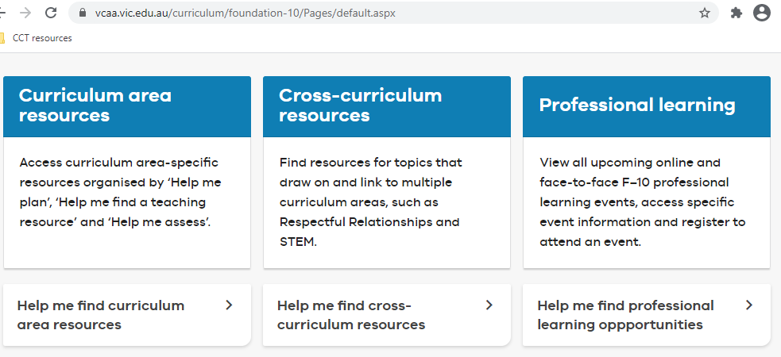
Resources
Notes:
There are a range of resources across the capabilities to support classroom teaching and whole school planning.

Slide 23
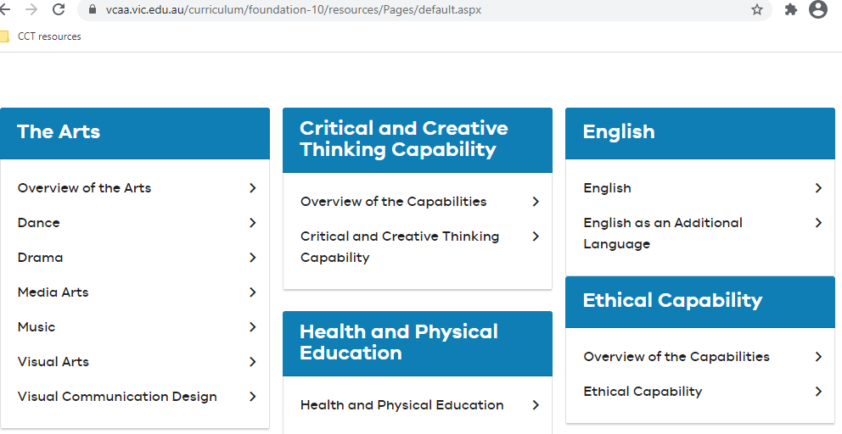
Resources
Notes:
We are adding to resources gradually so I encourage you to sign up to F-10 Curriculum Updates, which you can subscribe to through the VCAA website.
Most capabilities resources are under each of the capability tabs, not the Design and Technologies tab.

Slide 24
Resources
Notes:
Most resources are under ‘teaching resources’ but the other tabs are also useful.

Slide 25
Types of resources
Whole school planning advice and templates
Curriculum mapping examples and templates
General advice on teaching and assessment
Unpacking the content descriptions
Annotated external resources
Sample units of work and assessment rubrics
Some resources linking a learning area and capability
Notes:
We are adding to these all the time.

Slide 26
Resources

Slide 27
Resources
Notes:
Indicative progress templates and advice are there for all learning areas and capabilities.
The indicative progress templates include an example of what student work might include but not yet have in order to meet the standard.
For the capabilities, this was constructed through working with volunteer teachers who gave their advice based on looking at student work and the features of it, asking what makes one more sophisticated than another.
You are encouraged to do this in your school.
The formative assessment link will take you to a general guide including videos and text as well as example rubrics for all the Capabilities except Intercultural Capability. Example rubrics for this were developed in a separate project and can be found under the Intercultural Capability teaching resources tab shown earlier.

Slide 28
Questions?
Notes:
Any questions at this stage?
Thank you and take care.

Slide 29
Contact
Monica Bini, Capabilities Curriculum Manager:
monica.bini@education.vic.gov.au
Leanne Compton, Design and Technologies Curriculum Manager:
leanne.compton@education.vic.gov.au

