Slide 1
Victorian Curriculum: F-10 English as an Additional Language (EAL)
Thursday 13 August 2020
Kellie Heintz, EAL Curriculum Manager

Slide 2
Acknowledgment of Country
In recognition of Aboriginal and Torres Strait Islander people’s spiritual and cultural connection to country, we acknowledge the traditional custodians of the Kulin Nations. We acknowledge the continued care of the lands and waterways over generations and celebrate the continuation of a living culture that has a unique role in this region.
We pay our respects to Elders past, present and emerging, for they hold the memories, traditions, culture and hopes of all Aboriginal and Torres Strait Islander peoples across the nation and hope they will walk with us on our journey.

Slide 3
Introduction
This presentation is for teachers who are new to the teaching of EAL students.
It will focus on:
Using the Victorian F-10 EAL Curriculum
Considerations to be made by schools
Different content areas
Unpacking Pathways: A, B and C
Navigating the curriculum
Plurilingualism

Slide 4
2021
In 2021, the Victorian Curriculum F-10 EAL will be mandated for implementation in both government and Catholic schools.
Independent schools will be guided by their school.

Slide 5
Using the EAL Curriculum
All teachers are responsible for teaching EAL learners in their subject areas, this involves:
understanding the proficiency levels of their EAL students
focusing on the content-specific language students need to access the content of their learning areas
being able to plan for and support the language learning of EAL students in order to support their understanding of the different content

Slide 6
What does this mean for schools?
The whole school is responsible for planning and implementing the new EAL curriculum.
The expertise of specialist EAL teachers needs to be drawn upon.
Specialist EAL teachers will need time to work with teachers of EAL students.
In the absence of an EAL specialist, the literacy leader or English leader may need to take the lead with support from their school.

Slide 7
Step 1: some considerations
Evaluating current EAL teaching and learning programs
How well is the school’s current EAL teaching and learning program differentiated to support EAL student learning?
How well is the current EAL teaching and learning program aligned to the new EAL curriculum?
What roles will the specialist EAL teacher, classroom teachers and subject teachers play in the implementation of the new curriculum?

Slide 8
Step 2: some considerations
As a whole, the school will need to consider:
the current forms of assessment used for EAL learners
the pedagogical knowledge of teachers and the collective experience of teaching EAL learners
the structure and flexibility of teaching plans to accommodate the EAL learners
the current whole-school EAL approach and the adjustments that are required
the way the new curriculum aligns to other school initiatives

Slide 9
Step 3: some considerations
As a whole, the school will also need to consider:
what needs to be changed about reporting on EAL student learning
ways to provide resources to support teachers in their development and planning, for example, providing time for collaboration and the sharing of expertise or supporting attendance at relevant professional learning events.

Slide 10
What might this look like?
The specialist English or EAL teacher/s meet with classroom teachers and subject teachers of EAL students to:
review student assessment and identify a student’s initial pathway on the EAL curriculum
refer to the EAL curriculum for examples of appropriate language learning for that pathway
consider how the content of a specific learning area may be adapted and scaffolded to support the student’s access to language in that subject

Slide 11
Collaboration
School leaders will need to consider how the implementation of the EAL curriculum impacts on the whole-school EAL approach. This may mean changing:
how all teachers of EAL learners work together
who is involved in EAL planning
who has oversight of the EAL program
Opportunities for specialist EAL teachers to work collaboratively with generalist primary teachers and/or secondary subject teachers will also need to be considered.

Slide 12
A curriculum across all learning areas
The Victorian Curriculum F-10 EAL:
recognises that students need to access and to demonstrate learning in all learning areas

Slide 13
Example of teaching content specific language in Science
Content specific vocabulary | Linguistic specific (verbs of instruction) | Language for interaction | Language for clarification
test tube, test tube rack, 10ml measuring cylinder, heat proof mat, Bunsen burner, rubber hose, matches, wooden tongs | place, measure, pour, set up, hold, point…away, open, move and return | “first you…”, “then…”, “ok now you have to…”. | “sorry, can you repeat that?” or “what was the step again?”

Slide 14
Example of teaching content specific language in PE
Content specific vocabulary | Linguistic specific (verbs of instruction) | Language for interaction | Non-Verbal
Footy, pass, mark, behind, goal, point, kick, oval, boundary, umpire, ladder, Brownlow, handball, 50 meter line, possession, | Play on, pass, run, kick, mark, contest, | Move, run, over there, faster, get the ball, | Clear goal, goal. Behind, high tackle, trip, start game, end game

Slide 15
Secondary English/EAL teachers
Secondary English or EAL teachers report on the English language proficiency of their EAL students using the EAL curriculum.

Slide 16
Secondary school subject teachers
Teachers who are not EAL specialists do not need to report on the English language proficiency of their EAL students.
Teachers report on their learning area content, as is the current practice.

Slide 17
EAL Curriculum-content
Overview of the EAL Curriculum
Structure
Pathways and levels
Content descriptions
Elaborations
Achievement standards
Resources and Glossary
Notes:
.

Slide 18
Components of the curriculum
Pathways and levels
Language modes
• Speaking and Listening
• Reading and Viewing
• Writing
Strands & sub-strands
• Communication
• Cultural and Plurilingual awareness
• Linguistic structures and features
Content descriptions
Elaborations
Achievement standards

Slide 19
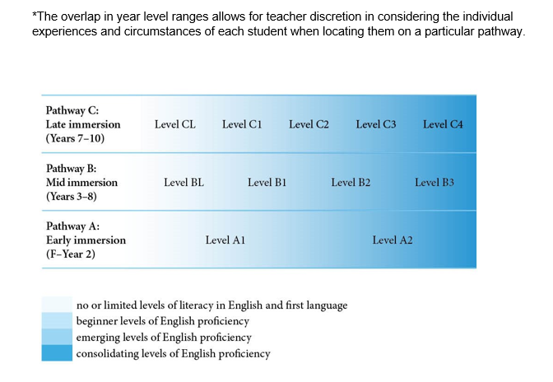
F-10 EAL Pathways

Slide 20
The pathways
The Victorian Curriculum F-10 EAL is:
a continuum structured as three EAL pathways (A, B, C).
Each pathway describes a different stage of English-language learning (early, mid and late), and each pathway is divided into different levels of language learning (A1, A2, BL, B1, B2, B3, CL, C1, C2, C3, C4).

Slide 21
Understanding the pathways
EAL Pathway A: Early immersion (Foundation–Year 2)
Early immersion language learners typically develop their literacy skills through experiences in the school context. Those who have had some experience of formal preschool or school will more readily adapt to the school setting.
A student located on EAL Pathway A may have some experience of formal learning in their home language or other languages and some experience of informal prior learning.
EAL Pathway A includes two levels of English-language learning: Level A1 and Level A2. Those with little or no experience of English begin at A1; those with some experience may begin at A2. The progress within these levels equates to the rates of progression expected in Foundation–Year 2.
Generally students who enter Foundation are pre-literate, regardless of their language background, and hence there is no Level AL. EAL students who enter Foundation with minimal literacy in other languages will begin their early immersion in English at Level A1.

Slide 22
Understanding the pathways
EAL Pathway B: Mid immersion (Years 3–8)
Mid immersion language learners have experience of the social use of language, which they can use as they learn English at school. A student located on EAL Pathway B may have some experience of informal learning in their home language or other languages. Some have yet to experience formal schooling, while others may have experienced formal learning that is equivalent to their English-speaking peers. This may have been in their home language or other languages.
EAL learners with little or no English proficiency, fewer than two years of formal learning and minimal home literacy experience will begin this pathway at Level BL, before moving to Level B1. Learners with prior experience of formal learning but no proficiency in English begin at Level B1, and move through Levels B1, B2 and B3. The progress within these levels equates to the rates of progression expected in Years 3–8.

Slide 23
Understanding the pathways
EAL Pathway C: Late immersion (Years 7–10)
Late immersion language learners have a mature understanding of themselves and their relations with others in different social contexts, and are capable of understanding abstract ideas and relationships in their experience and learning about the world.
EAL learners without prior formal learning and with minimal home language literacy experience will begin this pathway at Level CL, before moving to the other levels. Learners with prior experience of formal learning but no proficiency in English will begin on Level C1 and move through Levels C1, C2, C3 and C4. The progress within these levels equates to the rates of progression expected in Years 7–10.

Slide 24
Pathways and levels
The English as an Additional Language (EAL) curriculum sets out what students are expected to learn and is designed as a continuum of learning structured as three pathways. The pathways are presented in scope and sequence charts to support teachers to easily see the progression and assist in planning teaching and learning programs to meet the diverse needs of students.
These charts include the content descriptions and achievement standards. It is advised that they are read in conjunction with the introductory materials and the level descriptions in the curriculum.
EAL Scope and Sequence Pathway A.docx (106 KB)
EAL Scope and Sequence Pathway B.docx (116 KB)
EAL Scope and Sequence Pathway C.docx (118 KB)

Slide 25
Learning in EAL
Language Modes
Speaking and Listening
Reading and Viewing
Writing
Language Strands
Communication
Cultural and plurilingual awareness
Linguistic structures and features

Slide 26
Strands and sub-strands
Communication
Cultural understandings
Linguistic structures & features
Cultural & plurilingual awareness
Text structure and organisation
Plurilingual strategies
Grammatical patterns
Word knowledge
Grapho-phonics / phonology

Slide 27
Content Descriptions
In each level ,mode, strand and sub-strand sits the content descriptions. These statements form the core of the curriculum. Content descriptions include the knowledge and skills; the intended content that is the major focus of the mode and strand to be taught. These statements inform the learning objectives teachers are expected to teach and students are expected to learn.

Slide 28
Content Descriptions
Level
Level B2
Writing
Linguistic structures and features
Text structure and organisation
Use headings and text formats appropriate to the task
Write simple paragraphs with a logical sequence of sentences
Use simple time sequence markers and pronoun references to connect ideas in a text
Language mode
Strand
Sub-strand
Content descriptions
(Skills / actions that are teachable)

Slide 29
Content Descriptions
Use heading and text formats appropriate to the task.
Write simple paragraphs with a logical sequence of sentences.
Use simple time sequence markers and pronoun references to connect ideas in a text.

Slide 30
Elaborations
An example of a content description and the elaborations to support it from the B2 scope and sequence chart
B2 Writing
Linguistic structures and features
Text structure and organisation
Content Description: Write simple paragraphs with a logical sequence of sentences (VCEALL388)
Elaborations:
grouping sentences about the same topic into a paragraph
organising sentences using a simple sequence, for example chronological order of events or strong to weak arguments
using key words to write a simple topic sentence that states the main idea of the paragraph

Slide 31
Elaborations
An example of a content description and the elaborations to support it from the C2 scope and sequence chart
C2 Speaking and Listening
Communication
Content description: Negotiate interactions with reliance on an attentive conversation partner (VCEALC610)
Elaborations:
expressing complex thoughts and feelings in familiar situations
seeking assistance or feedback from speech partners to formulate or confirm corrected expressions
clarifying and elaborating on meaning by recasting and defining what has been said

Slide 32
Achievement standards
At the end of each level (A1, A2, BL, B1…..) of the EAL Curriculum in each of the modes, Speaking & Listening, Reading & Viewing and Writing sit the Achievement Standard. These statements sum up what students,who have reached the respective standard have learned and are able to demonstrate. They are virtually unchanged from the Achievement Standards from the EAL Companion to AUSVELS, the predecessor to this curriculum. For example, the final sentence in the B2 Writing Achievement Standard states “They use more advanced software functions to write, edit and present their texts.”
When planning, identifying the learning accomplishments in the achievement standards will assist teachers to focus planning, teaching and learning to the stated outcomes.

Slide 33
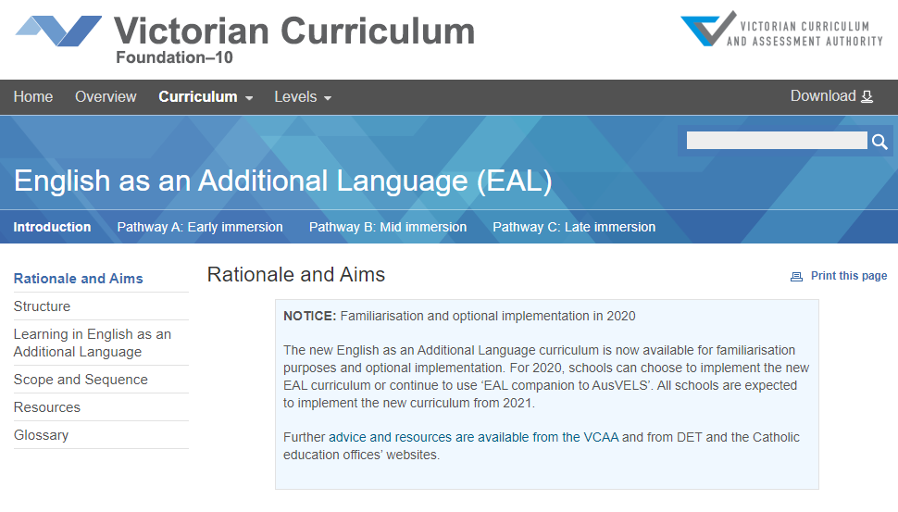
Navigating the EAL Curriculum
Structure
Taking a look at the Structure tab we see the articulation of the pathways. The EAL curriculum is organised by pathways, language modes and strands.
Pathway A: Early immersion (Foundation –Year 2)
Pathway B: Mid immersion (Years 3-8)
Pathway C: Late immersion (Years 7-10)

Slide 34
An online tour of the curriculum
https://victoriancurriculum.vcaa.vic.edu.au/english/english-as-an-additional-language-eal/introduction/rationale-and-aims

Slide 35
Plurilingualism
Strand: Cultural and plurilingual awareness
Sub strand: Plurilingual awareness
Plurilingual awareness refers to understanding that people can use knowledge of more than one language to learn and communicate.
It involves understanding that all languages spoken or used by a person form a repertoire that can be drawn upon, rather than seeing proficiency in one language as having no impact on capacity to learn another.

Slide 36
Plurilingual strategies
Provide opportunities for EAL learners to:
draw on the linguistic and cultural repertoire of other languages to support the learning of both content and the English language

Slide 37
Plurilingual strategies
Teachers can gain familiarity and apply the opportunities that the Content descriptions and Elaborations provide within the plurilingual strategies sub-strand. However it is not an area of the curriculum that is referenced in the Achievement Standards and as such it is not assessed.

Slide 38
Plurilingualism at work
CL | C1 | C2 | C3 | C4
Distinguish spoken English from other languages and attempt to respond in English | Check understanding of classroom English by asking for clarification from other home language speakers | Ask for the translation of specific words from other home language speakers | Explain the home language meaning of unfamiliar English words and phrases to home language peers | Discuss a point of language
Use sentence patterns from home language to communicate ideas | Use home language to formulate speech in English and communicate ideas | Use home language resources to support use of English | Clarify in home language to check understanding | Use home language resources to develop English
Transfer some simple language structures to other contexts | Transfer knowledge from home language to English learning | Transfer academic and communication skills from home language to English | Talk about cultural differences related to communication | Compare and contrast different ways of communicating meanings in home language and English

Slide 39
Coming in October
Plurilingualism
Assessment and Reporting
Whole-school planning

Slide 40
Contact
For any questions concerning the EAL curriculum, please contact me:
Kellie Heintz, EAL Curriculum Manager, VCAA
Kellie.Heintz@education.vic.gov.au
or
eal@education.vic.gov.au

